Slide 1

Work-let Name: Database System for devices launched in the Market
Worklet Details
Worklet ID: SE22KLU
College Name: K L University
Manual addition of Samsung Device details to Database
Displaying all Samsung Device Details in a List & selecting specific Samsung mobile to view all specifications
Crawling competitor mobile specifications.
Issues like we removed unwanted specifications and added required specs.
While performing web crawling on a website it is blocking out requests.
KPIs achieved till now
Any Challenges/ Issues faced
Comparing Samsung devices with other competitors.
Notifying via emails about device procurement, availability and status
Manual addition of Samsung Device details to Database
Displaying all Samsung Device Details in a List & selecting specific Samsung mobile to view all specifications
Successfully crawled mobile specs of competitors
Updating saved Samsung Device details.
Next Steps
Key Achievements/ Outcome till now
Date: 01-01-2021

Slide 2
Our Work

Slide 3
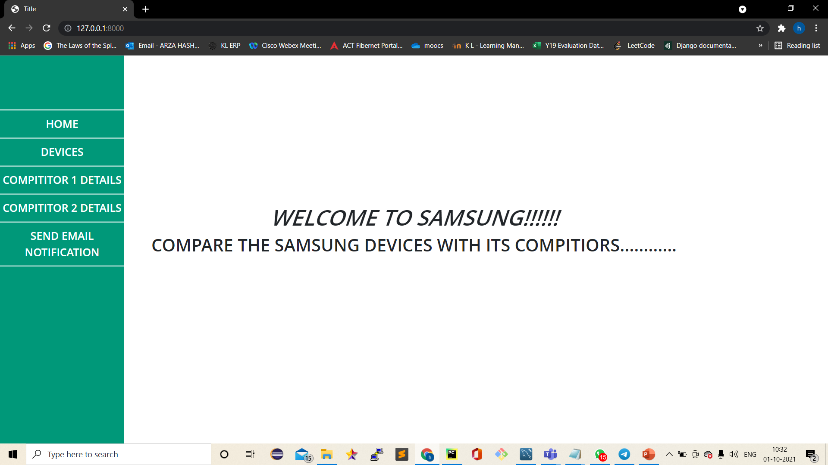

Slide 4
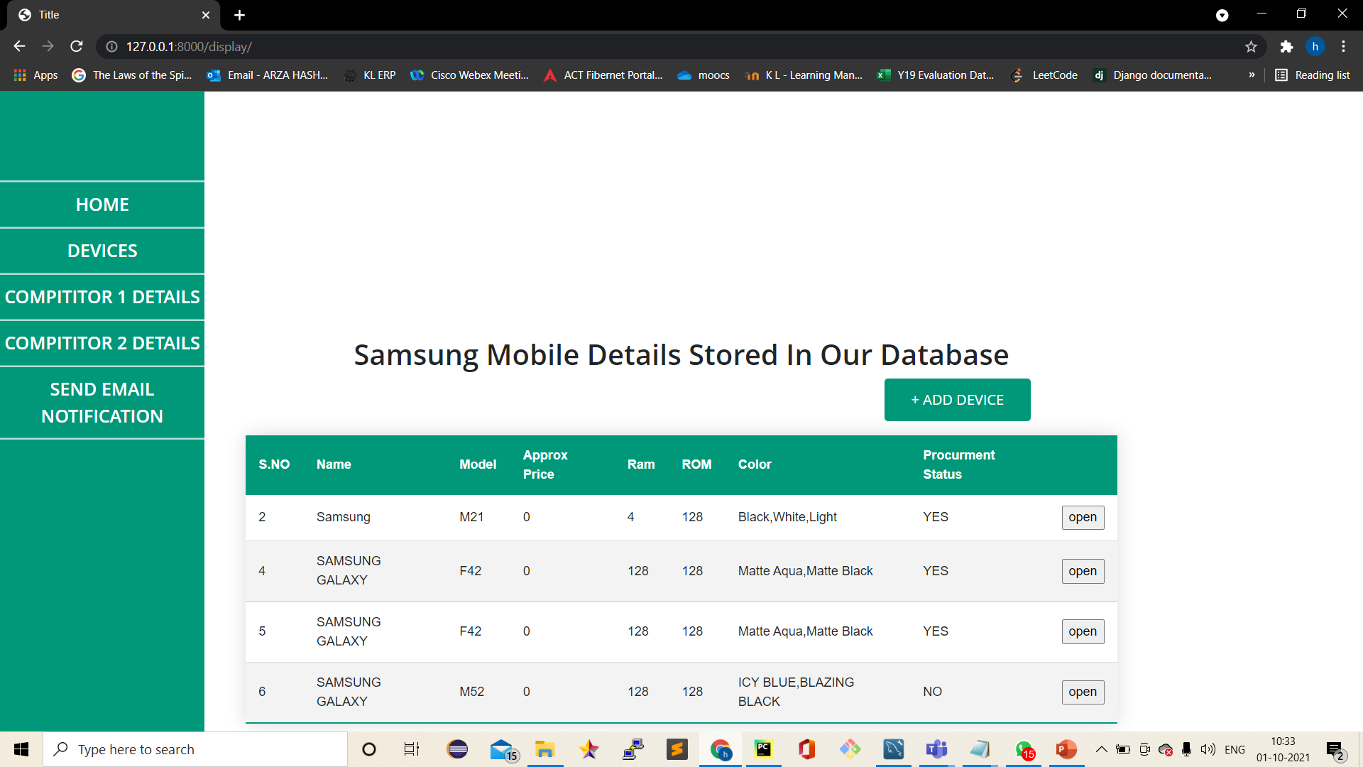

Slide 5
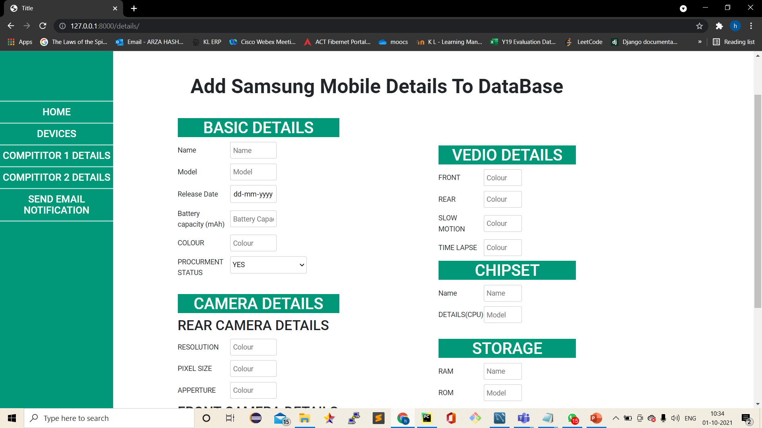
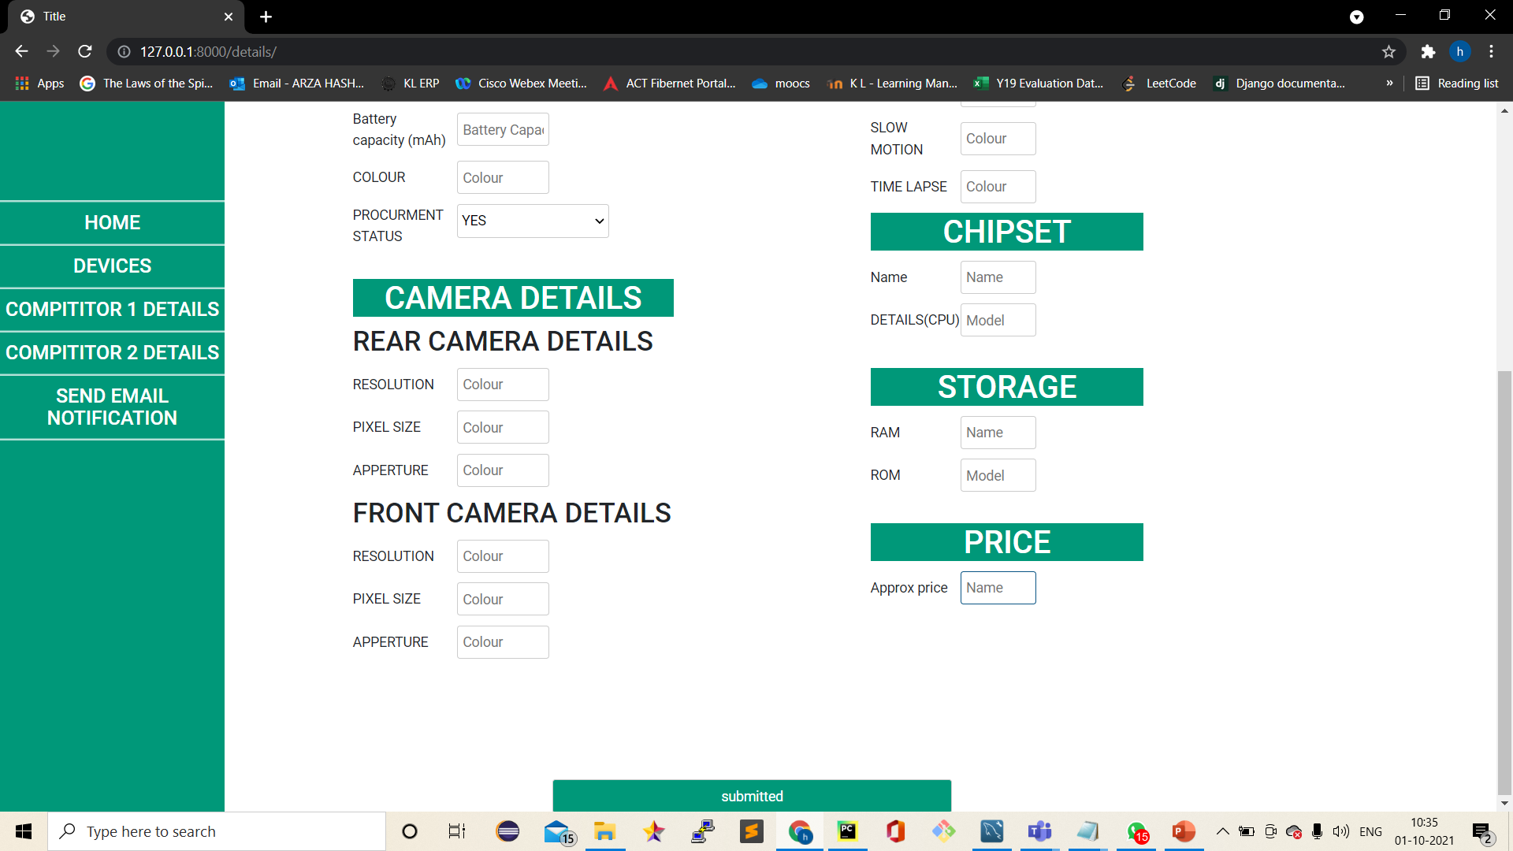

Slide 6
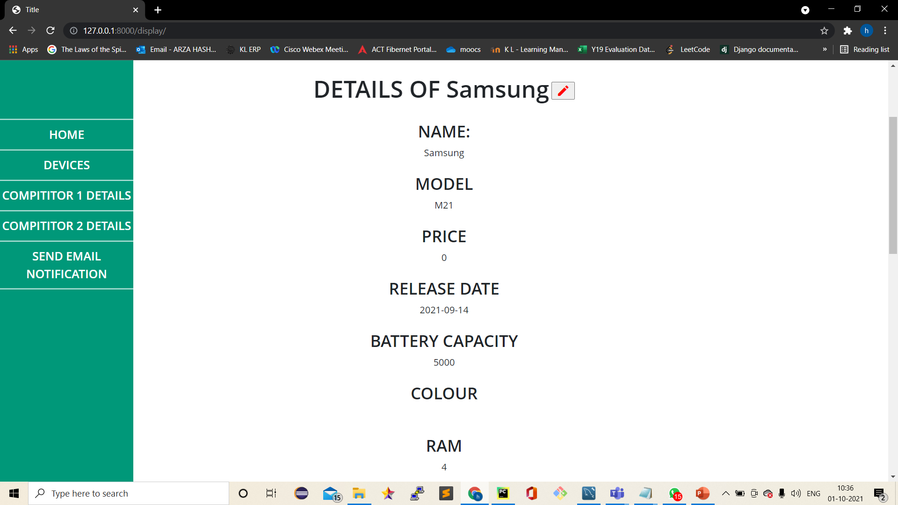
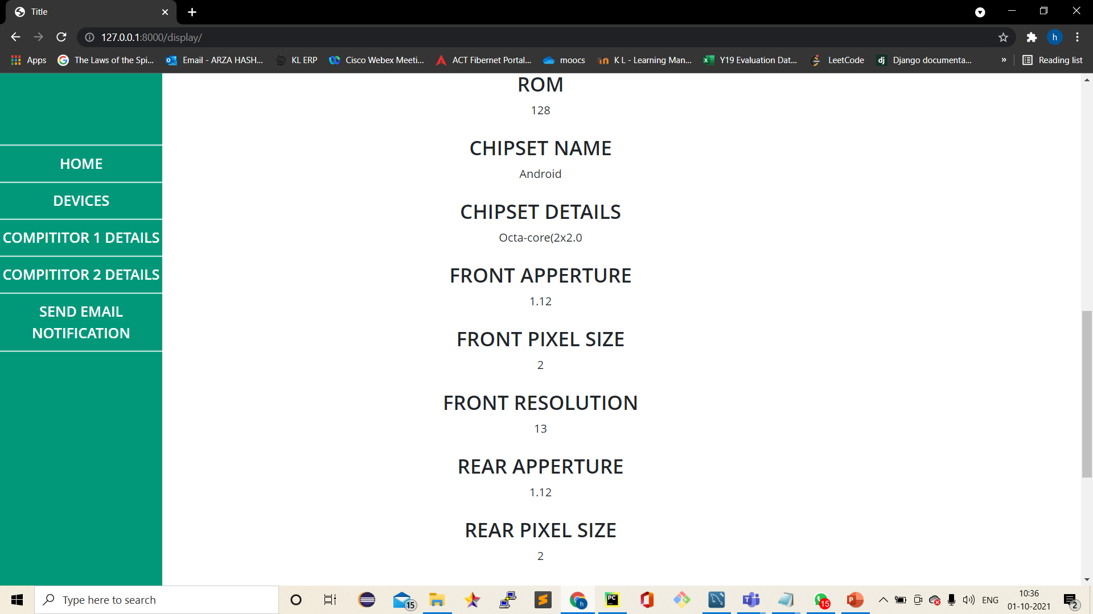

Slide 7
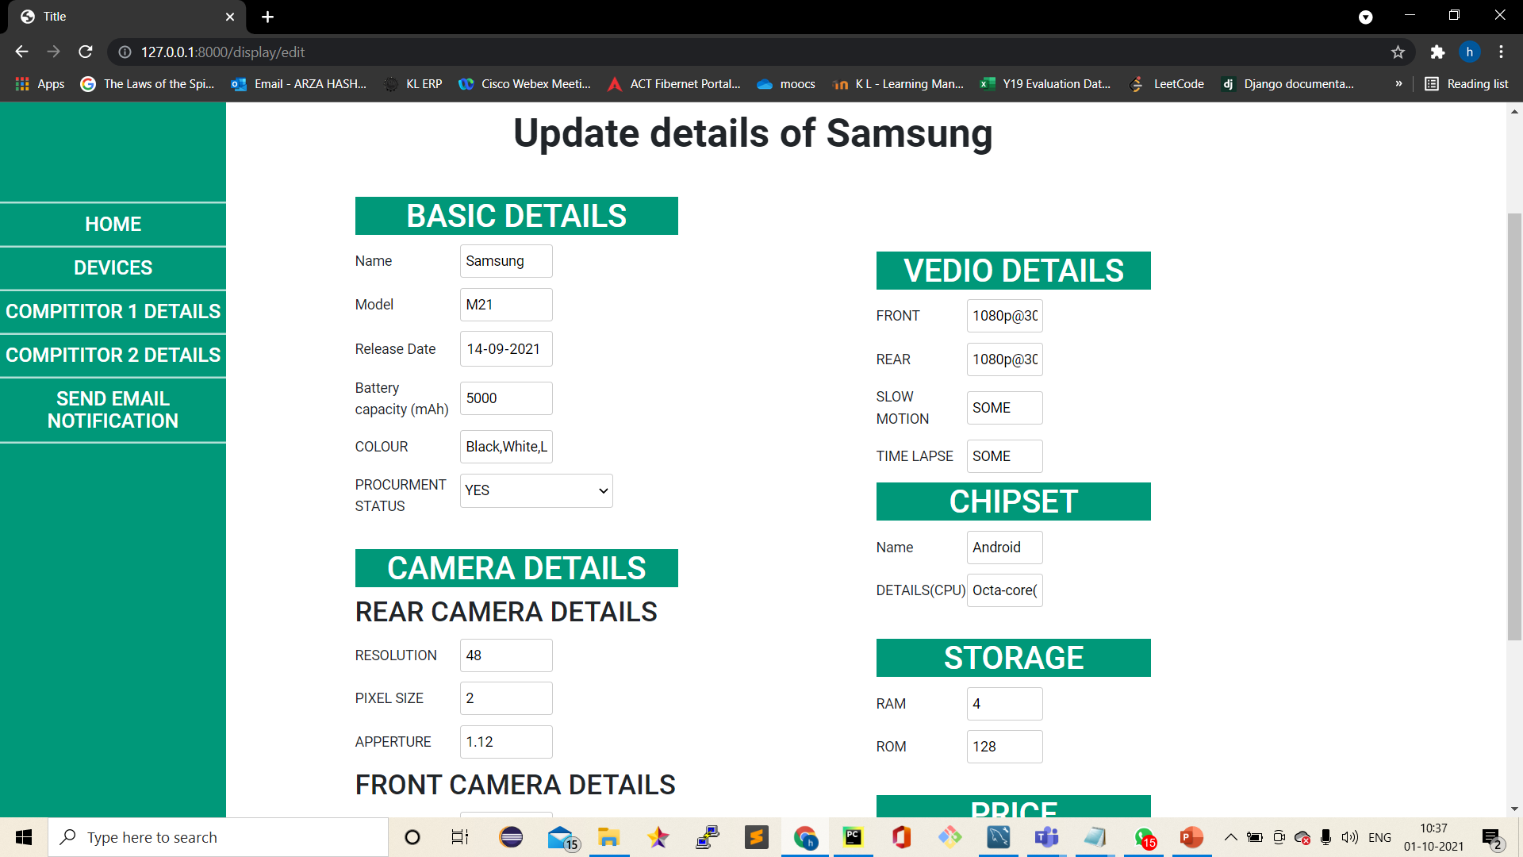
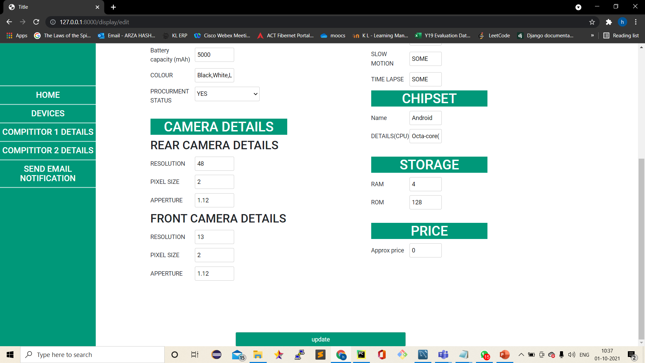

Slide 8
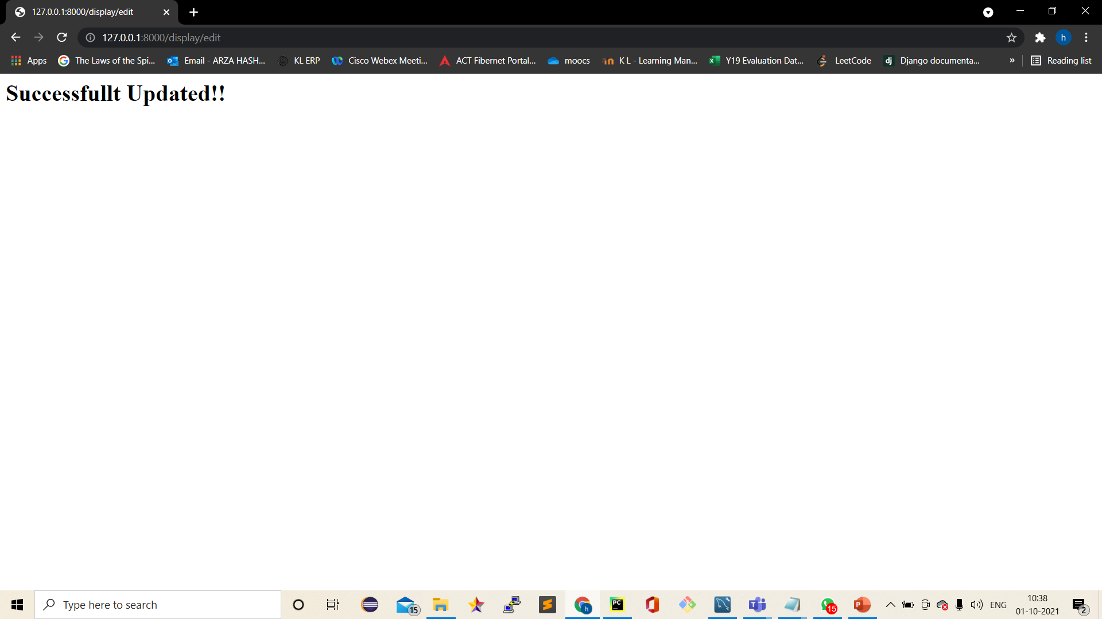

Slide 9
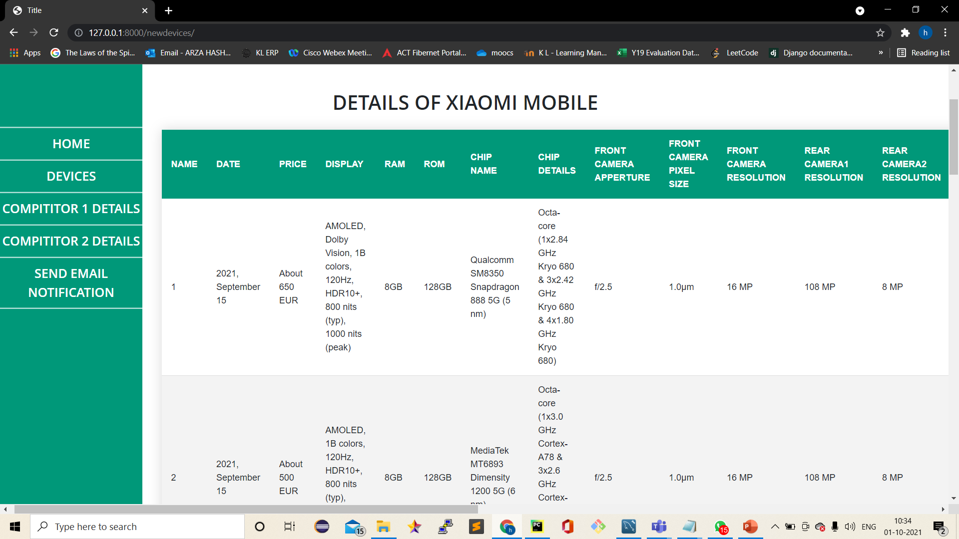

Slide 10
