Slide 1
4SO24EC027 | Chitthara K S
4SO24EC024 | Chaman R Shetty
4SO24EC026 | Chirag M N
4SO24EC044 | Hithashree

Slide 2
Report planning
Start date:10 March 2026
End date:2 May 2026
Chaman:
Chapter 2:Literature review
Chapter 4:Leaf cell design(Shift registers with testbench)
Work completed by 2nd May 2026
Chirag:
Research papers
Chapter 1:Introduction
Work completed by 2nd May 2026

Slide 3
Chitthara:
Research papers
Chapter 3:Proposed system design(architectutral diagram)
Chapter 4:Leaf cell design(multipliers with testbench)
Work completed by 2nd May 2026
Hitha:
Chapter 2:Proposed system design(Block diagram)
Chapter 4:Leaf cell design( with testbench)
Work completed by 2nd May 2026

Slide 4
Adaptive FIR filter using LMS algorithm

Slide 5
INTRODUCTION
Digital signal processing is widely used in applications such as communication systems, audio processing, and environmental monitoring. However, real-world signals are often affected by noise, which reduces system accuracy and performance. To address this issue, filtering techniques are used to extract useful information from noisy signals.
Problem Statement:
Real-time biomedical and environmental monitoring systems require efficient digital signal processing. Software-based FIR filtering can introduce latency and increased power consumption in wearable and IoT devices. Design and implement an FPGAbased hardware system capable of performing real-time digital filtering for streaming input data.
Objectives: The design focuses on developing an adaptive FIR filter architecture based on the LMS algorithm, optimized for efficient FPGA implementation. The filter employs a shift register–based delay line to store input samples, reducing resource utilization and improving hardware efficiency.

Slide 6
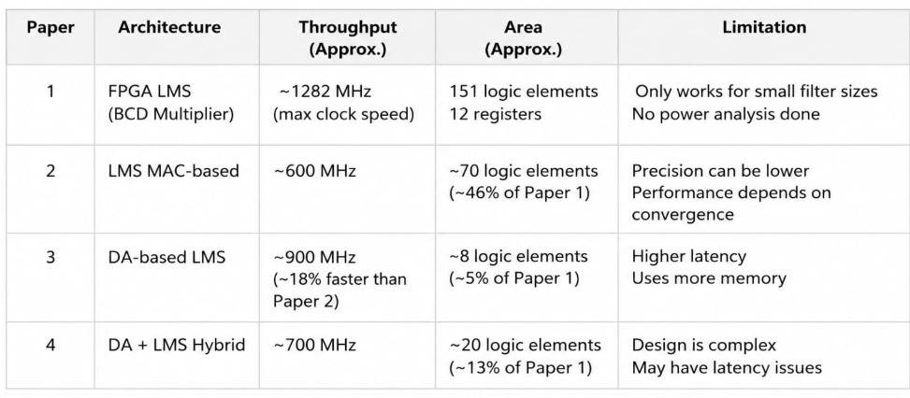
Comparative Analysis Table
This comparison helps identify the trade-off between speed, hardware utilization, and design complexity in different LMS architectures.
1.Highest Speed: FPGA LMS (BCD Multiplier)
2. Least Area: DA-based LMS
3. Best Trade-off: DA + LMS Hybrid

Slide 7
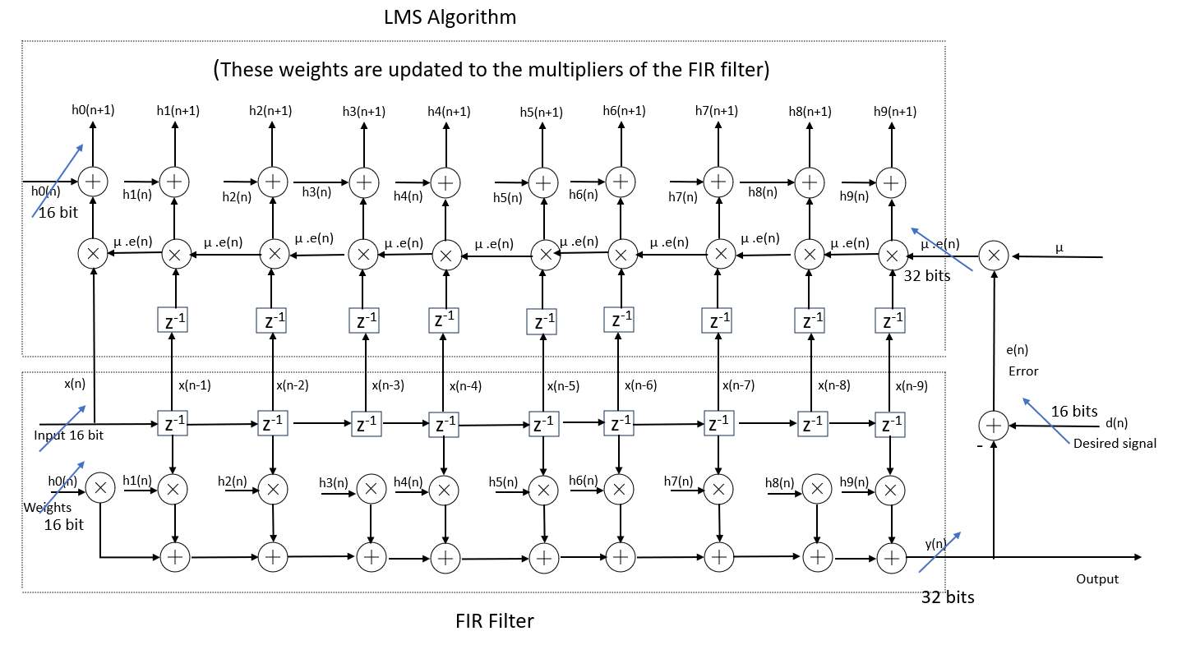
Architectural Diagram

Slide 8
Software used:
MATLAB/Simulink:
Used for testing the ANC filter
Helps to check noise cancellation
Xilinx Vivado:
Used for Verilog coding
Used for simulation
Power Point:
Used for making diagrams and presentation

Slide 9
System Architecture
1.Pipelined Multiplier
Used to multiply:Input samples × filter coefficients
Eror signal × input signal during LMS coefficient update
In FIR filtering:
y(n)=_{k=0}∑^{N−1} w_{k} (n)x(n−k) each tap requires multiplication.
Why pipelined multiplier is used:
1.Increases processing speed
2.Supports real-time signal processing
3.Reduces critical path delay
4.Efficiently utilizes FPGA DSP slices
5.Allows higher clock frequency

Slide 10
2) Carry Look Ahead Adder (CLA) Used to:Add outputs of all multipliers Compute filter output Calculate error signal Error equation: e(n)=d(n)-y(n) Why CLA is used: Faster than ripple carry adder Reduces carry propagation delay Improves overall FPGA speed Suitable for high-speed DSP systems Because FIR filters require continuous additions, fast adders are important.

Slide 11
3) Shift Registers
Used to:
Store previous input samples
Create delayed versions of the input signal
Delay operation:
x(n) , x(n-1) ,x(n-2)
Why shift registers are used:
FIR filters need past input samples
Each tap uses a delayed sample
Enables sequential data flow
FPGA SRL resources implement delays efficiently
Without shift registers, the filter cannot access previous samples

Slide 12
4) Error Calculation Block
Used to compute difference between:
Desired signal
Actual filter output
Error equation:
e(n)=d(n)-y(n)
Why it is used:
Measures filter performance
Indicates how close output is to desired signal
Drives coefficient adaptation
Essential for LMS learning process
The adaptive filter improves itself using this error value.

Slide 13
5) LMS Update Block
Used to continuously update filter coefficients (weights).
LMS update equation:
h(n+1)=h(n)+ μx(n)e(n)
Why LMS block is used:
Makes filter adaptive
Minimizes error over time
Automatically adjusts coefficients
Helps track changing signals/noise
Core learning unit of adaptive FIR filter
This block is what differentiates an adaptive FIR filter from a normal FIR filter

Slide 14
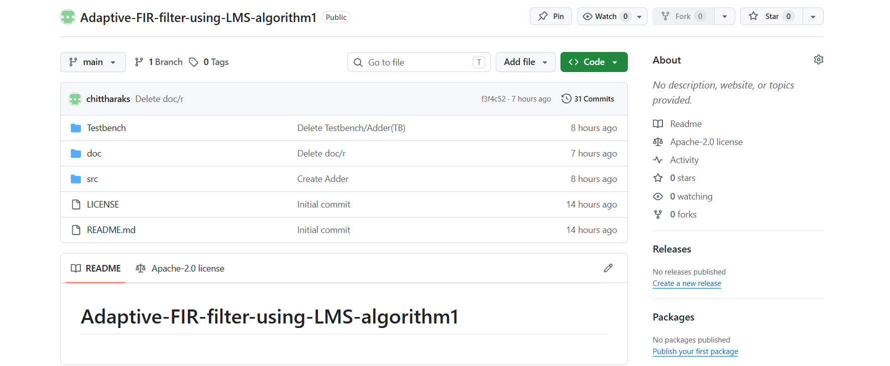
Github respository

