Slide 1


-by
N. Chitti Babu
B.V.Krishna Reddy
C.V.Mallikarjun Varma
Under the guidance of
Mr.G.M.V.S.Murthy

Slide 2
Motivation
Due to the huge volumes of text that is available online nowadays, we may require a tool which verifies whether a given statement (fact) is true or not.
Fact checker is a tool used to verify the truth of these fact statements.

Slide 3
Introduction
In this project we propose a tool that provides a user interface that takes a fact statement from the user.
Using a confidence score we conclude whether a given fact statement is true or not

Slide 4
Where it is useful?
Question answering
Automatic Essay grading
Verifying scientific papers
Verifying fact statements in law documents

Slide 5
Terminology
Verifiable Facts-Statements that can be verified
Non Verifiable Facts-Statements that can’t be verified
Stop words: The words that contribute less meaning to the sentence like is,of,in etc..
Content words: Words that contribute meaning of sentence
Synonyms: Words that have the similar meaning

Slide 6
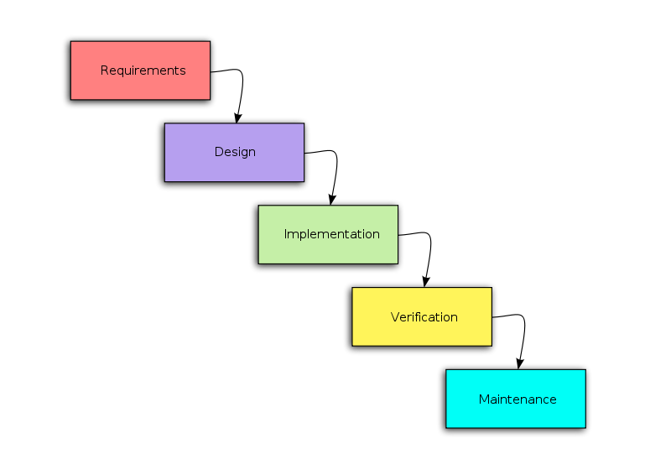
Methodology
To devlope this tool we use waterfall model

Slide 7
Assumptions
We ‘re dealing with Verifiable facts only
We’re not dealing with negation handling

Slide 8
Requirement Analysis
Hardware Requirements:
40 GB Hard disk
1 GB RAM
P4 Processor
Software Requirements:
Monty Tagger
WordNet 2.0
Java developer kit(jdk1.6)
Jwnl1.4.2 library
Visual Paradigm
Operating System:
Windows Xp / Vista

Slide 9
Algorithm
Take the statement from the user
Query the statement to the Google search engine
Obtain the top 5 web links
Get the information from each link
Filter the stop words from both the information obtained from web links and fact statement
Get the synonyms for each content word present in the fact statement
Select the best window that closely matches to the fact statement

Slide 10
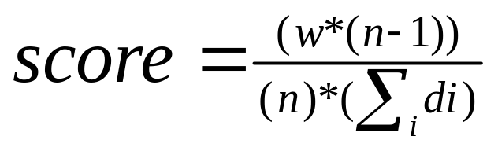
Calculate the score for the window using the below formula
where w=No.of content words present in the window
n=No.of content words in the fact statement
di=Distance b/w consecutive content words
Similarly calculate the scores for all documents & take average
Obtain the threshold from the training data consists of 100 fact statements
Tell whether the statement is fact or not based on the threshold value
Output the accuracy from test data consists of 50 fact statements

Slide 11
Design
We’ve used the following classes for designing the model for our tool
GoogleQuery: Class that responsible for query the statement to the Google Search engine,obtain the top 8 web links ,obtain the html pages from each each web link.
getResults()-Query the statement
getWebsites()-Obtain the related top 8 websites
getInformation()-Obtain the html pages from each link

Slide 12
TextProcessor : class that responsible for obtaining the information by filtering html tags from each web page, tagging parts of speech for each word & It verifies the fact statement based on score .
filterTags() - Filtering html tags from the html documents obtained from each link to get the plain text.
posTagger() -Tagging the parts of speech for each word
verify() - Verifies the fact statement.

Slide 13
StopWordFilter : Class that responsible for filtering the stop words from the given text.
filterStopWords() – Filters the stop words

Slide 14
WordNetInterface : Class that responsible for providing the interface to the wordnet for obtaining the synonyms of given word.
getSynonyms() – returns the list of synonyms

Slide 15
PatternMatcher : Class that responsible for calculating the score for best window from each document & returns the average score.
scoreCalculator() – Returns the average score
isMember() – Used by scoreCalculator for verifying whether the word is present in the lists of synonyms of content words in statement

Slide 16
FactCheckDriver : Class that contains main method from which we are invoking different routines to decide whether the statement is fact or not
It also provides user interface

Slide 17
Example Case
Let us take the the fact stmt. “Delhi is the capital of india”
We then append this stmt to http://ajax.googleapis.com/ajax/services/search/web?start=0&rsz=large&v=1.0&q= to obtain the complete url
The result after this step

Slide 18
We obtain the top 8 web links for the above statement as
http://en.wikipedia.org/wiki/India
https://www.cia.gov/library/publications/the-world-factbook/geos/in.html
http://www.incredibleindia.org/
http://india.gov.in/
http://www.google.co.in/
http://www.lonelyplanet.com/india
http://www.tourindia.com/
http://www.cricinfo.com/

Slide 19
We obtain the information after filtering html tags from the first link “ I:\New Folder\Fact checker\temp\final.txt”
Finally,We obtain the score of 1 for the statement.

Slide 20
STATUS
We’ve to train the system in order to find out the cut-off measure.
Then we’ve to evaluate the performance of the system.
Finally, we’ve to provide user interface.
We can complete it within one week.

Slide 21
Conclusion
Finally ,we conclude that using this tool we can verify the facts of any domain confidentially.

Slide 22
Thank You

