Slide 1


-by
N. Chitti Babu
B.V.Krishna Reddy
C.V.Mallikarjun Varma
Under the esteemed guidance of
Mr.G.M.V.S.Murthy

Slide 2
Motivation
Due to the huge volumes of text that is available online nowadays, we may require a tool which verifies whether a given statement (fact) is true or not.
Fact checker is a tool used to verify the truth of these fact statements.

Slide 3

Verifies the truthiness of the statement by using standard information retrieval techniques
Verifiable facts only
We’re not dealing with negation handling

Slide 4
Where it is useful?
Question answering
Automatic Essay grading
Verifying scientific papers
Verifying fact statements in law documents

Slide 5
Terminology
Verifiable Facts-Statements that can be verified
Non Verifiable Facts-Statements that can’t be verified
Stop words: The words that contribute less meaning to the sentence like is,of,in etc..
Content words: Words that contribute meaning of sentence
Synonyms: Words that have the similar meaning

Slide 6
Functional Requirements:
Verify the truthiness of the statement of any domain
Non-functional Requirements:
Provide simple user interface
Requirements Analysis

Slide 7
System Requirements
Hardware Requirements:
40 GB Hard disk
1 GB RAM
P4 Processor
Software Requirements:
WordNet 2.0
Java developer kit(jdk1.6)
Jwnl1.4.2 library
Visual Paradigm
Netbeans6.0
Operating System:
Windows Xp / Vista

Slide 8

Take the statement from the user
Obtain the URL object for the query statement by replacing white spaces with ‘+’s and it is appended to the Google API http://ajax.googleapis.com/ajax/services/search/web?start=0&rsz=large&v=1.0&q=
Obtain the top 5 web links by extracting pattern the “unescapedUrl:”
Get the information from each link by opening a connection to each web link

Slide 9
Filter the stop words from both the information obtained from web links and fact statement
Get the synonyms for each content word present in the fact statement using wordnet interface
Obtain the ASCII text(numbers and alphabets) only from each document
A window is selected of size 3*(n-1)+n, where n is no. of content words present in the fact statement

Slide 10
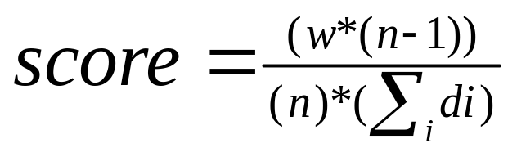
Calculate the score for the window using the below formula
Calculate the scores for all windows present in the document and take the best score for obtaining score of that document
Similarly, obtain scores for each document and take average of all scores to obtain the final score
If the score is greater than CUTOFF (0.5) determine it as a fact, else determine it as non fact

Slide 11
Analysis
For our system “Fact checker”, we followed Waterfall model, a traditional process model
As requirements are fixed, waterfall model is more convenient.

Slide 12
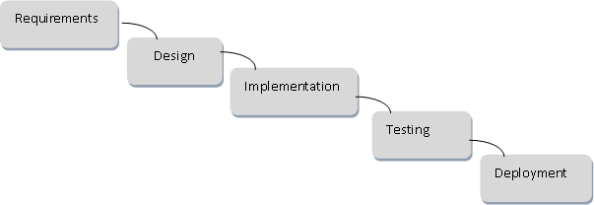
Waterfall Model

Slide 13
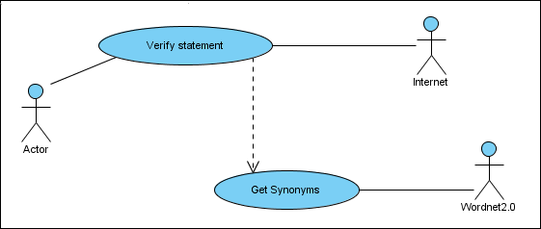
Design

Slide 14

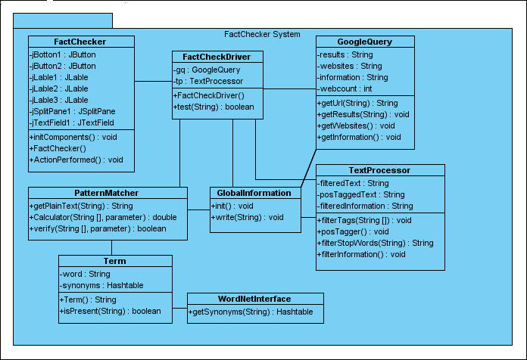

Slide 15
FactChecker
FactChecker is a class responsible for providing user interface and connects to the driver of the system.

Slide 16
FactCheckDriver
FactCheckDriver class is driver for the system. It provides communication between the system and user interface.

Slide 17
GoogleQuery
Responsible for query the statement to the Google Search engine, obtain the top 5 web links ,obtain the html pages from each web link.
getUrl()-obtain the url corresponding to query
getResults()-Query the statement
getWebsites()-Obtain the related top 5 websites
getInformation()-Obtain the html pages from each link

Slide 18
TextProcessor
TextProcessor is a class that responsible for obtaining the information by filtering html tags from each web page, tagging parts of speech for each word & It verifies the fact statement based on score
filterTags() - Filtering html tags from documents
filterStopwords()-filters the stop words from the given string
filterInformation()-filters stop words from all the documents and given fact statement

Slide 19
PatternMatcher
PatternMatcher is a class that responsible for calculating the score for best window from each document & returns the average score.
getPlainText() – obtain the ASCII text from the given string
scoreCalculator() – Returns the average score
verify() – Used by scoreCalculator for verifying whether the word is present in the lists of synonyms of content words in statement

Slide 20
Term
Term is a class that contains word and its synonyms. It also tells whether a word is present in its synonyms or not.

Slide 21
WordNetInterface
WordNetInterface is a class responsible for providing interface to the WordNet-2.0.It get the synonyms from the WordNet-2.0 for a particular word. It has only one method:
getSynonyms() –obtain synonyms for a particular word.

Slide 22
GlobalInformation
GlobalInformation is a class responsible for writing the intermediate results into temporary file

Slide 23

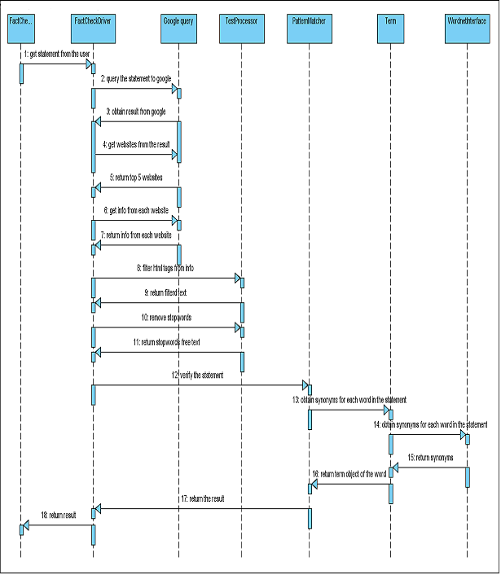

Slide 24
Implementation
We’ve implemented our system in Java
To provide interface with wordnet2.0 ,we used external jar file jwnl.jar
To design user interface , we used IDE, Netbeans6.0

Slide 25
Testing
Unit Testing
    Tested each module independently
System Testing
    Tested our system with 49 fact statements

Slide 26

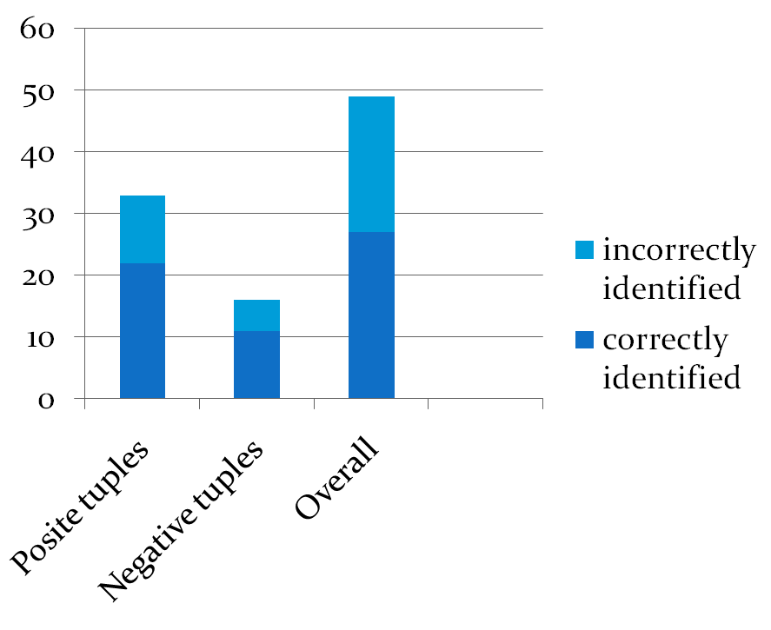
Sensitivity=0.6667
Specificity=0.6875
Accuracy=0.67349

Slide 27

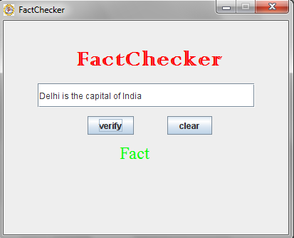

Slide 28
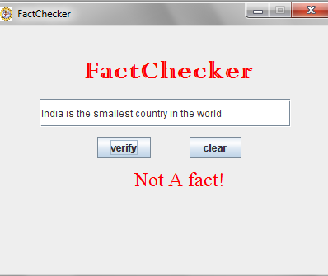

Slide 29
Future Enhancements
tense of the statement
negation of the statement
Pronoun resolving

Slide 30
Conclusion
The Fact Checker is designed and implemented to provide an application which verifies the truthiness of the statement
The system worked well with simple facts

Slide 31

Thank You

