Slide 1
Vision-Language Grounded
Semantic Navigation
for Autonomous Mobile Robots
Team 21:
Chittin Varunav Ravi
Madhumita Singh
Ravindran Vasoor Saravanan
Thirulok Sundar Mohan Rasu

Slide 2
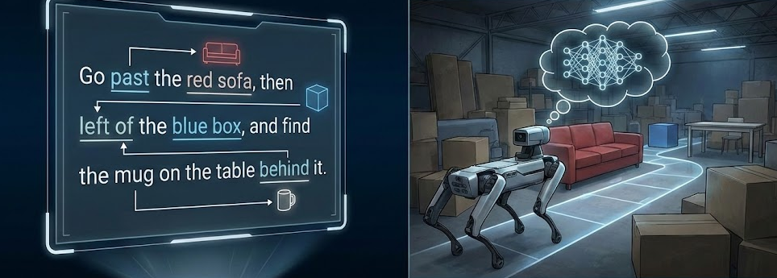
Problem Statement
Traditional robotic navigation relies on coordinate-based goals (X, Y), which are unintuitive for users and assume pre-built maps with known object labels. Our project’s goal is to enable robots to interpret compositional natural language commands (e.g., “go to the red cylinder”).

Slide 3
System Architecture Overview
Simulation
Gazebo simulation
3D Robot Simulation
LiDAR
2D laser scanning
RGB camera
Color image capture
Depth camera
Distance estimation
Exploration
Frontier explorer
Autonomous exploration
Cartographer SLAM
Mapping & localization
Mapping &
Perception
Occupancy grid
Free/occupied space map
Grounding DINO
Object Detection
3D localization
Object position estimation
Semantic map
Semantic map
Object memory storage
Command
& Navigation
Natural language command
e.g. "Go to the red cylinder"
Mission controller
Target + map query
→ goal coordinates
Nav2 stack
Navigation to goal
Goal
Goal reached
"Navigation complete — arrived at target"

Slide 4
SLAM Algorithm
Used Google Cartographer for 2D LiDAR SLAM on TurtleBot3
Pose graph: each node = robot pose (x, y, θ); each edge = sensor-derived constraint between poses
Local layer — online correlative scan matching aligns each new LiDAR scan to the current submap; motion filter skips redundant scans (< 0.1° rotation)
Global layer — pose graph optimizer runs every 20 nodes, searches for loop closures (min score 0.65), corrects accumulated drift via Ceres nonlinear least squares
Fuses wheel odometry + LiDAR for robust pose prediction between scans
Outputs /map (0.05 m/cell occupancy grid) input to frontier explorer and Nav2 costmaps

Slide 5
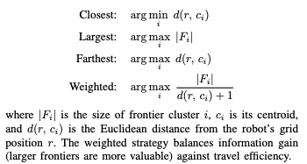
Frontier Exploration Algorithm
Frontier = boundary between known free space and unknown space in the occupancy grid — navigating there guarantees new information
Detection: dilate the unknown region by 1 pixel, AND with free-cell mask → frontier pixels; cluster with connected component labeling; discard small clusters < 10 cells
Selection strategy — Weighted (default): score = frontier_size / (distance_to_robot + 1) — balances information gain vs. travel cost for efficient full-room coverage
Failure recovery: if robot gets stuck (no movement > 0.3m in 45s), switches to Farthest strategy to escape corners and revisit-locked regions
Visited frontiers tracked — prevents re-sending robot to already-explored locations
Exploration terminates when no frontier clusters remain (full coverage)
Tightly coupled with semantic mapping: Grounding DINO runs every 1.5m of travel during exploration, populating the semantic map in parallel

Slide 6
Object Detection with Grounding Dino
Triggered during exploration (every ~1.5 m): Runs in parallel with frontier exploration to detect objects without stopping navigation
Open-vocabulary detection: Uses text prompts (e.g., “red cylinder”, “blue box”) to detect unseen object categories
CPU-based inference (5–10 s/image): Works without GPU but limits real-time performance
Confidence filtering & ranking: Threshold (~0.28) removes noise; detections sorted before downstream processing
Label cleaning heuristic: Fixes merged labels (e.g., “red cylinder blue box”) by matching to valid prompt terms

Slide 7


3D Object Localization from 2D Bounding Boxes
3-step pipeline: Converts 2D detections into real-world 3D positions
Depth estimation: Median depth from central region of bounding box; filters invalid values (0.1–10 m)
Camera projection: Uses pinhole model to map image pixel → 3D camera coordinates
World transformation: Converts camera coordinates to global frame using ROS2 TF
Key limitation: Camera intrinsic mismatch (~13%) introduces noticeable localization error

Slide 8
System Integration
Natural language command
e.g. "Go to the red cylinder"
Semantic map
{label: "red cylinder", position: [2.1, 3.4, 0.0]}
Once all individual modules are built, they need a single coordinator to tie them together.
The mission controller ties all modules into one pipeline.
State machine (IDLE → EXPLORING → NAVIGATING) activates modules in order
Triggers detection during exploration, building the semantic map on the fly
Parses commands, queries the map, sends goal to Nav2
Tracks navigation outcomes
Design: Core logic decoupled from ROS — testable standalone.
Mission controller
semantic_map.get_best_match("red cylinder")
→ goal = [2.1,3.4,0.0]
Command Parser
{action: "go",
target: "cylinder",
attribute: "red",}
Goal Reached
distance_to_goal < 0.25 m → "Navigation complete"
Nav2 stack
NavigateToPose(goal.x, goal.y, frame="map")

Slide 9
Command Parser | Semantic Map | Nav2 Navigation
Converts free-form text into a structured query the system can act on Uses Regex cascade to strip action verb, extracts color + shape, pulls out spatial relations Outputs target="cylinder" · attr="red" · query="red cylinder" | Stores the label, 3D position, confidence and observation count Merges Duplicates if there is same label within 0.5 m (weighted running average; more observations = more accurate) Uses Fuzzy querying "cylinder" matches "red cylinder"; tolerates DINO label concatenation | Uses Global planner (NavFn) costmap to get shortest collision-free path The Local controller (DWB) samples velocities at 20 Hz, scores on basis of heading, clearance and speed Uses Costmap inflation to inflate obstacles by robot radius (the pink halo in RViz) Action interface : navigate_to_pose → feedback stream → SUCCEEDED or FAILED

Slide 10
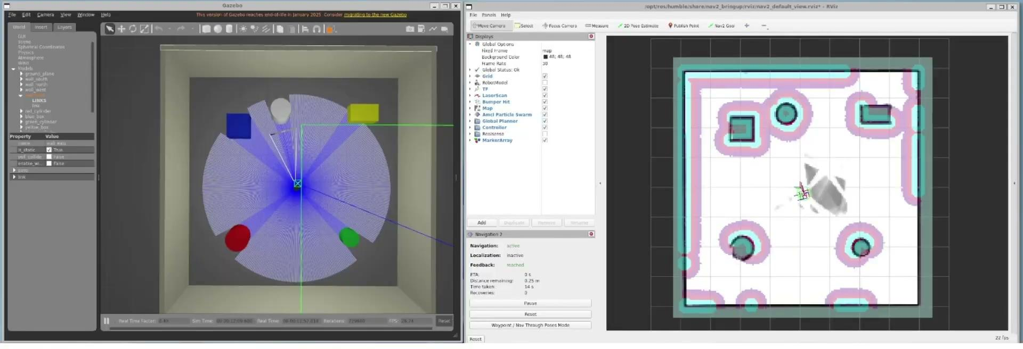
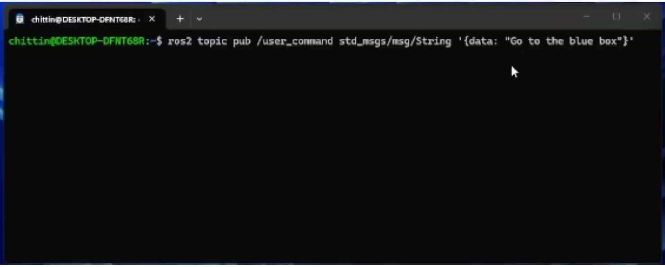
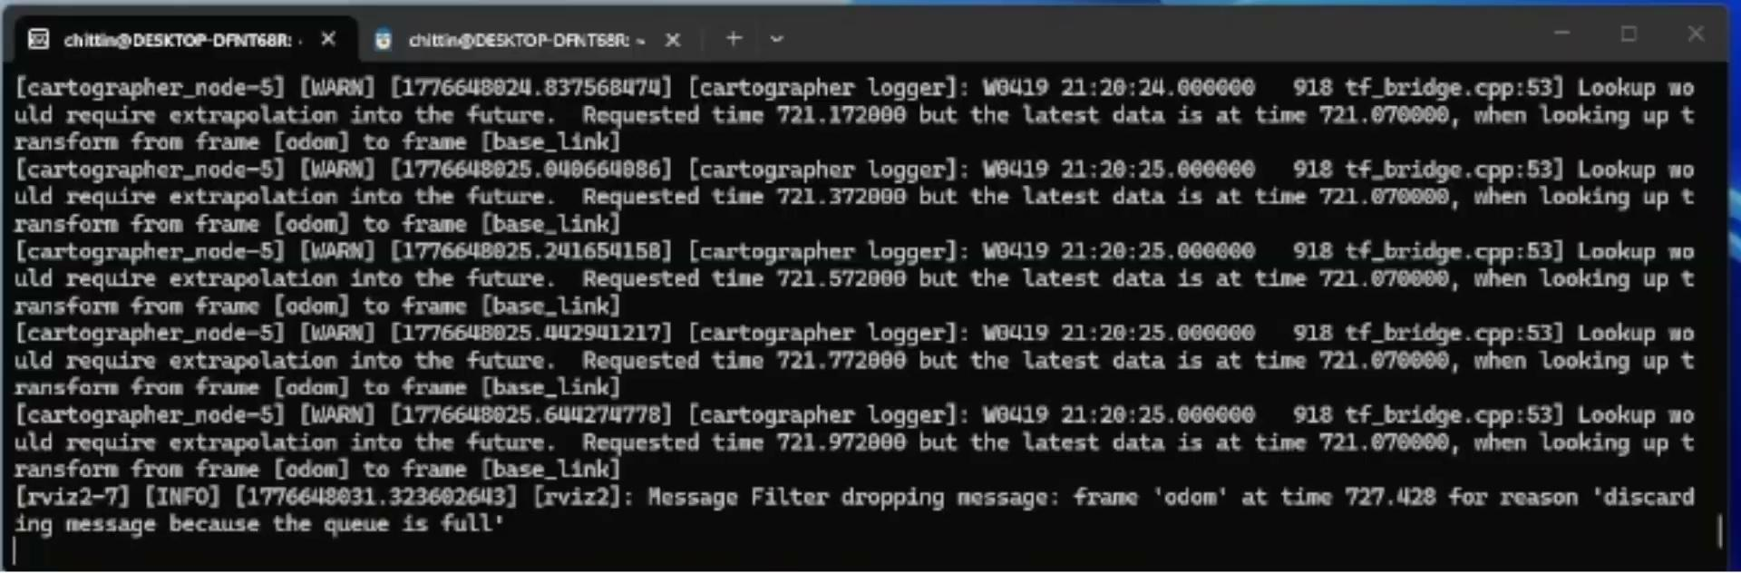
Simulation & Testing
Notes:
Now that we've built and implemented the full pipeline, we can simulate the entire system.
In the bottom left terminal, we give the robot a command — 'Go to the blue box.' On the top right is the occupancy map with blue box marked and we can watch the robot navigate to it in Gazebo.
In the bottom right terminal, we can see the system working — the mission controller sends the target location to Nav2. The navigation completes once robot is within 0.25 meters of target location. Here you can see another example for the command Go to the green cylinder, and the same process follows

Slide 11
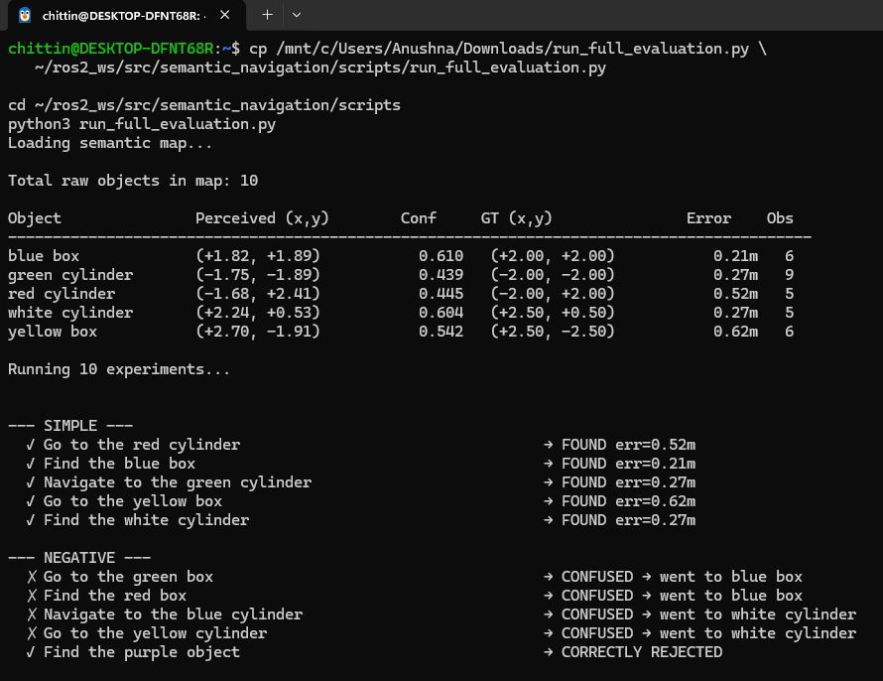
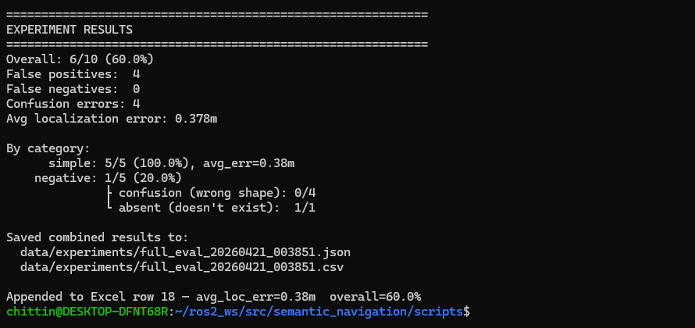
Results & Observations
We evaluate the system by running commands directly against the saved semantic map, allowing rapid testing without re-launching the simulation.
Localization: Compared mean perceived positions against ground truth. Avg error per run < 0.5 m, likely due to depth sensor noise and bounding box misalignment.
Confidence: Scores range 0.41–0.69 — moderate, given DINO wasn't trained on simple Gazebo shapes.
Commands: 5 simple (existing objects) + 5 negative (non-existent). All simple commands pass since every object in the environment was detected. Negative commands mostly fail because the map uses fuzzy matching — "green box" returns "blue box" as the closest match instead of rejecting it.
Notes:
“So those examples show the system working end-to-end. But to go beyond visual results, we evaluate its accuracy and reliability using our experimentation script.”
For localization, Average error within 0.5m is observed. Causes include depth noise and bounding box misalignment. DINO confidence is moderate since it wasn't trained on Gazebo shapes.
Additionally, we tested 5 commands for existing objects. Since all objects are detected, all tests pass.
And 5 for non-existent objects, such as green box, most fail because the keyword matching sends the robot to the closest label instead of rejecting it. Thus the Overall accuracy of the system 60% with an average error around 0.3m

Slide 12
Conclusion & Future Work
Conclusion:
A natural language command can successfully guide a robot to a target object using only vision and a semantic map
Multiple observations improve localization — the system gets more accurate the more it sees
The pipeline works end-to-end without any human intervention during exploration
Label rejection remains an open problem — the system is better at finding things than knowing what doesn't exist
Future Work:
Strict label matching — reject queries that don't exactly match the map
Fine-tune or swap detector for better confidence on simple shapes
Benchmark against other SLAM backends (particle filter, EKF) to compare localization accuracy and runtime
Test in larger, multi-room environments
Deploy on a real TurtleBot3 with real sensor noise
Notes:
To wrap up — we showed that you can give a robot a plain English command and it will navigate to the target.
With more observations the perceived object location converge closer to the true position. The main limitation is that The system is good at finding objects, but bad at rejecting objects that do not exist in the environment.
For future work — the most immediate fix is strict label matching so the system rejects what it hasn't seen. We'd also like to try a detector suitable for simple geometric shapes. Also, we can compare our Cartographer-based approach against other methods like particle filtering or EKF that would help us understand the tradeoffs in localization accuracy. And finally, testing on a real robot would validate whether this pipeline holds outside simulation."
And that wraps up our project. Thank you.

Slide 13
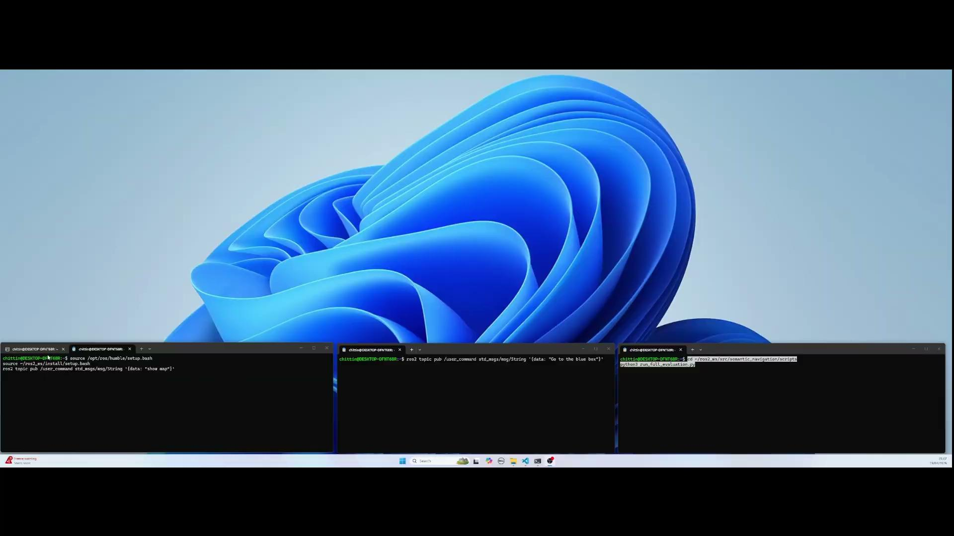
Appendix

