Slide 1

YouTube Popularity Prediction - A Machine Learning Driven Approach
C.S.RACHEL
121324030005

Slide 2
TABLE OF CONTENTS
ABSTRACT
PROBLEM STATEMENT
OBJECTIVES
APPLICABILITY & SCOPE
METHODOLOGY
DATASET
DATA PRE-PROCESSING
SYSTEM MODULES
CHATBOT
VIEWS PREDICTION
LIKES PREDICTION
HASHTAG RECOMMENDATION
SHOW INSIGHTS
CONCLUSION
FUTURE SCOPE

Slide 3
ABSTRACT
This project focuses on predicting the popularity of YouTube videos using machine learning techniques.
The system estimates video views and likes, recommends relevant hashtags, and provides analytical insights to support data-driven decision-making for content creators.
It integrates multiple prediction models, visualization tools, and a chatbot-based interface to enhance usability and performance analysis.

Slide 4
PROBLEM STATEMENT
YouTube content creators often lack reliable tools to accurately predict video performance before publishing.
Manual analysis of engagement metrics is time-consuming and does not provide actionable insights.
There is a need for an intelligent system that can forecast views and likes, recommend hashtags, and provide meaningful insights to improve content strategy.

Slide 5
OBJECTIVES
To predict the number of views of a YouTube video using machine learning models
To predict the number of likes based on early engagement and content features
To recommend suitable hashtags to improve video discoverability
To provide insights and visualizations for better content planning

Slide 6
APPLICABILITY
YouTube content creators
Digital marketing and media analytics
Educational and research purposes
SCOPE
View prediction using ensemble machine learning models
Likes prediction using engagement metrics
Hashtag recommendation using dictionary-based approach
Insights such as best time to upload and engagement analysis

Slide 7
METHODOLOGY
Data collection using YouTube API
Data cleaning and preprocessing
Feature engineering and selection
Model training and validation
Prediction of views and likes
Recommend relevant hashtags
Insights generation and visualization

Slide 8
DATASETS
Dataset
Self-collected data using YouTube Data API
Two datasets:
Views prediction dataset (~5000 records)
Likes prediction dataset (~5000 records)
Tools and Libraries
Python, Flask, Pandas, NumPy, Scikit-learn, Random Forest, Gradient Boosting, XGBoost, LightGBM, Matplotlib, Plotly

Slide 9
DATA PRE-PROCESSING
Removal of duplicate records
Handling missing values using median imputation and row removal
Outlier treatment for highly skewed data
Log and Yeo-Johnson transformations
Encoding categorical variables
Feature engineering for time-based and content-based attributes

Slide 10
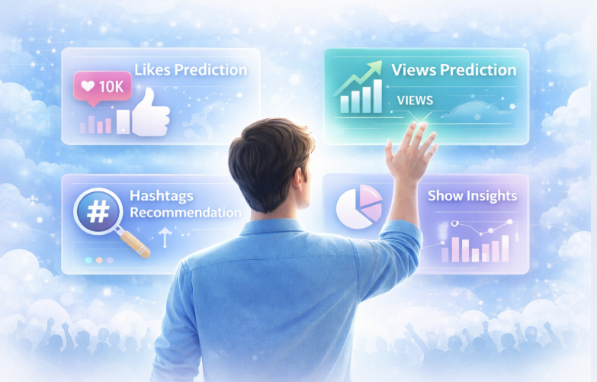
SYSTEM MODULES
Chatbot Module
Views Prediction Module
Likes Prediction Module
Hashtag Recommendation Module
Show Insights Module

Slide 11

VIEWS PREDICTION
Predicts expected views for a video
Uses multiple machine learning models:
Random Forest
Gradient Boosting
XGBoostLight
GBM
Allows users to select models based on accuracy, speed, and stability

Slide 12

LIKES PREDICTION
Predicts the number of likes using early engagement metrics
Features include views in the first hour, dislikes in the first hour, comments in the first hour, category, and description length
Implemented using Random Forest Regressor

Slide 13

HASHTAG RECOMMENDATION
Dictionary-based keyword matching approach
Uses video title and category
Suggests relevant hashtags
Improves video discoverability and reach

Slide 14

SHOW INSIGHTS
Best time to upload videos
Average views by hour and day
Engagement breakdown (views, likes, comments)
Model comparison analysis
Visualized using Matplotlib and Plotly

Slide 15
CONCLUSION
The project demonstrates that machine learning techniques can effectively predict YouTube video popularity.
The system helps content creators make informed decisions by providing predictions, hashtag recommendations, and analytical insights.
It serves as a practical tool for data-driven content optimization.
Multiple machine learning models provide flexibility in choosing accurate and efficient predictions.
Visualization and chatbot features improve usability and support better content decisions.

Slide 16
FUTURE SCOPE
Integration of deep learning models
Real-time data analysis and prediction
Sentiment analysis of comments
Thumbnail image analysis
Cloud deployment for scalability

Slide 17


