Slide 1


GUIDED BY, Mrs. E. Sri Santhoshini M.E., Assistant Professor
K.RAMAKRISHNAN COLLEGE OF TECHNOLOGY (AUTONOMOUS), TRICHY
IOT- ENABLED ROBOT HAND WITH ACCELEROMETER SENSOR BASED CONTROL
811721243006 - Ambalatharasan R M
811721243007 - Aravindh S
811721243013 - Chittrarasu K

Slide 2
OBJECTIVE
To develop a wireless robotic hand system that uses the Axelo IMU sensor for real-time gesture control, enabling accurate and smooth finger movements through Arduino-based processing and NRF24L01 communication.

Slide 3
EXISTING SYSTEM
Wired systems use myoware sensors connected to a microcontroller to control servo motors, offering reliability but limited mobility due to physical wiring
Wireless systems transmit sensor data via NRF24L01, Bluetooth, or Wi-Fi, providing flexibility but potentially facing signal interference or delays.
AI-enhanced systems use AI, IMUs, and cloud processing for precise gesture recognition, but they demand more processing power and are costlier.
Wired systems offer simplicity and reliability, while wireless and AI-enhanced systems provide greater mobility and performance at the expense of complexity and potential delays.
AI-enhanced systems are ideal for advanced applications like robotic prosthetics, requiring precise control and gesture recognition.

Slide 4
DRAW BACKS
Limited mobility due to physical wiring.
Requires high processing power, which may not be available in all devices.
More expensive due to additional components (AI algorithms, IMUs, cloud processing).
Development is more complex and requires specialized knowledge.

Slide 5
PROPOSED SYSTEM
The system features a wireless robotic hand controlled by a glove equipped with five ADXL335 accelerometer sensors to track real-time hand and finger movements.
Each sensor captures three-axis acceleration data, which is processed by the glove’s microcontroller.
ZigBee technology is used to wirelessly transmit the data to the robotic hand, enhancing mobility and eliminating wiring.
The robotic hand uses five servo motors—each for one finger—to replicate gestures based on the received data.
Precise calibration of the servo motors ensures accurate and natural movement, from simple to complex gestures.
The system is lightweight, ergonomic, and ideal for prosthetics, rehabilitation, and human-robot interaction due to its intuitive, real-time control and low power consumption.

Slide 6
ADVANTAGES
Allows hands-free, immediate control of the robotic hand.
Translates muscle signals into precise movements, suitable for detailed tasks.
Wireless design enables greater freedom of movement.
Ideal for prosthetics and rehabilitation applications, enhancing user functionality.

Slide 7
LITERATURE SURVEY
S.NO | TITLE | YEAR of PUBLICATION | AUTHORS | ALGORITHMS | MERITS | DEMERITS
1 | Biomimetic Design and Kinematic Analysis of a Rope-driven Soft Robotic Arm | 2024 | Ruile Ma, Jinzhu Peng, Pengfei Yu, Nan Zhao | Monte Carlo Method, Inverse Kinematics Calculation, Forward Kinematics Analysis | High flexibility, Safety, Efficient Control | Limited Load Capacity, Modeling Complexity, Friction and Installation,
2 | Estimation of Energy Absorption Capability of Arm Using Force Myography for Stable Human-Machine Interaction | 2024 | Andres Ramos, Keyvan Hashtrudi-Zaad | Excess of Passivity Estimation, Force Myography Measurement, Linear Interpolation, Statistical Analysis | Improved Safety in Human-Robot Interaction, Better Stability and Control, Low Cost, | Sensor Calibration Required, Overestimation Risk
3 | Robotic Arms Based on Carbon Fiber Reinforced Plastic and Aluminum Alloy | 2024 | Haibin Yin, Jing Liu, Feng Yang | Genetic Algorithm, Model Polynomial Interpolation for Trajectory Planning | Improved Energy Efficiency, Enhanced Dynamic Performance | Manufacturing Complexity, Longer Optimization Time, Higher Material Costs

Slide 8
LITERATURE SURVEY
S.NO | TITLE | YEAR of PUBLICATION | AUTHORS | ALGORITHMS | MERITS | DEMERITS
4 | Innovative Design Research on a Cable-Driven Humanoid Robotic Arm | 2024 | Zhiyuan Wu, Ye Huo, Kangji Ma, Yuanzeng Song , Haiyan Sun, Huaizhi Cao , Zhufeng Shao | Spherical Projection, Joint Design with Single Cable Constraints | Large Workspace, Lightweight & Compact Design, Lower Inertia, Scalability & Modularity | Complex Control System, Limited Load Capacity, Cable Stretch & Wear
5 | Integrating Contact, Modeling, and Control for the Robotic Hand Manipulation | 2024 | Shuwei Zhao, Jin Yu, Ye-Hwa Chen, Ruiying Zhao | Extended Udwadia-Kalaba Equation, Dynamic Modeling of Contact Forces | Improved Stability and Accuracy, Handles Singular Inertia Matrices, Mathematically Robust | High Computational Complexity, No Force Sensor Feedback
6 | Iteratively Calibratable Network for Reliable EEG-Based Robotic Arm Control | 2023 | Byeong-Hoo Lee, Jeong-Hyun Cho, Byung-Hee Kwon, Minji Lee, Seong-Whan Lee | Feature Extraction with Multiple Extractors, Network Expansion, Image Transformer-Based Classification | Personalized and Adaptable, Efficient Calibration | Computational Complexity, Potential Overfitting Risks

Slide 9
LITERATURE SURVEY
S.NO | TITLE | YEAR of PUBLICATION | AUTHORS | ALGORITHMS | MERITS | DEMERITS
7 | Multimodal Human-Robot Interface for Accessible Remote Robotic Interventions in Hazardous Environments | 2023 | Giacomo Lunghi, Raul Marin, Mario Di Castro, Alessandro Masi, Pedro J. Sanz | Deep Neural Network, Kernelized Correlation Filters, Model-View-Controller | Improved Accuracy, Enhanced Usability, Multi-Robot Control | Network Dependence, High Computational Load, Latency Issues, Limited Generalization
8 | Obstacle Avoidance Path Planning for Apple Picking Robotic Arm Incorporating Artificial Potential Field and A∗ Algorithm | 2020 | Min Zhuang, Ge Li, Kexin Ding | A* Algorithm, Rapidly-exploring Random Tree Algorithm | High Efficiency, High Accuracy, Smooth Path Planning | High Computational Cost, Increased Complexity

Slide 10
LITERATURE SURVEY
S.NO | TITLE | YEAR of PUBLICATION | AUTHORS | ALGORITHMS | MERITS | DEMERITS
9 | Shared Three-Dimensional Robotic Arm Control Based on Asynchronous BCI and Computer Vision | 2019 | Yajun Zhou, Tianyou Yu, Wei Gao, Weichen Huang, Zilin Lu, Qiyun Huang, Yuanqing Li | Computer Vision, Shared Control Strategy | High accuracy, flexible, operation, | High mental demand, Latency issues, Complexity of setup
10 | Wearable Extra Robotic Limb System With a Constant-Orientation Mechanism for the Handling of Construction Material | 2019 | Yeonho Ko, Joon Ho Kwon, Jihun Kim, Seonghyeon Won, Daehie Hong | Finite State Machine Algorithm, Series Elastic Actuator Control Algorithm | Improves Task Efficiency, Enhances Worker Comfort, Increases Load Capacity, Precision and Repeatability | Complex Setup, Limited Adaptability, Battery Weight

Slide 11
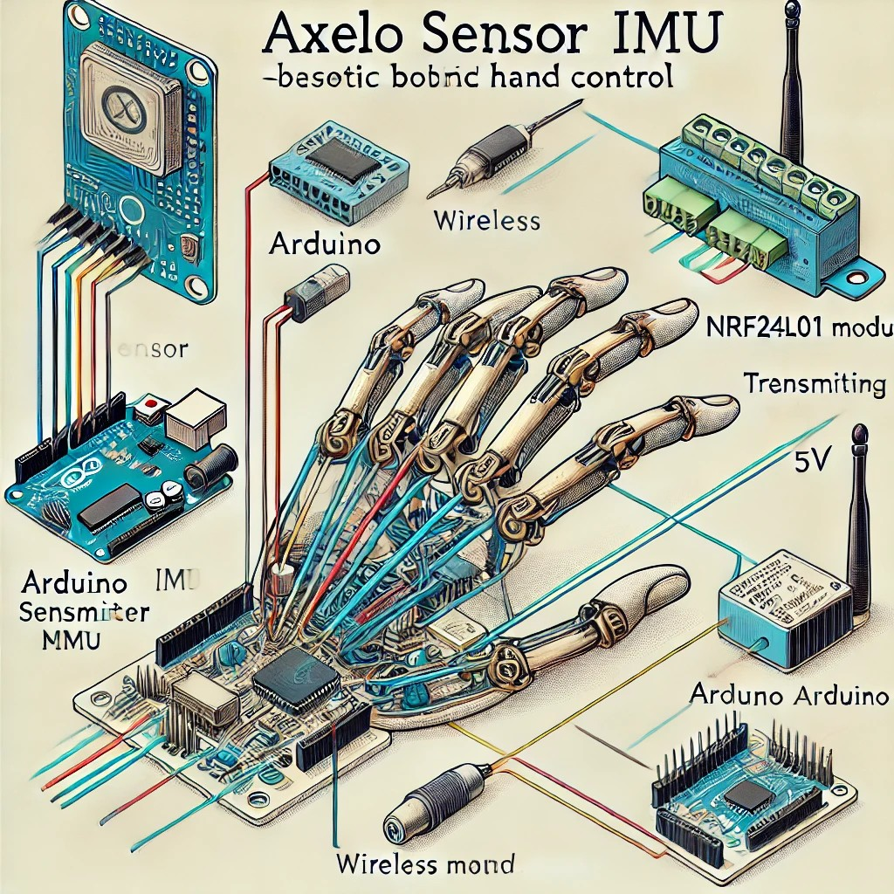
ARCHITECTURE DIAGRAM

Slide 12
ARCHITECTURE DIAGRAM
KIT 1
KIT 2
User initiates movement
Myoware EMG Sensor – To detect muscle signals
Arduino Uno/Nano – To process EMG signals
NRF24L01 Transmitter – For wireless communication
Battery Pack (5V) – Power supply
Resistors & Wires – For connections
Transmit signal to Kit 2
Arduino Uno/Nano – For processing received signals
Move finger based on analyzed signal
NRF24L01 Receiver – To receive signals
Servo Motors (SG90/MG995) – To move robotic fingers
External 5V Power Supply – For motors
Receive Kit 1 sensor signal

Slide 13
MODULES
Hand Motion Detection Module
Signal Processing and Mapping Module
Wireless Communication Module
Data Reception and Processing Module
Actuation and Control Module
Model Evaluation and Monitoring Module

Slide 14
MODULE 1: HAND MOTION DETECTION MODULE
The hand motion detection module uses a glove embedded with five ADXL335 accelerometers, each placed on a finger and the palm, to capture 3-axis motion data.
This data reflects finger and hand movements such as bending, lifting, and rotating, enabling accurate gesture recognition.
A microcontroller processes the analog signals using ADC, filtering, and calibration to reduce noise and ensure signal accuracy.
The processed data is formatted into packets and transmitted wirelessly using ZigBee for real-time, low-latency control.
Motion patterns are interpreted based on threshold values to distinguish between gestures and minor movements.

Slide 15
MODULE 1: HAND MOTION DETECTION MODULE
The system maps the detected gestures to servo motor commands to replicate motions on a robotic hand.
Sensors: ADXL335 3-axis analog accelerometers.
Wireless Communication: ZigBee protocol.
Microcontroller: For signal acquisition, ADC, filtering, and calibration.
Gesture Recognition: Threshold-based classification of movements.

Slide 16
MODULE 2: SIGNAL PROCESSING AND MAPPING MODULE
The signal processing and mapping module refines raw analog data from the ADXL335 accelerometers into digital commands for robotic hand control.
It starts with analog-to-digital conversion, sampling motion signals from all sensor axes at high frequency for real-time responsiveness.
Low-pass filters are applied to remove high-frequency noise, ensuring reliable gesture detection.
Calibration routines establish baseline sensor values to account for individual user variations and enhance motion interpretation.
Processed values are mapped to servo motor angles using linear or non-linear scaling, often normalized to match motor operating ranges.

Slide 17
MODULE 2: SIGNAL PROCESSING AND MAPPING MODULE
Each finger's motion is mapped independently, allowing precise and complex gesture replication.
The resulting data is formatted into structured frames and wirelessly transmitted via ZigBee for seamless real-time control.
Analog-to-Digital Conversion (ADC) for digitizing accelerometer signals.
Structured Data Framing for robust wireless communication.
Wireless Transmission via ZigBee for real-time remote control.
Low-pass Filtering to eliminate noise and ensure signal stability.

Slide 18
MODULE 3: WIRELESS COMMUNICATION MODULE
The wireless communication module enables real-time, cable-free data transfer between the glove and robotic hand using ZigBee technology.
It transmits structured motion data from the glove's microcontroller to the robotic hand via a pair of ZigBee modules operating on the 2.4 GHz band.
Data packets containing servo motor commands are sent continuously to reflect user gestures with minimal latency.
The protocol supports low power consumption and compact design, making it ideal for wearable applications like prosthetics or therapy.
Acknowledgment-based transmission ensures data reliability and accuracy during gesture replication.

Slide 19
MODULE 3: WIRELESS COMMUNICATION MODULE
The system supports secure communication and avoids interference through channel selection and auto-retry mechanisms.
This module enables seamless, synchronized gesture control, improving usability and user mobility in real-time applications.
Wireless Protocol: ZigBee (IEEE 802.15.4 standard).
Data Transmission: Serial communication between microcontroller and ZigBee.
Power Optimization: Low power modes for extended battery life.
Security Features: Encryption and network authentication.

Slide 20
MODULE 4: DATA RECEPTION AND PROCESSING MODULE
The data reception and processing module is the core controller in the robotic hand that interprets real-time motion data from the glove.
Upon receiving structured packets via ZigBee, the microcontroller establishes a serial link and parses incoming data for each finger.
It performs error checking, validates packet integrity, and maps motion data to corresponding servo motor commands.
Pulse Width Modulation (PWM) is used to generate precise motor control signals for each finger.
Smoothing algorithms and motion interpolation enhance fluidity, reducing mechanical stress and producing lifelike movement.

Slide 21
MODULE 4: DATA RECEPTION AND PROCESSING MODULE
Adaptive control features allow dynamic adjustments based on user behavior, improving comfort and responsiveness.
This module ensures real-time, synchronized, and accurate gesture replication in prosthetics, teleoperation, and assistive technologies.
Servo Control: Pulse Width Modulation (PWM).
Motion Enhancement: Smoothing algorithms, motion interpolation.
Real-Time Processing: Parallel, low-latency execution for multi-finger control.
Adaptive Features: User behavior-based threshold adjustments and control tuning.

Slide 22
MODULE 5:ACTUATION AND CONTROL MODULE
The actuation and control module translates processed gesture data into precise mechanical movement of the robotic fingers using servo motors.
Each finger is driven by a dedicated servo motor controlled via Pulse Width Modulation (PWM) for accurate positioning.
The microcontroller generates and updates PWM signals in real time based on received data, ensuring responsive, lifelike motion.
Calibration and range mapping prevent overextension and ensure safe, realistic joint movement.
Tuning of individual motor parameters and motion smoothing improves gesture accuracy and natural flow.

Slide 23
MODULE 5:ACTUATION AND CONTROL MODULE
Feedback mechanisms (e.g., encoders) may be used to compare desired vs. actual motor positions for enhanced precision.
Power management strategies (external sources, capacitors, thermal monitoring) ensure stable and safe operation.
Motor Control: Pulse Width Modulation (PWM).
Servo Calibration: Range mapping, min/max angle limits.
Microcontroller Logic: Individual servo tuning, gesture-specific profiles.
Modular Design: Scalable architecture for additional fingers/joints.

Slide 24
MODULE 6:MODEL EVALUATION AND MONITORING MODULE
The power supply module provides stable, regulated electrical energy to both the glove and robotic hand units.
In the glove unit, lightweight Li-Po or Li-ion batteries power low-consumption components like sensors and ZigBee modules, with voltage regulated using LDOs or buck converters.
Energy efficiency is maintained using sleep modes, low-power wireless transmission, and efficient sensor operation to extend battery life.
The robotic hand requires higher power for servo motors, often supplied by high-capacity batteries with voltage regulation and buffering to handle current spikes.
Power rails are isolated to prevent interference and ensure stable operation of sensitive electronics.

Slide 25
MODULE 6:MODEL EVALUATION AND MONITORING MODULE
Safety features include overcurrent protection, thermal shutdown, and battery management systems.
USB-based charging, LED indicators, and modular, scalable design support portability and future expansion.
Power Sources: Li-Po/Li-ion batteries.
Energy Efficiency: Sleep modes, low-power wireless operation, clock scaling.
Safety & Monitoring: Overcurrent protection, thermal shutdown, battery management ICs.
Charging & Interface: USB-C/Micro-USB charging, LED indicators.

Slide 26
ADVANTAGES
Advanced Prosthetics
Wireless Control
Arduino-Based Flexibility
Sensor Integration
Servo Motor Precision
Education & Research Potential

Slide 27
APPLICATIONS
Robotics & Automation
Medical & Rehabilitation
Remote Control & Teleoperation
Education & Research
Gaming & Virtual Reality(VR)

Slide 28
CONCLUSION
The robotic hand project successfully demonstrated precise finger movement control using servo motors. It achieved reliable, repeatable gestures through microcontroller-based control, making it suitable for assistive and robotic applications. This work lays the groundwork for future enhancements such as sensor integration, smarter control systems, and AI-based gesture recognition, highlighting its potential in prosthetics and human-machine interaction.

Slide 29
REFERENCES
Andres Ramos, Keyvan Hashtrudi-Zaad , 2024 , Estimation of Energy Absorption Capability of Arm Using Force Myography for Stable Human-Machine Interaction.
Byeong-Hoo Lee, Jeong-Hyun Cho, Byung-Hee Kwon, Minji Lee, Seong-Whan Lee , 2023 , Iteratively Calibratable Network for Reliable EEG-Based Robotic Arm Control.
Giacomo Lunghi, Raul Marin, Mario Di Castro, Alessandro Masi, Pedro J. Sanz , 2023 , Multimodal Human-Robot Interface for Accessible Remote Robotic Interventions in Hazardous Environments.
Haibin Yin, Jing Liu, Feng Yang , 2024 , Robotic Arms Based on Carbon Fiber Reinforced Plastic and Aluminum Alloy.
Min Zhuang, Ge Li, Kexin Ding , 2020 , Obstacle Avoidance Path Planning for Apple Picking Robotic Arm Incorporating Artificial Potential Field and A∗ Algorithm.

Slide 30
THANK YOU

