Slide 1

SQL Project
Employee Management System
By:
CH BHAVANI CHARY

Slide 2
About me :
Background: Post Graduated (MBA) -2024.
Interests: Passionate about transforming data into insights that drive smarter decisions. Skilled in Excel, SQL, Python, and Power BI with hands-on experience in data cleaning, transformation, and visualization. I enjoy building dashboards, analyzing datasets, and delivering reports that highlight key trends and opportunities.
LinkedIn profile: https://www.linkedin.com/in/bhavani-chary-chityala/
GitHub profile: https://github.com/chityala-bhavani-chary

Slide 3
Agenda :
Objective of the Project
ER Diagram and schema explanation
Tables Used in the Project
Key analysis questions (use cases)
SQL query results with screenshots or summaries
Challenges
Final business insights and recommendations
Conclusion (Key finding overall)

Slide 4
Objective of the Project:
To design and develop an Employee Management System (EMS) for efficient storage and management of employee data.
To organize employee information, including personal details, job roles, and department assignments in a structured database.
To manage payroll and compensation data, including salary, bonuses, and payroll calculations.
To track employee qualifications, skills, and professional records for better workforce management.
To monitor employee leave and absence records for accurate HR reporting and payroll adjustments.
To enable efficient querying and analysis of employee data to support better organizational decision-making.

Slide 5
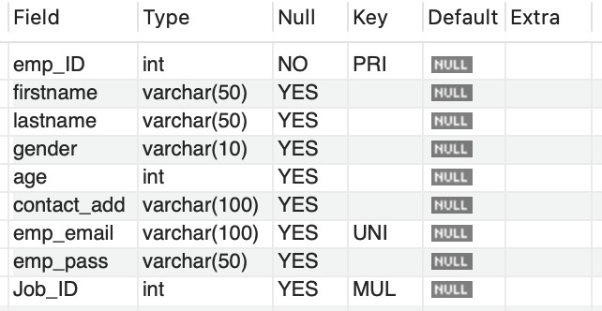
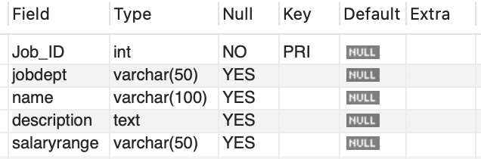
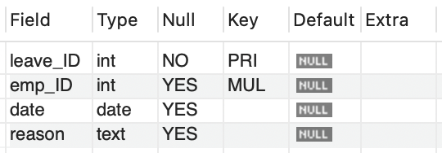
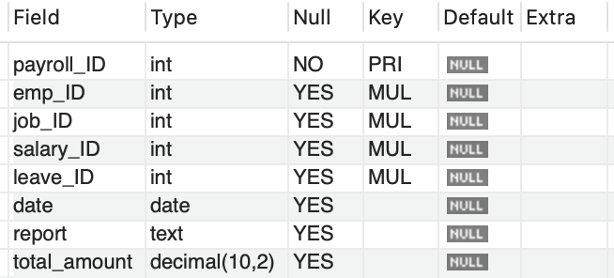
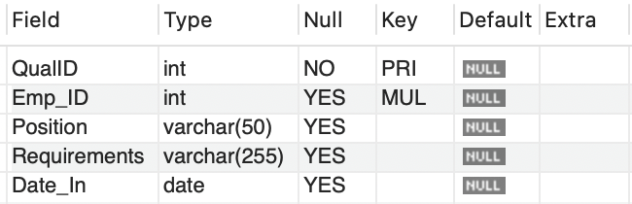
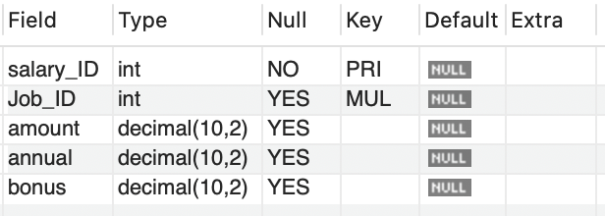
Tables info Used in the Project :
Employee
Job Department
Leaves
Payroll
Qualification
SalaryBonus

Slide 6
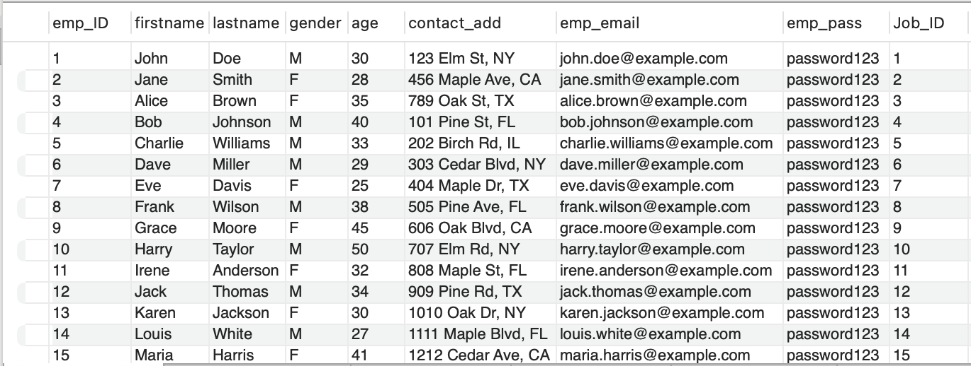
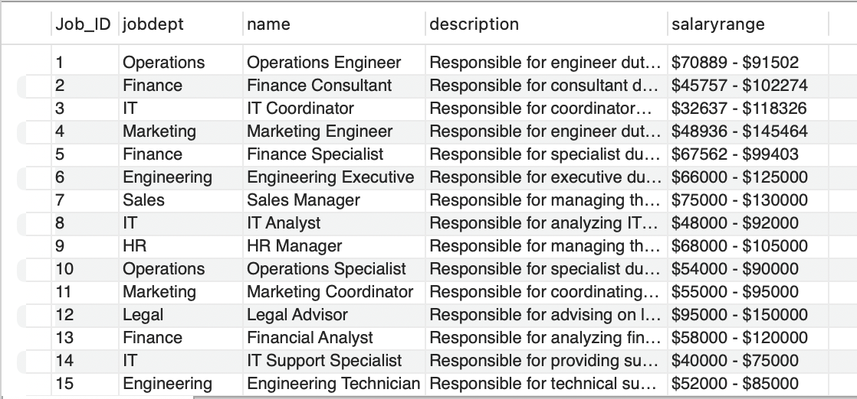
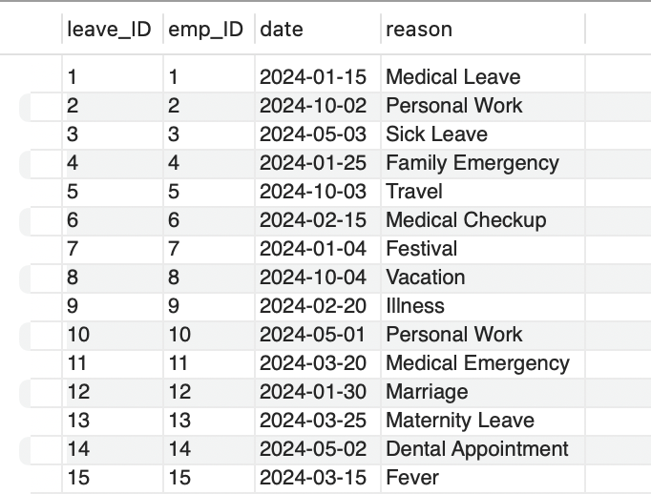
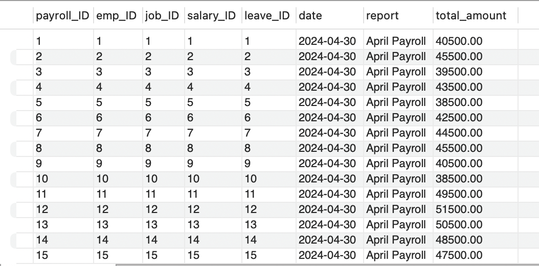
Tables Used in the Project :
Employee
Job Department
Leaves
Payroll

Slide 7
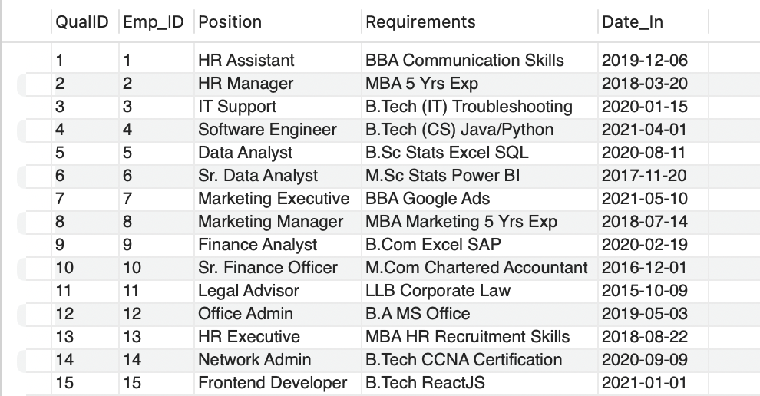
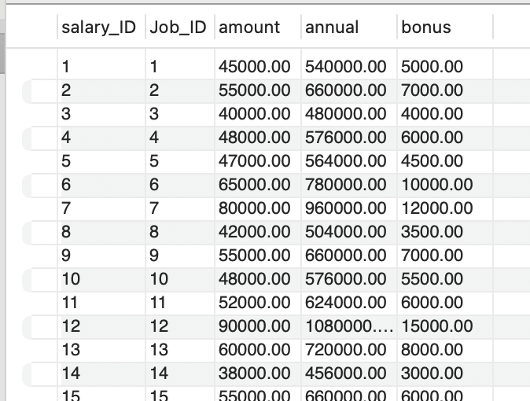
Tables Used in the Project :
Qualification
Salary bonus

Slide 8
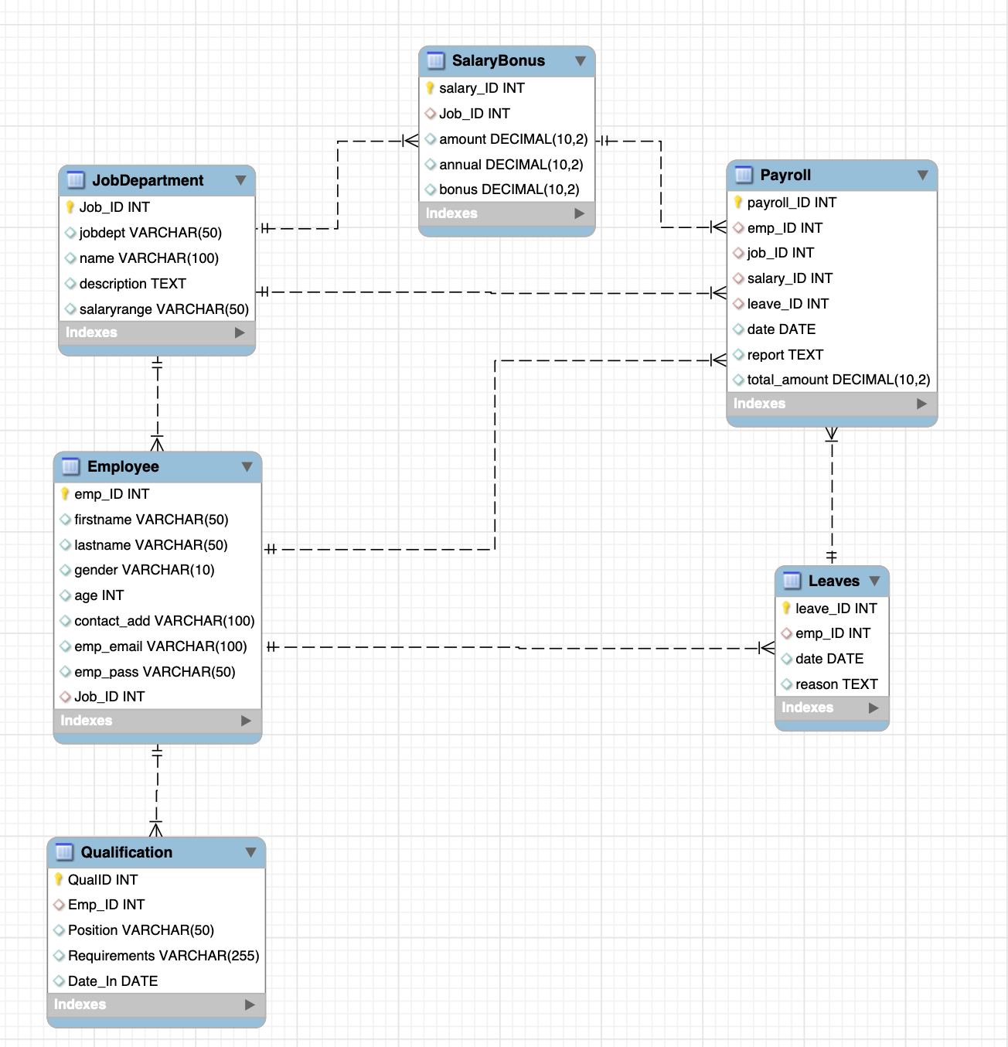
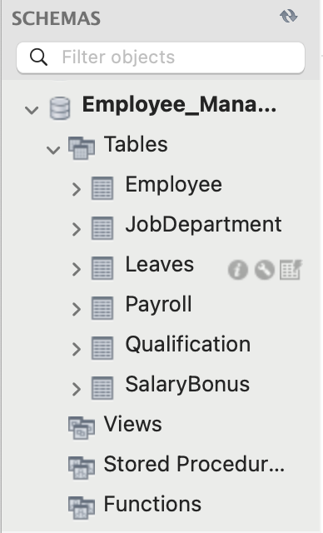
ER Diagram and schema :

Slide 9
Key analysis questions (use cases):
1. EMPLOYEE INSIGHTS
2. JOB ROLE AND DEPARTMENT ANALYSIS
3. QUALIFICATION AND SKILLS ANALYSIS
4. LEAVE AND ABSENCE PATTERNS
5. PAYROLL AND COMPENSATION ANALYSIS
6. DEPARTMENTAL STRUCTURE ANALYSIS

Slide 10
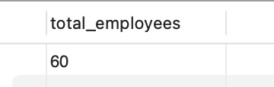

SQL query results with screenshots or summaries
1. EMPLOYEE INSIGHTS
Question: 1.1 Which video categories generate the most views?
Insight: The organization currently maintains records for 60 employees in the database

Slide 11
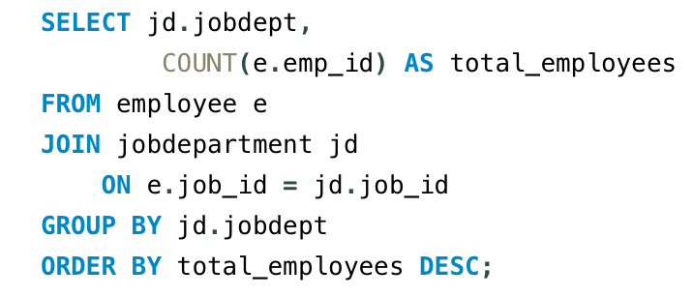
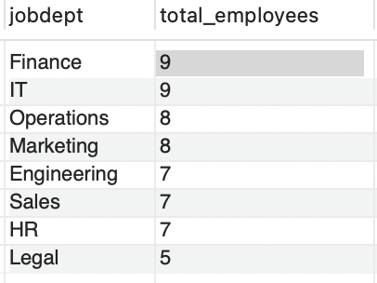
Question: 1.2 Which departments have the highest number of employees?
Insight: Finance and IT departments have the highest workforce with 9 employees each

Slide 12
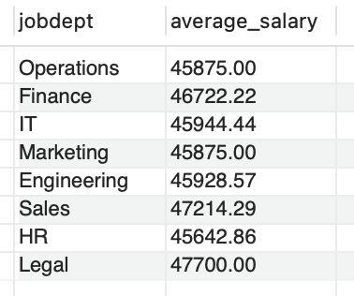
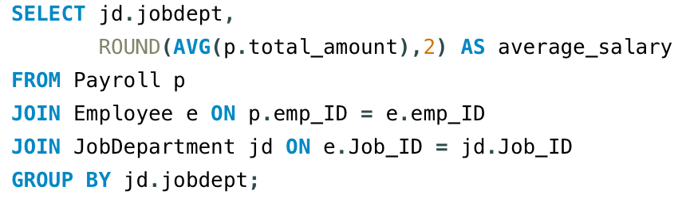
Question: 1.3 What is the average salary per department?
Insight: Average payroll across departments ranges roughly between ~45K and ~47K

Slide 13
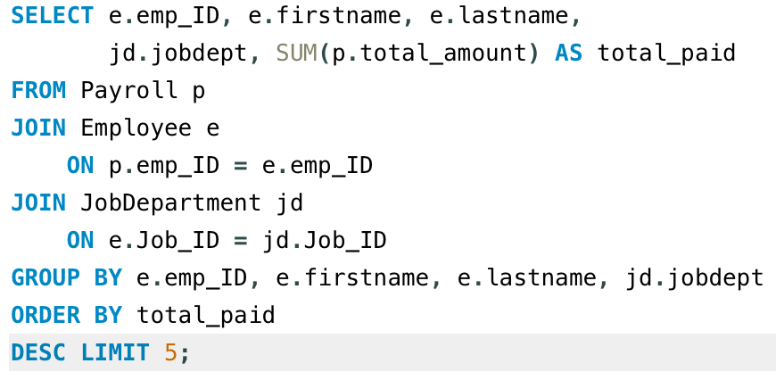
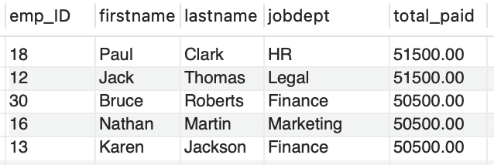
Question: 1.4. Who are the top 5 highest-paid employees?
Insight: The highest-paid employees include Paul Clark, Jack Thomas, Bruce Roberts, Nathan Martin, and Karen Jackson, each earning about 55K–56K total payroll

Slide 14

Question: 1.5. What is the total salary expenditure across the company?
Insight: The company spends approximately 2,778,000 in total payroll, reflecting the overall compensation cost for all employees.

Slide 15
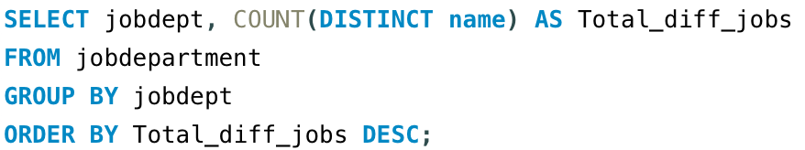
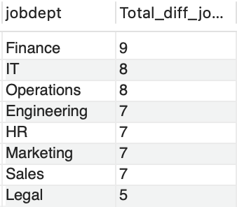
2. JOB ROLE AND DEPARTMENT ANALYSIS
Question: 2.1. How many different job roles exist in each department?
Insight: The Finance department has the highest role diversity with 9 different job roles

Slide 16
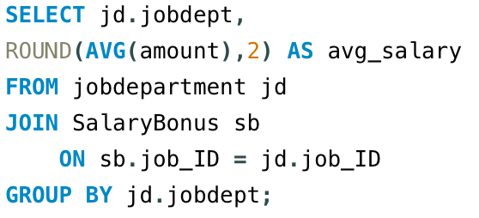
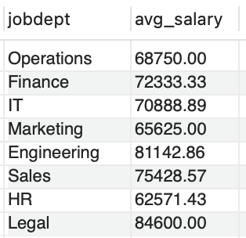
Question: 2.2 What is the average salary range per department?
Insight: Average salary structures vary across departments, with Legal and Engineering showing the highest average salary ranges.

Slide 17
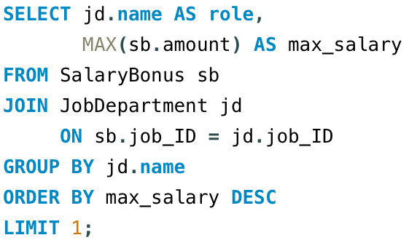

Question: 2.3 Which job roles offer the highest salary?
Insight: The Finance Director role offers the highest salary (170,000) among all job roles in the organization.

Slide 18
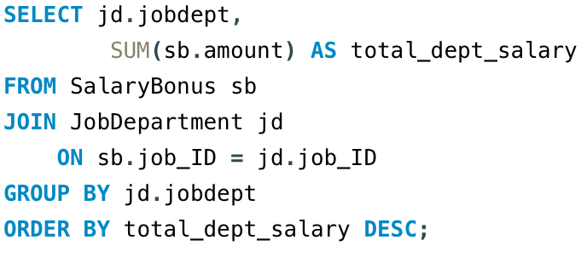
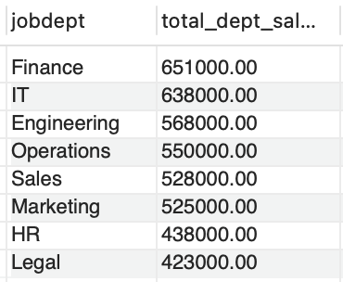
Question: 2.4 Which departments have the highest total salary allocation?
Insight: The Finance department has the highest total salary allocation (~651K), indicating larger payroll .

Slide 19

3. QUALIFICATION AND SKILLS ANALYSIS
Question: 3.1 How many employees have at least one qualification listed?
Insight: All 60 employees have at least one qualification recorded, showing complete skill documentation

Slide 20
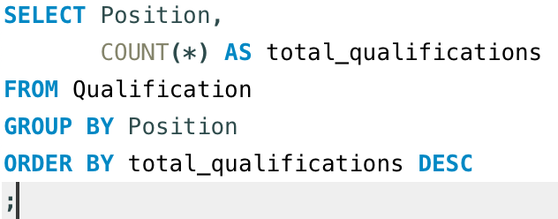
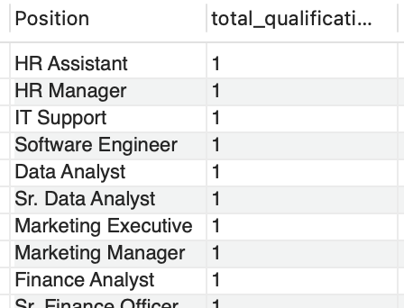
Question: 3.2 Which positions require the most qualifications?
Insight: Each position typically requires one key qualification, indicating clearly defined job skill requirements.

Slide 21
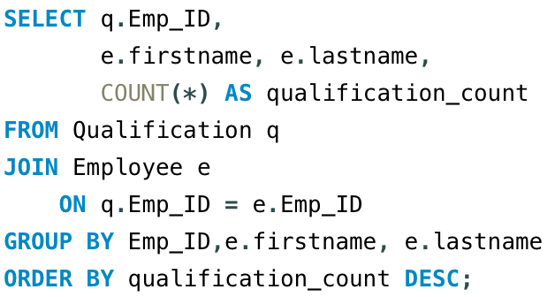
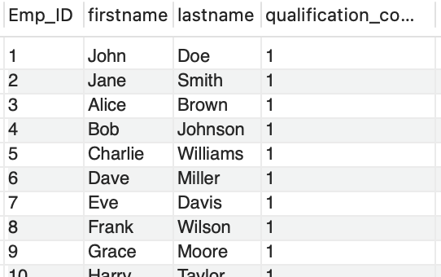
Question: 3.3 Which employees have the highest number of qualifications?
Insight: Most employees currently hold one qualification each, suggesting standardized hiring criteria across roles.

Slide 22
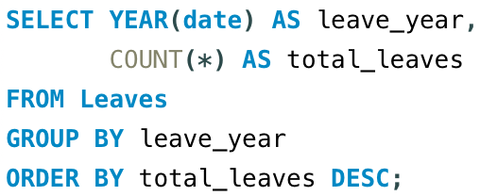
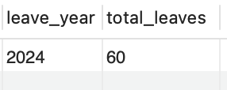
4. LEAVE AND ABSENCE PATTERNS
Question: 4.1 Which year had the most employees taking leave?
Insight: The year 2024 recorded the highest leave activity with 60 leave entries.

Slide 23
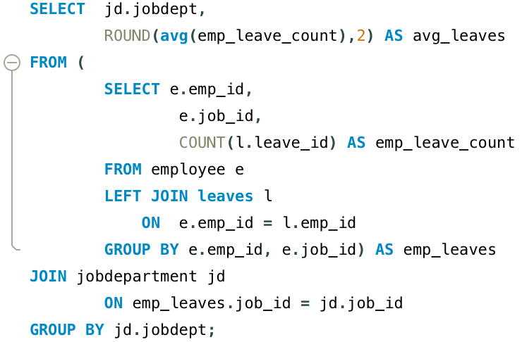
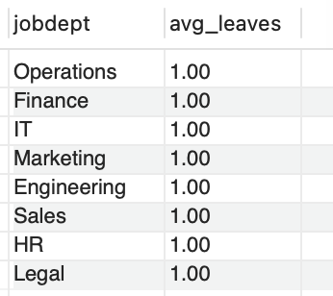
Question: 4.2 What is the average number of leave days taken by its employees per department?
Insight: On average, employees across departments take approximately one leave day each, showing balanced leave distribution.

Slide 24
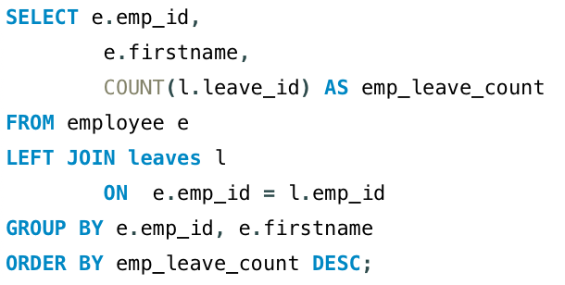
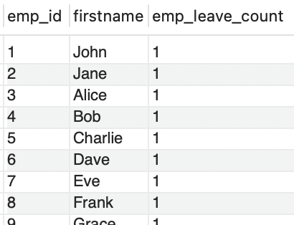
Question: 4.3 Which employees have taken the most leaves?
Insight: Leave records indicate similar leave counts across employees, s

Slide 25

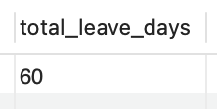
Question: 4.4 What is the total number of leave days taken company-wide?
Insight: The company recorded 60 total leave days, representing overall employee absence during the period.

Slide 26
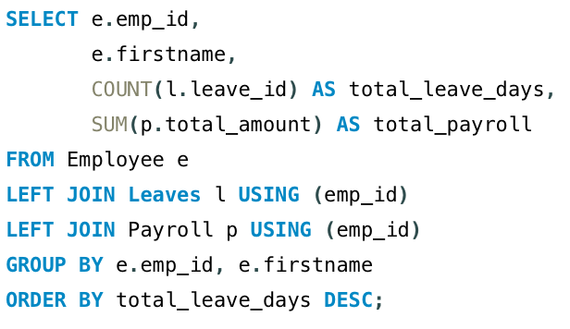
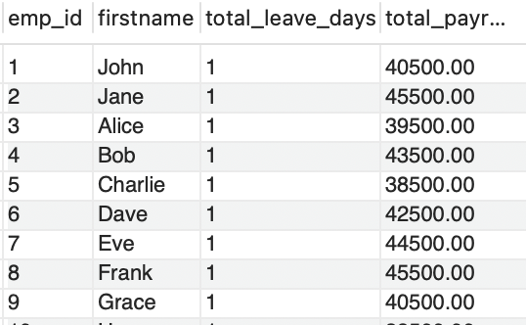
Question: 4.5 How do leave days correlate with payroll amounts?
Insight: Payroll values remain relatively consistent despite leave usage, indicating leave deductions have minimal impact on total payroll.

Slide 27
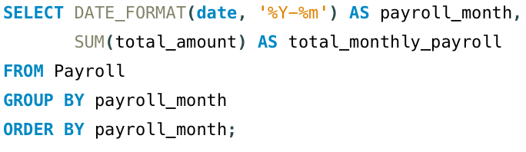
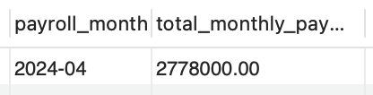
5. PAYROLL AND COMPENSATION ANALYSIS
Question: 5.1 What is the total monthly payroll processed?
Insight: The total payroll processed for April 2024 is approximately 2,778,000, representing the company’s monthly salary expense.

Slide 28
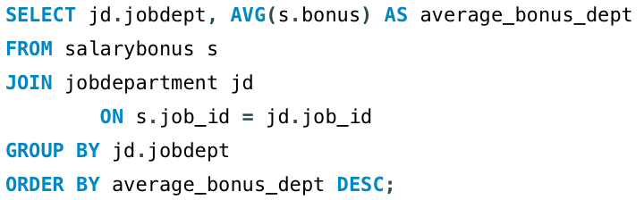
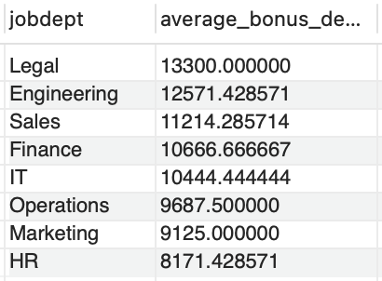
Question: 5.2What is the average bonus given per department?
Insight: The Legal department provides the highest average bonus ~13,300 compared to other departments.

Slide 29
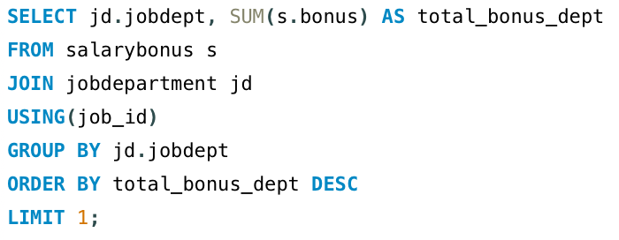
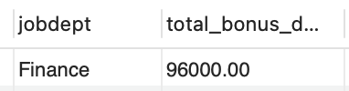
Question: 5.3 Which department receives the highest total bonuses?
Insight: The Finance department receives the highest total bonus allocation ~96,000 among all departments.

Slide 30
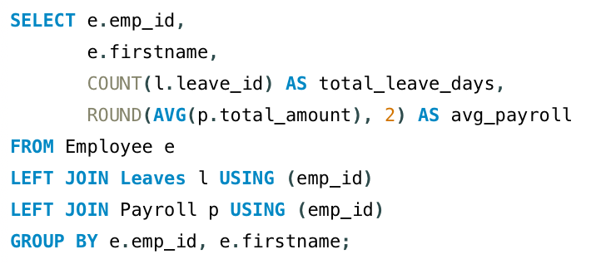
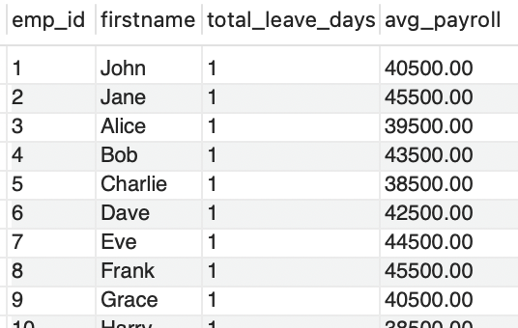
Question: 5.4 What is the average value of total_amount after considering leave deductions?
Insight: Average payroll per employee remains around 40K ~50K, indicating stable compensation even after leave considerations.

Slide 31
Challenges working on SQL Analysis Project:
Defining correct table relationships and ensuring accurate use of foreign keys.
Maintaining data consistency with cascading updates and deletes.
Writing complex joins for reports involving employee roles, leaves, and payroll.
Ensuring all date fields follow the YYYY-MM-DD format for reliable time-based analysis.
Preventing duplicate entries using unique constraints, especially on email fields.

Slide 32
Final business insights & recommendations:
The organization maintains 60 employee records across multiple departments, indicating a structured workforce with centralized employee data management.
Finance and IT departments employ the largest number of staff, suggesting these functions are critical for operational and strategic activities.
Payroll analysis shows a monthly salary expenditure of approximately 2.78 million, highlighting payroll as a major organizational cost requiring efficient management.
The Finance department receives the highest salary allocation and bonus distribution, reflecting its importance in financial operations and decision-making.
The Finance Director role offers the highest salary, indicating leadership roles command significantly higher compensation levels.
Leave analysis shows balanced leave usage across departments, suggesting consistent HR policies and fair employee benefits.
Implementing this Employee Management System enables efficient HR decision-making, improved payroll transparency, and better workforce planning through structured and accessible employee data.

Slide 33
Conclusion (Key finding overall) :
This project successfully designed and implemented an Employee Management System using SQL, enabling efficient storage, management, and analysis of employee data. By integrating multiple relational tables such as employee details, job roles, payroll, qualifications, and leave records, the system ensures data integrity, consistency, and efficient querying. The analysis provided valuable insights into department-wise workforce distribution, salary allocation, payroll expenditure, and employee leave patterns, helping identify key organizational trends. The results highlight the importance of departments like Finance and IT in workforce structure and compensation allocation. Overall, this system demonstrates how structured databases and SQL analytics can streamline HR operations, improve transparency in payroll management, and support data-driven decision-making for organizational growth.

Slide 34

THANK YOU
By:
CH BHAVANI CHARY

