Slide 1
Customer Segmentation Based on Credit Risk
In the rapidly evolving financial landscape, accurate credit risk assessment plays a crucial role in informed lending decisions for banks.
This project aims to develop a machine learning model that can predict the credit risk assessment for loan applicants based on their demographic and financial attributes.
The model aims to minimize the risk and maximize the profit of the bank by effectively segmenting customers into low-risk and high-risk categories. This is a binary classification problem, where the goal is to classify applicants as either good or bad credit risks.
The model will utilize a dataset containing demographic variables such as age, gender, job type, and housing status, as well as financial variables such as savings accounts, checking accounts, credit amount, duration, and purpose of the loan.
Through exploratory data analysis, data preprocessing, and machine learning techniques, the project seeks to uncover hidden patterns, trends, and key indicators that contribute to determining the creditworthiness of applicants. Ultimately, the developed model will assist banks in making informed decisions while accepting or rejecting loan applications, thereby minimizing potential losses and maximizing profitability from the bank's perspective.

Slide 2
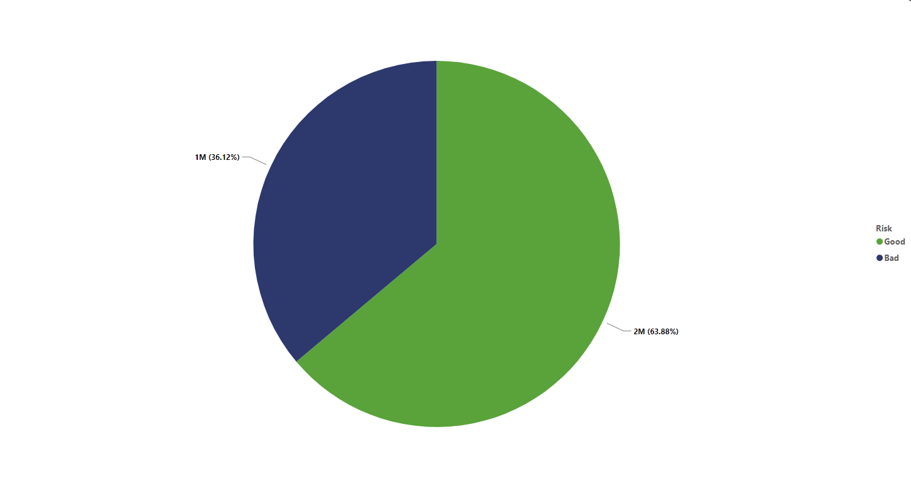
Sum of credit amount By Risk analysis
It is more probable that risk will have a positive outcome good (63.88%) than a negative one bad (36.12%).

Slide 3
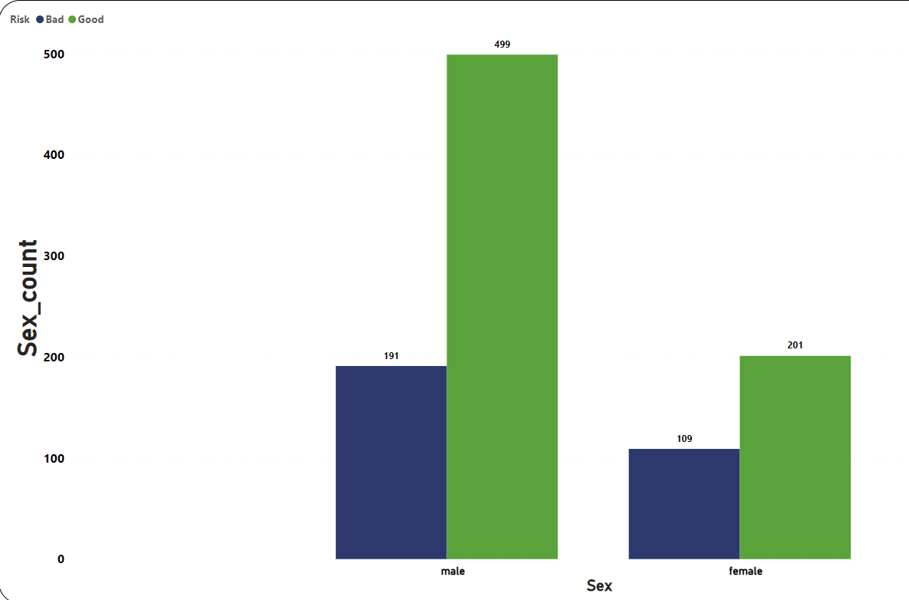
Sex count by Sex and Risk Analysis
According to the chart, the number of males with good risk is 499, which is higher than the number of females with the same risk, which is only 201. This data indicates that there could be a gender-based disparity in the likelihood of having good risk.

Slide 4
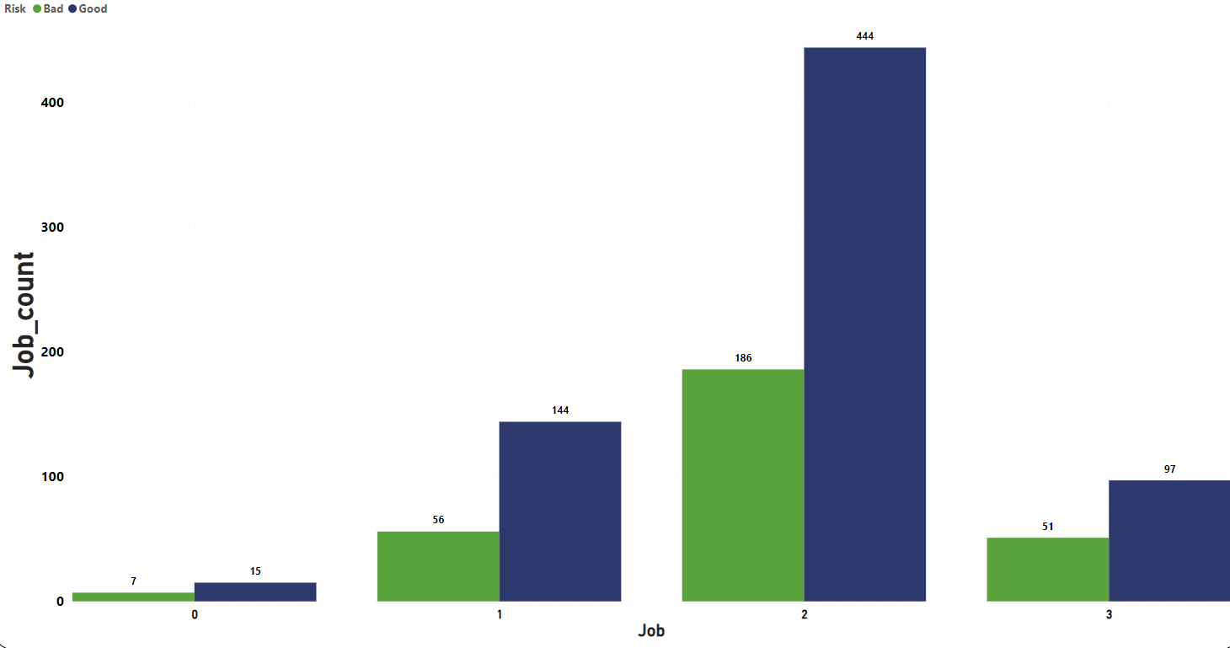
A sum of Job and Job count By Risk analysis
According to this chart, it seems that on average, having two jobs (444) is more likely to result in favorable outcomes than any other option in terms of risk.

Slide 5
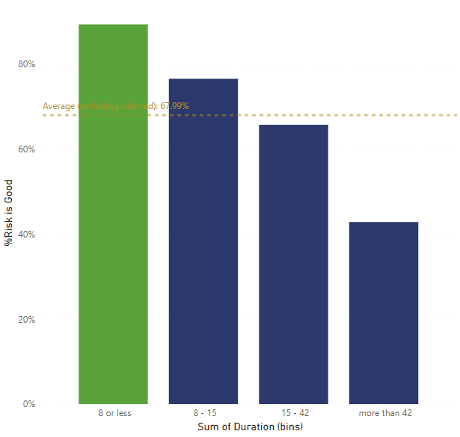
Sum of Duration By Risk analysis
Based on the chart, a duration of 8 or less is likely to be good risk.

Slide 6
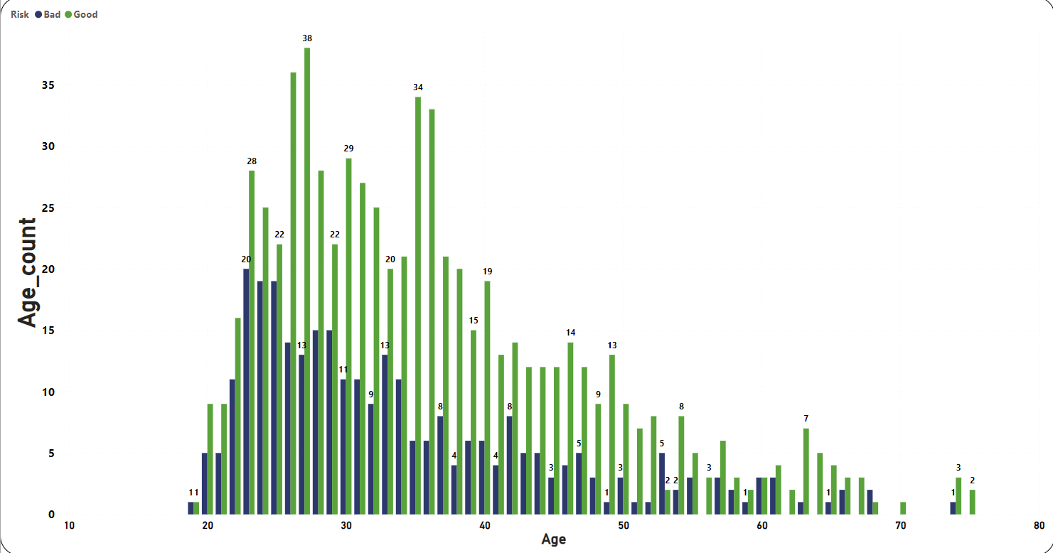
Age count By Age and Risk analysis
According to this chart, individuals over the age of 25 are considered to be a good risk.

Slide 7
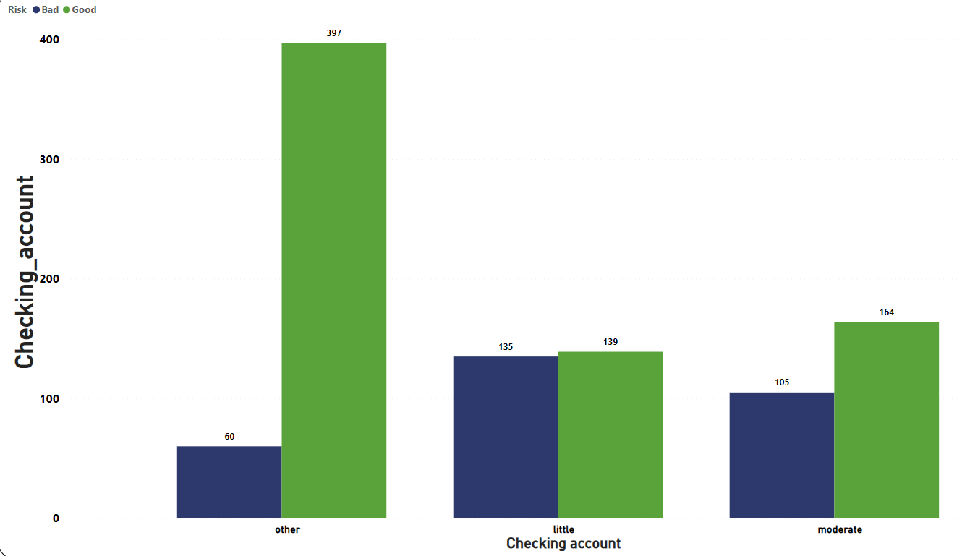
Checking account by checking and risk analysis
According to the chart, the likelihood of risk being good is higher for the checking account labeled as "other" (397), compared to "moderate" (164) and "little" (139). However, the risk is very bad for "other" (60), compared to "little" (135) and "moderate" (105).

Slide 8
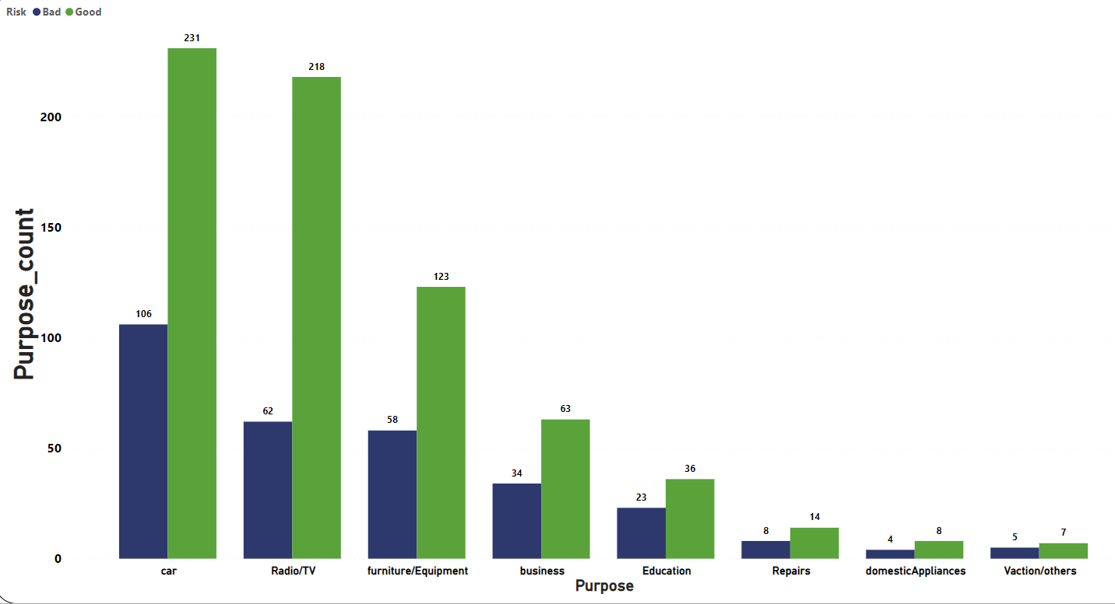
Purpose count By purpose and Risk analysis
Based on the chart, risk is more likely to be favorable when the purpose is Radio/TV (218) compared to other purposes, on average.

Slide 9
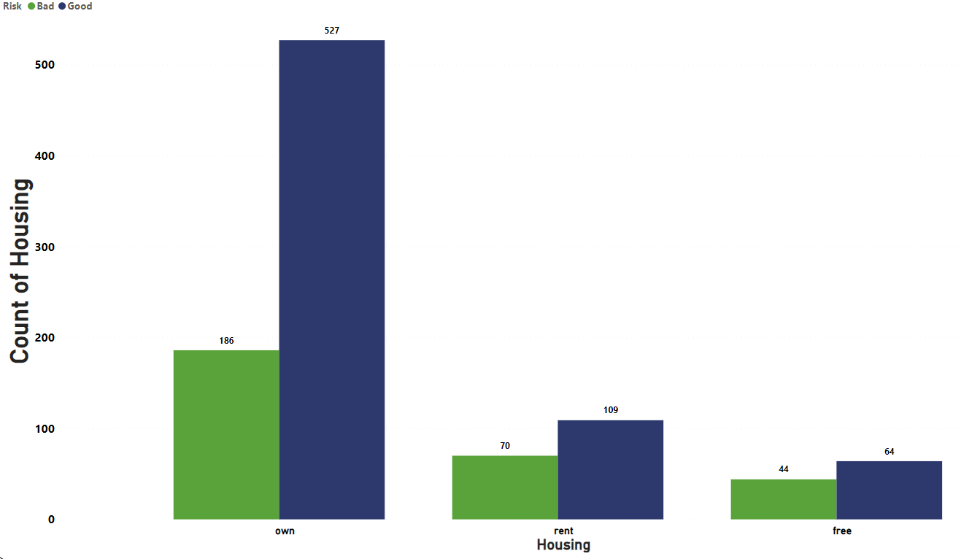
Count of Housing By Risk analysis
On average, owning a house (527) is more likely to result in a positive outcome than rent and free, according to the chart.

Slide 10
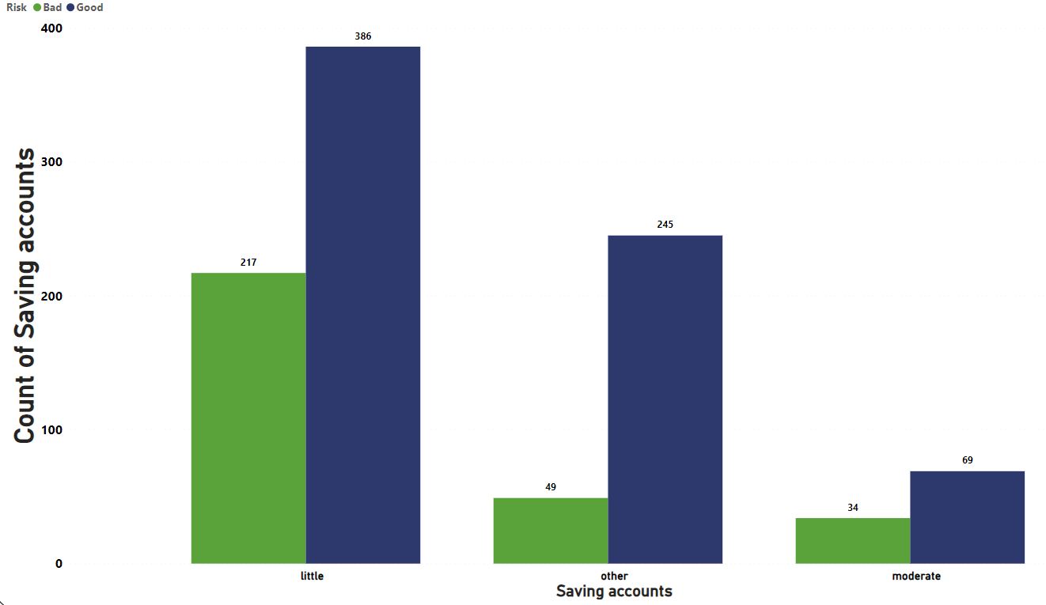
Count of savings account by savings account and risk analysis
According to my analysis risk is more likely to be good count of saving account is other(245) than otherwise(on average).

Slide 11
Thank you

