Slide 1







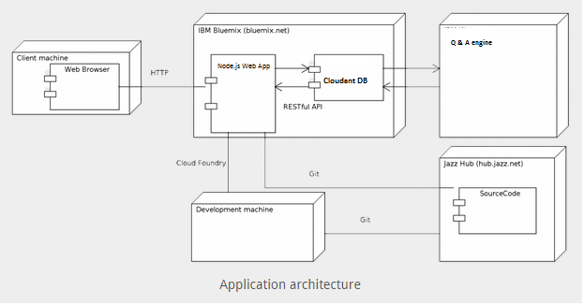
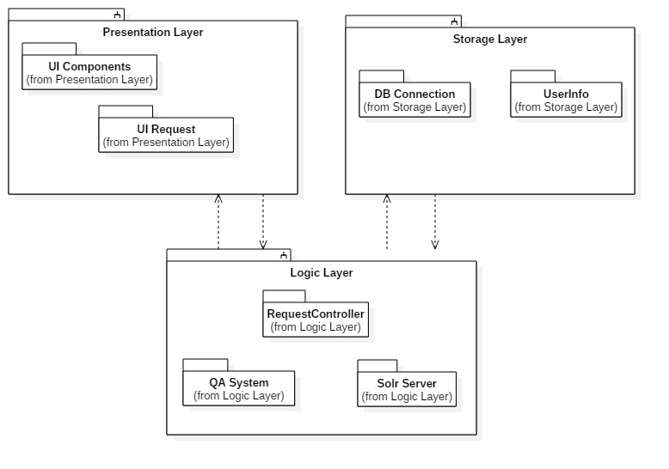
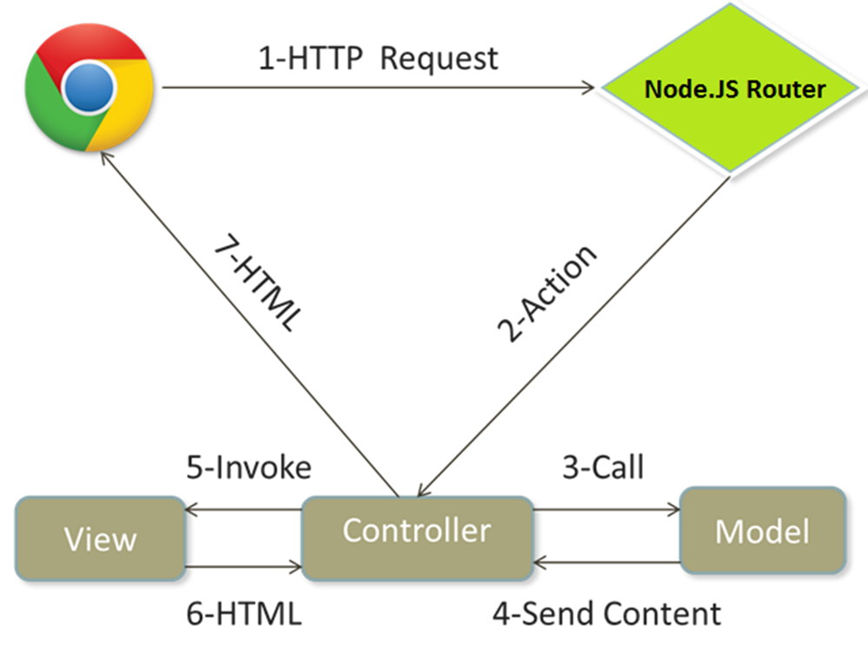
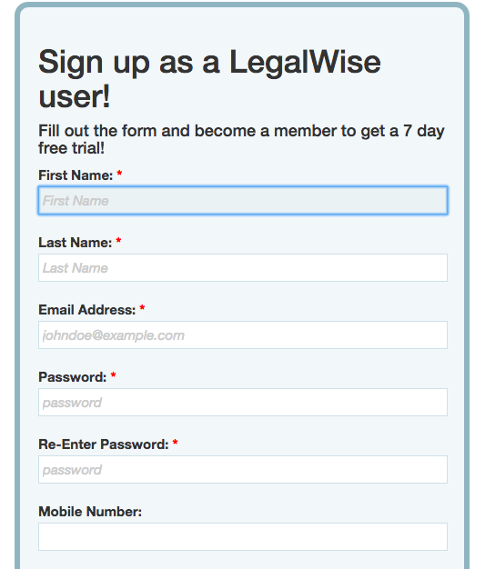
School of Computing & Information Sciences
Senior Project, 2015, Fall
LegalWise
Student: Amanda Chiu, Florida International University
Mentor: Jaime Borras, CTO at GeoToll
Instructor: Masoud Sadjadi, Florida International University
Problem
Current System
Requirements
The legal system uses a great amount of human labor to accomplish tedious tasks on formatted documents. When a lawyer is looking for a case referral in order to use it on his/her current case, the staff needs to go over all the related cases and find the appropriate one that suits the circumstances. This process is time consuming and also prone to errors. This system is being use for years making law services very expensive and time consuming.
The requirements of the system for this project are the following:
1. User can log into the system
2. System verifies the account when user creates an account with LegalWise
3. System answers legal questions that the user inputs
4. User uploads a PDF legal document for the system to analyze
5. Resets password when user forgets his/her password
Legal professionals spend a lot of time and resources to access files and information for future cases.
System Design
Object Design
Implementation
The LegalWise application is implemented in Node.js and hosted on IBM BlueMix. We used CouchDB for our database management.
We also used Express – a JavaScript framework that provides features to be imported for our current application. Frontend tools such as CSS, Bootstrap and HTML5 were used to implement the user interface.
Hardware and Software Mapping: To develop the LegalWise web application we decided to use Node.js web application starter from Bluemix.. On the backend we have an application built in Java using the Solr sever as Q&A system. The Q&A system was built in UNIX using the code from the Taming Text book. Our system also handles user authentication and stores user in the Cloudant DB. The Cloudant DB is a IBM project built in top on CouchDB (NoSql Database).
Presentation Layer: The presentation layer is in charge of the UI and contains all the code that interacts directly with the user.
Logic Layer: The logic layer handles all the interaction between the components of the application. It receives information from the Presentation Layer to be process, send and retrieves information from the database and interacts with the QA system.
Storage Layer: The storage layer handles all the request to the Cloudant Database for users.
MVC
Verification
Screenshots
Summary
Below is an example of a sunny day system test case.
LegalWise is a user-friendly web application that answers simple legal questions by analyzing the question and retrieving related documents associated with the answer.
LegalWise offers several service membership plans for registered users, such as annual payments, one-time usage, and monthly payments. The user registers for an account and selects the desire service plan.
Our web application allows the user to search big databases with legal documents in just a few seconds making the valuable time of our legal professionals more profitable.
Purpose | To test the functionality when a user register on the website. The user should receive an email to confirm his/her account.
Precondition | The application must be running properly on the IBM Cloud. The database needs to be properly bind to the application and accessible to the web services. The IBM Cloud and DevOps services must be working properly.
Input | A new user has access to the homepage and would like to create an account to use the application. The user clicks on Sign Up button on the top left corner of the website. The new user provides the following information. Once the user clicks the Submit button a new user is created on the database.
Expected Output | A new user is created on the database and the user receives an email to confirm the account. Once the user confirms the account he/she is able to login and use the application.
This is the navigation bar on the homepage. It allows user to log in and directs users to sign up for a new account and reset password.
This is the sign up page where users create account by filling out their personal information.
Two sunny day and one rainy day test case for each use case of the system.
Acknowledgement
I am thankful to the help that I received from my group member Valeria Lopez and from my mentor Jaime Borras. I would also like to thank Masoud Sadjadi for all the feedback and support given throughout the semester.

