Slide 1
Accident and Intention: That is the Question (in the Noisy Iterated Prisoner’s Dilemma)
Tsz-Chiu Au
University of Maryland, College Park
Department of Computer Science
Joint work with Prof. Dana Nau and Prof. Sarit Kraus

Slide 2
Social Games
We are interested in modeling several self-interested parties (i.e., agents) that repeatedly interact with each other
  Governments
  Terrorist groups
  Crime organizations
  Civilians
Performance of agents depends on how well they interact with each other
Objective: decide how to interact with different parties so as to maximize the performance of an agent
Interaction
Agent₁
Agent₂

Slide 3


Limitations of Existing Techniques
Most existing game-theoretic research
  Studies problems at an abstract mathematical level
  Neglects many features that can occur in the real world
This talk focuses mainly on one such feature: noise (i.e., errors in interaction)
Interaction
Agent₁
Agent₂
noise
Two kinds of noise:
  Accidents: An agent intends to do X, but accidentally does Y instead
    e.g., slippery hands, car accidents, sabotage by “invisible” spies
  Misinterpretations: One agent thinks another agent’s action was different from what the other agent actually did
    e.g., miscommunication due to poorly-written email, dirt on eye-glasses
Noise can cause serious problems
How to deal with noise?

Slide 4
I Will Discuss
Iterated Prisoner’s Dilemma (IPD)
  A game that is widely used for studying cooperation among agents.
Noisy Iterated Prisoner’s Dilemma
  IPD with error in the interaction
Symbolic Noise Detection
  Ways to
    Build model of the other player, based on their past behavior
    Use the model to detect noise
Derived Belief Strategy (DBS)
  A strategy for playing IPD in noisy environment
    Minimize the effect of noise in the learning of opponent model using symbolic noise detection
    More accurate opponent model ⇒ higher quality of decision
Performance
  20th Anniversary IPD Competition
Generalizations
  Other games similar to IPD

Slide 5


Prisoner’s Dilemma
Will he betray me?
Should I betray him?
Two suspects are arrested by the police (and become prisoners)
But the police does not have sufficient evidence for a conviction.
The police want the prisoners to betray each other.
Prisoner₂ Prisoner ₁ | Cooperate (Not Betray) | Defect (Betray)
Cooperate (Not betray) | Prisoner₁: 1 year Prisoner₂: 1 year | Prisoner₁: 5 years Prisoner₂: free
Defect (Betray) | Prisoner₁: free Prisoner₂: 5 years | Prisoner₁: 3 years Prisoner₂: 3 years

Slide 6
Prisoner’s Dilemma (cont.)
No matter what the other prisoner does, I better defect
What will the prisoners do?
  Sadly, both prisoners betray each other
    because they are self-interested and they do not completely trust each other.
Prisoner₂ Prisoner₁ | Cooperate | Defect
Cooperate | 1, 1 | 5, 0
Defect | 0, 5 | 3, 3
Nash
Equilibrium

Slide 7
Iterated Prisoner’s Dilemma
Wait a minute… If I betray my partner, he will betray me in future
But this game is not a zero-sum game.
  The prisoners can think “win-win”
How can the prisoners cooperate with each other?
Solution: if the same prisoners play the game many many times…
  “punish” the other prisoner if he does not cooperate in the past
Due to this threat of punishment, cooperation can (not must) emerge
The new game is called Iterated Prisoner’s Dilemma (IPD)
Timeline
C
C
C
C
C
C
C
C
C
C
C
C
:
:

Slide 8
Example:
A real-world example of the IPD, described in Axelrod (1997):
  Trench warfare in World War I
Incentive to cooperate:
  If I attack the other side, then they’ll retaliate and I’ll get hurt
  If I don’t attack, maybe they won’t either
Result: emergence of cooperation
  Even though the two infantries were supposed to be enemies, they avoided attacking each other
This was one of the reasons why World War I lasted so long
German
infantry
British
infantry

Slide 9
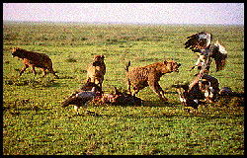
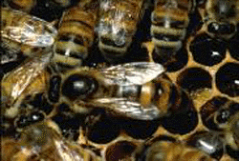
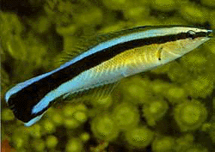
Evolution of Cooperation
Question: In general, under what conditions will cooperation emerge in a world of egoists without central authority?
Answer: hard to tell
IPD is the “fruit fly” in the study of evolution of cooperation
  “The Selfish Gene” by Richard Dawkins (1976)
  “The Evolution of Cooperation” by Robert Axelrod (1984)
    His paper on IPD was cited 2000 times!
A cross-disciplinary topic
  political science (foreign policy)
  economics and business (trading, auction)
  biology (evolution, animal behaviors),
  social science (group behaviors)
  and lately, computer science (peer-to-peer computing, bitTorrent)
  How about AI? (multi-agent system, computer games)

Slide 10
Strategies for the IPD
But the threat of punishment (or the shadow of the future) does not necessarily result in cooperation.
  It still depends on how the other players treat you.
There are many different strategies for playing IPD:
  ALLC: always cooperate
  ALLD: always defect
  GRIM: cooperate until the other player defects, then defect forever
  TESTER: defect every other move if the other player does not retaliate for detection.
Question: which strategy is the best?
  In general, there is no optimal strategy for IPD
    Performance depends on the other player’s strategy, which is not known beforehand
A famous political scientist called Axelrod proposed to use computer simulation to study which strategy can usually perform well.
  The Iterated Prisoner’s Dilemma Tournament
    Ask people to submit programs to the tournament.
    Every program plays with every other program.
    Winning program is the one with the highest average score.

Slide 11
Results of the Axelrod’s IPD tournaments
A strategy called Tit-for-Tat (TFT) has been shown to cooperate extremely well with a wide variety of opponents
  Cooperate on the first move. On the nth move, repeat the other player’s (n–1)-th move
    It could establish and maintain cooperation with many other players
    It could prevent malicious players from taking advantage of it
  TFT won several open IPD tournaments.
Extremely influential: TFT becomes a key principle in foreign policy making
TFT
AllC
TFT
AllD
TFT
Grim
TFT
TFT
TFT
Tester
C
C
C
D
C
C
C
C
C
D
C
C
D
D
C
C
C
C
D
C
C
C
D
D
C
C
C
C
C
C
C
C
D
D
C
C
C
C
C
C
C
C
D
D
C
C
C
C
C
C
C
C
D
D
C
C
C
C
C
C
:
:
:
:
:
:
:
:
:
:

Slide 12
IPD with Noise
I see that he defected, so I’ll defect next time
But there is a serious problem with TFT…
In noisy environments,
  There is a nonzero probability that Cooperate (C) will become Defect (D), and vice versa
  e.g., 10% chance that a “noise gremlin” will change some of the actions
Noise causes big problems for strategies like Tit-for-Tat
  Mutual defection occurs
How can we survive if all foreign policies are based on TFT?
Timeline
C
C
C
C
Noise
C
D
C
D
C
C
D
D
C
C
D
D
C
:
:

Slide 13
Example of Noise
Artillery
German
infantry
British
infantry
Story from a British army officer in World War I:
“I was having tea with a company when we heard a lot of shouting and went out to investigate. We found our men and the Germans standing on their respective parapets. Suddenly a bomb arrived but did no damage. Naturally both sides got down and our men started swearing at the Germans,….”
If you were the British army officer, what would you do?
  Fight back (consider the bombing is intentional)
  Don’t fight back (consider the bombing is just an accident)

Slide 14
Existing Approach for Coping with Noise
Forgiving is a virtue
Principle: More forgiving, don’t retaliate
Tit-For-Two-Tats (TFTT)
  Retaliates only when it receives two defections in two previous iterations
  But susceptible to exploitation of its generosity
Generous Tit-For-Tat (GTFT)
  Forgive randomly: randomly choose to cooperate with a small probability if the other player defects
    avoided exploitation
Pavlov
  Repeat previous move if I earn a lot of points in the previous iteration
  If the other player defects continuously, my agents will defect alternatively.
    Punish less for mutual defections
Timeline
C
C
C
C
Noise
C
D
C
D
C
C
D
D
C
Forgive
C
C
C
C
:
:

Slide 15
Forgiving at will
The existing approaches are not very effective.
  Forgiving at will
  Sometimes they forgive too often, sometimes, they forgive too little.
We think a better approach should avoid forgiving too often or too little.
Observation: if the players knew exactly which actions were affected by noise, the conflict could be avoided.
Unfortunately, players can never be sure about which actions were actually affected by noise
But what if players can actually make good guesses of which actions have been affected by noise?
C
C
C
C
I wish I know these defection are due to noise, but I don’t know.
C
C
C
D
C
C
C
C
D
C
C
C
C
C
:
:

Slide 16
A New Approach for Coping with Noise
Under what condition players can make good guesses about which actions have been affected by noise?
  The other player plays predictably.
  For example, if the other player used to cooperate in the past, there is a high chance that a sudden detection is due to noise.
Our Approach: use a deterministic model of behavior to tell whether an action has been affected by noise
  For highly predictable actions, build a deterministic model to predict them
  Use it to tell whether an action has been affected by noise
C
C
My partner usually cooperates
C
C
C
C
So I won’t retaliate here, because it’s likely these defections are due to noise
C
D
C
C
C
C
D
C
C
C
C
C
:
:

Slide 17
Noise Detection based on Deterministic Model of Behavior
?
Prussian
Artillery
German
infantry
British
infantry
Then the story went on:
“… our men started swearing at the Germans, when all at once a brave German got onto his parapet and shouted out: “We are very sorry about that; we hope no one was hurt. It is not our fault. It is that damned Prussian artillery””
If you were the British army officer, did you believe the brave German?
  Do you believe the brave German if the bombing is not consistent with the German infantry’s past behavior?

Slide 18

Change of Behavior
I am GRIM. If you ever betray me, I will never forgive you.
However, there is a problem..
  What if German really attack us?
If the other player genuinely changes its behavior, the deterministic model learnt from the past is no longer valid.
  Cannot be used to detect noise
Changes of behavior occur because
  The player can change its strategy anytime
  E.g., if noise affects one of Player 1’s actions, this may trigger a change in Player 2’s behavior
    Player 1 does not know this
How to distinguish noise from a real change of behavior?
  Is an anomaly of observed behavior accidental or intentional?
C
C
C
C
C
D
C
C
D
C
D
C
D
These moves are not noise
:
D
:
D
:
:

Slide 19
Detection of a Change of Behavior
Temporary Tolerance:
When we observe unexpected behavior from the other player,
  Don’t immediately decide whether it’s noise or a real change of behavior
  Instead, defer judgment for a few iterations
Why?
  We can often distinguish noise from a change of behavior by observing moves in the next few iterations and gathering enough evidence
My partner usually cooperates, so I will too
C
C
C
C
C
C
The defections might be accidents, so I shouldn’t lose my temper too soon
C
D
C
D
C
D
D
D
I think his behavior has really changed, so I’ll change mine too
D
D
:
:

Slide 20
Temporary Tolerance
?
Prussian
Artillery
German
infantry
British
infantry
If you were the British army officer, do you believe the brave German?
  Don’t believe immediately when the bombing occurs, even if this is not consistent with the German infantry’s past behavior.
  Temporary tolerate the bombing, as if it did not occur
  After a short period of time,
    If the German infantry’s behavior continues to consistent with their past behavior, we consider this is an accident, as suggested by the brave German.
    Otherwise, this means war.

Slide 21
Symbolic Noise Detection (SND)
A summary of SND:
Build a deterministic model of how the other player behaves
Watch for any deviation from the deterministic behavior predicted by the model
If a deviation occurs, check to see if the inconsistency persists in the next few iterations
  If the inconsistency does not persist, assume the deviation is due to noise
  If the inconsistency persists, assume there is a change in the behavior
Why does SND be effective in IPD?
  Deterministic behavior is abundant in IPD
  In IPD, it is useful to cooperate with other players
    Most players are cooperative
  Clarity of behavior is an important ingredient of long-term cooperation
    To cooperate effectively, you need to give the other player a good idea how you will react
    As observed by Axelrod in his analysis of TFT
  Therefore, we can often build a deterministic behavioral model of the other player easily.
  Thus, noise are often detectable by using SND.

Slide 22
Derived Belief Strategy (DBS)
Derived Belief Strategy (DBS) is a strategy based on symbolic noise detection
  Learn and maintain a model π of the other player’s behavior
    π is partly deterministic, partly probabilistic
    Initially, π is assumed to be TFT
    π is updated as the game progresses
  π has two primary functions:
    Use the deterministic part of π to do symbolic noise detection
    Use π to predict the other player’s future moves, for decision-making based on game-tree search
Basic idea: use symbolic noise detection to detect and isolate noise so as to keep π as accurate as possible for decision-making
  High accurate π ⇒ High quality decisions.

Slide 23
DBS Example
Us
Them
C
C
Opponent model π = TFT predicts C, so we do C too
These moves are what π = TFT predicts, so don’t change π
C
C
C
C
C
D
These Ds are not what π predicted. Temporarily tolerate them, as if they were C instead
Opponent model still is π = TFT, so we still do C
C
D
C
D
Here, we decide the deviations are a change of behavior. Compute a new opponent model, π'
D
D
The new opponent model π' predicts D, so we do D too
D
D
:
:

Slide 24

Representing the Opponent Model
We model the opponent’s behavior as a policy represented as a set of rules of such as
(my last move, their last move) → p
  A rule is deterministic if p is 0.0 or 1.0
  Otherwise the rule is probabilistic
TFT can be modeled using deterministic rules:
  π = {(C,C) → 1.0,
    (C,D) → 1.0,
    (D,C) → 0.0,
    (D,D) → 0.0}
Suppose we have the rule
(C,C) → 0.7
Moves in the previous iteration
Probability that the opponent will cooperate in this iteration
C
C
C
D
D
C
C
C
??
The rule predicts
P(C) = 0.7, P(D) = 0.3

Slide 25
Move Generator in DBS
Basic idea: game-tree search
  Use the policy π to predict probabilities of the other player’s moves
  Compute expected utility EU(x) for move x
    EU(x) is the estimated score after the player choose the move x
  Choose a move with the highest expected utility
Current
Iteration
(C,C) (C,D) (D,C) (D,D)
Next
Iteration
Iteration after next
:
:
:
:
:
:
:
:
:
:
:
:
:
:
:
:

Slide 26
Example
Suppose we have the rules
1. (C,C) → 0.7
2. (C,D) → 0.4
3. (D,C) → 0.1
4. (D,D) → 0.1
(C,C) (C,D) (D,C) (D,D)
Suppose we search to depth 1
  EU(C) = U(C,C) × 0.7 + U(C,D) × 0.3
= 3 × 0.7 + 0 × 0.3 = 2.1
  EU(D) = U(D,C) × 0.7 + U(D,D) × 0.3
= 5 × 0.7 + 1 × 0.3 = 3.8
  So D looks better
Unwise to choose D
  On the move at depth 2, the opponent will retaliate with P=0.9
If we search deeper, we’ll see this and we’ll choose C instead
C
C
C
D
D
C
C
C
??
Rule 1 predicts
P(C) = 0.7, P(D) = 0.3

Slide 27
How to Search Deeper
Game trees grow exponentially with search depth
  How to search to the tree deeply?
Assumption: the other player’s future behavior will continue to be π
  Our opponent’s decisions depend only on the previous moves as described in the policy π
Then we can use dynamic programming
  Makes the search polynomial in the search depth
  Can easily search to depth 60
  This generates fairly good moves
Current
Iteration
(C,C) (C,D) (D,C) (D,D)
Next
Iteration
Iteration after next
:
:
:
:

Slide 28
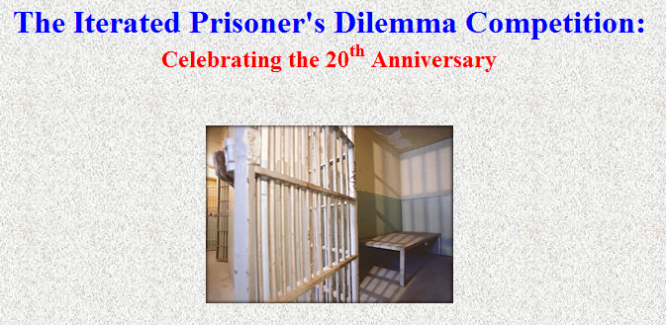
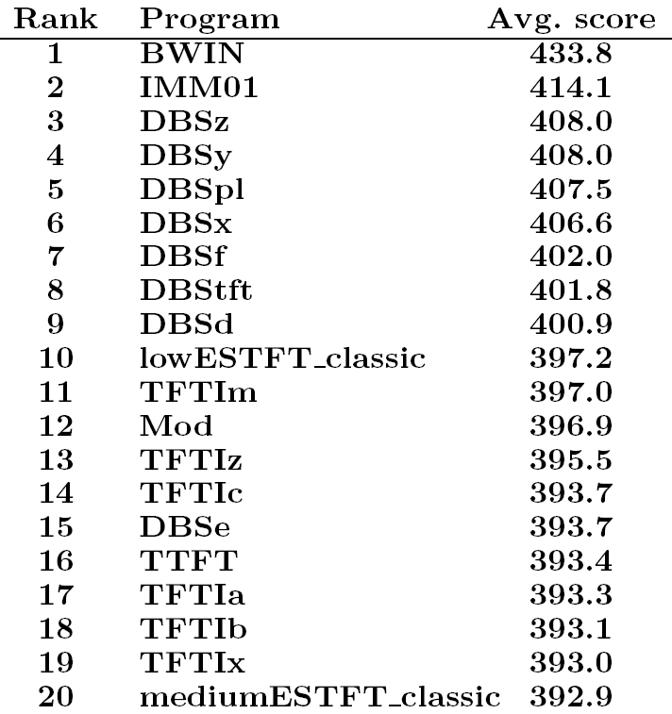
The 20th-Anniversary IPD Competition
http://www.prisoners-dilemma.com
Category 2: Noisy IPD
  Play each program against all programs, including itself
  Noise level = 10%
165 programs participated
DBS dominated the top ten places, but ...
DBS was beaten by two other programs: BWIN and IMM01

Slide 29
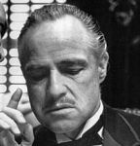
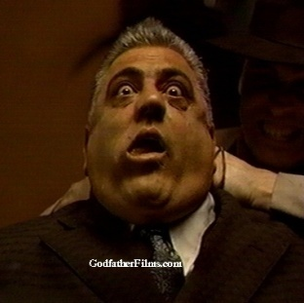


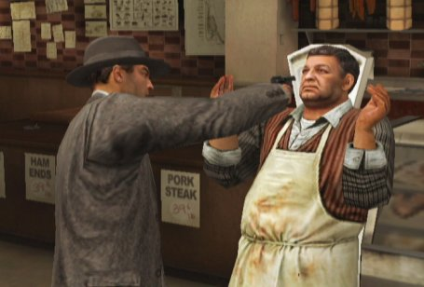
How BWIN and IMM01 worked
Each participant could submit up to 20 programs
Some participants submitted
20 programs that worked as a team
    1 master + 19 slaves
  When slaves play with master
    they cooperate and master detects
    master gets all the points
  When slaves play with anyone not in
  their team, they defect
Analysis
  The average score of each
  master-and-slaves team was much
  lower than DBSz’s average score
  If BWIN and IMM01 each had ≤ 10
  slaves, DBS would have placed 1st
  If BWIN and IMM01 had no slaves,
  they would have done badly
My strategy? I order my goons to beat them up
I order my goons to give me all their money

Slide 30


DBS cooperates, not coerces
Unlike BWIN and IMM01, DBS had no slaves
  None of the DBS programs even knew the others were there
DBS worked by establishing cooperation with many other agents
DBS could do this despite the noise, because it could filter out the noise

Slide 31
Summary
Noisy Environments
  Actions can be altered by noise
  Noise can induce changes of behavior
Important question in maintaining cooperation in noisy environment
  Is an anomaly of observed behavior accidental or intentional?
Our solution: symbolic noise detection
  Use deterministic behavior to detect noise
  Defer judgments until there is enough evidence
DBS performed extremely well in the 20th-Anniversary IPD competition
Observation: deterministic behavior is abundant in IPD
  That’s why symbolic noise detection is effective

Slide 32
Would SND be effective in Other Games?
Clarity of behavior is observed in some non-zero-sum games such IPD
  But what about other games?
Consider zero-sum games such as chess and RoShamBo (i.e., Rock, Paper, Scissors)
  There is no intention to play deterministically or predictably.
Questions:
  In what type of games deterministic behavior can be abundant?
  Would SND be effective in those games?
We believe:
  SND will be most effective in games in which strategies are likely to exhibit deterministic behavior.

Slide 33

SND-based Wrappers
To study this question, we proposed a wrapper that can be put around any strategy
  Examine the input using symbolic noise detection
  Modify the input as follows
    When we don’t think there’s any noise, make no change
    When we think we’ve detected noise, replace it with
    what we think the other player actually did
  Output: whatever action that the strategy chooses for this modified input
Wrapper
Filter
Agent 1
Agent 2
Advantages of the wrapper approach:
  can place around any existing strategy
  enable us to compare different strategies

Slide 34
Naïve Symbolic Noise Filter
Naïve Symbolic Noise Filter (NSNF)
  A simple wrapper that can be easily implemented
  Based on SND, but doesn’t defer judgment about whether an anomaly is due to noise or to a change of behavior
NSNF has only one parameter: the promotion threshold T
  In each iteration,
    If a behavior has occurred ≥ T times without contradiction, assume it’s a deterministic behavior and record it
  At the first violation of a deterministic behavior
    Correct the action
      assume the observed input (e.g, Defect) is due to noise
      change Defect to Cooperate or Cooperate to Defect before the input is fed into the strategy
    Drop the deterministic behavior
      assume the behavior has changed
      should identify new behavior or re-identify the same behavior in future

Slide 35

The Skeleton of Naïve Symbolic Noise Filter
Naïve SNF
Opponent Model
Predicted Action
Is Derived?
Yes = Enable
No = Disable
Correction
Observed
Action
Corrected Action
Agent 1
Agent 2

Slide 36
How does Naïve SNF work?
Naïve SNF
Update Model
Opponent Model
I change C to D
Predicted Action is C
Is Derived?
I receive C
I choose C
Yes = Enable
Correction
Observed
Action is D
Action corrected to C
Agent 1
Agent 2

Slide 37
Naïve SNF vs Full-strength SND
Naïve SNF does not defer judgment about whether a derivation (i.e., anomaly of behavior) is due to noise.
  All derivations from the opponent model, once observed, are considered due to noise.
In contrast, DBS uses deferred judgment to increase the accuracy of noise detection
  If the opponent’s behavior before and after a derivation are the same, the derivation is due to noise.
The difference:
  Naïve SNF utilizes information before a derivation only
  Full-strength SND utilizes information before and after a derivation
Full-strength SND is more accurate than Naïve SNF

Slide 38

Why Naïve SNF, not Full-Strength SND?
TFT +
Naïve SNF
TFT
TFT
TFT
Simple implementation is available
  no need to maintain the opponent model
    Just look at the history to identify noise
  no need to “rewind” the state of the underlying strategy
    suitable to our wrapper approach
As an example:
  promotion threshold = 2
C
C
C
C
C
C
C
C
C
C
C
C
C
D
C
C
D
C
C
C
D
C
C
C
C
D
C
C
D
C
C
D
C
C
D
D
C
D
D
D
C
C
D
D
:
:
:
:

Slide 39
Chicken Game
To evaluate Naïve SNF, we use two games as the test beds
  Iterated Chicken Game
  Iterated Battles of the Sexes
Chicken Game:
  Two players compete for a resource
  If neither player concedes, both of
  them will suffer
Example
  Two groups need to divide a piece
  of land between them
  If they can’t agree upon how to
  divide it, they’ll fight
Nash equilibrium strategies (with no iteration):
  Do the opposite of what the other player is doing
Iterated Chicken Game (ICG)
  Mutual cooperation does not emerge
    Each player wants to establish him/herself as the defector
Payoff matrix:
Player₂ Player₁ | Cooperate | Defect
Cooperate | 4, 4 | 3, 5
Defect | 5, 3 | 0, 0

Slide 40
Battle of the Sexes
Battle of the Sexes:
  Two players need to coordinate
  their actions to achieve some goal
  They each favor different actions
Example
  Two nations must act together
  to win against a common enemy
  Each of them wants the other
  nation to make the biggest effort
Nash equilibrium strategies (with no iteration):
  Do what the other player is doing
Iterated Battle of the Sexes (IBS)
  Mutual cooperation does not emerge
  Each player wants to take advantage of each other
Payoff matrix:
Husband Wife | Opera | Football
Opera | 2, 1 | 0, 0
Football | 0, 0 | 1, 2

Slide 41
Evaluation: Noisy Tournaments
We organized two tournaments:
  The Noisy ICG tournament and The Noisy IBS tournament
Agents:
  37 agents for each tournament
    written by 37 students in an advanced-level AI class
What students knows:
  Payoff matrices
  Number of iterations in each game ≥ 50
  Noise level is 10%
  Robin-robin tournament
    Every agent will play 1000 games with every other agents (including a copy of itself)
  The “internal memory” of the agents is “reset” at the beginning of every game

Slide 42
Experiments
For each program P, we ran two sets of tournaments
  P against the others
  An enhanced version of P against the others
    The enhancement: use Naïve SNF to detect noise and correct action affected by noise.

Slide 43
Accuracy of Naïve SNF
Naïve SNF is highly accurate in predicting a player’s next move
  96% in ICG, 93% in IBS
When NSNF makes a correction, how accurate is the correction?
  True positive: corrected action was affected by noise
  False positive: corrected action wasn’t affected by noise
At 300 iterations with noise level of 10%,
  noise affects about 30 actions/game
In ICG, about 25.4 corrections/game
  71% were true positives
In IBS, about 27.1 corrections/game
  59% were true positives
Baseline: random correction
  % of true positives = 10 %
  So Naïve SNF is much better
  than random correction
 | ICG | IBS
Accuracy of predictions | 96% | 93%
Number of corrections | 25.4 out of 300 moves | 27.1 out of 300 moves
True pos. | 71% | 59%
False pos. | 29% | 41%

Slide 44
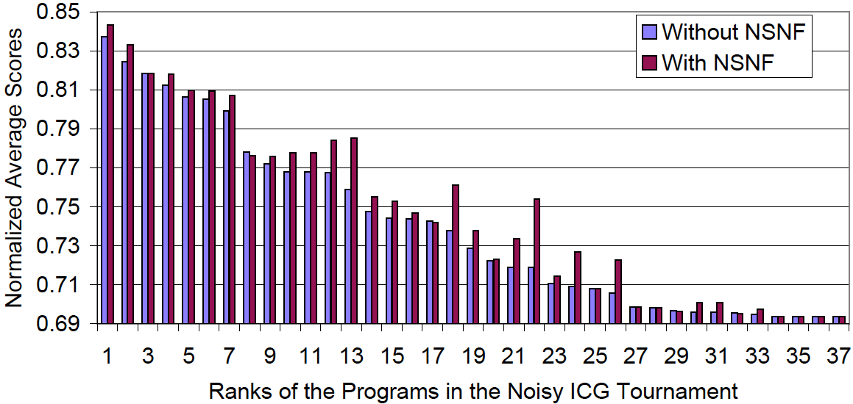
Naïve SNF in the Iterated Chicken Game
On average:
  Naïve SNF improved each strategy’s score by 0.9% (or 0.0068 in normalized score)
  Naïve SNF improved each strategy’s ranking 1.51
Difference in score of the best and worst strategies is only 0.144
  Thus a program’s ranking can be changed by a small change in its score

Slide 45
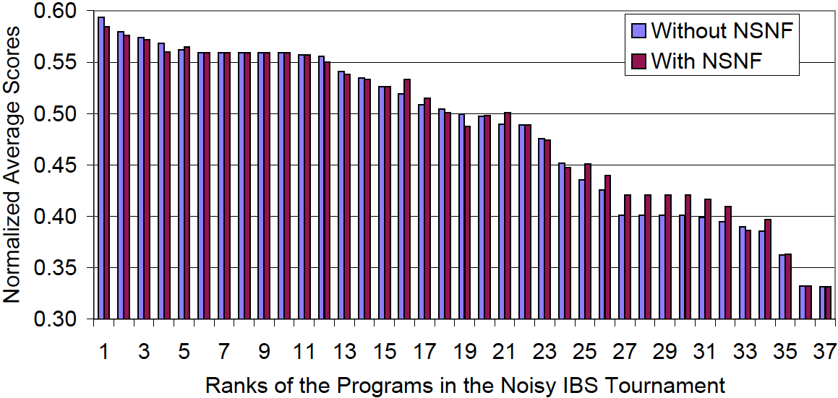
Naïve SNF in the Iterated Battle of the Sexes
On average, NSNF improved each strategy’s score by 1.2% (or 0.0035 in normalized score)
  larger than ICG (0.9%), but doesn’t change the rank as much
Difference in score of the best and worst strategies is 0.262 (in ICG, it is 0.144)
  To change a program’s ranking, need to change its score by about twice as much as in ICG

Slide 46
Naïve SNF on Strong, Average, and Weak Strategies
But the benefit of SNF varies among different strategies
  In ICG, strong and average strategies benefit from Naïve SNF, but not weak strategies
  In IBS, average and weak strategies benefit from Naïve, but not the strong strategies
    Some strategies perform even worse after using Naïve SNF

Slide 47
Three Key Variables and Their Relationships
To explain the difference among strong, average, and weak strategies, we identify three key variables and compare them
  Average score (X)
    normalized to the range [0,1]
  Accuracy of correction (Δ)
  Increase in average scores (γ)
Objective: identify the factors that would affect the effectiveness of Naïve SNF.
  Under what conditions would Naïve SNF be effective?
  The explanations can help us to determine when we should use Naïve SNF, and when we should not use Naïve SNF

Slide 48
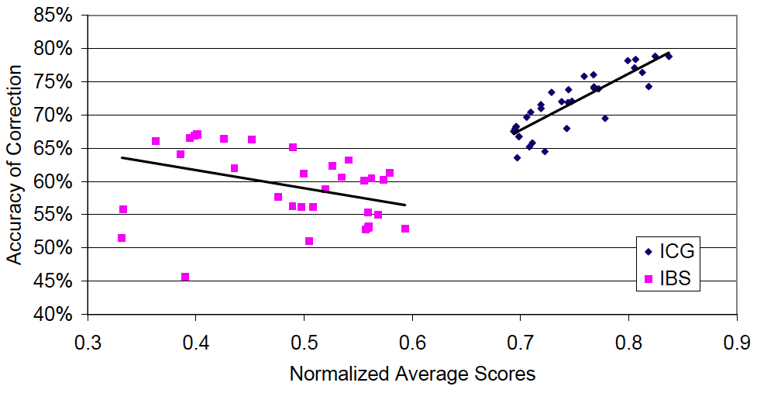
Average Scores X vs Accuracy of Correction γ
ICG: strong positive linear correlation
IBS: weak negative linear correlation (with outliners)
Correction Accuracy in ICG > Correction Accuracy in IBS

Slide 49
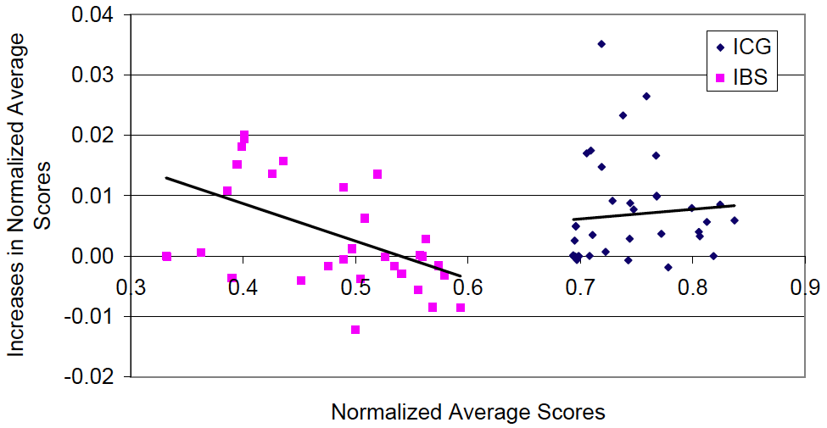
Average Scores X vs Increases in Avg. Scores Δ
ICG: No obvious correlation; but most strategies have an increase in average scores after using Naïve SNF
IBS: weak negative linear correlation (with outliners); about half of the strategies have an decrease in average scores after using Naïve SNF.

Slide 50
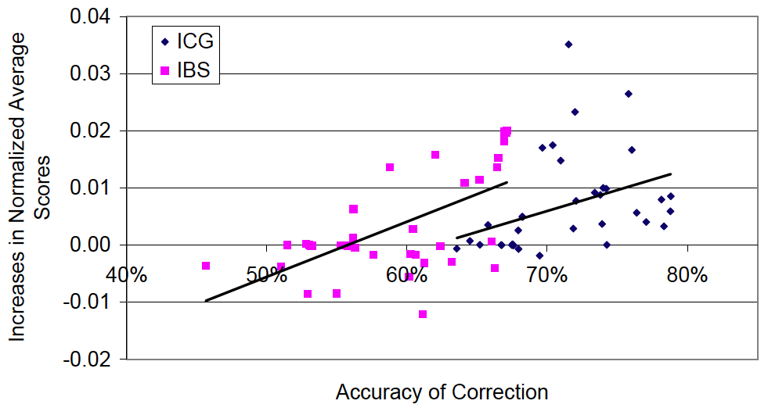
Accuracy of Correction γ vs Increase in Avg. Scores Δ
ICG and IBS: no obvious correlation
Low correction accuracy → decrease or no increase in average score

Slide 51
Experimental Explanation
We explain the relationships among the variables experimentally, via two variables concerning the decisions made by players
  The frequency of choosing defect (D)
  The frequency of “flip-flop”--- changing decisions (from cooperate to defect or vice versa) between two consecutive iterations. (F)
We will explain the relationships between
  average scores and accuracy of correction
  average scores and increases in average scores
We can deduce the relationship between the accuracy of correction and increases in average scores

Slide 52
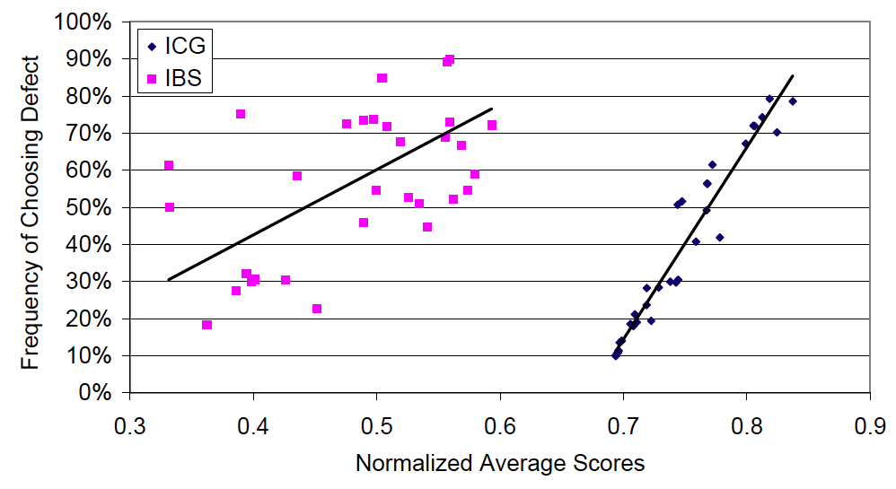
Average Scores X vs Frequency of Defection D
ICG: Strong positive linear correlation (i.e., top strategies often defects)
IBS: no obvious correlation

Slide 53
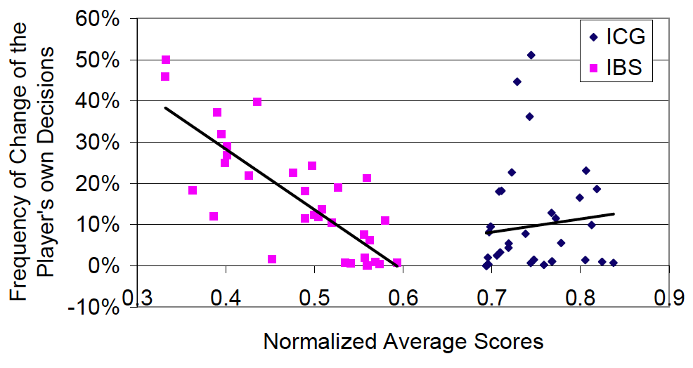
Average Scores X vs Freq. of Flip-Flop F
ICG: no obvious correlation
IBS: strong negative linear correlation (with outliners) (i.e., top strategies does not change decisions frequently)

Slide 54
Average Scores vs Accuracy of Correction
First, let us explain why there is a strong positive linear correlation in ICG
  Top players have higher accuracy of correction

Slide 55
Average Scores vs Accuracy of Correction
In ICG
  strong players often defect
  weak players often cooperate
  average players often flip-flop (changing cooperate to defect, or vice versa)
When facing strong players, it is better to cooperate to earn 3 points instead of defect to earn 0 point
  strong players force the average players to cooperate
  → average players often exhibit a clear deterministic behavior
  → High correction accuracy
When facing weak players who cooperates, there is little difference between cooperate and defect (4 points ≅ 5 points)
  Weak players fails to force the average players to cooperate
  → Average players continue to flip-flop
  → Low correction accuracy
Player₂ Player₁ | Cooperate | Defect
Cooperate | 4, 4 | 3, 5
Defect | 5, 3 | 0, 0

Slide 56
Average Scores vs Accuracy of Correction
Second, we explain why there is a weak negative linear correlation in IBS

Slide 57
Average Scores vs Accuracy of Correction
In IBS
  strong players often defect
  weak players often flip-flop
When facing strong players, there is little difference between cooperate and defect (1 points ≅ 0 points)
  Strong players less successfully in forcing other players to cooperate
  → Other Players exhibit less clear deterministic behavior
  → Lower correction accuracy
When facing weak players who flip-flop, it is better to defect than to cooperate in long run
  Weak players causes other players to defect more often
  → Higher correction accuracy
Player₂ Player₁ | Cooperate | Defect
Cooperate | 0, 0 | 1, 2
Defect | 2, 1 | 0, 0

Slide 58
Average Scores X vs Increases in Avg. Scores Δ
Third, we explain the relationship between the increase in average score and the average scores
Very similar!
The larger the amount of flip-flops, the higher the increases in average scores after using Naïve SNF

Slide 59
Average Scores X vs Increases in Avg. Scores γ
The increases in average scores seems to be less dependent to the accuracy of correction.

Slide 60
Observation and Prediction
What strategies do not get a better performance when using Naïve SNF?
  Strategies which are insensitive to the other player’s moves
    e.g., almost always choose defects no matter what.
What strategies can potentially get a performance boost when using Naïve SNF?
  Strategies which are sensitive to the other player’s moves.
    e.g, TFT
    e.g., ICG strategies which often change their decisions (flip-flops).
The increase of average scores seems to be less dependent of the accuracy of correction.
  But there are still some effects
For strategies that works with Naïve SNF, our prediction:
  Where
    α = average score in noise-free environment
    β = average score in noisy environment
    γ = accuracy of correction
    K is a constant
Change of average scores = K × (α – β) × (γ – 50%)

Slide 61
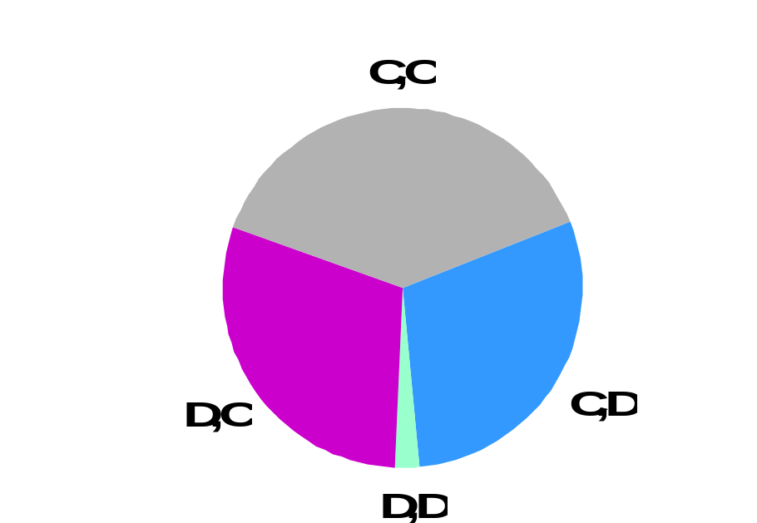
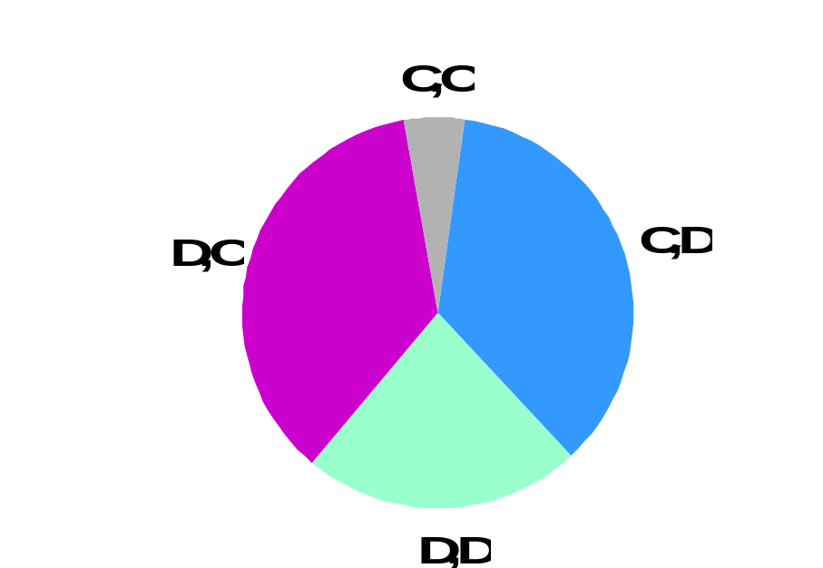
Other Results: Distribution of Decision Pairs
ICG:
Player₂ Player₁ | Cooperate | Defect
Cooperate | 4, 4 | 3, 5
Defect | 5, 3 | 0, 0
-5%
+6%
-1%
IBS:
Player₂ Player₁ | Cooperate | Defect
Cooperate | 0, 0 | 1, 2
Defect | 2, 1 | 0, 0
-1%
+3%
-2%

Slide 62
Summary
Noisy Environments
  Actions can be altered by noise
  Noise can induce changes of behavior
Important question in maintaining cooperation in noisy environments
  Is an anomaly in observed behavior accidental or intentional?
Our solution: symbolic noise detection
  Use deterministic behavior to detect noise
  Defer judgments until there is enough evidence
DBS performed extremely well in the 20th-Anniversary IPD competition
We propose to use SND as a general technique for detection and correction of errors in interaction among agents in multi-agent systems
  Wrapper-based approach to equip existing strategies with symbolic noise detection
  Naïve Symbolic Noise Filter
    can be put around any strategy for 2 × 2 normal-form games

Slide 63
Summary (cont.)
Hypothesis: SND is effective in situations where strategies often exhibit deterministic behavior
  We have experimentally verified this hypothesis in
    The Iterated Chicken Game (ICG)
    The Iterated Battles of the Sexes (IBS)
SND is effective in noise detection in ICG and IBS
  Accuracy of prediction: 96% in ICG, 93% in IBS
  Accuracy of correction: 71% in ICG, 59% in IBS
Overall scores of all strategies increased in both games after using SND
  +0.0068 in ICG, +0.0035 in IBS
Our hypothesis seems valid:
  SND is indeed effective in situations where strategies often exhibit deterministic behavior
    But in ICG and IBS, this deterministic behavior is often a threat rather than an expression of cooperation

Slide 64
Summary (cont.)
But if we look at strategies individually
  Most programs benefited from noise detection, but not all
  High accuracy in noise detection ≠ high score
  Some strategies, especially in IBS, did better with uncorrected inputs
To see why, we conducts experiments to explain the relationships between
  Average scores
  Increases in average scores
  Accuracy of noise correction
Conclusion:
  Strategies that are insensitive to the other player’s moves do not get a better performance when using Naïve SNF
    e.g., almost always choose defects no matter what (e.g., strong players in both ICG and IBS)
  Strategies that are sensitive to the other player’s moves potentially get a performance boost when using Naïve SNF
    e.g, TFT
    e.g., ICG strategies which often change their decisions (flip-flops).
  The increase of average scores seems to be less dependent of the accuracy of correction.
  Change of average scores = K × (α – β) × (γ – 50%)

Slide 65
Future Work
Noise can occur in nearly all kind of multi-agent systems in which agents has to interact as with each other.
  How to deal with noise is an important issue, especially in situations where the success of agents greatly depends on the robustness of interaction (i.e., IPD-like situations)
  Can SND be used to deal with errors in interaction in those real-world situations?
    Need to modify SND to handle more actions, more agents, and more complicated situations.
Open questions:
  Which type of games can benefit from using SND?
  Which type of programs can benefit from using SND?

Slide 66
Conclusion
Noise is less problematic when the incentive
for cooperation is strong
Thank you!
Thank you!
Any Questions?

