Slide 1

Learning Finite-State Machines: Conserving Fitness Evaluations by Marking Used Transitions
Daniil Chivilikhin and Vladimir Ulyantsev
National Research University of IT, Mechanics and Optics
St. Petersburg, Russia
Machine Learning Applications in Software Engineering @ ICMLA’13
December 6, 2013

Slide 2
Motivation: Reliable software
Systems with high cost of failure
  Energy industry
  Aircraft industry
  Space industry
  …
We want to have reliable software
  Testing is not enough
  Verification is needed
Learning FSMs: Conserving Fitness Evaluations

Slide 3
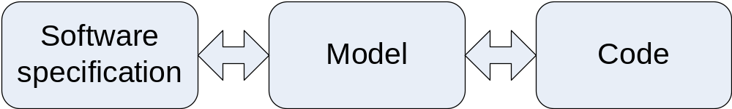
Introduction (1)
Automated software engineering
Model-driven development
Automata-based programming
Learning FSMs: Conserving Fitness Evaluations

Slide 4
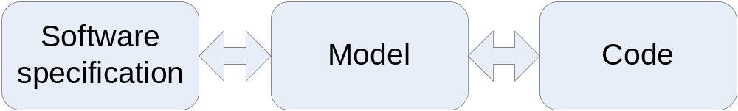
Introduction (2)
Finite-state machine
Learning FSMs: Conserving Fitness Evaluations

Slide 5
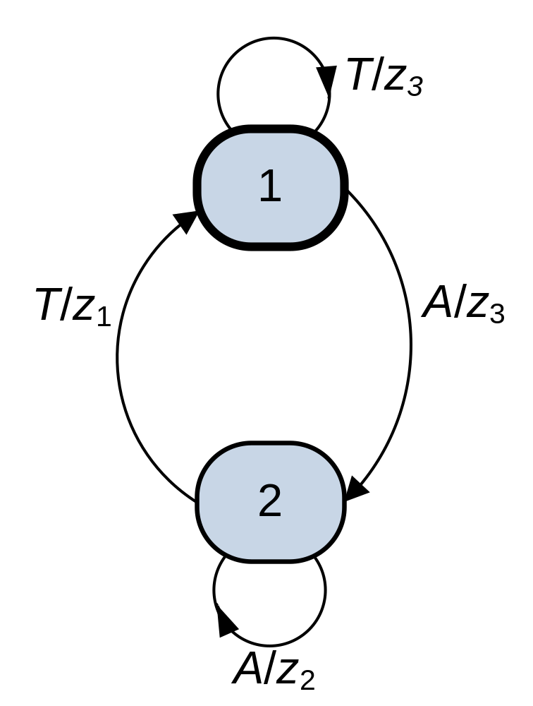
Finite-State Machine
Σ – set of input events
Δ – set of output actions
δ: S×Σ→S – transition function
λ: S×Σ→Δ – actions function
Learning FSMs: Conserving Fitness Evaluations

Slide 6
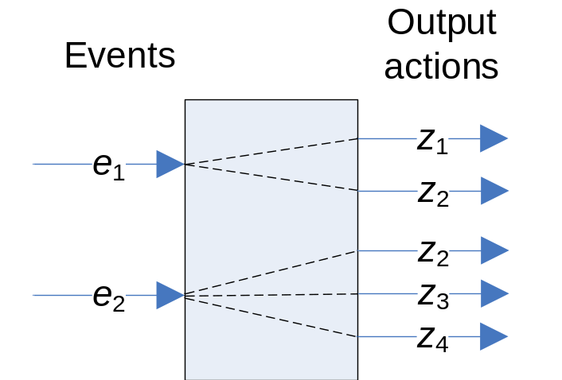
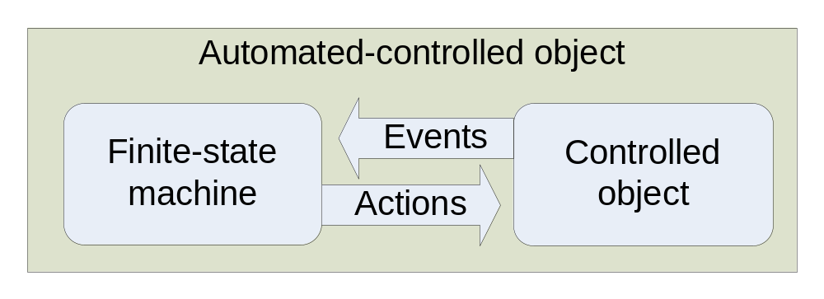
Automata-based programming
Design programs with complex behavior as automated-controlled objects
Learning FSMs: Conserving Fitness Evaluations

Slide 7
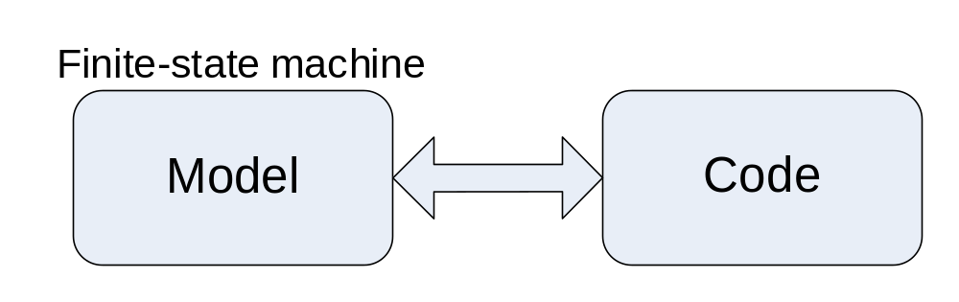
Automata-based programming: advantages
Model before programming code, not vice versa
Possibility of program verification using Model Checking
You can check temporal properties (LTL)
Learning FSMs: Conserving Fitness Evaluations

Slide 8
Issues
Hard to build an FSM with desired structure and behavior
One of approaches – mutation-based metaheuristics
Learning FSMs: Conserving Fitness Evaluations

Slide 9
Mutation-based FSM learning
Evolution Strategies (ES)
Genetic Algorithms (GA)
Mutation-based Ant Colony Optimization (MuACO)
All these algorithms use FSM mutations
Learning FSMs: Conserving Fitness Evaluations

Slide 10
Mutation-Based Ant Colony Optimization
Proposed by the authors of this work in 2012
Based on Ant Colony Optimization
Can be thought of as an ES “with memory”
No time to go into detail ☹
Learning FSMs: Conserving Fitness Evaluations

Slide 11
Solution representation
Transition table |  |  |  | Output table
δ | Event |  |  | λ | Event
State | A | T |  | State | A | T
1 | 1 | 2 |  | 1 | z₁ | z₂
2 | 2 | 1 |  | 2 | z₂ | z₃
Learning FSMs: Conserving Fitness Evaluations

Slide 12
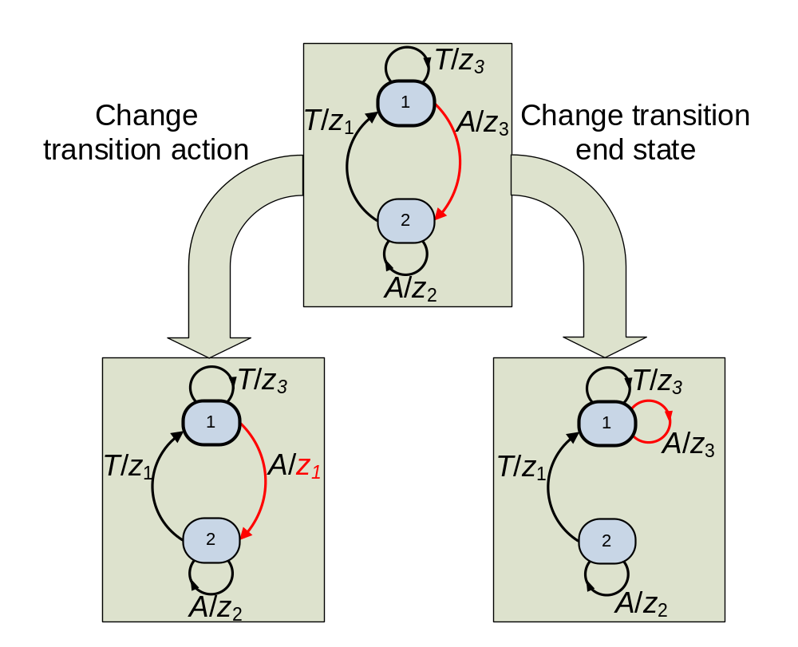
FSM Mutations
Learning FSMs: Conserving Fitness Evaluations

Slide 13
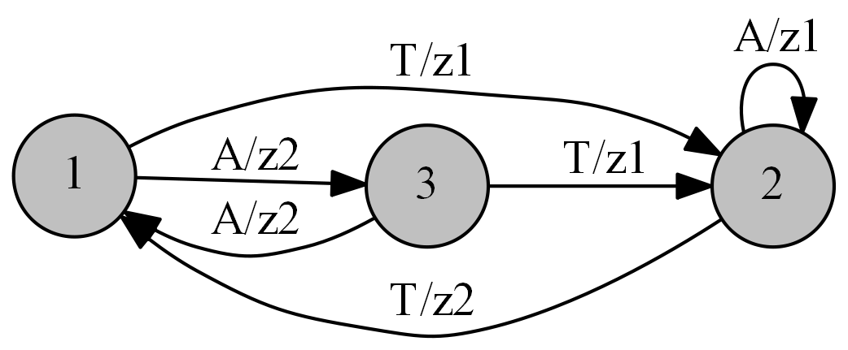
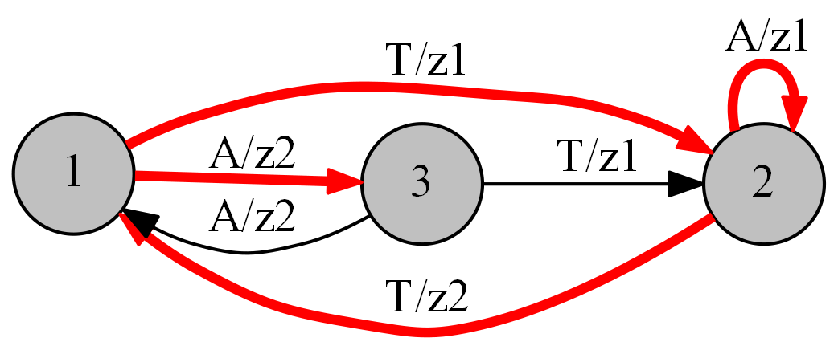
Fitness evaluation: used transitions
Calculated fitness
Used transitions
Learning FSMs: Conserving Fitness Evaluations

Slide 14
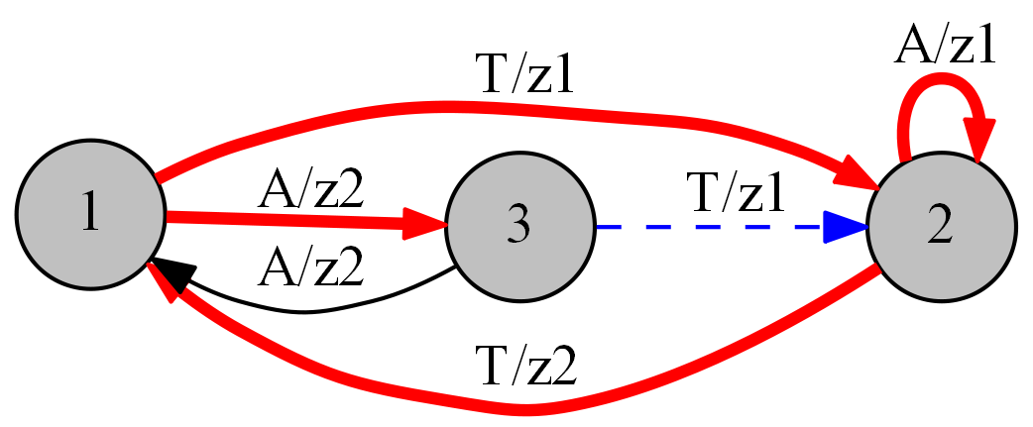
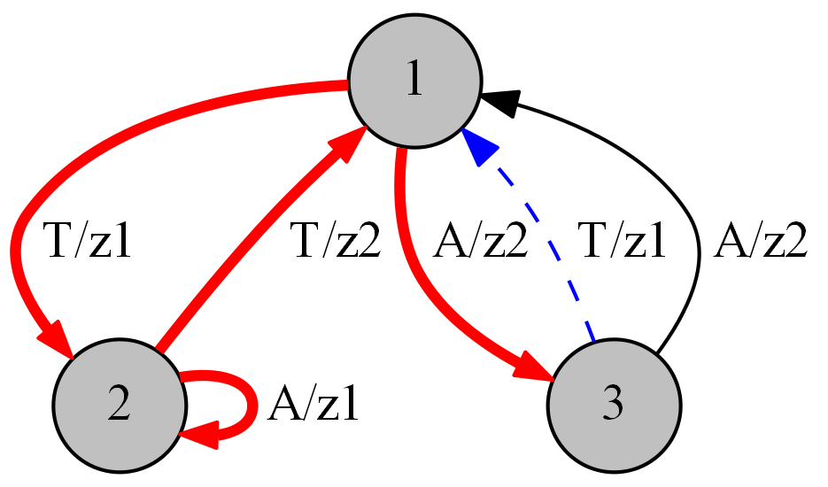
Mutation
Mutate this transition
Learning FSMs: Conserving Fitness Evaluations

Slide 15
Observation
Used transition
Compute fitness
Mutation
Unused transition
Fitness has not changed
Learning FSMs: Conserving Fitness Evaluations

Slide 16
Challenge
OK, found a way not to calculate fitness of FSMs in some cases
Can we design an efficient implementation?
Will it make a difference in performance?
Limits of applicability?
Learning FSMs: Conserving Fitness Evaluations

Slide 17
Implementation
Store an array of transition usage marks for each FSM
Mark used transitions during fitness evaluation
Copy marks when not calculating fitness
Learning FSMs: Conserving Fitness Evaluations

Slide 18
Experiments: Purpose
Determine if transition marking makes a difference in algorithm performance
Measure amount of resources used to implement transition marking
Learning FSMs: Conserving Fitness Evaluations

Slide 19
Experiments: Algorithms
Evolutionary strategy (ES)
Genetic algorithm (GA)
Mutation-Based Ant Colony Optimization for learning FSMs (MuACOsm)
Learning FSMs: Conserving Fitness Evaluations

Slide 20
Experiments: Problems
Artificial Ant Problem
Learning EFSMs from tests
Learning DFA from noisy samples
Learning FSMs: Conserving Fitness Evaluations

Slide 21
General experimental setup
Tune each algorithm for time t_{tune}
  Using full factorial design of experiment
Run each algorithm with selected parameters
Learning FSMs: Conserving Fitness Evaluations

Slide 22
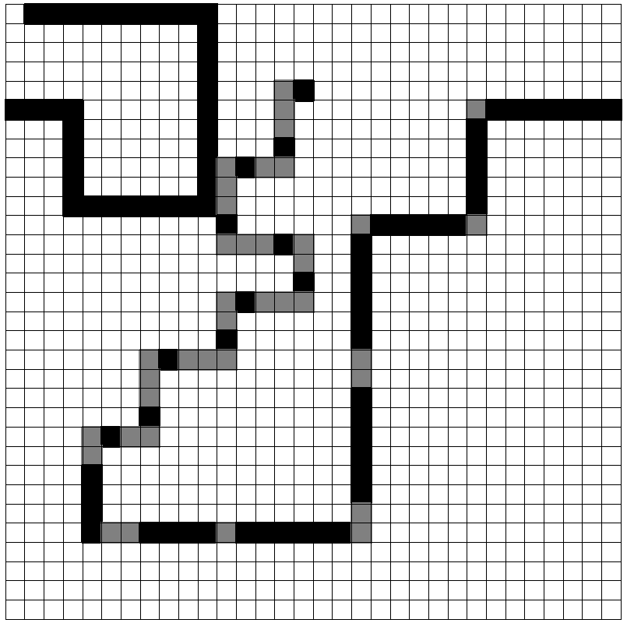
Artificial Ant Problem
Toroidal field N×N
M pieces of food
s_{max} time steps
Fixed position of food and the ant
Goal – build an FSM, such that the ant will eat all food in K steps
Field example: John Muir Trail
Learning FSMs: Conserving Fitness Evaluations

Slide 23
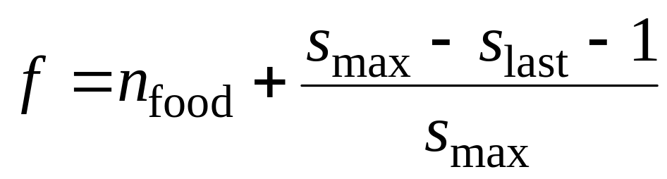
Artificial Ant: Fitness function
n_{food} – number of eaten food pieces
s_{max} – max number of allotted steps
s_{last} – number of used steps
eaten food
f
used time steps
Learning FSMs: Conserving Fitness Evaluations

Slide 24
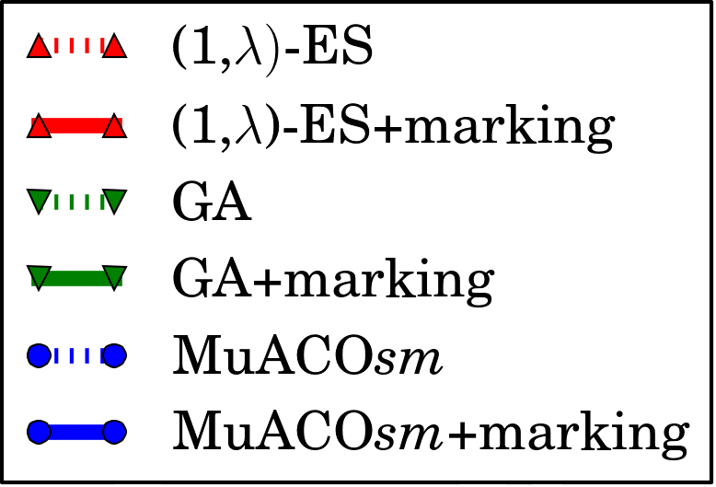
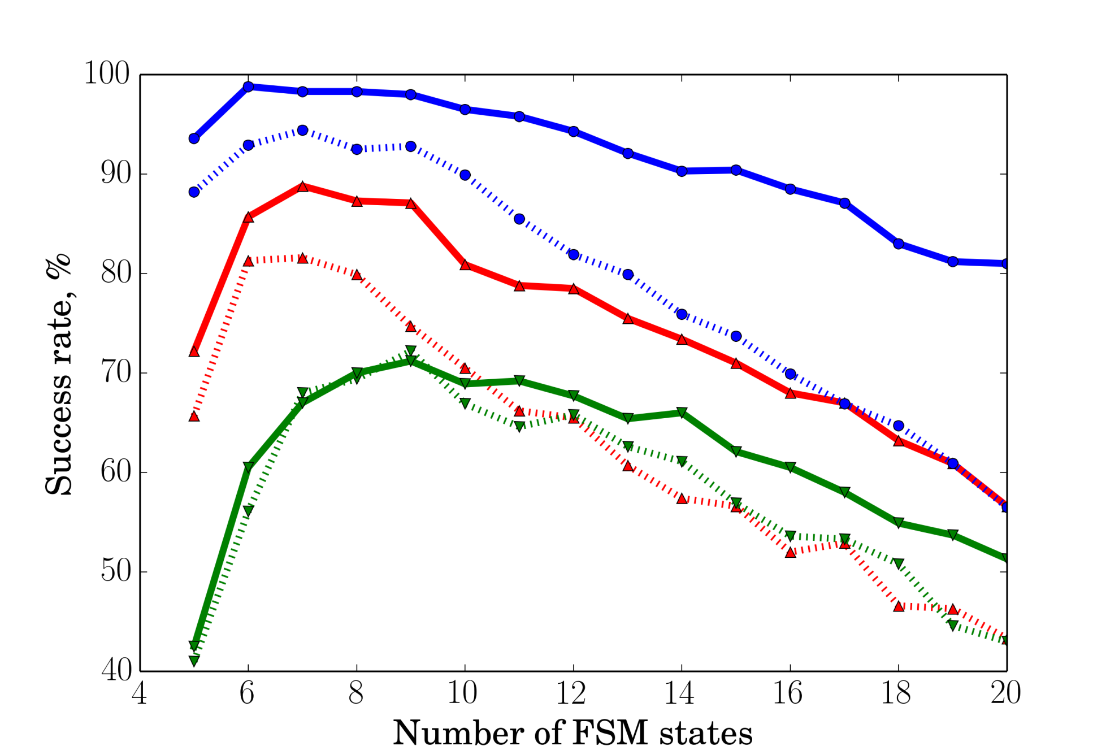
Success rate

Slide 25
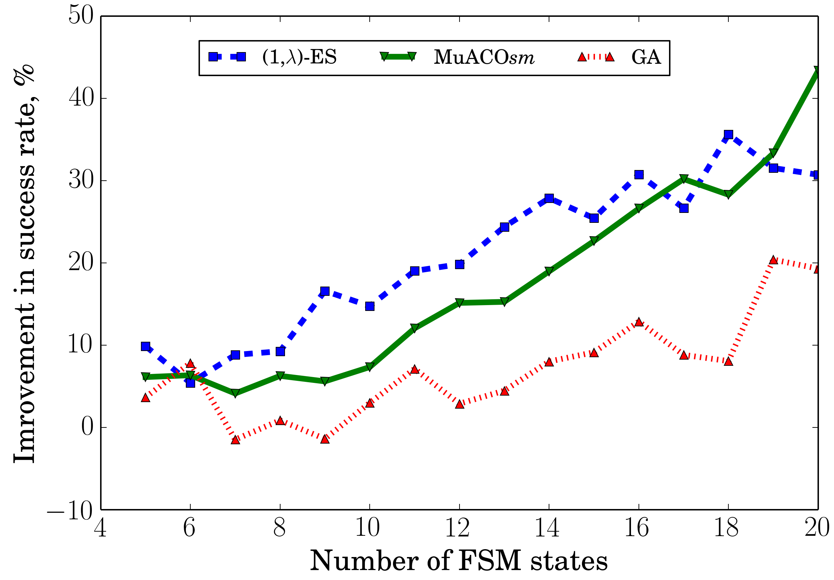
Improvement in success rate

Slide 26
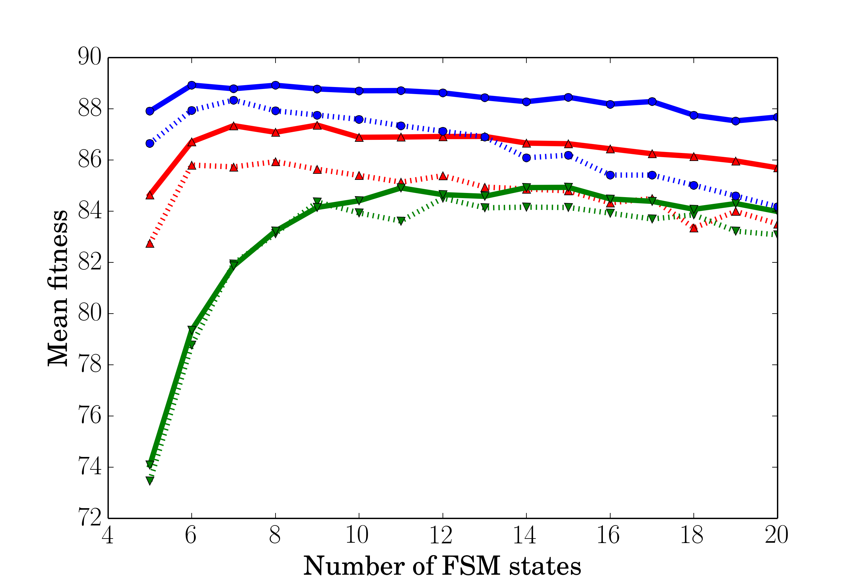
Mean fitness

Slide 27
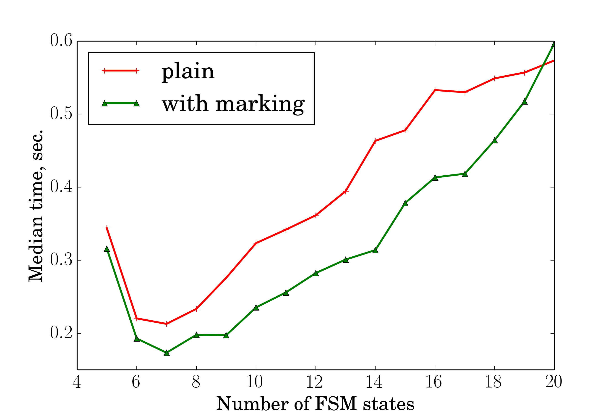
ES median time

Slide 28
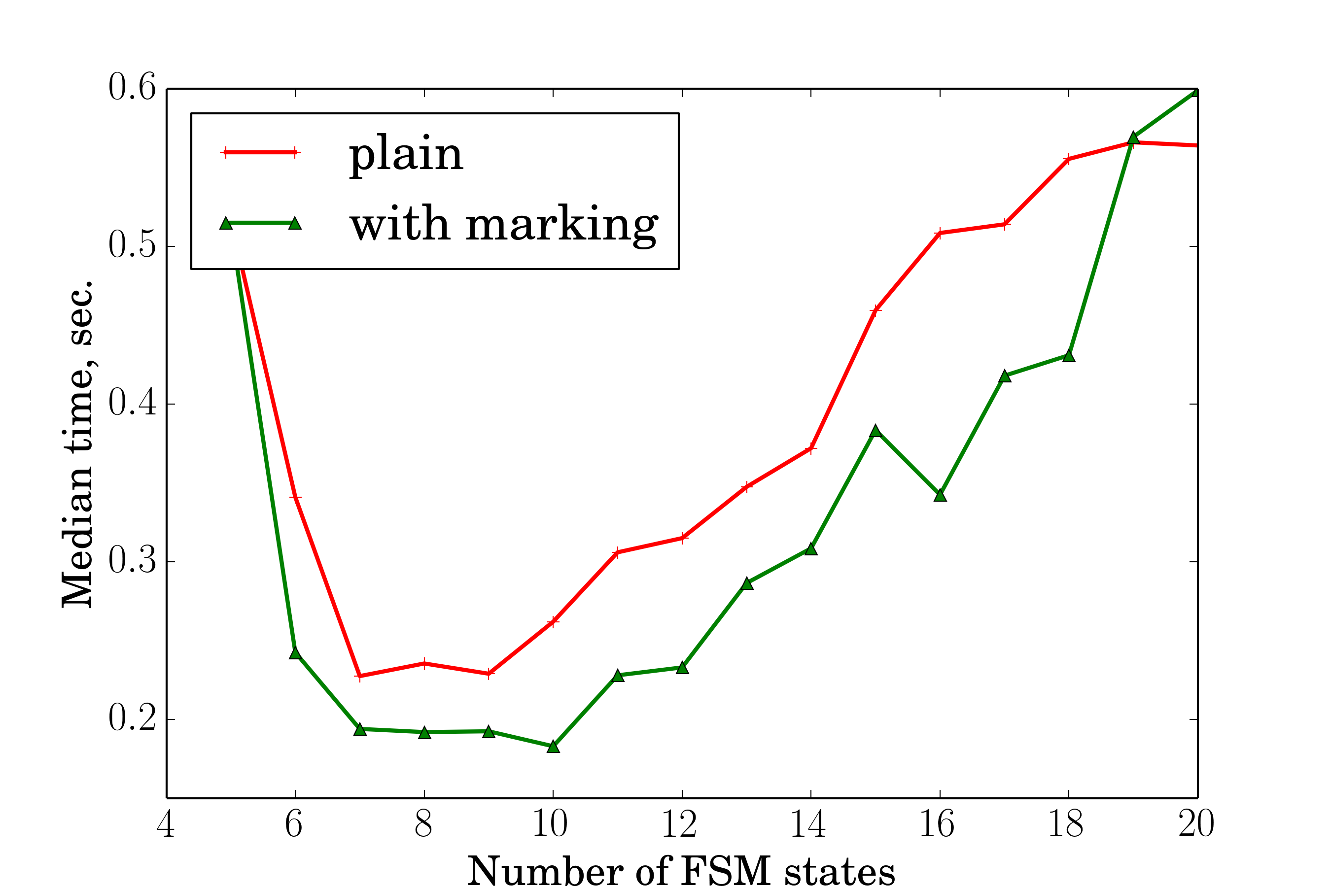
GA median time

Slide 29
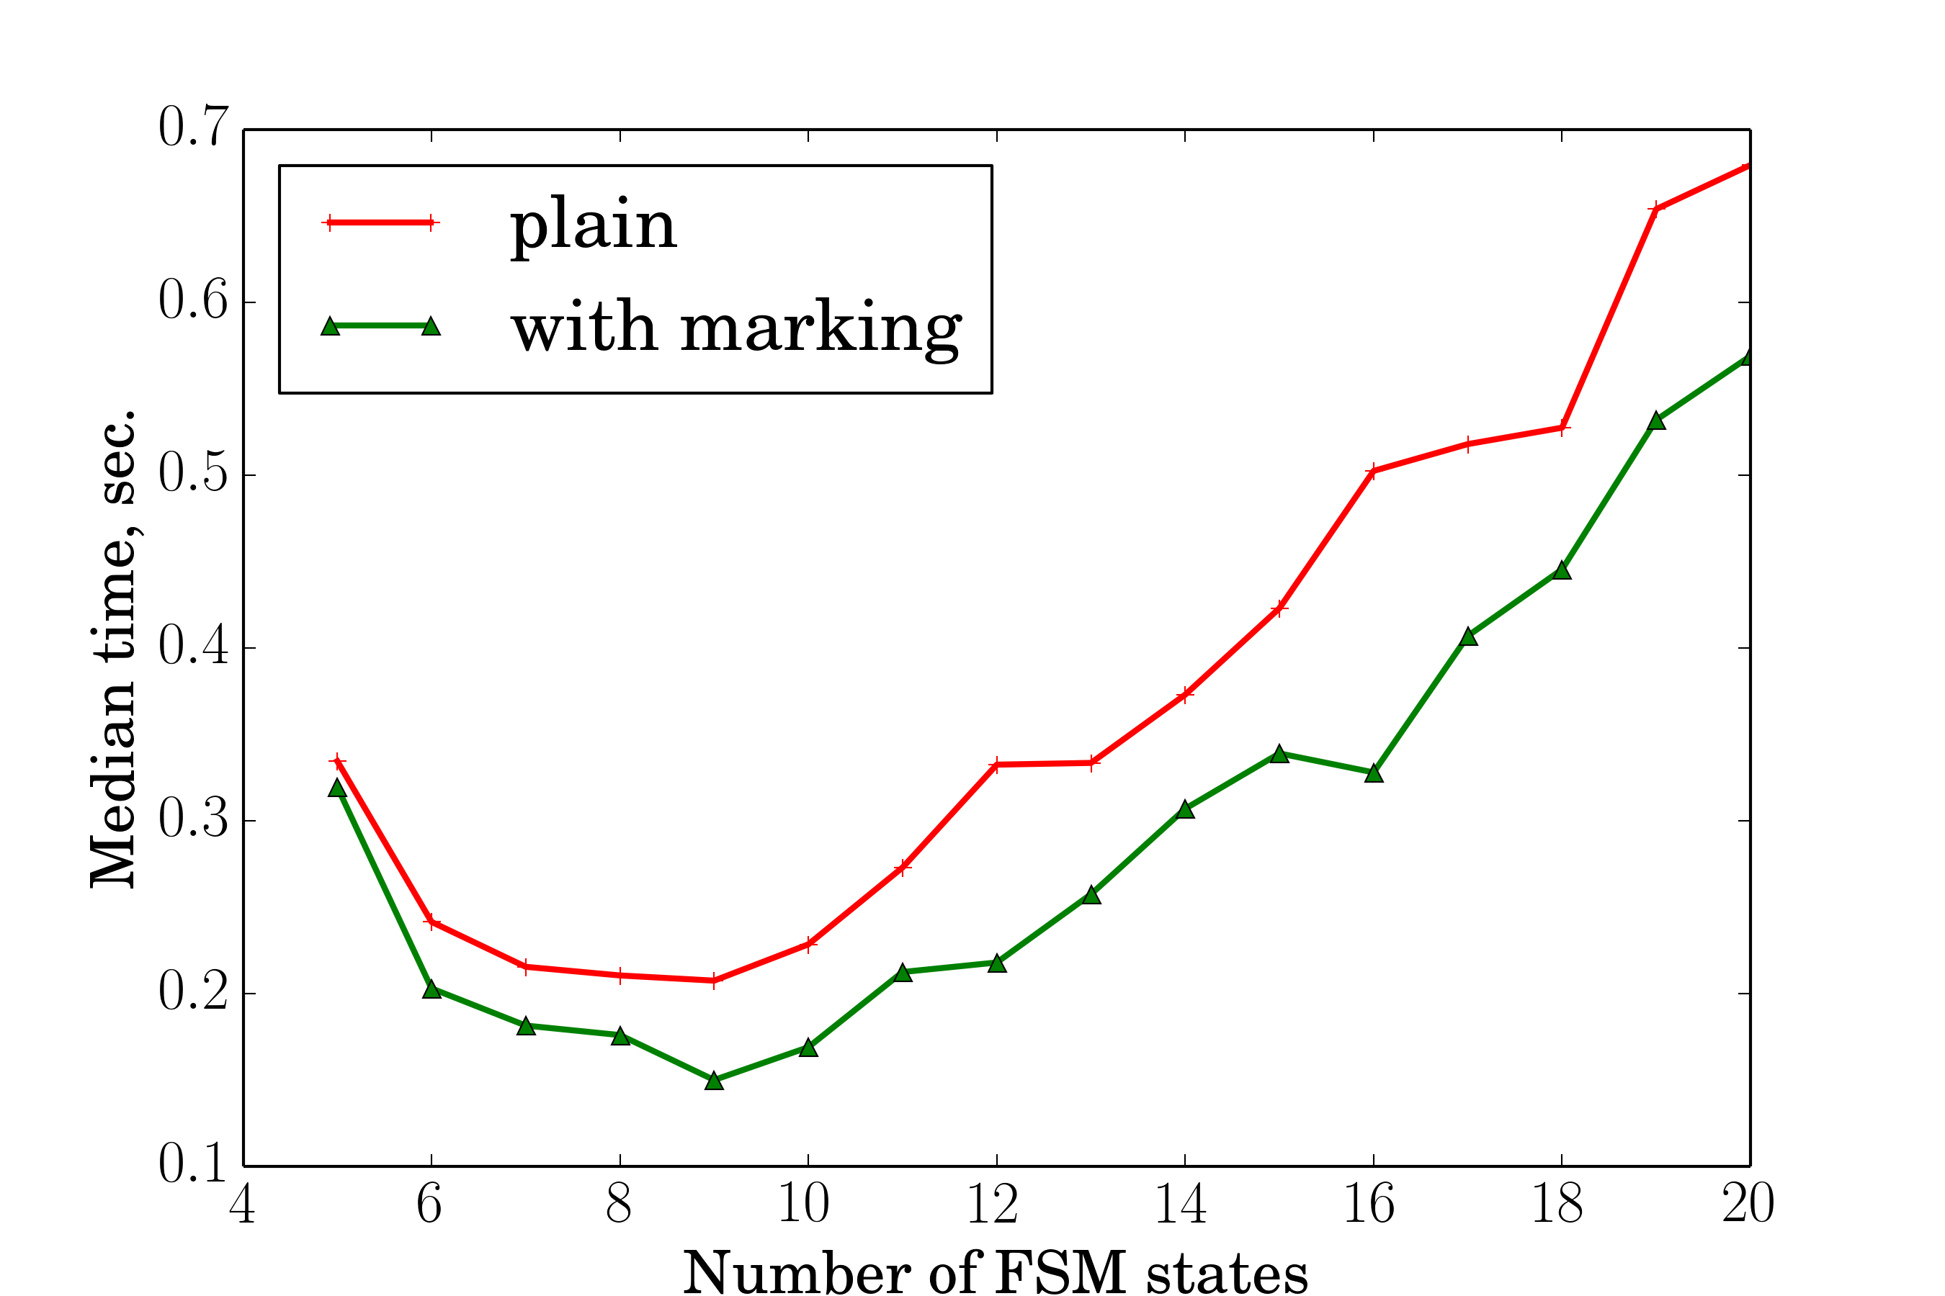
MuACO median time

Slide 30
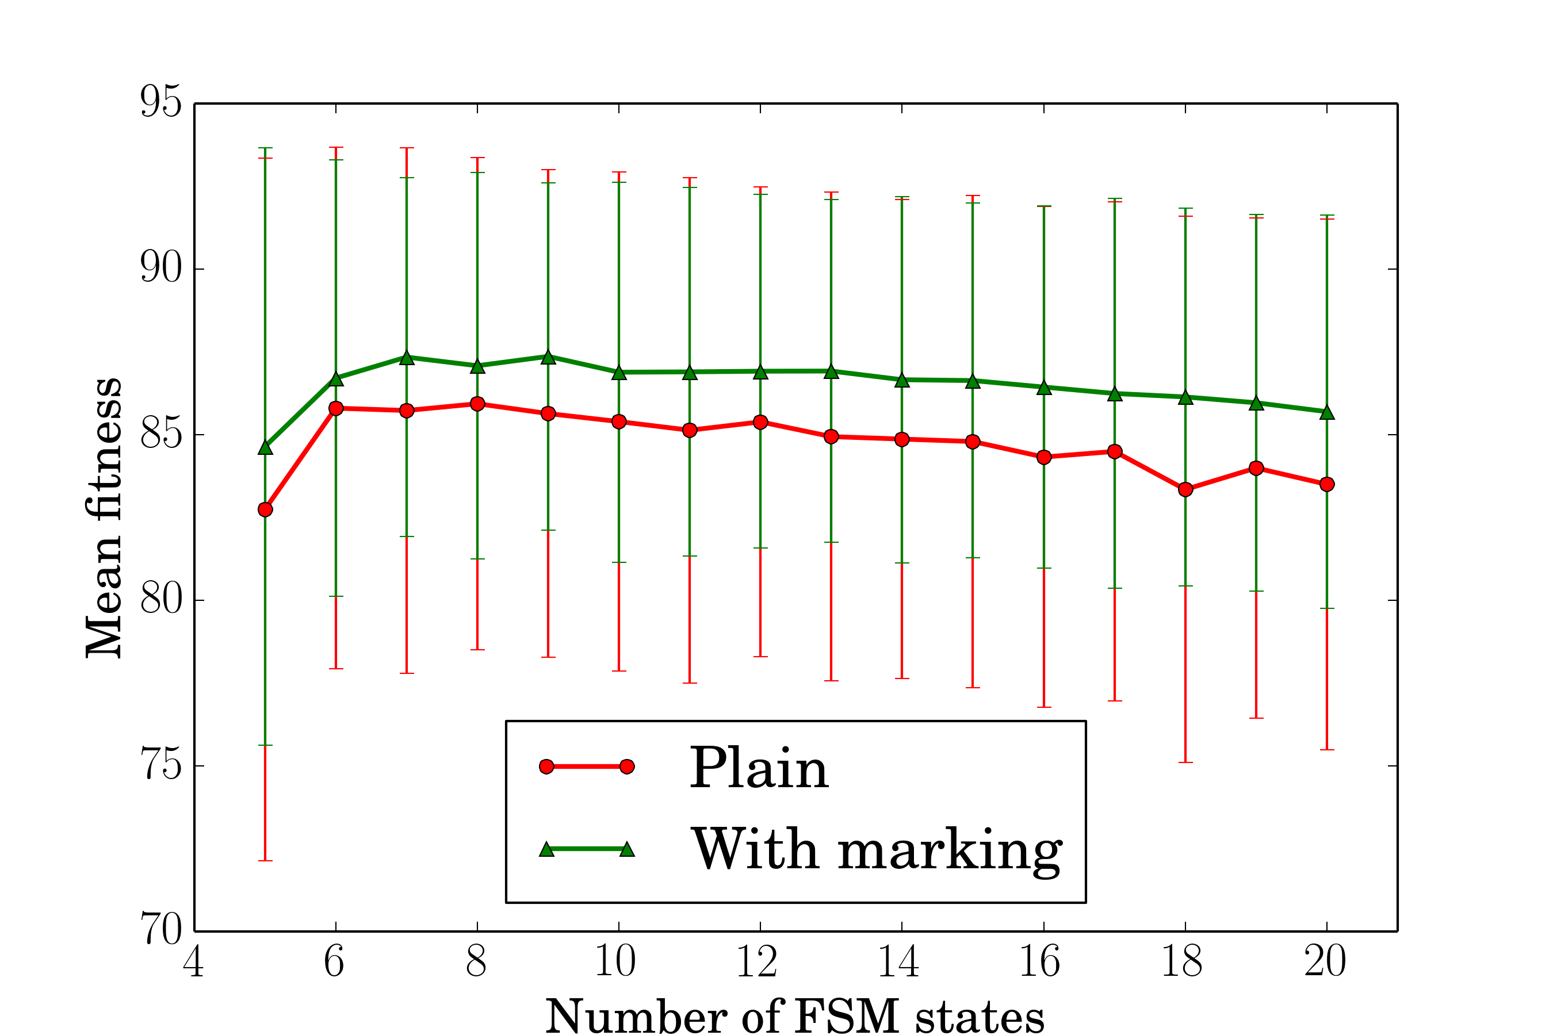
ES Fitness

Slide 31
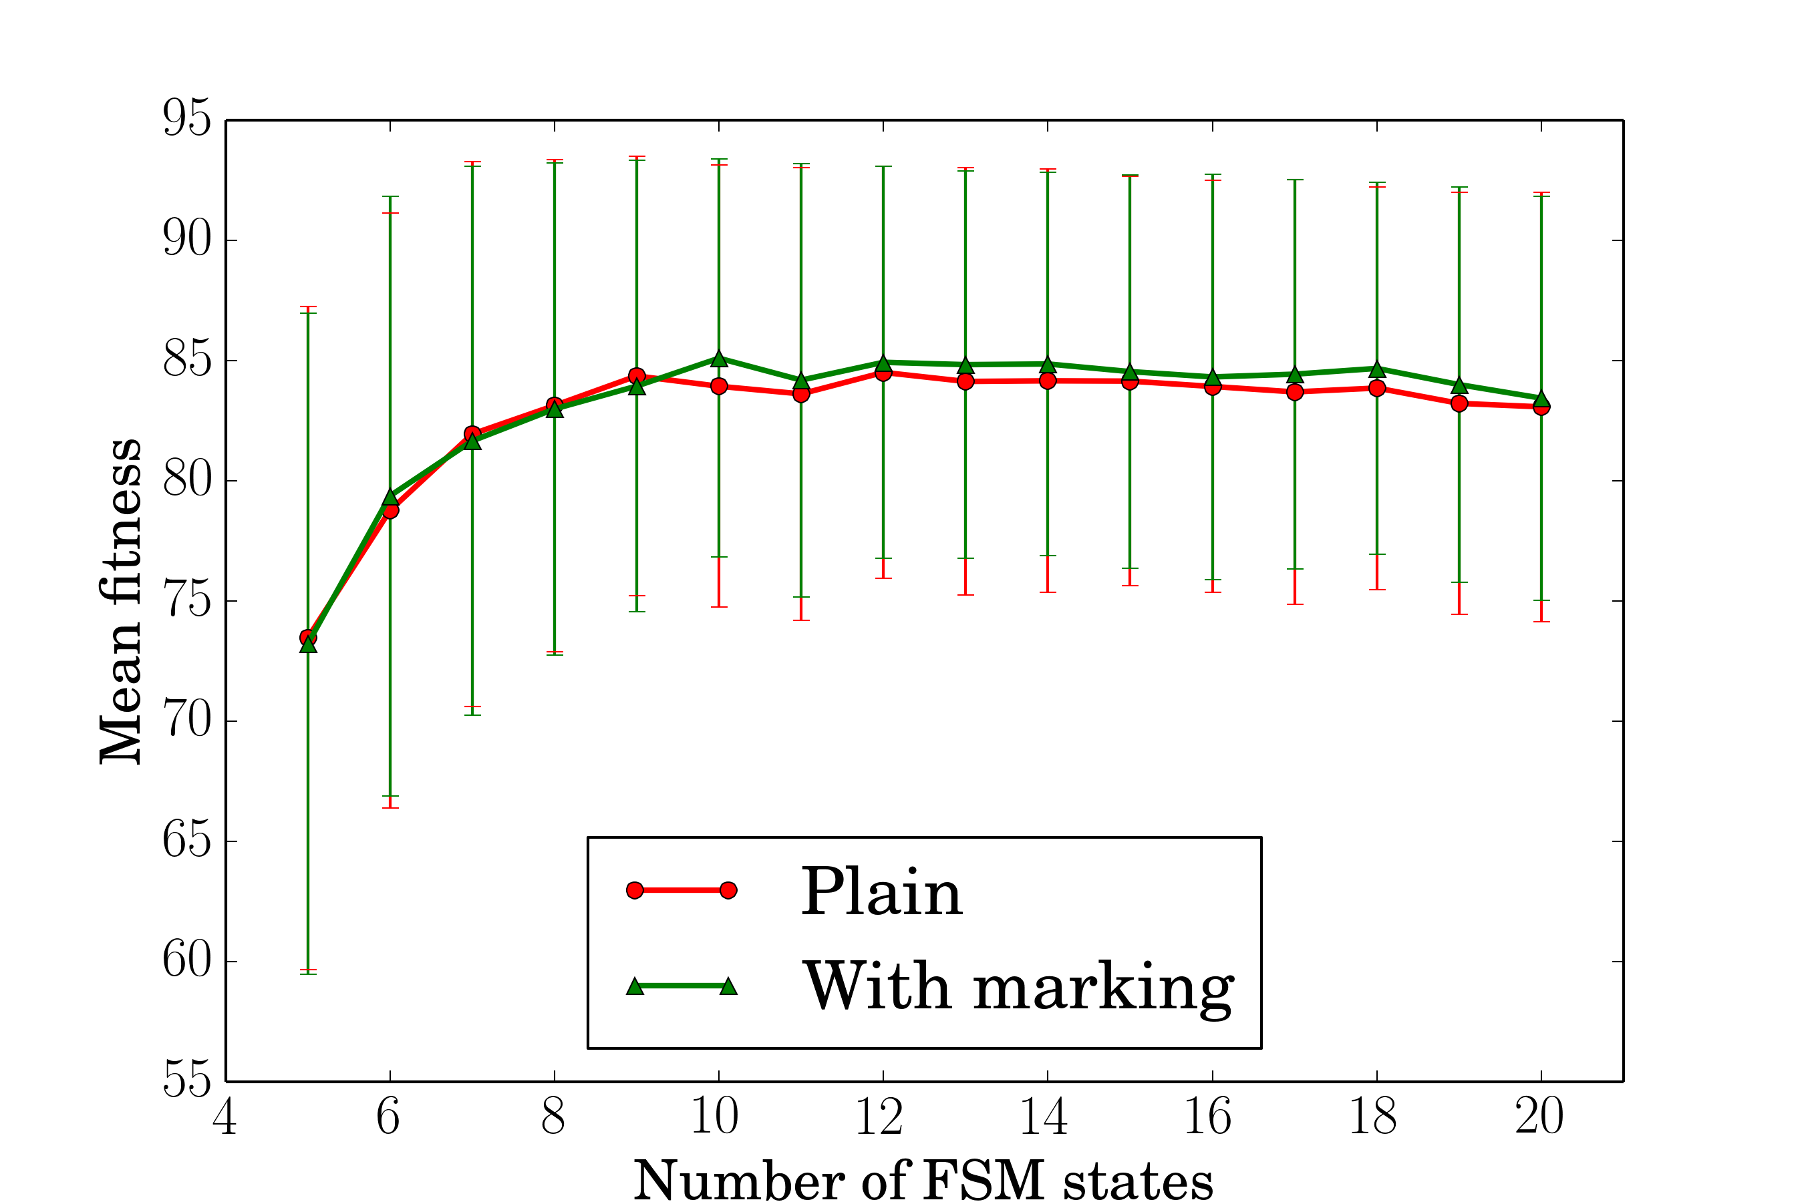
GA Fitness

Slide 32
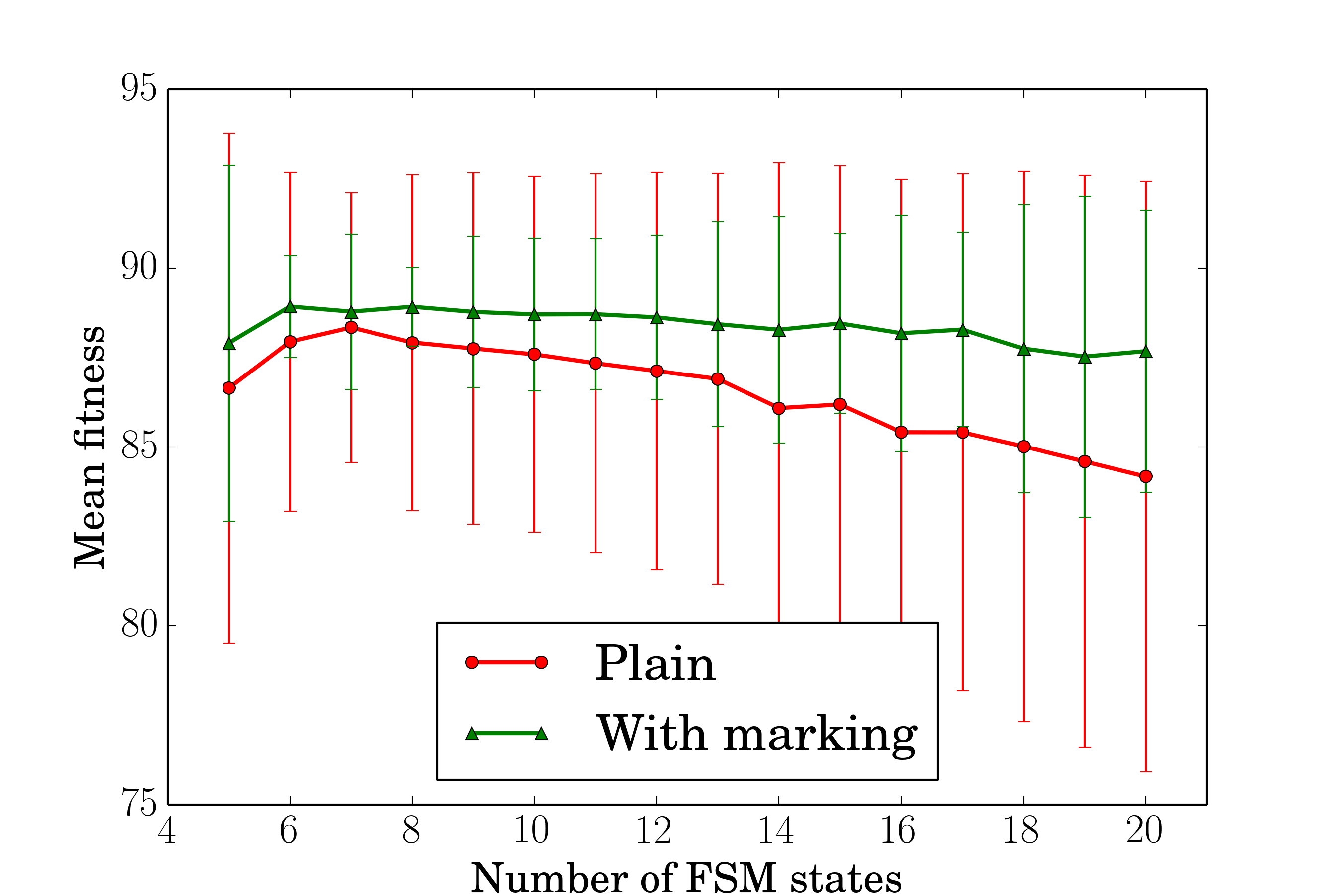
MuACO Fitness

Slide 33
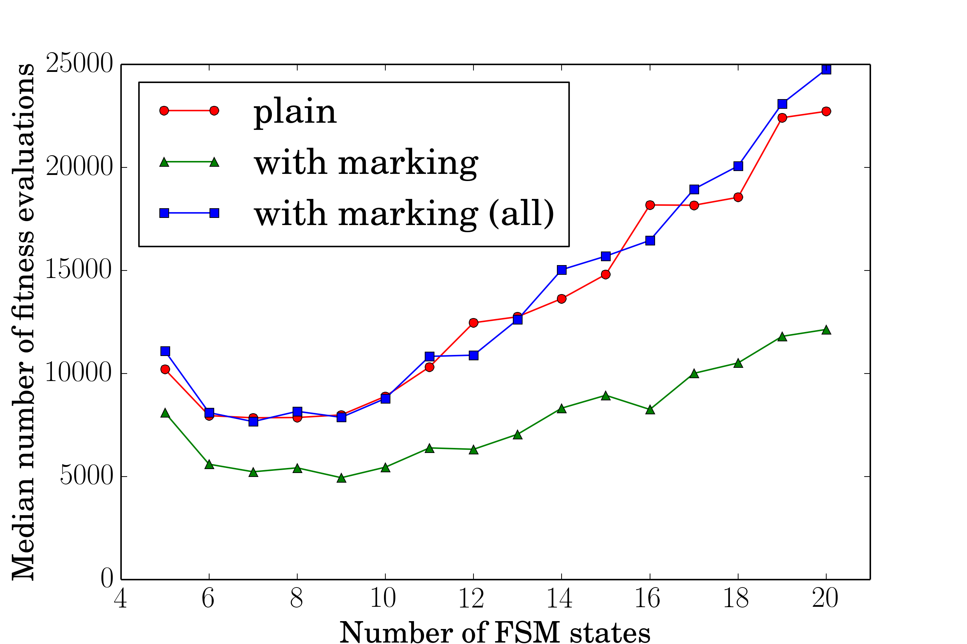
MuACO fitness evaluations

Slide 34
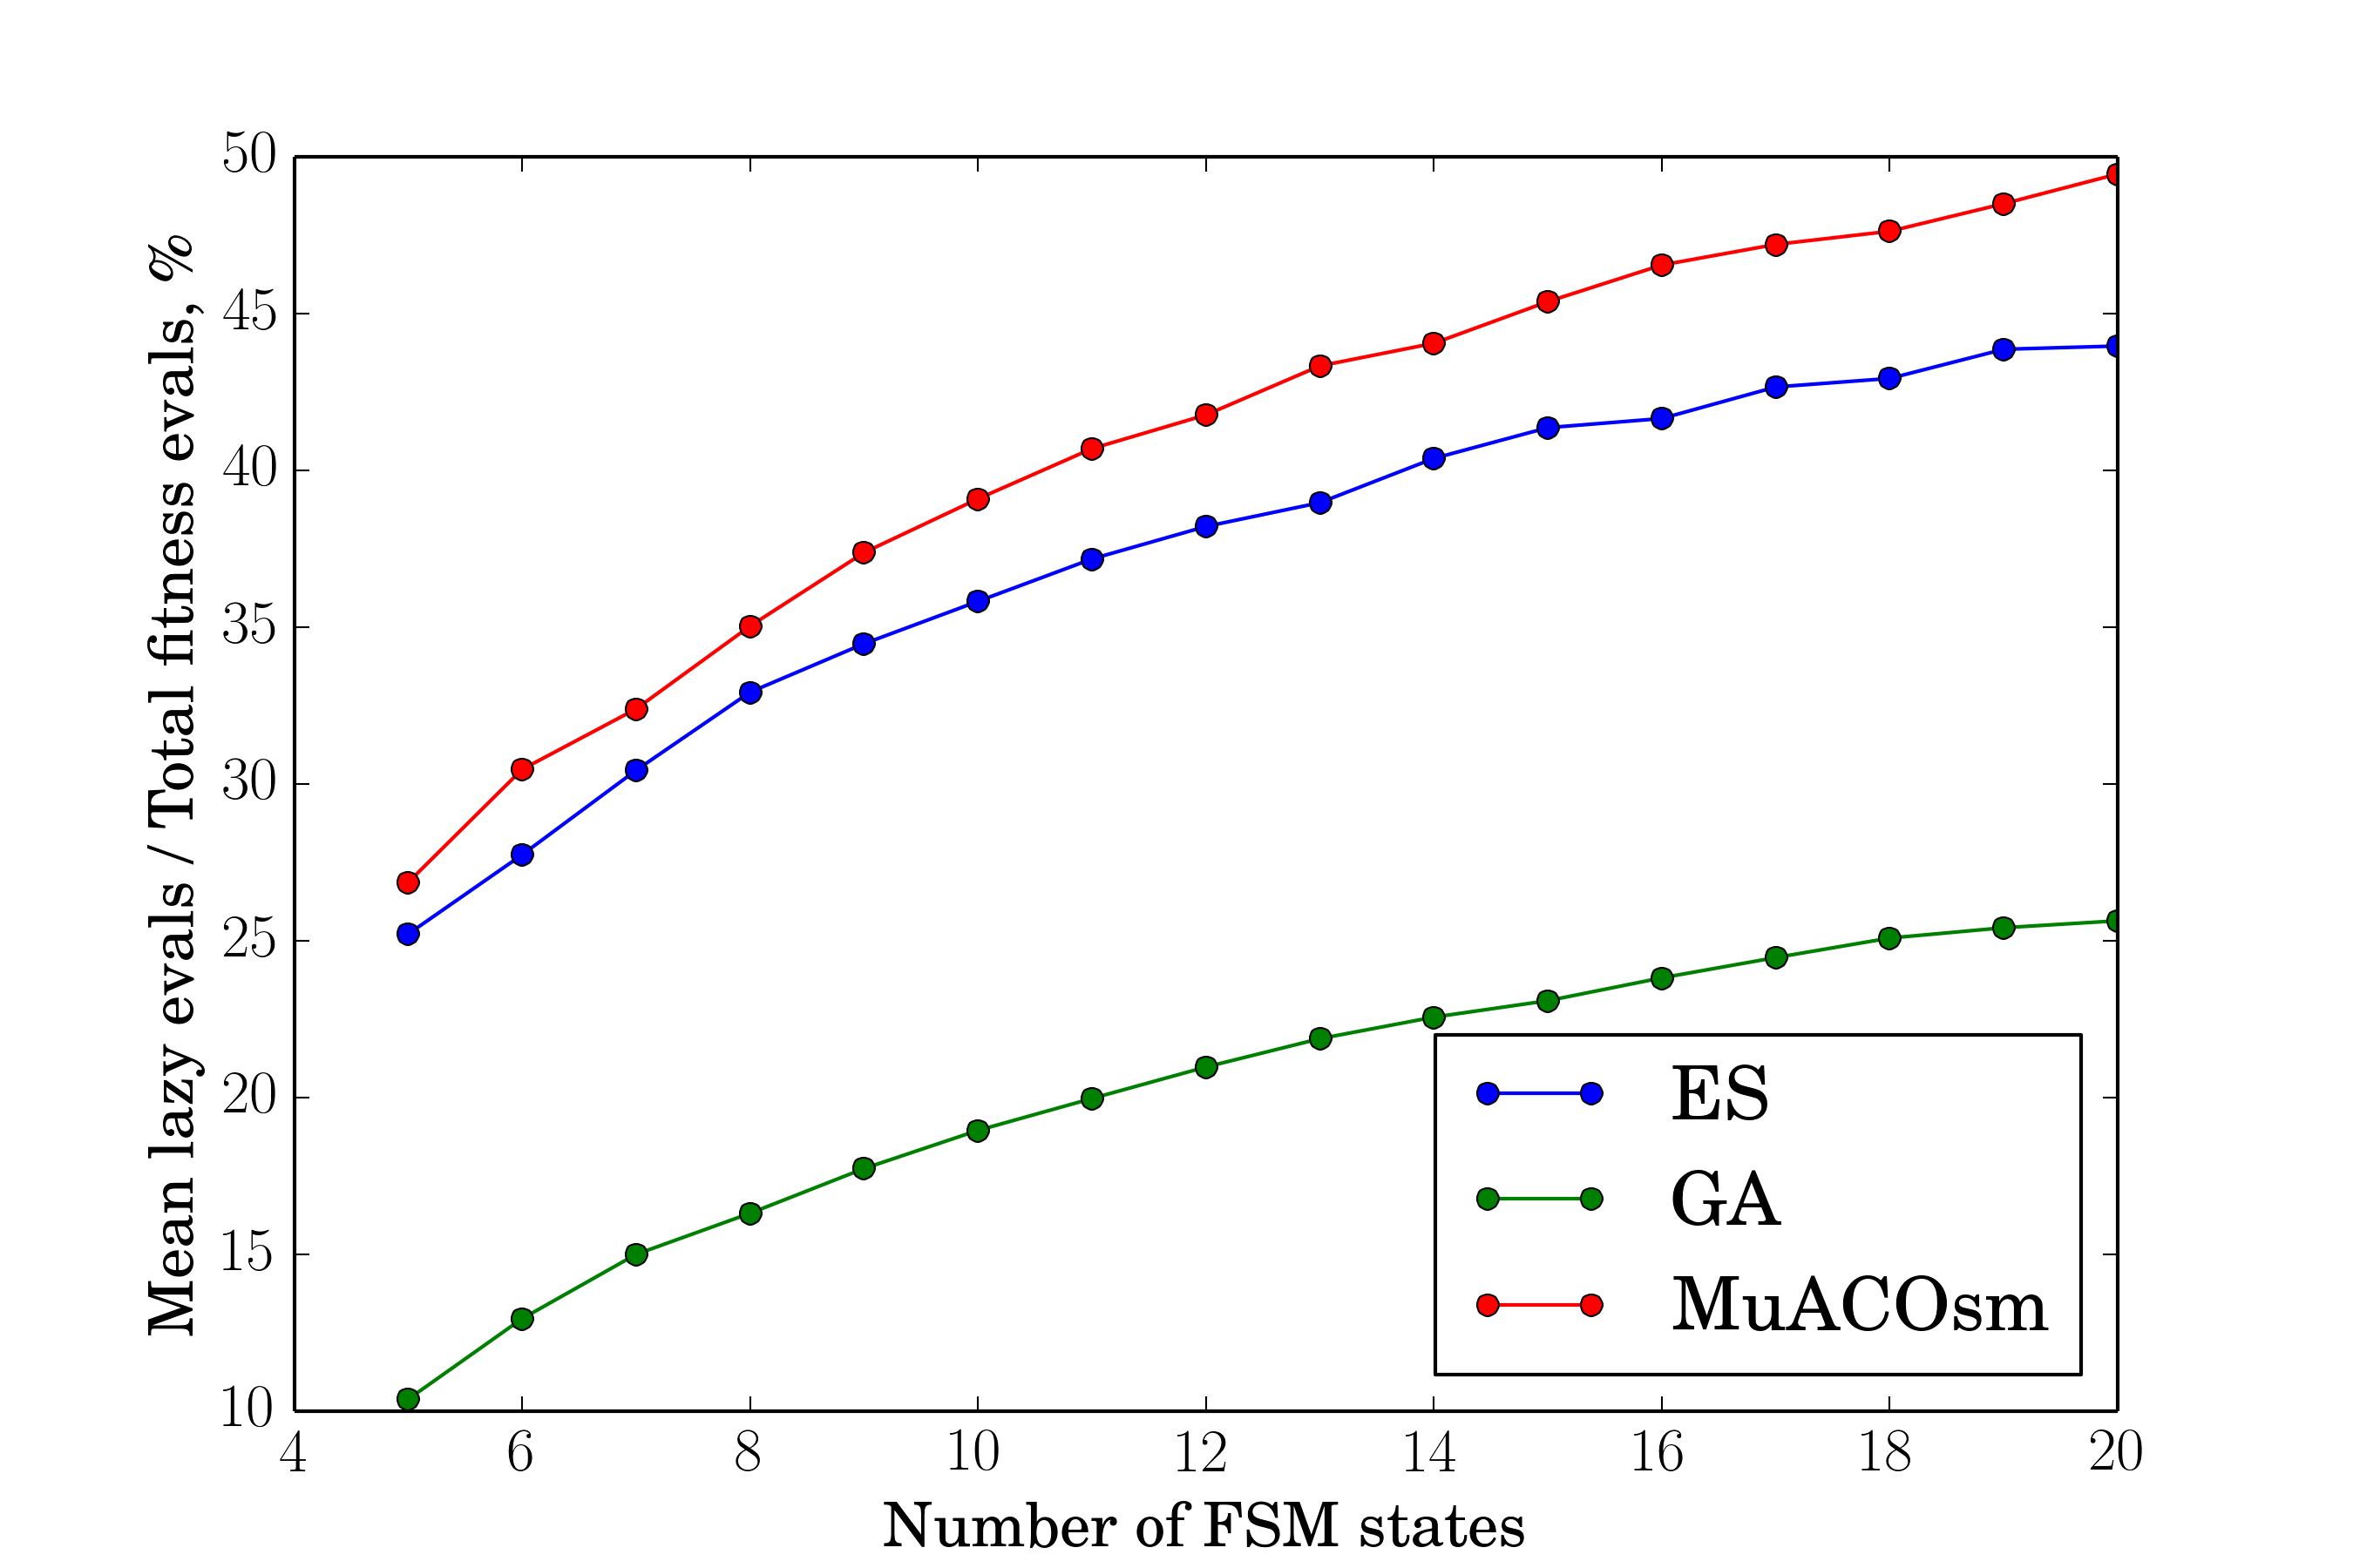
Ratio of lazy evaluations

Slide 35
Statistical Significance
ANOVA test
Fitness distributions significantly different for ES and MuACOsm
Insignificant for GA
Learning FSMs: Conserving Fitness Evaluations

Slide 36
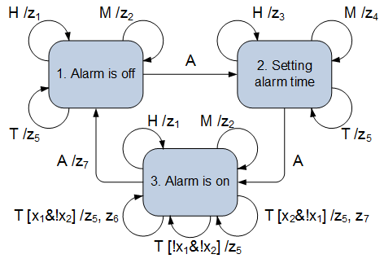
Learning Extended Finite-State Machines from tests (1)
Learning FSMs: Conserving Fitness Evaluations

Slide 37
Learning Extended Finite-State Machines from tests (2)
Input data:
Number of states C and sets Σ and Δ
Set of test examples T
T_{i} =<input sequence I_{j,} output sequence O_{j}>
NP-hard problem: build an EFSM with C states compliant with tests T
Learning FSMs: Conserving Fitness Evaluations

Slide 38
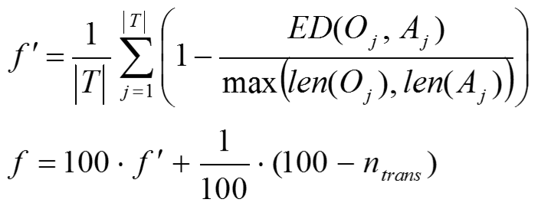
Learning EFSMs: Fitness function
Pass inputs to EFSM, record outputs
Compare generated outputs with references
Fitness = string similarity measure (edit distance)
Learning FSMs: Conserving Fitness Evaluations

Slide 39
Experimental setup
Generate random EFSM with C states
Generate set of tests of total length C×150
Learn EFSM from tests
Experiment for each C repeated 100 times
Run until perfect fitness
Learning FSMs: Conserving Fitness Evaluations

Slide 40
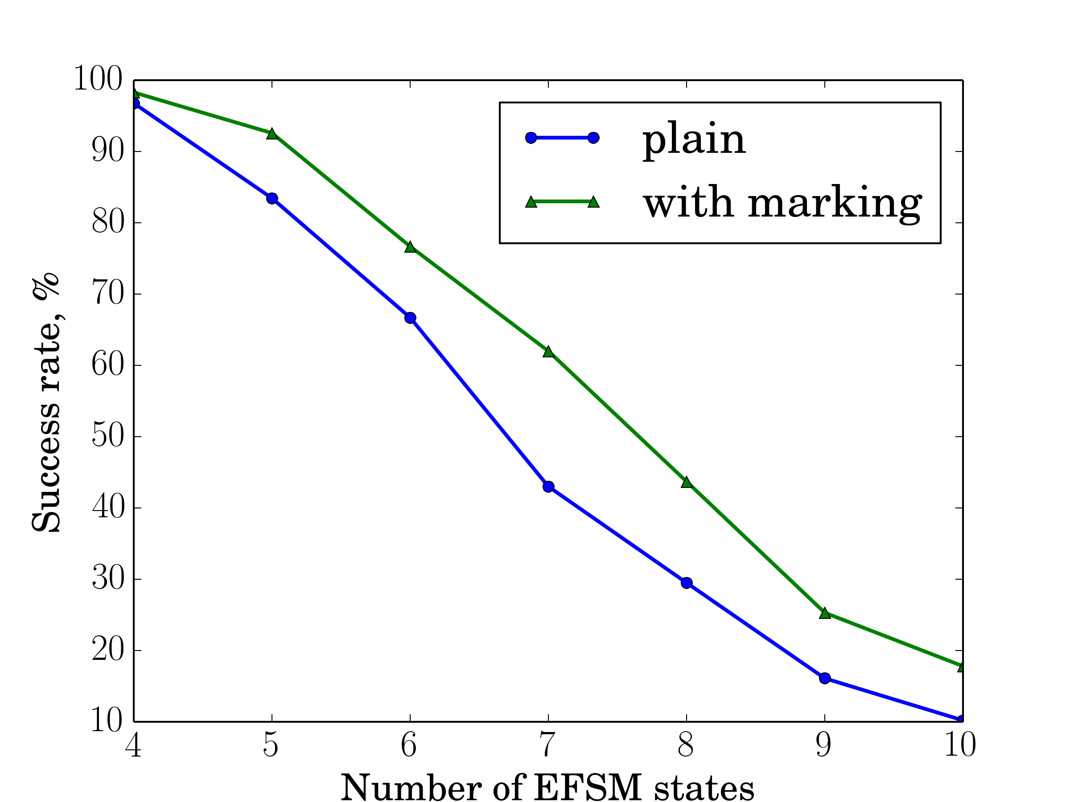
Success rate

Slide 41
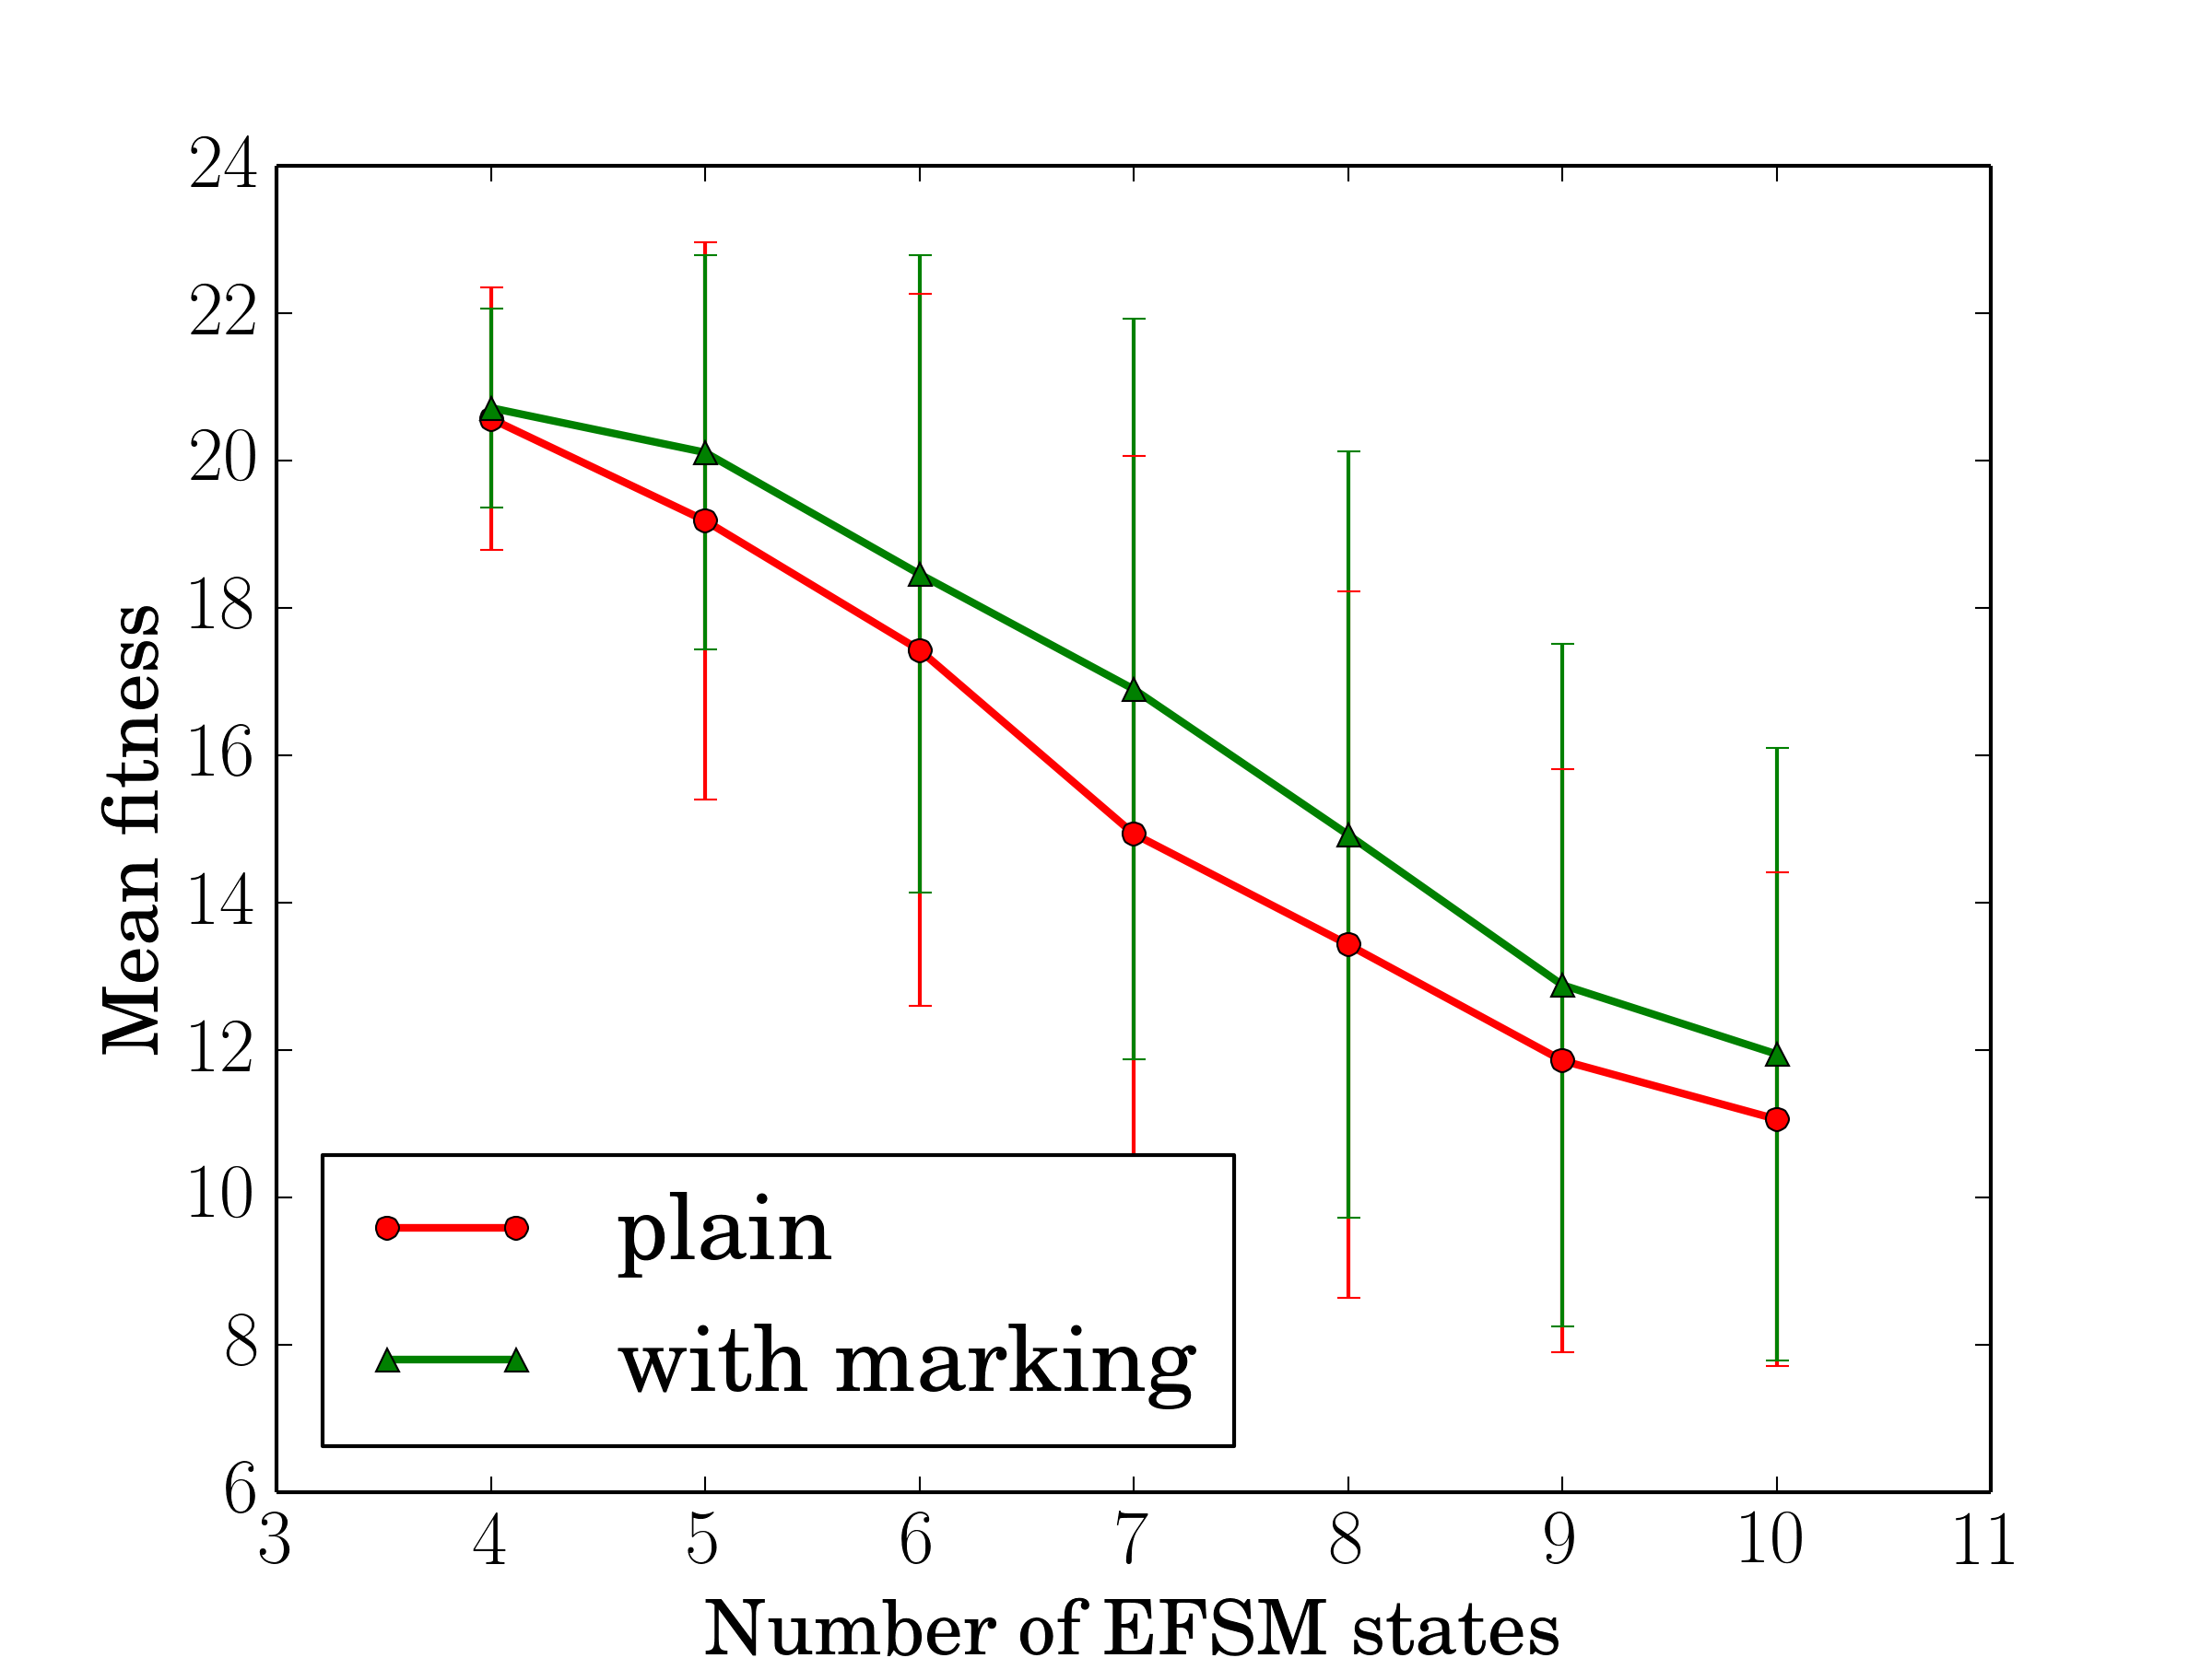
Mean fitness

Slide 42
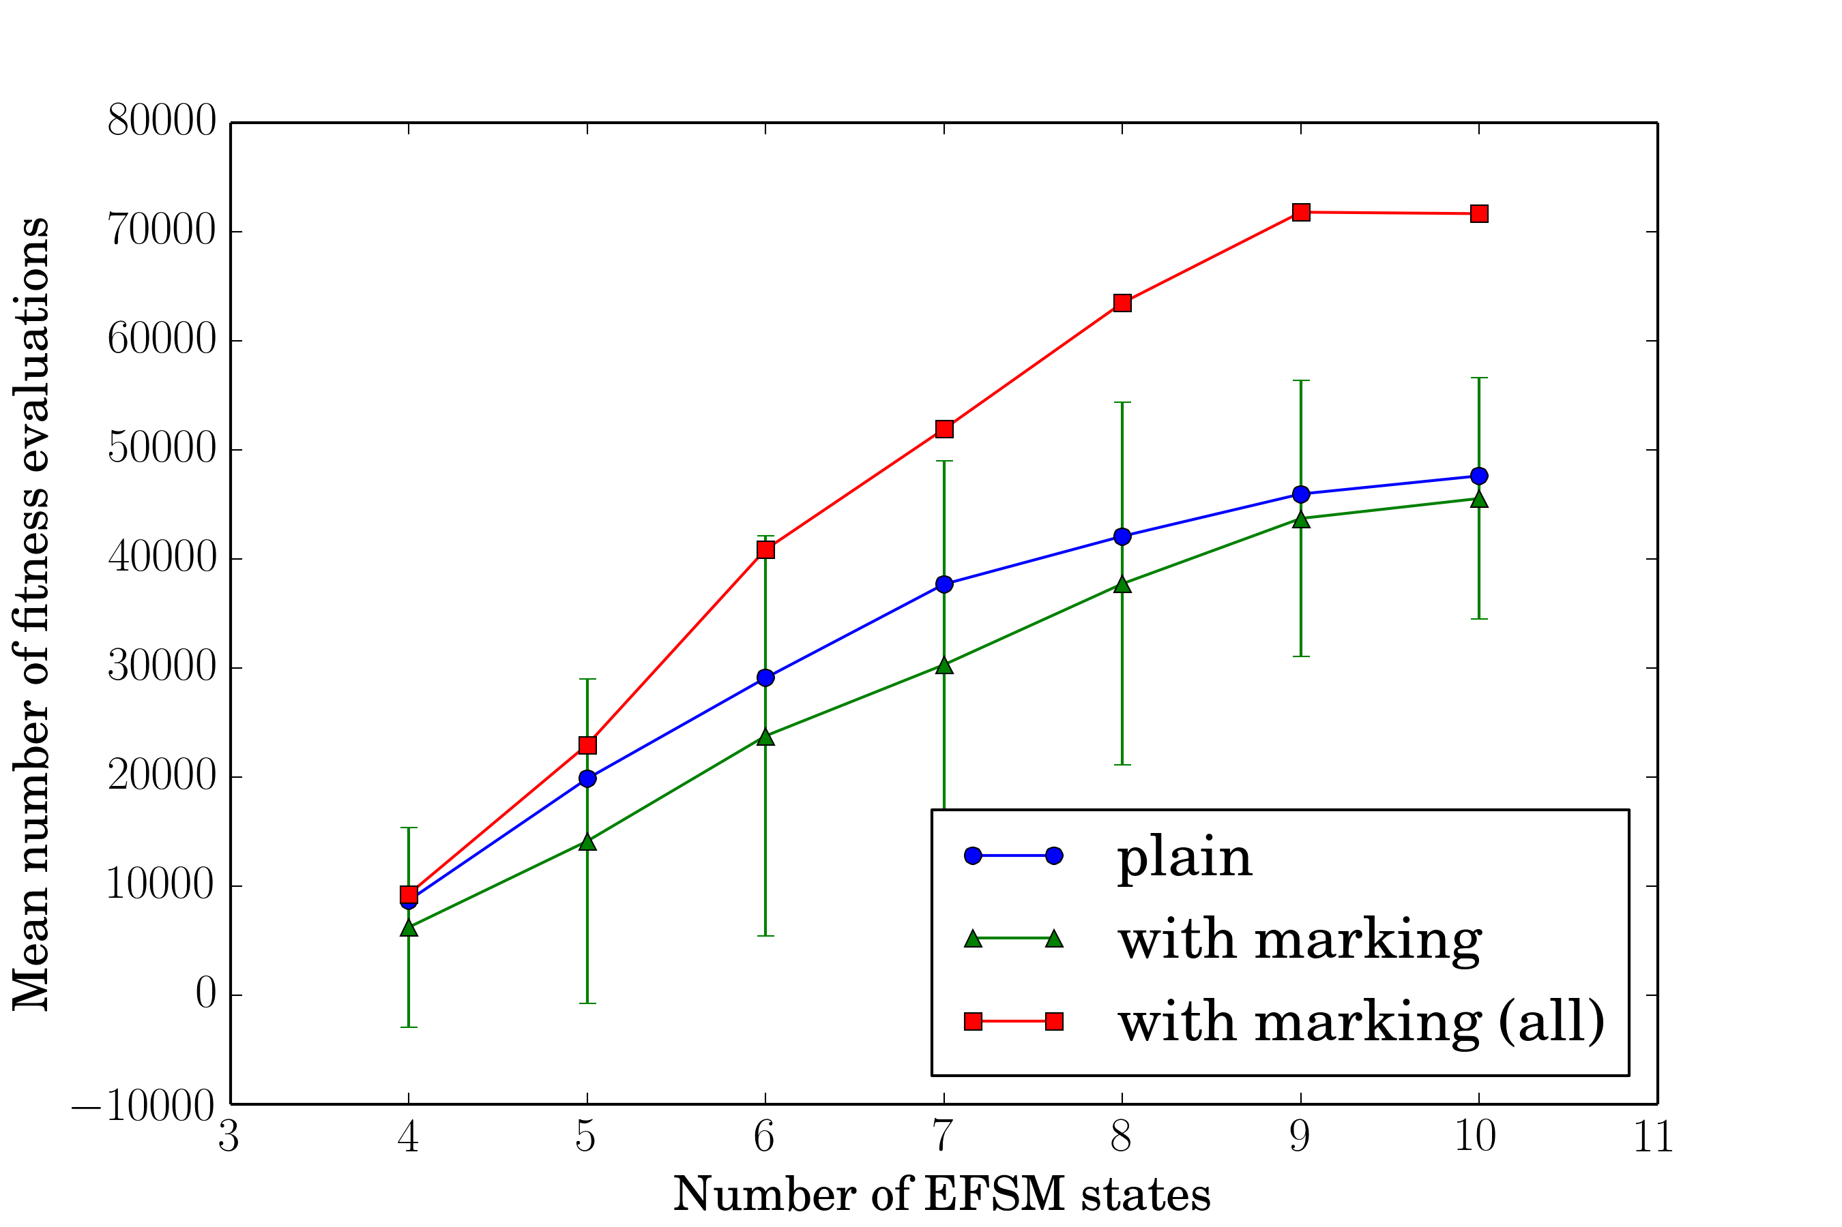
Fitness evaluations

Slide 43
Conclusion
Developed approach
  Applicable to all FSM learning algorithms that use mutations
  Allows to explore more FSMs with the same number of fitness evaluations
  Effectively improves performance
Learning FSMs: Conserving Fitness Evaluations

Slide 44
Future work
Explore more ways of using domain knowledge in FSM learning algorithms
Learning FSMs: Conserving Fitness Evaluations

Slide 45
Acknowledgements
University ITMO research project 610455
Ministry of Education and Science of Russian Federation in the framework of the federal program “Scientific and scientific-pedagogical personnel of innovative Russia in 2009-2013” (contract 16.740.11.0455, agreement 14.B37.21.0397)
Learning FSMs: Conserving Fitness Evaluations

Slide 46
Thank you for your attention!
Learning FSMs: Conserving Fitness Evaluations by Marking Used Transitions
Daniil Chivilikhin
Vladimir Ulyantsev
{chivdan,ulyantsev}@rain.ifmo.ru
This presentation online:
TBD!!!
Learning FSMs: Conserving Fitness Evaluations

