Slide 1

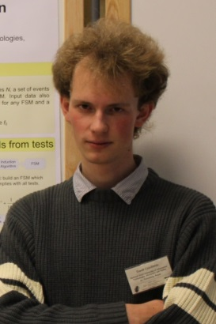


Extended Finite-State Machine Inference with Parallel Ant Colony Based Algorithms
Daniil Chivilikhin
PhD student
ITMO University
Vladimir Ulyantsev
PhD student
ITMO University
Anatoly Shalyto
Dr.Sci., professor
ITMO University
BIOMA @ PPSN’14
September 13, 2014

Slide 2
Motivation: Reliable software
Systems with high cost of failure
Energetics
Aerospace
Finances
…
We want to have reliable software
Testing is not enough
Verification is needed

Slide 3
Challenge
Reliable systems are hard to develop
Verification is time consuming

Slide 4
Model-driven development
Automated software engineering
Model-driven development

Slide 5
Automata-based programming
Extended Finite-state machine

Slide 6
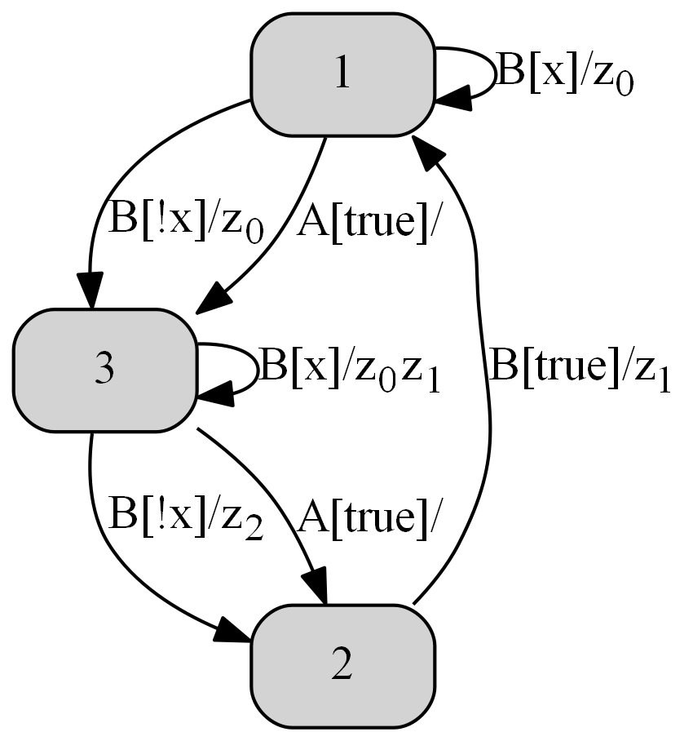
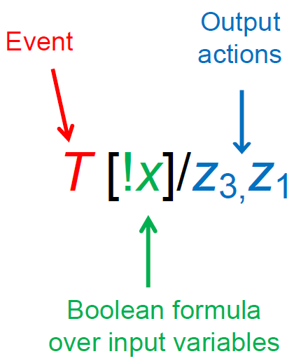
Extended Finite-State Machine

Slide 7
Automata-based programming

Slide 8
Automata-based programming: advantages
Model before programming code, not vice versa
Possibility of program verification using Model Checking

Slide 9
Conventional workflow
Requirements
Programming
Testing
Verification

Slide 10
Automata-based programming workflow
Requirements
Automated inference
Easy for the user
Time-consuming for computer
Program

Slide 11
Issues
Hard to build an EFSM with desired behavior
Sometimes, several hours on a single machine
Use parallel algorithms

Slide 12
EFSM inference algorithms
Genetic algorithm (GA)
Previous work: Mutation-based Ant Colony Optimization (MuACO)
…
No parallel implementations so far

Slide 13
In this work
Develop several parallel versions of MuACO
Compare
With each other
With parallel GA
Statistical significance

Slide 14
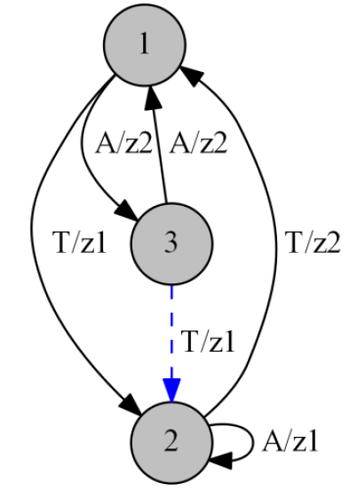
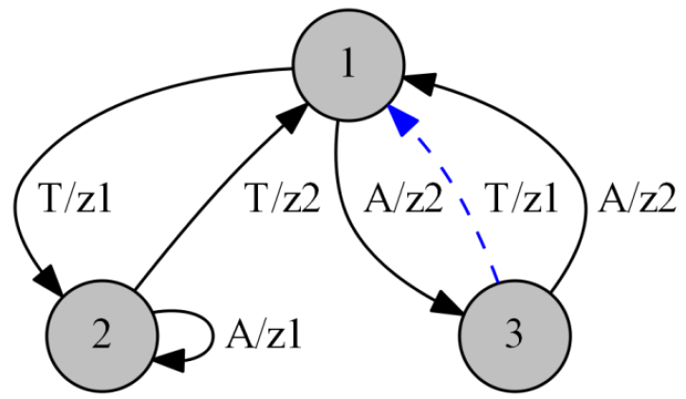

EFSM mutations

Slide 15
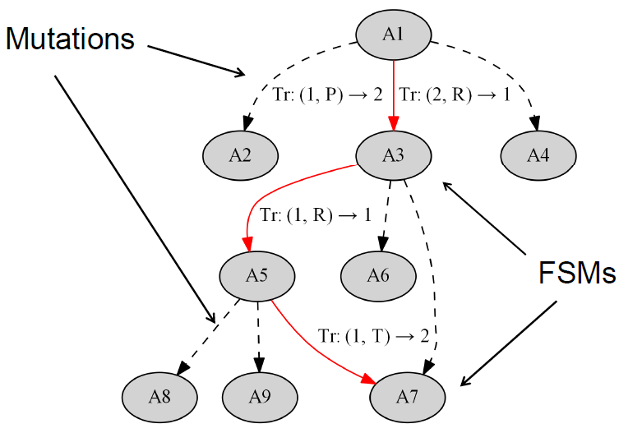
MuACO algorithm

Slide 16
MuACO algorithm
A₀ = random FSM
Graph = {A₀}
while not stop() do
ConstructAntSolutions
UpdatePheromoneValues

Slide 17
Constructing ant solutions
Use a colony of ants
An ant is placed on a graph node
Each ant has a limited number of steps
On each step the ant moves to the next node

Slide 18
Ant step: selecting the next node
P = 1 – P_{new}
P = P_{new}
Probabilistic selection
Go to best mutated FSM

Slide 19
Why parallel MuACO?
Single-node MuACO is more efficient than GA for EFSM inference
Chivilikhin D., Ulyantsev V. MuACOsm - A New Mutation-Based Ant Colony Optimization Algorithm for Learning Finite-State Machines / In GECCO’13
Chivilikhin D., Ulyantsev V. Inferring Automata-Based Programs from Specification With Mutation-Based Ant Colony Optimization / In GECCO’14

Slide 20
Parallel combinatorial optimization
Randomized algorithms
More exploration – higher chance of finding optimal solution
Increase exploration using parallelism

Slide 21
Parallel metaheuristics
Evolutionary algorithms
Island scheme
Migration
MuACO doesn’t have a population
Ant Colony algorithms
Multiple colonies
This can work

Slide 22
Three parallel MuACO algorithms
Independent parallel MuACO
Shared best solutions
MuACO with crossover

Slide 23
Independent parallel MuACO
m processors
Generate m random initial solutions
Start m MuACO algorithms
Terminate when at least one finds optimal solution
NO interaction between algorithms

Slide 24
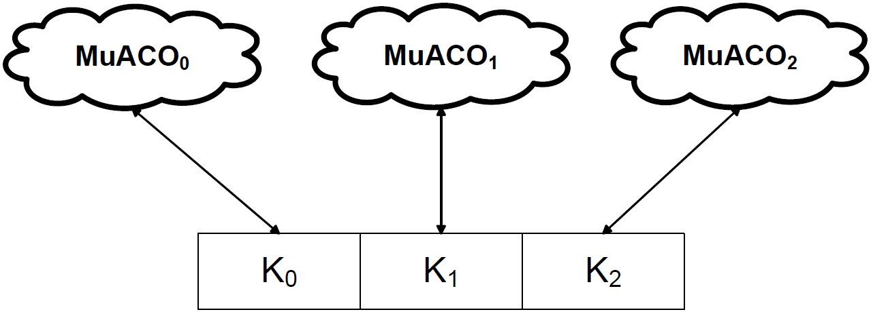
Shared best solutions
i-th algorithm restarts with j-th algorithm’s best solution

Slide 25
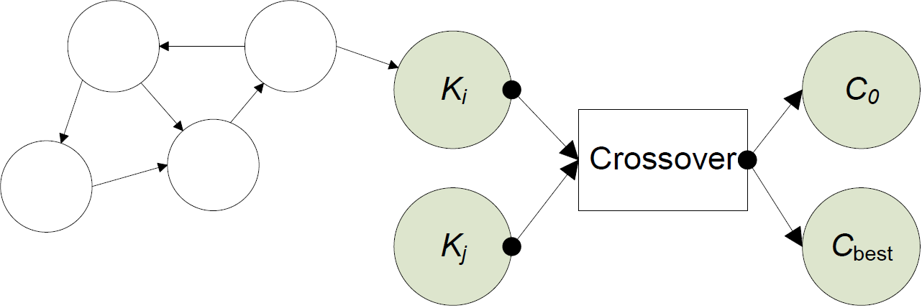
MuACO with crossovers
Crossovers from: F. Tsarev and K. Egorov. Finite state machine induction using genetic algorithm based on testing and model checking. In GECCO’11 Companion Proc., pp.759–762, Dublin, Ireland, 2011.

Slide 26
Other tested approaches
Parallel fitness evaluation
Different algorithm settings
…
No good

Slide 27
Learning EFSMs from scenarios and temporal properties
Input data:
Number of states C
Set of test scenarios
Set of temporal properties
Goal: build an EFSM with C states compliant with scenarios and temporal properties

Slide 28
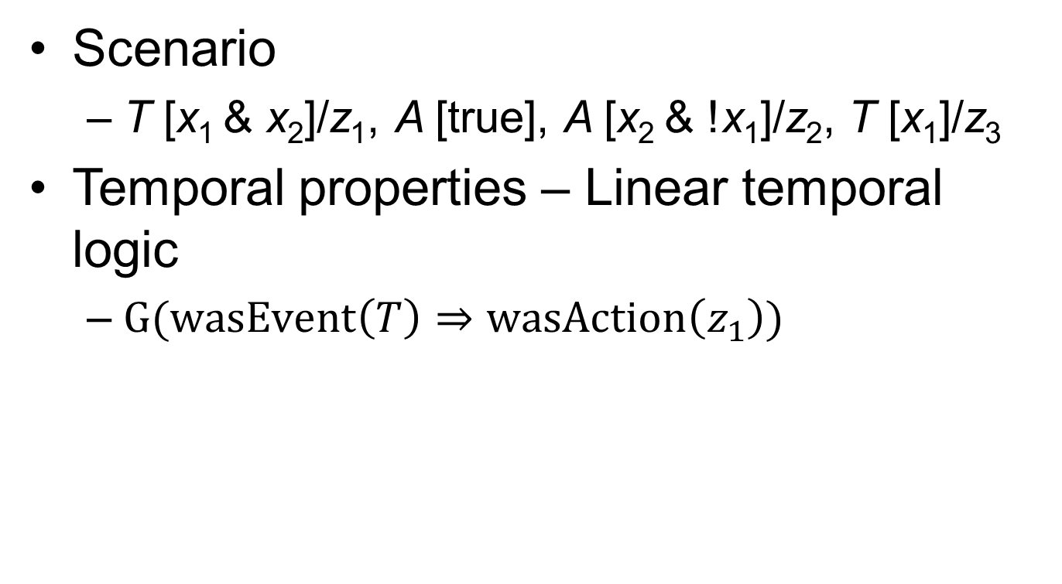
Scenarios and temporal properties
Scenario
T [x₁ & x₂]/z₁, A [true], A [x₂ & !x₁]/z₂, T [x₁]/z₃
Temporal properties – Linear temporal logic
$G(wasEvent\left(T\right)⇒wasAction\left(z_{1}\right))$

Slide 29
Learning EFSMs: Fitness function
Pass inputs to EFSM, record outputs
Compare generated outputs with references
Use verifier to check temporal properties
Fitness = string similarity measure (edit distance) + verification part

Slide 30
Experimental setup
50 random EFSMs with 10 states
One input variable
Two input events
Two output actions
Sequence length up to 2
24-core AMD Opteron 6234 2.4 GHz processor

Slide 31
Compared algorithms
Sequential MuACO
Independent parallel MuACO
Parallel MuACO + Shared best
Parallel MuACO + Crossovers
Parallel MuACO + Shared best + Crossovers
Independent parallel GA

Slide 32
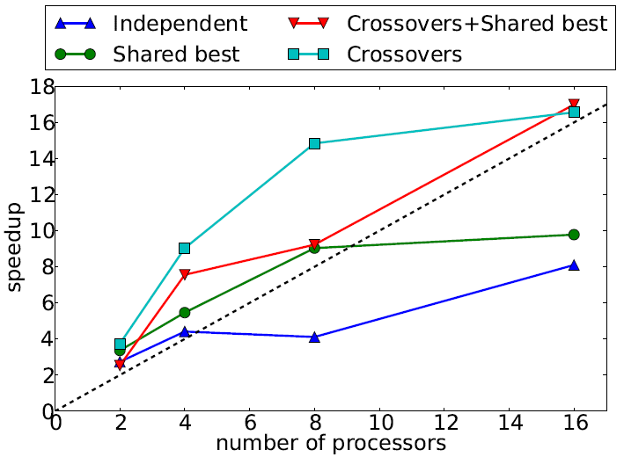
Results: MuACO speedup
Sequential MuACO runtime = 1392 s.

Slide 33
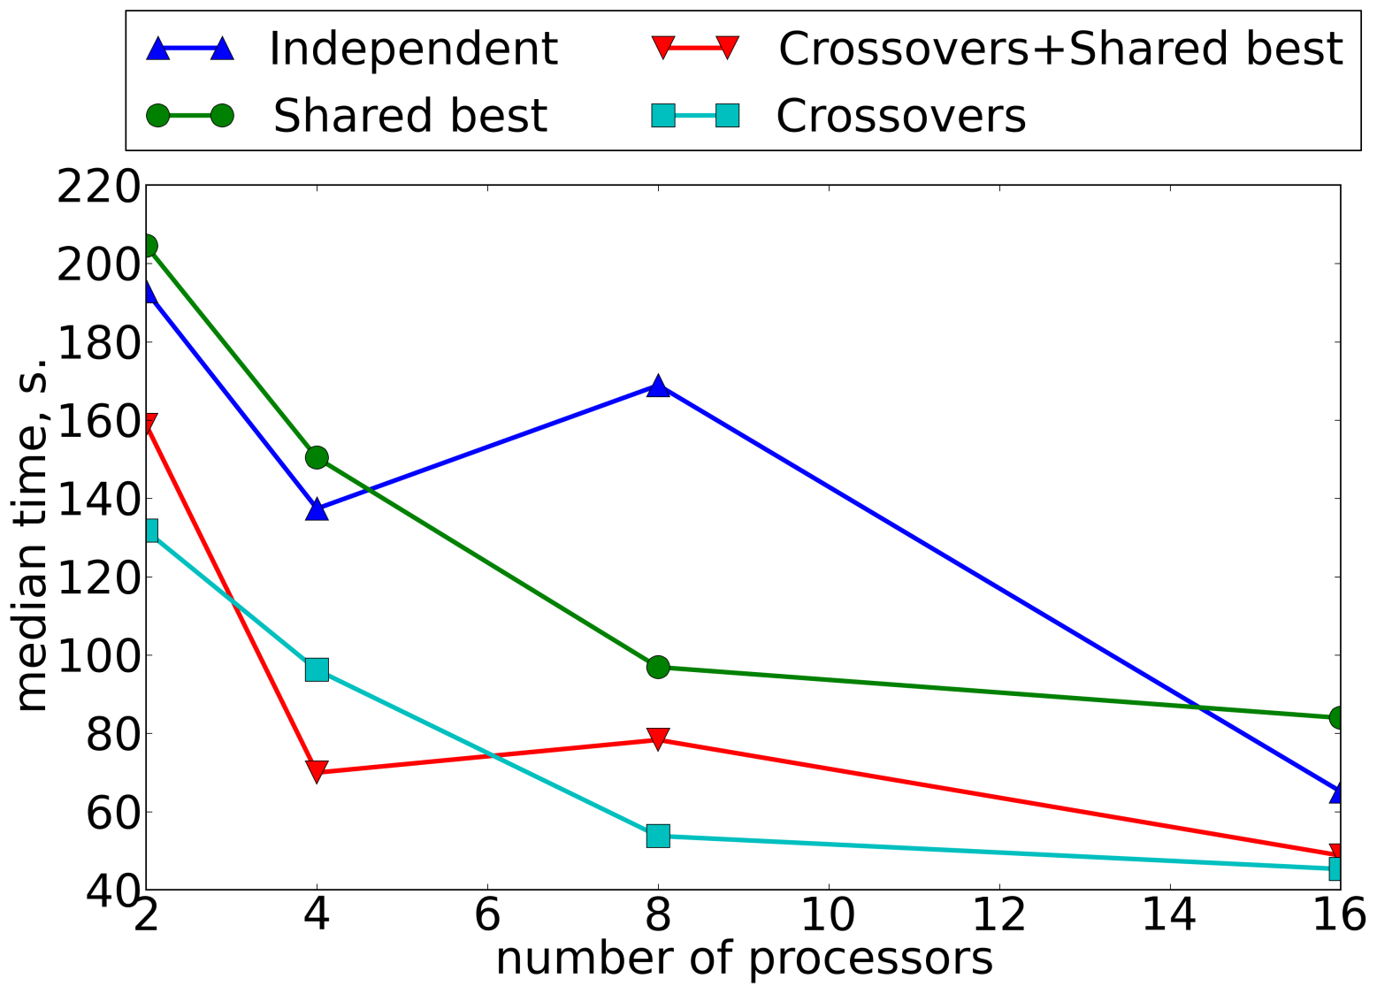
Results: median time

Slide 34
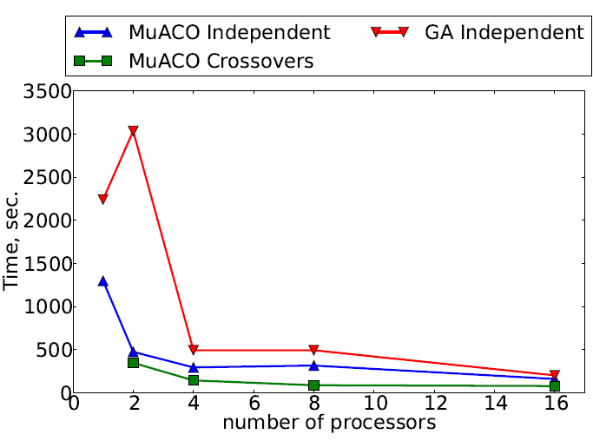
Results: comparison with GA

Slide 35
Statistical significance
Both “Crossovers” are significantly better than other algorithms
Not significantly different from each other

Slide 36
Combining exact and metaheuristic algorithms
ICMLA’14: Combining Exact And Metaheuristic Techniques For Learning Extended Finite-State Machines From Test Scenarios and Temporal Properties (accepted)

Slide 37
Combining exact and metaheuristic algorithms
Scenarios
Fast exact algorithm
EFSM 1
MuACO
Temporal properties
Final EFSM

Slide 38
Combining exact and metaheuristic algorithms: results
 | Crossovers | Exact + Crossovers
Mean time, s. | 208 | 78
Median time, s. | 73 | 28

Slide 39
Conclusion
Parallel EFSM inference algorithms are very efficient
Parallel MuACO algorithms with crossover demonstrated best performance
With super-linear speedup

Slide 40
Future work
Parallel MuACO-GA algorithm
Experiments using more computational nodes
More experiments with exact algorithms

Slide 41
Acknowledgements
This work was financially supported by the Government of Russian Federation, Grant 074-U01, and also partially supported by RFBR, research project No. 14-01-00551 a.

Slide 42

Thank you for your attention!
Extended Finite-State Machine Inference with Parallel Ant Colony Based Algorithms
Daniil Chivilikhin
Vladimir Ulyantsev
Anatoly Shalyto
{chivdan,ulyantsev}@rain.ifmo.ru

