Slide 1
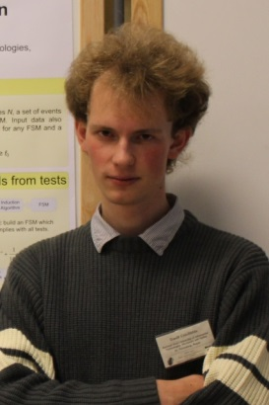
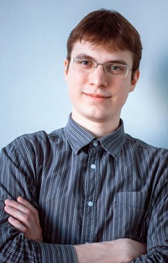
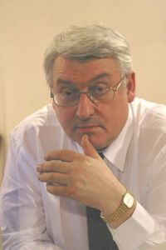

Combining Exact and Metaheuristic Techniques For Learning Extended Finite-State Machines From Test Scenarios and Temporal Properties
Daniil Chivilikhin
PhD student
ITMO University
Vladimir Ulyantsev
PhD student
ITMO University
Anatoly Shalyto
Dr.Sci., professor
ITMO University
Maxim Buzdalov
PhD student
ITMO University
ICMLA ’14
December 5, 2014
Notes:
Thank you for the introduction

Slide 2
Motivation: Reliable software
Systems with high cost of failure
Energy
Aviation
Space
…
We want to have reliable software
Testing can reveal errors
But cannot prove that the program is correct
Verification
Check properties in all computational states
Notes:
The motivation for this work is designing reliable software for systems with a high cost of failure, for example, in energy, aviation and space applications. Software normally undergoes the process of testing, which can only reveal errors, but cannot prove that the software is correct.
Verification is a step closer: it allows to check certain properties of software in all possible computational states.

Slide 3
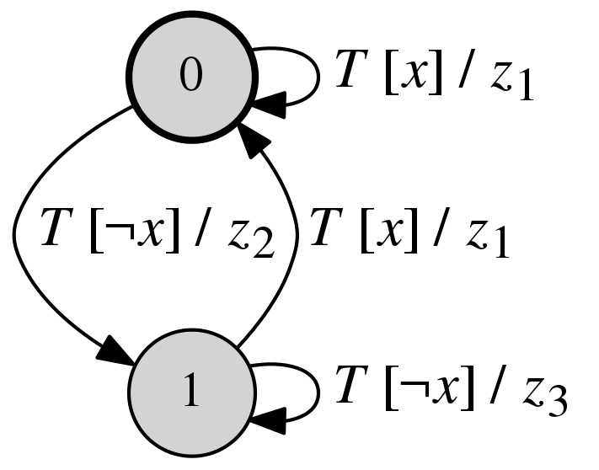
Automata-based programming
Model-driven development
Extended Finite-state machine
Notes:
However, the process of verification is hard. We are going to approach this problem with automata-based programming, which is a kind of model-driven development. Here, from a defined software specification one first builds a model which is then used to generate code.
In automata-based programming the model is an extended finite-state machine.

Slide 4
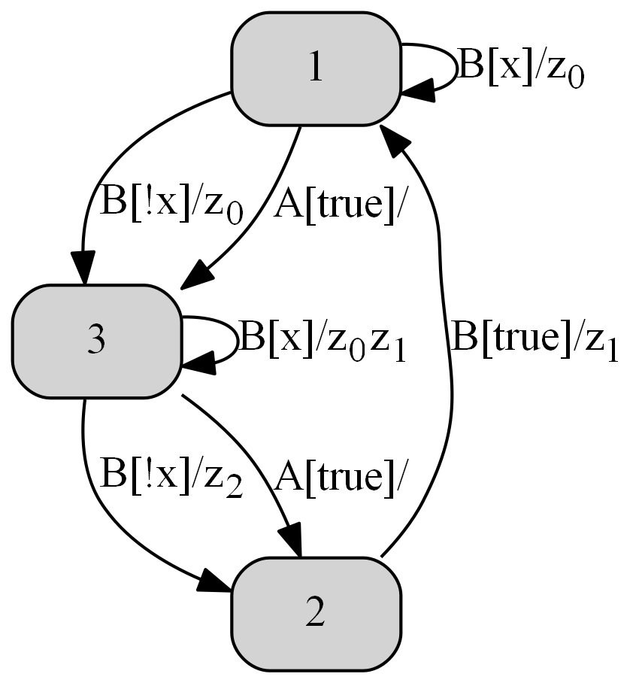
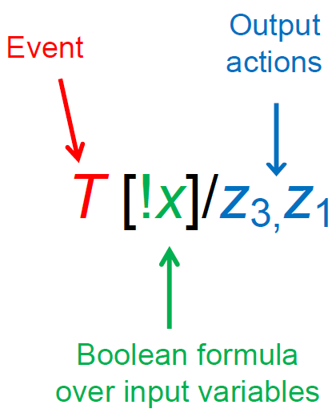
Extended Finite-State Machine
Notes:
An extended finite-state machine is basically an automaton, in which a transition is marked with an event, a Boolean formula over input variables, and a sequence of output actions.

Slide 5
Conventional reliable program development workflow
Requirements
Programming
Testing
Verification
Notes:
Let’s have a look at the conventional reliable program development workflow. First, we have requirements, which are used as a basis for programming. Then, we have a testing-programming loop, and then we have a verification-programming loop. This process is very time consuming and requires a lot of human labor.

Slide 6
Automata-based programming workflow
Requirements
Automated inference
Easy for the user
Time-consuming for computers
Verification
Testing
Program
Notes:
On the other hand, in automata-based programming testing and verification are incorporated into an automated inference procedure,
which does not require human involvement. It is very easy for the user, but time-consuming for computers.

Slide 7
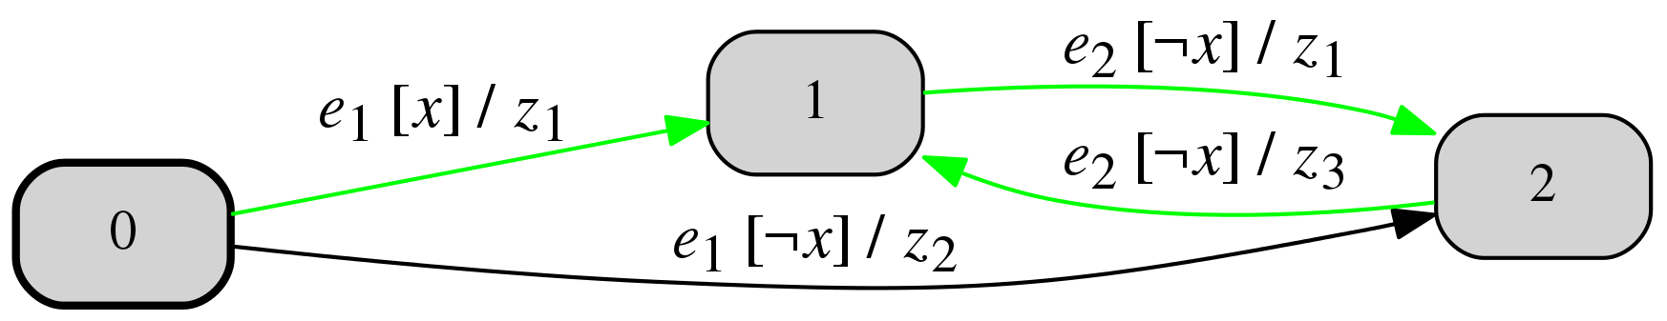
Testing
Testing
“Test scenarios”
Check if model satisfies scenario
<e₁, x, (z₁)>, <e₂, ¬x, (z₁)>, <e₂, ¬x, (z₃)>
Candidate model
7
Notes:
In testing we check the our model satisfies certain test scenarios. For example, the model below satisfies the scenario – it has all the appropriate transitions in appropriate states.

Slide 8
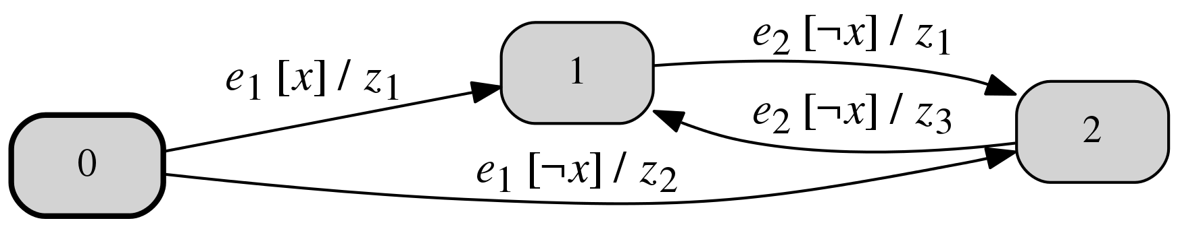
Verification
Verification
Linear Temporal Logic properties (LTL)
Use model checker
G(U(wasEvent(e₁), wasEvent(e₂)))
8
Notes:
For verification we are going to use Linear temporal logic (LTL) and use a model checker to check LTL properties.
For example, the model below satisfies this LTL formula, which basically states that event e1 always happens before event e2. As we can see, this is true for this EFSM.

Slide 9
Automated inference problem statement
Given
Number of states C
Test scenarios
Temporal properties
Goal: find an EFSM with C states compliant with scenarios and temporal properties

Slide 10
EFSM inference algorithms
Type of data
Testing + Verification
Testing
Genetic algorithm
MuACO
SAT-based algorithm
Tsarev, Egorov. GECCO 2011
Chivilikhin, Ulyantsev. GECCO 2014
Ulyantsev, Tsarev. ICMLA 2011
Notes:
There are two types of algorithms for EFSM inference out there. For Testing and Verification input data we have a genetic algorithm from GECCO 2011 and the MuACO algorithm from GECCO 2014.

Slide 11
EFSM inference algorithms
Type of data
Testing + Verification
Testing
Metaheuristics
Genetic algorithm
MuACO
SAT-based algorithm
Tsarev, Egorov. GECCO 2011
Chivilikhin, Ulyantsev. GECCO 2014
Ulyantsev, Tsarev. ICMLA 2011
Notes:
These two algorithms are metaheuristics and are not guaranteed to find a solution within any reasonable time.

Slide 12
EFSM inference algorithms
Type of data
Testing + Verification
Testing
Exact and fast
Genetic algorithm
MuACO
SAT-based algorithm
Tsarev, Egorov. GECCO 2011
Chivilikhin, Ulyantsev. GECCO 2014
Ulyantsev, Tsarev. ICMLA 2011
Notes:
The second group can only use testing for EFSM inference. Here we have an algorithm based on Satisfiability problem solvers, which is exact and fast. In this work we try to combine algorithms from these two groups to achieve something better.

Slide 13
Paper Contributions
New exact algorithm based on Constraint Satisfaction Problem (CSP) solvers
No verification
Much simpler than previous algorithm based on SAT
Combined algorithm
CSP algorithm
MuACO
Uses CSP to find approximate solution
Solve full problem with MuACO
13
Notes:
In this paper we propose a new exact algorithm based on Constraint Satisfaction problem solvers, which uses a much simpler translation than
the previous SAT algorithm. We also propose to combine the CSP algorithm and MuACO algorithm: the CSP algorithm is used to find an approximate solution and MuACO is the used to solve the full problem.

Slide 14
EFSM inference using CSP solvers
Input
Test scenarios
Number of states C
Output
EFSM
Or message that it does not exist
CSP algorithm
Scenario tree construction
Consistency graph construction
Constraint set construction
Solving constraints
Constructing an EFSM from satisfying assignment
14
Notes:
Let’s look into the CSP algorithm. For input it receives a set of test scenarios and the number states C, and it must output an EFSM with C states that satisfies all scenarios or print the such an EFSM does not exist. The algorithm consists of five steps, which we will look into.

Slide 15
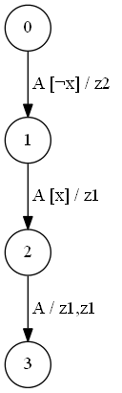
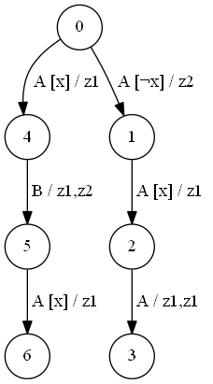
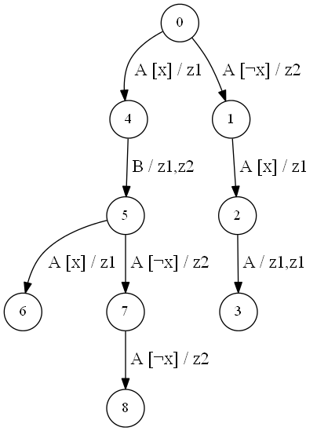
1. Scenario tree construction
Basic idea – scenario tree coloring
15
Notes:
First, all scenarios are stored in a structure called a scenario tree, which is similar to a trie. The basic idea of the algorithm is do find a coloring of the scenario tree into exactly C states. Vertices with the same color are merged into one state of the EFSM.

Slide 16
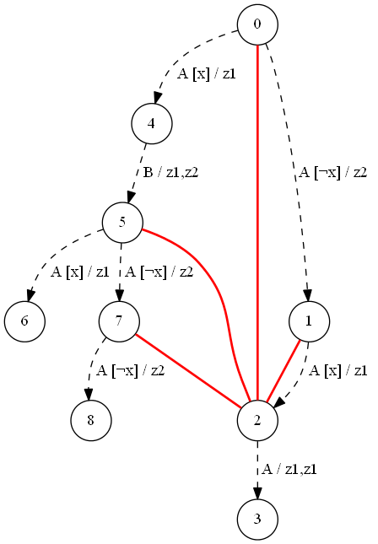
2. Consistency graph construction
Vertices are same as in scenario tree
Two vertices are connected by an edge if there is a sequence telling them apart
Basically, that they cannot be merged into one state
Constructed using dynamic programming
16
Notes:
Next, we will need to construct a consistency graph. It has the same set of vertices as the scenario tree.
Two vertices of the graph are connected if there is a sequence telling them apart. Basically, this means that they cannot be merged into one state. This graph is constructed using dynamic programming.

Slide 17
3. Used integer variables
x_{v} – color of vertex v ∈ V (V – set of scenario tree vertices)
x_{v} ∈ [0, C–1]
y_{i,e,f} – state to which the transition from state i marked with event e and Boolean function f leads to
y_{i,e,f} ∈ [0, C–1], e ∈ Σ, f ∈ F_{e}
17
Notes:
We use two types of integer variables. x_v is the color of a scenario tree vertex v. y_ief is the state to which the transition from state I marked with event e and Boolean formula f leads to.

Slide 18
4. Constraint set construction
x_{v} ≠ x_{u} – colors of inconsistent vertices v and u should be different
(x_{v} = i) => (x_{u} = y_{i,e,f}) – tree coloring must comply with EFSM transitions
for each edge uv of scenario tree and each color i
18
Notes:
We use two main types of constraints. The first one is that the colors of inconsisten nodes should be different. The second states that the scenario tree coloring must comply with EFSM transitions.

Slide 19
5. Solving constraints
Choco CSP solver
http://www.emn.ft/z-info/choco-solver
Java library
Easy to use
Efficient
19
Notes:
We use the Choco CSP solver to solve the constructed set of constraints. Choco is Java library, it is easy to use and efficient.

Slide 20
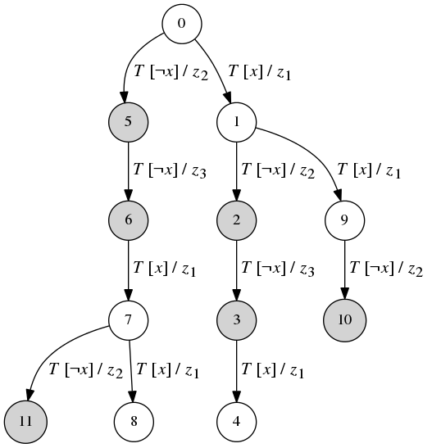
6. Constructing an EFSM from satisfying assignment
Merge vertices with same color
20
Notes:
If Choco found a satisfying assignment, then it corresponds to coloring of the scenario tree. Vertices with the same color are merged into one state of the EFSM.

Slide 21
Proposed combined algorithm
Scenarios
CSP algorithm
Approximate EFSM
MuACO
Temporal properties
Final EFSM
Notes:
In the proposed combined algorithm we first use the CSP algorithm to build an approximate EFSM from scenarios. Scenarios, the approximate EFSM and temporal properties are then use by the MuACO algorithm to solve the full problem with verification.

Slide 22
Experimental setup
50 random EFSMs with 5–10 states
Two input variables
Two input events
Two output actions
Sequence length up to 2
Computer AMD 3.2 GHz Processor
Measured time
Notes:
In our experiments we considered random EFSMs with 5-10 states, having two input variables, two input events, two output actions, output sequence length up to two. We used a computer with a 3.2 GHz processor and measured the time it takes an algorithm to find the optimal solution.

Slide 23
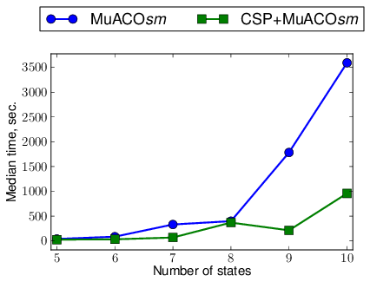
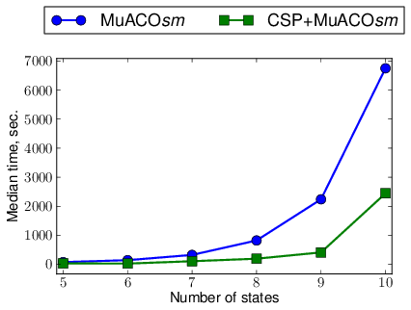
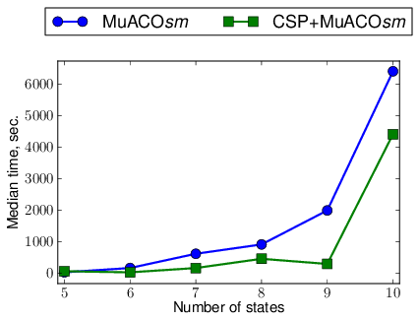
Results
Small scenarios
50 × C
Medium scenarios
100 × C
Large scenarios
200 × C
23
Notes:
Here the results are shown for small, medium, and large sets of scenarios. It can be seen that the combined algorithm is almost always faster than the plain MuACO algorithm.

Slide 24
Statistical testing results
Wilcoxon signed-rank test
Alternative: less
 | Scenarios size
C | 50 × C | 100 × C | 200 × C
5 | 0.394 | 0.011 | 0.711
6 | 0.748 | 0.140 | 0.0180
7 | 0.011 | 0.019 | 0.0004
8 | 0.417 | 0.003 | 0.142
9 | 0.0001 | 0.0002 | 0.037
10 | 0.222 | 0.158 | 0.033
24
Notes:
We also performed statistical testing using the Wilcoxon test, which revealed, for example, that for largest EFSMs with 10 states and largest scenario size the combined algorithm is statistically better than the plain MuACO algorithm.

Slide 25
Acknowledgements
This work was financially supported by the Government of Russian Federation, Grant 074-U01, and also partially supported by RFBR, research project No. 14-07-31337 mol_a.

Slide 26
Thank you for your attention!
Daniil Chivilikhin
Vladimir Ulyantsev
Anatoly Shalyto
{chivdan,ulyantsev}@rain.ifmo.ru

