Slide 1

Inferring Temporal Properties of Finite-State Machines with Genetic Programming
Daniil Chivilikhin
PhD student
ITMO University
Ilya Ivanov
Undergrad student
ITMO University
Anatoly Shalyto
Dr. Sci., professor
ITMO University
GECCO’15 Student Workshop
July 11, 2015

Slide 2
Introduction
Software models
Not always created
If created, not always kept up to date
2

Slide 3
Model inference
Executable program
Finite-state machine
Model inference algorithm
Program model
Test cases
Quite a few good algorithms
3

Slide 4
Temporal logics
Used to express time-related propositions
In software verification: state requirements for software systems
Example statement
“If a request is received, an answer is eventually generated”
4

Slide 5
Linear temporal logics
Propositional variables: elementary statements
Boolean logic operators: ∨, ∧, ¬, →
Temporal operators
X(f) – f has to hold in the next state
F(f) – f has to hold in some state in the future
G(f) – f has to hold for all states
U(f, g) – f has to hold until g holds
…
5

Slide 6
Specification inference
Executable program
Specification inference algorithm
Temporal properties
Test cases
Only very simple properties
6

Slide 7
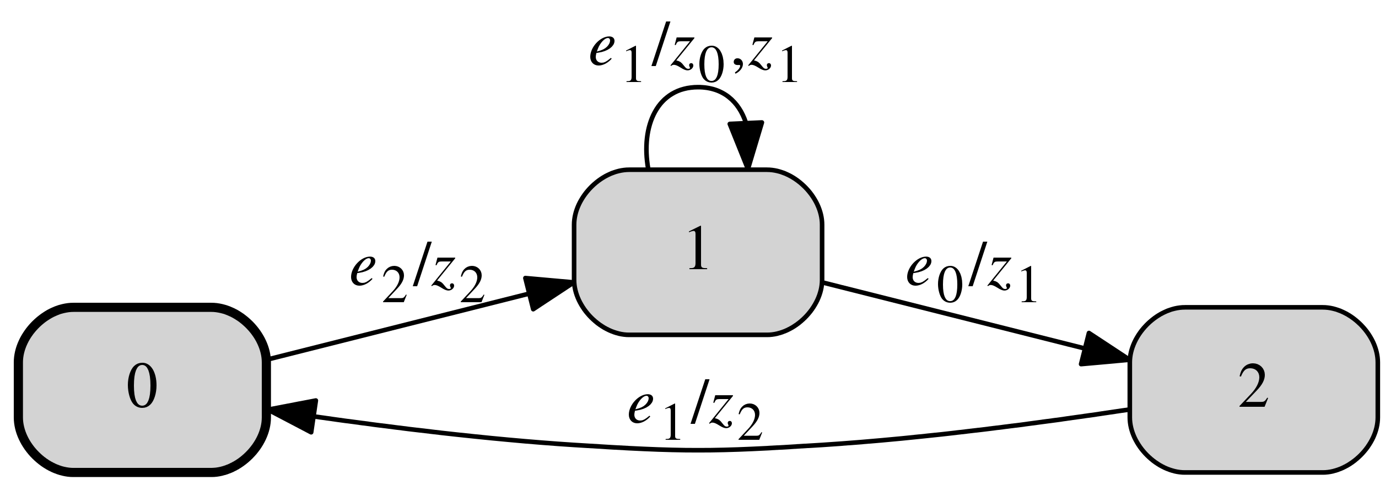
Finite-State Machines
e₁ / z₀, z₁
output actions
event

Slide 8
LTL for FSMs
Propositional variables
wasEvent(e) for all events e
wasAction(z) for all output actions z
G (wasEvent(e₂) → wasAction(z₂))
8

Slide 9
Problem statement
Find some non-trivial “interesting” LTL properties (formulas) of a given FSM
All formulas must hold for input FSM
Short formulas are better than long ones
Should not hold for FSMs similar to the input FSM
9

Slide 10
Proposed approach
Use Genetic Programming (GP)
Evolve a population of LTL formulas
Express constraints using several fitness functions
Multiobjective optimization
10

Slide 11
Main challenge
Design a set of fitness functions that result in proper LTL properties
11

Slide 12
FF #1: Formula must hold for input FSM
Main search objective
Use model checker to check formula f against FSM a
12

Slide 13
FF #2: Minimal formula weight
Measure structural complexity of a formula
Operators O = {∨, ∧, ¬, →, X, F, U, R}
Propositional variables
S = {wasEvent(e) for all e ∈ E} U {wasAction(z) for all z ∈ Z}
13

Slide 14
FF #2: Minimal formula weight (continued)
Each operator and variable are assigned weight W
W(s)= w_{s} for s ∈ S
W(o(arg₁, [arg₂])) = w_{o} + W(arg₁) [+W(arg₂)]
14

Slide 15
FF #3: Random FSMs
Idea: if a large number of randomly generated FSMs satisfy an LTL formula, it is meaningless
Generate a number of random FSMs with the same interface as the input FSM a₁, . . . , a_{Nsample}
15

Slide 16
FF #4: Mutants of input FSM
Idea: if a formula is not violated by a small change in the FSM, it is not so “interesting”
Generate random mutants of the input FSM m₁, . . . , m_{Nsample}
Mutation operators
Change transition end state
Add/delete transitions
16

Slide 17
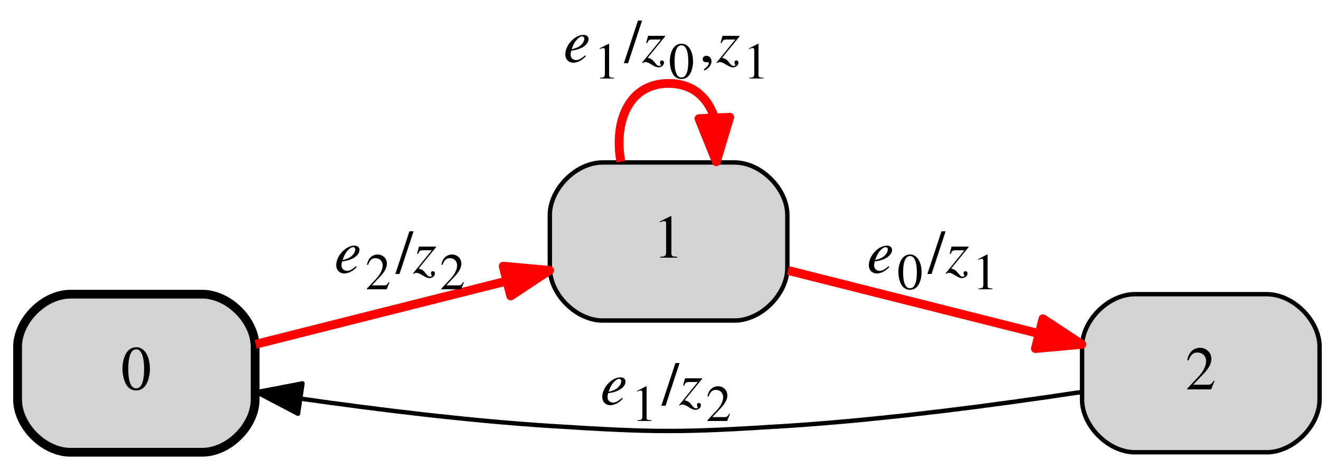
FF #5: FSM constructed from scenarios
A scenario is a finite path in an FSM
Example:
17

Slide 18
FF #5: FSM constructed from scenarios (continued)
Derive random scenarios of fixed length from input FSM a
Use fast exact algorithm to construct an FSM a* from scenarios
Note: a* probably differs from a
Note: not all formulas that are true for a are true for a*
18

Slide 19
FF #6: Mutants of FSM constructed from scenarios
Same as FF #4, but mutants are generated from the FSM constructed from scenarios
19

Slide 20
Implementation
ECJ library used for EA implementation
Multiobjective EAs: NSGA-II and SPEA2
Standard GP operators
https://cs.gmu.edu/~eclab/projects/ecj/
20

Slide 21
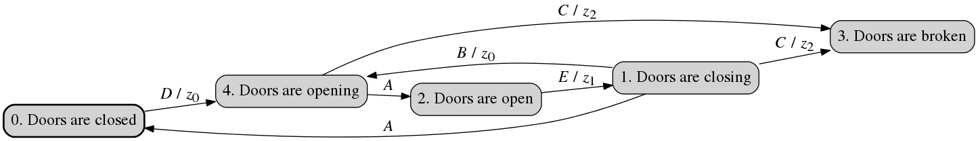
Experiments
Case study: Elevator doors control FSM
Input events: A, B, C ,D, E
Output actions: z₁, z₂, z₃
17 manually created LTL formulas
21

Slide 22
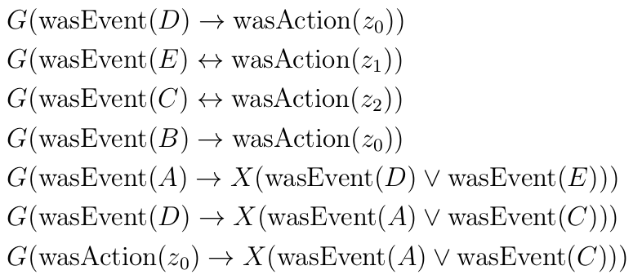
Original LTL properties
22

Slide 23
Experiments goal
Goal: infer formulas similar to manually created ones
But how do we measure the quality of inferred formulas?
Introduced two empirical metrics
Coverage metric
Mutants metric
23

Slide 24
Coverage metric
{f_{old}} – original manually created formulas
{f_{new}} – inferred formulas
Derive scenarios from original FSM a
Model inference: build FSM a’ from scenarios and {f_{new}}
Metric: how many formulas from {f_{old}} does a’ satisfy?
24

Slide 25
Mutants metric
{f_{old}} – original manually created formulas
{f_{new}} – inferred formulas
Generate M’ ≤ 1000 different mutants of original FSM a
Ratio of mutants that violate at least one formula from {f_{old}}
Metric:
25

Slide 26
Experimental setup
Tried both NSGA-II and SPEA2
EAs run for 50 generations
Population size = 500
Result of experiment: all formulas in Pareto front
Each experiment repeated 20 times
FF₁ and FF₂ in all experiments, all combinations of the rest
26

Slide 27
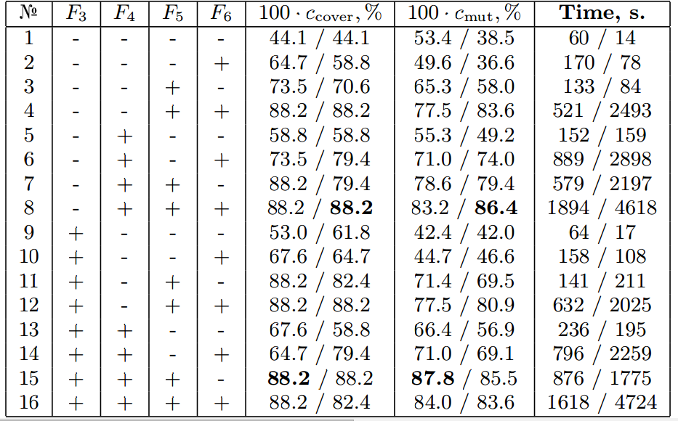
Experimental data
27

Slide 28
Experimental results
NSGA-II and SPEA2 yield similar formula quality
SPEA2 is much faster than NSGA-II
Config #8 = {all but FF₃} is best for NSGA-II
Config #15 = {all but FF₆} is best for SPEA2
Significance validated using Wilcoxon signed-rank test
28

Slide 29
Varying other parameters
Use SPEA2 with config #15
Varied population size from 100 to 1000
Change number of generations from 25 to 200
No significant changes
Pop size | 100 | 250 | 500 | 1000
100 ∙ c_{learn}, % | 23 | 86 | 86 | 86
100 ∙ c_{mut}, % | 13 | 79 | 96 | 96
29

Slide 30
Larger example
ATM control FSM
12 states
14 events
13 output actions
30 LTL formulas
Mutants metric: 100 ∙ c_{mut} = 65 %
Coverage metric: infeasible
30

Slide 31
Results
Proposed GP-based approach for inferring LTL properties of FSMs
Feasibility demonstrated on two examples using two empirical quality metrics
Approach is able to infer up to 100 % of human-written LTL formulas
31

Slide 32
Future work
Couple with existing model inference algorithms

Slide 33
Acknowledgements
This work was financially supported by the Government of Russian Federation, Grant 074-U01.
33

Slide 34
Thank you for your attention!
Daniil Chivilikhin
Ilya Ivanov
Anatoly Shalyto
chivdan@rain.ifmo.ru
34

