Slide 1






Reconstruction of Function Block Logic using Metaheuristic Algorithm: Initial Explorations
Daniil Chivilikhin
PhD student
ITMO University
Anatoly Shalyto
Dr. Sci., professor
ITMO University
Sandeep Patil
PhD student
Luleå University of Technology
Valeriy Vyatkin
Dr. Eng., professor
Luleå University of Technology,
Aalto University,
ITMO University
INDIN ’15, Cambridge, UK, July 23, 2015

Slide 2

Presentation given by
Igor Buzhinsky
PhD student
ITMO University
Igor Buzhinsky
PhD student
ITMO University

Slide 3
Motivation
Migration from legacy code to IEC 61499
Existing approaches assume that source code is available
What if
source code is lost?
there are no engineers that could quickly understand the code?
Notes:
In this paper we address the problem of migration from legacy code to the IEC 61499 standard. All existing approaches assume the availability of the source code. But how do we solve this problem if the source code is either lost or there are no engineers that could quickly understand it?

Slide 4
Problem statement
Reconstruct Function Block Logic without using code
Inputs
FB
Reconstruction algorithm
Reconstructed FB
Outputs
Notes:
Therefore, in this paper we try to reconstruct function block logic without using the code.
The proposed approach is based on testing.
The main idea is to put the FB in a test environment, record its reactions to the tests, and then use the inputs and outputs in an algorithm that would reconstruct the original function block.

Slide 5
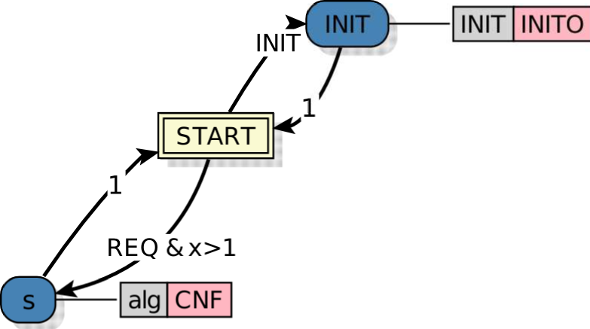
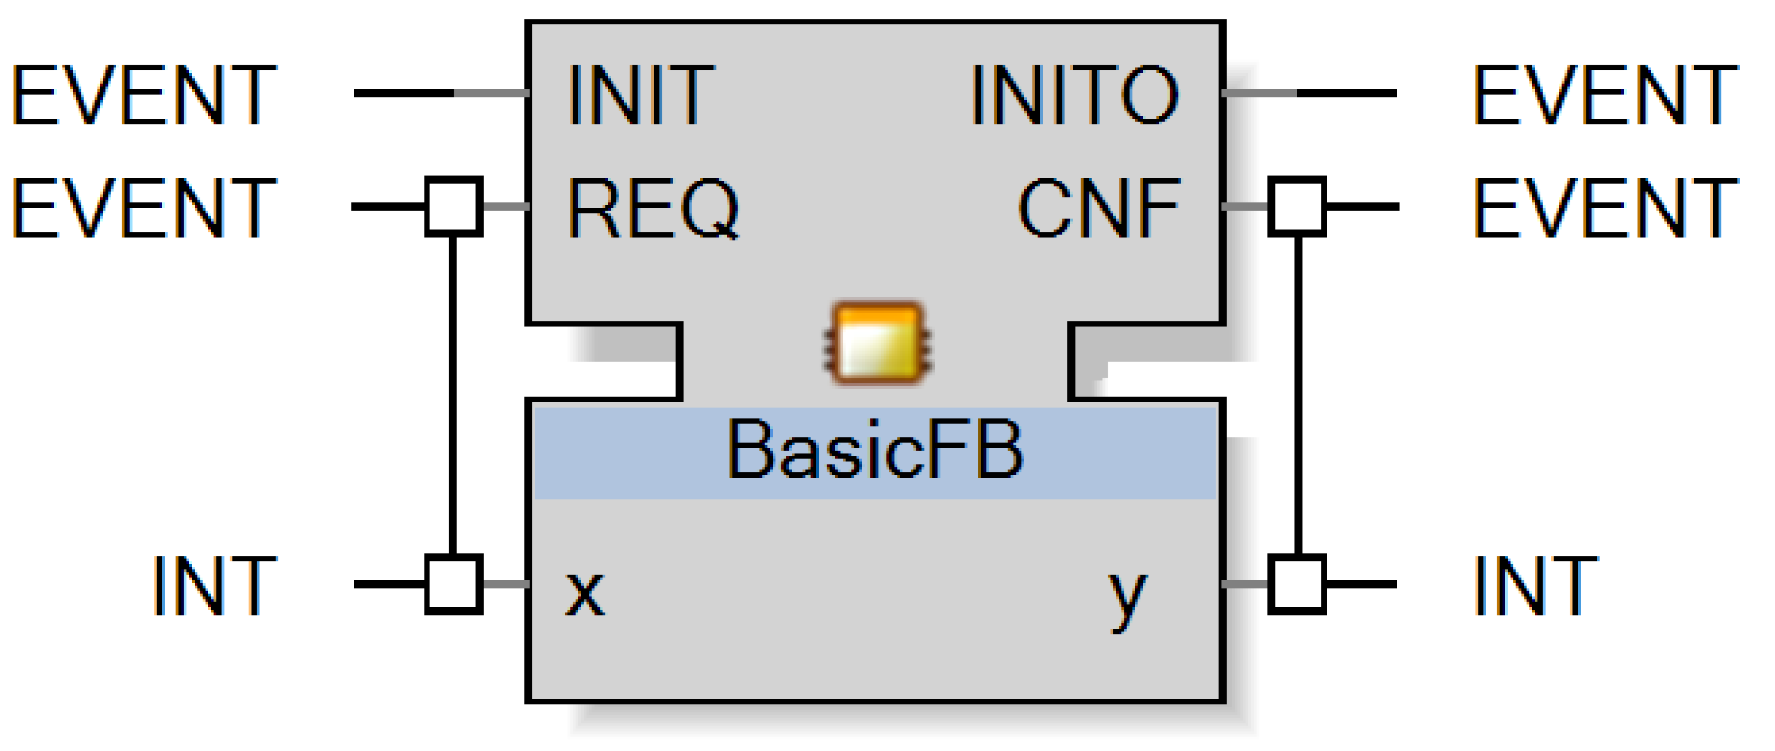
IEC 61499 function blocks
Function block interface
Execution Control Chart (ECC)
Notes:
A function block is characterized by an interface, which defines input/output events and input/output actions.
In this paper we concentrate on basic function blocks, which are defined by so-called Execution Control Charts or ECCs.

Slide 6
IEC 61499 Execution Control Chart
states
Notes:
An ECC is a finite-state machine and has set of states.

Slide 7
IEC 61499 Execution Control Chart
Guard conditions
Boolean formulas
input/output variables
internal variables
constants
Notes:
Transitions between states are labeled with events and guard conditions, which are Boolean formulas over input/output/internal variables and constants.

Slide 8
IEC 61499 Execution Control Chart
Algorithms
Change output variables
Notes:
States can be associated with algorithms, which are used to set values of output variables.

Slide 9
Simplifications
No input/output events (only REQ and CNF)
Only Boolean input/output variables
Guard conditions
only input variables
Notes:
We introduce some simplifications.
First, we do not work with events, assuming that only the standard REQ and CNF events are used.
Second, only Boolean input and output variables are allowed.
Finally, guard conditions may depend on input variables only.

Slide 10
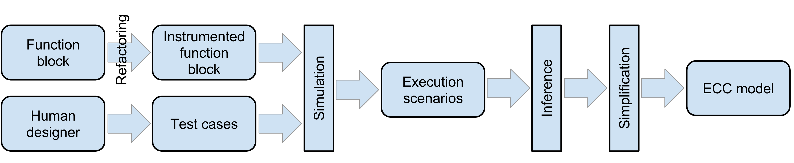
Proposed approach
Notes:
Assuming these simplifications, we propose the following approach.
The function block is first refactored in order to allow test outputs recording.
A human designer supplies test cases.
The function block is run on test cases in simulation, execution scenarios are recorded.
The we use the proposed inference algorithm to construct an FB that complies with recorded scenarios.

Slide 11
Execution scenario
List of scenario elements
Scenario element = <(input variable values), (output variable values)>
Scenario example
<000, 00>; <001, 01>; <101, 11>
Notes:
An execution scenario is a list of scenario elements, and a scenario element is simply a pair of input variable values and corresponding output variable values.
Here is an example of a scenario when there are three input variables and two output variables.

Slide 12
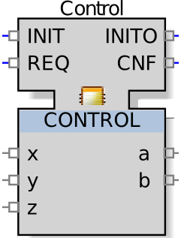
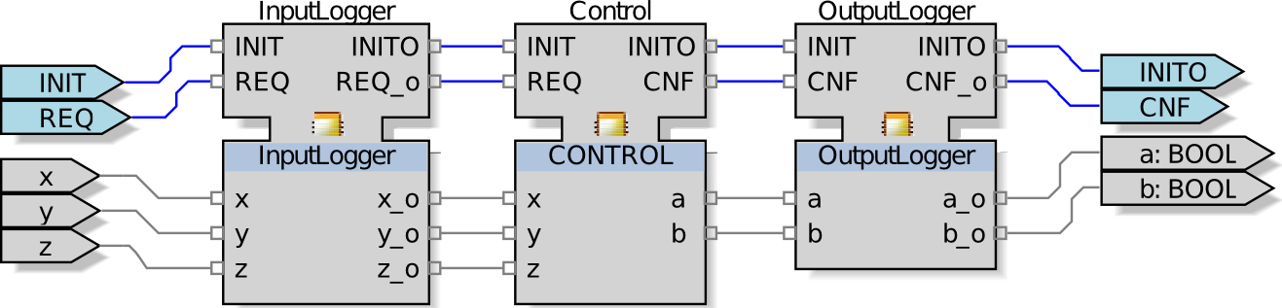
Recording execution scenarios
Target function block
Automated refactoring
Notes:
In order to be able to record execution scenarios, we augment the target function block with an InputLogger and OutputLogger function blocks.
The InputLogger simply takes the input variable values, saves them, and passes them unchanged to the target function block.
The OutputLogger does the same thing with the output variable values.

Slide 13
ECC construction algorithm (1)
Parallel MuACO algorithm [Chivilikhin et al, 2014]
Metaheuristic
Search-based optimization
Explore search space in a randomized way
Notes:
For ECC construction we use an algorithm from our previous work on finite-state model inference – the parallel MuACO algorithm.
Here it is sufficient to know that it is a metaheuristic, meaning that it performs a search-based optimization by exploring the search space in a randomized way.

Slide 14
ECC construction algorithm (2)
Start with random solution
Build new solutions with mutation operators
Evaluate new solutions with fitness function
Notes:
Basically, the algorithm starts with some randomly generated solution, builds new solutions using mutation operators, and evaluates new solutions with a fitness function.

Slide 15
ECC construction algorithm (3)
Parameterized by
Solution representation (model)
Mutation operators
Fitness function
Notes:
To use this algorithm for ECC construction, we need to supply it with a solution representation, a set of mutation operators, and a fitness function to evaluate candidate solutions.

Slide 16
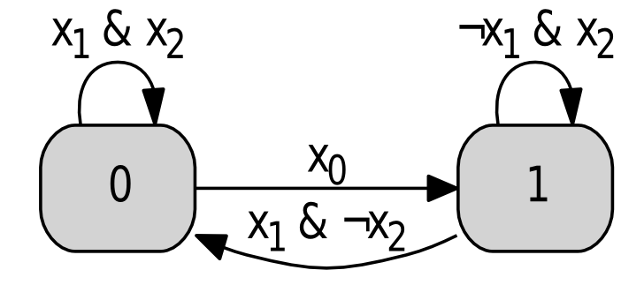
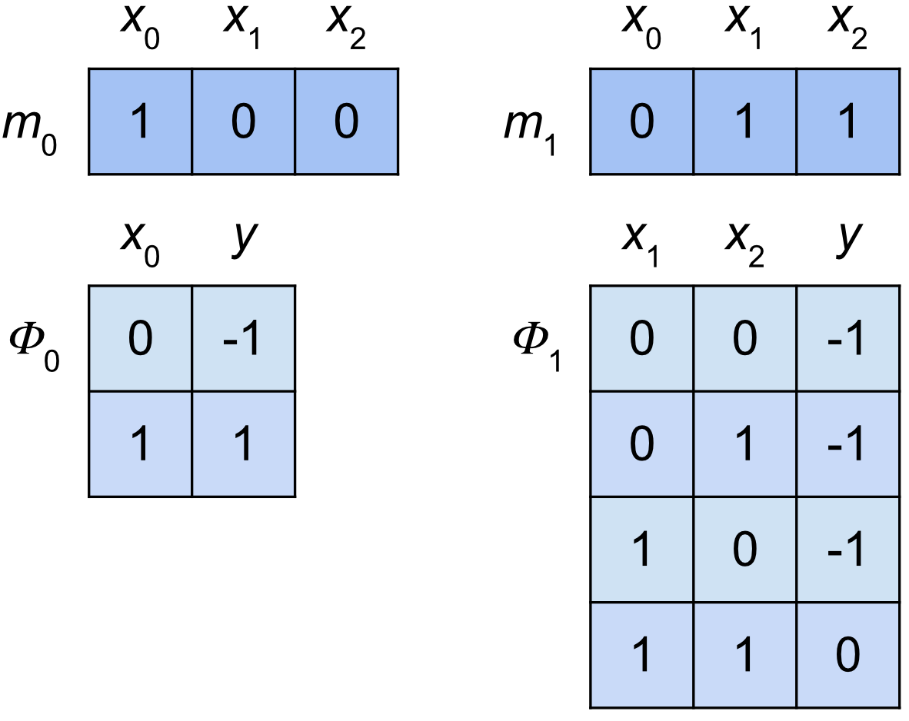
ECC model
Set of states
Each state – set of transition groups
Each group
Variable significance mask
Reduced transition table
Does not include algoritms
Notes:
We represent an ECC a set of states, each state is represented by a set of so-called transition groups.
A transition group is defined by a variable significance mask and a reduced transition table.

Slide 17
ECC model
Set of states
Each state – set of transition groups
Each group
Variable significance mask
Reduced transition table
Algorithms are not included
Notes:
For example, here only x1 and x2 are significant, and the transition is only performed when both x1 and x2 are true.
Note that algorithms are not included in the model and are not evolved by the inference algorithm.
Instead, we deduce them from scenarios on each fitness evaluation.

Slide 18
Algorithm representation
Algorithms are strings over {‘0’, ‘1’, ‘x’}
a_{i}=‘0’: set z_{i}=0
a_{i}=‘1’: set z_{i}=1
a_{i}=‘x’: preserve value of z_{i}
Notes:
Since we only consider Boolean output variables, the algorithms are quite simple.
We represent them a strings over the alphabet (0,1 x).
A zero means that the corresponding output variable should be set to zero,
A one means that it should be set to one,
And an “x” means that we should preserve the current value of the variable.

Slide 19
Mutation operators
Operator #1: Change transition end state
Pick a random transition
Change the state it points to
Operator #2: Add/delete transitions
Add random transition to a state
Delete random transition
19/34
Notes:
We use four mutation operators.
The first operator simply selects a random ECC transition and changes the state it leads to to some other state, which is selected uniformly at random.
The second operator either adds a random transition to a state, or deletes a random transition.

Slide 20
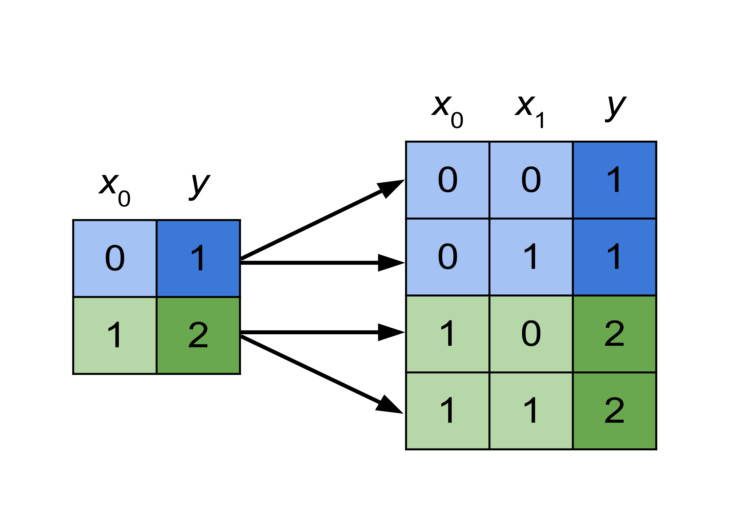
Mutation operator #3: Add significant variable
Notes:
The third mutation operator adds a significant variable to a randomly selected transition group.
We double the size of the transition table and add transitions for all values of the new variable.

Slide 21
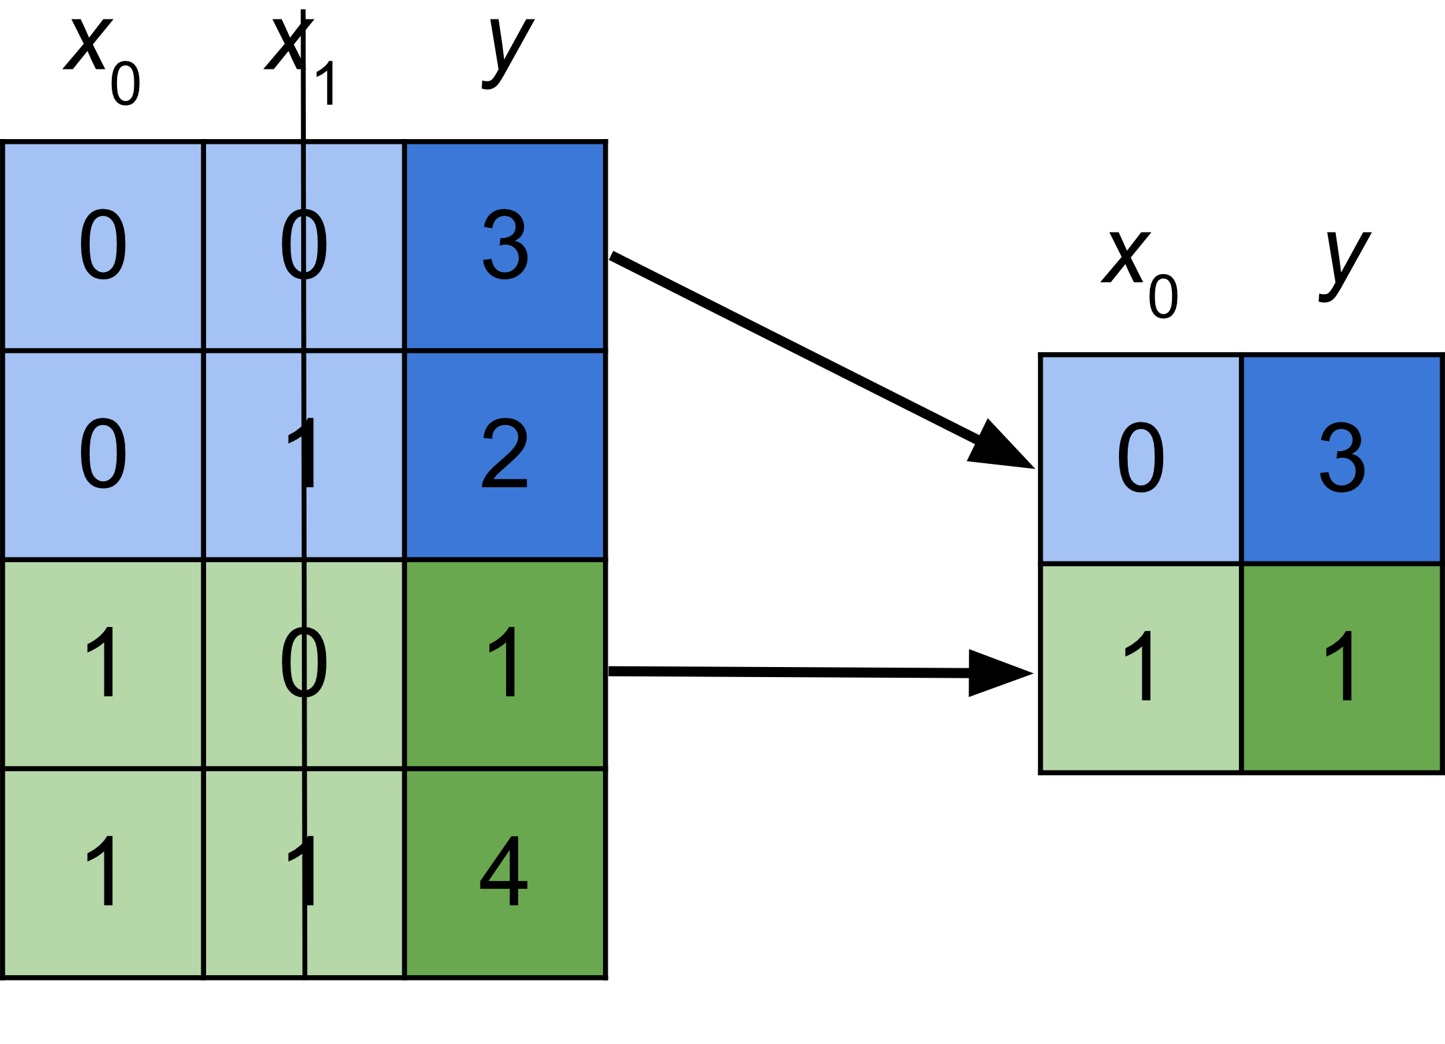
Mutation operator #4: Delete significant variable
Notes:
The final mutation operator deletes a significant variable from a randomly selected transition group.
Here we shrink the transition table by a factor of two, deleting every second transition.

Slide 22
Candidate model evaluation
Candidate model
State labeling
Model + algorithms
Fitness function
Scenarios
Notes:
For candidate model evaluation we first pass it along with the scenarios to a state labeling procedure that determines the appropriate algorithm for each state.
Then the model is evaluated using the fitness function, which checks how well it complies with execution scenarios.

Slide 23
State labeling: determine appropriate algorithms
Run scenarios through ECC
For each state and each output variable
a_{i}=‘0’
Change | Algorithm | Frequency
0 → 1 | ‘1’ | 37
1 → 0 | ‘0’ | 58
0 → 0 | ‘0’ | 0
1 → 1 | ‘1’ | 0
Notes:
To determine the appropriate algorithms, we run scenarios through the ECC and for each state and each output variable we count,
how many times the variable changed from 0 to 1, from 1 to 0, from 0 to 0 and from 1 to 1.
Finally, we select the algorithm component that corresponds to the maximum frequency.
For example, here the algorithm component should be zero, since 58 is the largest frequency and it corresponds to changing a 1 to 0.

Slide 24
Fitness function
Run scenarios through ECC
F = 0.9 F_{ed} + 0.1 F_{fe} + 0.0001 F_{sc}
F_{ed} – edit distance between scenario outputs and candidate solution outputs
F_{fe} – position of first error in outputs
F_{sc} – number of times the ECC changed to a new state
Notes:
For fitness function evaluation we again run scenarios through the ECC.
The fitness function has three components.
The first is based on a string similarity measure between outputs recorded in scenarios and the ones demonstrated by the candidate ECC.
The second component is the position of the first error the ECC makes in outputs
The third component is based on the number of times the ECC switches to a new state

Slide 25
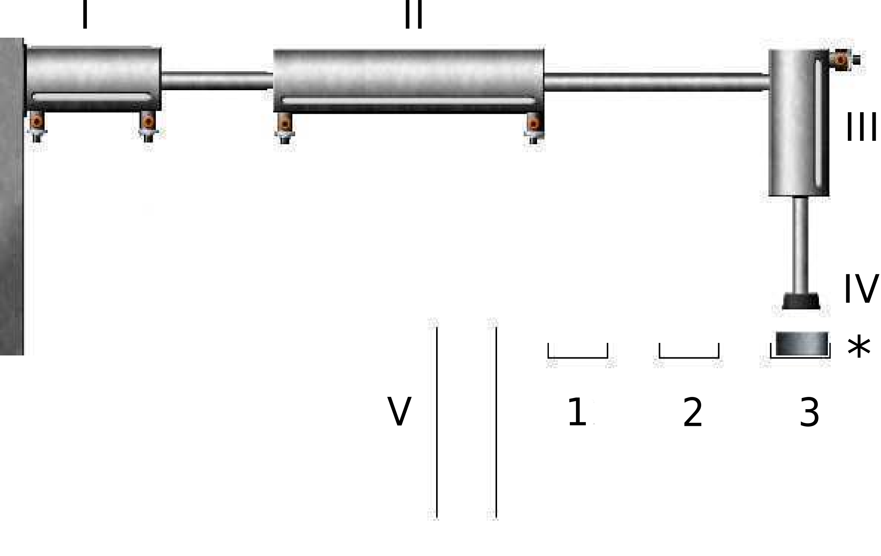
Experiments: Pick-n-Place manipulator
Notes:
In experiments we worked with the Pick-and-Place manipulator.
It has two horizontal cylinders, one vertical cylinder, a suction unit, three input trays, and an output slider.
When a work piece appears in one of the trays, cylinders are used to move the suction unit in position, pick up the work piece, and move it to the output slider.

Slide 26
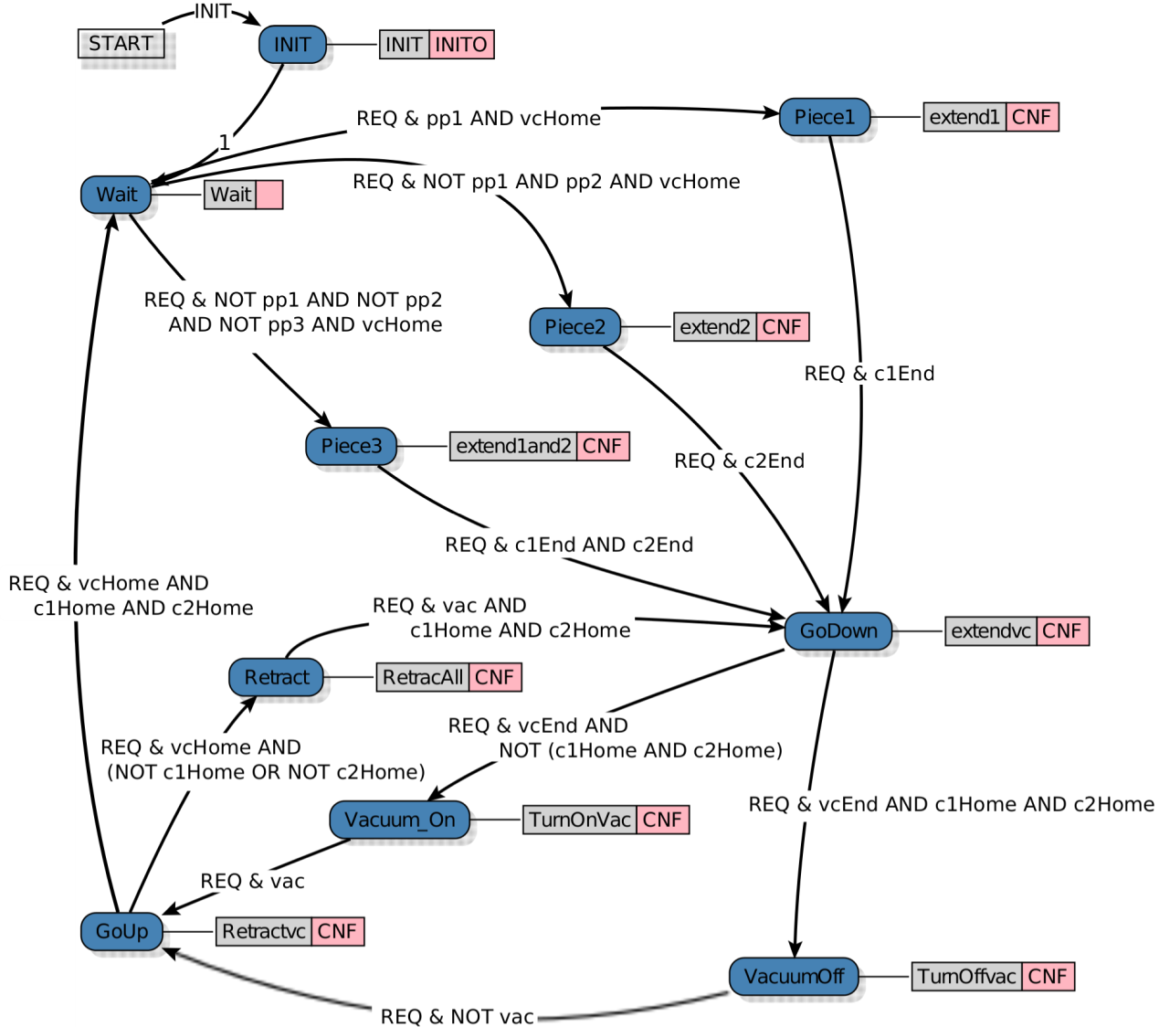
Target ECC: CentralizedControl
9 states
14 transitions
Notes:
All logic control in this implementation is performed by a single basic function block – CentralizedControl.
It implements some non-trivial logic, has 9 states and 14 transitions.
In experiments we tried to reconstruct this function block.

Slide 27
Experiment setup
10 tests: order of work piece deployment
1, 1-2, 2-3, 3-2-1, …
Models allowed to have
10 states
4 transition groups in each state
Notes:
We recorded 10 test cases, which define the order of work piece deployment.
For example, 3-2-1 means that first a work piece appears in tray #3, then in tray #2, and then in tray #1.
Models were allowed to have a maximum of 10 states and 4 transition groups in each state.

Slide 28
Experiment protocol
Reconstruct ECC
Convert to XML
Convert to Java & compile
Simulate in FBDK
Notes:
The experiment protocol was as follows: reconstruct the ECC with the proposed algorithm, convert the constructed ECC to XML, then convert it to java, compile, and simulate in FBDK.

Slide 29
Results
Used 16 cores of 64-core AMD Opteron™ 6378 @ 2.4 Ghz
Experiment was repeated 20 times
Average of 4.5 hours to infer perfect ECC
from 30 minutes to 10 hours
All ECCs work correctly in simulation
On longer test cases: OK
Notes:
The experiment was repeated 20 times.
It took our algorithm an average of 4.5 hours to infer a perfect ECC (from 30 minutes to 10 hours).
Simulation testing confirmed that all constructed ECCs work correctly in simulation.
We also tested some ECCs on longer test cases, and they also worked OK.

Slide 30
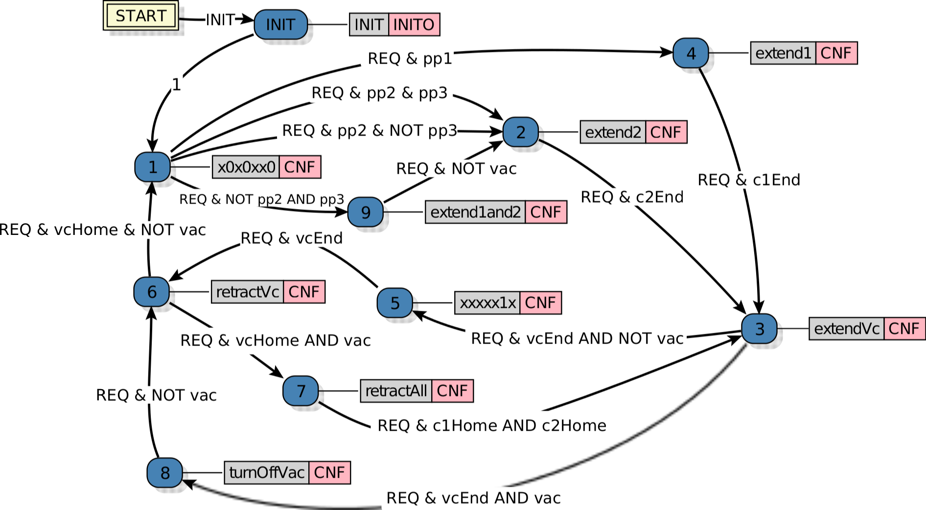
Inferred ECC example
Notes:
This is an example of the constructed ECC with 9 states.

Slide 31
Conclusion
Proposed an approach for reconstructing FB logic that does not require source code
Performed sanity-check experiments of the proposed approach – it works
Notes:
So, in conclusion, we proposed an approach for reconstructing function block logic that does not require source code.
The initial sanity-check experiments confirmed that the approach is feasible.

Slide 32
Future work
Augment model with input/output events
Handle other types of variables (int, real, string, …)
Switch to inferring ECCs from expert data
Preliminary results @ ISPA’15 in August
Notes:
For future work we plan to:
Augment the model with input/output events
Handle other types of variables
And switch to inferring ECCs from expert data.
Some initial results on this will be presented at the ISPA conference in Helsinki this August.

Slide 33
Acknowledgements
This work was financially supported by the Government of Russian Federation, Grant 074-U01.
33/34

Slide 34
Thank you for your attention!
Daniil Chivilikhin
Sandeep Patil
Anatoly Shalyto
Valeriy Vyatkin
chivdan@rain.ifmo.ru

Slide 35
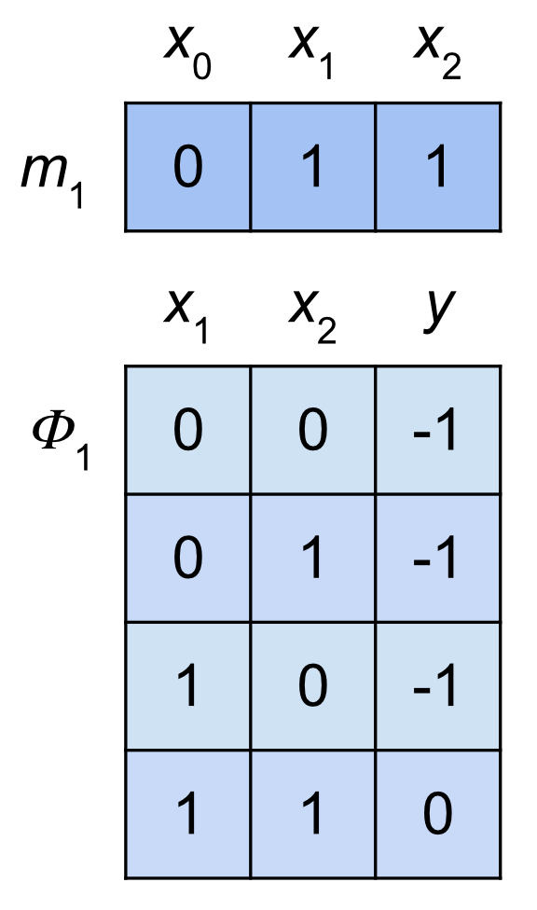
ECC model: representing guard conditions
Issue: large number of input variables
Solution: reduced tables approach [Polikarpova et al, 2010]
variable significance mask
Only supports simple formulas
x₁ ∧ ¬x₂ ∧ x₃

Slide 36
ECC model: representing guard conditions
Need to support general-form formulas
For example: x₁ ∧ (¬x₂ ∨ ¬x₃)
Represent in DNF
(x₁ ∧¬x₂ )∨(x₁ ∧¬x₃ )
Use several reduced tables per state
significant
x₁ and x₂
significant
x₁ and x₃

Slide 37
Model simplification
Data should be explained by the simplest possible model
Remove unused transitions
Simplify guard conditions
6 -> 5 ["REQ [c1Home & !c1End & vcEnd & !pp2]"];
6 -> 5 ["REQ [c1Home & !c1End & vcEnd & pp2] "];
7 -> 0 ["REQ [vcHome & !vac]"];
7 -> 3 ["REQ [vcHome & vac]"];
8 -> 7 ["REQ [!c1End & c2End]"];
8 -> 7 [“REQ [c1End & !c2End]"];
8 -> 7 ["REQ [c1End & c2End]"];
9 -> 1 [“REQ [c2End & vcHome & !vac]"];
6 -> 5 ["REQ [vcEnd]"];
7 -> 0 ["REQ [vcHome & !vac]"];
7 -> 3 ["REQ [vcHome & vac]"];
8 -> 7 ["REQ [!c2End]"];
8 -> 7 ["REQ [c2End]"];
9 -> 1 ["REQ [c2End]"];
Notes:
Another thing is that inferred models are often redundant – they contain

