Slide 1





Inferring Automation Logic from Manual Control Scenarios: Implementation in Function Blocks
Daniil Chivilikhin
PhD student
ITMO University
Anatoly Shalyto
Dr. Sci., professor
ITMO University
Valeriy Vyatkin
Dr. Eng., professor,
Aalto University,
Luleå University of Technology
DIAS@ISPA ’15, Helsinki, Finland, August 21, 2015

Slide 2
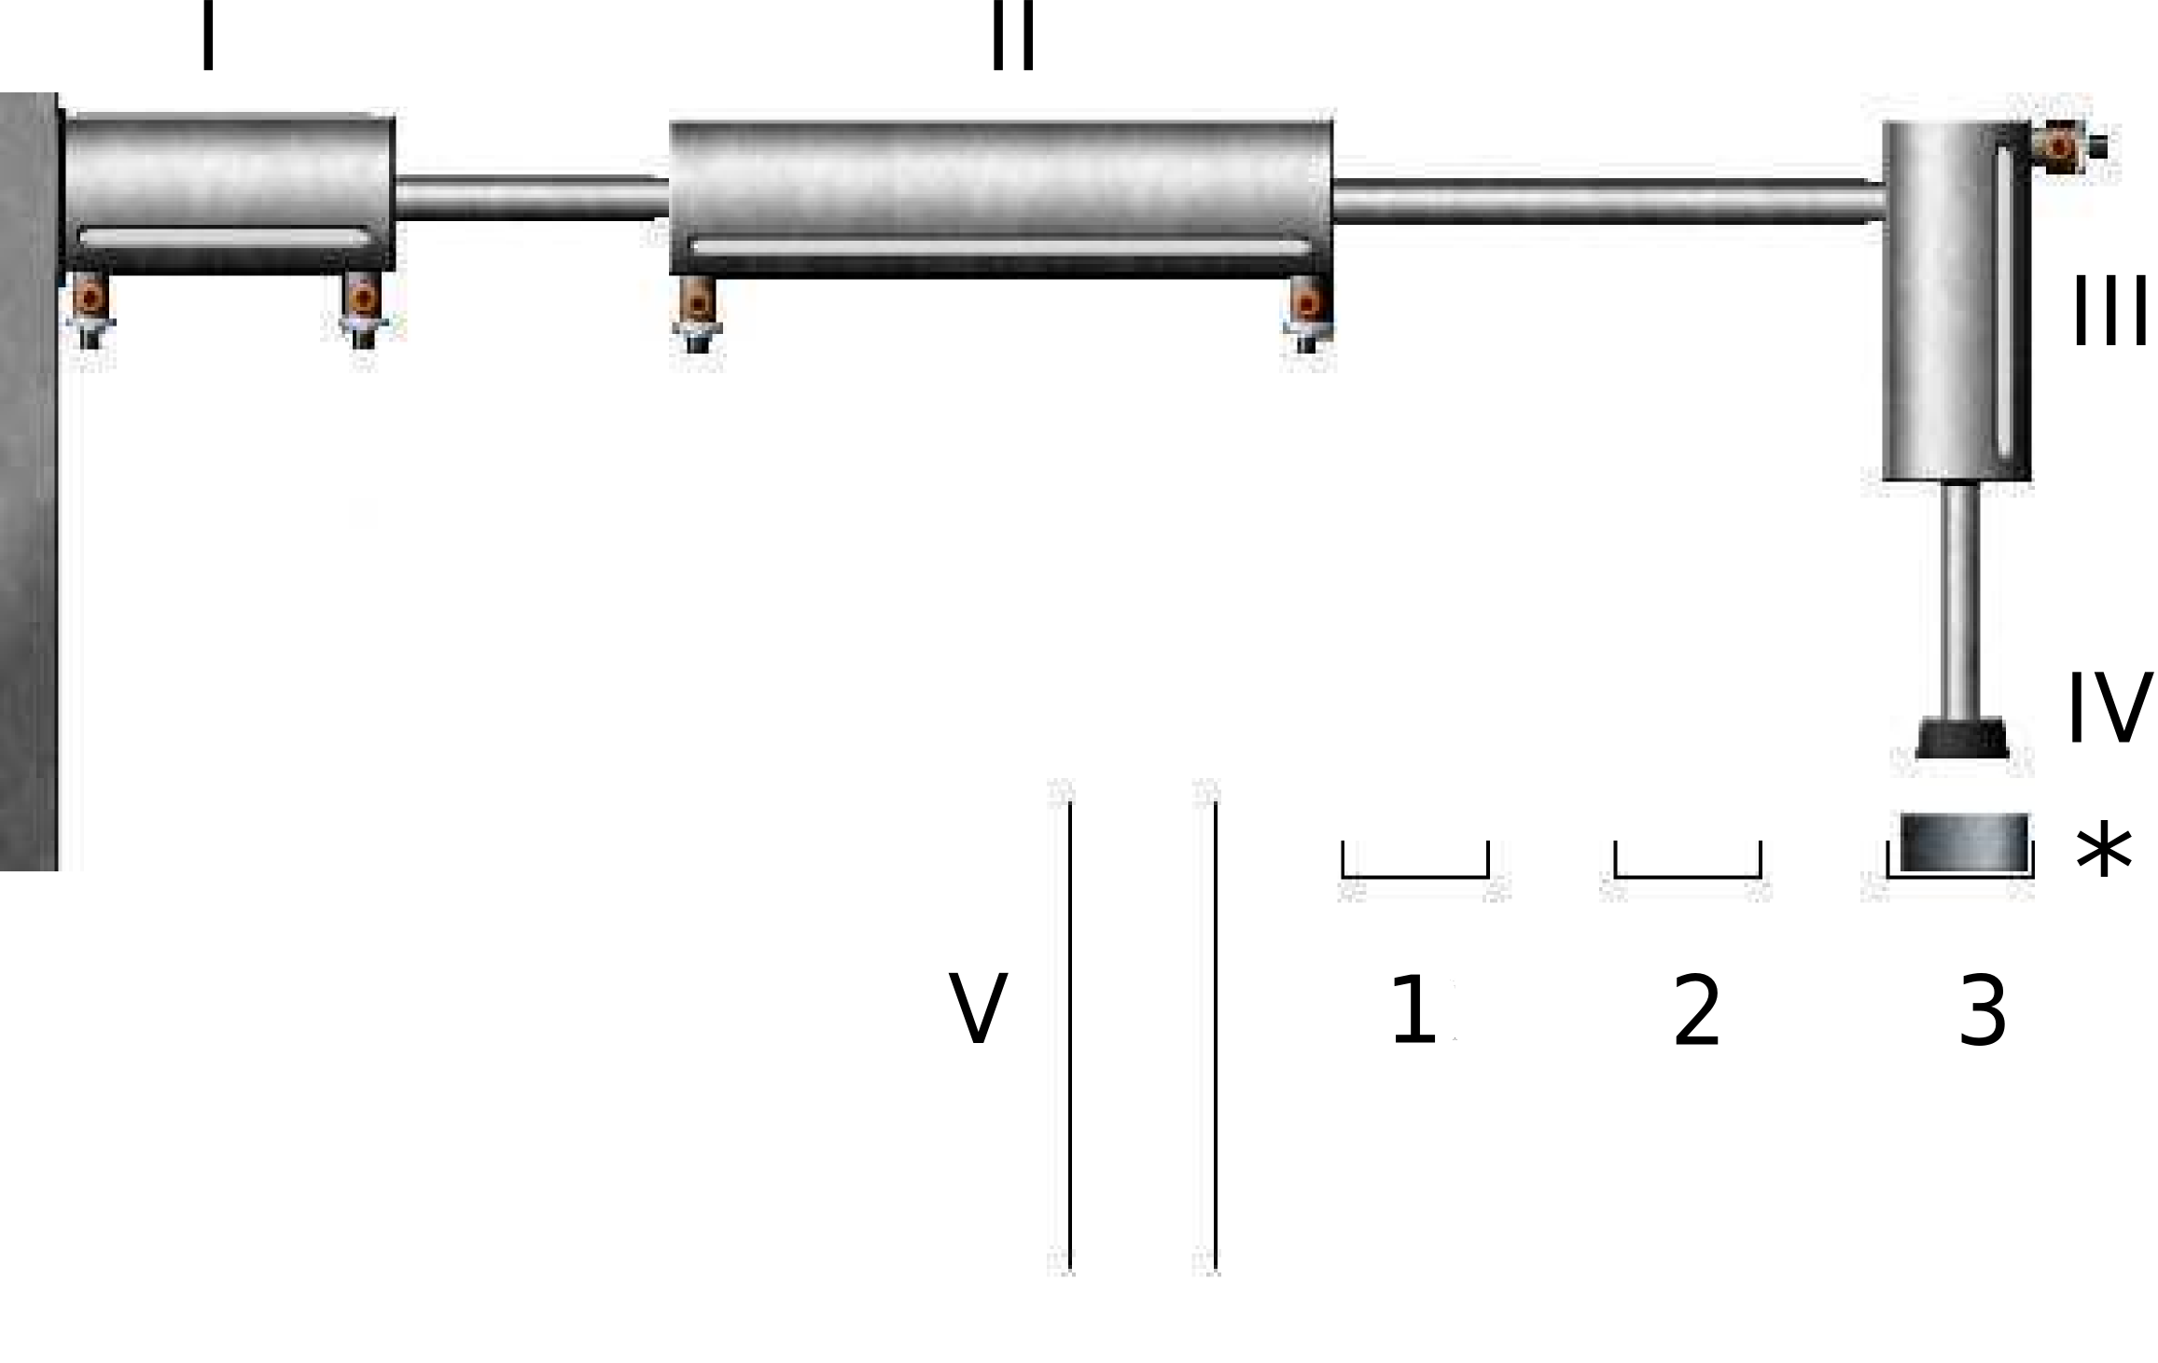
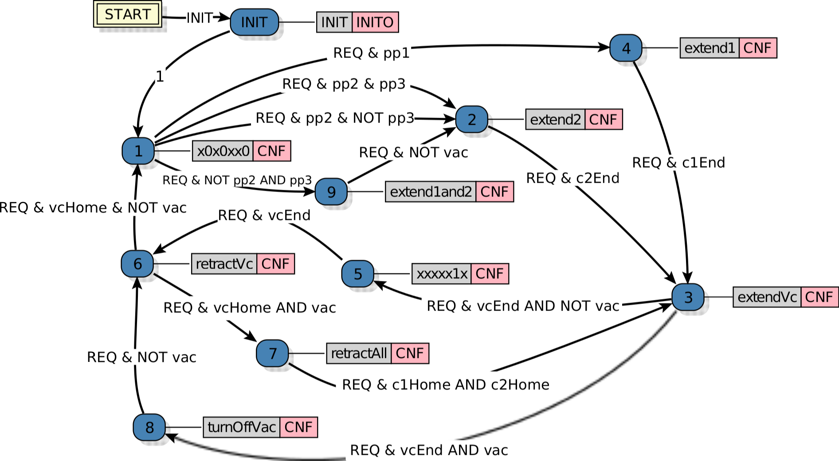
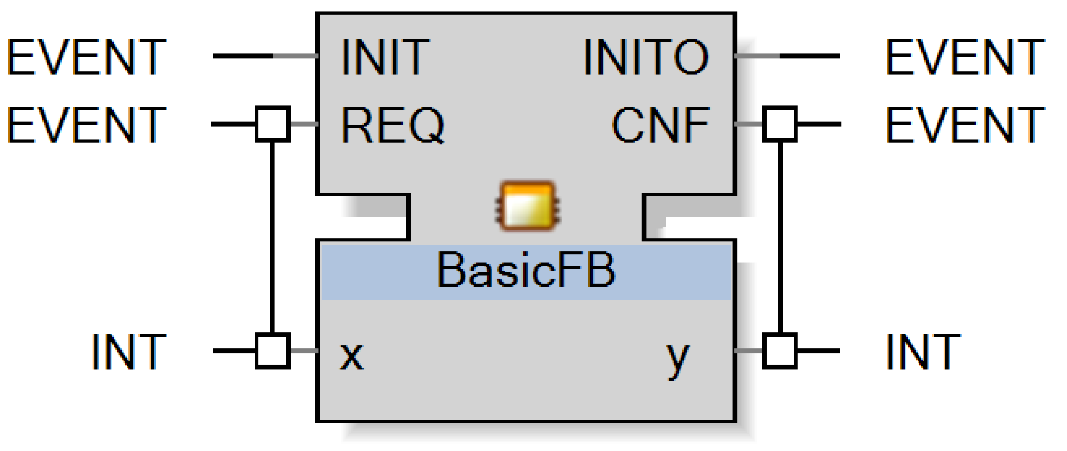
MVC application engineering
1. View
3. Controller
use to debug
2. Model

Slide 3
MVC application engineering
1. View
3. Automated controller
generation
4. Controller
use to debug
2. Model

Slide 4
Problem statement
Develop a method for
automated controller generation
for
MVC applications

Slide 5
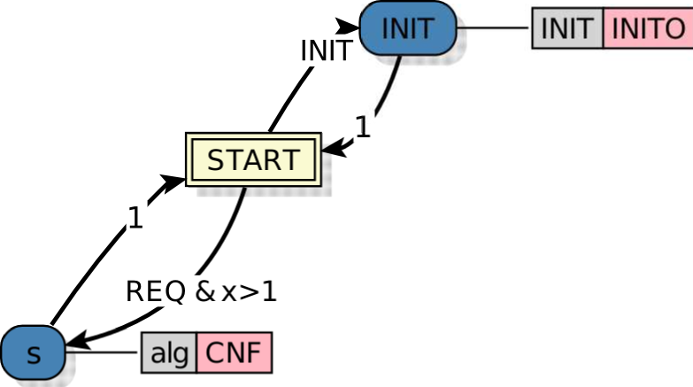
Implementation: IEC 61499 function blocks
Function block interface
Execution Control Chart (ECC)
Notes:
A function block is characterized by an interface, which defines input/output events and input/output actions.
In this paper we concentrate on basic function blocks, which are defined by so-called Execution Control Charts or ECCs.

Slide 6
IEC 61499 Execution Control Chart
states
Notes:
An ECC is a finite-state machine and has set of states.

Slide 7
IEC 61499 Execution Control Chart
Guard conditions
Boolean formulas
input/output variables
internal variables
constants
Notes:
Transitions between states are labeled with events and guard conditions, which are Boolean formulas over input/output/internal variables and constants.

Slide 8
IEC 61499 Execution Control Chart
Algorithms
Change output variables
Notes:
States can be associated with algorithms, which are used to set values of output variables.

Slide 9
Assumptions and simplifications
Model and View are implemented
Only Boolean input/output variables
Guard conditions – only input variables
Notes:
We introduce some simplifications.
Only Boolean input and output variables are allowed.
Finally, guard conditions may depend on input variables only.

Slide 10
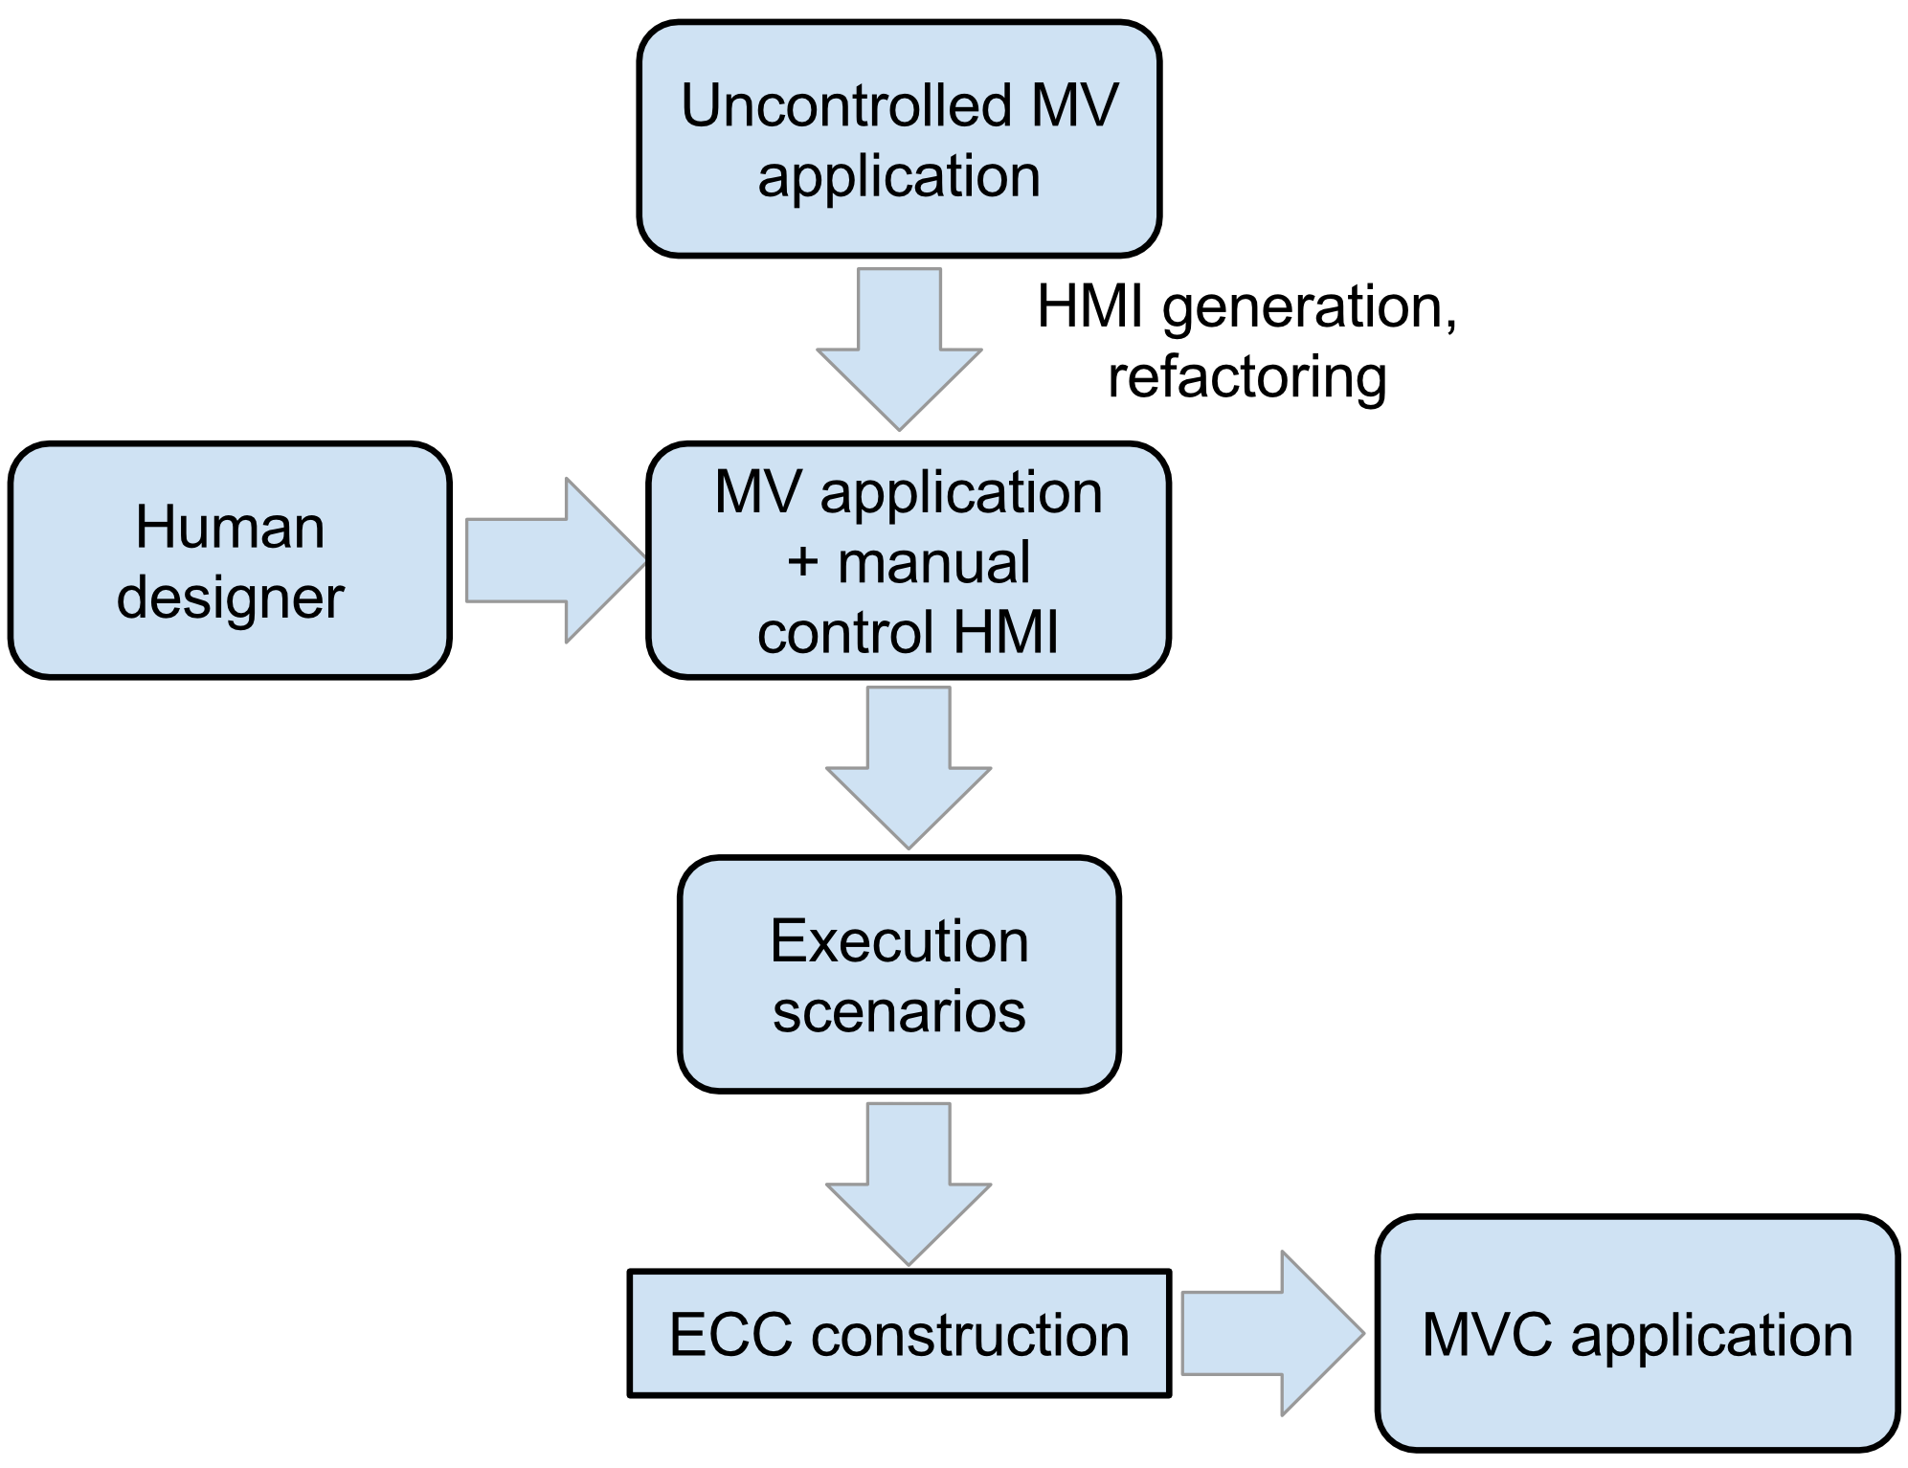
Proposed approach

Slide 11
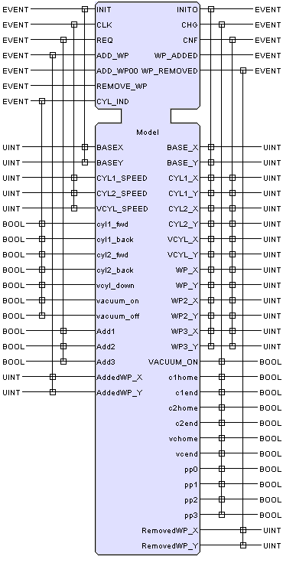
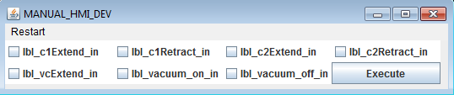
HMI generation
M.I: Model’s inputs that should be set by Controller
M.O: Model’s outputs to be used in controller

Slide 12
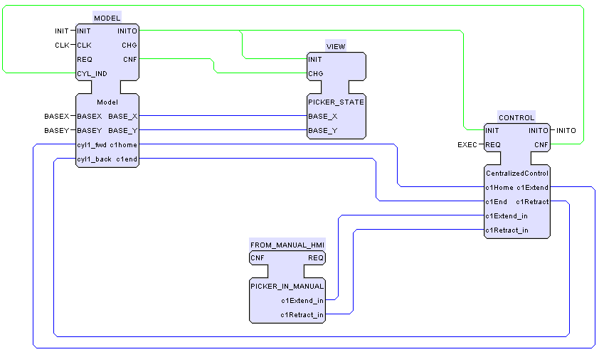
Refactored MVC scheme

Slide 13
Execution scenario
s₀ | s₁ | s₂ | s₃ | s₄ | s₅
Input event | Input variables | Output variables | Output event
REQ | 01011010 | 101010 | CNF
Notes:
An execution scenario is a list of scenario elements, and a scenario element is simply a pair of input variable values and corresponding output variable values.
Here is an example of a scenario when there are three input variables and two output variables.

Slide 14
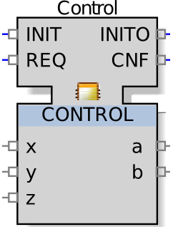
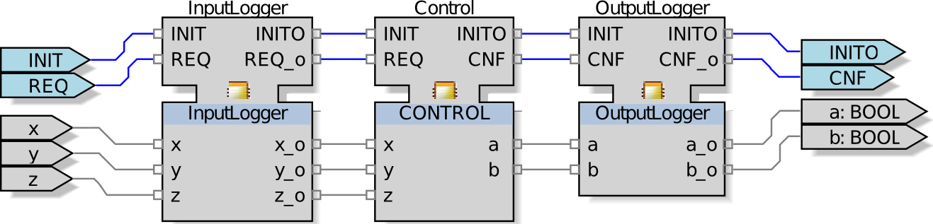
Recording execution scenarios
Dummy function block
Automated refactoring

Slide 15
ECC construction algorithm: previous work
Metaheuristic algorithm
Chivilikhin et al. Reconstruction of Function Block Logic using Metaheuristic Algorithm: Initial Explorations / In Proceedings of the 13th IEEE International Conference on Industrial Informatics (INDIN'15)
No theoretical bounds on running time
In one special case we can do better!
Notes:
For ECC construction we use an algorithm from our previous work on finite-state model inference – the parallel MuACO algorithm.
Here it is sufficient to know that it is a metaheuristic, meaning that it performs a search-based optimization by exploring the search space in a randomized way.

Slide 16
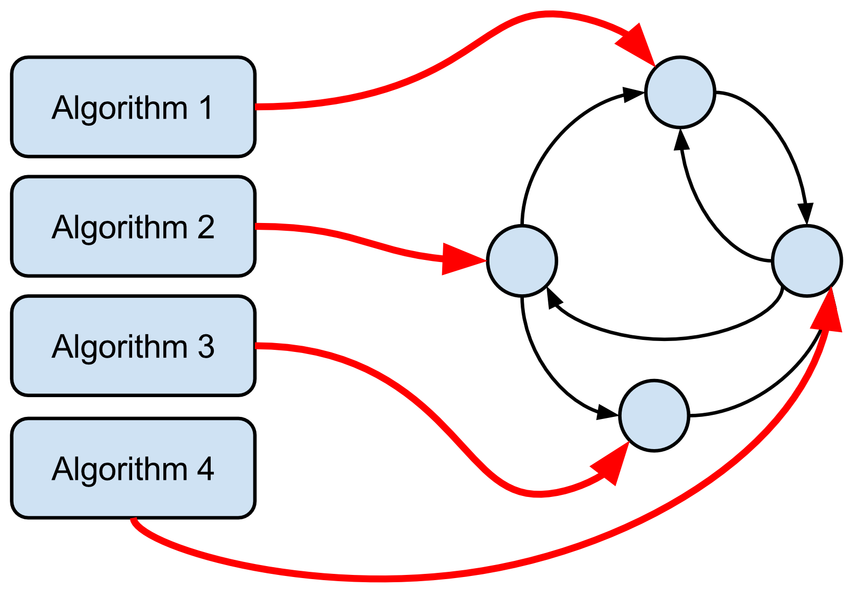
Exact ECC construction
If each algorithm is used in exactly one state
We can determine algorithms automatically
And then construct the ECC
+ only for Boolean inputs/outputs!

Slide 17
Proposed ECC construction algorithm
Determine minimal set of state algorithms
Construct ECC from scenarios labeled by found algorithms
Simplify ECC

Slide 18
Algorithm representation
Algorithms are strings over {‘0’, ‘1’, ‘x’}
a_{i}=‘0’: set z_{i}=0
a_{i}=‘1’: set z_{i}=1
a_{i}=‘x’: preserve value of z_{i}
Example
z
0 | 1 | 1 | 0
a
x | 1 | 0 | 1
a(z)
0 | 1 | 0 | 1
Notes:
Since we only consider Boolean output variables, the algorithms are quite simple.
We represent them a strings over the alphabet (0,1 x).
A zero means that the corresponding output variable should be set to zero,
A one means that it should be set to one,
And an “x” means that we should preserve the current value of the variable.

Slide 19
Determine initial set of simple algorithms
For each scenario s and each pair of elements s_{i} and s_{i+1}
Calculate algorithm a for transforming s_{i} → s_{i+1}
Function calcAlg(s_{i} ,s_{i+1})
Example
s_{i}
0 | 1 | 0 | 1
s_{i+1}
0 | 1 | 1 | 0
a
x | x | 1 | 0
19/33

Slide 20
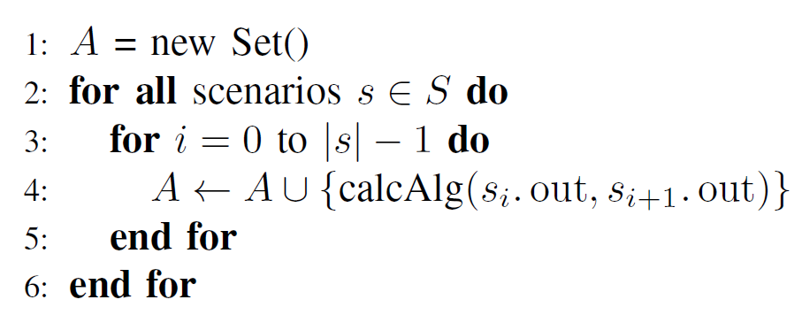
Determine initial set of simple algorithms
20/33

Slide 21
Merge algorithms
Function merge(a, b)
Example
a
0 | x | 1 | 0
b
0 | 1 | 1 | x
m^{ab}
0 | x | 1 | x
21/33

Slide 22
Only consistent algorithms are merged
Algorithms are consistent if they don’t have contradicting elements
0 | x | 1 | 0
contradiction
1 | 1 | 1 | x
22/33

Slide 23
Checking if merge is valid
Invariant: algorithms are sufficient to represent all scenarios
For each scenario s
For each s_{i} and s_{i+1}
A’ ← A \ {a, b}
A’ ← A’ U {m^{ab}}
if A’ satisfies invariant
then A ← A’
23/33

Slide 24
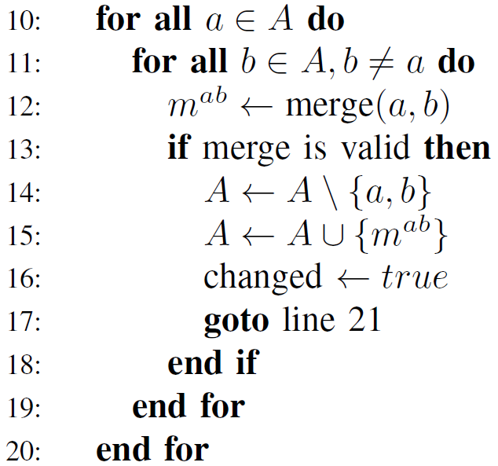
Merging algorithms: pseudocode
Try to merge each pair of algorithms
Until no more merges can be made
24/33

Slide 25
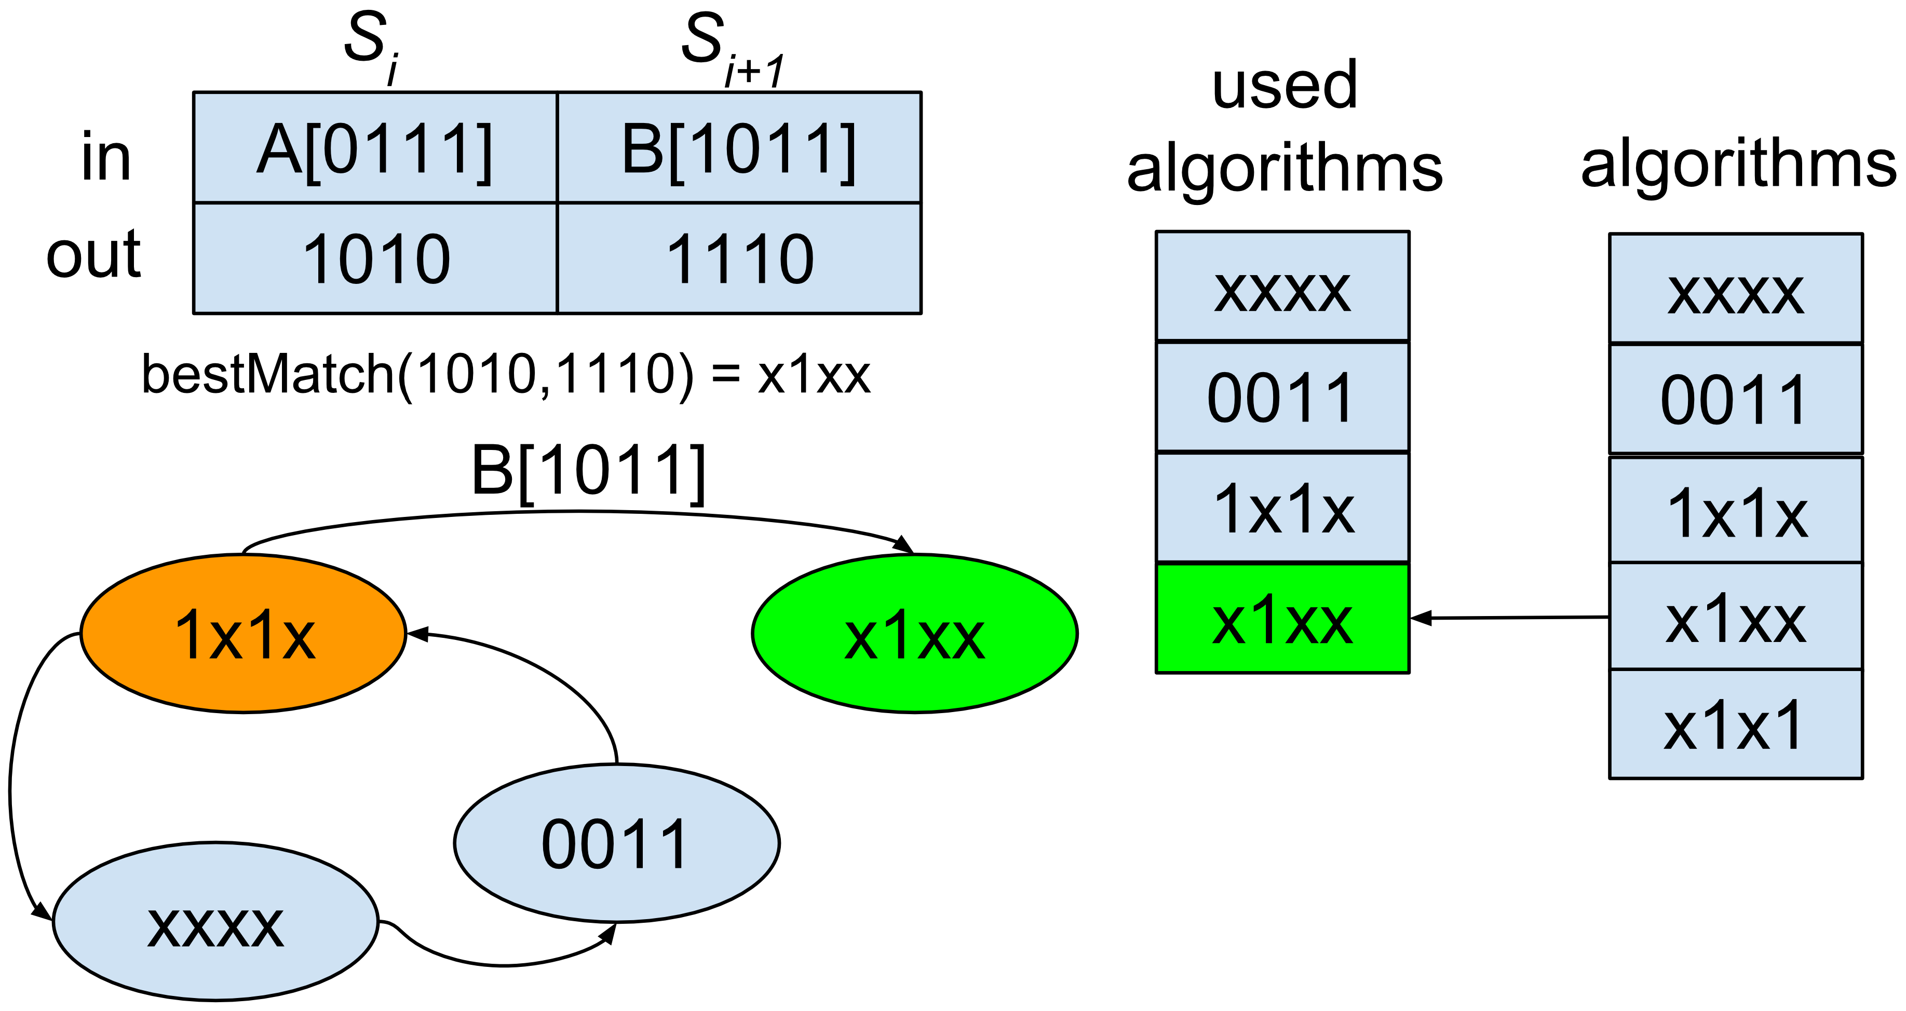
Constructing ECC using found algorithms
25/33

Slide 26
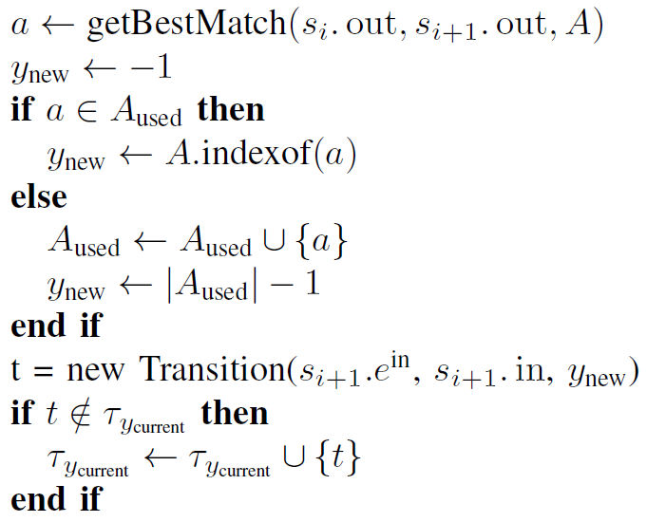
Constructing ECC using found algorithms
26/33

Slide 27
Simplifying ECC
Constructed ECCs are redundant
Each guard depends on all input variables
6 -> 5 ["REQ [c1Home & !c1End & vcEnd & !pp2]"];
6 -> 5 ["REQ [c1Home & !c1End & vcEnd & pp2] "];
7 -> 0 ["REQ [vcHome & !vac]"];
7 -> 3 ["REQ [vcHome & vac]"];
8 -> 7 ["REQ [!c1End & c2End]"];
8 -> 7 [“REQ [c1End & !c2End]"];
8 -> 7 ["REQ [c1End & c2End]"];
9 -> 1 [“REQ [c2End & vcHome & !vac]"];
6 -> 5 ["REQ [vcEnd]"];
7 -> 0 ["REQ [vcHome & !vac]"];
7 -> 3 ["REQ [vcHome & vac]"];
8 -> 7 ["REQ [!c2End]"];
8 -> 7 ["REQ [c2End]"];
9 -> 1 ["REQ [c2End]"];
Notes:
Another thing is that inferred models are often redundant – they contain

Slide 28
Experiments: Pick-n-Place manipulator
Notes:
In experiments we worked with the Pick-and-Place manipulator.
It has two horizontal cylinders, one vertical cylinder, a suction unit, three input trays, and an output slider.
When a work piece appears in one of the trays, cylinders are used to move the suction unit in position, pick up the work piece, and move it to the output slider.

Slide 29
Experiment setup
10 tests: order of work piece deployment
1, 1-2, 2-3, 1-2-3, 2, 2-1, 2-3, 3-2, 3-2-1
Notes:
We recorded 10 test cases, which define the order of work piece deployment.
For example, 3-2-1 means that first a work piece appears in tray #3, then in tray #2, and then in tray #1.
Models were allowed to have a maximum of 10 states and 4 transition groups in each state.

Slide 30
Experiment protocol
Record scenarios
Construct ECC
Convert to Java & compile
Simulate in FBDK
Notes:
The experiment protocol was as follows: reconstruct the ECC with the proposed algorithm, convert the constructed ECC to XML, then convert it to java, compile, and simulate in FBDK.

Slide 31
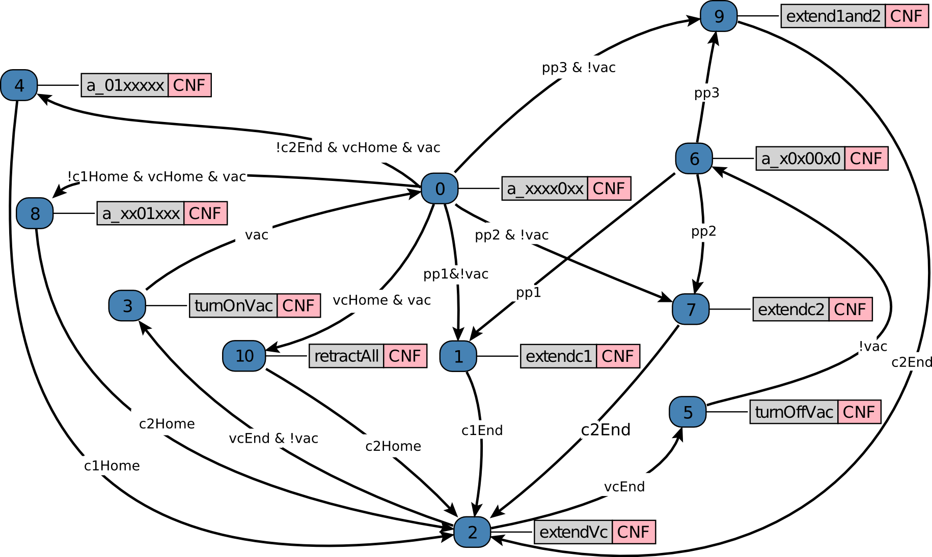
Results
Proposed method constructs the ECC in less than a minute
Previous method required ~ 4.5 hours on 16-core machine
Simulation showed that the ECC works correctly
Notes:
The experiment was repeated 20 times.
It took our algorithm an average of 4.5 hours to infer a perfect ECC (from 30 minutes to 10 hours).
Simulation testing confirmed that all constructed ECCs work correctly in simulation.
We also tested some ECCs on longer test cases, and they also worked OK.

Slide 32
Limitations & Future work
Approach is only useful if manual control is easier than designing the ECC
User bears all responsibility for scenario correctness and completeness
What about generalizing?
Consider temporal properties
Notes:
So, in conclusion, we proposed an approach for reconstructing function block logic that does not require source code.
The initial sanity-check experiments confirmed that the approach is feasible.

Slide 33
Acknowledgements
This work was financially supported by the Government of Russian Federation, Grant 074-U01.
33/33

Slide 34
Thank you for your attention!
rain.ifmo.ru/~chivdan

