Slide 1
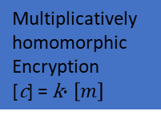

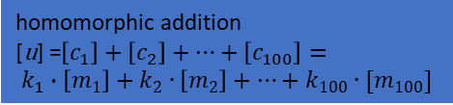
100 random variables $k$
Using Python module random
Make a list of numbers smaller than 100
Encryption
m -> [m]
Multiplicatively homomorphic Encryption
[c] = k$∙\left[m\right]$
homomorphic addition
[u] =${\left[c_{1}\right]+\left[c_{2}\right]+⋯+\left[c_{100}\right]=}_{ }$
$$k_{1}∙\left[m_{1}\right]+k_{2}∙\left[m_{2}\right]+⋯+k_{100}∙[m_{100}]$$
Decryption
[u]-> u
Select random 100 plaintexts $m$
Using Python module random
Make a list of numbers smaller than 1023
Compare the outcome with the target results

