Slide 1

Computer Vision Homework #1
TA：Syahrul Munir (Moon)
Email： t111999406@ntut.org.tw
Robot Vision Lab (Room 1421)

Slide 2
Homework Assignment
2026/03/09 – Homework 1 assigned, due 03/23
2026/03/30 – Homework 2 assigned, due 04/13
2026/04/27 – Homework 3 assigned, due 05/11
2026/05/25 – Homework 4 assigned, due 06/08

Slide 3
Homework Assignment
Target:
Write the main functions by yourself to understand the theories of computer vision deeply.
Improve your skills about using C/C++/Python
Rules:
Cannot directly use the function of OpenCV Lib or others to do the main part of homework.
Example:
cvtColor(image, gray, CV_RGB2GRAY) //convert RGB to Gray
cv2.copyMakeBorder(image, pad, pad, pad, pad, cv2.BORDER_REPLICATE) //give a padding to an image
numpy.convolve() or cv2.filter2D() or from scipy.signal import convolve2d or etc //directly do a convolution
Can only use the basic function, such as load and save images, find the shape of images

Slide 4
OpenCV
OpenCV (Open Source Computer Vision Library) is a popular and widely used open-source library that provides tools for real-time computer vision applications.
Supports a wide range of image and video processing tasks, from basic operations like reading and manipulating images to advanced techniques like object detection and facial recognition.
It has C++, Python, Java and MATLAB interfaces and supports Windows, Linux, Android and Mac OS
How to install :
https://docs.opencv.org/master/df/d65/tutorial_table_of_content_introduction.html
With C++ : https://opencv.org/releases/ (download)
With Python : pip install opencv-python

Slide 5
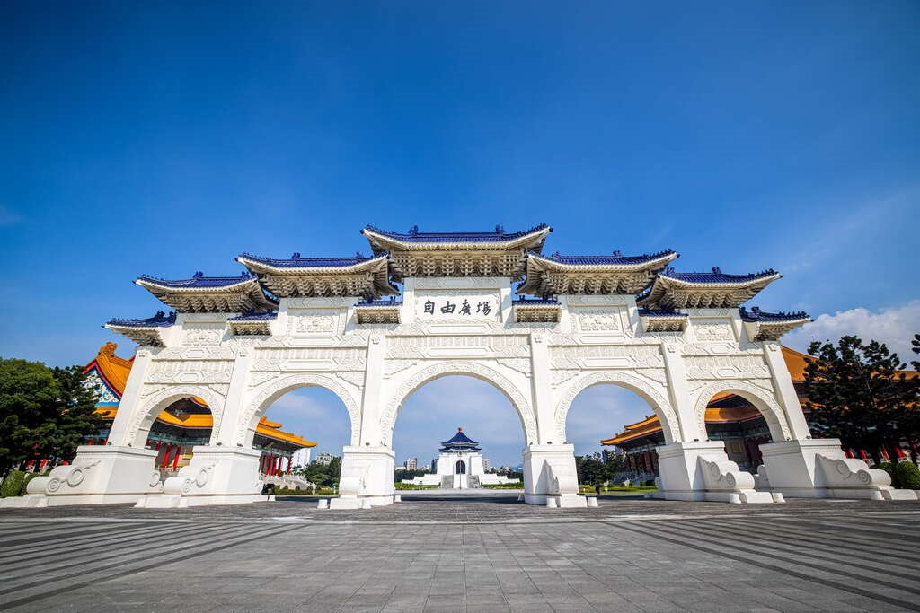
OpenCV (in Python)
Import Library:
import numpy as np
import cv2
Read an image:
img = cv2.imread('image.png’)
Check image size:
height, width, channels = img.shape
Show image:
cv2.imshow('My Image', img)
cv2.waitKey(0)
cv2.destroyAllWindows()
Write image:
cv2.imwrite('output.png', img)

Slide 6
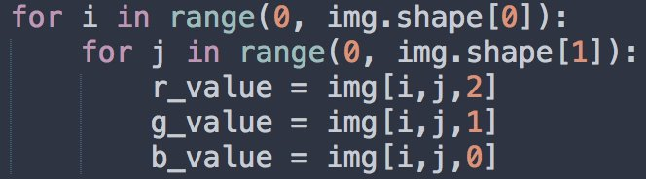
OpenCV (in Python)
Example for get each pixel value:
Create new mat:
rgb_mat = np.zeros((height, width, 3), np.uint8)
gray_mat = np.zeros((height, width, 1), np.uint8)

Slide 7
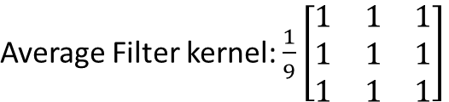

Homework 1
Give an image (CKS.png) for testing as follow:
Color Transformation: Read a RGB image and write a function to convert the image to grayscale image. (save as CKS _Q1.png)
Image Quantization: Reduce the number of intensity levels in a grayscale image. Take the original 256 levels (0-255) and map them to only 4 levels (31, 95, 159, 223). (save as CKS _Q2.png)
Convolution Operation: Using the grayscale/Q1 image, Implement a convolution with 3×3 Box Blur (Average Filter) with padding and stride 1. (save as CKS _Q3.png)
Image Downsampling:
Using the grayscale/Q1 image, implement convolution with 2x2 kernel below using stride 2. (save as CKS _Q4a.png)
Using the blur/Q3 image, implement convolution witha 2x2 kernel below using stride 2. (save as CKS _Q4b.png)
※ There are totally 5 PNG images in your report.

Slide 8
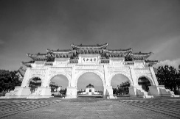
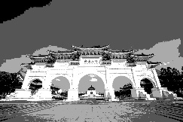


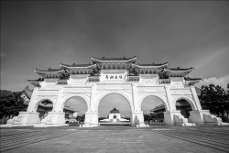
Homework 1 Flow
Input
CKS.png
Q1
Output1
CKS_Q1.png
Q2
Output2
CKS_Q2.png
Q3
Output3
CKS_Q3.png
Q4a
Output4a
CKS_Q4a.png
Q4b
Output4b
CKS_Q4b.png

Slide 9
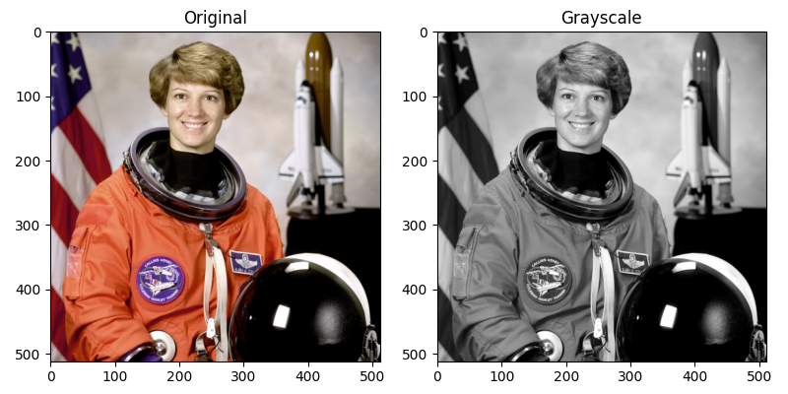
Color Transformation
Digital color images are 3D matrices (W×H×3) where each pixel contains a triplet of Red, Green, and Blue intensities ranging from 0 to 255.
Grayscale conversion reduces data complexity from three channels to a single Luminance channel (Y), representing the scene's brightness at each coordinate.

Slide 10
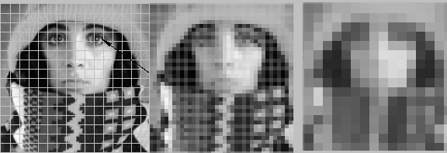
Image Quantization
Quantization is the process of mapping a continuous range of intensity values (e.g., 0–255) into a smaller, discrete set of levels.
Example for 4 level quantization:
For pixel value at 0-63, change it into the middle value (31).
For pixel value at 64-127, change it into the middle value (95).
For pixel value at 128-191, change it into the middle value (159).
For pixel value at 192-255, change it into the middle value (223).
This process determines the intensity resolution of a digital snapshot by defining how many bits are used to represent each pixel's brightness.
This technique is fundamental for image compression and reducing storage requirements, as using fewer levels decreases the amount of data needed to represent the image.

Slide 11
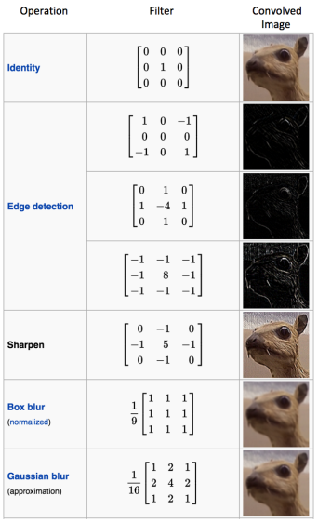
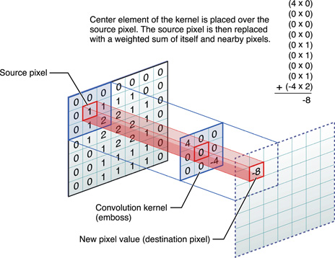
Convolution Operation
Operation that combines an image with a filter (also called a kernel) to produce a modified output

Slide 12
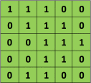

Convolution Operation
5 x 5 image
3 x 3 kernel

Slide 13
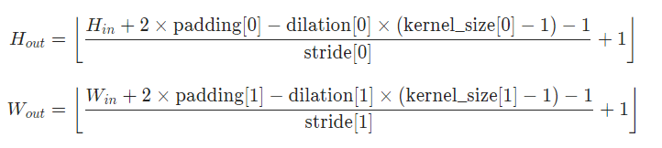
Padding
Adding extra pixels around the border of an image before performing convolution.
Control the size of the output image and ensure that the convolution can be applied to the pixels near the edges.
Img
Zero Padding :
https://www.youtube.com/watch?v=akf-b2jF3CA

Slide 14
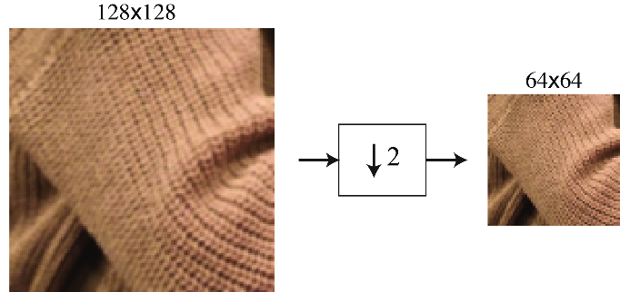
Image Downsampling
Image downsampling is a spatial operation that reduces the total number of pixels by increasing the distance between samples.
When an image contains very fine details or sharp edges, a low sampling density cannot capture these patterns accurately.
This mismatch causes high-frequency information to appear as distorted, low-frequency patterns such as jagged lines.
Pre-filtering with a blur kernel removes these problematic fine details, allowing the downsampled grid to represent the scene smoothly without visual artifacts.

Slide 15
Grading
Program (80%)
Q1: 10%
Q2: 15%
Q3: 25%
Q4: 30%
Report : 20%
Explain your program and method
Put the result images (1 input images, 5 outputs images)
Compare and discuss the difference between the output image file size produced by grayscale image (Q1) and the image quantization (Q2).
Compare and discuss the difference between the output produced by grayscale image + downsampling (Q4a) and box filter + downsampling (Q4b).

Slide 16
Folder Structure
Python
C/C++
111999406_hw1/
├─ test_img/
│ ├─ CKS.png
├─ result_img/
│ ├─ CKS _Q1.png
│ ├─ CKS _Q2.png
│ ├─ CKS _Q3.png
│ ├─ CKS _Q4.png
├─ 111999406 _hw1.py
├─ 111999406 _hw1.pdf
├─ Readme.txt
111999406 _hw1/
├─ project_hw1/
│ ├─ test_img/
│ │ ├─ CKS.png
│ ├─ result_img/
│ │ ├─ CKS _Q1.png
│ │ ├─ CKS _Q2.png
│ │ ├─ CKS _Q3.png
│ │ ├─ CKS _Q4.png
│ ├─ include/
│ │ ├─ func.h
│ ├─ func.cpp
│ ├─ main.cpp
├─ 111999406 _hw1.pdf
├─ Readme.txt
Write your report in English (PDF)
Explaining how your main function working and shown the results on your report.

Slide 17
Homework #1
Please compress your files (program and report)
StudentID_hw1( for example: 111999406_hw1.zip)
Please submit to iStudy, in Homework 1 Assignment.
Deadline: 2026/03/23 23:59:59
For each hour late, 10% of the total score will be deducted.
Don’t share your code and your report with other students. Do it by yourself.

Slide 18
Thanks for your attention

