Slide 1

ICL vs. CML: Performance Insights on Structured Data
Group 6：
Yitao JIANG 224040260
Han SONG 224040165
Chiyu WANG 224040323
Jingyi ZHANG 224040124
Yuxin XIAO 224040162
Nijia XU 224040153
Notes:
READ PLEASE!
Before you open this template be sure that you have installed these fonts:
OpenSans-Light.ttf from: http://www.fontsquirrel.com/fonts/open-sans
All fonts are free for use in commercial projects!
If you have any problems with this presentation, please contact with me from this page: http://graphicriver.net/user/Bandidos?ref=bandidos
In this slide there is a background placeholder. Click to the small icon on the center of the slide and choose an image from computer.
When add an image, you must sent it to back with Right Click on Image -> Send to Back -> Send to Back.

Slide 2
CONTENT
Chapter1 Introduction
Chapter4 Insights on CML
Chapter2 Experimental Setup
Chapter5 Comparison and Analysis
Chapter3 Insights on ICL
Chapter6 Conclusion and Future Work

Slide 3
In recent years, the capabilities of large language models (LLMs) such as GPT-3, ChatGLM, and Qwen have redefined how we approach supervised learning tasks. One of the most remarkable developments in this space is In-Context Learning (ICL) — a paradigm where LLMs can solve tasks by simply conditioning on a prompt that includes a few example input-output pairs, without the need for gradient updates or weight tuning.
Project Goal：
Evaluate how well ICL performs in structured data domains compared to these traditional supervised learning models.
We examine not just whether LLMs can replicate CML performance, but also when, why, and how they fall short — or excel. Our exploration includes:
The impact of model size and architecture on ICL performance;
The role of prompt construction and K-shot demonstration count;
A comparative study of ICL vs. CML across classification and regression tasks.
1 Introduction

Slide 4
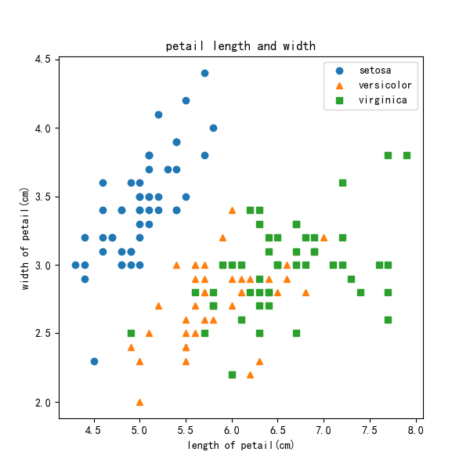
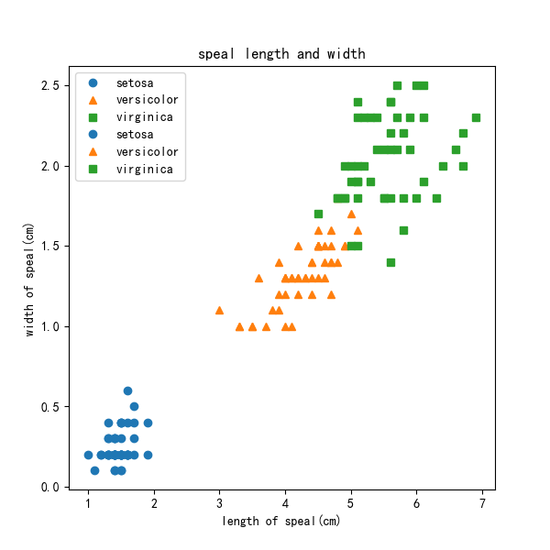
2.1 Datasets
Iris Dataset (Classification)
150 samples, 3 classes (Setosa, Versicolor, Virginica)
4 numerical features: sepal length, sepal width, petal length, petal width
Target variable: class labels {0, 1, 2}
California Housing Dataset (Regression)
20,640 samples (1990 U.S. Census)
8 continuous numerical features: median income, house age, average rooms per household, etc.
Target variable: median house value (in hundreds of thousands of dollars)

Slide 5
2.2 Data Preprocessing 2.3 Models Evaluated
Data Preprocessing
CML Models Preprocessing
Standardization of all continuous features
80/20 train-test split (stratified for Iris)
Label encoding for categorical values
ICL Preprocessing
Raw numerical values used directly (without normalization) to preserve readability
Raw features presented as key-value pairs in natural format
Models
CML Models
Support Vector Machine (SVM) — with RBF kernel for classification
Random Forest (RF) — 100 estimators, max depth tuned via grid search
Multi-Layer Perceptron (MLP) — 2 hidden layers with ReLU activation
ICL Models (Accessed via SiliconFlow API)
Qwen2-1.5B and Qwen2.5-7B (Alibaba DAMO Academy)
ChatGLM3-6B and GLM-4-9B (THUDM, Tsinghua University)

Slide 6
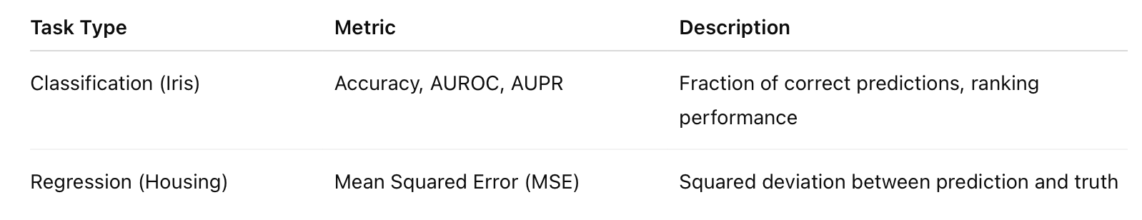
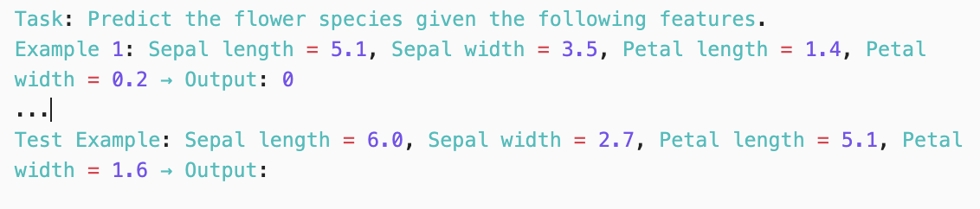
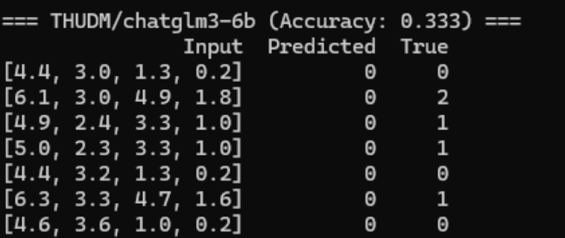
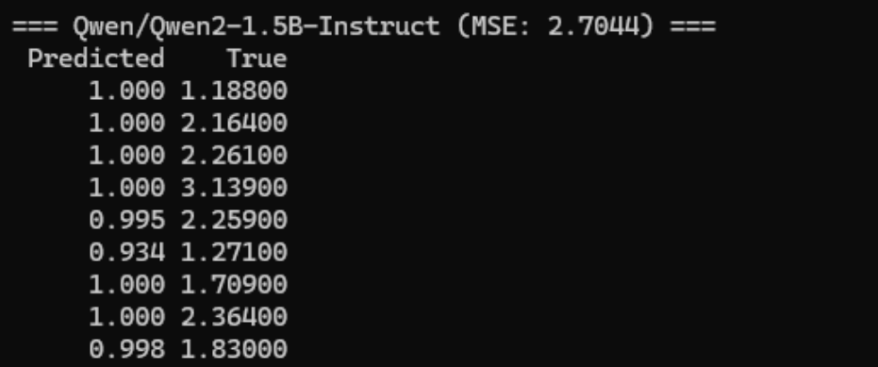
2.4 Prompt Design for ICL
2.5 Evaluation
•For classification, the output is an integer class label.
•For regression, the output is a continuous value.
Two prompt sizes were evaluated:
•5-shot: Five examples before test input
•10-shot: Ten examples before test input
Evaluation Scope
Each ICL model was evaluated on 30 randomly sampled test instances, while CML models were evaluated on the full test set.
The output of classification
The output of regression
Notes:
In this slide there is a background placeholder. Click to the small icon on the center of the slide and choose an image from computer. When add an image, you must sent it to back with Right Click on Image -> Send to Back -> Send to Back.
You can change the other image with Right click -> Change Picture-> Browse

Slide 7
3 Insights on ICL
Insight 3: Task Type Affects Model Preference – Qwen Favors Classification, THUDM Favors Regression
Insight 1: Larger Models Yield Better Performance in ICL
Insight 2: Increasing the Number of In-Context Examples Improves Accuracy
Insight 4: Prompt Format and Instruction Clarity Significantly Affect Output Quality

Slide 8
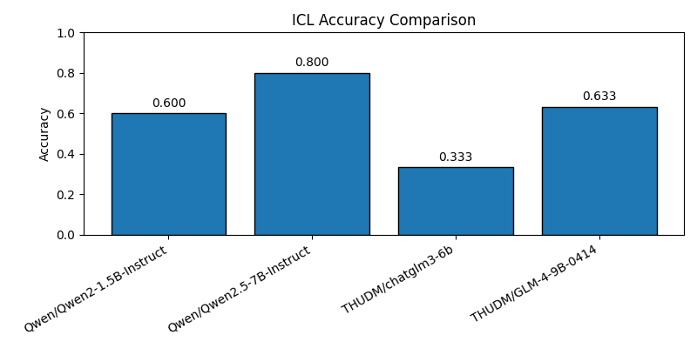
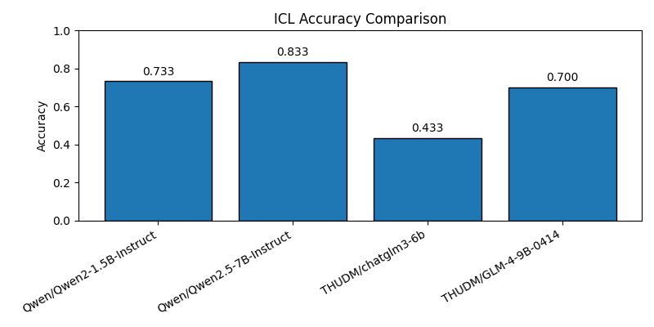
Insight 1: Larger Models Yield Better Performance in ICL
5-shot accuracy comparison
10-shot accuracy comparison
Evidence from Classification Task (5-shot & 10-shot)
Qwen2.5-7B consistently outperforms Qwen2-1.5B
GLM-4-9B outperforms ChatGLM3-6B, particularly in 10-shot settings
Accuracy improvements more pronounced for larger models as shot size increases
Notes:
You can change an image with Right click -> Change Picture-> Browse

Slide 9
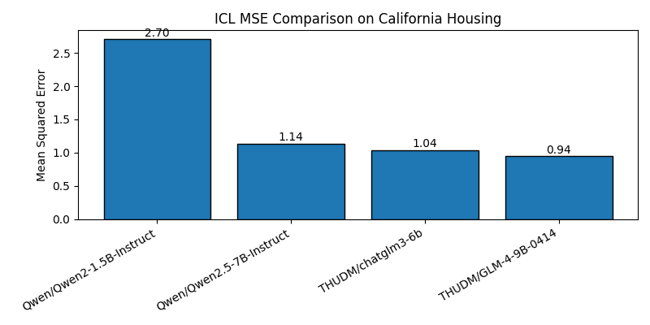
Insight 1: Larger Models Yield Better Performance in ICL
Evidence from Regression Task
GLM-4-9B yields the lowest Mean Squared Error (MSE).
ChatGLM3-6B performs better than both Qwen models.
Regression MSE
Explanation
Larger models benefit from:
Better representation learning due to wider and deeper transformer layers.
Longer effective context usage to parse example patterns.
Broader pretraining coverage including numerical and tabular reasoning tasks.
Notes:
You can change an image with Right click -> Change Picture-> Browse

Slide 10
Insight 2: Increasing the Number of In-Context Examples Improves Accuracy
5-shot accuracy comparison
10-shot accuracy comparison
Classification Task Accuracy Changes
From 5-shot to 10-shot, all models show accuracy improvements of 6-13%
Qwen2-1.5B jumps from 60% to 73%
Even the best-performing models (Qwen2.5-7B, GLM-4-9B) improve by 2-5%
Interpretation
Longer prompts offer better clarification of input-output format
Richer coverage of class distribution
More signal for models to detect task semantics
Notes:
You can change an image with Right click -> Change Picture-> Browse

Slide 11
Insight 3: Task Type Affects Model Preference
Regression MSE
10-shot accuracy comparison
Conclusion
Qwen excels at discrete label prediction, likely due to training on QA and classification tasks
THUDM models are stronger on continuous prediction, benefiting from more mathematical or numeric data exposure
Notes:
You can change an image with Right click -> Change Picture-> Browse

Slide 12

Insight 4: Prompt Format and Instruction Clarity Significantly Affect Output Quality
Common Issues
Output formatting mismatches (extra text, units, or no output at all)
Misinterpretation of numeric output in regression tasks
Default fallback to the most frequent class label
Mitigation Measures
Add explicit instructions: "Your response should contain only an integer label"
Apply temperature = 0 to enforce deterministic behavior
Use regex or numeric validation post-processing
Conclusion
This fragility makes ICL pipelines more susceptible to formatting issues compared to robust CML models
Iren Roe
Manager
Notes:
In this slide there is a background placeholder. Click to the small icon on the center of the slide and choose an image from computer. When add an image, you must sent it to back with Right Click on Image -> Send to Back -> Send to Back.
You can change the other image with Right click -> Format Picture -> Fill Tab -> Picture or texture fill -> File button

Slide 13
4 Insights on CML
Insight 6: Visual Separation in Feature Space Explains Model Success
Insight 5:CML Models Achieve Near-Perfect Accuracy
Insight 7: Full Training and Optimization Gives CML a Structural Advantage

Slide 14
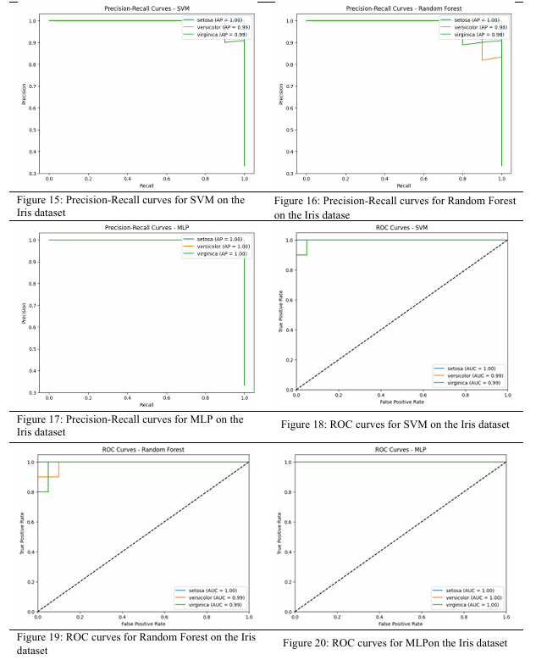
Insight 5: CML Models Achieve Near-Perfect Accuracy
AUPR & AUROC Performance
SVM: AUROC ≈ 0.99, AUPR ≈ 0.98
Random Forest: AUROC ≈ 1.00, AUPR ≈ 1.00
MLP: AUROC ≈ 0.98, AUPR ≈ 0.97
Notes:
You can change an image with Right click -> Change Picture-> Browse

Slide 15
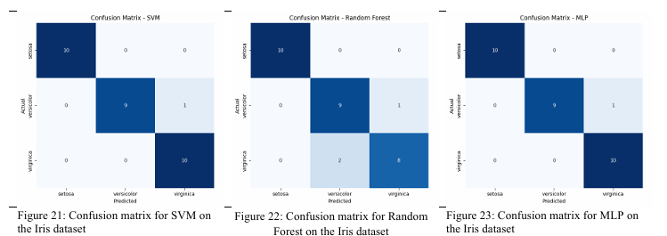
Insight 5: CML Models Achieve Near-Perfect Accuracy
Confusion Matrix Results
Each model's confusion matrix shows a dense diagonal, indicating highly accurate predictions with very few misclassifications:
Random Forest achieved perfect prediction on all three classes.
MLP and SVM had 1–2 off-diagonal entries, still yielding accuracy above 96%.
Notes:
You can change an image with Right click -> Change Picture-> Browse

Slide 16
Insight 6: Visual Separation in Feature Space Explains Model Success
One reason CML performs so well on the Iris dataset is the clear feature separability in the original input space. When visualizing the petal and sepal measurements, the three Iris classes form distinct clusters, enabling models like SVM or Random Forest to find optimal decision boundaries.
Petal length and width: Near-perfect linear separability
Sepal length and width: Moderate but informative clustering
This makes the dataset highly “learnable” using traditional methods, especially when the entire dataset is available during training. In contrast, ICL models operate on a small number of examples (5 or 10), limiting their exposure to the full class distributions.
Notes:
You can change an image with Right click -> Change Picture-> Browse

Slide 17
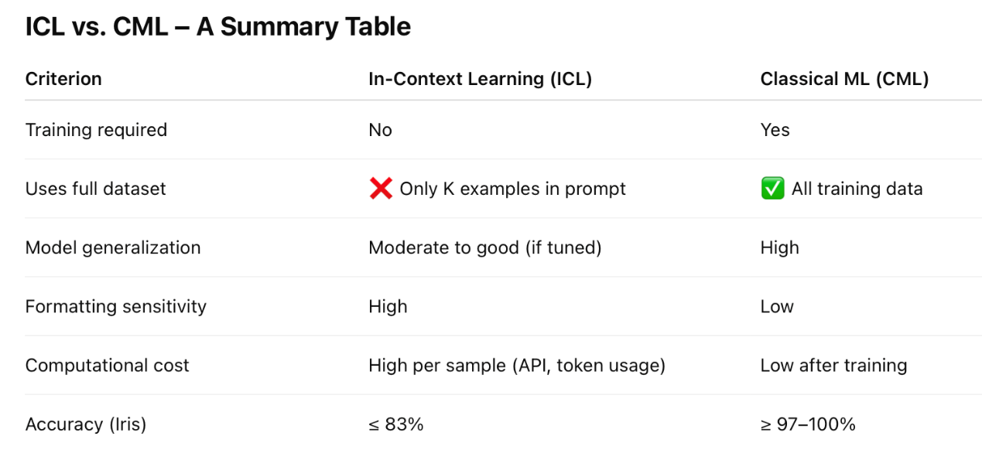
Insight 7: Full Training and Optimization Gives CML a Structural Advantage
Notes:
You can change an image with Right click -> Change Picture-> Browse

Slide 18
5 Comprehensive Comparison and Analysis
Having independently evaluated In-Context Learning (ICL) and Classical Machine Learning (CML) approaches, we now turn to a head-to-head comparison across key dimensions:
performance
Generalization
Flexibility
Interpretability

Slide 19
5.1 Performance Comparison:
CML Outperforms ICL on Structured Tasks
Classification (Iris Dataset)
CML (SVM, RF, MLP) achieved ≥97% accuracy, with AUROC and AUPR both near 1.0.
ICL models peaked at 83% accuracy (Qwen2.5-7B, 10-shot).
ICL models also showed higher variance and formatting sensitivity.
Regression (California Housing Dataset)
Best ICL model (GLM-4-9B) reached MSE ≈ 0.94, which is strong but still less consistent than traditional regression models trained on the entire dataset.
Qwen2-1.5B, a smaller ICL model, had MSE > 2.7, indicating weak generalization.

Slide 20
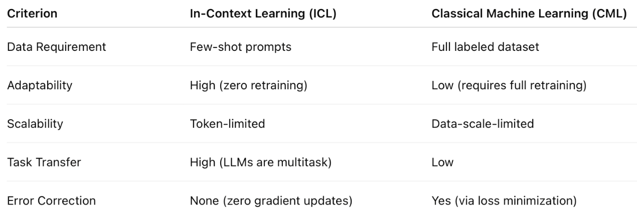
5.2 Generalization and Flexibility
CML is better when:
Full training data is available.
High accuracy and stability are required.
Feature engineering and model interpretability matter
ICL is appealing in scenarios where:
Labeled data is unavailable.
Real-time adaptation is required.
Deployment must be lightweight and training-free.

Slide 21
5.3 Interpretability and Stability
CML models offer traceable decision paths (e.g., feature importance in Random Forests, coefficients in SVM), facilitating debugging and interpretability.
ICL predictions are hard to trace; even deterministic outputs can change due to small prompt changes (e.g., wording or formatting).
CML outputs are reproducible given the same input. ICL predictions may vary across API calls or under small perturbations.

Slide 22
5.4 Limitations of ICL in Structured Tasks
Despite the elegance of ICL, it suffers from the following limitations:
Context Length Limitations Most LLMs have ~2,000–4,000 token limits. For high-dimensional tabular data or longer K-shot setups, this becomes a hard bottleneck.
Lack of Task-Specific Learning Without gradient updates, ICL cannot learn from mistakes or adjust to systematic errors across test instances.
Prompt Sensitivity Formatting, example order, label phrasing, and instruction wording can all significantly affect performance—sometimes more than model architecture itself.
Numerical Instability in Regression In regression tasks, LLMs sometimes generate non-numeric output or format-incompatible values, requiring post-processing logic.

Slide 23
5.5 Summary
While In-Context Learning represents a paradigm shift in how we deploy models, it is not yet a replacement for traditional machine learning in structured data settings. On datasets like Iris and California Housing:
CML models are faster, more accurate, and more stable.
ICL models offer generality and flexibility, especially useful for low-data or zero-training settings.
The ideal strategy may lie in hybrid approaches—where LLMs bootstrap quick initial predictions, and CML models refine them with data-specific learning.

Slide 24
6 Conclusion and Future Work
Strengths and Limitations of ICL
Summary of Findings
Future Directions
Interpretability

Slide 25
6.1 Summary of Findings
Larger LLMs like Qwen2.5-7B and GLM-4-9B consistently outperformed smaller models across both tasks. This confirms that greater model capacity improves pattern generalization, especially in low-data ICL settings.
Model Size Matters
Prompt Quantity Improves Accuracy
Moving from 5-shot to 10-shot prompts led to significant accuracy gains (up to +13%), especially in smaller models like Qwen2-1.5B. More examples help the model better understand task intent and input-output structure.
Qwen models were stronger in classification tasks, likely due to their pretraining on structured text and reasoning.
THUDM models performed better in regression, especially GLM-4-9B, suggesting robustness in numerical prediction.
Task Type Affects Model Suitability
Classical models (SVM, RF, MLP) achieved nearly perfect classification on Iris, with AUROC and AUPR ≈ 1. ICL models peaked at 83% accuracy. This gap is primarily due to:
CML’s use of the full dataset during training
ICL’s reliance on limited prompt examples and no parameter updates
CML Outperforms ICL on Structured Data

Slide 26
6.2 Strengrhs and Limitations of ICL
Training-Free Deployment: LLMs require no retraining for new tasks
Few-Shot Adaptability: Rapid prototyping with a handful of labeled examples
Multi-task Versatility: ICL models generalize across tasks and formats
Strengths
Context Window Constraint: Token limits restrict the number of in-context examples
No Learning Signal: ICL can't adapt or improve from errors
Prompt Sensitivity: Minor format changes can cause erratic outputs
Lower Accuracy on Tabular Data: Especially for numeric regression
Limitations

Slide 27
6.3 Future Directions
To overcome the limitations of pure ICL and further explore its integration with structured data learning, we suggest several future research paths:
Hybrid Approaches
Broader Benchmarking
Prompt Engineering Automation
Structured Data Pretraining
Chain-of-Thought and Reasoning Layers

Slide 28
6.4 Final Remarks
In-Context Learning is a powerful tool in the era of large foundation models, enabling task-solving without weight updates or labeled dataset access. However, when applied to structured data, its performance is still inferior to classical methods due to architectural and representational mismatches.
Nevertheless, ICL's ease of use, flexibility, and adaptability make it a compelling complementary strategy, particularly in resource-limited or rapidly changing environments. With further research, it could play a vital role in hybrid pipelineswhere LLMs and CML models work together to deliver accurate, efficient, and scalable AI systems.

Slide 29
Thanks For Watching

