Slide 1
Will They Go to ICU?
Predicting Unplanned ICU Admission from Intraoperative Blood Pressure Patterns
Dr Idris
Data: VitalDB · 100 surgical cases · Seoul National University Hospital

Slide 2
The Clinical Problem
● Every anaesthetist faces this at case end: "Does this patient need ICU or can they go to the ward?"
● The decision is usually based on gut feeling + experience
● Getting it wrong matters:
● Missed ICU → patient deteriorates on the ward
● Over-triage → wasted ICU bed in a scarce resource
Can we use data already being recorded to help make this call?

Slide 3
What Data Do We Already Have?
● Every patient with an arterial line has continuous MAP recorded every 2 seconds
● By end of case: thousands of blood pressure readings we currently ignore
● Plus: blood loss, fluids given, vasopressor use — all routinely documented
We are sitting on a goldmine of data we already collect but don't systematically use

Slide 4
Study Design
Data Source
Two Models Compared
● VitalDB — open-access surgical database
● 100 cases with complete arterial line recordings
● 51 went to ICU, 49 to ward
● Beat-averaged MAP at ~2-second resolution
Model A — Intraop Only 16 features from surgery alone (MAP metrics + blood loss + fluids + vasopressors)
Model B — Full Model 22 features = Model A + age, BMI, ASA, emergency status, comorbidities
Key question: Does knowing who the patient is before surgery add anything to what we observe during surgery?

Slide 5
What Did We Measure from Blood Pressure?
Turning a continuous MAP signal into interpretable numbers
Average MAP
Overall perfusion pressure
Longest episode duration
Sustained hypoperfusion
% time MAP < 65 mmHg
Total hypotension burden
Time to first episode
Early fragility marker
% time MAP < 55 mmHg
Severe hypotension (organ damage)
MAP variability (SD, IQR)
Haemodynamic lability
Number of hypotensive episodes
How many times BP dropped
MAP trend (slope)
Getting worse or stable?
+ Clinical variables: estimated blood loss, urine output, crystalloid/colloid, vasopressors, transfusion

Slide 6
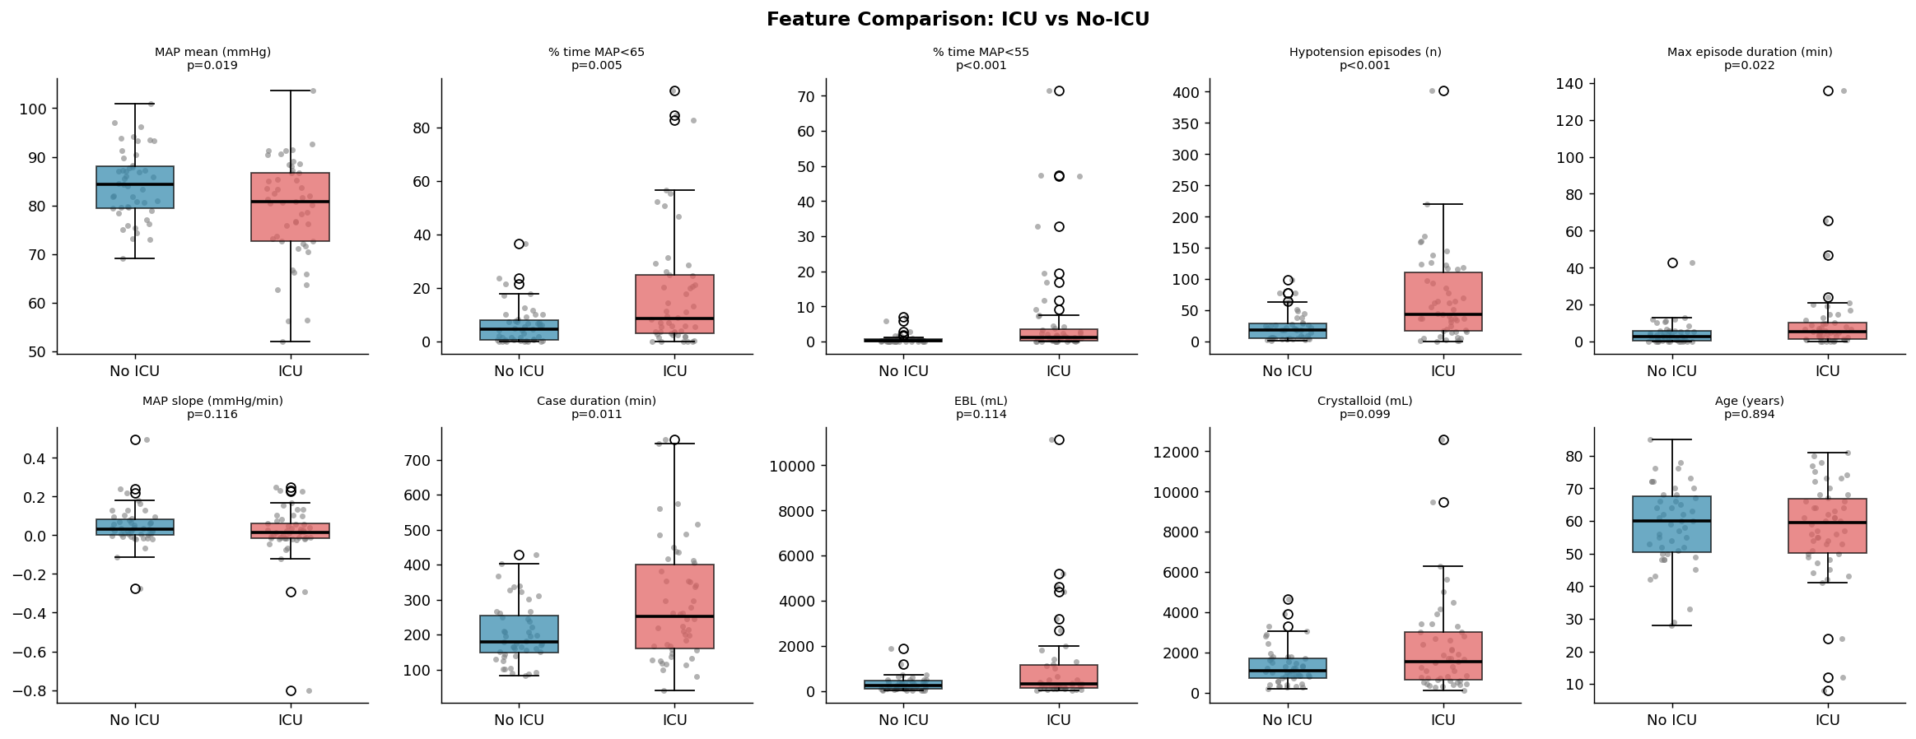
ICU vs Ward: What Looks Different?
No single number perfectly separates ICU from ward — the combination of features provides discriminative power

Slide 7
The Machine Learning Approach
Keeping it simple
● Random Forest = a committee of 300 decision trees
● Each tree asks simple yes/no questions: "Is MAP < 70?" "Episodes > 3?" "Blood loss > 500 mL?"
● All 300 trees vote → majority rules → ICU or Ward
● Validated with 5-fold cross-validation: Train on 80%, test on 20% — repeated 5 times so every patient gets tested on data the model hasn't seen
Logistic Regression (linear baseline)
Random Forest (committee of trees)
Gradient Boosting (learns from mistakes)

Slide 8
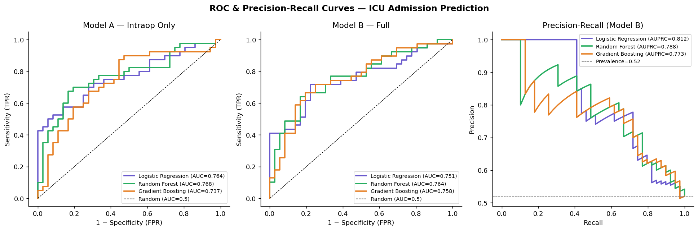
Results: How Well Does It Work?
AUC = 0.789 (Intraop Only, Random Forest) "Pick one ICU + one ward patient at random → model identifies which is which 79% of the time"
Intraop-only model BEAT the full model! What happens during surgery predicts ICU better than who the patient was before surgery

Slide 9
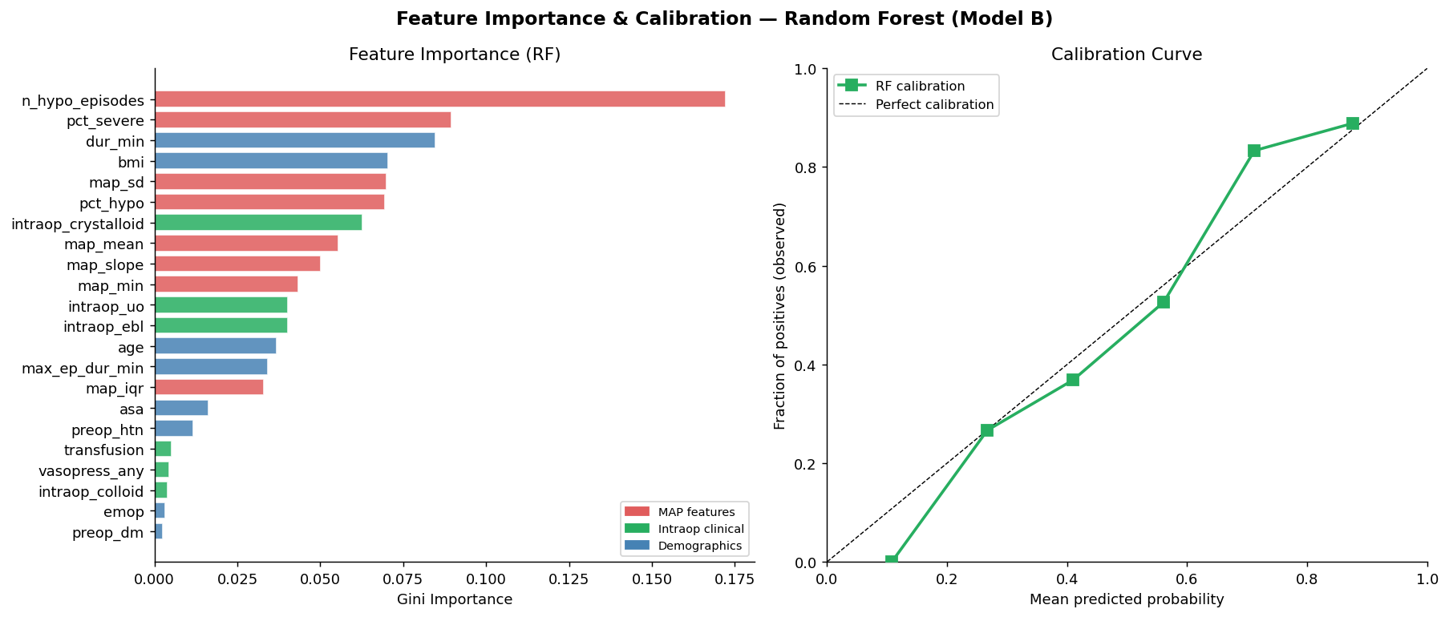
What Matters Most?
Feature importance from Random Forest
#1 Number of hypotensive episodes — not total time hypotensive!
#2 Severe hypotension (MAP < 55) — below autoregulation threshold
#3 Case duration — proxy for surgical complexity

Slide 10
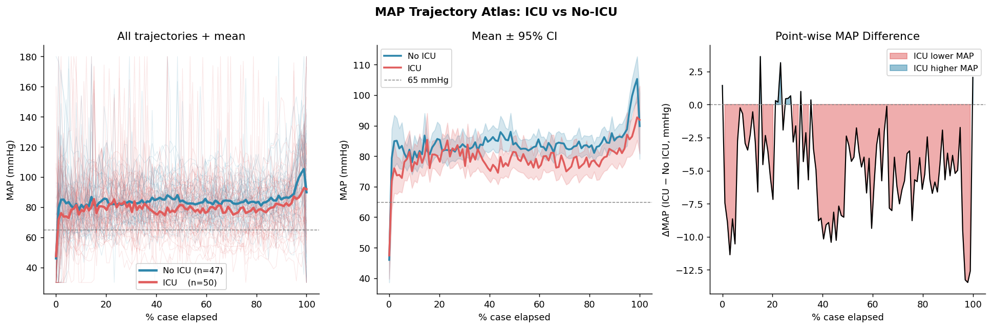
The MAP Trajectory Atlas
Comparing blood pressure patterns throughout the entire case
● ICU patients have persistently lower MAP throughout — not just at isolated moments
● Biggest gap during the maintenance phase (middle of surgery)
● Mean MAP: ICU 79.1 vs Ward 83.9 mmHg (p = 0.036) — even 5 mmHg matters

Slide 11
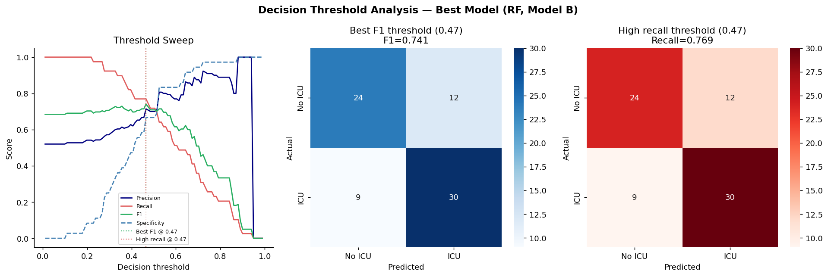
Clinical Performance
At the optimal decision threshold (0.50)
77%
67%
0.74
72%
Sensitivity (Catches ICU patients)
Specificity (Correctly clears ward)
F1 Score (Overall balance)
Accuracy (Overall correct)

Slide 12
The Key Clinical Message
Count the Dips, Not Just the Duration
● The #1 predictor was number of hypotensive episodes — not total time spent hypotensive
● Repeated drops and recoveries (ischaemia-reperfusion cycles) may be more injurious than one sustained dip
● This aligns with emerging evidence on episodic vs cumulative hypotension burden
● Clinically: a patient who dips below MAP 65 six times may be at higher risk than one who stays at MAP 60 for 10 minutes

Slide 13
How Would This Work in Practice?
1
Arterial line MAP is already recorded in the AIMS
2
At case end, algorithm automatically calculates risk score
3
Score ≥ 50% triggers a clinical review alert
4
Anaesthetist reviews MAP trajectory + clinical data
5
Final ICU decision remains with the clinician
No new equipment · No manual data entry · Decision support, not replacement

Slide 14
Limitations
● Small sample size (100 cases) — needs external validation
● Enriched ICU prevalence (51% vs real-world ~15–20%) → requires prevalence recalibration before deployment
● Single-centre data (Seoul) — generalisability to other populations and practice patterns unknown
● Retrospective design — no proof yet that it changes outcomes
● Missing variables: cardiac output, depth of anaesthesia, temperature, regional anaesthesia techniques

Slide 15
Key Takeaways
1
Intraoperative MAP patterns predict ICU admission with AUC = 0.789
2
What happens during surgery matters more than who the patient was before surgery
3
Count the dips — episode count beats total hypotension duration as a predictor
4
Even a 5 mmHg sustained MAP difference is prognostically meaningful
5
This could be automated with zero additional monitoring equipment

Slide 16
Thank You
Questions?
Data: VitalDB (vitaldb.net) — open access
Key references:
Walsh et al. Anesthesiology 2013 — MAP thresholds & outcomes
Wesselink et al. BJA 2018 — Hypotension & adverse outcomes review
Lee et al. Sci Data 2022 — VitalDB dataset

