Slide 1
Seven levels of building beautiful websites with Claude Code
One product. One ladder. Two models. Every artifact preserved verbatim — and everything in this talk is live at one link.
Notes:
One product, one ladder, two models. Everything you'll see is live at the link on screen.

Slide 2
WHY THIS TALK
95% of Claude-built websites look generic — and it isn't the model's fault.
Missing skills and references — “Mozart with no piano.”
Source: Jack Roberts' “7 Levels of Building Claude Code Websites.”
This is a replication with receipts — plus a model comparison the video didn't do.
Notes:
Credit the source video. This is a replication with receipts — and a model comparison he didn't do.

Slide 3
THE EXPERIMENT
One yellow iPhone. The same prompts, run twice.
Fable 5 and Opus, in parallel folders — same references, same skills, same order.
Every level's HTML frozen the moment it was built; SHA-256 checksummed in the repo.
The medium is the message: this deck and the tutorial site were built the same way.
Notes:
The medium is the message: this deck and the tutorial site were built with Claude Code too.

Slide 4
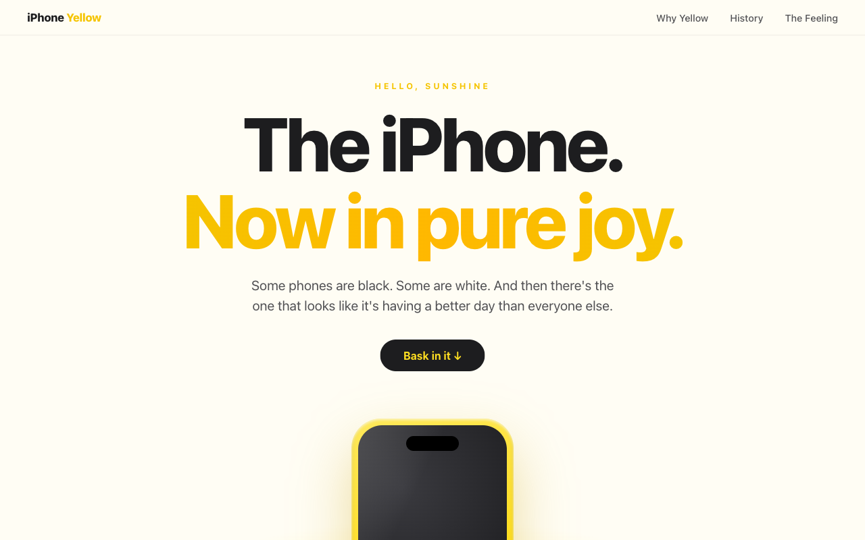
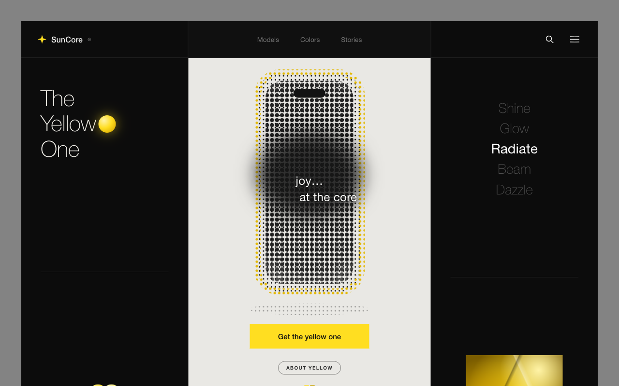
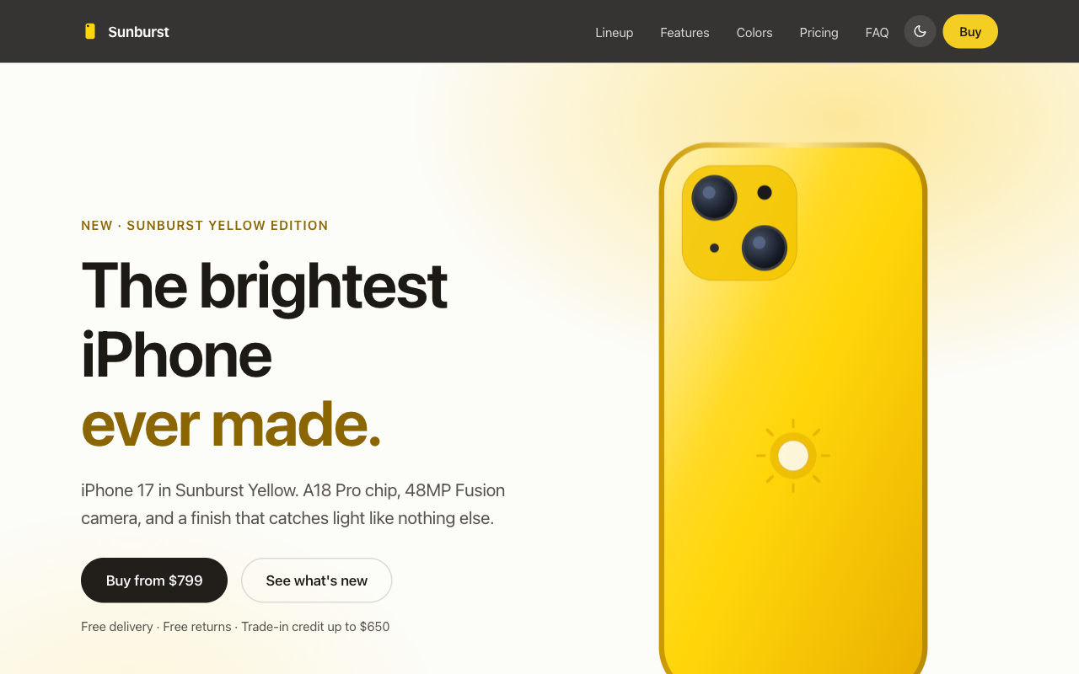

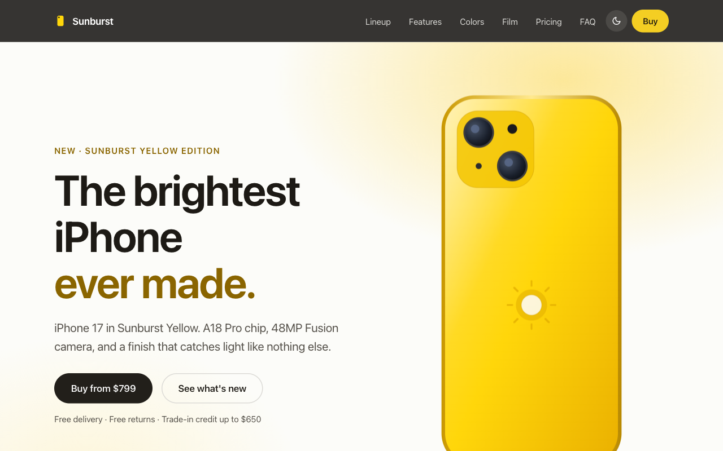
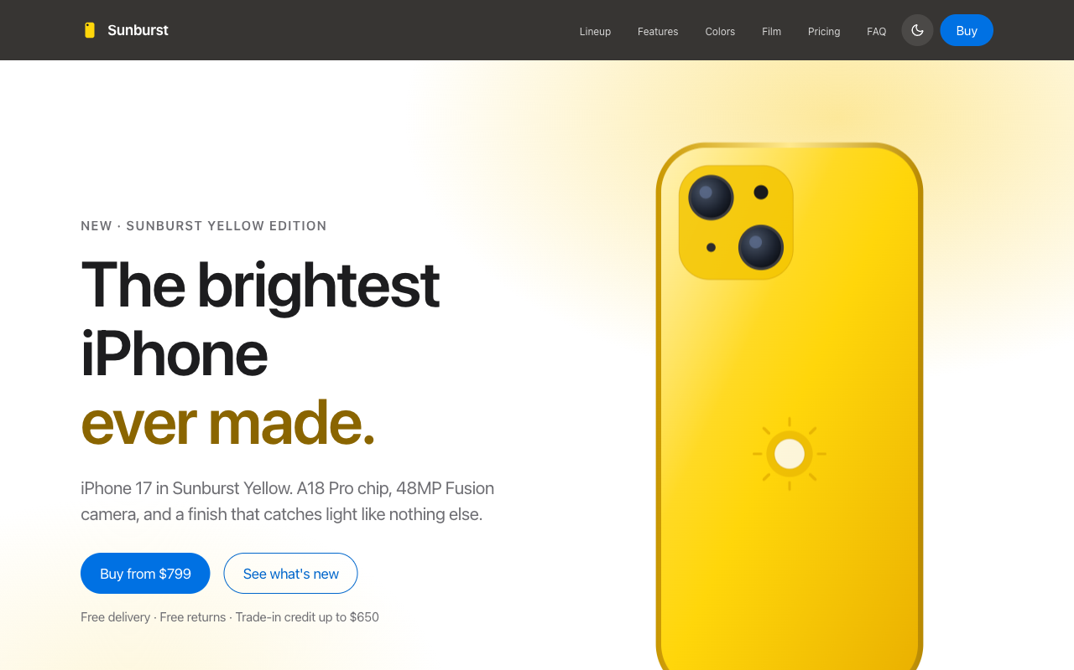
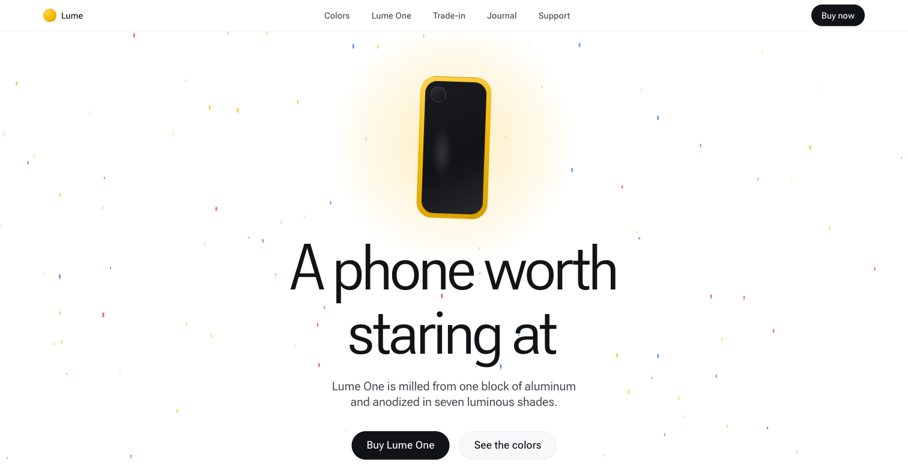
THE MENTAL MODEL FOR THE HOUR
The ladder
1
2
3
4
5
6
7
Grab & go
References
Design skills
UI snipping
AI video
Data
Extraction
Each level adds one technique. They compound.
Notes:
Each level is one technique, and they compound. Our order swaps video/snipping vs the source video.

Slide 5
GROUND RULES
Treat prompting experiments like experiments.
Verbatim evidence — no touch-ups after the fact.
Named output files per level, so history stays immutable.
One variable changed at a time (even: “do NOT use superpowers plugin”).
Notes:
This discipline is what makes the comparison meaningful.

Slide 6
LEVEL 1 · GRAB AND GO
The prompt everyone writes
Claude, I want you to build for me a simple website or just a nice looking website that is cool about iPhones that are yellow. Build me one of those website.
name the file as yellow-iphone-web-level-1.html
Notes:
Read the prompt out loud. It's the prompt everyone writes.

Slide 7
LEVEL 1 · RESULT
What “default AI design” looks like
LIVE DEMO — /compare?level=1
Competent, safe, generic — in both models.
Fable spontaneously asked about reference images sitting in the folder: agents look around.
Notes:
LIVE DEMO 1 (~3 min): open /compare?level=1, scroll both panes. Point out default AI design: centered hero, safe gradient, no point of view.

Slide 8
LEVEL 2 · SCREENSHOTS & REFERENCES
Show, don't tell.
One reference image replaces paragraphs of adjectives.
Hunting grounds: godly.website · Land-book · Awwwards · Dribbble.
Attach the screenshot: “use this as the reference style.”
Notes:
An image speaks a thousand words — literally true for design prompting.

Slide 9
LEVEL 2 · RESULT
The layout inherits the reference's rhythm
Level 1 — before
Level 2 — after one reference image
War story: Opus overwrote level 1 on its first try — state the save-as rule up front.
Notes:
References convey looks, not behavior — 'make the buttons work' was a separate ask.

Slide 10
LEVEL 3 · DESIGN SKILLS
Mozart gets a piano
Skills = packaged design expertise: 67 UI styles, 161 palettes, font pairings, UX rules.
Install from GitHub once (ui-ux-pro-max, power-design, shadcn) — invoke by asking.
The model stops guessing what good looks like.
Notes:
The Mozart-gets-a-piano moment. Opus prompt pinned variables: do NOT use superpowers plugin.

Slide 11
LEVEL 3 · RESULT
The model catches its own bug
File size doubled, 20KB → 56KB: that's the design system arriving.
Fable's WCAG pass caught a real CSS specificity bug — white-on-yellow nav — and fixed it to 11.3:1 contrast.
Let the model verify: dark mode, 320px reflow, contrast. It finds real bugs.
Notes:
Let the model verify — it finds real bugs.

Slide 12
LEVEL 4 · UI SNIPPING
Don't re-engineer the fireplace — copy it.
Production components from 21st.dev, Magic UI, CodePen, Mobbin.
Paste the code — or just screenshots of it — and ask Claude to integrate.
Here: balloons-js, a celebration animation, into a no-build HTML page.
Notes:
Don't re-engineer the fireplace — copy it.

Slide 13
LEVEL 4 · RESULT
Same ask, different engineering
 | Fable 5 | Opus
Dependency strategy | Inlined the library — self-contained file | Runtime import from esm.sh
Bonus move | Fixed an upstream memory leak it spotted in its own screenshots | Translated React → vanilla JS on the fly
Notes:
Model personality shows up at the dependency-strategy level, not the pixel level.

Slide 14
LEVEL 5 · AI IMAGE & VIDEO
Generate the media you don't have
OpenArt: image model → pick a product shot → video model.
Trick: start frame = end frame → the rotation loops perfectly.
Then two words of art direction to Claude: “be relevant.”
Notes:
Media is what separates AI website from production website.

Slide 15
LEVEL 5 · RESULT
The single biggest perceived-quality jump
LIVE DEMO — /compare?level=5
Both models chose muted, scroll-triggered autoplay unprompted — they know browser policy.
Notes:
LIVE DEMO 2 (~4 min): open /compare?level=5, let the product film play in both panes.

Slide 16
LEVEL 6 · DATA RESEARCH
A beautiful site that doesn't convert is a Ferrari with no engine.
Firecrawl scrapes live sites: type scale, palette, spacing, tone — from apple.com itself.
Bigger pattern: research winners vs losers in your market, score them, build from evidence.
The actual scrapes are preserved in the repo.
Notes:
Mention the research-prompt pattern: winners vs losers analysis, scoring matrix, evidence-based blueprint.

Slide 17
LEVEL 6 · THE OVERWRITE INCIDENT
Two sessions raced. One file lost.
The level-7 session silently clobbered level-6.html while it was being built.
Fable diagnosed the race, mined the other session's transcript for the build recipe, and restored the file — flagged as a rebuild, not the original.
Lessons: partition concurrent sessions; transcripts are recoverable state.
Notes:
Best war story of the experiment.

Slide 18
LEVEL 7 · DESIGN EXTRACTION
The strongest lever
A skill extracts a site's full design language: tokens, type ladder, easing, load-bearing rules.
Claude rebuilds your product in that language. Translation, not cloning.
Target here: antigravity.google — grey palette, weight-450 headings, pill shapes, alpha borders.
Notes:
Most humans can't articulate why a design is great — the skill does it for them.

Slide 19
LEVEL 7 · RESULT
Lume vs LUMA
LIVE DEMO — /compare?level=7
Both models independently invented near-identical brand names from the same design language. Extraction converges.
Opus shipped a full kit: tokens.json, structure.css, builder brief, verified preview.
Notes:
LIVE DEMO 3 (~4 min): open /compare?level=7. Show process-artifacts/ if time allows.

Slide 20
THE WHOLE CLIMB
Night and day. Chalk and cheese.
Level 1 — one prompt
Level 7 — the same model, with a system
Notes:
Pause here. This is the money slide.

Slide 21
FABLE VS OPUS · METHODOLOGY
Only one variable: the model
Same prompts, same references, same skills, same order.
Parallel folders, parallel sessions, artifacts frozen at each level.

Slide 22
FABLE VS OPUS · DIVERGENCE
Where they split
 | Fable 5 | Opus
Dependencies | Inline everything | Import from CDN
Verification | Screenshots aggressively; QAs contrast & viewports | Verifies at milestones
Artifacts | One self-contained page | Kits: blueprint + scaffold + memory
Level 5 file size | 151 KB (all inlined) | 46 KB (CDN)
Fable QAs harder; Opus scaffolds harder.
Notes:
Fable QAs harder; Opus scaffolds harder.

Slide 23
FABLE VS OPUS · CONVERGENCE
Where they agree
Near-identical brand names from the same design language (Lume / LUMA).
Same autoplay policy, same layout instincts, same accessibility reflexes.
Technique dominates model choice: level-7 Opus beats level-1 Fable, every time.
Notes:
Technique dominates model choice.

Slide 24
VERDICT
The ladder is the lever.
The model is the multiplier.

Slide 25
META-LESSONS
Four inequalities to remember
References > adjectives
Skills > instructions
Research > invention
Verification > hope

Slide 26
TRICKS & GOTCHAS
Field notes
Name output files — keep every level as immutable evidence.
Change one variable at a time; exclude plugins explicitly.
Partition concurrent sessions — they will race on files.
Budget one extra prompt from blueprint → deliverable.
Let the model look at its own screenshots.

Slide 27
WHAT THIS MEANS FOR KITE
The scaffolding is the product
Agent-built UI is production-viable today — with skills, references, data access, and paid tools (Firecrawl, OpenArt).
Every level up the ladder, the agent consumed more external services autonomously.
Agents that research, buy assets, and verify on their own need identity and payments — that's Agent Passport.
Notes:
Tie to Agent Passport: the OpenArt/Firecrawl steps are agentic commerce in miniature.

Slide 28
TRY IT YOURSELF
Everything is one link
Live site, all 14 demos, the compare view, this deck.
The curated prompt log — the exact prompts, per level.
The design-language extraction skill, ready to install.
github.com/chizhangucb/claude-code-seven-levels

Slide 29
Q&A
Which level has the best ROI? Where would you stop for internal tools? What should we extract next?
Notes:
Seed questions if quiet: best ROI = levels 2-3. Internal tools can stop at level 3.

