Slide 1
Title: Skill‑Task Tracker
NAME: James Kariuki
Date: 29th JUNE
Subtitle: Phase 1 Portfolio Project

Slide 2
Project Overview
Skill-Task is a skill progress tracker that enables:
- Live profile editing
- CRUD operations for Projects, Tasks, and Notes
- Light/Dark mode toggle
- Real-time DOM updates with server sync

Slide 3
Technologies Used
HTML & CSS
JavaScript
JSON Server (local API)
DOM Manipulation
Fetch API
Responsive Design

Slide 4
Key Features
Developer Profile (with upload support)
Project Portfolio Manager
Task Tracker
Learning Notes Section
Dark Mode with persistence
Modular layout and responsive design

Slide 5
Challenges & Fixes
Image upload glitch caused by base64 rendering in form resets.
Fixed by handling form reset timing + fallback image logic.
Ensures uploaded images are valid base64 or hosted URLs.

Slide 6
Deployment & Usage
Run JSON Server:
json-server --watch db.json.
Open index.html in browser.
All data is stored and synced via JSON Server.
Ideal for local portfolio showcase.

Slide 7
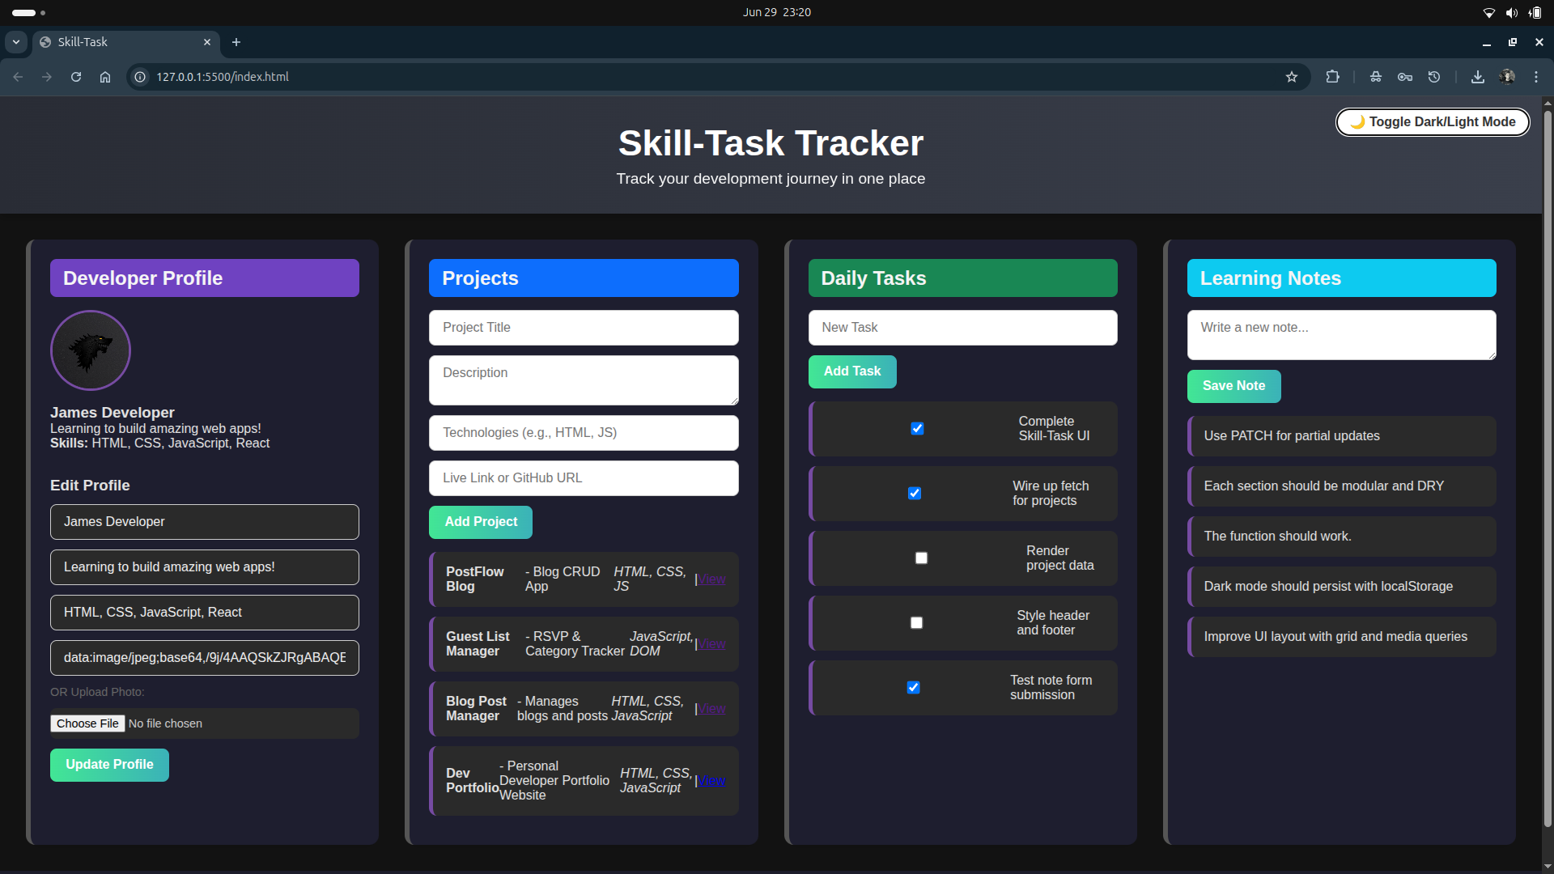
UI Screenshots

Slide 8
VIDEO LINK

Slide 9
About the Developer
Name: James Kariuki
Email: [james.kariuki5@student.moringaschool.com]
GitHub: https://github.com/chiznox6
Linked-in: www.linkedin.com/in/chizno-x-669514216

Slide 10
Thank You!
Thanks for viewing the Skill-Task Tracker.
Feel free to explore the GitHub repository or reach out for feedback.
🔗 github.com/jamesdev/skill-task

