Slide 1

Java와 swing을 활용한
Mole javagame Application
추호진

Slide 2
01
02
03
About
TimeLine
Architecture
- 프로젝트 소개
- 개발환경
- 프로그램 개발(3주)
- Refactoring(1달)
- 시스템구조
- 프로그램 구조
- FileServer 구조
- DataBase 설계
04
05
06
ClassDiagram
SequenceDiagram
Play
- 패키지별 Class 설명
- 팀폴더검색 유즈케이스
- 시연 동영상 및 Q&A

Slide 3





About
Timeline
Architecture
Class
Sequence
Play
공모전/게시판
TeamMatching
스케쥴러
팀폴더

Slide 4















About
Timeline
Architecture
Class
Sequence
Play
<Development Environment>
Language
WAS
Tool
Framework/lib

Slide 5
About
Timeline
Architecture
Class
Sequence
Play
TIME
07.08~07.14
프로젝트 분석
07.15~07.25
프로젝트 설계
07.26~08.02
코딩 및 디버깅
주제선정 / 벤치마킹
/ SWOT분석/ 요구사항정의서
/ 1차 키추출/ Usecase-Diagram
/ Usecase 명세서 / 2차 키추출
분석단계 Diagram / Class-Diagram / DataBase 설계 / 화면설계 / Sequence-Diagram
코드 작성
/ 디버깅 / 코드 수정

Slide 6
About
Timeline
Architecture
Class
Sequence
Play
LINE
10.13 ~ 10.16
프로젝트 분석
10.17 ~ 10.22
프로젝트 설계
10.22 ~ 10.26
코딩 및 디버깅
Refactoring 적용 기술 학습
/ 프로젝트 분석 및 테스트
DataBase 수정 및 설계
/ Class 수정 및 설계
/ Sequence-Diagram작성
코드작성 / 테스트

Slide 7
.게임구성
로그인
-> 회원가입
-> ID,PW입력
로그인
o로그인
시작
게임뷰
대기실
-> 게임참가 인원 정보보기
-> 게임참가 인원 1:1채팅
-> 게임참가 인원 랜덤대전
-> 게임참가 인원 대전신청
-> 대기실 인원 채팅
정보보기
대기실
1:1 채팅
- 게임방
-> 게임 준비,실행
-> 게임방 채팅
-> 대기실 인원 보기

Slide 8



About
Timeline
Architecture
Class
Sequence
Play
<System Architecture>
GET
POST
…
request
WAS
Container
request
response
DBMS
(Oracle)
Client
response
Data
GET
POST
…
Servlet
request
Data
Fileserver
(Dropbox)
Client
response

Slide 9



About
Timeline
Architecture
Class
Sequence
Play
<Software Architecture>
Container
DAO
Form
Validator
DTO
HTML/JSP
Servlet
DBManager
Model
Member
Post
Contest
Team
Schedule
File
Model
Manager

Slide 10
About
Timeline
Architecture
Class
Sequence
Play
<Software Architecture>
Container
DAO
Model
DTO
Dispatcher
Servlet
HTML/JSP
Controller
Service
Model
TeamFolder

Slide 11




About
Timeline
Architecture
Class
Sequence
Play
<SpringFramework>
ControllerClassName
HandlerMapping
InternalResource
ViewResolver
HandlerMapping
ViewResolver
-servlet.xml
DispatcherServlet
Client
Controller
Service

Slide 12





About
Timeline
Architecture
Class
Sequence
Play
<FileServer 구조>
Root
첨부파일
포트폴리오
팀폴더
사용자ID
사용자ID
팀번호
팀번호
게시물번호
게시물번호

Slide 13
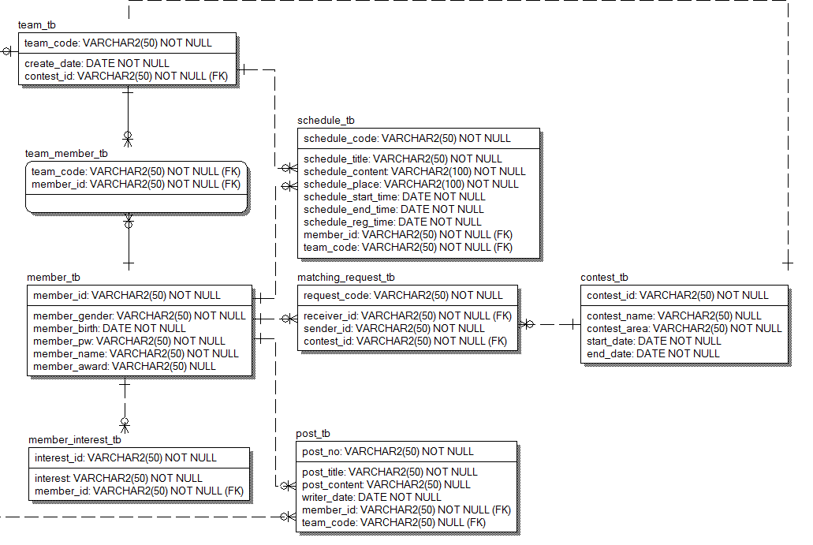
About
Timeline
Architecture
Class
Sequence
Play
<DataBase 설계>

Slide 14
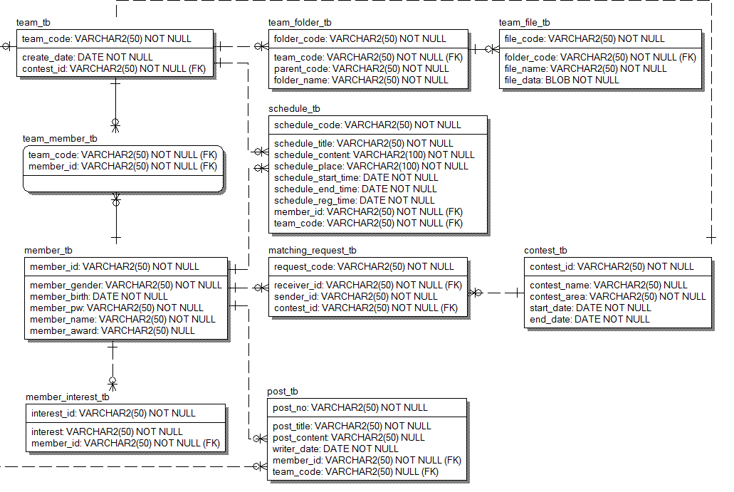
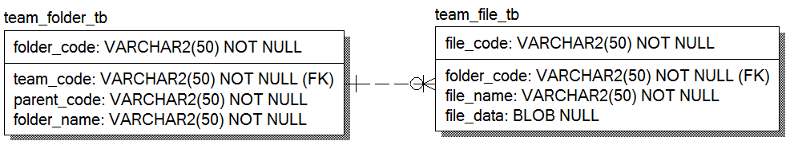
About
Timeline
Architecture
Class
Sequence
Play
<DataBase 설계>

Slide 15
About
Timeline
Architecture
Class
Sequence
Play
Servlet
MemberContollerServlet
Form
DTO
PostContollerServlet
FileContollerServlet
Validator
Client로부터 요청을 받아 처리하고
응답하는 객체를 모아놓은 패키지
DAO
ContestContollerServlet
TeamContollerServlet
Manager
DBManager
Model
ScheduleContollerServlet

Slide 16
About
Timeline
Architecture
Class
Sequence
Play
ScheduleSearchForm
Servlet
ScheduleModifyForm
Form
DTO
ScheduleAddForm
ScheduleRemoveForm
Client로부터 넘어온 데이터를
캡슐화한 객체를 모아놓은 패키지
PostInfoForm
Validator
DAO
SearchForm
MemberRegisterForm
Manager
MemberModifyForm
DBManager
MemberLoginForm
Model
ContestInfoForm

Slide 17
About
Timeline
Architecture
Class
Sequence
Play
ScheduleSearch Validator
Servlet
ScheduleModify Validator
Form
DTO
ScheduleAdd Validator
ScheduleRemove Validator
Presentation계층에서
Application계층으로 넘어온
데이터의 유효성을 검사하는
객체를 모아놓은 패키지
PostInfoValidator
Validator
DAO
SearchValidator
MemberRegister Validator
Manager
MemberModify Validator
DBManager
MemberLogin Validator
Model
ContestInfo Validator

Slide 18
About
Timeline
Architecture
Class
Sequence
Play
TeamFolderController
ScheduleAddManager
Servlet
ScheduleSearchManager
ScheduleDetailManager
ScheduleRemoveManager
ScheduleModifyManager
Form
DTO
TeamAddManager
TeamRemoveManager
TeamSearchManager
TeamDetailManager
TeamJoinManager
TeamExitManager
TeamMatching
SearchManager
TeamMatching
RequestManager
Client로부터 받은 요청을
Servlet으로부터 위임받아
처리하는 객체를 모아놓은 패키지.
TeamMatching
AgreeManager
TeamMatching
DisagreeManager
Validator
DAO
TeamMatching
DetailManager
PostRemoveManager
PostAddManager
PostSearchManager
PostDetailManager
PostModifyManager
MemberWithdrawManager
MemberIdentifyManager
MemberLoginManager
MemberDetailManager
Manager
DBManager
MemberModifyManager
MemberRegisterManager
MemberSearchManager
ContestRemoveManager
Model
ContestAddManager
ContestModifyManager
ContestDetailManager
ContestSearchManager

Slide 19
About
Timeline
Architecture
Class
Sequence
Play
FolderInfo
FileInfo
Servlet
FolderTreeInfo
ScheduleInfo
Form
DTO
ScheduleInfoList
TeamScheduleInfo
List
TeamInfoList
TeamInfo
프로그램에 필요한 데이터를
일정한 기준에 의해 캡슐화한
객체를 모아놓은 패키지
MatchingRequest
Validator
DAO
MatchingRequestList
TeamPostInfoList
PostInfoList
PostInfo
MemberLoginInfo
MemberAddedeInfo
Manager
DBManager
MemberInfoList
MemberInfo
Model
ContestInfoList
ContestInfo

Slide 20
About
Timeline
Architecture
Class
Sequence
Play
Servlet
TeamFolderService
Form
DTO
ScheduleDBManager
TeamDBManager
프로그램에 필요한 DAO를
서비스별로 캡슐화한
객체를 모아놓은 패키지
Validator
DAO
TeamMatchingDBManager
PostDBManager
Manager
DBManager
MemberDBManager
Model
ContestDBManager

Slide 21
About
Timeline
Architecture
Class
Sequence
Play
DBConnectionPool
Servlet
BaseDAO
Form
DTO
MemberInterestDAO
ContestDAO
MatchingRequestDAO
Data Access Object의 약자로써
DB에 접근하여 Data를 관리하는
역할을 하는 객체를 모아놓은 패키지
PostDAO
Validator
DAO
TeamDAO
TeamMemberDAO
MemberDAO
ScheduleDAO
Manager
DBManager
TeamFolderDAO
Model
TeamFileDAO
SequenceDAO

Slide 22
About
Timeline
Architecture
Class
Sequence
Play
TeamFolderDTO
Servlet
TeamFileDTO
Form
DTO
ScheduleDTO
Data Transfer Object의 약자로써
계층간 데이터 전송시 사용하는
객체를 모아놓은 패키지.
TeamDTO
Validator
DAO
TeamMemberDTO
PostDTO
Manager
DBManager
MemberInterestDTO
Model
MemberDTO

Slide 23
About
Timeline
Architecture
Class
Sequence
Play
teamMain.jsp
DispatcherServlet
ControllerClassNameMapping
1 : 팀폴더를 선택한다.()
2 : doGet(httpServletRequest,HttpServletRequest,httpServletResponse:HttpServletResponse)
-servlet.xml
3
TeamFolderController반환

Slide 24
TeamFolderController
TeamFolderService
TeamFolderDAO
4 : index(teamCode:String):ModelAndView
applicationContext.xml
5 : searchTeamFolderList(teamCode:String):List<FolderTreeInfo>
6 : findByTeamCode(teamCode:String):List<TemFolderDTO>
DTO를 MODEL로 변환
MODEL을 JSONObject로 변환

Slide 25
HashMap
ModelAndView
폴더목록정보
<<create>>
7 : put(key:String,value:Object)
folderView
8 : ModelAndView(viewName:String)
9 : addAllObject(modelMap:Map<String,Object>)
Notes:
7.HashMap을 생성 후 JSONObject형태로 변환한 폴더정보를 HashMap에 저장합니다.
8,9. folderView라는 명칭을 전달인자로 ViewName으로 설정한 ModelAndView를 생성하고 HashMap을 Model에 추가합니다.

Slide 26
DispatcherServlet
InternalResourceViewResolver
folderView.jsp
-servlet.xml
10
/JSP/folderView.jsp
11 : 응답(response)
Notes:
10. DispatcherServlet이 InternalResourceViewResolver를 이용하여 Controller를 통해 반환된 ModelAndView의 논리적 View와 Mapping되는 WEB-INF폴더 하위에 존재하는 View자원을 반환합니다. –servlet.xml에 prefix와 suffix를 설정해놓아서 /JSP/folderView.jsp라는 View자원을 반환합니다.
11. DispatcherServlet이 View와 Model을 렌더링 한 후 결과를 client에게 응답(response) 합니다.

Slide 27
About
Timeline
Architecture
Class
Sequence
Play

Slide 28
About
Timeline
Architecture
Class
Sequence
Play
Q & A

Slide 29
♥
♥
Thank you!

