Slide 1
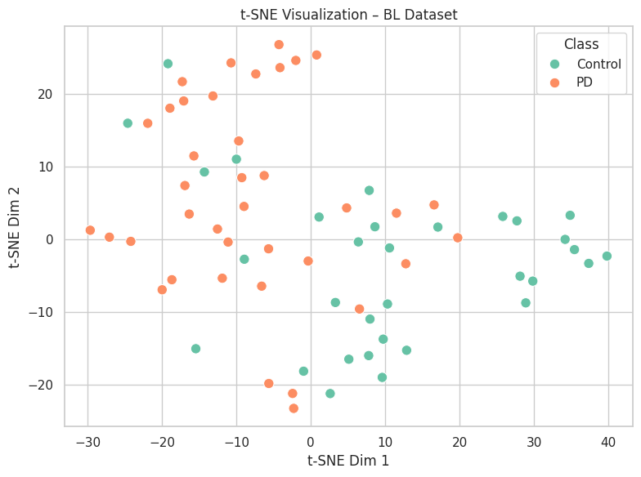
t-SNE Visualization of BL Dataset
BL (Baseline) Dataset Observations
The classes are mixed, especially near the center.
Overlap may reflect difficulty with distinguishing between PD and Control
Metabolic differences at Baseline are subtle, or not fully present yet.
Notes:
t-SNE Visualization of BL Dataset
This plot shows a t-distributed stochastic neighbor embedding (t-SNE) visualization of the Baseline metabolomics data, with each point representing a Parkinson’s Disease or Control individual.
t-SNE was applied after feature selection and normalization to reduce the high-dimensional metabolite data to two dimensions for visualization.
There is some clustering, with Parkinson’s Disease samples tending to group more in the upper-left corner while Control samples are more common in the lower-right.
While overlap exists, especially in the middle, there are still hints that the Baseline metabolite profiles may contain signals that differentiate Parkinson’s Disease from Control groups.

Slide 2
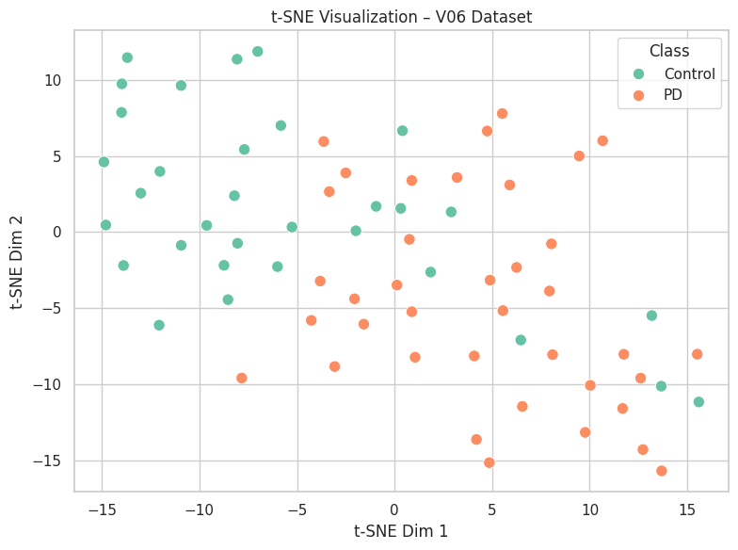
t-SNE Visualization of V06 Dataset
V06 (6-Month Follow-Up) Dataset Observations
More distinct cluster separation, with more PD group samples on the right and Controls on the left.
Fewer overlaps or ambiguous zones than in the BL dataset
Potential indication that disease progression enhances metabolic separability
Notes:
t-SNE Visualization of V06 Dataset
This plot shows a t-SNE visualization of the V06 metabolomics data. Like the previous plot, each point represents a Parkinson’s Disease or Control individual.
Class separation is more pronounced here than with the Baseline dataset. Parkinson’s Disease samples are clustered more toward the right and the Control samples are more concentrated in the upper-left.
This may indicate that the V06 metabolite profiles provide stronger or more distinct signals for Parkinson’s Disease classification.

Slide 3
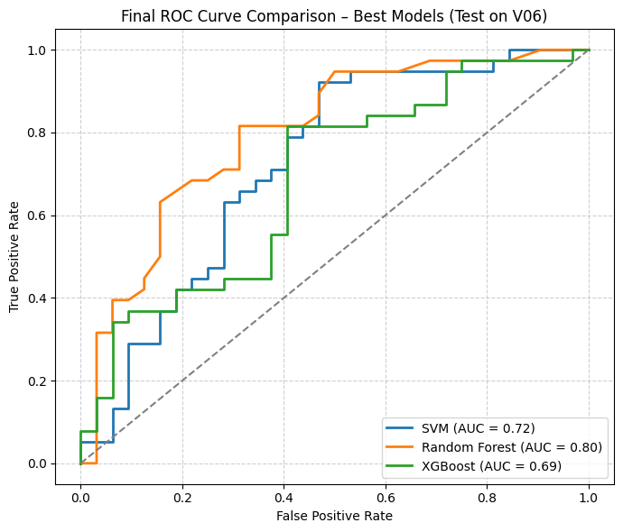
Tuned ROC Curves Tested On V06
Procedure
SVM, Random Forest, and XGBoost trained on the Baseline dataset and tested on the V06 dataset using their top RFE-selected features
Model | Accuracy | Precision | PD Recall | Control Recall | F1 | AUC
SVM | 0.7 | 0.70 | 0.79 | 0.59 | 0.74 | 0.72
Random Forest | 0.7 | 0.73 | 0.71 | 0.69 | 0.72 | 0.8
XGBoost | 0.7 | 0.70 | 0.79 | 0.59 | 0.74 | 0.69
Notes:
Hyperparameter Tuned ROC Curves Tested On V06
This plot compares the Receiver Operating Characteristic (ROC) curves of the three optimized machine learning models: SVM, Random Forest, and XGBoost. Each has been trained on the baseline (BL) dataset using their top 20 RFE-selected features, then evaluated on the 6-month follow-up (V06) dataset.
The Random Forest model achieved the highest area under the curve (AUC = 0.80), indicating the best overall ability to distinguish between Parkinson’s Disease and Control samples. SVM and XGBoost followed with AUCs of 0.72 and 0.69. While SVM and XGBoost produced identical confusion matrices, as seen in the next slide, their ROC curves differ due to variation in predicted probability distributions across samples. All of the models performed significantly better than random chance.

Slide 4
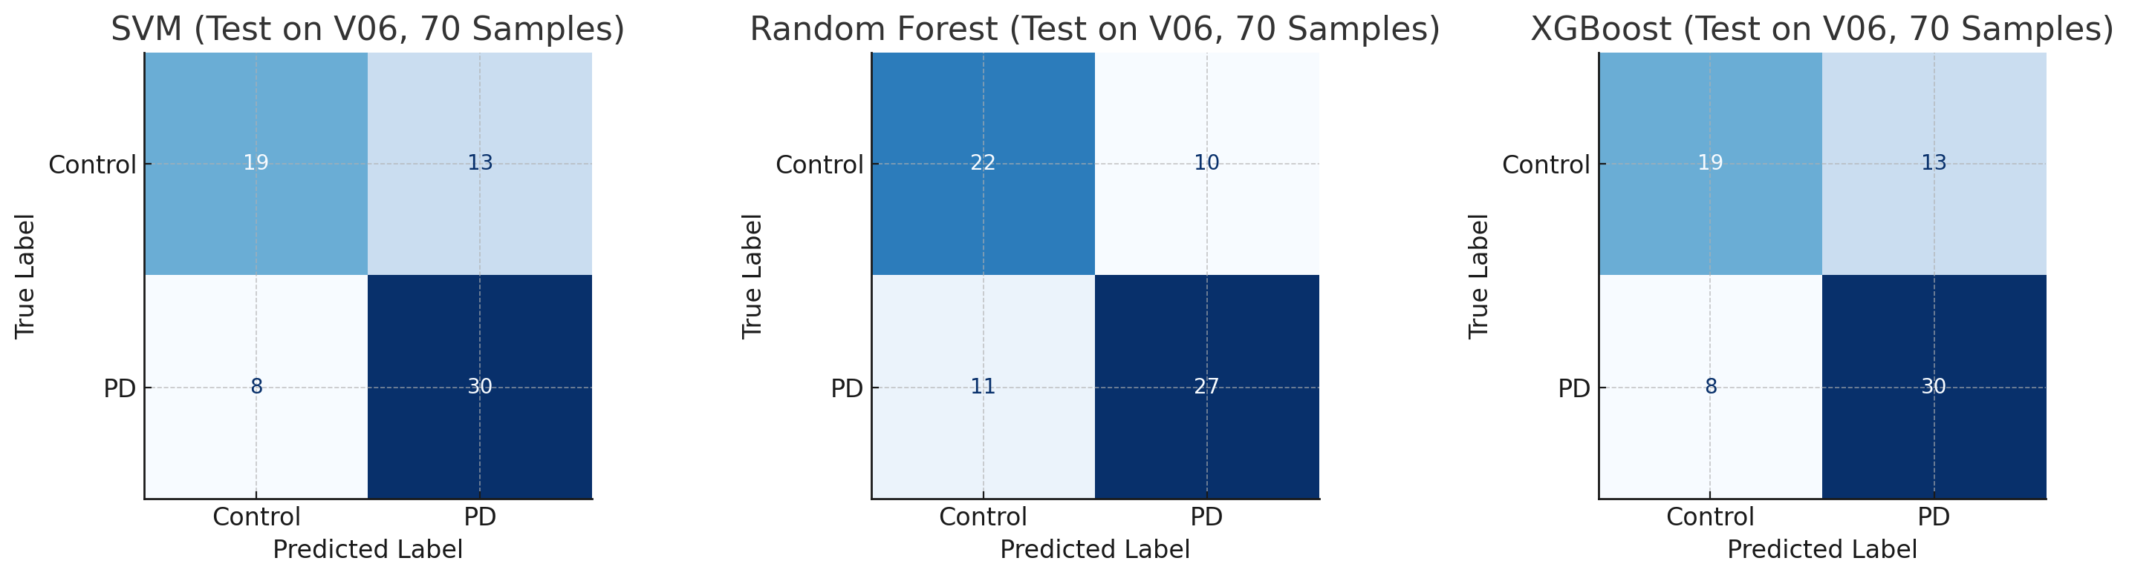
Confusion Matrices Tested On V06
Model | Accuracy | Precision | Recall | F1 Score
SVM | 0.7 | 0.70 | 0.79 | 0.74
Random Forest | 0.7 | 0.73 | 0.71 | 0.72
XGBoost | 0.7 | 0.70 | 0.79 | 0.74
Notes:
Confusion Matrices Tested on V06
To evaluate classification performance, we compared the confusion matrices of three machine learning models: SVM, Random Forest, and XGBoost. They were trained on the baseline dataset using their top 20 RFE-selected features and tested on the 6-month follow-up V06 dataset.
Each model was assessed based on its ability to correctly distinguish between Parkinson’s Disease (PD) and Control samples. Surprisingly, SVM and XGBoost showed identical class-level predictions, correctly identifying 30 out of 38 PD samples, but misclassifying 13 of 32 controls.
Random Forest was more balanced. All models achieved an overall accuracy of 70%, with F1 scores ranging from 0.72 to 0.74.
SVM Results:
True Positives (PD correctly identified): 30
True Negatives (Controls correctly identified): 19
False Positives (Controls misclassified as PD): 13
False Negatives (PDs missed): 8
Accuracy: 70%
Parkinson’s Disease Recall: 79%
Control Recall: 59%
Random Forest Results:
True Positives: 27
True Negatives: 22
False Positives: 10
False Negatives: 11
Accuracy: 70%
Parkinson’s Disease Recall: 71%
Control Recall: 69%
XGBoost Results:
True Positives: 30
True Negatives: 19
False Positives: 13
False Negatives: 8
Accuracy: 70%
Parkinson’s Disease Recall: 79%
Control Recall: 59%

Slide 5
Shared Baseline Metabolites
Procedure
Applied RFE using three different supervised models: SVM, Random Forest, and XGBoost
Results
Three biomarkers found in the top 20 metabolites of each model
Recent studies suggest links between these metabolite and Parkinson’s disease. (Bourque, et al., 2024). (Chen, et al., 2021). (Kaur, et al., 2024).
CHEM_ID | CHEMICAL_NAME | SUPER_PATHWAY | SUB_PATHWAY
100003470 | Pregnanediol-3-glucuronide | Lipid | Progestin Steroids
100001613 | Tetradecanedioate (C14-DC) | Lipid | Fatty Acid, Dicarboxylate
100020823 | Lithocholate sulfate (1) | Lipid | Secondary Bile Acid Metabolism
Notes:
Shared Baseline Metabolites
Recursive Feature Elimination (RFE) was applied using three different supervised models: Support Vector Machine, Random Forest, and XGBoost with the top 20 features selected from each model based on predictive importance for the Baseline dataset.
The following three metabolites were found to be present in all three lists, indicating that they are unlikely to be the result of one model’s bias or parameter settings.
This makes these metabolites strong candidates for further validation and study, with an increased likelihood that these biomarkers present real differences between Parkinson’s Disease and Control groups.
Upon chemically identifying them it was found that there are studies that lend support to these findings:
Pregnanediol-3-glucuronide (PDG) is a metabolite that is produced when the body breaks down progesterone. PDG can be used to indirectly measure progesterone levels, which are thought to have neuroprotective effects. (Bourque, et al., 2024).
Studies suggest that tetradecanedioate may be linked to the development and progression of neurodegenerative diseases like Parkinson's and Alzheimer’s. (Chen, et al., 2021).
Studies suggest that elevated levels of lithocholate sulfate (LCA) are present in PD patients and may contribute to the aggregation of α-synuclein, a protein that forms toxic fibrils in Parkinson’s disease. (Kaur, et al., 2024).

Slide 6
Shared V06 Metabolites
Procedure
Applied RFE using three different supervised models: SVM, Random Forest, and XGBoost
Results
Two biomarkers found in the top 20 metabolites of each model
Unidentified metabolites but they may have significance in distinguishing between Control and PD groups.
CHEM_ID | CHEMICAL_NAME | SUPER_PATHWAY | SUB_PATHWAY
999912830 | X-12830 | Unknown | Unknown
999916087 | X-16087 | Unknown | Unknown
Notes:
Shared V06 Metabolites
Recursive Feature Elimination (RFE) was applied to select the top 20 metabolites from each model based on predictive importance, with the following pair of metabolites present in all three lists for the V06 dataset.
Unfortunately, these are unnamed chemicals with unknown metabolic pathways, and their designations are not universally recognized chemical names. This makes it virtually impossible to definitively identify them without additional information, like cross reference chemical identifiers from other sources like the Chemical Abstracts Service (CAS), which are not presented for them in the dataset. Still, if these metabolites could be identified and analyzed further, they may prove to be suitable biomarkers for distinguishing between Parkinson’s Disease and Control groups.

Slide 7
Shared Baseline and V06 Metabolites
Procedure
Applied RFE using three different supervised models: SVM, Random Forest, and XGBoost
Results
Two biomarkers found in the top 20 metabolites of each model
Recent studies suggest links between these metabolite and Parkinson’s disease. (Chen, et al., 2022). (Griffith, et al., 2008).
CHEM_ID | CHEMICAL_NAME | SUPER_PATHWAY | SUB_PATHWAY
100000463 | Indolelactate | Amino Acid | Tryptophan Metabolism
100001257 | N-acetyl asparagine | Amino Acid | Alanine and Aspartate Metabolism
Notes:
Shared Baseline and V06 Metabolites
Once again, Recursive Feature Elimination (RFE) was applied to select the top 20 metabolites from each model based on predictive importance, with the following pair of metabolites present in all three lists for the BL and V06 datasets.
This makes these metabolites strong candidates for further validation and study, with an increased likelihood that these biomarkers could present real differences between PD and Control.
There are also studies that lend support to these findings:
Indole derivatives like indole-3-lactic acid (I3LA) have been linked to the gut-brain axis and may play a role in Parkinson's disease as it influences inflammation and may be involved in the progression of neurodegenerative diseases like PD. (Chen, et al., 2022).
N-acetyl aspartate (NAA) levels are reduced in the brains of individuals with Parkinson's disease, particularly in those with dementia. (Griffith, et al., 2008).

Slide 8
5 Metabolites Shared By SHAP and LASSO
Procedure
Selected the top 20 metabolites based on both SHAP values and LASSO coefficients from the Baseline dataset. Stability confirmed through cross-validation, model performance evaluation, and generalization testing from BL to V06 datasets.
Results
Five biomarkers found in the top 20 metabolites of each model.
CHEM_ID | CHEMICAL_NAME | SUPER_PATHWAY | SUB_PATHWAY
100004326 | 3-Acetylphenol Sulfate | Xenobiotics | Chemical
100000463 | Indolelactate | Amino Acid | Tryptophan Metabolism
100001613 | Tetradecanedioate (C14-DC) | Lipid | Fatty Acid, Dicarboxylate
100020823 | Lithocholate Sulfate (1) | Lipid | Secondary Bile Acid Metabolism
100019978 | Octadecenedioate (C18:1-DC) | Lipid | Fatty Acid, Dicarboxylate
Notes:
SHAP and LASSO’s 5 Shared Significant Metabolites
Procedure
The top 20 metabolites were identified based on both SHAP values and LASSO coefficients from the Baseline dataset. Stability was confirmed through cross-validation, model performance evaluation, and generalization testing from BL to V06 datasets.
Results
Five biomarkers found in the top 20 metabolites of each model. These were 3-acetylphenol sulfate, indolelactate, tetradecanedioate (c14-dc), lithocholate sulfate (1), and octadecenedioate (c18:1-dc).

Slide 9
Considerations Regarding Differences Between the BL and V06 Datasets
Biological drift during the time between Baseline and V06
Metabolite levels can change over a span of months due to several factors
Control ≠ unchanging
“Ignoring drift can lead to inaccurate conclusions about the relationship between metabolites and various factors.” (Bararpour, et al., 2020)
No shared client identifiers between the datasets
Cannot compare changes in individuals over time if you cannot identify them
Collected samples could be from different individuals between the two datasets
There’s still valid biological insight to be gained from the datasets
Notes:
Considerations Regarding Differences Between the BL and V06 Datasets
We found that were significant differences between the Baseline and V06 datasets in terms of featured metabolites. Although frustrating, this could be rationalized by different factors.
Biological drift during the 6-month span between samples could explain some of the differences between the Baseline and V06 datasets
Even in healthy individuals, metabolite levels can naturally change over a span of months due to diet, exercise, stress, sleep patterns, disease progression, medications, and other factors.
It should also be noted that just because a group is called the “Control” it doesn’t mean that they are static and unchanging. It is composed of individuals who are also subject to individual changes over time.
“Ignoring drift can lead to inaccurate conclusions about the relationship between metabolites and various factors.” (Bararpour, et al., 2020).
Another concern is that there are no shared client identifiers between the two datasets
This makes it virtually impossible to track changes in individuals, as the samples cannot be matched between the datasets.
This could also indicate that the samples were collected from different individuals between the two datasets.
Despite the lack of identifiers, there’s still valid biological insight to be gained from the datasets. Still, identifiers would definitely be beneficial to the datasets along with sample sizes larger than just 70 individuals.

Slide 10
References
Bararpour, N., Gilardi, F., Carmeli, C., Sidibe, J., Ivanisevic, J., Caputo, T., Augsburger, M., Grabherr, S., Desvergne, B., Guex, N., Bochud, M., & Thomas, A. (2020). Visualization and Normalization of Drift Effect across Batches in Metabolome-Wide Association Studies. https://doi.org/10.1101/2020.01.22.914051
Bourque, M., Morissette, M., & Di Paolo, T. (2024). Neuroactive steroids and Parkinson's disease: Review of human and animal studies. Neuroscience &amp; Biobehavioral Reviews, 156, 105479. https://doi.org/10.1016/j.neubiorev.2023.105479
Chen, H., Qiao, J., Wang, T., Shao, Z., Huang, S., & Zeng, P. (2021). Assessing causal relationship between human blood metabolites and five neurodegenerative diseases with GWAS summary statistics. Frontiers in Neuroscience, 15. https://doi.org/10.3389/fnins.2021.680104
Chen, S.-J., Chen, C.-C., Liao, H.-Y., Wu, Y.-W., Liou, J.-M., Wu, M.-S., Kuo, C.-H., & Lin, C.-H. (2022). Alteration of gut microbial metabolites in the systemic circulation of patients with Parkinson's disease. Journal of Parkinson’s Disease, 12(4), 1219–1230. https://doi.org/10.3233/jpd-223179
Forero-Rodríguez, J., Zimmermann, J., Taubenheim, J., Arias-Rodríguez, N., Caicedo-Narvaez, J. D., Best, L., Mendieta, C. V., López-Castiblanco, J., Gómez-Muñoz, L. A., Gonzalez-Santos, J., Arboleda, H., Fernandez, W., Kaleta, C., & Pinzón, A. (2024). Changes in bacterial gut composition in Parkinson's disease and their metabolic contribution to disease development: A gut community reconstruction approach. Microorganisms, 12(2), 325. https://doi.org/10.3390/microorganisms12020325
Griffith, H. R., den Hollander, J. A., Okonkwo, O. C., O’Brien, T., Watts, R. L., & Marson, D. C. (2008). Brain N-acetylaspartate is reduced in Parkinson disease with dementia. Alzheimer Disease &amp; Associated Disorders, 22(1), 54–60. https://doi.org/10.1097/wad.0b013e3181611011

Slide 11
References
Kaur, H., Swadia, D., & Sinha, S. (2024). Bile acids as modulators of α-synuclein aggregation: Implications for Parkinson's therapy. ACS Chemical Neuroscience, 15(21), 4055–4065. https://doi.org/10.1021/acschemneuro.4c00459
LeWitt, P. A., Li, J., Lu, M., Guo, L., & Auinger, P. (2017). Metabolomic biomarkers as strong correlates of Parkinson disease progression. Neurology, 88(9), 862–869. https://doi.org/10.1212/wnl.0000000000003663
LeWitt, P. A., Li, J., Wu, K.-H., & Lu, M. (2023). Diagnostic metabolomic profiling of Parkinson's disease biospecimens. Neurobiology of Disease, 177, 105962. https://doi.org/10.1016/j.nbd.2022.105962
Ostrakhovitch, E. A., Ono, K., & Yamasaki, T. R. (2025). Metabolomics in Parkinson's disease and correlation with disease state. Metabolites, 15(3), 208. https://doi.org/10.3390/metabo15030208
Trezzi, J., Galozzi, S., Jaeger, C., Barkovits, K., Brockmann, K., Maetzler, W., Berg, D., Marcus, K., Betsou, F., Hiller, K., & Mollenhauer, B. (2017). Distinct metabolomic signature in cerebrospinal fluid in early Parkinson's disease. Movement Disorders, 32(10), 1401–1408. https://doi.org/10.1002/mds.27132
Zhao, Y., Lai, Y., Darweesh, S. K. L., Bloem, B. R., Forsgren, L., Hansen, J., Katzke, V. A., Masala, G., Sieri, S., Sacerdote, C., Panico, S., Zamora‐Ros, R., Sánchez, M., Huerta, J. M., Guevara, M., Vinagre‐Aragon, A., Vineis, P., Lill, C. M., Miller, G. W., … Vermeulen, R. (2024). Gut microbial metabolites and future risk of Parkinson's disease: A metabolome‐wide association study. Movement Disorders, 40(3), 556–560. https://doi.org/10.1002/mds.30054

