Slide 1

SMART DOOR LOCK for Apartments
RAMAKRISHNA REDDY ALAVALA
MURALI KRISHNA SAI CHUKKA

Slide 2
Problem Overview
Now a days, everyone is using ecommerce website for shopping. But online delivery has become major problem as the order is not delivered on time due to apartment main door lock. Not only that when every our friends or family members want to visit our home they are facing the same issue.
Smart door lock will gives the solution for this problem by generate pass code for certain period of time.

Slide 3
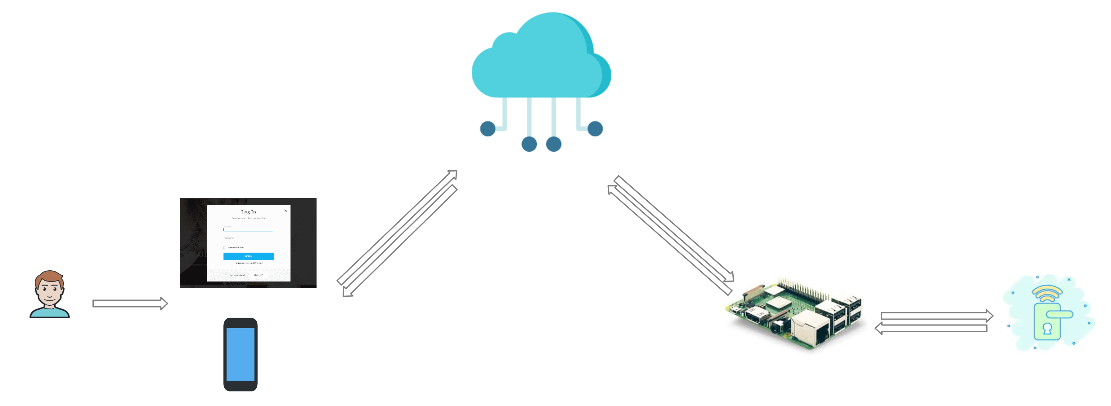
Architecture

Slide 4
Web application

Slide 5
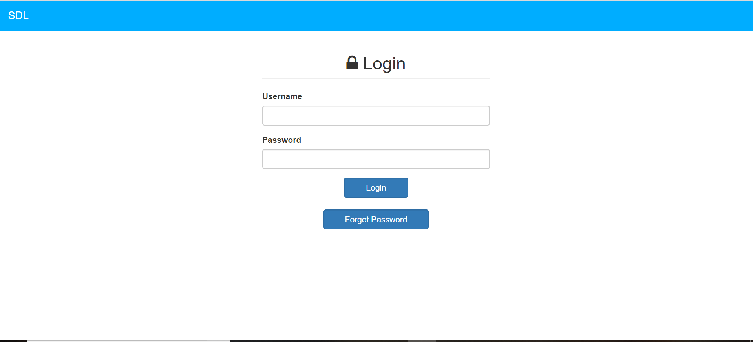
Login page

Slide 6
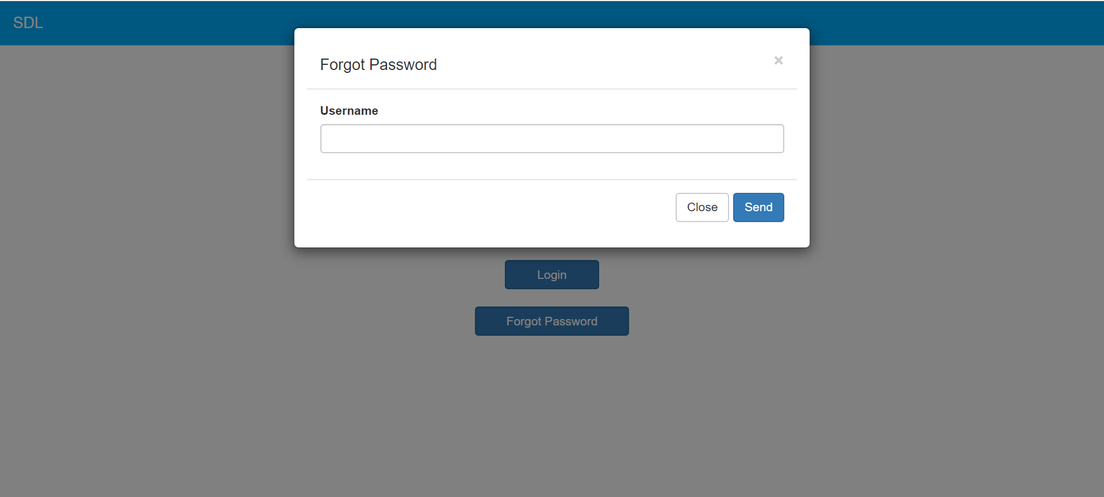
Forgot password

Slide 7
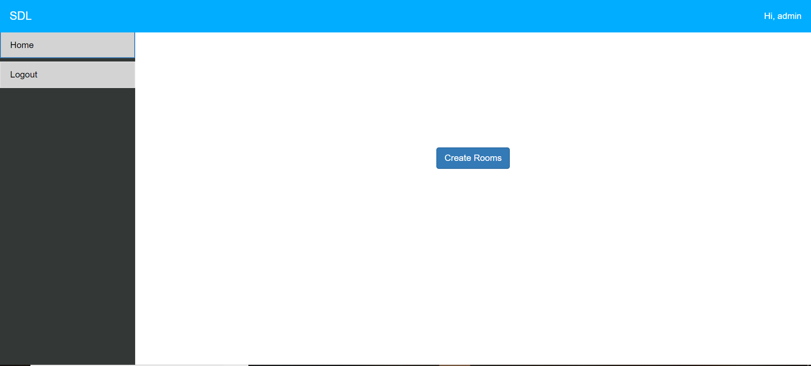
Admin Home First Time

Slide 8
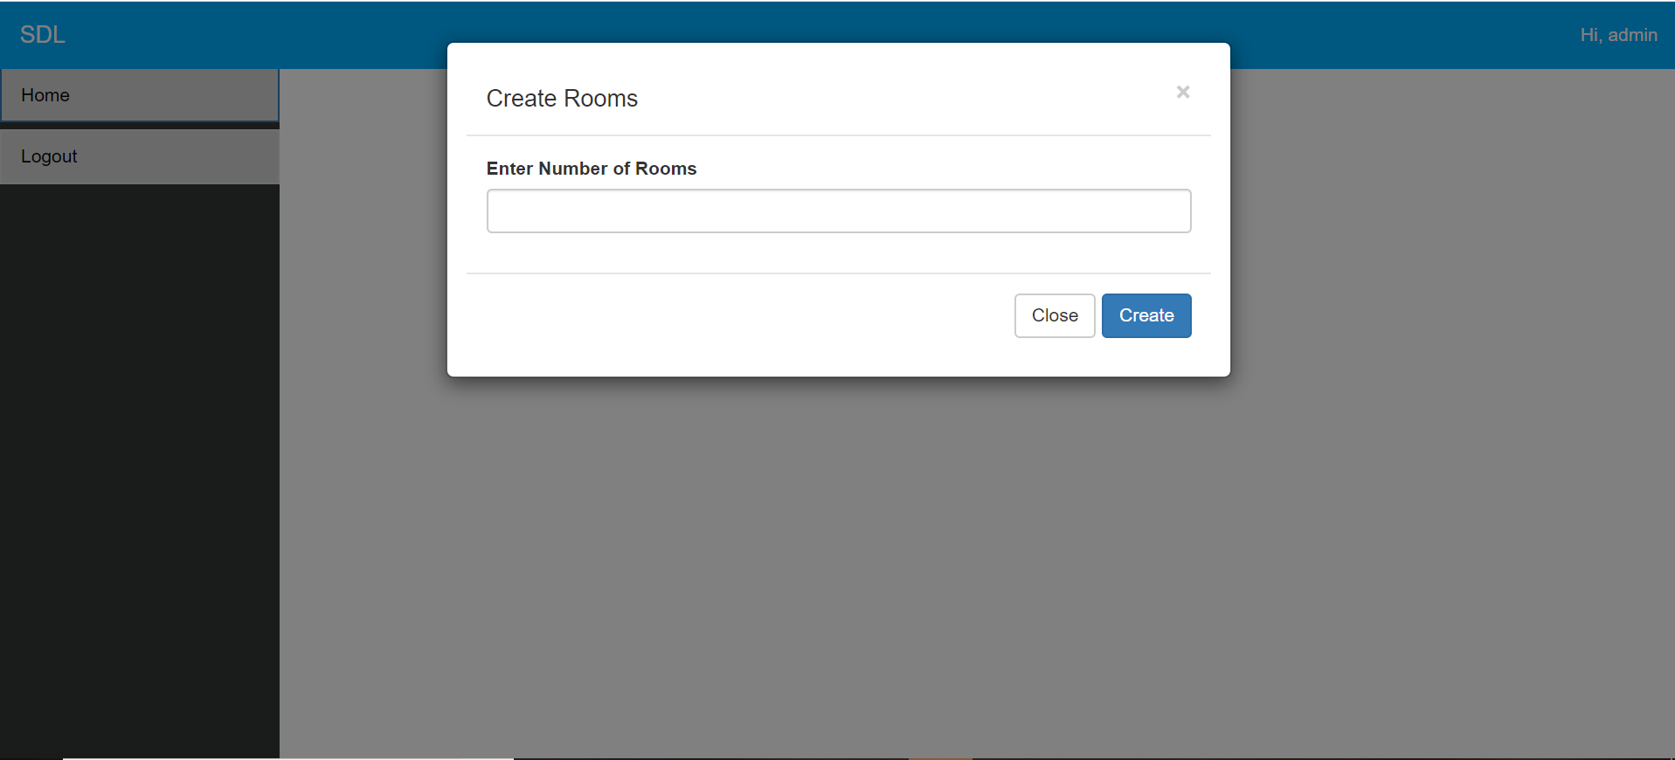
Creating Rooms First Time

Slide 9
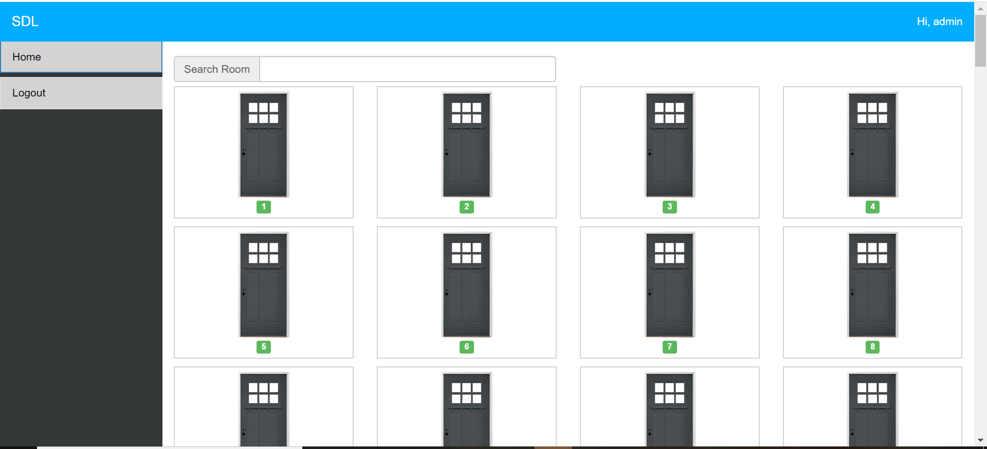
After Adding Rooms

Slide 10
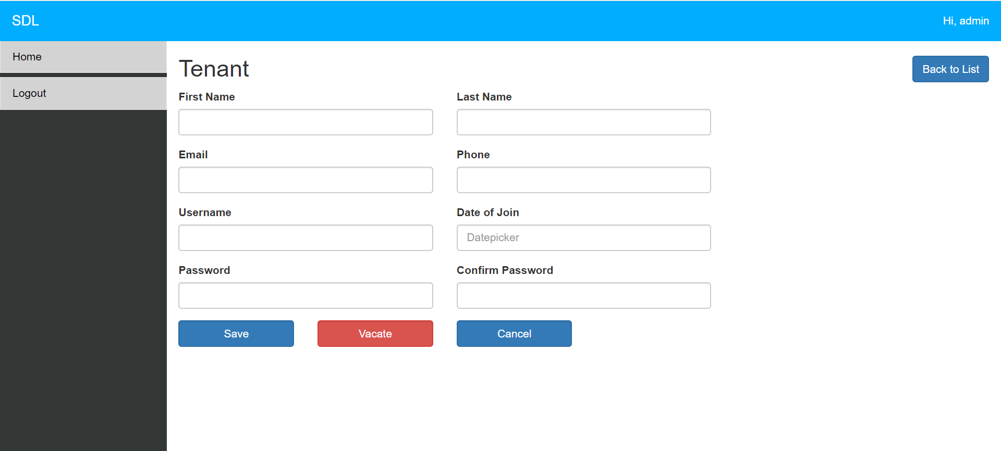
Tenant Information

Slide 11
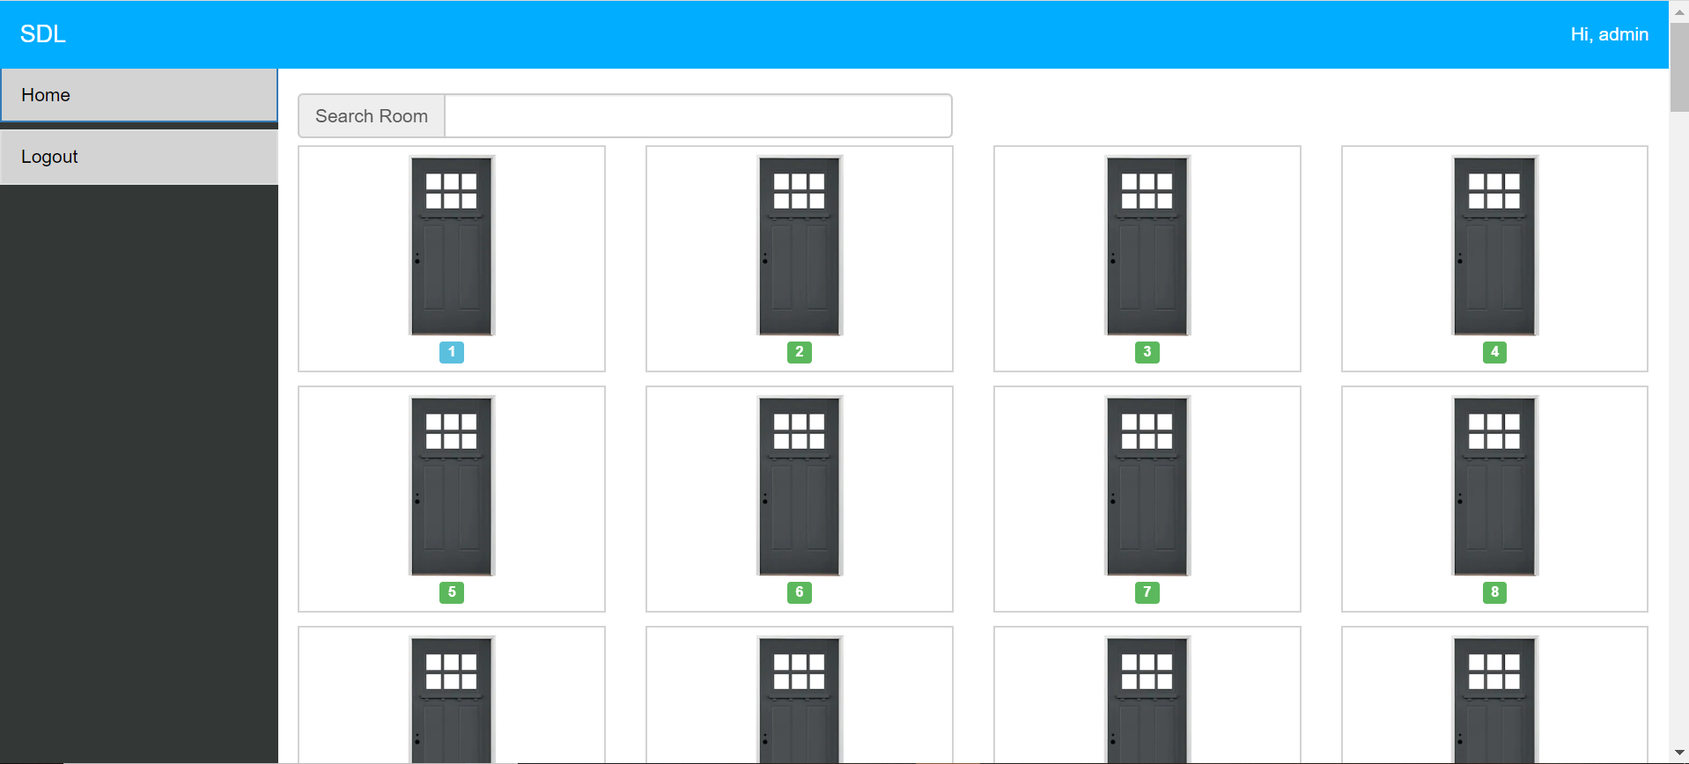
After Adding The Tenant Info

Slide 12
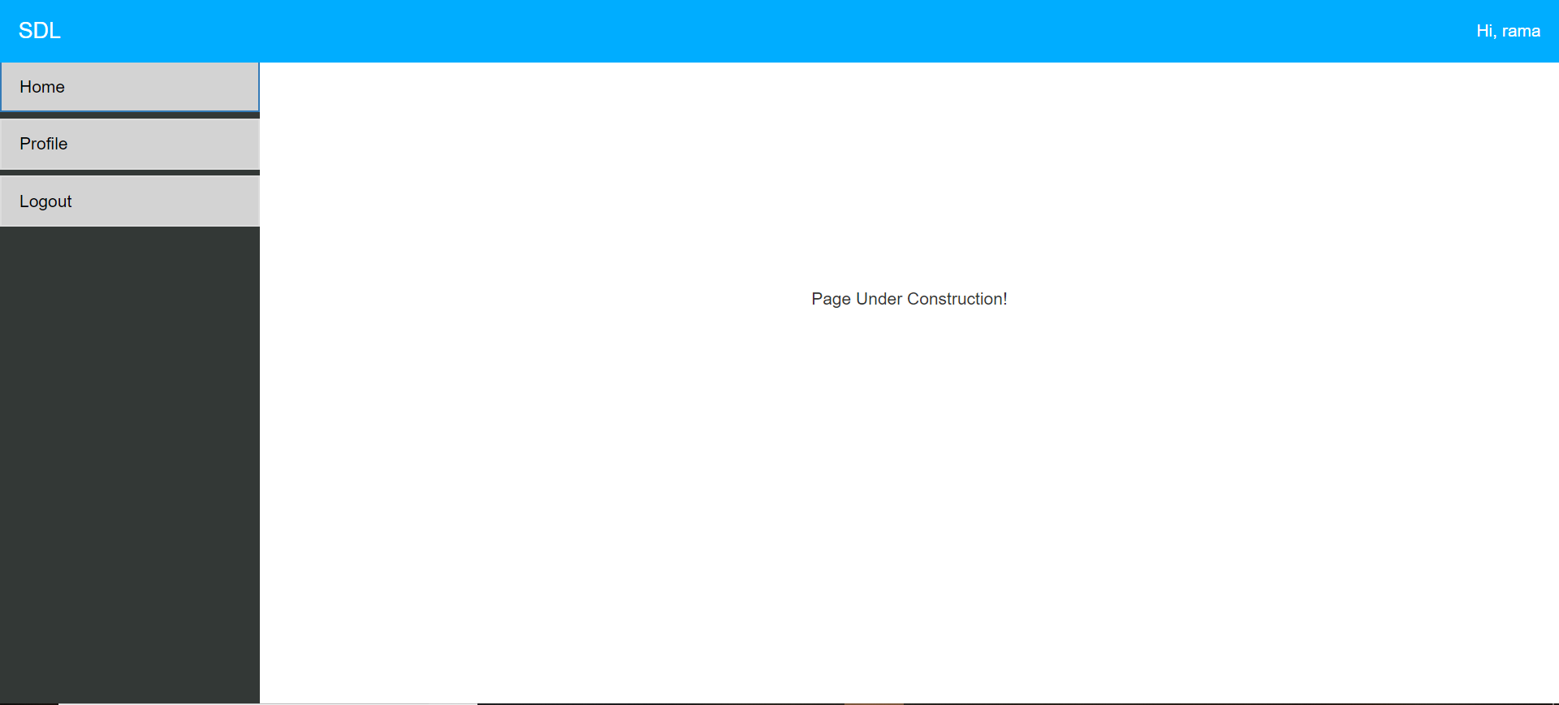
Tenant Home Page

Slide 13
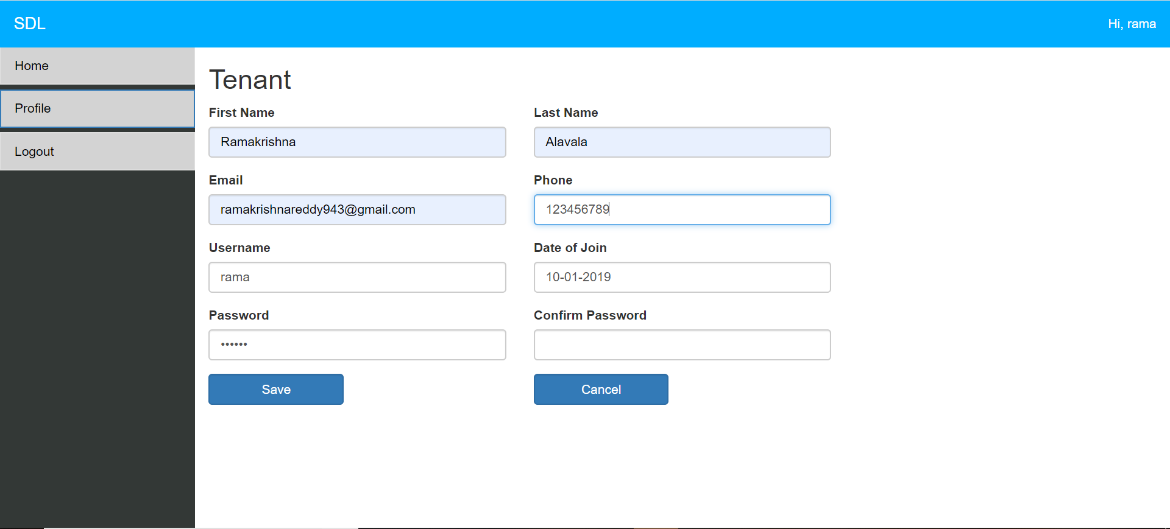
Tenant Profile Page

Slide 14
Mobile Application

Slide 15
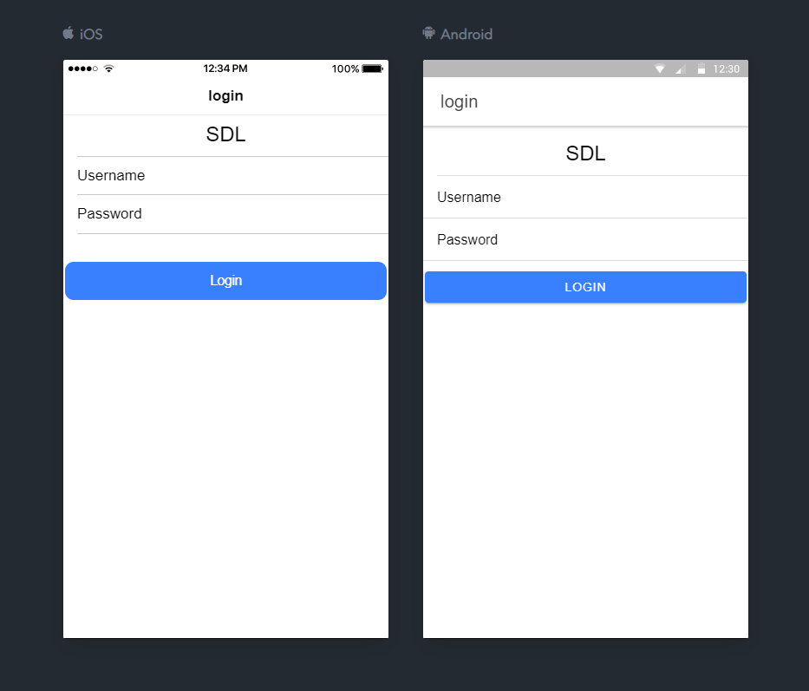
Login Page

Slide 16
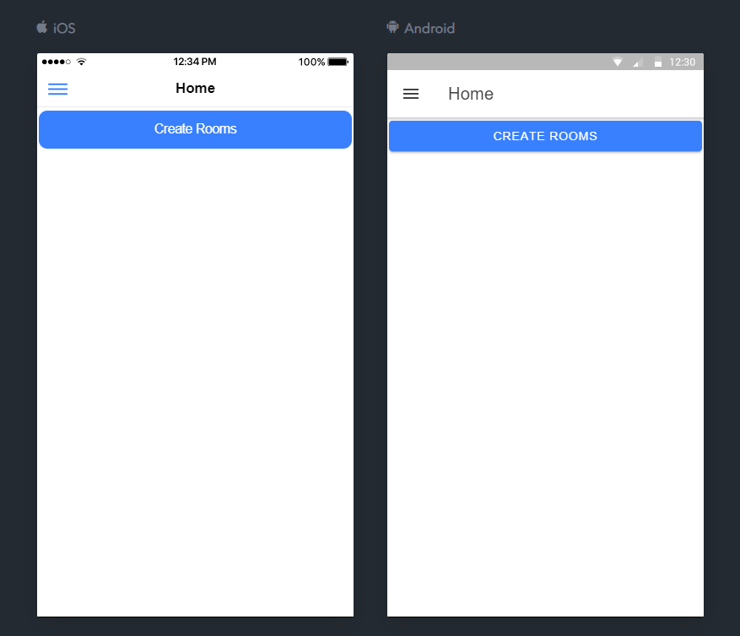
Home Page

Slide 17
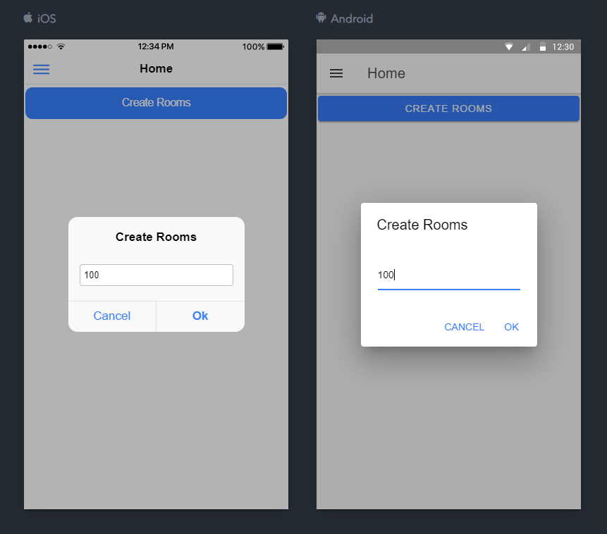
Creating Rooms

Slide 18
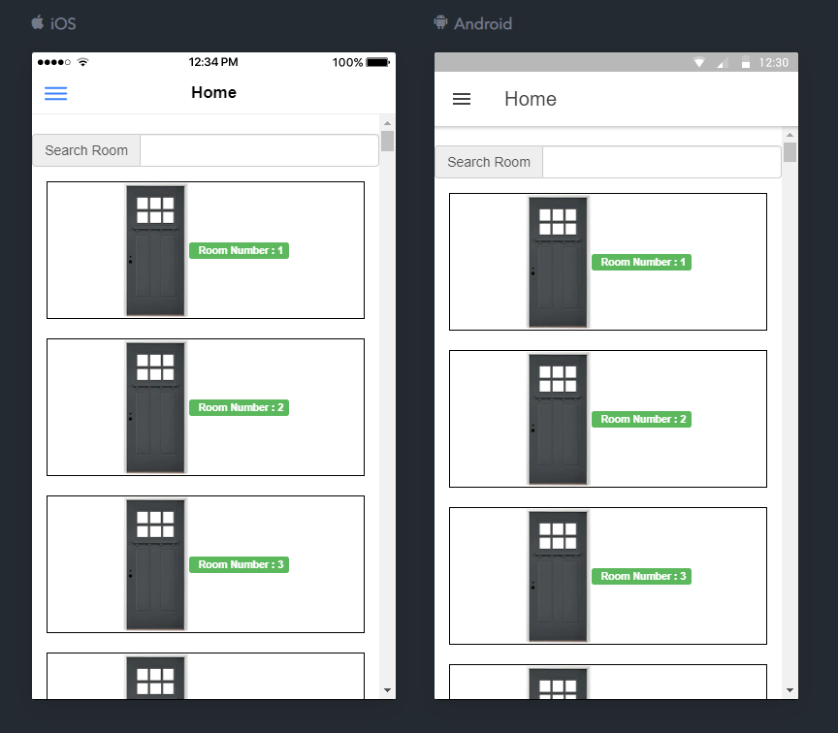
Home Page After Creating Rooms

Slide 19
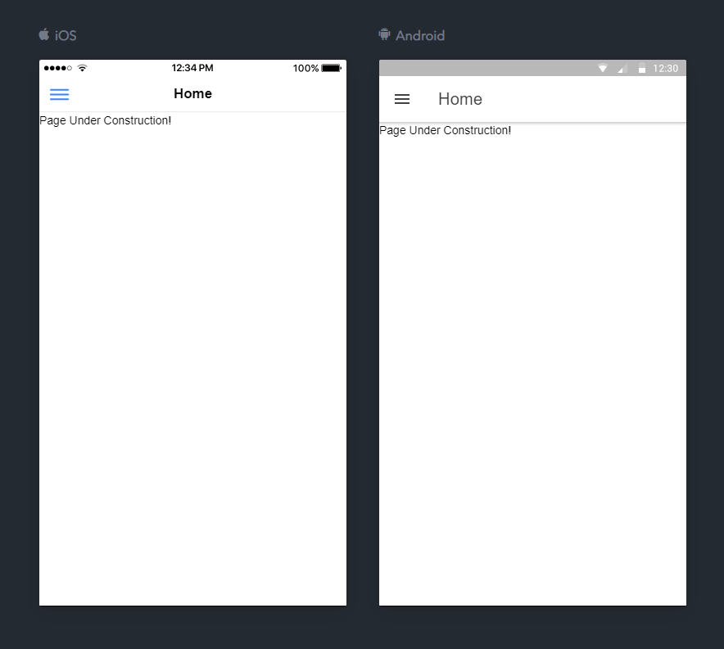
Tenant Home Page

Slide 20
Issues Faced
Azure set up.
New learning – Ionic 4.
IOT hardware set up.

Slide 21
To-do List
Forgot password in Mobile.
Tenant Home page.
Users page.
Setting page.
IOT Camera set up.
Controlling servo motor using web api.
Pass code generation page.
Advance filter search in Home page.
Deleting Rooms.
Video chat.

Slide 22
Questions ?

Slide 23
Thank you

