Slide 1
EduLer AR H&R Block
Murali Krishna Sai Chukka
Joshmitha Tammareddy
Sahaja Adavelli
Pravalhika Kampally

Slide 2
Introduction

Slide 3
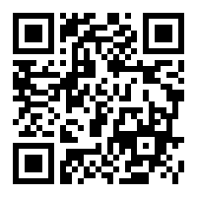

Demo

Slide 4
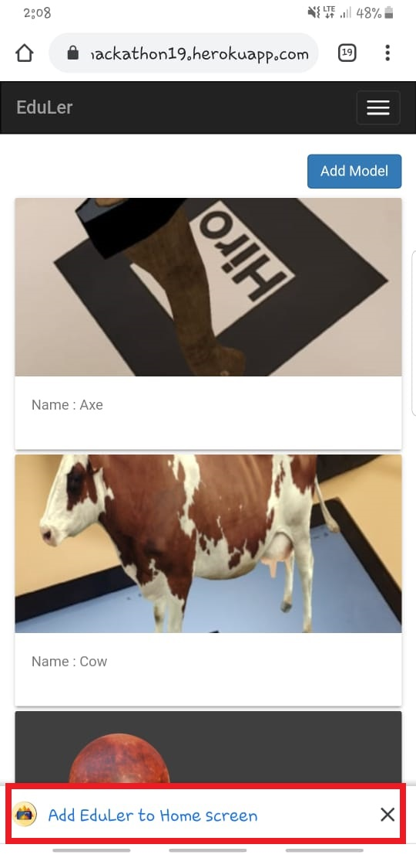
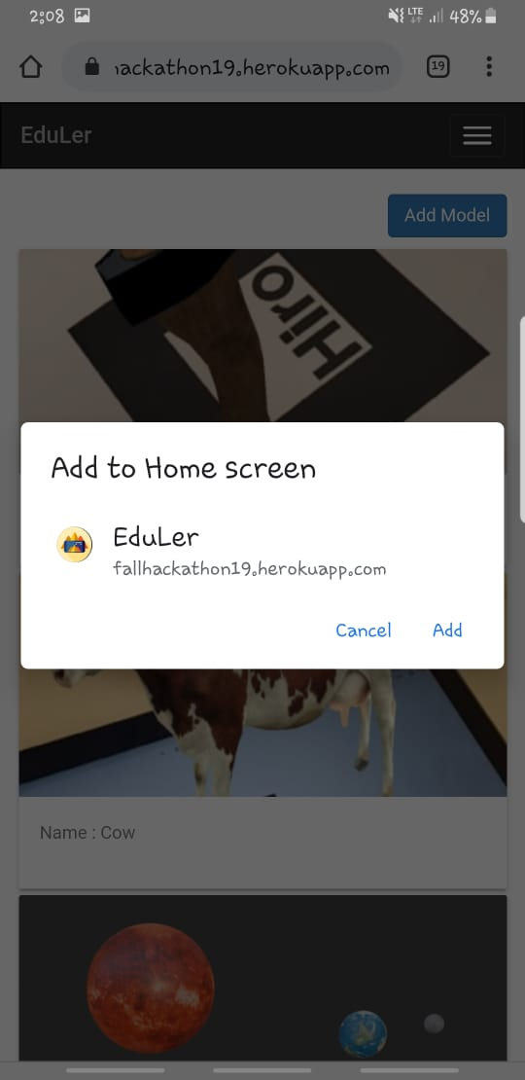
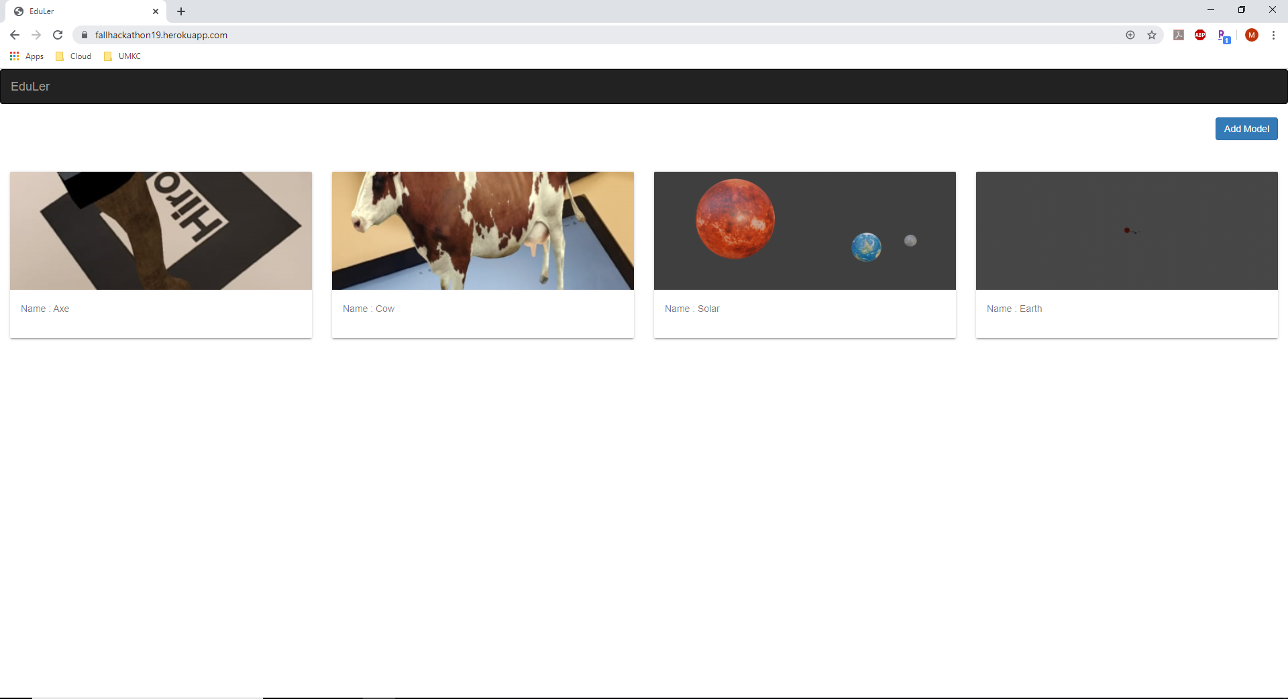
Home Page

Slide 5
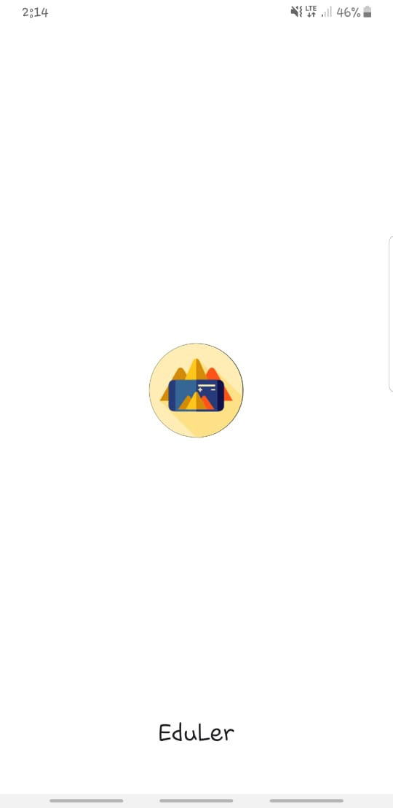
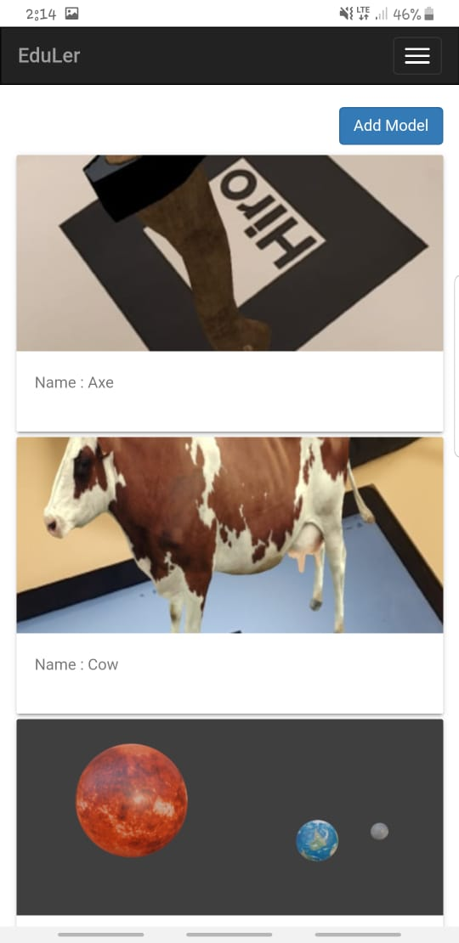
Opening APP IN PHONE

Slide 6
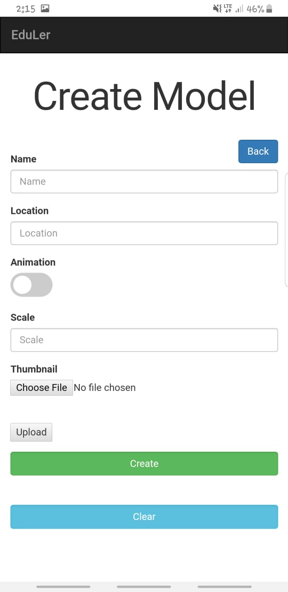
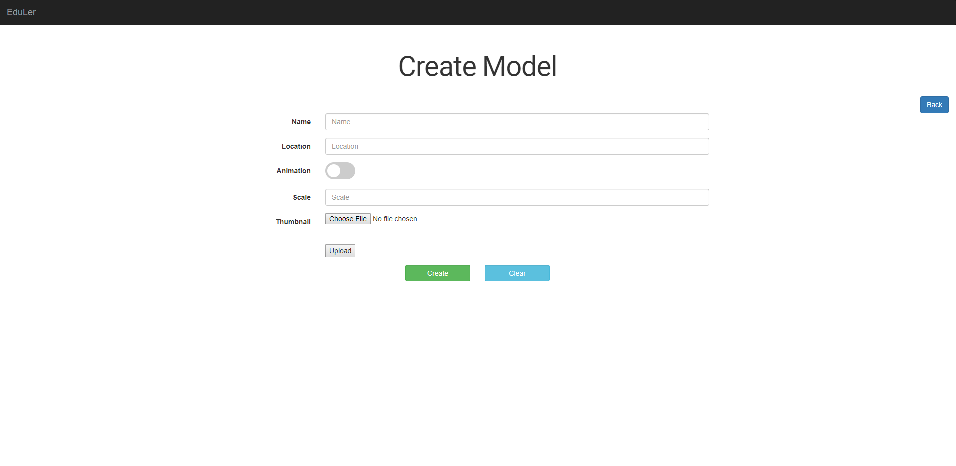
Add Model Page

Slide 7
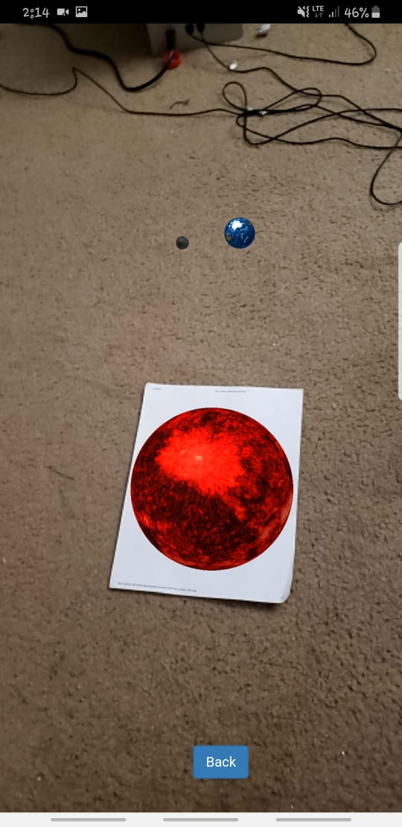
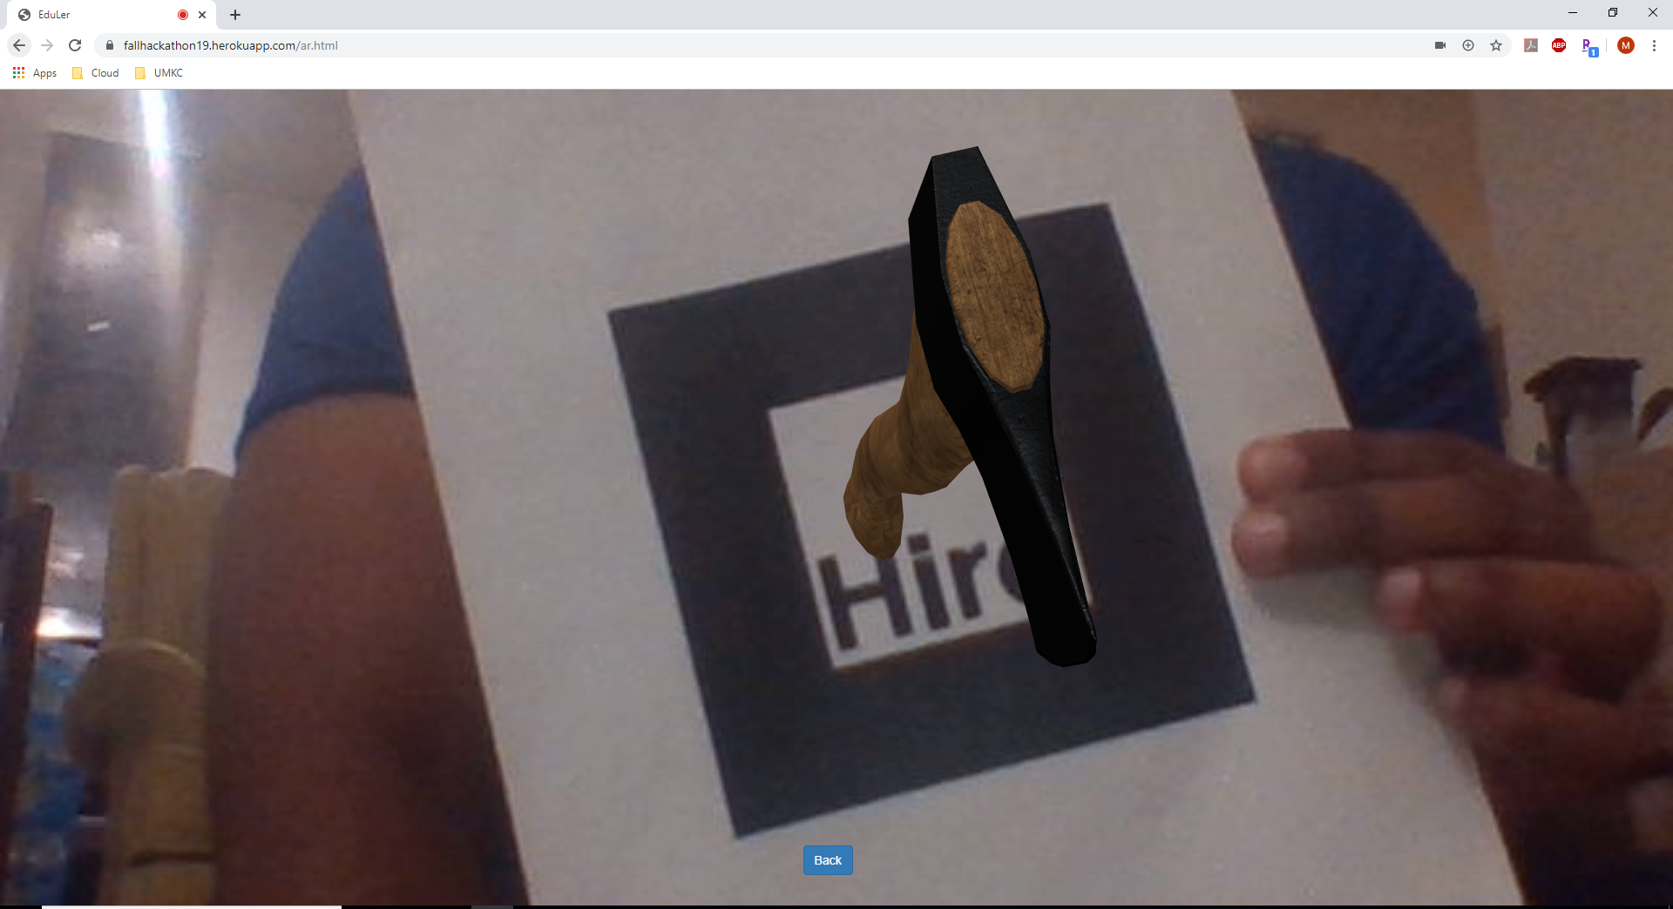
AR Page

Slide 8
Technology
MEAN STACK
PWA
AR.JS
A-FRAME

Slide 9
Questions ?

Slide 10
Thank you!

