Slide 1
EduLer AR H&R Block
TEAM : 4
Murali Krishna Sai Chukka
Joshmitha Tammareddy
Sahaja Adavelli
Pravalhika Kampally

Slide 2
Introduction

Slide 3


Demo

Slide 4
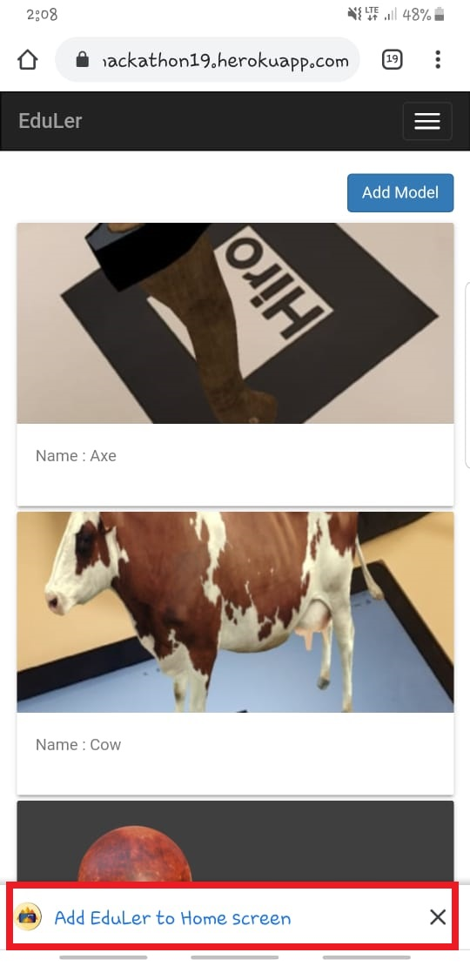
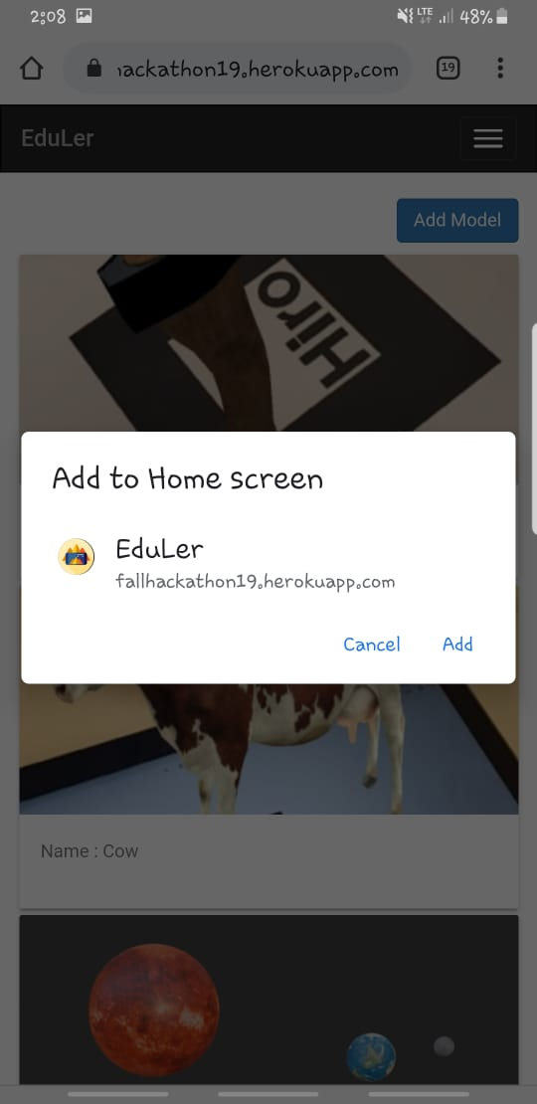
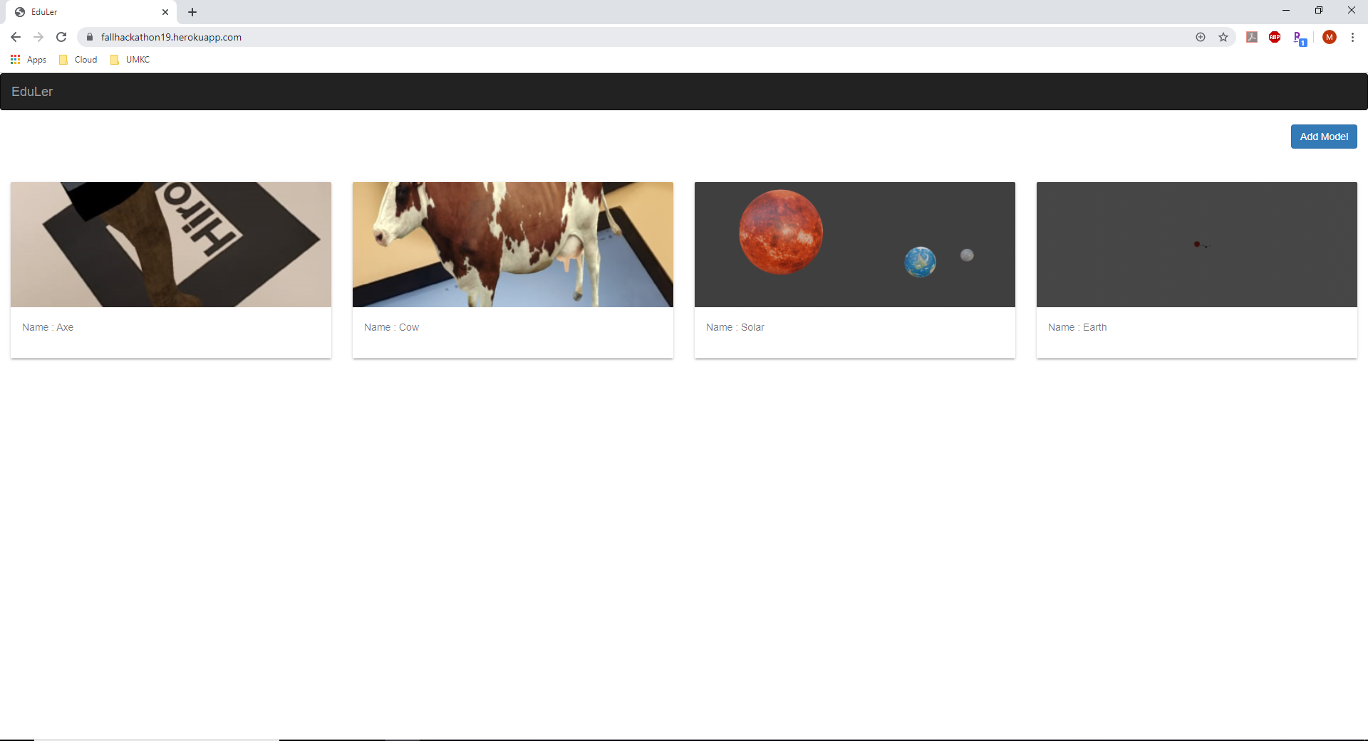
Home Page

Slide 5
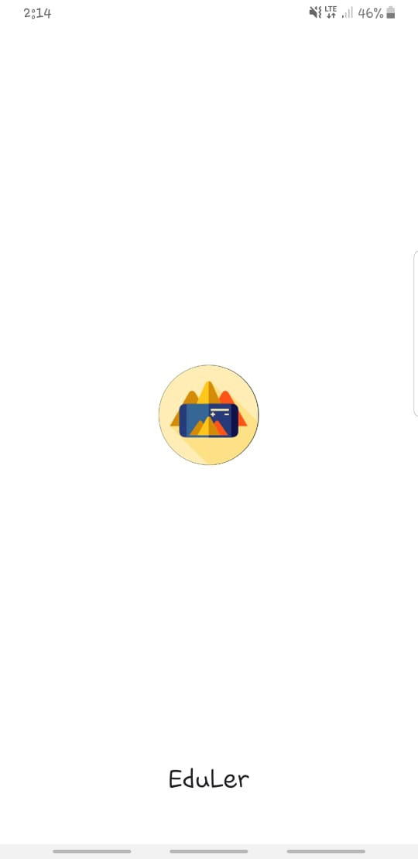
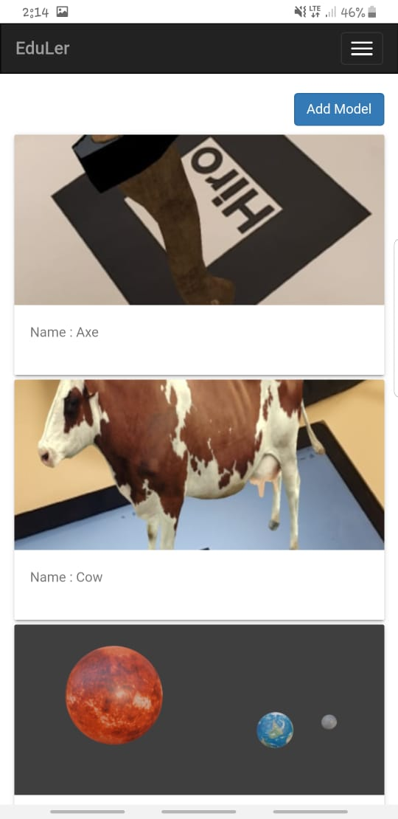
Opening APP IN PHONE

Slide 6
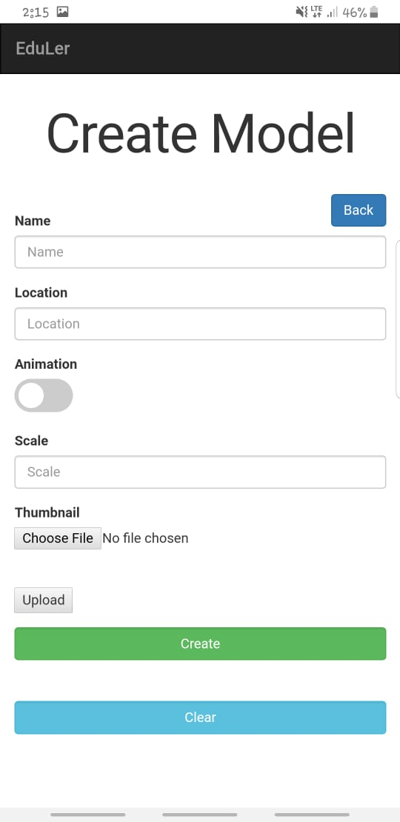
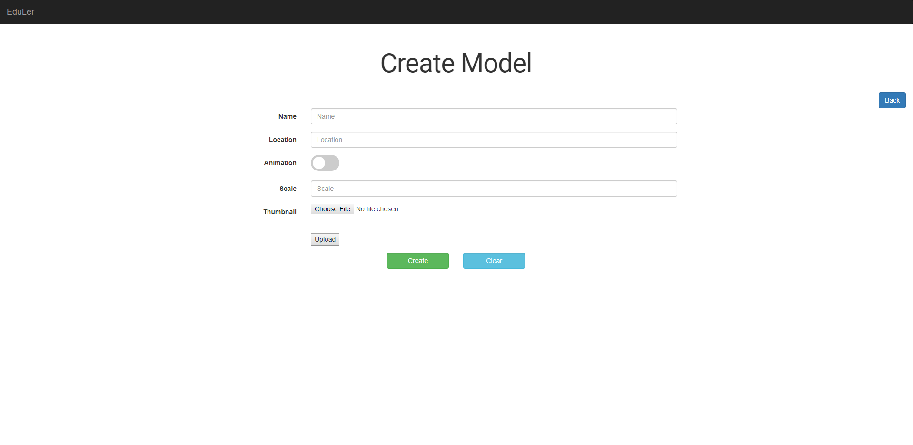
Add Model Page

Slide 7
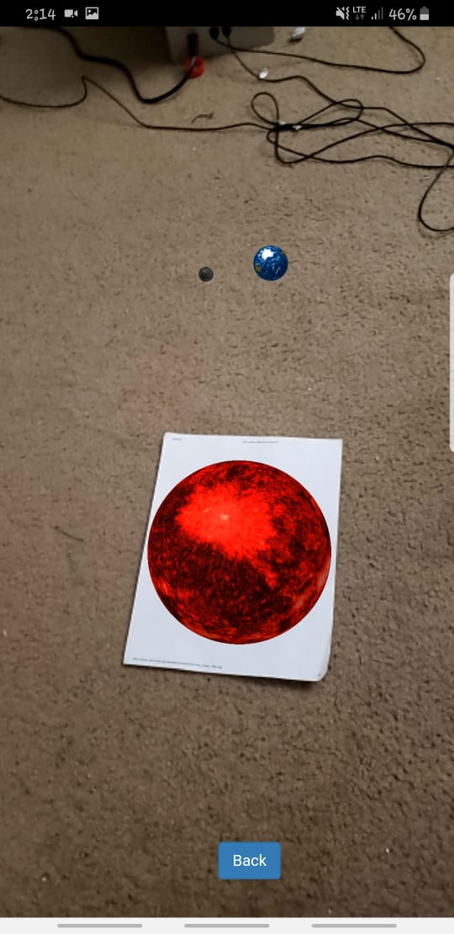
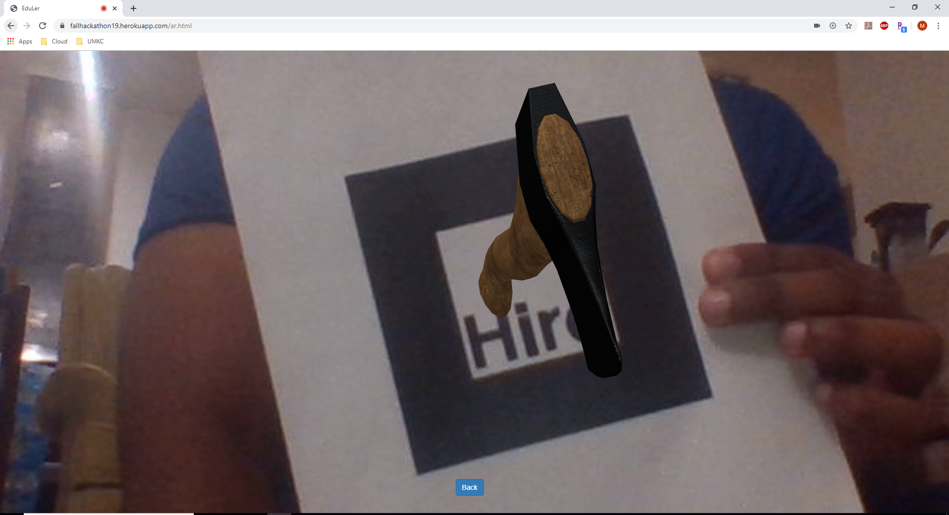
AR Page

Slide 8
Technology
MEAN STACK
PWA
AR.JS
A-FRAME

Slide 9
References
https://www.youtube.com/watch?v=w2pw8eVq_Qk (File uploading)
https://www.youtube.com/watch?v=gcx-3qi7t7c&t=1064s (PWA)
https://medium.com/@akashkuttappa/using-3d-models-with-ar-js-and-a-frame-84d462efe498 (Ar.js and A-FRAME)

Slide 10
Questions ?

Slide 11
Thank you!

