Slide 1
Labs 4 and 5
CSE140L
Summer 2018

Slide 2
Data Parity
Purpose: error detection
  additional, more elaborately generated parity bits used for error correction
For Labs 4 and 5
  7-bit data (next slide)
  append parity as MSB
  count number of 1s
    if even, parity bit = 0
    if odd, parity bit = 1
  examples
    7’b010_0000 (space char. in 7-bit ASCII) becomes 8’b1010_0000
    7’b100_0001 (B) becomes 8’b0100_0001

Slide 3
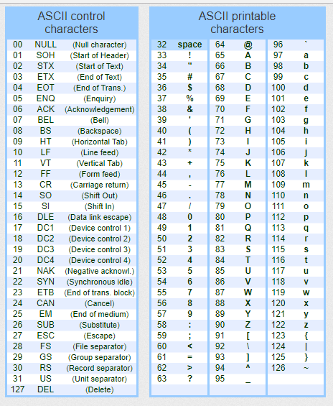
ASCII Table

Slide 4
Preamble / Prefix
We are going to scramble/encrypt the data using a rolling code generated by an 8-tap LFSR.
The LFSR can start in any of 255 possible states (everything except all 0s)
A maximal length 8-tap LFSR, one that has all 2⁸-1 nonzero states, can be built using any of six different sets of 4 taps or two sets of 6 taps
If we provide a known sequence of data (we’ll use ASCII space characters) that has been encrypted with the LFSR, the receiver can figure out our starting state (easy) and which of the 8 possible LFSR tap patterns we used, in no more than 8 transitions (9 clock cycles).

Slide 5
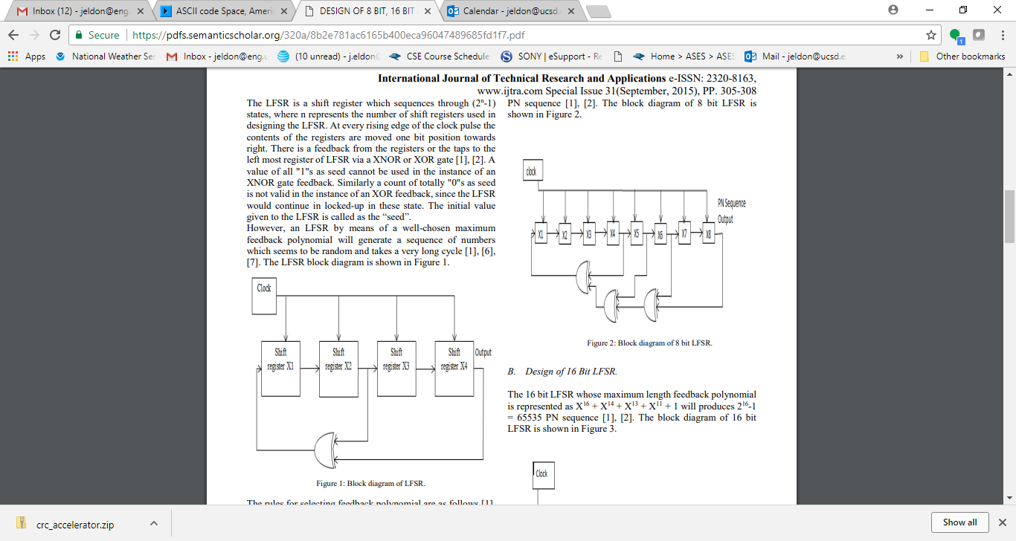
8-tap LFSR with feedback ptrn 0xB8 (why?)

Slide 6
LFSR parallel, not serial, output
In Lab 3 we generated a single bit stream output by connecting only one of the LFSR’s registers to an output port.
This time we are going to port all 8 internal LFSR state bits to an array of 8 data strings.
On each clock cycle we shall bitwise XOR the current data value with the current state of the LFSR to generate our encrypted output.

Slide 7
Example
first preamble data value = ASCII space = 7’b010_0000;
Parity-pad to: 8’b1010_0000;
initial LFSR state = 8’h11 = 8’b0001_0001
encrypted data value = 8’b1011_0001
second preamble value also = 8’b1010_0000 w/ parity
if taps = 8’he1, second LFSR state = 8’b0010_0011
encrypted data value = 8’h1000_0011

Slide 8
8 candidate LFSR feedback patterns
0: r1 = 8'he1; // tap positions 7650
1: r1 = 8'hd4; // tap positions 7642
2: r1 = 8'hc6; // tap positions 7621
3: r1 = 8'hb8; // tap positions 7543
4: r1 = 8'hb4; // tap positions 7542
5: r1 = 8'hb2; // tap positions 7541
6: r1 = 8'hfa; // tap positions 765431
7: r1 = 8'hf3; // tap positions 765410

Slide 9
Implementation
data memory – testbench will store raw data into addresses 0-47
testbench will provide instructions in addresses 61-63
student DUT will store encrypted data stream into addresses 128-251
DUT will comprise:
  this data memory (reg. file)
  controller (state machine)
  data path (connects to both)

Slide 10
Deliverables
working Verilog model
  state machine for control/sequencing
  data path comprising a data register file / memory and arithmetic/logic circuitry.
Screenshots
  waveform viewer (from ModelSim)
  transcript
  top-level block diagram (from Quartus)
  control unit block diagram
  data path diagram
Readme.txt
  help graders wade through your code
  alert us regarding what worked and what didn’t.

Slide 11
Lab 5
Given an encrypted data sequence with a preamble of known (encrypted space) characters:
  train & synchronize the receiver/decrypter’s internal LFSR
  what starting LFSR state was used during encryption?
  what combination of feedback taps was used during encryption?
  continue to run the internal LFSR to decode/decrypt the message
  how long was the message?
    it will have space characters up front and also at the end
    we want the length of just the message itself, with the front and back padding removed

