Slide 1
Lab 2:
Robertson's Multiplication
Section 1: Verilog Implementation
  Part 1: (OMIT/optional) Basic implementation with 2N+1-bit Adder/Subtractor
  Part 2: Switch to 2N-bit Adder/Subtractor with sign-extension
  Part 3: Use the multiplicand’s MSB for the shift in value
  Part 4: Fix issue with using multiplicand’s MSB
  Part 5: Fix final corner case of maximum negative inputs

Slide 2
2’s Complement Theory
Binary representation of integers
Capable of representing both positive and negative integers
An n-bit number can represent the range [ -2^{n-1}, 2^{n-1} )
  The maximum representable negative integer does not have a corresponding positive representation
Each bit has an associated positional weight
  In 2’s complement notation, each bit can be considered to carry a positive positional weight, except for the MSB which is considered negative.
  The sum of the weights corresponding to ‘1’ bits is the value of the 2’s complement number.
Example:
(1101)₂
2⁰ + 2² + (-2³) = 1 + 4 – 8 = -3
Check: Flip the bits and add 1 for opposite sign representation
(1101)₂ → (0011)₂ = (3)₁₀
Negative Weight

Slide 3
Binary Addition and Overflow
Overflow occurs when the addition result is too large to fit in the given bit width
  The sum of two n-bit integers may be larger than what can be represented with n-bits.
  No more than n+1 bits are necessary to accurately represent the sum of any two n-bit integers
In signed addition, there are scenarios where overflow is not possible
  In addition, overflow cannot occur if the operands are of opposite sign.
  Similarly, in subtraction, overflow cannot occur if the operands are of the same sign.
The occurrence of overflow does not mean the addition result is useless
  Depending on the context, the result with overflow may still be restored to the correct result
  In applications requiring modulo 2**N arithmetic, the overflow is simply discarded/ignored.

Slide 4
Overflow Examples
0110 (6)₁₀
+ 0101 (5)₁₀
1011 (-5)₁₀
0101 (5)₁₀
- 1101 (-3)₁₀
1000 (-8)₁₀
Overflow Possible
0111 (7)₁₀
+ 1011 (-5)₁₀
0010 (2)₁₀
0110 (6)₁₀
- 0101 (5)₁₀
0001 (1)₁₀
Overflow Not Possible
1101 (-3)₁₀
+ 1010 (-6)₁₀
1 0111 (-9)₁₀
0101 (5)₁₀
- 1101 (-3)₁₀
0 1000 (8)₁₀
Overflow Corrected
Extra headroom allows overflow to be corrected.
How do we determine the value of this bit?

Slide 5
How to Correct Overflow?
In this lab, you will explore several possibilities to develop a solution to fix overflow in a multiplier circuit with n-bit inputs
Possible solutions include:
  Using an n+1 bit adder to perform the addition during intermediary steps of the multiplication algorithm.
    Larger adder incurs area and delay penalties
  Using an n-bit adder and sign extending the result during intermediary steps.
    Straightforward implementation
    Does not fix overflow, but perpetuates it
  Matching the sign of the partial sums during intermediary steps with the multiplicand’s sign.
    Works (except for MSB of result), but introduces a bug for some cases that must be fixed
  Considering the signs of both the multiplier and multiplicand to determine the sign of the final multiplication result.
    Final solution

Slide 6
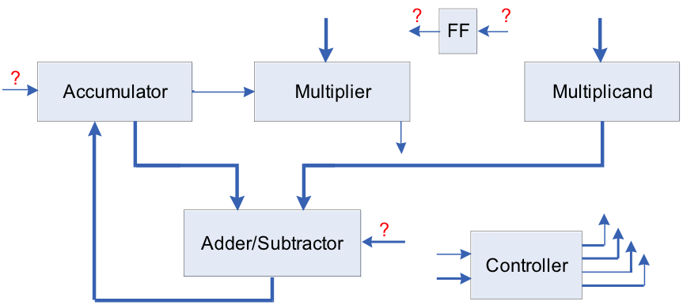
2’s Complement
Robertson’s Multiplication
Basic Idea
Accumulate a partial sum in multiple steps.
The rightmost bit of the multiplier is checked on every step to determine if the multiplicand should be added to the partial sum.
Shift the partial sum and the multiplier one bit to the right on every step.
  Make the partial sum line up with the multiplicand;
  Always check the rightmost bit of multiplier, no need to check higher bits;
  Lower bits of the partial sum shifted into the multiplier register for storage.
Subtraction step at the end for negative multiplicands.

Slide 7
Multiplication Example
accumulator
multiplier
multiplicand
1010₂ * 1100₂
step1:
0000
1100
1010
right shift
1100 multiplier
1010 multiplicand
00000000
0000000
111010 (add 1010, sign ext.)
00110 (sub 1010)
00011000 result
step2:
0000
0110
1010
right shift
step3:
0000
0011
1010
accumulator = accumulator + multiplicand
1010
0011
1010
right shift
correction step:
1101
0001
1010
accumulator = accumulator - multiplicand
0011
0001
1010
right shift
0001
1000
1010
Result: 00011000

Slide 8
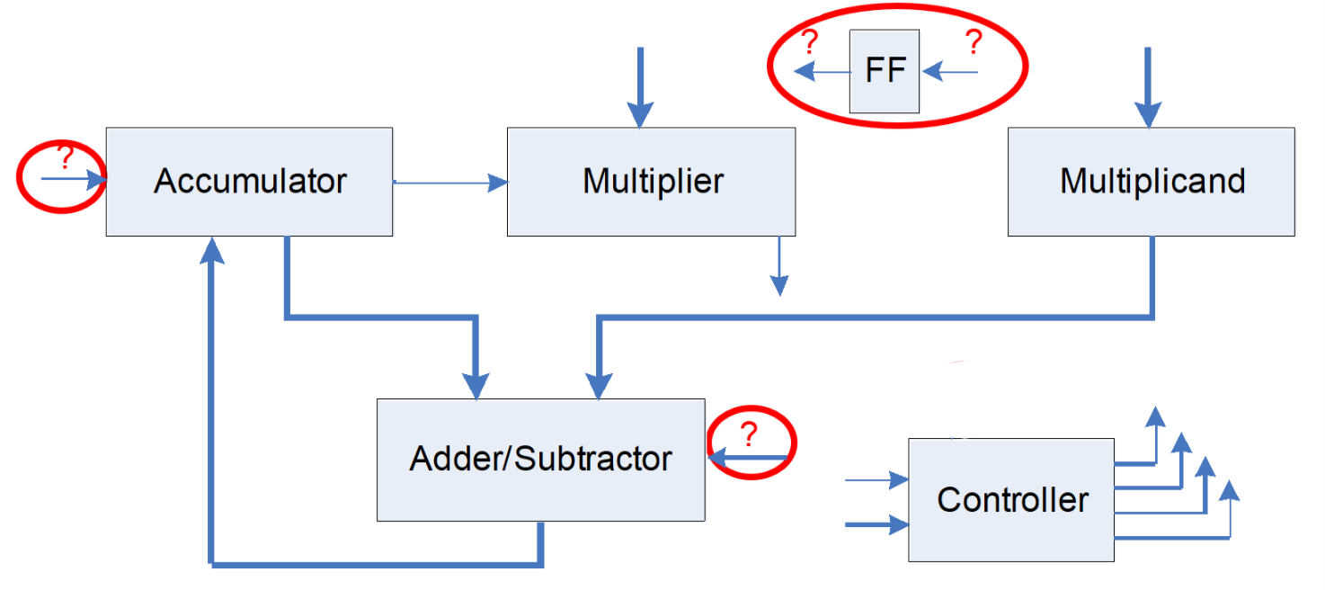
Overall Guidelines: Glue Logic
Use D Flip Flop En wo/SQ/ Provided
The most significant bit of the accumulator during a shift
  Different in each part of the lab
The A/S signal for the adder/subtractor.
  Add if A/S = 0; subtract if A/S = 1.

Slide 9
Implementation Summary
 | Acc. And Add/Sub Width | Multiplicand Register Width | Accumulator Shift-in (except last Shift) | Accumulator Shift-in (last Shift only)
Part 1 | 17-Bit (OMIT) | 16-Bit | Sign-extend Acc. MSB | Sign-extend Acc. MSB
Part 2 | 16-Bit | 16-Bit | Sign-extend Acc. MSB | Sign-extend Acc. MSB
Part 3 | 16-Bit | 16-Bit | MSB of multiplicand | Sign-extend Acc. MSB
Part 4 | 16-Bit | 16-Bit | ‘0’ until first ‘1’ in multiplier, then MSB of multiplicand | Sign-extend Acc. MSB
Part 5 | 16-Bit | 16-Bit | ‘0’ until first ‘1’ in multiplier, then MSB of multiplicand | Correct sign of multiplication result

Slide 10
Verilog Components
Fill in the guts of:
N-bit addsub
N-bit counter-down
mux 2, 3, 5
N-bit and 2N-bit registers
Control unit FSM and microcircuits
Data path
robsmult: contains data path and control block
ROM – machine code instructions
shift_register – does logical or arithmetic right-shift
signed-mult – dummy block to test the testbench
toprobertson: contains robsmult (arguably excess layer)
upc_reg: program counter

Slide 11
Verilog Implementation
Given Modules:
  JAE_Lab2_assgn.zip: This is a full Robertson’s multiplier, but with the details of the individual components left for you to fill in.
  robertsontest.sv, the tesbench, is included in the .zip. You are encouraged to insert additional operand value test cases – try a few large and small numbers, some positive, some negative.
  signed_mult.sv: This is a dummy behavioral multiplier to enable you to test your testbench – do not use for your final turn in!
Turn in:
  See full list of turn-in components under TED/Content/Labs/Lab2

