Slide 1
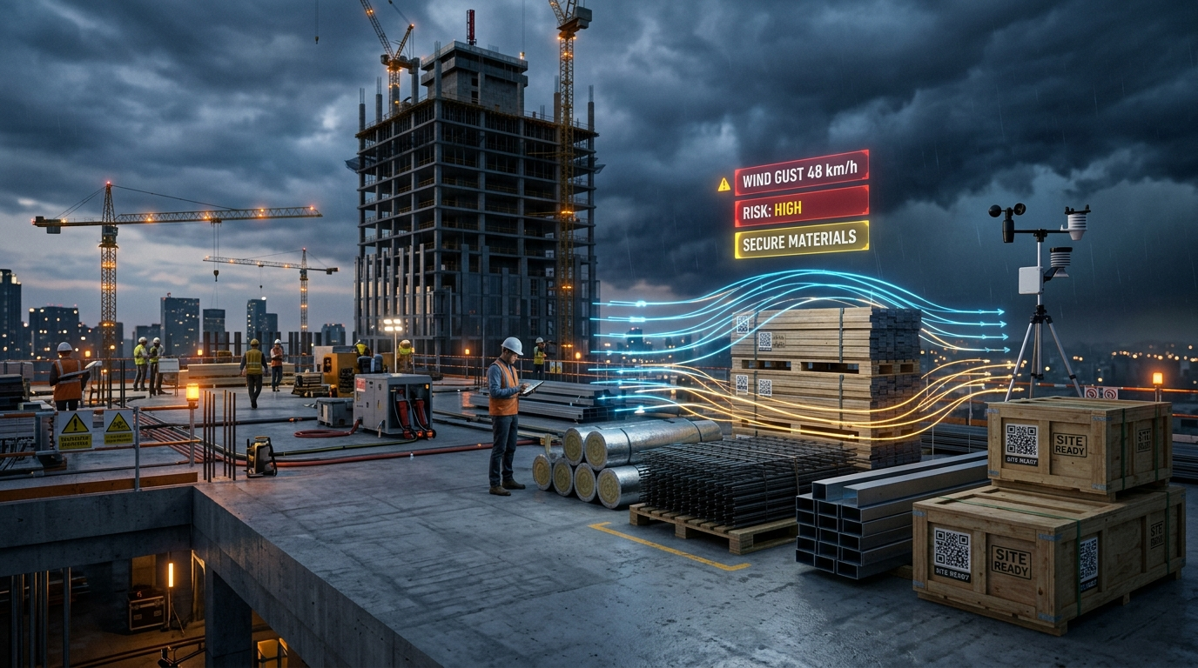
AUTONOMOUS AERODYNAMIC RISK MANAGEMENT
SafeStack Weather Guard
Real-Time Construction Yard Aerodynamic Safety & Dynamic Weather Risk Intelligence Platform
LIVE WEATHER PIPELINE
KMA Ultra-Short-Term API
24-Hour Predictive Gust Models
GPS Multi-Hub Site Switching
5 PHYSICS RISK ENGINES
NASA Aerodynamic Drag & Lift
Sliding, Toppling & Uplift FS
Dual-Height Edge Fall Protection
MOBILE PATROL & AI
Gemini 3.8 Flash Vision Intake
Sub-Second Camera QR Decoding
5-Entry Safety Audit Trail

Slide 2
THE HIGH-RISE WIND HAZARD GAP
Why Conventional Staging Protocols Fail in High Winds
1. Elevation Wind Amplification (Boundary Layer z/z0)
2. The Guardrail Overtopping Trap (Dual-Elevation)
Ground winds of 10 m/s amplify to over 16-22 m/s at 45m (12F) due to zero ground friction and structural corner vortices. Ground inspectors cannot visually gauge this critical threshold.
Materials stacked to 2.2m behind standard 1.2m perimeter railings create an aerodynamic pivot. Toppling cargo leverages over the rail and plunges 45m into street levels below.
3. Delayed Physical Action Window
4. Unverifiable Compliance Audit Paperwork
When sudden squalls strike, safety staff cannot manually inspect 20+ scattered yard locations to check which bundles lack ratchet straps or rubber friction pads.
KOSHA and OSHA regulations mandate quantitative audit trails for windproofing, but construction sites still rely on retrospective, subjective paper logs.
SafeStack Weather Guard | Autonomous Construction Yard Aerodynamic Safety

Slide 3
METEOROLOGICAL BACKBONE
Real-Time KMA Open API Pipeline & 24h Predictive Timeline
Live Observation API
Multi-Hub Regional Presets & GPS
Virtual Wind Simulator Bench
• Direct connection to Korea Meteorological Administration Ultra-Short-Term API
• Pulls 10-minute mean wind (V_mean) and instantaneous peak gust (V_gust)
• Tracks barometric pressure, precipitation, and wind vector angles
• Songdo Landmark Tower (Incheon): Coastal gale exposure
• Gangnam Highrise (Seoul): Urban canyon wind vortexing
• Haeundae Marine Complex (Busan): Maritime typhoon gusts
• HTML5 GPS automatic local grid coordinate (nx, ny) assignment
• Interactive test slider from 0 to 35 m/s
• Simulates typhoon and seasonal gust escalations in real-time
• Automatic siren & notification triggering at threshold (>= 14.0 m/s)
SafeStack Weather Guard | Autonomous Construction Yard Aerodynamic Safety

Slide 4
CLASSICAL MECHANICS & AERODYNAMICS
The 5 Physical Failure Modes Formulation
1. Sliding (미끄러짐)
FS = [μ·(M·g + F_strap - F_lift)] / [0.5·ρ·V²·Cd·A]
Static friction vs stagnation aerodynamic drag force. Rubber pads raise μ from 0.35 to 0.65; ratchet straps add downward normal force.
2. Toppling (전도)
FS = [(M·g + F_strap - F_lift)·(W/2) + M_strap] / [F_drag·(H/2)]
Wind overturning moment at geometric center of pressure (H/2) vs restoring moment from base dunnage width (W_support) and strap anchoring.
3. Uplift (들림)
FS = [M·g + F_strap] / [0.5·ρ·V²·Cl·A_top]
Aerodynamic Bernoulli lift over top surfaces with positive Cl (> 0.3). Critical for stacked plywood, formwork panels, and insulation boards.
4. Edge Fall (추락/낙하)
FS_fall = (d_edge / 2.0) · min(FS_s, FS_t) · f(H_rail, H_stack)
Dual-elevation rule: If stack height exceeds railing (+ΔH), protection factor drops to 0.65. Missing railing drops protection to 0.40.
5. Scattering (비산)
V_crit = √[ (2·σ·g) / (ρ·Cd) ], where σ = M/A
Threshold wind speed for loose sheets. Unstrapped EPS insulation flies at gusts as low as 8.8 m/s unless tightly strapped or netted.
SafeStack Weather Guard | Autonomous Construction Yard Aerodynamic Safety

Slide 5
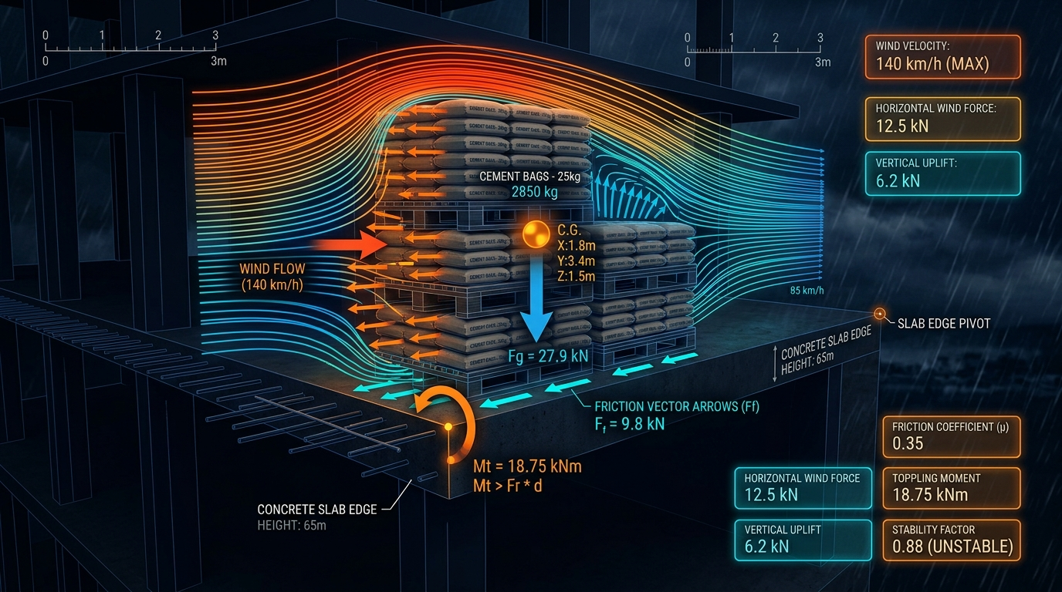
VISUAL AERODYNAMIC DIAGNOSTICS
Real-Time 3D CFD Aerodynamic Wind Tunnel Visualization
ELEVATION SHEAR & TERRAIN PROFILE
• Elevation Adjustment: Effective gust scaled by power-law exponent (α = 0.22 for open rooftop; α = 0.18 for enclosed core).
• Corner Vortex Factor: 1.15x multiplier for storage yards located within 3m of perimeter slab corners.
• Venturi Funneling: 1.20x multiplier for unprotected slab openings.
• Dynamic display of effective wind speed superimposed directly onto diagnostics.
SafeStack Weather Guard | Autonomous Construction Yard Aerodynamic Safety

Slide 6
AUTONOMOUS WARNING SYSTEM
Multi-Channel Automated Alarm & Web Audio Siren Synthesizer
Automated Triggers
Web Audio Synthesizer
OS System Notifications
• Trigger 1: Instantaneous gust >= 20.0 m/s
• Trigger 2: Observed mean wind >= 14.0 m/s
• Trigger 3: Active DANGER count >= 3 yards
• Immediate visual banner with pulsing hazard countdown.
• 100% Client-side dual oscillator audio engine
• Frequency modulation sweep (850Hz <-> 450Hz)
• Zero external MP3 downloads or lag
• One-click mute and audible drill testing.
• HTML5 Notification API integration
• Pushes background alerts to mobile devices
• Direct vibration and smartwatch notification
• Eliminates need for manual walkie-talkie relay.
SafeStack Weather Guard | Autonomous Construction Yard Aerodynamic Safety

Slide 7
VISUAL INTELLIGENCE & OCR
Gemini 3.8 Flash Multimodal Intake & Parameter Extraction
3-STEP VISION INTAKE PIPELINE
EXTRACTED JSON ENGINEERING SCHEMA
1. Field Photography:
Inspector photographs incoming delivery trucks or newly staged storage stacks using mobile camera.
2. Multimodal Gemini 3.8 Flash Parsing:
AI identifies material grade, estimates quantity, counts stacking tiers, gauges packaging tightness, checks ratchet straps, and detects anomalies.
3. Zero-Click Database Insertion:
Extracted engineering schema is parsed to JSON and written directly to site database with automatic safety factor recalculation.
{
"material_name": "Extruded EPS Insulation (100T)",
"category": "INSULATION",
"estimated_count": 36,
"stack_tiers": 3,
"bundle_state": "INDIVIDUAL_SHEETS",
"has_ratchet_straps": false,
"support_width_m": 0.8,
"anomalies": [
"Missing ratchet straps",
"Stack height exceeds 1.2m guardrail"
],
"confidence_score": 0.94
}
SafeStack Weather Guard | Autonomous Construction Yard Aerodynamic Safety

Slide 8
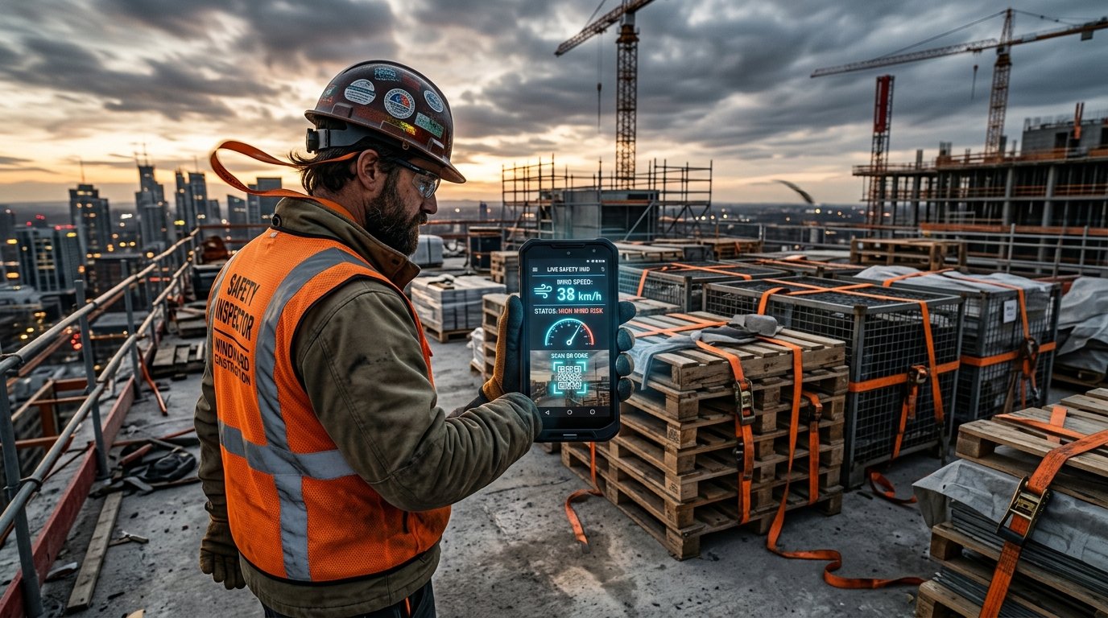
FIELD OPERABILITY & ASSISTANT
Mobile Field Patrol View & Gemini AI Safety Assistant
CONVERSATIONAL GEMINI AI PATROL ASSISTANT
• Real-time contextual QnA trained on live site status.
• 1-Tap Field Query Chips:
- '🚨 Where is urgent danger right now?'
- '🔍 Which location should I inspect first?'
- '⚠️ Which yards have loose unstrapped cargo?'
• Actionable Briefings: Gives 1-2 sentence decisive answers and generates a direct '[Inspect Target Yard Now]' jump link.
SafeStack Weather Guard | Autonomous Construction Yard Aerodynamic Safety

Slide 9
FIELD HARDWARE TELEMETRY
Camera-Based QR Code Yard Tag Scanner (jsQR Engine)
Sub-Second Video Frame Decoding
Tactile Audio & Laser Visual Reticle
Runs pure client-side computer vision on the HTML5 camera video stream at 30 FPS, decoding QR payloads in under 200 milliseconds without internet latency.
Includes animated laser scanning sweep, high-contrast corner reticles, and pleasant audio chime confirmation upon QR acquisition.
Instant Yard Telemetry Linking
Built-In Tag Simulation Bench
Scanning physical pallet tags pulls up storage elevation, live safety factor (FS), material cross-section, and maintenance history immediately.
Interactive sample tag buttons allow seamless live demonstration and testing on laptops without active camera permissions.
SafeStack Weather Guard | Autonomous Construction Yard Aerodynamic Safety

Slide 10
AUDIT TRAIL & VERIFIABILITY
5-Entry Location Safety Maintenance History Audit Log
PERSISTENT 5-ENTRY AUDIT COMPLIANCE PER YARD
2026-10-15 13:40 | Lead Safety Officer Kim | [SAFE]
Dunnage leveled with spirit level; ratchet strap tension verified at 2.5kN on rooftop pallet.
2026-10-15 09:15 | Site Inspector Park | [ACTION TAKEN]
Re-fastened upper ratchet straps after KMA strong wind advisory was issued.
2026-10-14 16:30 | Structural Field Inspector Lee | [SAFE]
Relocated top insulation bundle 3.0m inward away from slab edge; guardrail clearance restored.
SafeStack Weather Guard | Autonomous Construction Yard Aerodynamic Safety

Slide 11
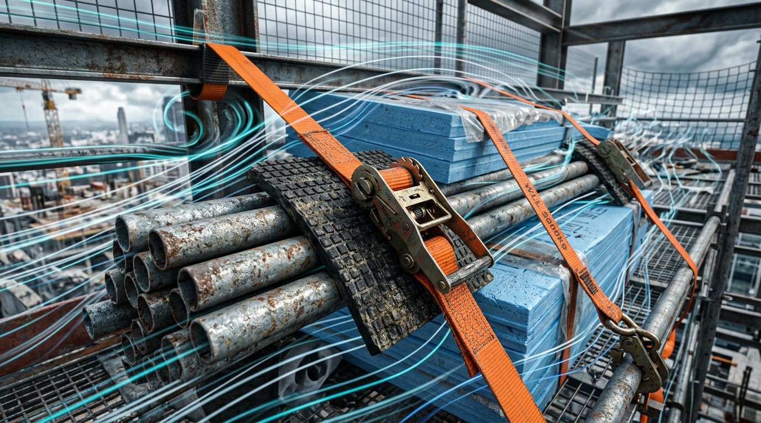
PREDICTIVE MITIGATION DECISION
Real-Time What-If Mitigation Simulation (Before vs. After)
BEFORE VS. AFTER DELTA RECALCULATION
• Sliding Safety Factor:
0.42 (DANGER) -> 1.68 (SAFE) [Δ +1.26]
• Overturning Safety Factor:
0.88 (DANGER) -> 2.15 (SAFE) [Δ +1.27]
• Perimeter Fall Factor:
0.65 (DANGER) -> 1.84 (SAFE) [Δ +1.19]
• 1-Click Commit: Writes the verified mitigation state directly to site database with zero human transcription error.
SafeStack Weather Guard | Autonomous Construction Yard Aerodynamic Safety

Slide 12
ENTERPRISE MULTI-LOCALE
Nationwide Site Presets & 100% Dual-Language System
100% COMPLETE BILINGUAL PARITY
NATIONWIDE HUB PROFILES
• Complete dictionary parity across 220+ technical keys in i18n service.
• Seamless instantaneous KO <-> EN switching.
• Zero state reset, zero formula loss, zero page reload.
• Empowers multinational field workers and foreign safety auditors with identical aerodynamic telemetry.
• Pre-calibrated terrain roughness profiles, coastal proximity factors, and building elevation heights for major Korean industrial corridors:
- Incheon Songdo (Coastal gale profile)
- Seoul Gangnam (Dense urban boundary profile)
- Busan Haeundae (Maritime typhoon profile)
- Gangwon Pyeongchang (Mountain ridge profile)
SafeStack Weather Guard | Autonomous Construction Yard Aerodynamic Safety

Slide 13
SYSTEM SPECIFICATION
High-Performance Client-Authoritative Stack
React 19 & Vite 8
TypeScript 5 Strict
Gemini 3.8 Flash SDK
jsQR Computer Vision
60 FPS reactive UI with sub-second HMR and instant state re-rendering.
Zero runtime type coercion errors across physical aerodynamic math.
State-of-the-art vision and streaming QnA assistant integration.
30 FPS client-side video frame decoding with zero external API calls.
PRODUCTION RESILIENCE HIGHLIGHTS
• Sub-2ms Physics Execution: All aerodynamic formulas run client-side without network bottlenecks.
• LocalStorage Persistence: Yard configurations, inspection logs, and custom regions survive browser restarts.
• Responsive Zero-Overflow Design: Validated across 4K displays down to 360px mobile viewports.
SafeStack Weather Guard | Autonomous Construction Yard Aerodynamic Safety

Slide 14
VERIFIABLE VALUE
Transforming Yard Wind Safety into an Exact Science
>90%
45 Min
100%
Reduction in Wind Accidents
Time Saved per Shift
Verifiable Digital Audit Trail
Eliminates toppling and perimeter drop catastrophes through proactive FS checks.
Replaces manual walkie-talkie checks and paper calculation with 0.2s QR telemetry.
Provides continuous compliance with KDS structural and KOSHA safety guidelines.
SafeStack Weather Guard | Autonomous Construction Yard Aerodynamic Safety

