Slide 1
SaaS Subscription Churn Prediction
Data Science Internship Project
Naviotech Solution Pvt. Ltd.
Prepared by: Lavi Chaudhary

Slide 2
1. Project Overview
Business problem: SaaS companies lose recurring revenue when subscribers churn.
Goal: predict customers who are likely to churn before cancellation.
Category: Binary Classification.
Dataset: 1,500 synthetic customer records.

Slide 3
2. Problem Statement
Build an early-warning machine-learning system for customer churn.
Use subscription, engagement, support, satisfaction and payment signals.
Prioritize recall/F1 because missing an at-risk customer can be costly.

Slide 4
3. Objectives
Explore churn patterns.
Preprocess numerical and categorical variables.
Train Logistic Regression and Random Forest.
Evaluate accuracy, precision, recall, F1 and ROC-AUC.
Produce actionable retention recommendations.

Slide 5
4. Dataset & Features
1,500 customer records; synthetic educational data.
Subscription: plan, contract, auto-renewal, trial status.
Engagement: logins, active days, features used.
Support: tickets, resolution time, satisfaction.
Billing: revenue, payment failures, discounts.
Target: churn (1 = churned, 0 = retained).

Slide 6
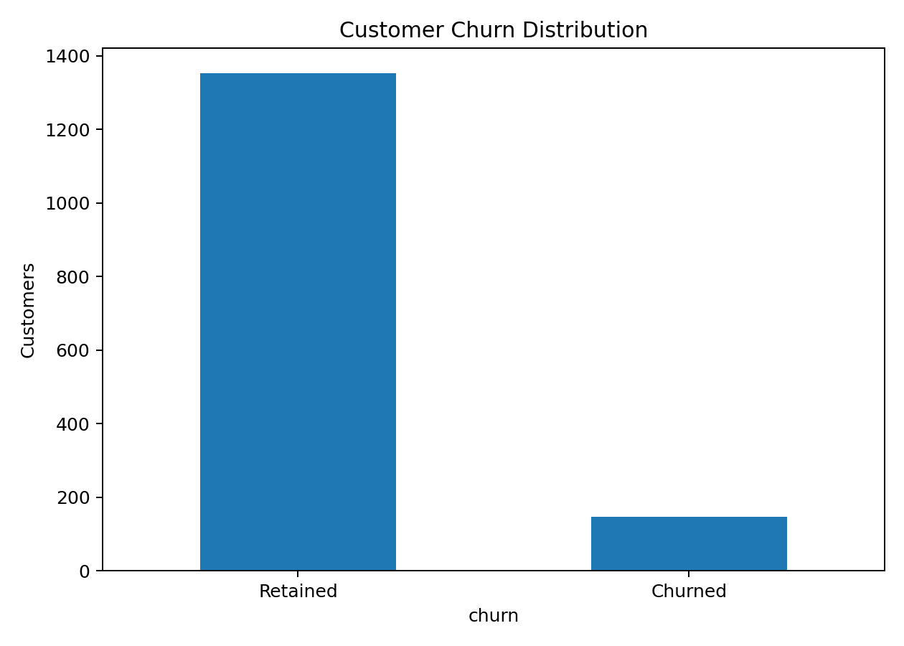
5. Exploratory Data Analysis
Observed churn rate: 9.80%.
Churn is imbalanced, so accuracy alone is not sufficient.
Churn rates were compared by plan, contract type and acquisition channel.

Slide 7
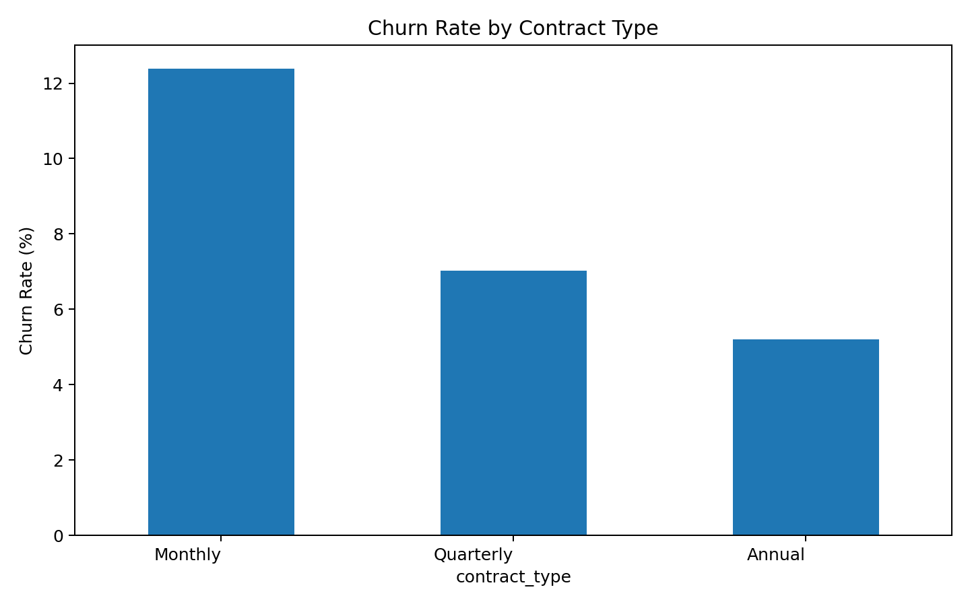
6. Churn Patterns
Monthly contracts show higher churn risk than longer commitments in the generated data.
Lower engagement and satisfaction are associated with increased churn risk.
Payment failures and support burden are useful warning signals.

Slide 8
7. Data Preprocessing
Numerical values: median imputation + standard scaling.
Categorical values: most-frequent imputation + one-hot encoding.
Train/test split: 80/20 with stratification.
Class weighting used to address imbalance.

Slide 9
8. Machine Learning Models
Logistic Regression: interpretable probability-based baseline.
Random Forest: non-linear ensemble comparison.
Metrics: Accuracy, Precision, Recall, F1 and ROC-AUC.
Business selection focuses on detecting churners, not only maximizing accuracy.

Slide 10
9. Model Comparison
Logistic Regression — Accuracy 0.707, Recall 0.690, F1 0.312, AUC 0.767.
Random Forest — Accuracy 0.903, Recall 0.034, F1 0.065, AUC 0.747.
Random Forest has higher accuracy but very low recall at the default threshold.
Logistic Regression is more useful for the churn-screening objective.

Slide 11
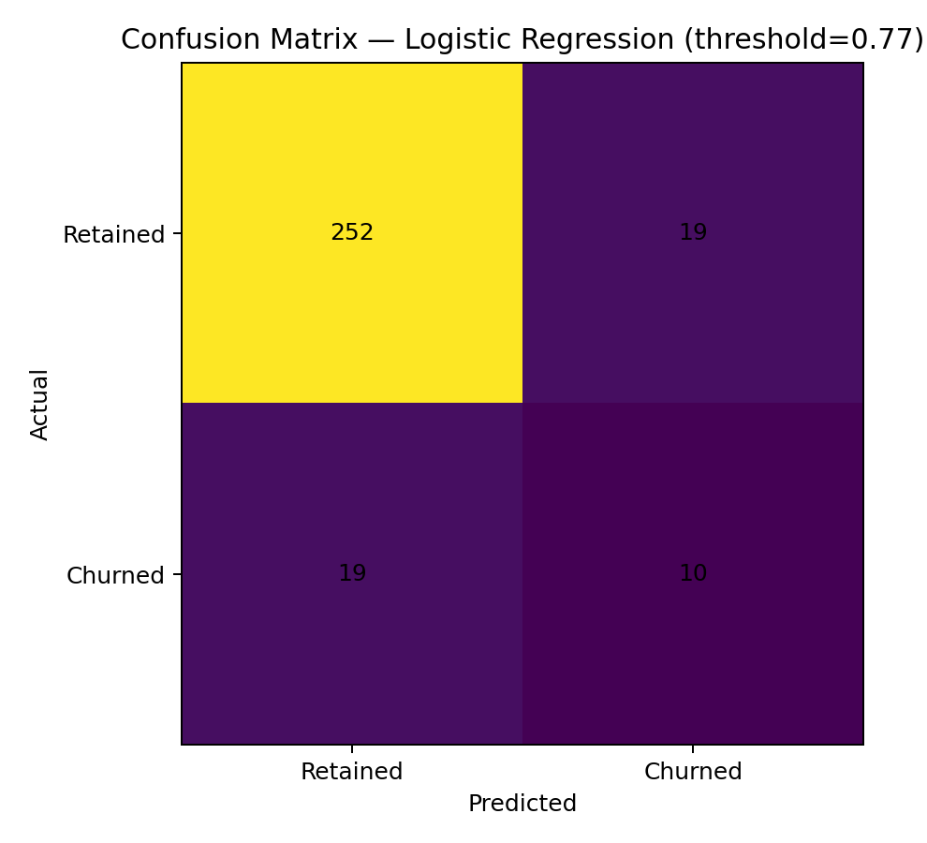
10. Threshold Tuning
Default threshold: 0.50.
Selected Logistic Regression threshold: 0.77.
Tuned results — Accuracy 0.873, Precision 0.345, Recall 0.345, F1 0.345.
Threshold tuning increases the model's ability to flag potential churners.

Slide 12
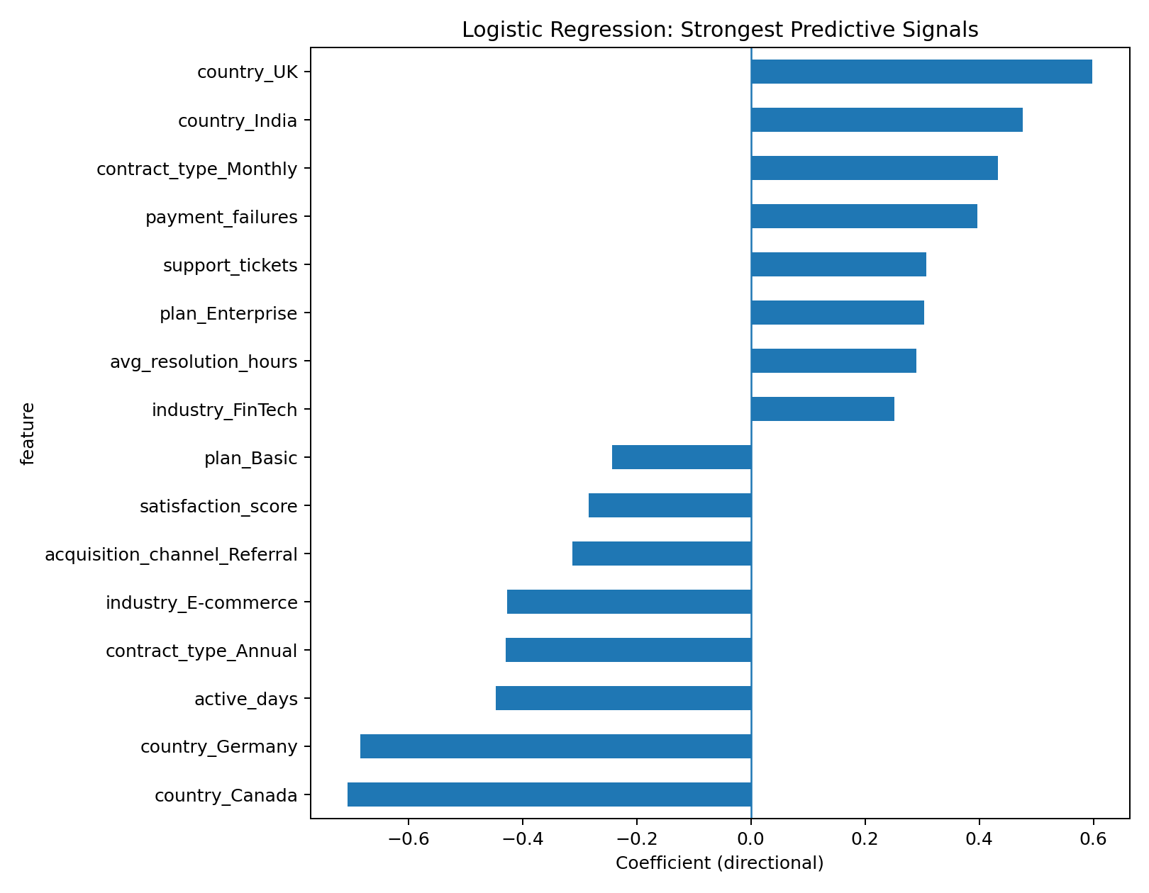
11. Key Findings
Contract type and auto-renewal are strong churn signals.
Low engagement and satisfaction indicate higher risk.
Payment failures and support issues can precede churn.
Model probabilities can support targeted customer-success outreach.

Slide 13
12. Business Recommendations
Create a high-risk customer queue.
Run re-engagement campaigns for low-activity customers.
Recover failed payments quickly.
Escalate unresolved support issues.
Encourage longer-term plans through value-based offers.
Monitor model precision/recall after deployment.

Slide 14
13. Limitations & Future Scope
Synthetic dataset; not a production benchmark.
Use real anonymised SaaS data for deployment.
Use cross-validation and a separate validation set for threshold tuning.
Future: SHAP explainability, hyperparameter tuning, calibration, drift monitoring and dashboard/API deployment.

Slide 15
14. Conclusion
The project delivers an end-to-end churn prediction workflow.
Logistic Regression provides an interpretable churn-risk score.
Threshold tuning makes the classifier more aligned with an early-warning use case.
Data-driven churn alerts can help SaaS teams focus retention resources.

Slide 16
15. Thank You
Thank you
Questions & Discussion

