Slide 1



Lee ChaeHyeon
201635841
Gachon Route Guide
Team 5
Park Juni
201935048
Kim JongMin
201935028
Lee SeoBin
201935096

Slide 2

Index
01. Members
- Information of Team Members
02. Title & Goal
- Theme of Project
03. Description
- Brief Description of Project
04. Role Distrubution
- Theme of Project
05. Scheduling

Slide 3




Member
Student Number : 201635841
Name : Lee Chae Hyeon
E-mail Address : chlee1001@naver.com
Student Number : 201935028
Name : Kim Jong Min
E-mail Address : kjm0202@empas.com
Student Number : 201935048
Name : Park Juni
E-mail Address : juneya10@naver.com
Student Number : 201935096
Name : Lee Seo Bin
E-mail Address : leeseobin00@gachon.ac.kr
01
Notes:
이미지 하나 필요

Slide 4
Title
Gachon Route Guide
Considering the entrance to Gachon University,
it guides the fastest route
02

Slide 5




Description
Algorithm : Grapth algorithm - Dijkstra
Language : Python
Visualization : Folium Library (Python)
Code’s revision control: Github
03

Slide 6
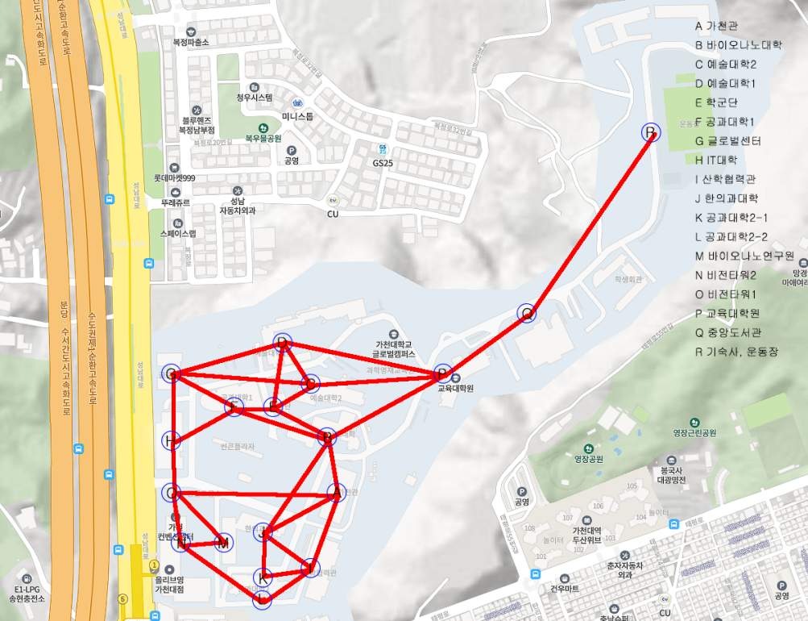
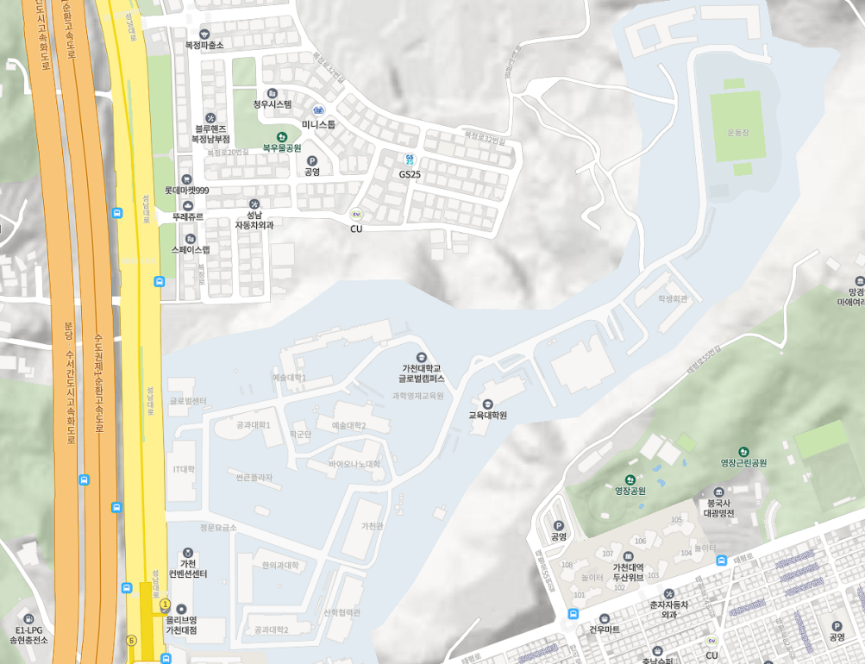
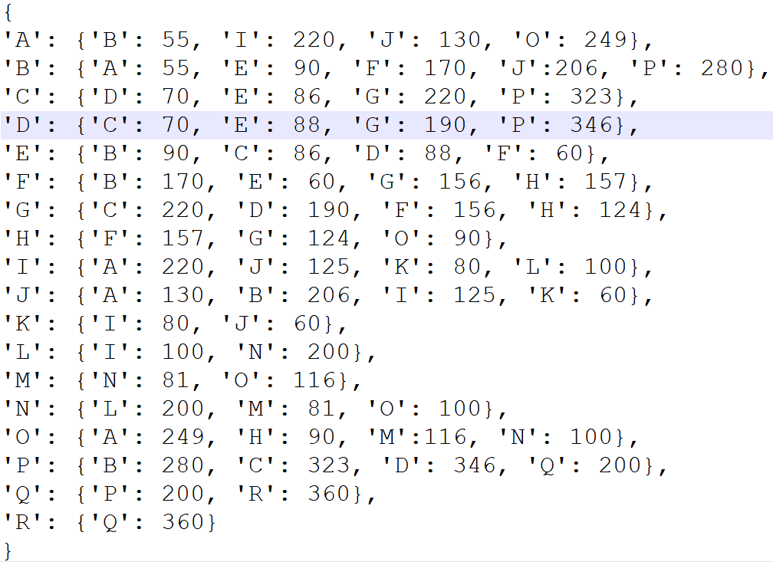
Description
04

Slide 7
Description
05
Notes:
자료 출처: https://github.com/python-visualization/folium

Slide 8
Role Distribution
Name : Lee Chae Hyeon
Expected Role : Collect Data + Python Programming + Implemention GUI
Name : Kim Jong Min
Expected Role : Collect Data + Python Programming + Implemention GUI
Name : Park Juni
Expected Role : Collect Data + Python Programming + Implemention GUI
Name : Lee Seo Bin
Expected Role : Collect Data + Python Programming + Implemention GUI
06

Slide 9
Schedule
11/NOV.
Sun |  |  |  | Mon |  |  |  | Tue |  |  |  | Wed |  |  |  |  | Thu |  |  | Fri |  | Sat
1 |  |  |  | 2 |  |  |  | 3 |  |  |  | 4 |  |  |  |  | 5 |  |  | 6 |  | 7
 |  |  |  |  |  |  |  | Proposal Presentattion |  |  |  |  |  |  |  |  |  |  |  |  |  | Data Collection
8 |  |  |  | 9 |  |  |  | 10 |  |  |  | 11 |  |  |  |  | 12 |  |  | 13 |  | 14
 |  |  |  |  |  |  |  |  |  |  |  | Implemention the Algorithm
15 |  |  |  | 16 |  |  |  | 17 |  |  |  | 18 |  |  |  |  | 19 |  |  | 20 |  | 21
22 |  |  |  | 23 |  |  |  | 24 |  |  |  | 25 |  |  |  |  | 26 |  |  | 27 |  | 28
 |  |  |  |  |  |  |  |  |  |  |  |  |  |  |  |  |  |  |  | Implement GUI
29 |  |  |  | 30 |  |  |  | 12/1 |  |  |  | 12/2 |  |  |  |  | 12/3
 |  |  |  |  |  |  |  | Make Final PPT |  |  |  |  |  |  |  |  | Final Presentation
07

Slide 10
THANK
YOU

