Slide 1
Data Science
Term Project
201635837 이신정
201635841 이채현
201735842 신재원

Slide 2
TOC
Objective Setting
Data Preprocessing
Data Curation
Data Analysis
Data Inspection
Evaluation

Slide 3


1
Objective Setting
People are always wondering if they will win or lose while watching the game.
Classify the wins or losses with the events in the game.

Slide 4

1
Objective Setting
Used Data
Year 2020
challenger, grandmaster, master game data (Korea, 2020)
Win/Lose

Slide 5
2
Data Curation
Dataset
match_winner_data_version1
match_loser_data_version1
Size
each 108,829 rows
each 17 columns
Features

Slide 6
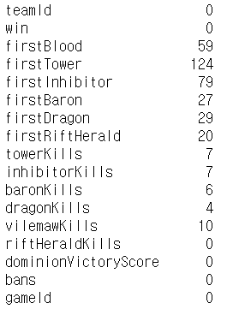
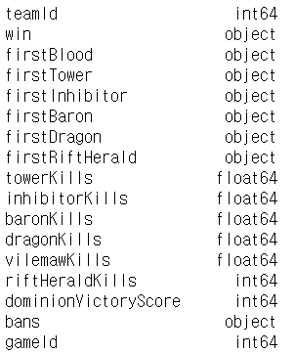
2
Data Curation
Missing Data
Categorical Data
data.isnull.sum()
data.dtypes

Slide 7
2
Data Curation
win T(win) / F(lose)
firstBlood First kill or not
firstTower First tower kill or not
firstInhibitor First inhibitor kill or not
towerKills tower kill count
inhibitorKills inhibitor kill count
baronKills baron kill count
dragonKills dragon kill count
riftHeraldKills riftherald kill count
gameId gameId (foreign key)
Used Features
17 columns → 10 columns

Slide 8

3
Data Inspection
Contains label results Win / Lose
Sufficient number of features, rows 108,829 x 17
Dirty data Missing data
Categorical data ex) firstBlood
Suitability

Slide 9
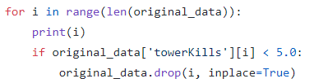
4
Data Preprocessing
Unusable Data Cleaning
Finding the wrong game that is not divided by win or lose and any others (Check using towerkills)
Winner Data
108,829 rows → 78,163 rows

Slide 10



4
Data Preprocessing
Missing Data Cleaning - Numerical Data
Fill with mean (Rounds mean to nearest integer)

Slide 11
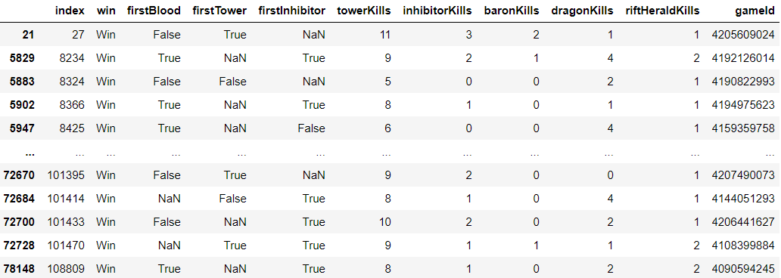

4
Data Preprocessing
Missing Data Cleaning - Categorical Data (1)
〮〮〮〮
Find the ‘index’ with missing value and the ‘gameId’ value of the row in ‘original_data_remove_wrongGame.csv’

Slide 12
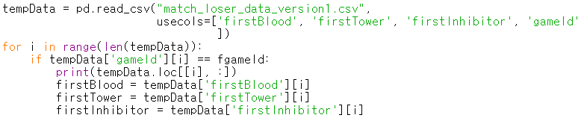
4
Data Preprocessing
Missing Data Cleaning - Categorical Data (2)
Find empty data using ‘gameId’ among existing loser data

Slide 13
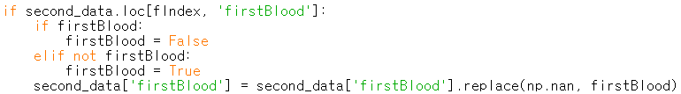
4
Data Preprocessing
Missing Data Cleaning - Categorical Data (3)
Last, since the data are Boolean data
→ The opposite value of the found value is entered

Slide 14
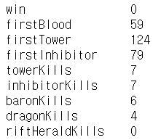
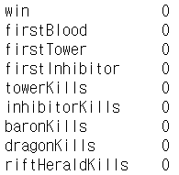
4
Data Preprocessing
Missing Data Cleaning - Result
After

Slide 15

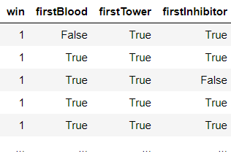
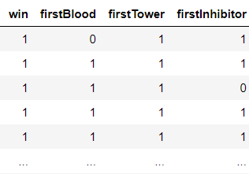
4
Data Preprocessing
Label Encoder
After
Categorical
Numeric

Slide 16
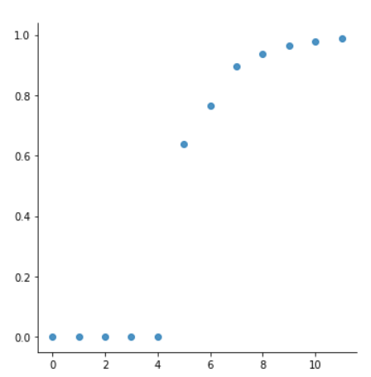
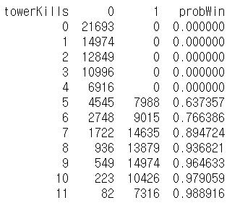
4
Data Preprocessing
Probability victory based on the number of tower kill
Notes:
win과 numeric data의 상관관계를 알아보기 위한 것
그 중 가장 큰 상관관계를 가진 tower kill과 dragon kill을 시각화하여 표현

Slide 17
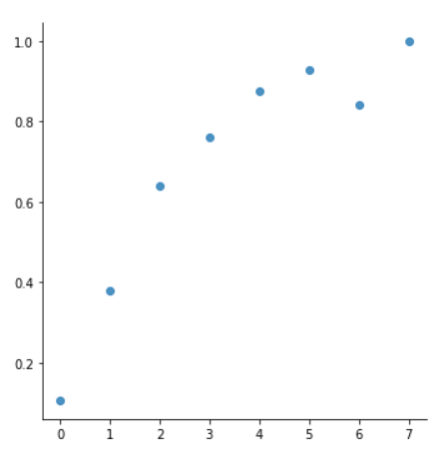
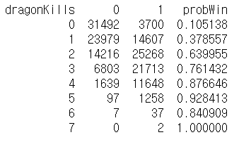
4
Data Preprocessing
Probability victory based on the number of dragon kill

Slide 18
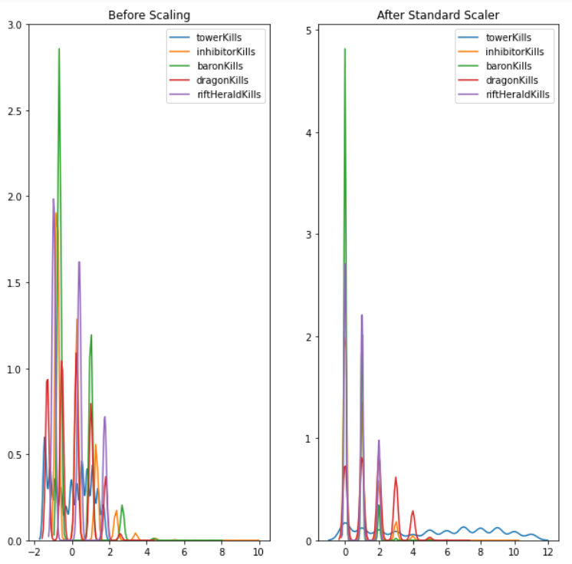
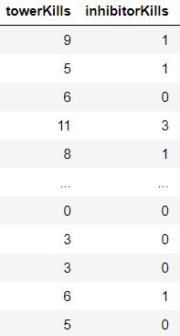
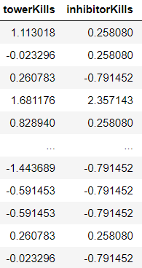
4
Data Preprocessing
Standardization
After

Slide 19
5
Data Analysis
1. Multiple Linear Regression
2. Decision Tree

Slide 20
5
Data Analysis
Holdout Method

Slide 21
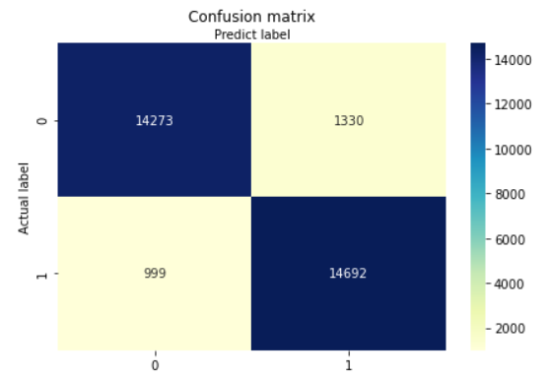
6
Evaluation
Logistic Regression
Heatmap
precision
14273 / (14273 + 999) = 0.935
recall
14273 / (14273 + 1330) = 0.915
accuracy
(14273+14692) / (14273 + 14692 + 999 + 1330)
= 0.926
Notes:
precision : win이라고 예측한 데이터 중에 실제 win인 비율
recall : 실제 win인 데이터 중의 win으로 판별된 비율

Slide 22
6
Evaluation
Logistic Regression
K-Fold Cross Validation k=10
Accuracy

Slide 23

6
Evaluation
Decision Tree
Confusion Matrix
precision
14050 / (14050 + 505) = 0.965
recall
14050 / (14050 +1553) = 0.900
accuracy
(14050+15186) / (14050 + 15186 + 505 + 1553)
= 0.934
Notes:
precision : win이라고 예측한 데이터 중에 실제 win인 비율
recall : 실제 win인 데이터 중의 win으로 판별된 비율

Slide 24
6
Evaluation
Decision Tree
K-Fold Cross Validation k=10
Accuracy

Slide 25



7
Role
이신정
이채현
신재원
Data Inspection
Data Preprocessing
Data Analysis
Data Evaluation
Data Inspection
Data Preprocessing
Data Analysis
Data Evaluation
Data Inspection
Data Preprocessing
Data Analysis
Data Evaluation

Slide 26
Thank You

