Slide 1



Advanced Analytics
Cloud Agnostic Loss Run Parser Engine
Mar 2026

Slide 2




Cloud Agnostic Solution Design Approach
Upload Files through Streamlit UI
2
Stores the file in Blob Storage
Solution Flow:
1. Ingestion: User uploads Excel or CSV Loss Run files through the Streamlit Web UI, which initiates the processing workflow.
2. File Storage: The uploaded files are stored in the Blob/File Storage Layer to maintain the raw input for traceability and reprocessing.
3. Parsing & Extraction: A Loss Run Parsing Engine (Python) processes the uploaded file, performs layout detection, and extracts relevant claim fields, generating an intermediate structured output.
4. Review & Configuration: The user reviews the extracted output in the review layer and defines configuration files that control how the final output should be generated.
5. Post-Processing & Normalization: The system applies post-processing and normalization rules based on the configuration files to generate normalized structured data.
6. Downstream Integration: The normalized data is delivered through APIs to downstream systems such as Duck Creek or Guidewire.
7. Storage & Feature Layer: The finalized structured data is stored in the Claims Domain Model and Feature Store for downstream analytics and business processing.
Loss run file Parsing Engine (Python) lay out detection and Fields Extraction
1
3
Review layer
User reviews extracted output and configures output generation through configuration files.
4
5
Post Processing and Normalisation
config file
Normalised Structure Data
6
API
Claims
Domain Model
7
Feature Store*

Slide 3
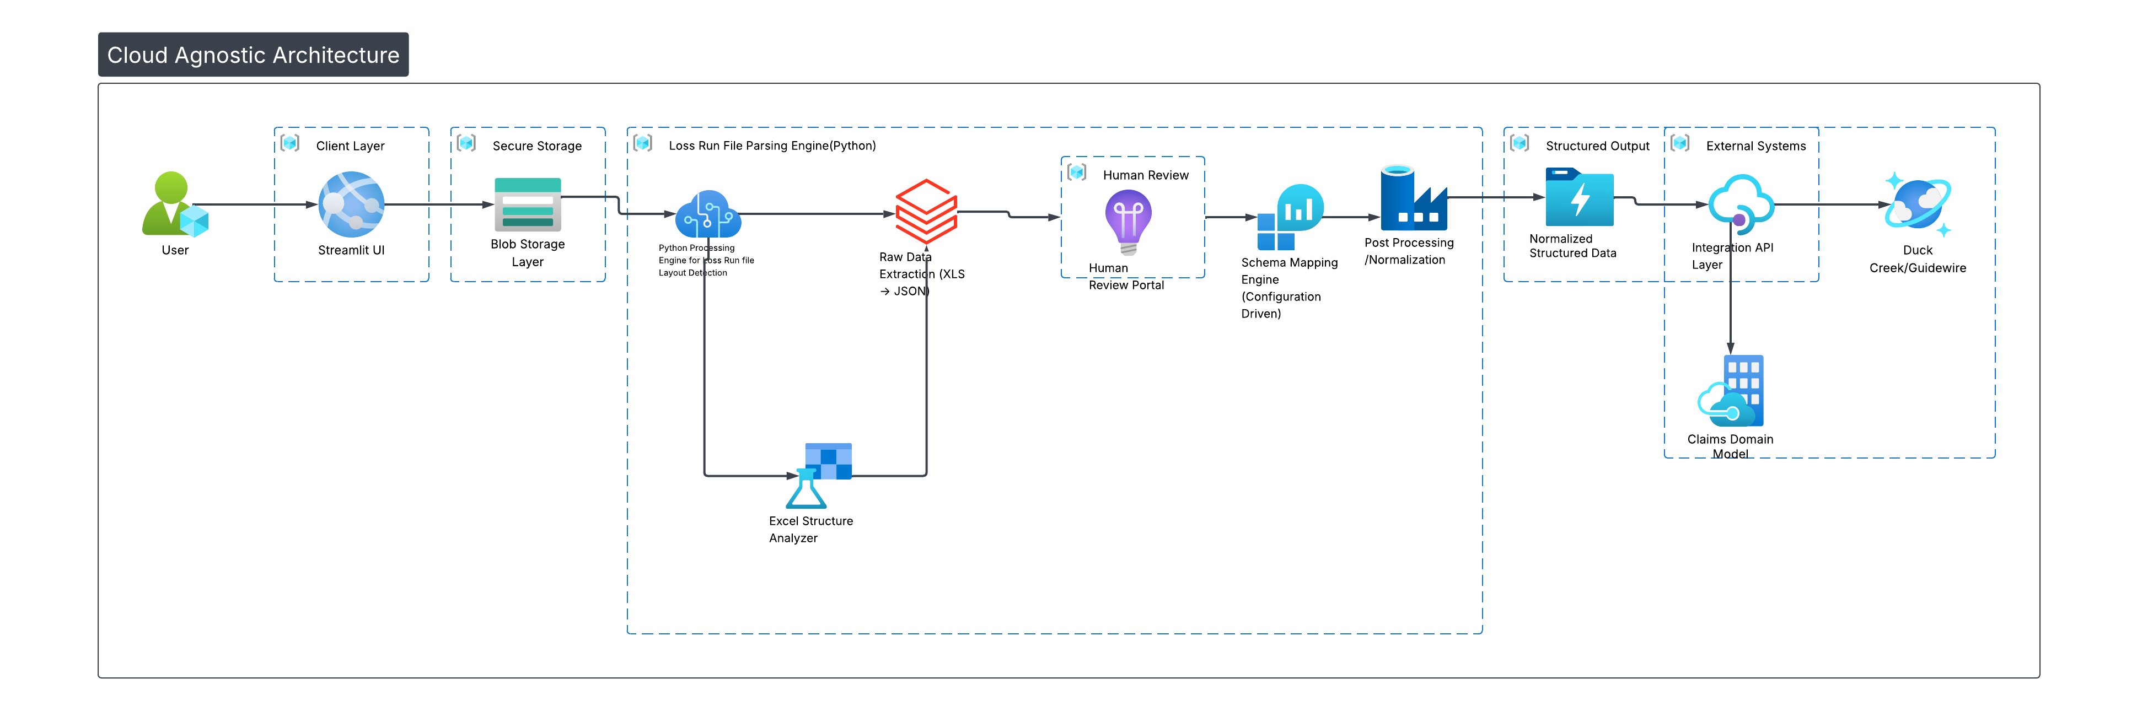
Cloud Agnostic Architecture Flow for Loss Run Parsing
Notes:
User – Business user uploads Loss Run files for processing.
Streamlit UI (Client Layer) – Web interface used to upload files and initiate the parsing workflow.
Blob Storage Layer (Secure Storage) – Uploaded files are securely stored before processing begins.
Python Processing Engine – Core service that orchestrates file parsing and layout detection.
Excel Structure Analyzer – Detects the file structure and identifies claim tables and relevant sections.
Raw Data Extraction (XLS → JSON) – Extracts claim data from the file and converts it into structured JSON format.
Human Review Portal – Users review extracted values and validate or correct the parsed data.
Schema Mapping Engine (Configuration Driven) – Applies configurable mappings to align extracted data with the target schema.
Post Processing / Normalization – Cleans, standardizes, and prepares the data for downstream systems.
Normalized Structured Data – Final structured dataset ready for integration and storage.
Integration API Layer – Exposes processed data to external systems through APIs.
Claims Domain Model – Stores the normalized claims data in the canonical business data model.
Duck Creek / Guidewire – Downstream insurance platforms consume the processed claims data.

Slide 5

ADI Solution Design Approach
Azure Document Intelligence (ADI) for file classification, Template detection
Solution Flow:
1.Ingestion: User uploads Excel or PDF files via a Custom Web App. The files are stored in Azure Blob Storage.
2.Extraction : An Azure Function triggers Azure Document Intelligence (ADI) to extract text, tables, and key-value pairs.
3.Confidence Check: The system checks the confidence score for each field.
High Confidence (>=0.9): Data is auto accepted and stored.
Low Confidence (< 0.9): Data is routed to the Review Interface.
4.Human Review: A user reviews the extraction in a custom UI, makes edits, and hits "Save."
5.Storage: Both the Raw AI Output and the Human-Reviewed Response are stored for business use.
2
Blob Storage
1
TPA
Ingestion
Files
4
[{XLS, Forms}, {Loss Run, SOVs, Accord}]
Review
Processed files/
Feedback
3
Input/ Feedback
Structured Doc Parser
(E.g., Loss Run Parser)
Response
Azure Functions Orchestrator
5
Reviewed Input
7
API
Claims
Domain Model
6
Feature Store*
Transform

Slide 6
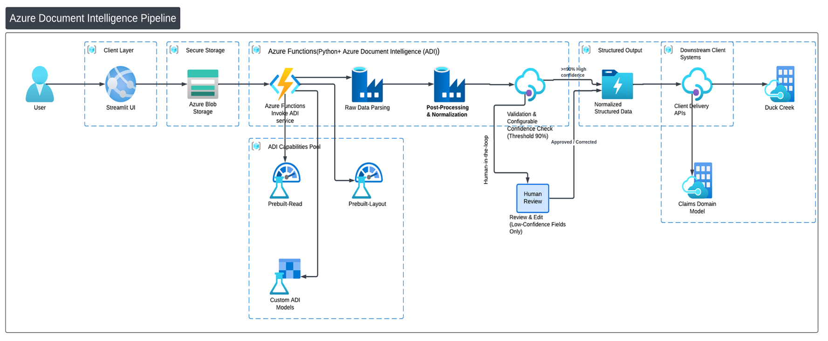
Architecture Flow for Loss Run Parsing
Notes:
Steps description:
1. User End-user or enterprise client initiates the document ingestion process via a web interface or API call.
2. Client Web Application (UI / API) Front-end layer- Streamlit UI that accepts uploaded loss run documents and routes them securely into the processing pipeline.
3. Azure Blob Storage Temporarily stores raw uploaded files (Excel, PDF, images) in a secure, scalable cloud container before processing.
4. Azure Functions — Invoke ADI Service All invoked through a python Notebook which invokes a Serverless trigger that picks up stored documents and dispatches them to the appropriate Azure Document Intelligence model.
5. Prebuilt-Read Extracts plain text and key-value content from unstructured documents using OCR.
6. Prebuilt-Layout Detects and extracts structured tables, rows, and bounding-box coordinates from formatted documents like loss runs.
7. Custom ADI Models Domain-trained models that recognize insurance-specific fields (claim numbers, incurred amounts, loss dates) not handled by prebuilt models.
8. Raw Data Parsing Converts ADI JSON output into normalized row-level records aligned to the expected claims schema.
9. Post-Processing & Normalization Cleans, deduplicates, and standardizes extracted field values (dates, currency formats, name casing) for downstream consumption.
10. Validation & configurable Confidence Check (Threshold ≥99%) Routes each field — high-confidence records pass automatically; anything below 99% is flagged for human review.
11. Human Review — Review & Edit (Low-Confidence Fields Only) Adjuster or analyst manually verifies and corrects only the flagged low-confidence fields via the TPA Claims Review Portal.
12. Normalized Structured Data Final validated, schema-compliant dataset ready for delivery, stored as structured JSON or database records.
13. Client Delivery APIs Exposes the normalized claims data via REST APIs for downstream system consumption.
14. Duck Creek/Guide wire Pushes structured claim records directly into the Duck Creek/Guidewire P&C policy and claims management platform.
15. Claim Domain Model Creates and stores in the Claims domain Model

Slide 7
ADI capabilities
ADI Capability | Core Function | Scenario (When to Use) | Example Documents
Prebuilt Read | OCR that extracts all visible text with reading order, without interpreting layout or tables. | Text-heavy documents where only content needs to be searchable, classified, or analyzed without table reconstruction. | Claim notes, adjuster reports, medical narratives, emails, policy wording documents.
Prebuilt Layout | Detects structural elements such as tables, rows, columns, headers, and spatial relationships with cell-level coordinates. | Table-based reports with varying formats where rows/columns must be reconstructed before mapping to a standard schema. | Loss run Excel/PDF, bordereaux reports, financial statements, exposure schedules, claim listings.
Custom Classification | Trained model that predicts document type based on layout and content patterns. | Multiple document types enter the pipeline and must be routed to the correct extraction logic. | Mixed uploads: loss runs, FNOL, policies, invoices, bordereaux.
Custom Extraction | Trained model that learns standardized fields or table schema from labeled documents across layout variations. | Specific business fields must be extracted consistently from highly diverse templates where layout parsing alone is insufficient. | Multi-carrier loss runs, ACORD forms, claim intake forms, underwriting submissions.

Slide 8
Key ADI Features and How They Enable Document Processing
Capability / Model | Description | How it Helps
Prebuilt-Read | Extracts printed and handwritten text from PDFs, images, Word, Excel, and HTML with preserved reading order. | Converts unstructured documents into machine-readable text for downstream processing.
Prebuilt-Layout | Detects document structure such as tables, paragraphs, headers, and selection marks with spatial relationships. | Enables structured data extraction and accurate table/field reconstruction.
Bounding Regions | Provides precise spatial location of each field using multi-point polygon geometry. | Supports visual overlays and robust extraction from rotated or complex layouts.
Confidence Scores | Assigns reliability score (0.0–1.0) to each extracted element and word. | Enables quality filtering, validation thresholds, and human-in-the-loop review.
Word-Level Accuracy | Confidence available at individual word granularity. | Allows fine-grained validation and targeted correction of extracted data.

Slide 9
Additional Azure Document Intelligence(ADI) Capabilities
ADI Features | Technical Capability | Our P&C Usage
prebuilt-layout | Table extraction, structure detection, 95%+ accuracy | Primary model for loss runs, registers, bordereaux
prebuilt-read | Advanced OCR (printed/handwritten), Word/Excel support | Scanned docs, handwritten notes, legacy PDFs
prebuilt-invoice | Invoice-specific field extraction | Premium invoices, vendor payments
prebuilt-identity | ID document extraction (DL, Passport) | Underwriting identity verification
prebuilt-financial | Bank statement, receipt extraction | Premium reconciliation
Custom Model Extraction | Train on 5+ samples, 97%+ accuracy | 10 custom models for ACORD, TPAs, inspections
Custom Model Classification | Auto-split multi-doc PDFs | Mixed submission files (app + docs)
Bounding Regions | Polygon coordinates for each field | Click-to-highlight in review portal
Confidence Scores | Word-level accuracy (0.0-1.0) | Field validation and QA flagging

