Slide 1
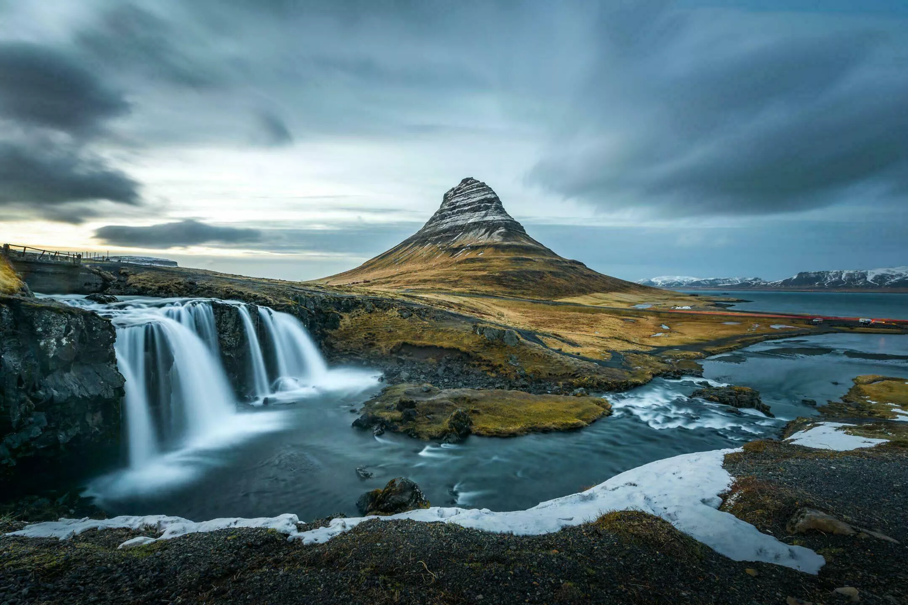



ISLANDE
PLANET Leslie / BARBEAU Xavier / DECOUST Chloé
Mme BIEBER / Mme CANNON
BUT SD1

Slide 2
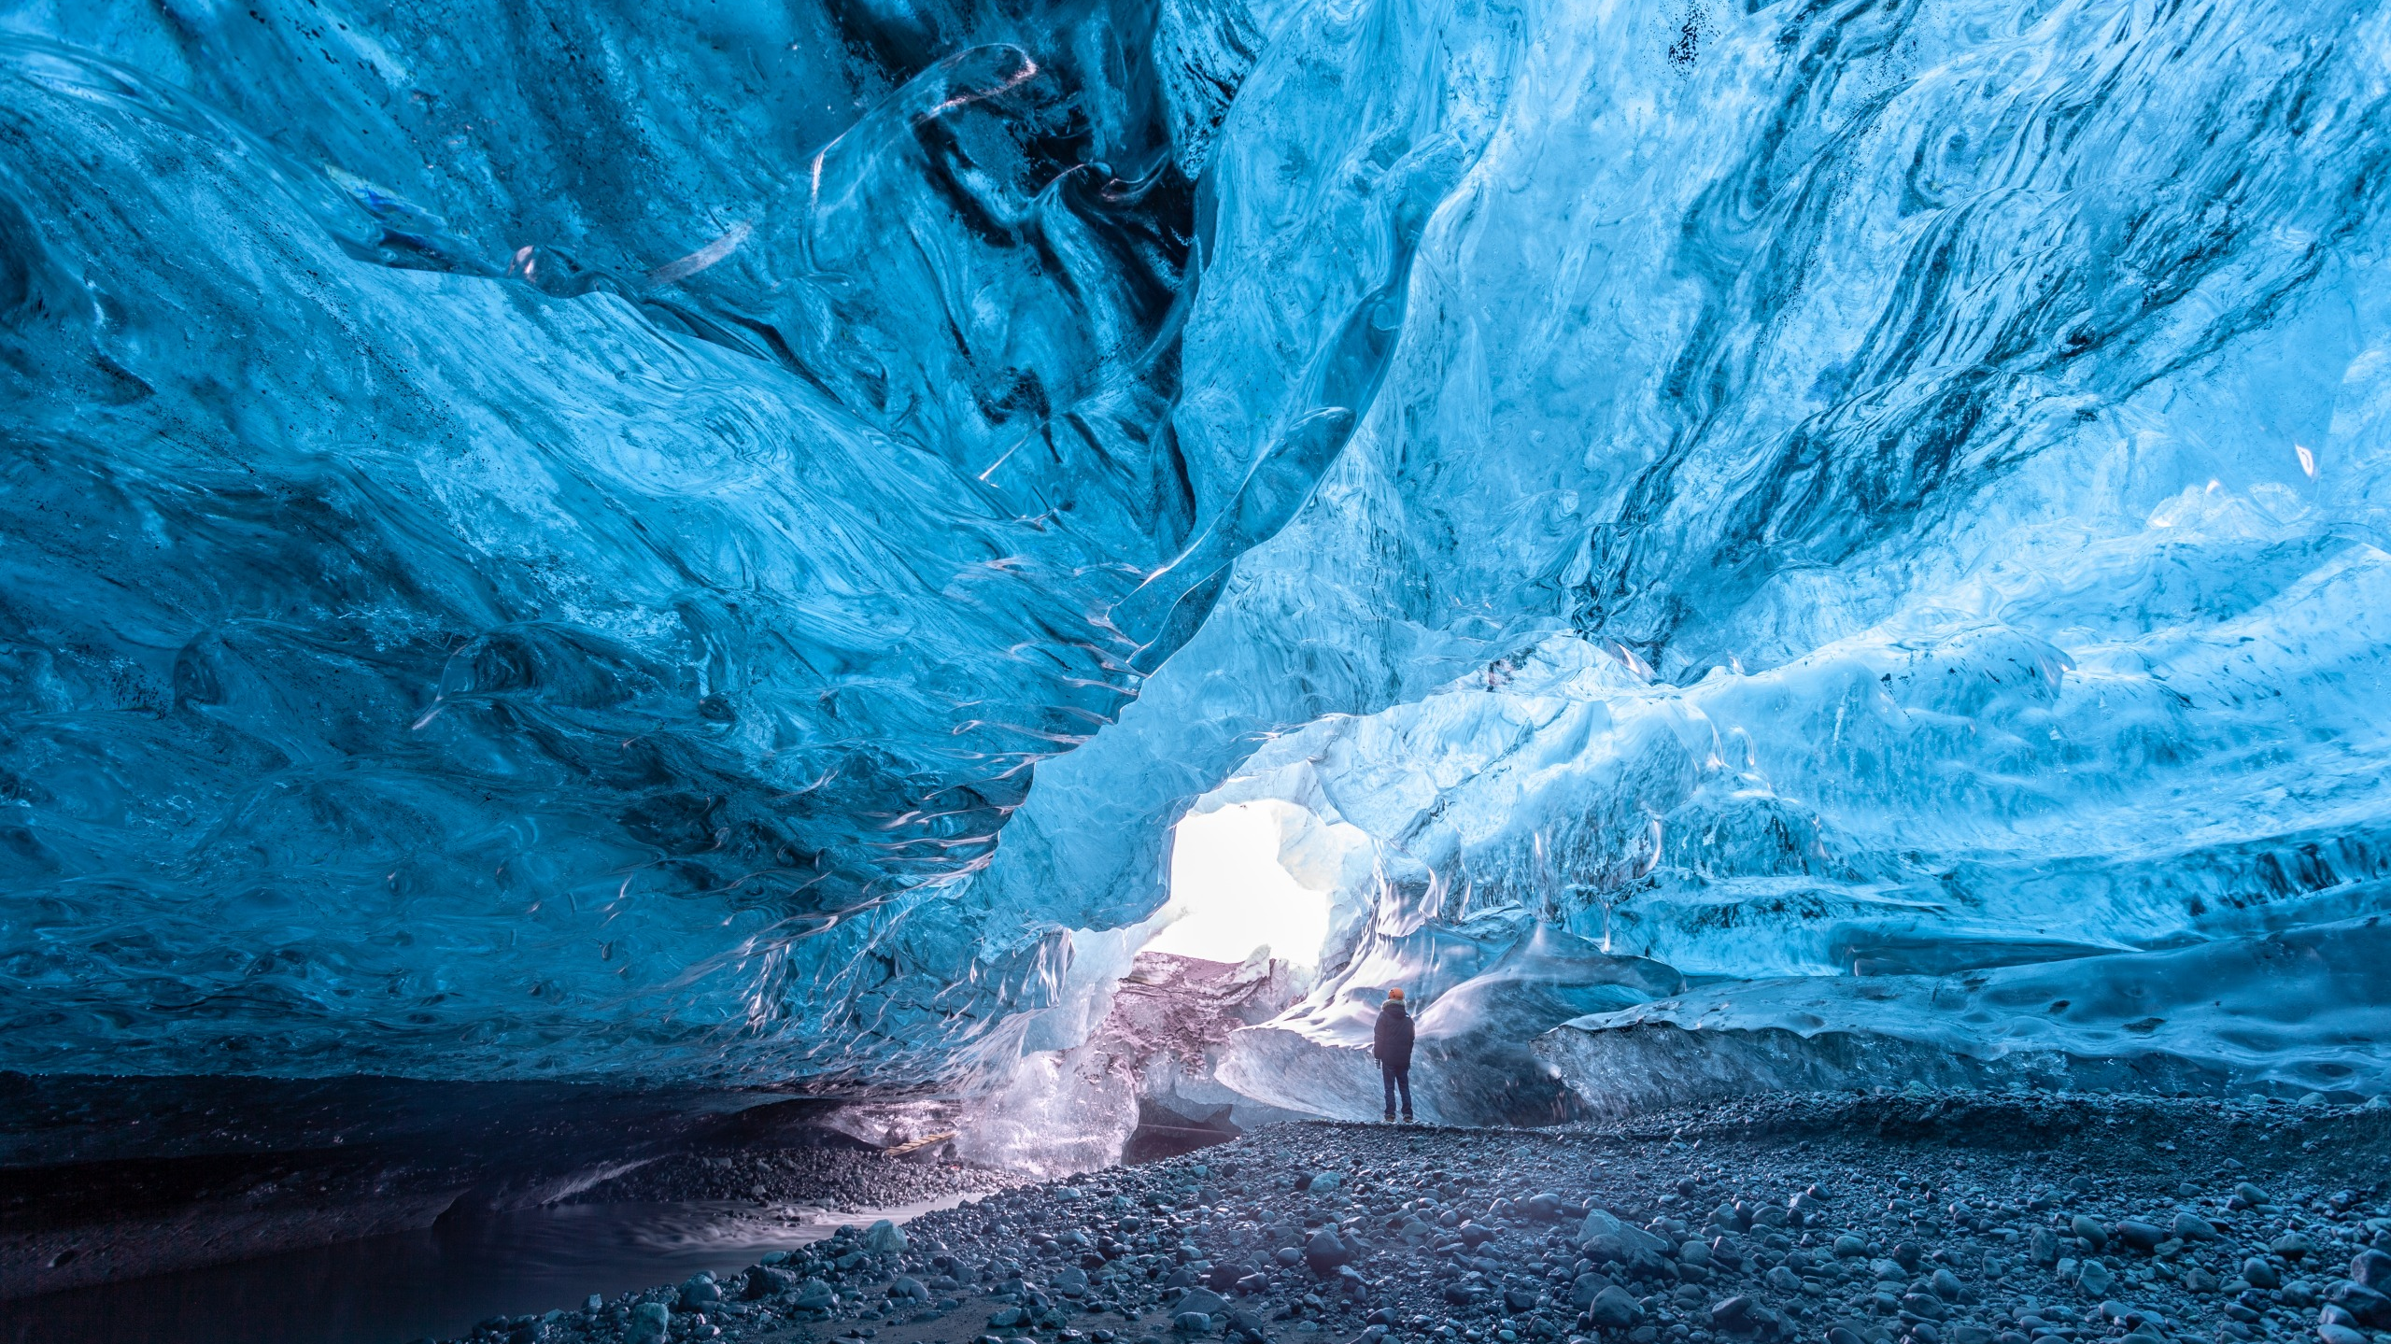
Table of contents
Presentation of Iceland
Geography
Demography
Economy
II. Culture
Histoire et religions
Architecture
Culinaire
Tourisme
1

Slide 3
I. Presentation of Iceland
Geography
Demography
Economy
II. Culture
Histoire et religion
Architecture
Culinaire
Tourisme
Located : nearby Arctic Circle
Climate :
Temperate oceanic
Tundra
Continental
Polar
Temperature according to the month and the town ; statistics
2

Slide 4
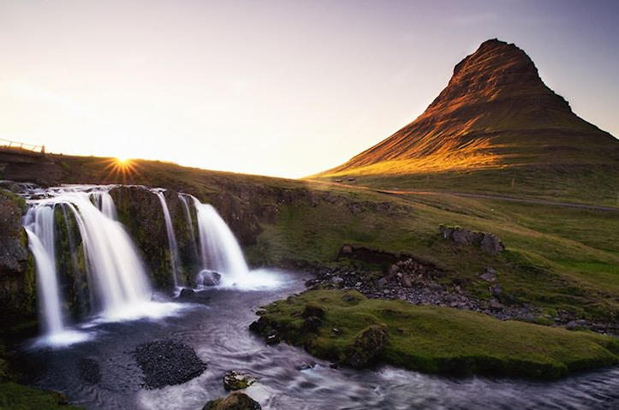
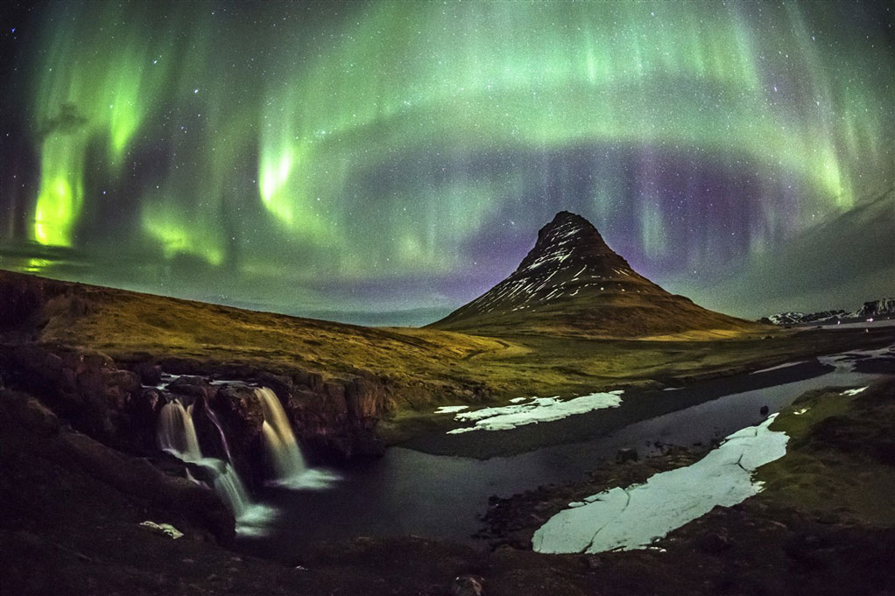
I. Presentation of Iceland
Geography
Demography
Economy
II. Culture
Histoire et religion
Architecture
Culinaire
Tourisme
Midnight sunset on Kirkjufell ; kwerfeldein
Aurora borealis on Kirkjufell ; evaneos
3

Slide 5
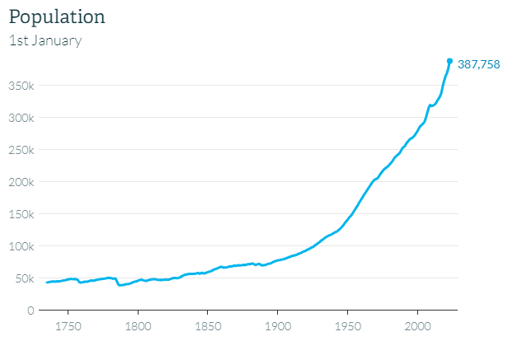
I. Presentation of Iceland
Geography
Demography
Economy
II. Culture
Histoire et religion
Architecture
Culinaire
Tourisme
Evolution of population ; statistics
4

Slide 6
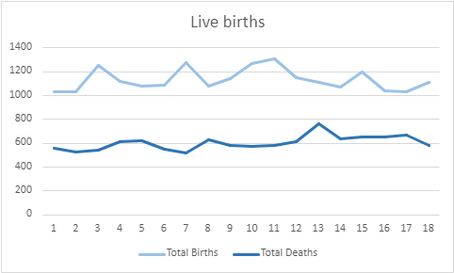
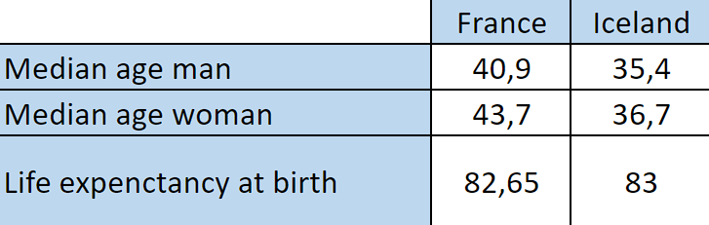
I. Presentation of Iceland
Geography
Demography
Economy
II. Culture
Histoire et religion
Architecture
Culinaire
Tourisme
Age comparisaon by country ; INSEE / statistics
Live birth ; statistics
5

Slide 7
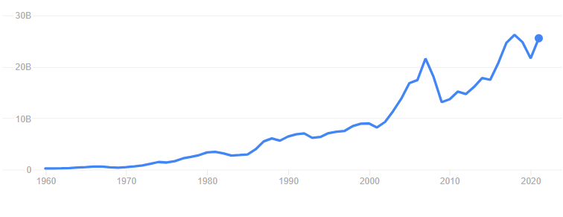
I. Presentation of Iceland
Geography
Demography
Economy
II. Culture
Histoire et religion
Architecture
Culinaire
Tourisme
Evolution of GDP over the years ; statistics
6

Slide 8
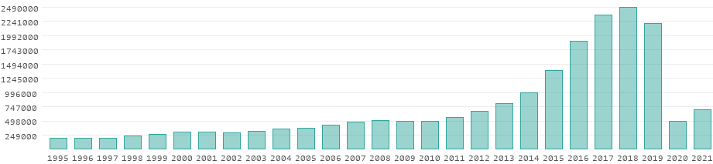
I. Presentation of Iceland
Geography
Demography
Economy
II. Culture
Histoire et religion
Architecture
Culinaire
Tourisme
The fishing : pillar of the economy
Iceland : a tourist destination
Evolution of number of tourists ; donneemondiales
7

Slide 9
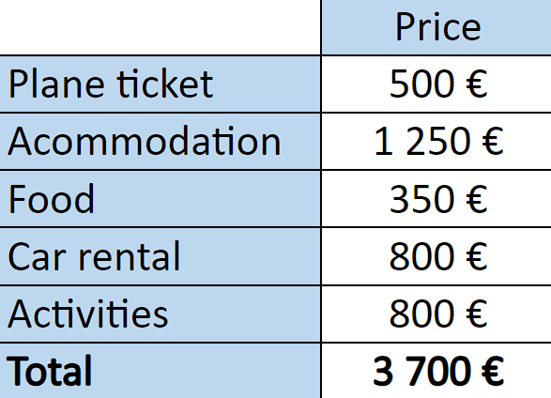
I. Presentation of Iceland
Geography
Demography
Economy
II. Culture
Histoire et religion
Architecture
Culinaire
Tourisme
A travel : very expensive
Budget for a two week trip ; air France and islande-explora
8

Slide 10

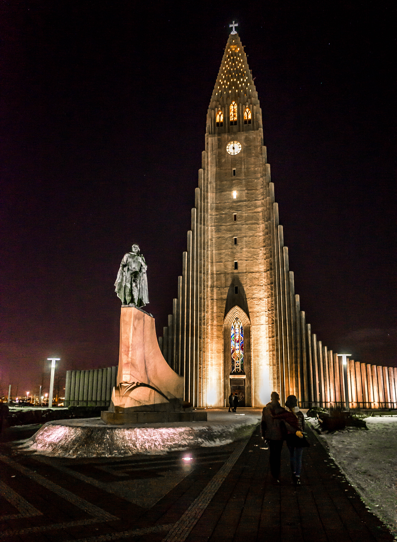
I. Presentation of Iceland
Geography
Demography
Economy
II. Culture
Histoire et religion
Architecture
Culinaire
Tourisme
Manuscrit Landnámabók, récit de la colonisation ; wikipédia
Eglise évangélique-luthérienne à Hallgrímskirkja en Islande ; islande explora
9

Slide 11
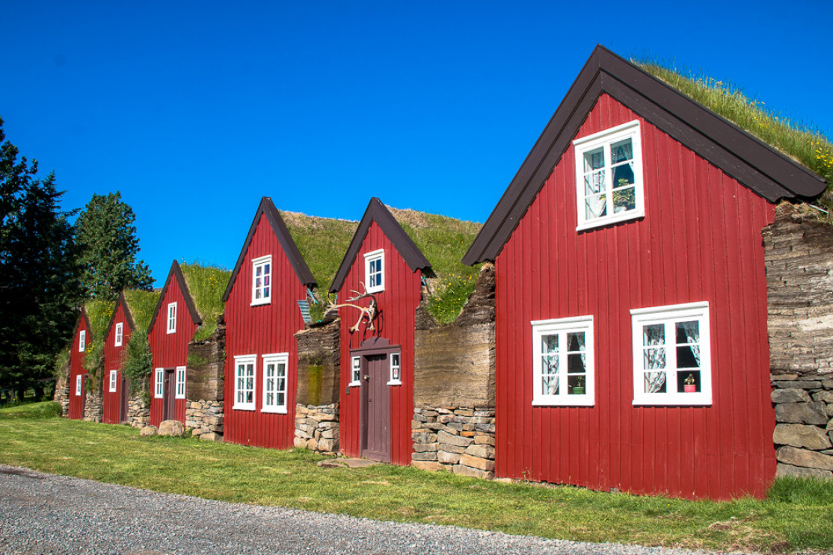
I. Presentation of Iceland
Geography
Demography
Economy
II. Culture
Histoire et religion
Architecture
Culinaire
Tourisme
Les raisons :
Ecologique
Acoustique
Economique
Bustarfell Museum ; voyage-Islande
10

Slide 12
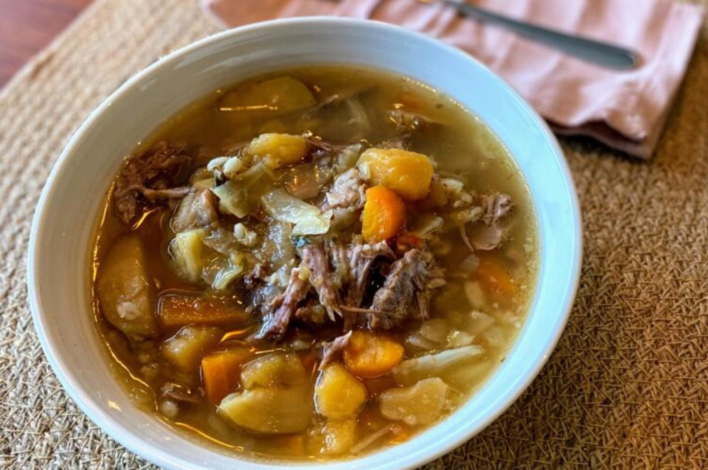
I. Presentation of Iceland
Geography
Demography
Economy
II. Culture
Histoire et religion
Architecture
Culinaire
Tourisme
Base de la nourriture :
Agneau
Produits laitiers
Poisson
Spécialité :
Soupe d’agneau / Kjötsúpa
Skyr
Þorramatur
Kjötsúpa ; nbl.is
11

Slide 13
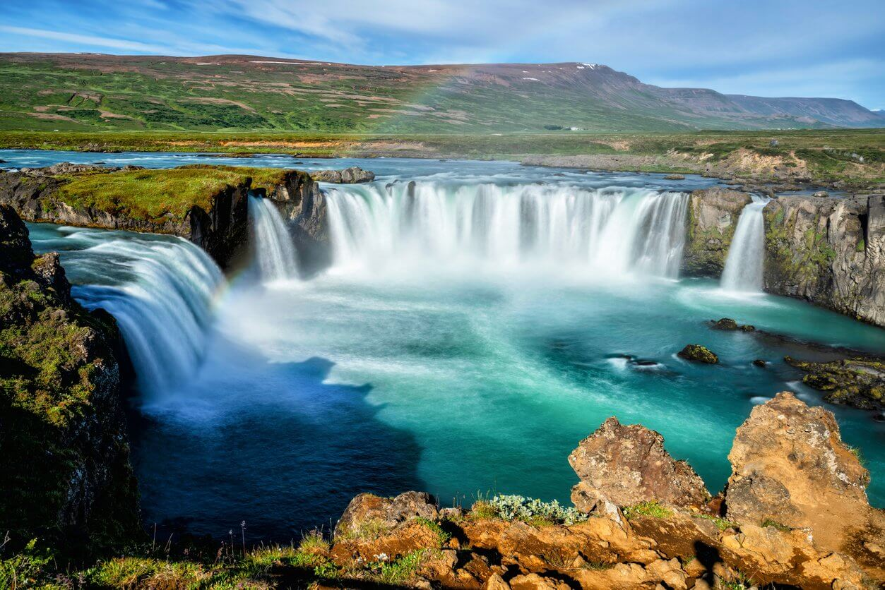
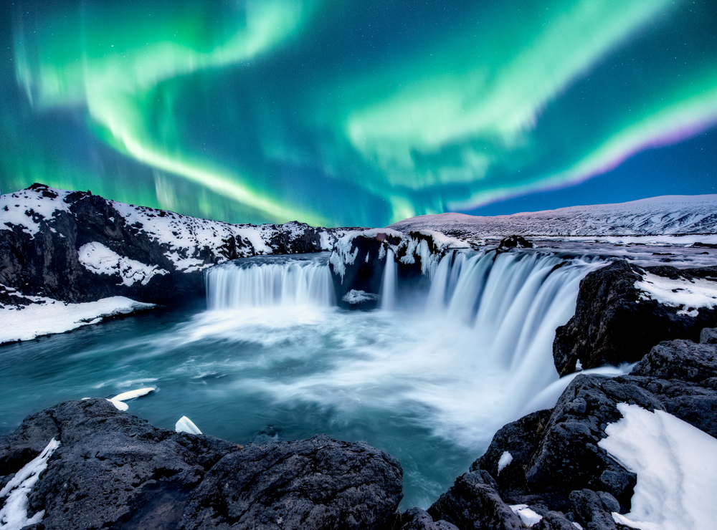
I. Presentation of Iceland
Geography
Demography
Economy
II. Culture
Histoire et religion
Architecture
Culinaire
Tourisme
En été :
En hiver :
Les chutes de Godafoss ; ou-et-quand
Les chutes de Godafoss ; islande24
12

Slide 14
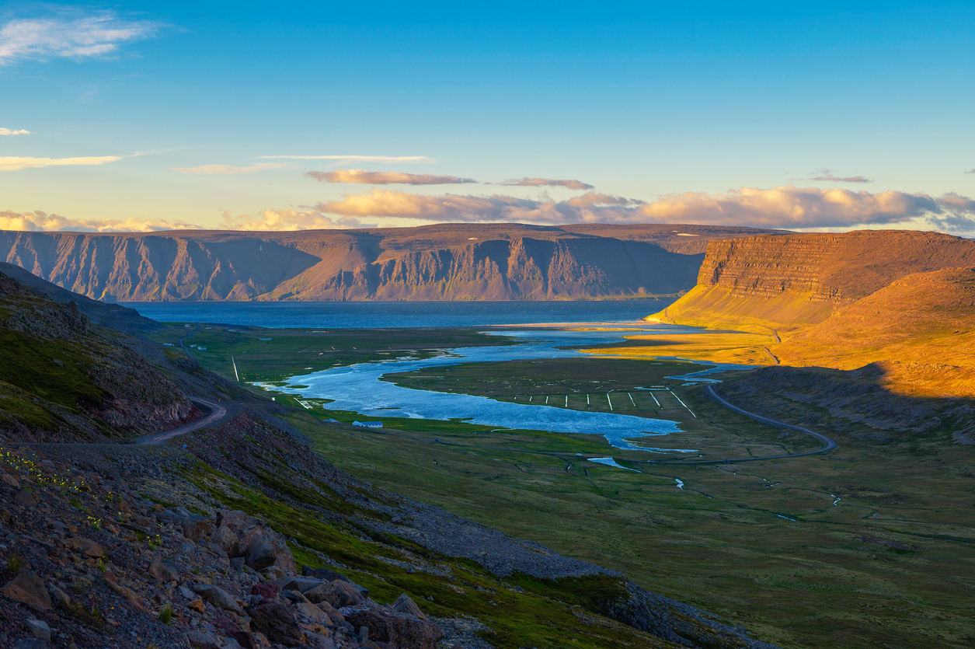
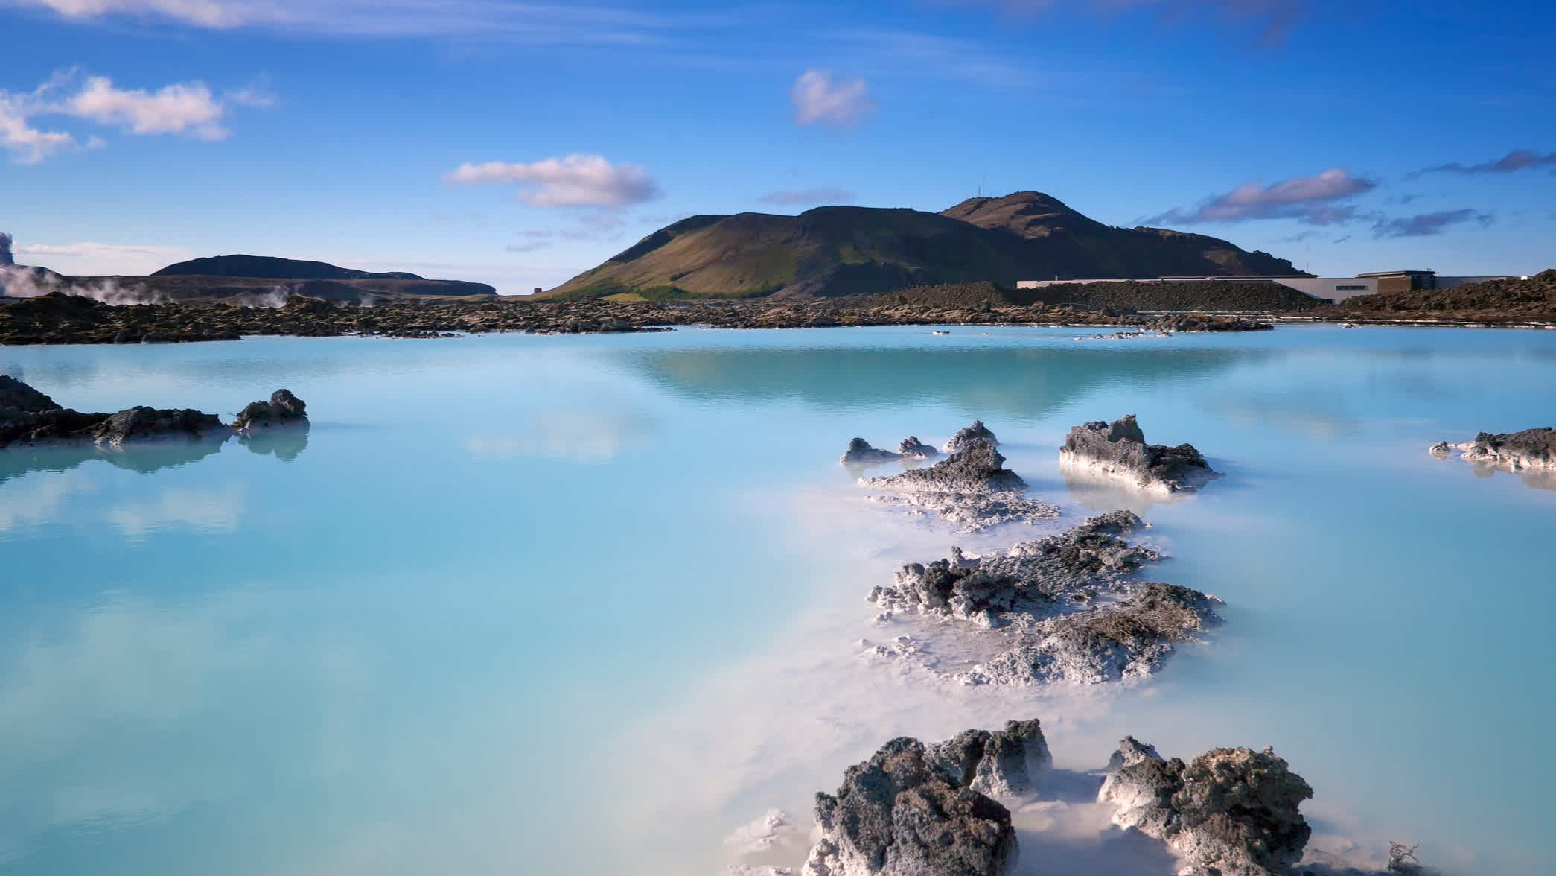
I. Presentation of Iceland
Geography
Demography
Economy
II. Culture
Histoire et religion
Architecture
Culinaire
Tourisme
Des paysages :
Magnifiques
Attractifs
Différents
De détentes
Les Fjords de l’ouest ; islande-explora
Le lagon bleu ; guideislande
13

Slide 15
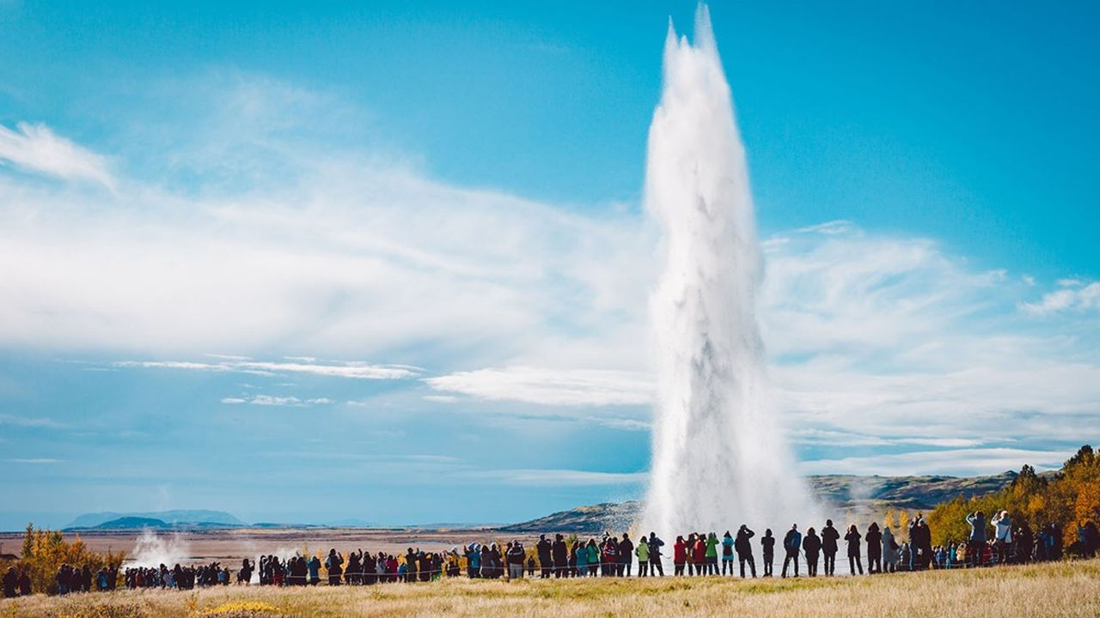
I. Presentation of Iceland
Geography
Demography
Economy
II. Culture
Histoire et religion
Architecture
Culinaire
Tourisme
Du tourisme au surtourisme :
Néfaste pour l’environnement
Hausses des taxes
Foule admirant un Geyser islandais ; les echos
14

Slide 16
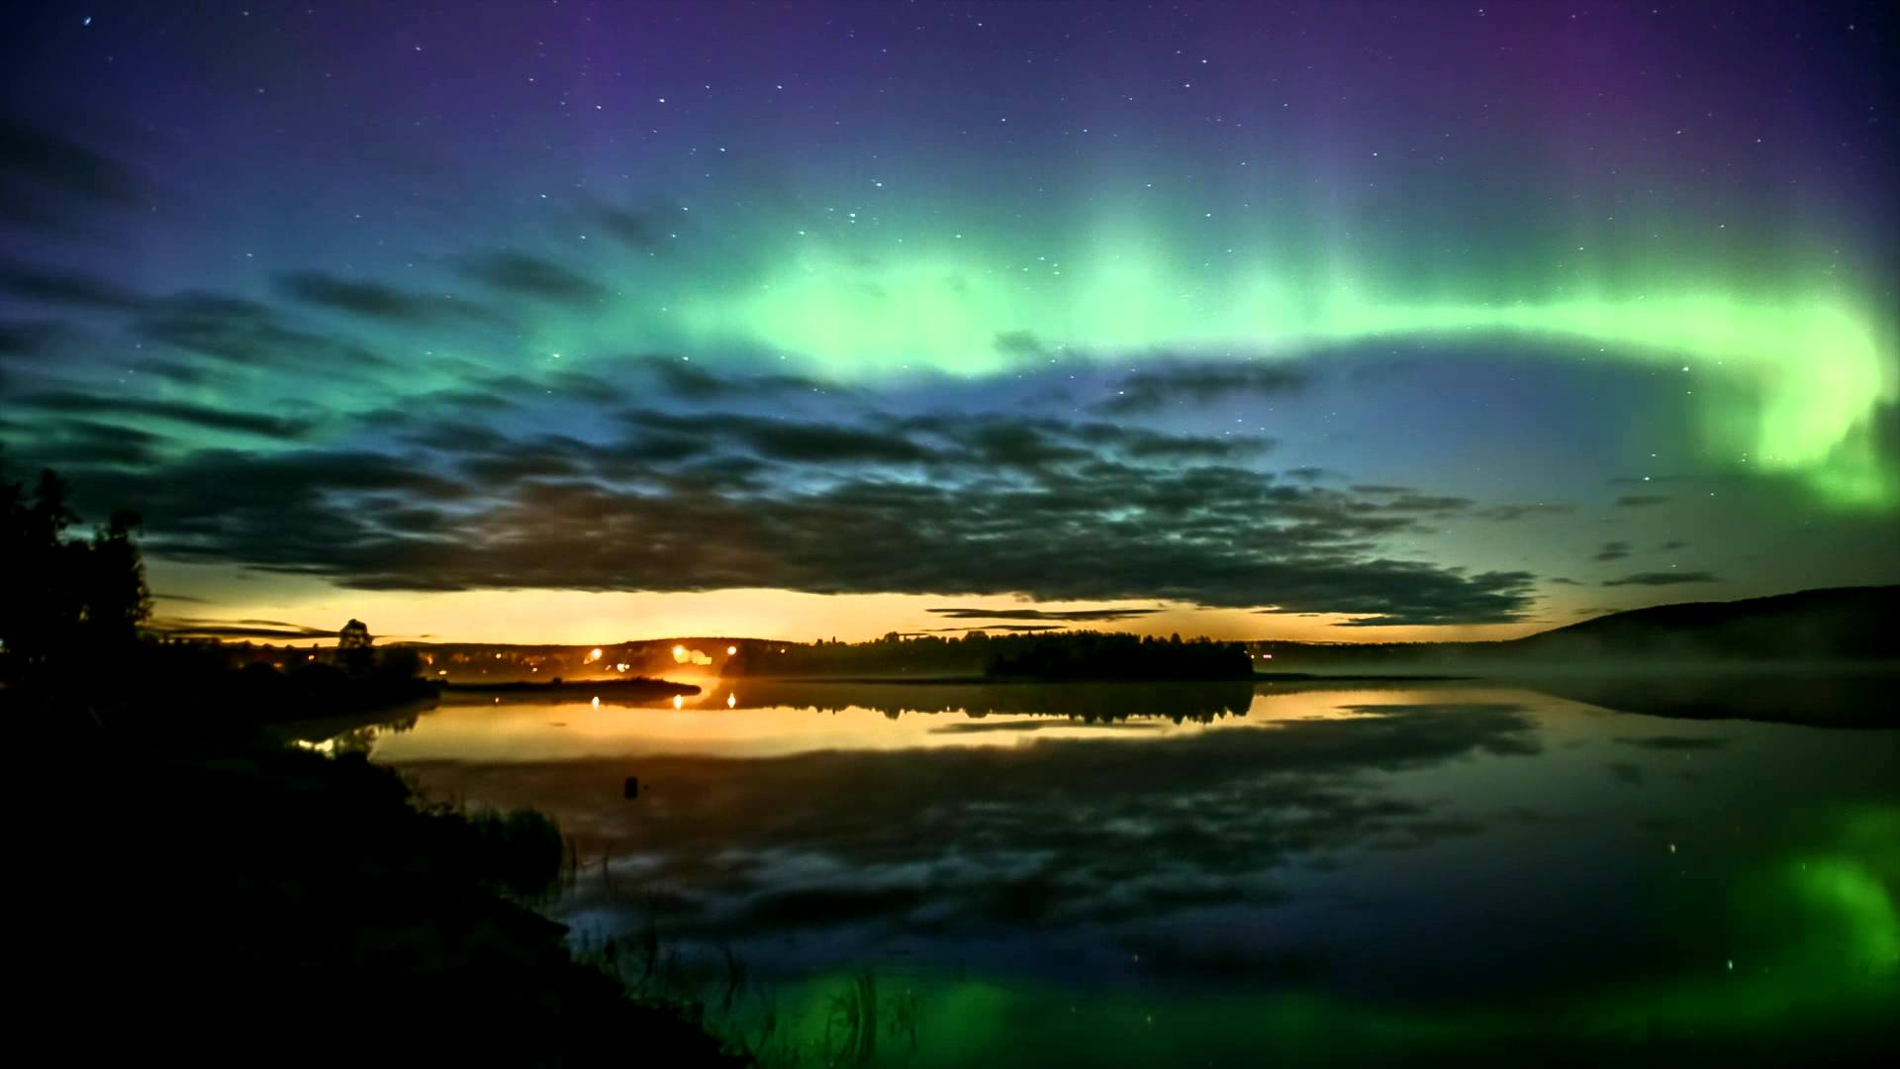
I. Presentation of Iceland
Geography
Demography
Economy
II. Culture
Histoire et religion
Architecture
Culinaire
Tourisme
Aurore boréale en Laponie ; diazmag.com
14

