Slide 1
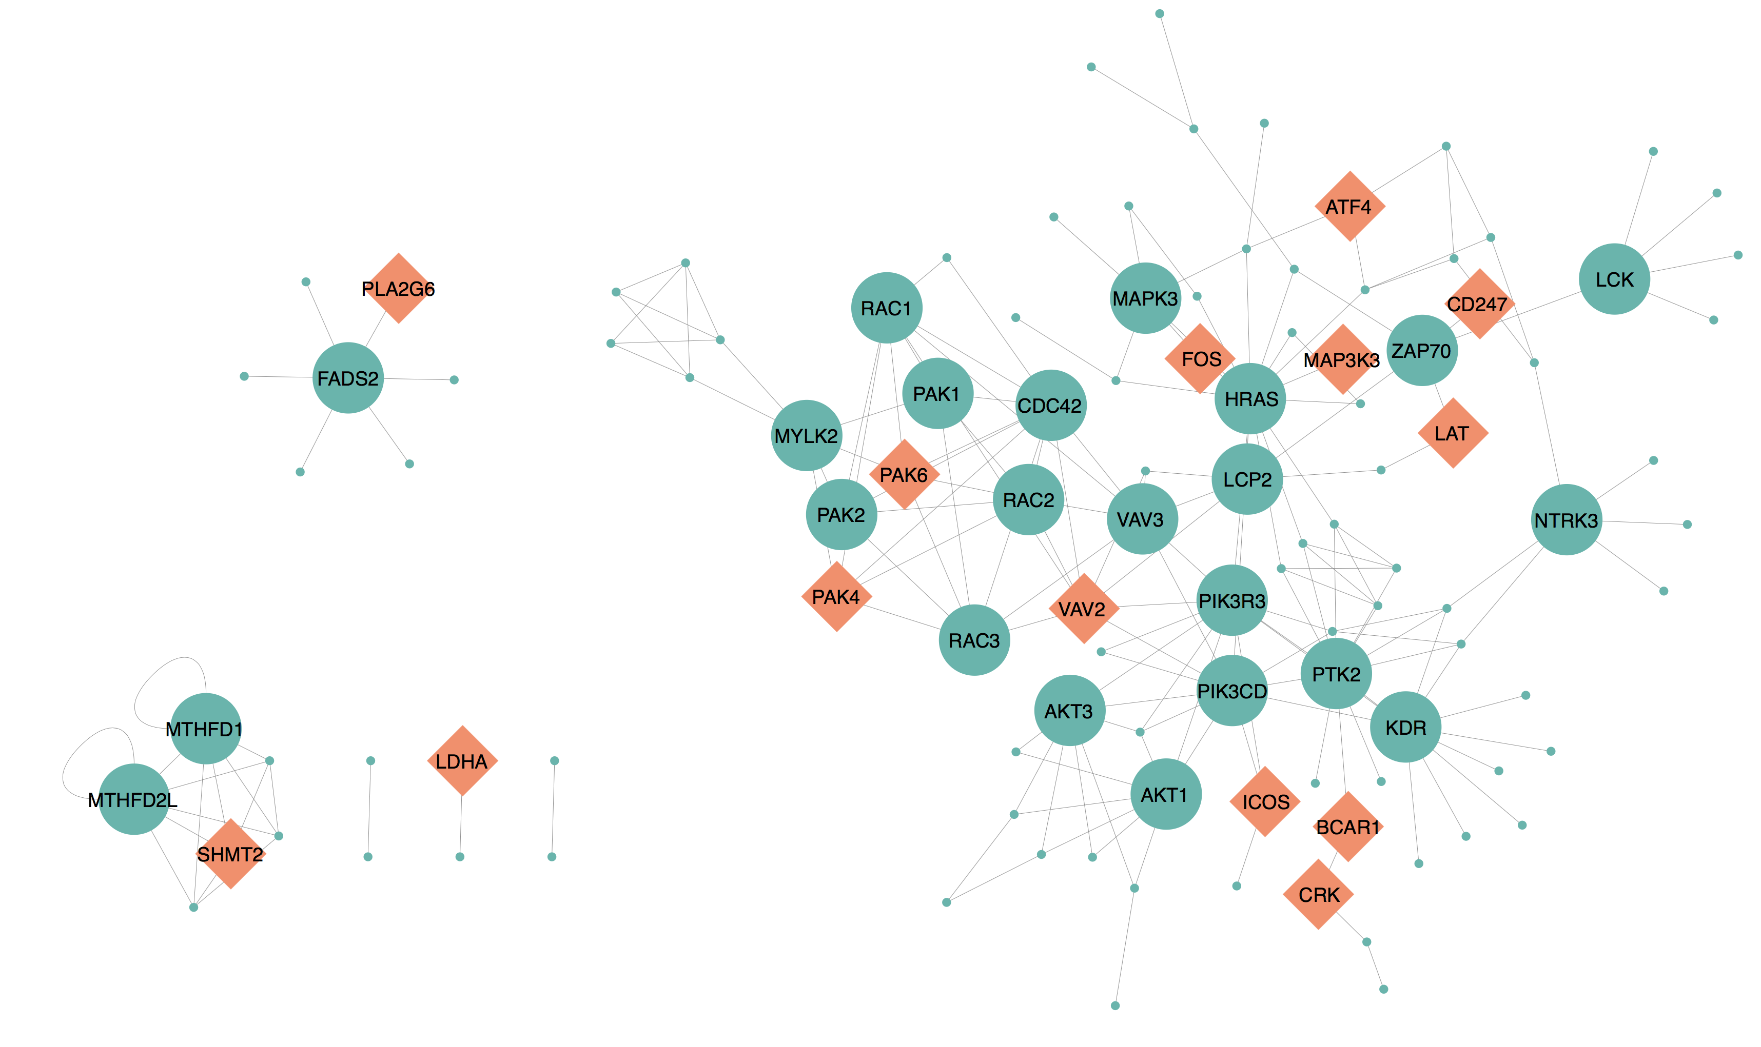
alpha-Linolenic acid metabolism
PPAR signaling pathway
One carbon pool by folate
Dorso-ventral axis formation
Neurotrophin signaling pathway
T cell receptor signaling pathway
Pancreatic secretion
Glioma
Focal adhesion
Prion diseases
Pyruvate metabolism

