Slide 1
RESEARCH PROGRESS | FIGURES 2, 4–5
Spatial organization and age-prediction value
of cortical column profiles
From mapping validation to spatial organization and age prediction
Figure 2 | Mapping validation and registration QC
Figure 4 | Spatial similarity and correlation length
Figure 5 | Representation contributions to age prediction
Advisor meeting • 28 October 2026
Cortical MD profiles | Registration-QC cohort update | 320 participants
1
Notes:
Advisor discussion deck. All results are from the latest saved formal Figure 4 and LSQR Figure 5 outputs. These analyses describe spatial profile organization and prediction under a fixed model; they do not establish independent biological units or a unique optimal scale.

Slide 2
FIGURE 2. MAPPING VALIDATION
Figure 2. Mapping validation
Validate recovered depth profiles and shared T1→DWI registration before spatial and prediction analyses.
O2-Column
O2-FS
O3
Sample MD along native columns first; combine profile values using barycentric weights.
FreeSurfer volume-to-surface depth sampling, followed by spherical surface resampling.
Interpolate native pial/white endpoints first; construct and sample the target column.
A/B: same 50 participants • 21 depths • pairwise valid anatomical mask
C: 327 registration-QC participants • shared bbregister transform
Source: figure2_AB_method_comparison.ipynb and its exported analysis / QC outputs.
2
Notes:
Figure 2A/B use 50 participants with both method comparisons available (100 hemisphere records per comparison). C uses the 327-participant registration-QC manifest. These are different denominators. Figure 3 has not yet been performed and is omitted. O3 is a comparison reference, not biological ground truth. All metrics use canonical pial-to-white 21-depth orientation.

Slide 3
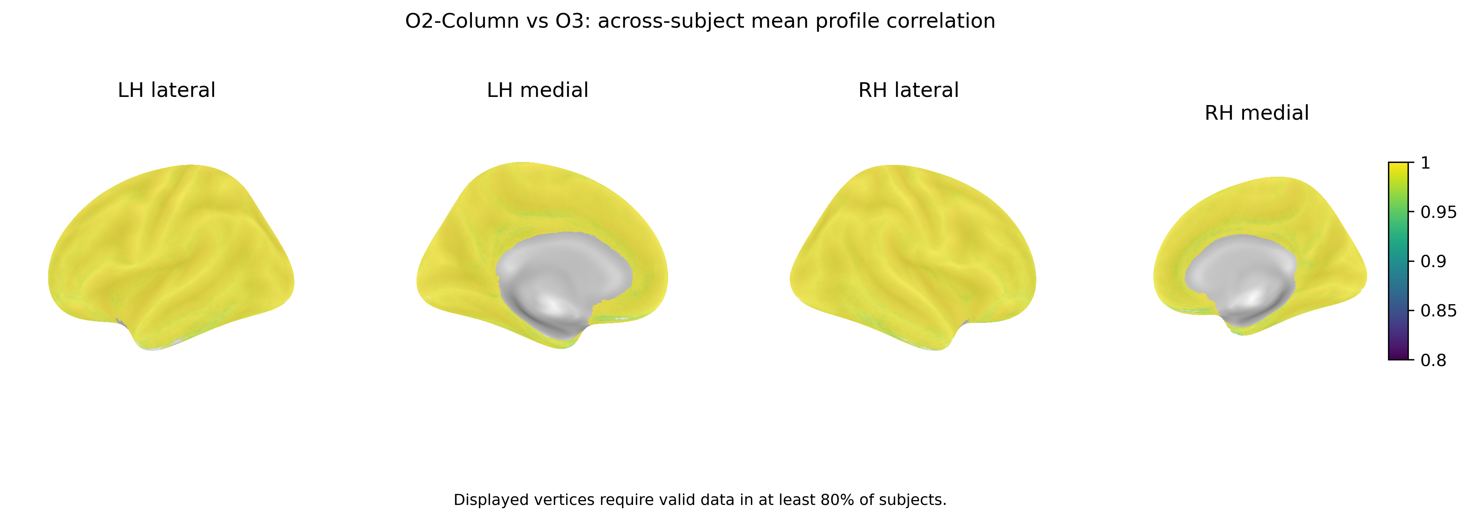
FIGURE 2. MAPPING VALIDATION
Figure 2A. O2-Column versus O3: agreement on fsaverage
Per-vertex Pearson r across 21 depths; Fisher-z average across participants; inflated surfaces.
O2-Column closely preserves the O3 depth-profile shape; agreement is not proof of absolute accuracy.
Source: figure2_AB_method_comparison.ipynb and its exported analysis / QC outputs.
3
Notes:
Exact exported surface map. Display criterion: defined correlations in at least 80% of the 50 participants. Cortex.label ∩ valid DK cortical labels; pairwise complete-profile validity. Constant profiles are excluded from Fisher averaging. Shared color range .8–1.0. Surface summary is not the subject-level median. Subject-level agreement: median .996497, IQR .995349–.997169.
Exact notebook-embedded image output used; no image redrawing or extra annotations.

Slide 4
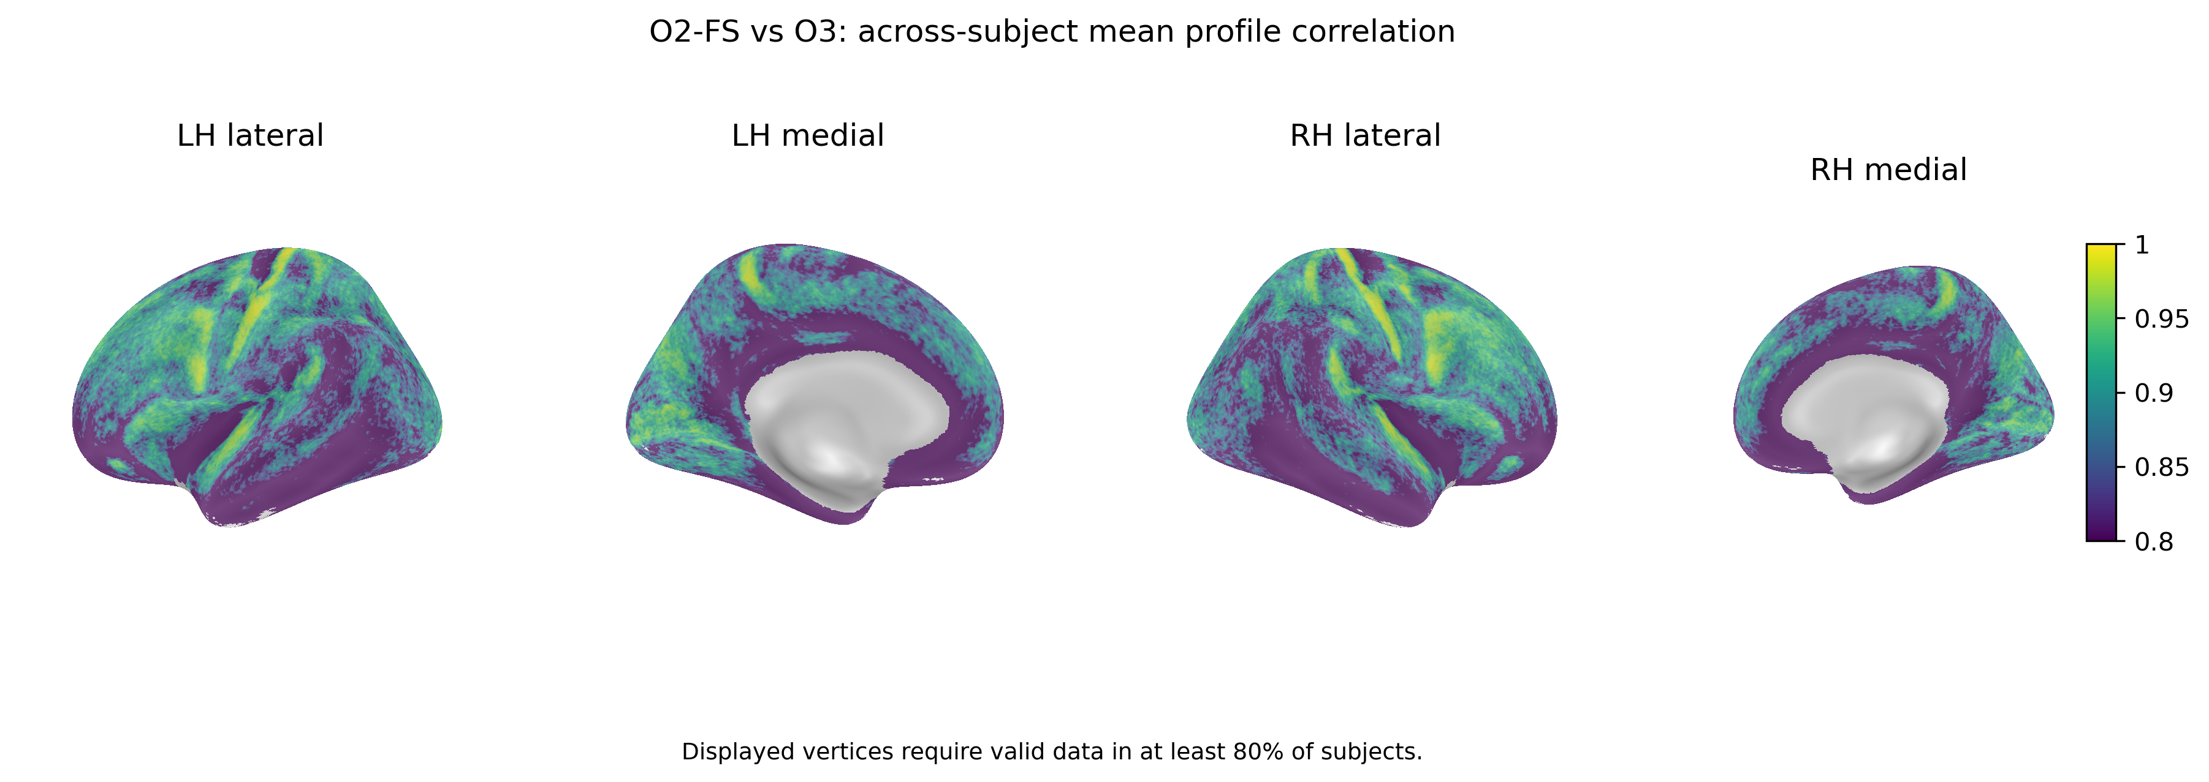
FIGURE 2. MAPPING VALIDATION
Figure 2A. O2-FS versus O3: agreement on fsaverage
Same participants, depth direction, analysis mask, display threshold, and color range.
O2-FS shows lower profile-shape agreement with O3 than O2-Column does.
Source: figure2_AB_method_comparison.ipynb and its exported analysis / QC outputs.
4
Notes:
Exact exported O2FS surface map. The subject-median r has group median .870392, IQR .845704–.902817. Correlation alone does not quantify MD magnitude differences. Between-method discrepancies cannot by themselves identify which method is biologically correct.
Exact notebook-embedded image output used; no image redrawing or extra annotations.

Slide 5
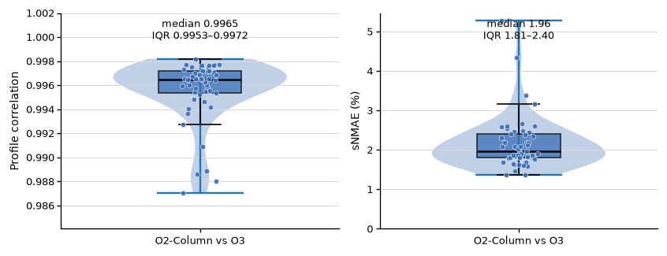
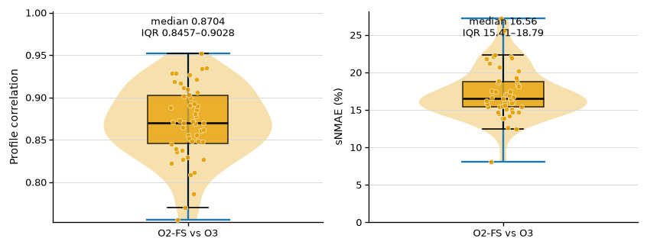
FIGURE 2. MAPPING VALIDATION
Figure 2A. Quantitative agreement across participants
One point per participant: median across pairwise-valid bilateral vertices (n = 50 per comparison).
O2-Column vs O3
O2-FS vs O3
Median r / sNMAE: O2-Column 0.9965 / 1.96%; O2-FS 0.8704 / 16.56%.
Source: figure2_AB_method_comparison.ipynb and its exported analysis / QC outputs.
5
Notes:
Exact notebook-exported panels. O2Column r=.996497 [.995349,.997169], sNMAE=1.957145% [1.807125,2.396821]. O2FS r=.870392 [.845704,.902817], sNMAE=16.557108% [15.408177,18.793826]. Brackets here are subject IQRs. sNMAE=200*MAE/(median|A|+median|B|). Pairwise mean valid coverage 98.297% and 98.706%, respectively. Three-method common-mask sensitivity yields near-identical subject-median results.
Exact notebook-embedded image output used; no image redrawing or extra annotations.

Slide 6
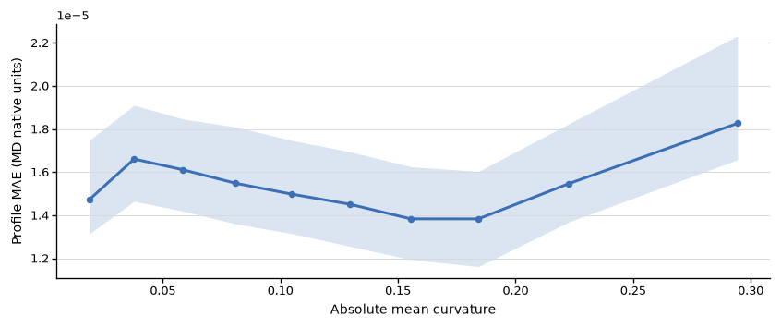
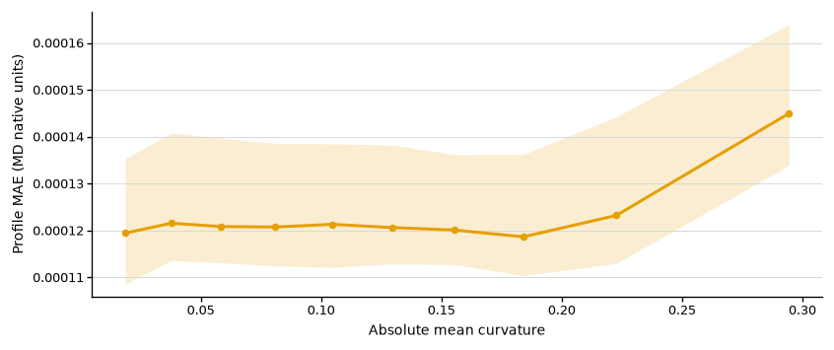
FIGURE 2. MAPPING VALIDATION
Figure 2B. Profile difference versus cortical curvature
Ten subject-specific equal-frequency bins; group median and between-participant IQR.
O2-Column vs O3
O2-FS vs O3
Differences increase modestly across curvature bins; participant-level associations are small (ρ≈.019 / .039).
Source: figure2_AB_method_comparison.ipynb and its exported analysis / QC outputs.
6
Notes:
x is barycentrically interpolated absolute native white-surface mean curvature, sum(w_i*abs(H_i)). y is mean absolute difference over 21 depths at a vertex. Within each subject, bilateral vertices are binned and summarized by median MAE; group aggregation weights subjects equally. Within-subject Spearman rho medians are .019080 and .039205 with bootstrap CIs [.007333,.025661] and [.030822,.046250]. These are small associations despite low Wilcoxon p-values. Do not attribute differences solely to interpolation order; O2FS also differs in projection/column construction.
Exact notebook-embedded image output used; no image redrawing or extra annotations.

Slide 7
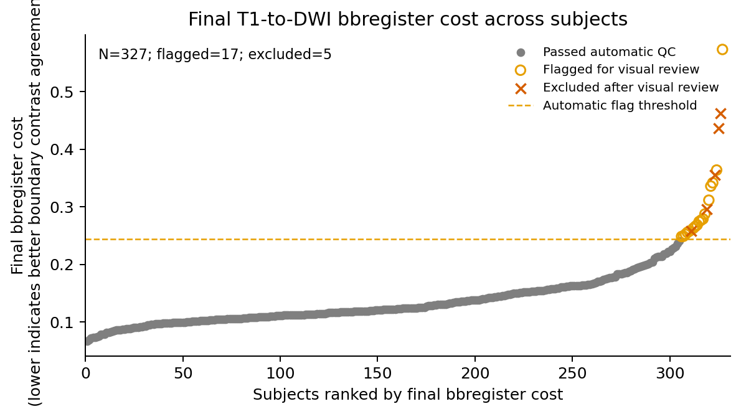
FIGURE 2. MAPPING VALIDATION
Figure 2C. T1→DWI registration quality across participants
Shared boundary-based registration: 327 participants; 22 automatic flags; 5 confirmed visual exclusions.
Boundary-based cost is a QC score; final exclusion is based on visual review, not cost alone.
Source: figure2_AB_method_comparison.ipynb and its exported analysis / QC outputs.
7
Notes:
Use the latest exported Figure2C_T1_DWI_registration_cost.png, not the older notebook-cache plot reporting zero exclusions. Latest tables: median cost .123435, IQR .106595–.160340; all327 final transforms and costs readable. Five reviewed failures: D0128,D0163,D0248,D0296,D0388. All five are present in the historical Figure4 325 manifest; the updated retained Figure4 cohort has 320. This does not imply 327−5=320: the registration-QC and complete-profile cohorts differ. Cost is dimensionless and not a displacement in mm. Robust z=3.5 is a review threshold, not automatic exclusion. The tutorial .5 reference appearing in the exported panel is not the cohort decision threshold. Other flagged participants are not necessarily visually cleared.
Exact notebook-embedded image output used; no image redrawing or extra annotations.

Slide 8
FIGURE 2. MAPPING VALIDATION
Figure 2D. Registration QC examples
Reserved for one visually acceptable case and one flagged case.
Good alignment
Flagged alignment
QC image placeholder
QC image placeholder
Source: figure2_AB_method_comparison.ipynb and its exported analysis / QC outputs.
8
Notes:
QC images intentionally left empty at the user’s request. Insert matched T1/DWI reference views and identical surface overlays later. Good/flagged labels are layout placeholders and do not assign status to any participant.

Slide 9
FIGURE 2. MAPPING VALIDATION
From mapping validation to spatial organization
Figure 2 establishes method agreement and QC; Figure 4 asks what spatial detail is worth retaining.
•
Mapping: O2-Column and O3 yield highly consistent profiles; O2-FS differs more.
•
QC: remove the five confirmed registration failures from the Figure 4 cohort.
•
Next: characterize spatial redundancy (Figure 4), then assess age-prediction value (Figure 5).
Updated analysis scope: Figure 4 n = 320; Figure 5 n = 196 CN participants.
Source: figure2_AB_method_comparison.ipynb and its exported analysis / QC outputs.
9
Notes:
Figure 3 is not yet performed. Transition directly to Figure4. Interpret Figure2 agreement as internal method comparison rather than validation against an external ground truth. Use the 320-participant registration-QC-passing cohort for updated Figure4 summaries and the unchanged 196-participant CN cohort for Figure5.

Slide 10
FIGURES 4–5
Two linked questions guide the analysis
A finer representation is useful only if its additional spatial detail supports the modeling objective.
Q1 Spatial organization
Q2 Predictive value
How do column-profile differences vary with cortical distance and DK boundaries?
Does retaining depth and finer spatial sampling improve age prediction?
Spatial correlation describes redundancy; held-out prediction tests practical value.
Cortical MD profiles | Registration-QC cohort update | 320 participants
10

Slide 11
FIGURES 4–5
Cohort definition: 320 spatial profiles, 196 CN prediction participants
The prediction cohort is a subset of the spatial-analysis cohort.
448
369
325
320
268
200
196
Metadata
Imaging matched
Complete profiles
Figure 4: QC pass
Date eligible
CN eligible
Figure 5
•
Date eligibility: HIGH / MEDIUM match, or prespecified LOW exception with multiple consistently CN visits.
•
Prediction inclusion: CN status, manual T1–DWI registration QC, and ≥95% valid-column coverage.
Sources: cohort_manifest.csv; exclusion_summary.csv; feature_build_report.json
11
Notes:
Metadata: 448; imaging available: 369; complete profiles: 325; remove five visually confirmed registration failures: 320; date eligible: 268; CN: 200; ≥95% coverage: 196. Original and updated cohort files are preserved separately. Counts are sequential, not independent exclusions.
Data provenance: Sources: cohort_manifest.csv; exclusion_summary.csv; feature_build_report.json

Slide 12
FIGURES 4–5
Sample composition and age coverage
Figure 4 includes diagnostic heterogeneity; Figure 5 trains and evaluates age prediction in CN participants only.
Matched-visit diagnosis | Fig. 4 | Fig. 5
Normal | 235 | 196
MCI | 23 | 0
AD | 7 | 0
Other/Impaired non-demented | 26 | 0
Unknown | 29 | 0
Age, mean ± SD (range)
Figure 4: 57.8 ± 11.8 (28–80) y
Figure 5: 58.1 ± 10.5 (28–78) y
Age source: clinical VISIT_AGE at the QIAL-matched visit.
Each participant contributes one merged out-of-fold age prediction in Figure 5.
Source: cohort_manifest.csv joined to the Figure 4 and final Figure 5 subject lists.
12
Notes:
Diagnosis labels are harmonized at the QIAL-matched clinical visit; ambiguous/LOW matches occur in Figure 4. Age is VISIT_AGE at that visit, not an independently verified scan-date age. Sex codes remain numeric because their codebook was not verified; no male/female interpretation is assumed.
Data provenance: Source: cohort_manifest.csv joined to the Figure 4 and final Figure 5 subject lists.

Slide 13
FIGURES 4–5
From full fsaverage to the analyzed column representations
A column is a computational depth trajectory at a template vertex, not a histological cortical column.
Representation | Bilateral positions | MD features / subject
Full fsaverage mesh | 327,684 | 327,684 × 21 grid
Template analysis mask | 299,879 | Subject-specific validity applied
DK regional profile | 68 regions | 1,428
ico3 / ico4 / ico5 | 1,175 / 4,687 / 18,742 | 24,675 / 98,427 / 393,582
Each retained profile samples MD at 21 depths: 0–100%, in 5% steps, pial → white.
Sources: build_features.py; feature_build_report.json; reference profile masks; spacing summary.
13
Notes:
Full fsaverage has 163,842 vertices per hemisphere (327,684 bilateral). Reference in_analysis_mask has 149,953 left +149,926 right =299,879 positions. This is a fixed template analysis-mask count, not the valid count for every participant. Subject-specific validity varies. The masks retain 1,175/4,687/18,742 ico3/4/5 centers, pooled across hemispheres. Official ico mesh totals before mask: 1,284/5,124/20,484. Depth fractions are 0, .05, ..., 1, directed pial to white.
Data provenance: Sources: build_features.py; feature_build_report.json; reference profile masks; spacing summary.

Slide 14
FIGURES 4–5
Figure 4 methods: distance-dependent profile differences
Formal A–C: 320 participants; official ico5 anchors; dense within-DK candidates.
•
18,742 bilateral anchors; up to 15 candidates per anchor in each 2-mm bin, from 0–30 mm.
•
Distance: fsaverage white-surface mesh-edge geodesic distance.
•
Shape: D = 1 − Pearson r across the 21-depth MD profile.
•
Magnitude: symmetric relative MAE = 200 × MAE(x,y) / (median|x| + median|y|).
Summarize within participant first; group curves show median and participant-level IQR.
Sources: formal notebook; formal_pair_qc.json; Figure 4A group tables.
14
Notes:
Pair list contains 4,182,592 directed pairs across bins. K=15 is a target maximum per anchor-bin; sparse bins can contain fewer candidates. Self pairs and duplicates are excluded. Distances are mesh-edge geodesics on fsaverage white. Aggregation for A: pair metric → anchor × 2-mm-bin median → bilateral subject median → group median/IQR. Mean profile shape is preserved in raw r, so high far-distance r does not indicate independent profiles.
Data provenance: Sources: formal notebook; formal_pair_qc.json; Figure 4A group tables.

Slide 15
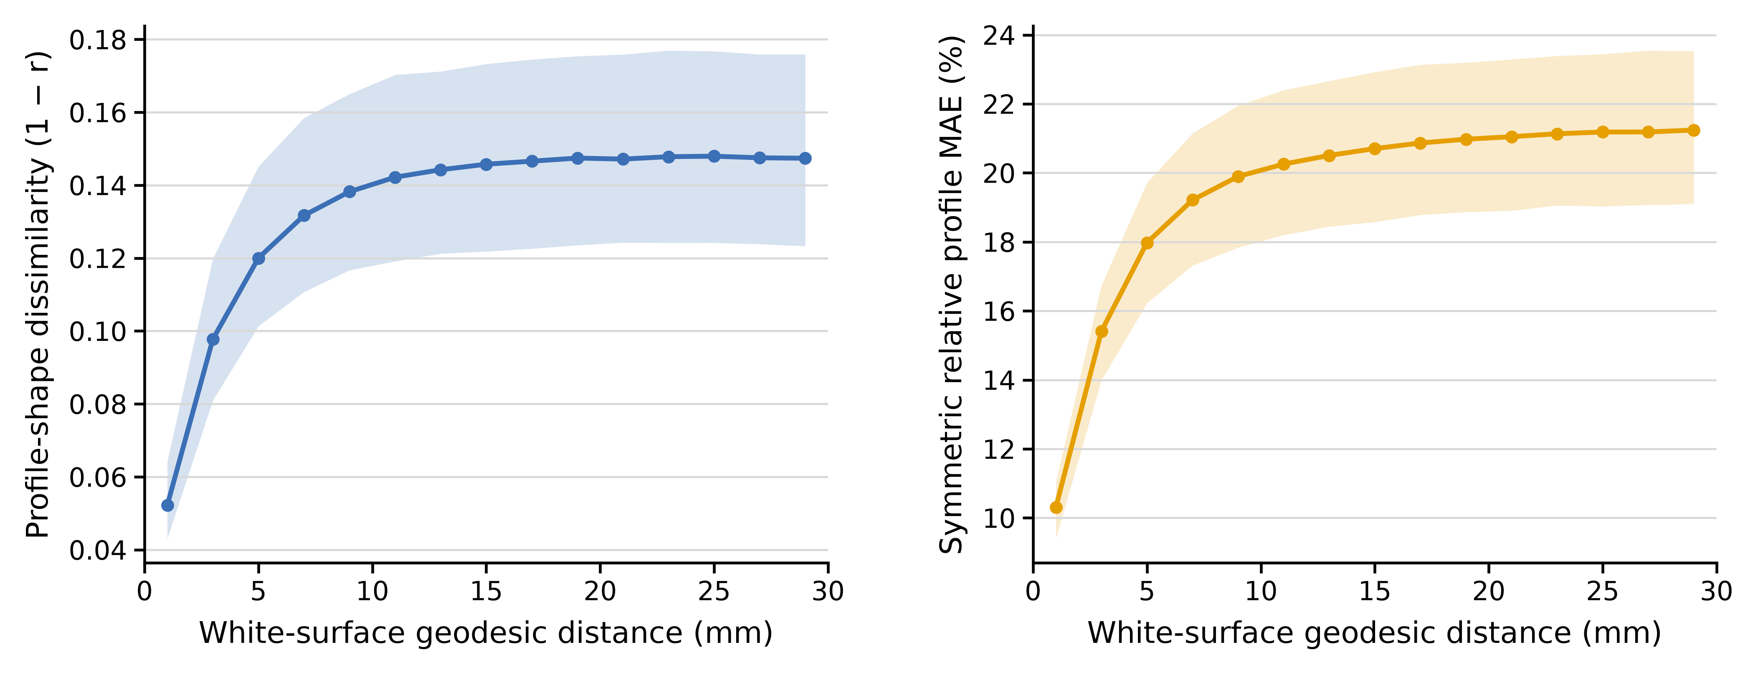
FIGURES 4–5
Figure 4A: nearby columns are more similar
Within-DK profile-shape dissimilarity increases rapidly at short distances, then levels off.
Local profile-shape similarity is spatially structured; high correlation does not imply identical MD.
Source: figure4A_ico5_k15_real_group_summary.csv.
15
Notes:
Native PowerPoint line segments reproduce the saved median and IQR curves. IQR describes between-participant dispersion, not the confidence interval of the median. The reference plateau is 20–30 mm; it is an approximate reference, not a claim of perfect flatness.
Data provenance: Source: figure4A_ico5_k15_real_group_summary.csv.
Displayed figure: exact notebook-exported PNG, without redrawing or modification. Source: /mnt/newStor/paros/paros_WORK/xintong/code/cortical_trajectory_analysis/qc/figure4/outputs/registration_qc_pass_320/real/cohort/Figure4A_ico5_K15_with_relative_MAE.png
Displayed figure: exact notebook-exported PNG, without redrawing or modification. Source: /mnt/newStor/paros/paros_WORK/xintong/code/cortical_trajectory_analysis/qc/figure4/outputs/registration_qc_pass_320/real/cohort/Figure4A_ico5_K15_with_relative_MAE.png
Exact notebook-embedded image output used; no image redrawing or extra annotations.

Slide 16
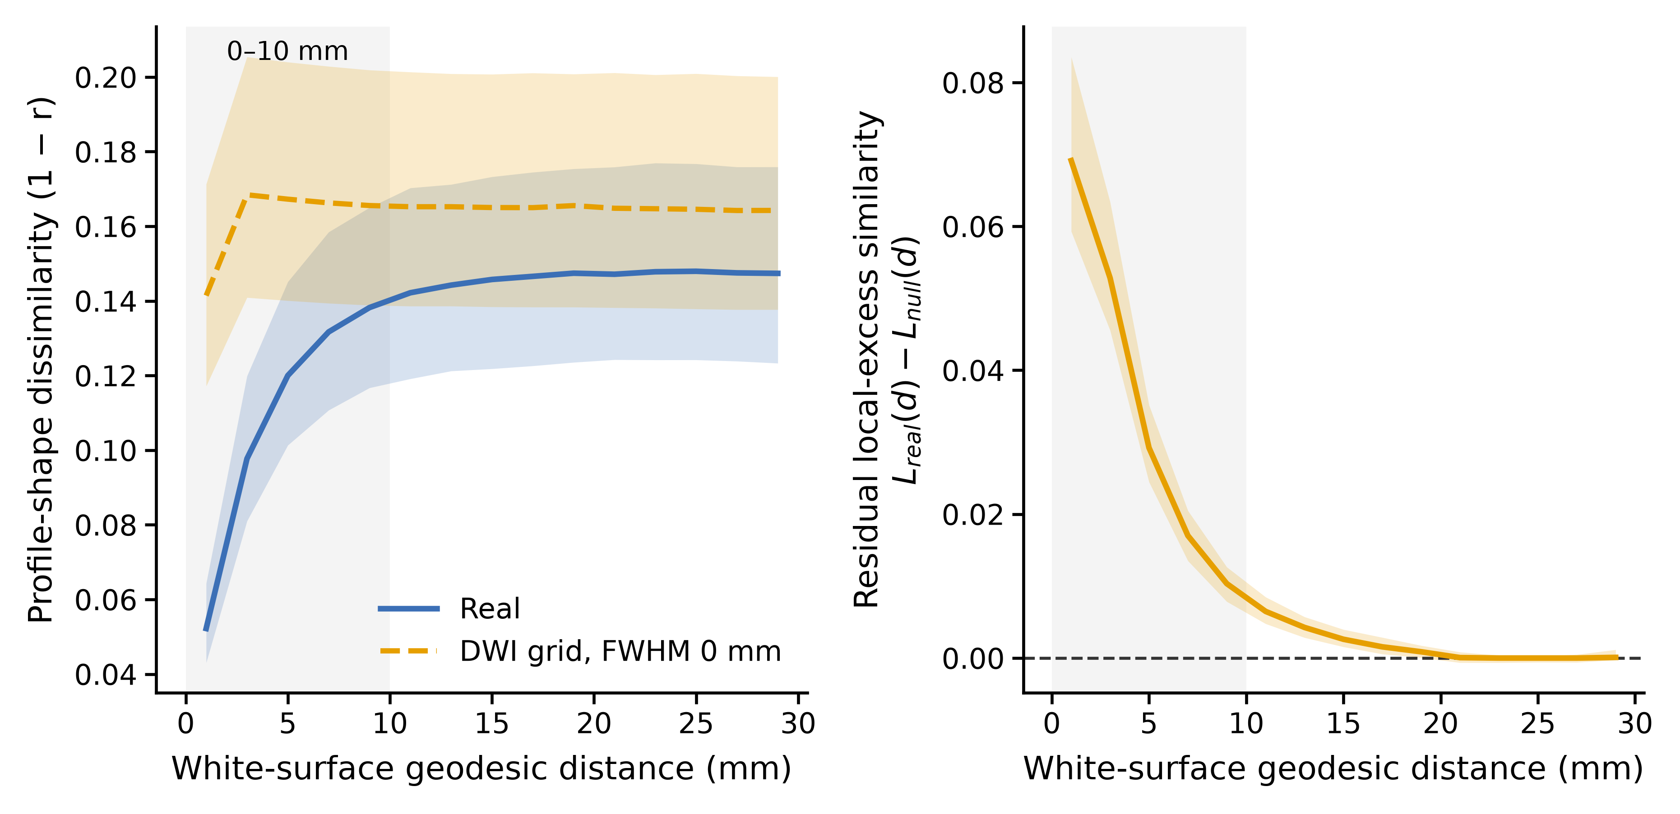
FIGURES 4–5
Figure 4B: acquisition and sampling explain part of local similarity
Primary null: native-DWI Gaussian noise, FWHM = 0 mm, 100 realizations per participant.
Residual structure exceeds this interpolation-only null; it is not a purely physiological estimate.
Sources: formal Figure 4B notebook and seed-fixed acquisition-null cohort tables.
16
Notes:
Generate independent Gaussian noise on each native DWI grid, sample at real O3 coordinates with trilinear interpolation, then recolor to match subject-specific depth mean and 21×21 covariance. FWHM=0 means no additional Gaussian PSF, not an absence of interpolation-induced smoothness. Local excess L(d)=D_far−D(d), far reference 20–30 mm. Residual=L_real−L_null. AUC is not a proportion of biological information. Nonzero PSF sensitivity from older analyses is not merged into this formal primary result.
Data provenance: Sources: formal Figure 4B notebook and seed-fixed acquisition-null cohort tables.
Displayed figure: exact notebook-exported PNG, without redrawing or modification. Source: /mnt/newStor/paros/paros_WORK/xintong/code/cortical_trajectory_analysis/qc/figure4/outputs/registration_qc_pass_320/acquisition_null_fwhm0_seedfix/cohort/Figure4B_ico5_K15_formal_main.png
Displayed figure: exact notebook-exported PNG, without redrawing or modification. Source: /mnt/newStor/paros/paros_WORK/xintong/code/cortical_trajectory_analysis/qc/figure4/outputs/registration_qc_pass_320/acquisition_null_fwhm0_seedfix/cohort/Figure4B_ico5_K15_formal_main.png
Exact notebook-embedded image output used; no image redrawing or extra annotations.

Slide 17
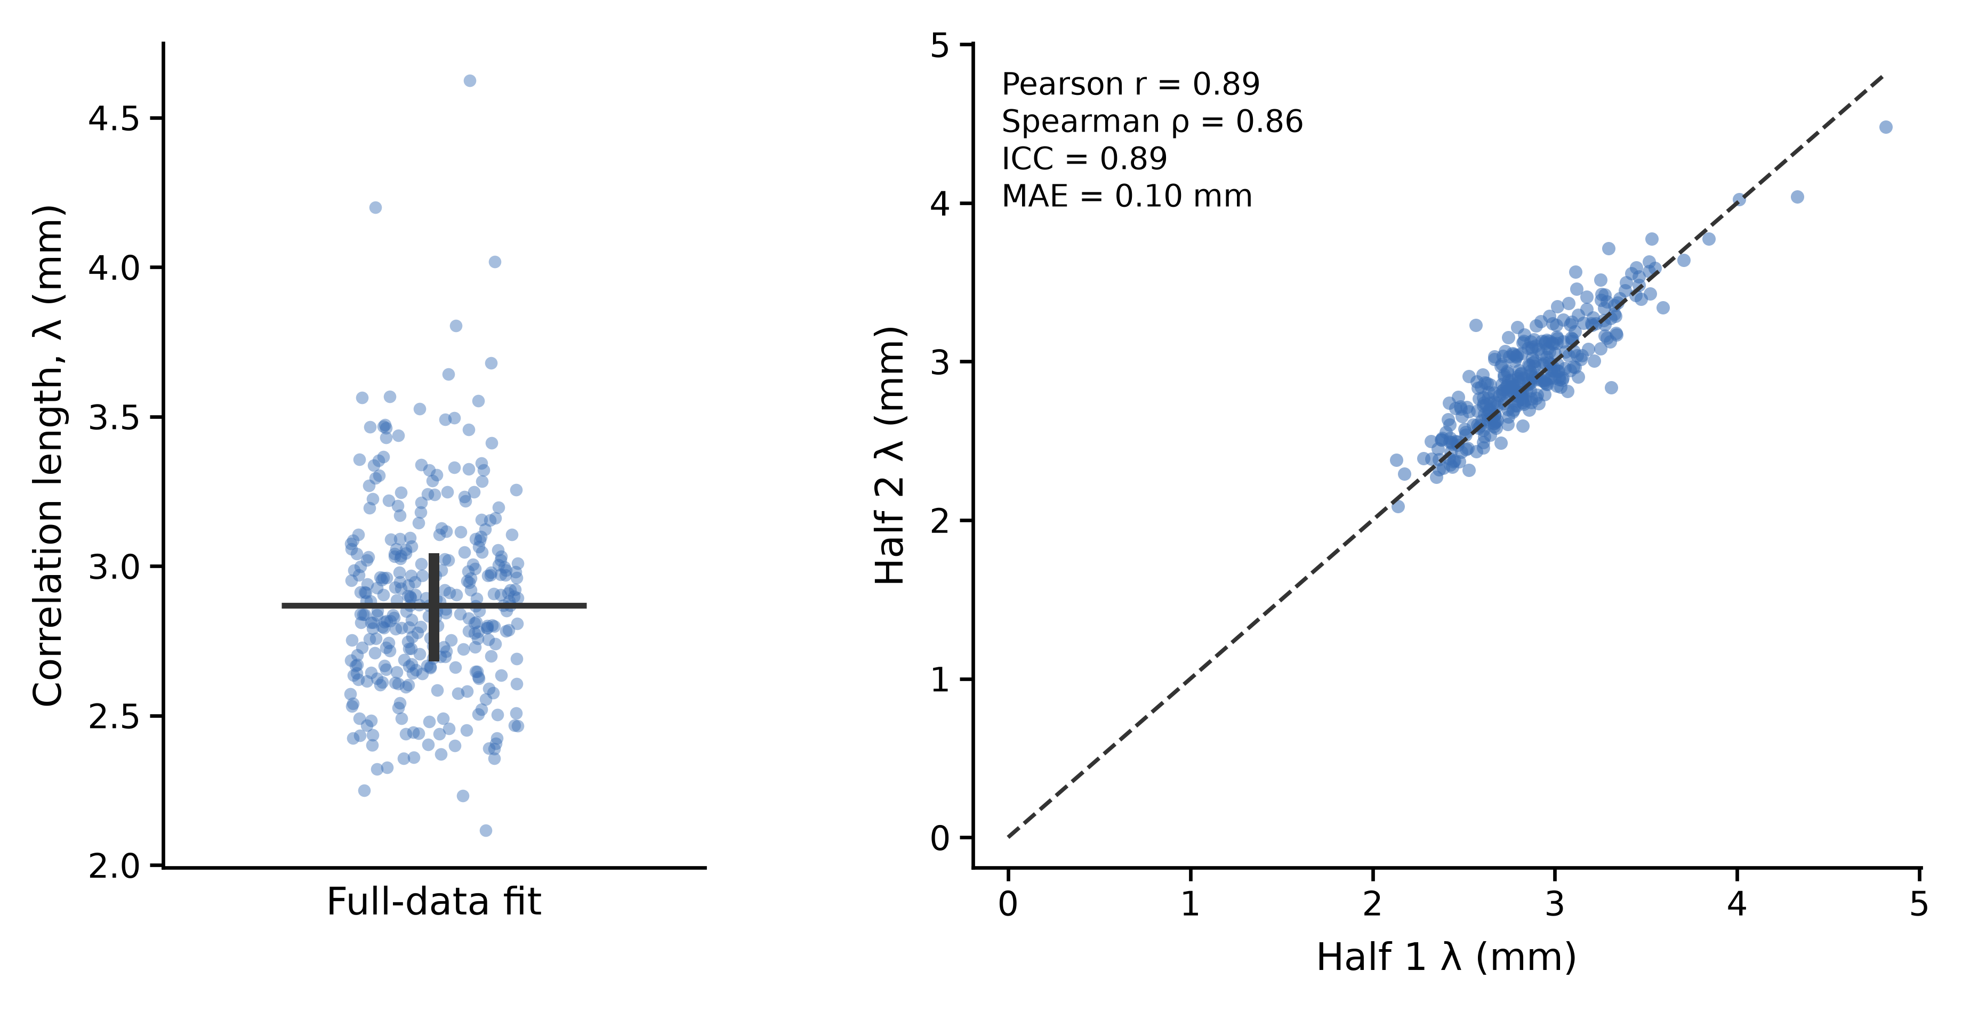
FIGURES 4–5
Figure 4C: a stable millimeter-scale summary of spatial similarity
Exponential model: D(d) = D∞ − A exp(−d / λ).
The fitted scale is stable to anchor splitting; λ does not define a hard sampling threshold.
Sources: figure4C_full_fit_summary.csv; figure4C_fixed_split_reliability.csv.
17
Notes:
λ is the e-folding length of fitted excess similarity, not a hard radius of independence. Fixed anchor split is stratified by hemisphere × DK region and reused across all bins. This is anchor split-half stability, not scan-rescan reliability. Full data: all 320 fits acceptable. Half fits: 320 paired acceptable; no retained fit hits a parameter boundary. Acceptance: R² ≥ .5 and no boundary hit.
Data provenance: Sources: figure4C_full_fit_summary.csv; figure4C_fixed_split_reliability.csv.
Displayed figure: exact notebook-exported PNG, without redrawing or modification. Source: /mnt/newStor/paros/paros_WORK/xintong/code/cortical_trajectory_analysis/qc/figure4/outputs/registration_qc_pass_320/correlation_length/cohort/Figure4C_ico5_K15_correlation_length.png
Displayed figure: exact notebook-exported PNG, without redrawing or modification. Source: /mnt/newStor/paros/paros_WORK/xintong/code/cortical_trajectory_analysis/qc/figure4/outputs/registration_qc_pass_320/correlation_length/cohort/Figure4C_ico5_K15_correlation_length.png
Exact notebook-embedded image output used; no image redrawing or extra annotations.

Slide 18
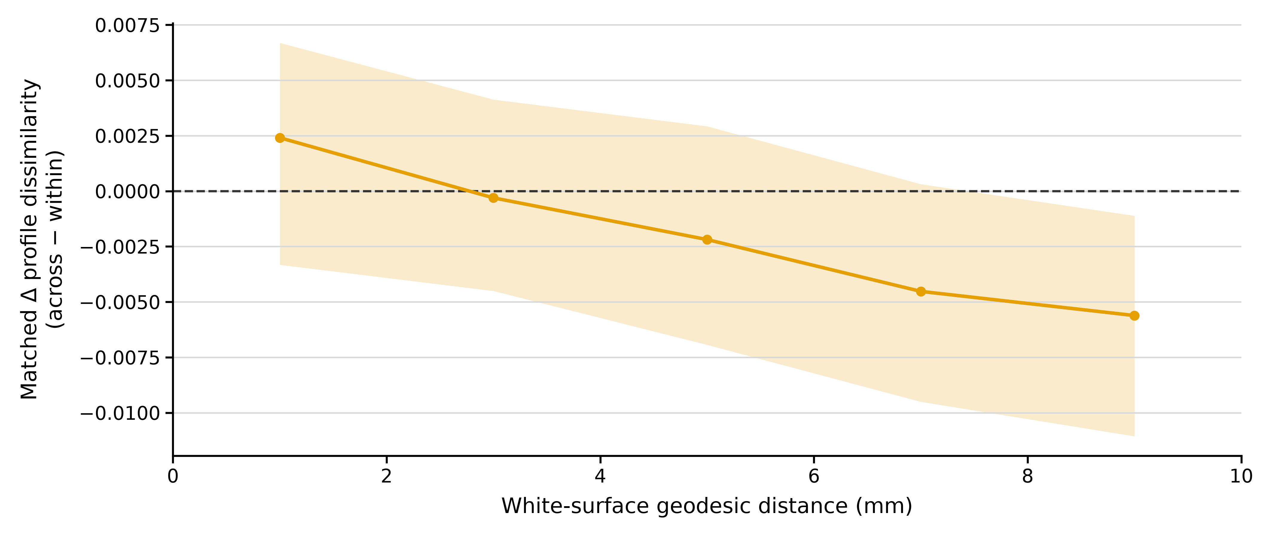
FIGURES 4–5
Figure 4D: no consistent positive DK-boundary shape effect
Same-anchor within/across candidates matched one-to-one; geodesic mismatch ≤0.1 mm.
DK boundaries do not consistently separate more dissimilar local profile shapes under this design.
Sources: formal boundary_matched cohort group and 0–10-mm summary tables.
18
Notes:
ΔD=(1−r_across)−(1−r_within). Aggregate matched-pair mean → anchor-bin mean → bilateral subject-region-bin mean → equal-region subject-bin mean → group median/IQR. Effect is conditional on boundary-eligible anchors and distance matching. Curve uses varying eligible anchors across bins. It is not directly comparable to A’s all-anchor within-region medians. Earlier positive-boundary conclusions are superseded. A small negative aggregate does not establish that DK anatomy is invalid or that cross-region profiles are intrinsically more alike.
Data provenance: Sources: formal boundary_matched cohort group and 0–10-mm summary tables.
Displayed figure: exact notebook-exported PNG, without redrawing or modification. Source: /mnt/newStor/paros/paros_WORK/xintong/code/cortical_trajectory_analysis/qc/figure4/outputs/registration_qc_pass_320/boundary_matched/formal/cohort/Figure4D_boundary_matched_0_10.png
Displayed figure: exact notebook-exported PNG, without redrawing or modification. Source: /mnt/newStor/paros/paros_WORK/xintong/code/cortical_trajectory_analysis/qc/figure4/outputs/registration_qc_pass_320/boundary_matched/formal/cohort/Figure4D_boundary_matched_0_10.png
Exact notebook-embedded image output used; no image redrawing or extra annotations.

Slide 19
FIGURES 4–5
Figure 5 methods: a controlled representation comparison
Same 196 CN participants; shared nested folds; fixed LSQR Ridge framework.
•
Outer 5-fold CV estimates prediction error; inner 5-fold CV selects regularization by MAE.
•
Median imputation and feature standardization are fitted within training folds.
•
Ridge α: 21 logarithmically spaced values from 10⁻⁴ to 10⁶.
•
Primary metric: merged out-of-fold MAE; r, RMSE, and R² are secondary.
95% CIs: 10,000 subject-level bootstrap resamples of saved OOF predictions.
Sources: run_ridge.py; saved fold definitions; submission_lsqr_20261028.json.
19
Notes:
Outer 5-fold CV, inner 5-fold CV, stratified by age quantile bins. Median imputation and StandardScaler fit within each training fold. Tune Ridge alpha over logspace(−4,6,21) using inner MAE; evaluate held-out outer folds. Metrics are recomputed from merged OOF predictions. Subject-bootstrap intervals condition on the saved OOF predictions; they do not include model retraining or resampling of the full CV pipeline. Age is from the matched clinical visit. Use fixed LSQR outputs consistently.
Data provenance: Sources: run_ridge.py; saved fold definitions; submission_lsqr_20261028.json.

Slide 20
FIGURES 4–5
Feature comparisons separate depth, spatial density, and geometry
All feature dimensions below are bilateral and are measured per participant.
Scientific comparison | Representations | Feature count
Depth at DK scale | Mean MD → 21-depth profile | 68 → 1,428
Spatial sampling with depth | DK → ico3 → ico4 → ico5 | 1,428 → 24,675 → 98,427 → 393,582
Depth at ico4 scale | Column mean → full profile | 4,687 → 98,427
Geometry at ico4 scale | Full profile + length / curvature | 103,114 each; 107,801 combined
Spatial resolution and feature dimensionality change together; interpret gains under the fixed model.
Sources: feature_build_report.json; column-mean and geometry build reports.
20
Notes:
Mean MD collapses depth within each column; regional mean MD also averages spatially within each DK region. Full ico4 depth features: 4,687×21=98,427. Adding length or curvature adds one scalar per center, 4,687 features each. Length is trajectory length; it is not automatically identical to cortical thickness. Native curvature is mapped using stored barycentric weights.
Data provenance: Sources: feature_build_report.json; column-mean and geometry build reports.

Slide 21
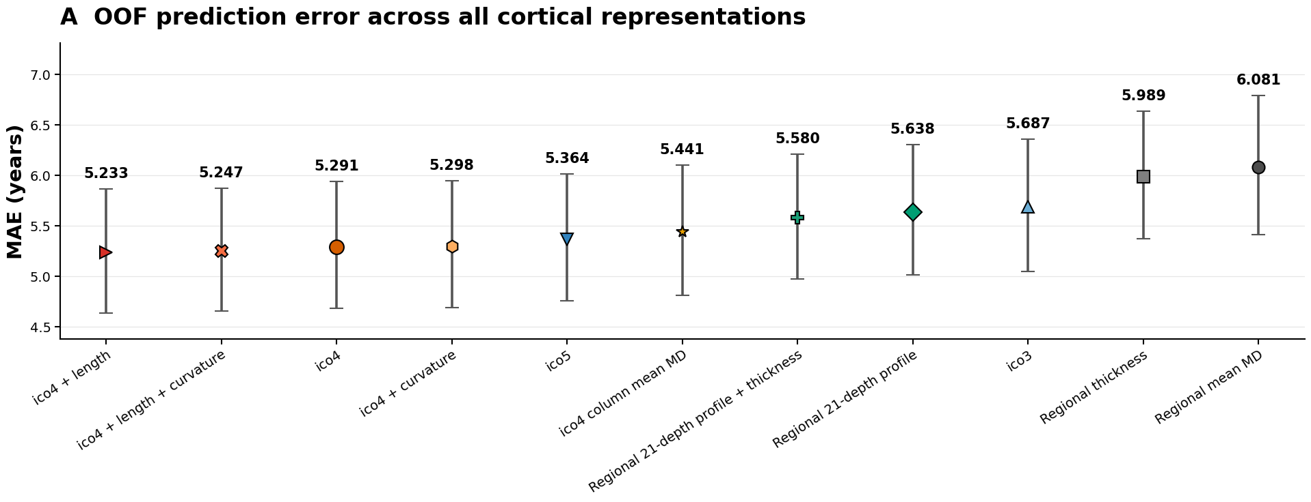
FIGURES 4–5
Depth profiles improve prediction over DK mean MD
Notebook overview of all 11 representations; the DK mean-to-depth contrast provides the baseline.
DK mean → depth: MAE reduction 0.443 y; original FDR q = 0.018.
At the DK scale, preserving depth provides supported predictive benefit.
Sources: Figure5_all_metrics.csv; original predefined_paired_bootstrap.csv.
21
Notes:
Original seven-test comparison family: regional_mean_md−regional_profile ΔMAE=.442738, 95% CI [.149596,.739245], p=.002600, BH q=.018198. These are the original correction-family statistics, not the redefined family in the newer exploratory table.
Data provenance: Sources: Figure5_all_metrics.csv; original predefined_paired_bootstrap.csv.
Displayed figure: exact notebook-exported PNG, without redrawing or modification. Source: /mnt/newStor/paros/paros_WORK/xintong/code/cortical_trajectory_analysis/qc/figure5/outputs/figures/Figure5A_MAE.png
Displayed figure: exact notebook-exported PNG, without redrawing or modification. Source: /mnt/newStor/paros/paros_WORK/xintong/code/cortical_trajectory_analysis/qc/figure5/outputs/figures/Figure5A_MAE.png
Exact notebook-embedded image output used; no image redrawing or extra annotations.

Slide 22
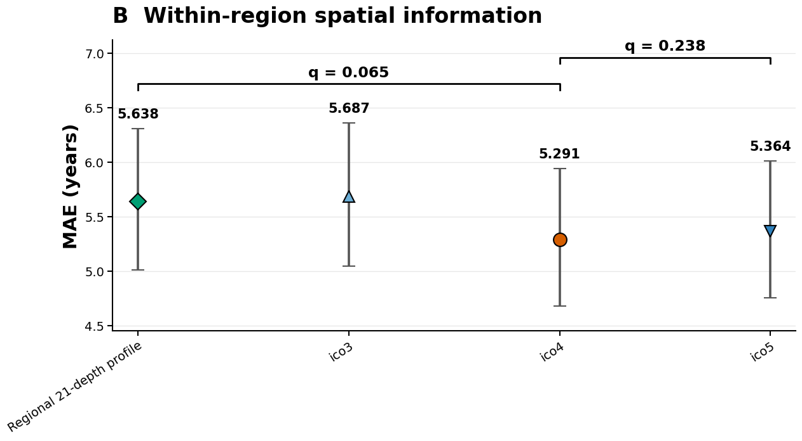
FIGURES 4–5
Spatial density: ico4 improves numerically; ico5 adds no observed gain
The spatial sequence is not a monotonic improvement with denser sampling.
DK depth → ico4: q = 0.065 | ico5 → ico4: q = 0.238.
The ico4 spatial gain is suggestive; it does not meet the exploratory FDR 0.05 threshold.
Sources: Figure5_all_metrics.csv; Figure5_displayed_MAE_statistics.csv.
22
Notes:
DK profile−ico4 ΔMAE=.347735; original bootstrap CI [.057035,.652521], unadjusted p=.019798; original seven-test BH q=.052728. ico4−ico5 ΔMAE=−.072997; CI [−.177822,.029289], q=.226777. A CI excluding zero combined with q>.05 is possible because CI is unadjusted and q is multiplicity adjusted. No equivalence or noninferiority claim is made.
Data provenance: Sources: Figure5_all_metrics.csv; Figure5_displayed_MAE_statistics.csv.
Displayed figure: exact notebook-exported PNG, without redrawing or modification. Source: /mnt/newStor/paros/paros_WORK/xintong/code/cortical_trajectory_analysis/qc/figure5/outputs/figures/Figure5B_spatial_resolution_MAE.png
Displayed figure: exact notebook-exported PNG, without redrawing or modification. Source: /mnt/newStor/paros/paros_WORK/xintong/code/cortical_trajectory_analysis/qc/figure5/outputs/figures/Figure5B_spatial_resolution_MAE.png
Exact notebook-embedded image output used; no image redrawing or extra annotations.

Slide 23
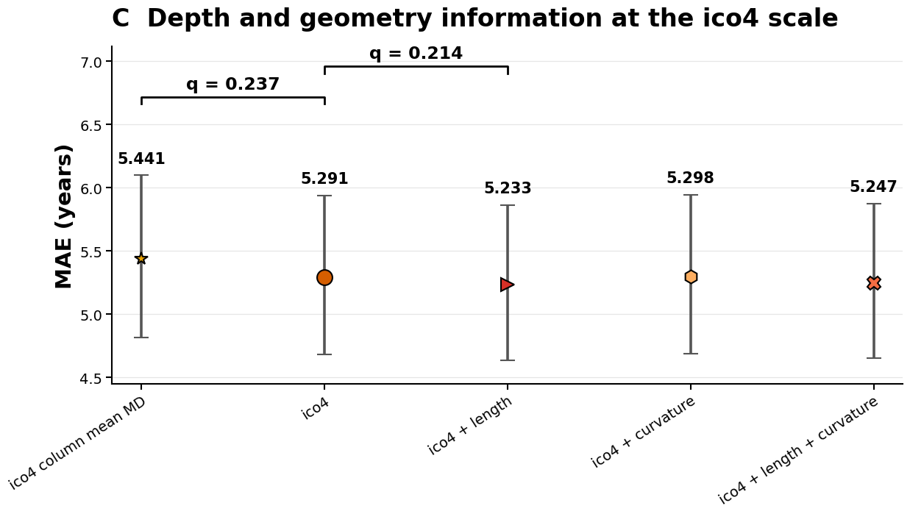
FIGURES 4–5
At ico4, depth and geometry yield modest additional changes
Column mean, full depth, and geometry extensions address distinct information contributions.
Mean → depth: exploratory q = 0.237 | Depth → +length: exploratory q = 0.214
ico4 + length has the lowest numerical MAE (5.233 y); extra-feature benefits remain uncertain.
Sources: latest Figure 5 metrics and displayed paired statistics.
23
Notes:
Column mean vs full depth added after reviewing results: exploratory unadjusted p=.161984, ΔMAE=.149993, CI [−.057946,.364215]. Full depth vs +length ΔMAE=.057147, CI [−.000321,.115386], original three-test geometry q=.160784. Curvature and combined geometry do not show supported additional improvements. Lowest numerical MAE should not be called statistically best.
Data provenance: Sources: latest Figure 5 metrics and displayed paired statistics.
Displayed figure: exact notebook-exported PNG, without redrawing or modification. Source: /mnt/newStor/paros/paros_WORK/xintong/code/cortical_trajectory_analysis/qc/figure5/outputs/figures/Figure5C_ico4_features_MAE.png
Displayed figure: exact notebook-exported PNG, without redrawing or modification. Source: /mnt/newStor/paros/paros_WORK/xintong/code/cortical_trajectory_analysis/qc/figure5/outputs/figures/Figure5C_ico4_features_MAE.png
Exact notebook-embedded image output used; no image redrawing or extra annotations.

Slide 24
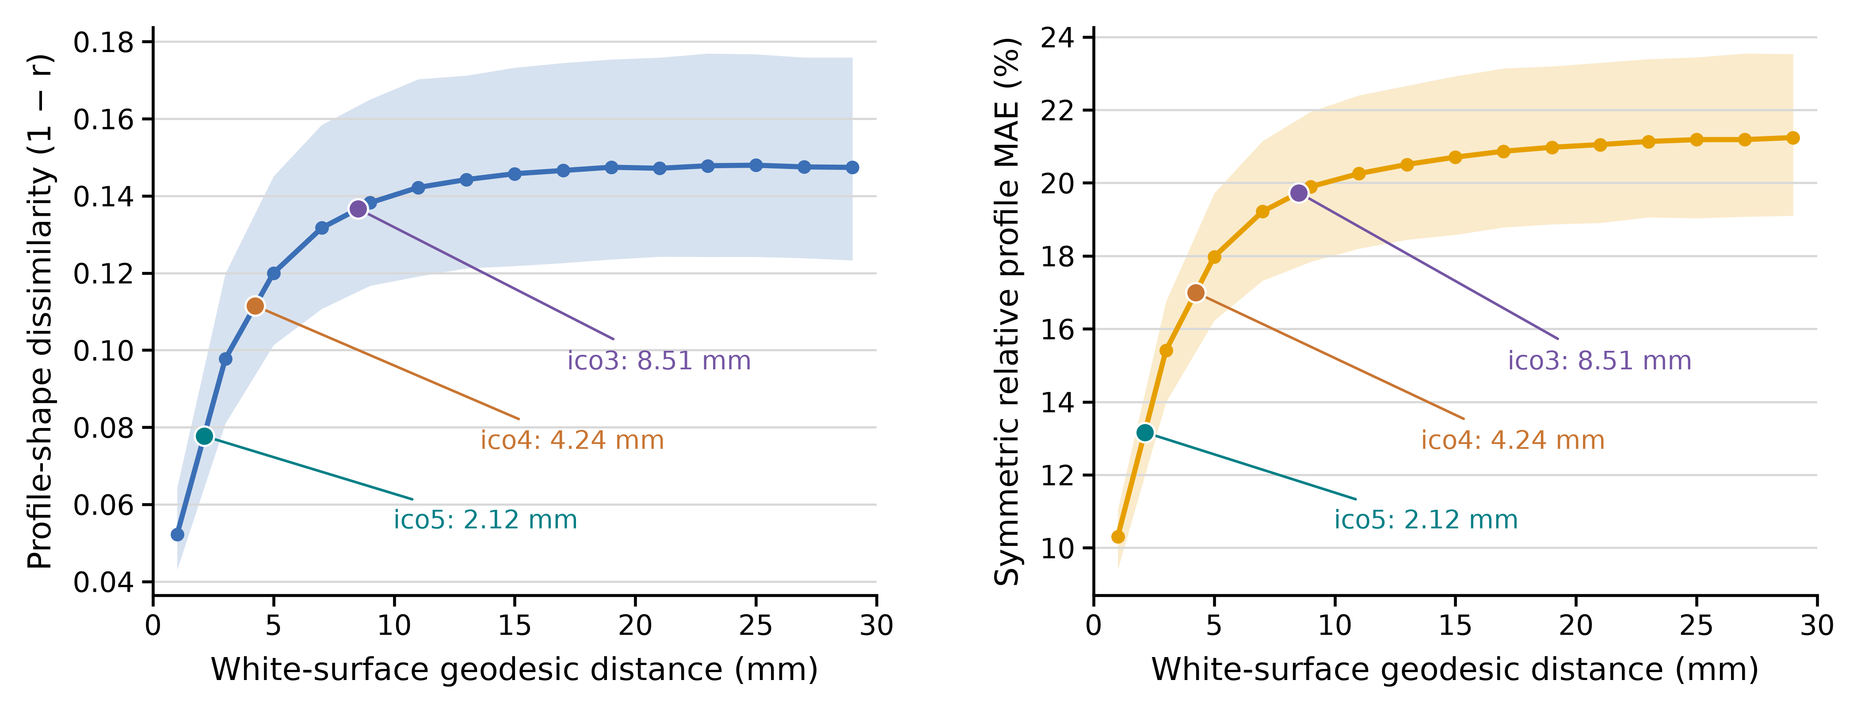
FIGURES 4–5
Integrating spatial similarity with sampling density
Sources: formal Figure 4A/C; ico_nearest_neighbor_summary.csv; Figure 5 OOF metrics.
24
Notes:
Slide 24 uses Figure4A_sampling_scales_annotated.png at the user’s explicit request. The curve uses the 320-participant Figure4A group summary. Markers show ico5 2.12 mm, ico4 4.24 mm and ico3 8.51 mm median nearest-neighbor spacing. Marker y positions are interpolated on the binned median curve for illustration.

Slide 25
FIGURES 4–5
Interpretation and questions for discussion
The strongest evidence concerns depth information; the optimal spatial density remains open.
•
Established: local profiles show distance-dependent similarity; DK depth profiles outperform DK mean MD.
•
Suggestive: ico4 provides a favorable numerical balance of prediction error and feature dimension.
•
Unresolved: added depth at ico4 and geometry yield modest changes with uncertain incremental benefit.
•
Discussion: use ico4 as the working representation, and prioritize generalization and sensitivity checks?
A practical working scale is supported more clearly than a unique biological or predictive optimum.
Cortical MD profiles | Registration-QC cohort update | 320 participants
25
Notes:
Suggested advisor discussion: whether to prioritize ico4 as a pragmatic working representation, whether the formal DK-boundary result merits a main or supplementary panel, and whether further validation should focus on repeated CV/external generalization rather than additional model ranking. Do not present planned analyses as completed.

Slide 26
APPENDIX A
Appendix | Complete prediction metrics
All 11 representations; same 196 merged OOF predictions.
Representation | MAE, y | RMSE, y | Pearson r | R²
ico4 + length | 5.233 | 6.851 | 0.770 | 0.574
ico4 + length + curvature | 5.247 | 6.851 | 0.771 | 0.574
ico4 | 5.291 | 6.939 | 0.761 | 0.563
ico4 + curvature | 5.298 | 6.935 | 0.762 | 0.564
ico5 | 5.364 | 6.992 | 0.757 | 0.556
ico4 column mean MD | 5.441 | 7.100 | 0.741 | 0.543
DK depth profile + thickness | 5.580 | 7.160 | 0.733 | 0.535
DK depth profile | 5.638 | 7.314 | 0.717 | 0.515
ico3 | 5.687 | 7.377 | 0.717 | 0.506
DK thickness | 5.989 | 7.516 | 0.698 | 0.488
DK mean MD | 6.081 | 7.902 | 0.662 | 0.433
Source: Figure5_all_metrics.csv; metric CIs available in companion CSV.
26
Notes:
Data provenance: Source: Figure5_all_metrics.csv; metric CIs available in companion CSV.

Slide 27
APPENDIX B
Appendix | Statistical contrasts and correction families
Use current exploratory FDR families; the added column-mean comparison remains exploratory.
A − B | ΔMAE, y | 95% CI | Statistical status
DK mean − DK depth | 0.443 | [0.150, 0.739] | Historical benchmark q=.018
DK depth − ico4 | 0.348 | [0.057, 0.665] | Exploratory q=.065; 3 tests
ico4 − ico5 | −0.073 | [−0.175, 0.027] | Exploratory q=.238; 3 tests
ico4 mean − depth | 0.150 | [−0.058, 0.364] | Exploratory q=.237; 4 tests
ico4 − ico4 + length | 0.057 | [−0.0003, 0.1154] | Exploratory q=.214; 4 tests
No formal all-model pairwise ranking or equivalence claim is made.
Sources: original representation / geometry paired-bootstrap tables; Figure5_displayed_MAE_statistics.csv.
27
Notes:
Current Figure 5 notebook uses post hoc exploratory/secondary BH-FDR families: spatial resolution (3 contrasts) and ico4 ablation (4 contrasts). Benchmark DK mean-to-depth contrast is retained separately as a historical benchmark and is not part of the current 3+4 families. See notebook cell12 output for the authoritative current table.

Slide 28
APPENDIX C
Appendix | Cohort and metadata qualifications
Detail | Figure 4 (n=320) | Figure 5 (n=196)
HIGH / MEDIUM date match | 105 / 144 | 71 / 107
LOW / ambiguous date match | 45 / 26 | 18 / 0
Sex code 1 / 2 / 9 | 117 / 202 / 1 | 65 / 130 / 1
Age source | Matched-visit VISIT_AGE | Matched-visit VISIT_AGE
LOW matches in Figure 5 require multiple distinct clinical dates with consistently CN status. Sex codes are reported as stored; the codebook was not verified.
Sources: cohort_manifest.csv; cohort_selection/README.md; feature_build_report.json.
28
Notes:
Data provenance: Sources: cohort_manifest.csv; cohort_selection/README.md; feature_build_report.json.

Slide 29
APPENDIX D
Appendix | Analysis provenance and scope
Formal outputs take precedence over historical notebook results.
•
Figure 4: figure4_formal_ico5_k15.ipynb; frozen within-DK A–C and matched-boundary D.
•
Figure 5: plot_figure5.ipynb; fixed-LSQR outputs; 11-representation OOF summaries.
•
Spacing: ico_nearest_neighbor_summary.csv; fsaverage white-surface mesh-edge geodesics.
•
Limitations: mixed diagnosis in Figure 4, clinical-visit age proxy, high feature dimension, and internal validation only.
Text and tables are editable; result panels use the exact notebook-exported figures.
Cortical MD profiles | Registration-QC cohort update | 320 participants
29
Notes:
Full absolute paths are included in the companion data_sources.json and per-slide speaker notes. This presentation changes no analysis outputs and does not retrain models.

