Slide 1
RESEARCH PROGRESS | FIGURES 4–5
Spatial organization and age-prediction value
of cortical column profiles
From local profile similarity to the value of finer spatial sampling
Figure 4 | Spatial similarity, sampling effects, and correlation length
Figure 5 | Depth, spatial density, and geometry in brain-age prediction
Advisor meeting • 28 October 2026
Cortical MD profiles | Registration-QC cohort update | 320 participants
1
Notes:
Advisor discussion deck. All results are from the latest saved formal Figure 4 and LSQR Figure 5 outputs. These analyses describe spatial profile organization and prediction under a fixed model; they do not establish independent biological units or a unique optimal scale.

Slide 2
FIGURES 4–5
Two linked questions guide the analysis
A finer representation is useful only if its additional spatial detail supports the modeling objective.
Q1 Spatial organization
Q2 Predictive value
How do column-profile differences vary with cortical distance and DK boundaries?
Does retaining depth and finer spatial sampling improve age prediction?
Spatial correlation describes redundancy; held-out prediction tests practical value.
Cortical MD profiles | Registration-QC cohort update | 320 participants
2

Slide 3
FIGURES 4–5
Cohort definition: 320 spatial profiles, 196 CN prediction participants
The prediction cohort is a subset of the spatial-analysis cohort.
448
369
325
320
268
200
196
Metadata
Imaging matched
Complete profiles
Figure 4: QC pass
Date eligible
CN eligible
Figure 5
•
Date eligibility: HIGH / MEDIUM match, or prespecified LOW exception with multiple consistently CN visits.
•
Prediction inclusion: CN status, manual T1–DWI registration QC, and ≥95% valid-column coverage.
Sources: cohort_manifest.csv; exclusion_summary.csv; feature_build_report.json
3
Notes:
Metadata: 448; imaging available: 369; complete profiles: 325; remove five visually confirmed registration failures: 320; date eligible: 268; CN: 200; ≥95% coverage: 196. Original and updated cohort files are preserved separately. Counts are sequential, not independent exclusions.
Data provenance: Sources: cohort_manifest.csv; exclusion_summary.csv; feature_build_report.json

Slide 4
FIGURES 4–5
Sample composition and age coverage
Figure 4 includes diagnostic heterogeneity; Figure 5 trains and evaluates age prediction in CN participants only.
Matched-visit diagnosis | Fig. 4 | Fig. 5
Normal | 235 | 196
MCI | 23 | 0
AD | 7 | 0
Other/Impaired non-demented | 26 | 0
Unknown | 29 | 0
Age, mean ± SD (range)
Figure 4: 57.8 ± 11.8 (28–80) y
Figure 5: 58.1 ± 10.5 (28–78) y
Age source: clinical VISIT_AGE at the QIAL-matched visit.
Each participant contributes one merged out-of-fold age prediction in Figure 5.
Source: cohort_manifest.csv joined to the Figure 4 and final Figure 5 subject lists.
4
Notes:
Diagnosis labels are harmonized at the QIAL-matched clinical visit; ambiguous/LOW matches occur in Figure 4. Age is VISIT_AGE at that visit, not an independently verified scan-date age. Sex codes remain numeric because their codebook was not verified; no male/female interpretation is assumed.
Data provenance: Source: cohort_manifest.csv joined to the Figure 4 and final Figure 5 subject lists.

Slide 5
FIGURES 4–5
From full fsaverage to the analyzed column representations
A column is a computational depth trajectory at a template vertex, not a histological cortical column.
Representation | Bilateral positions | MD features / subject
Full fsaverage mesh | 327,684 | 327,684 × 21 grid
Template analysis mask | 299,879 | Subject-specific validity applied
DK regional profile | 68 regions | 1,428
ico3 / ico4 / ico5 | 1,175 / 4,687 / 18,742 | 24,675 / 98,427 / 393,582
Each retained profile samples MD at 21 depths: 0–100%, in 5% steps, pial → white.
Sources: build_features.py; feature_build_report.json; reference profile masks; spacing summary.
5
Notes:
Full fsaverage has 163,842 vertices per hemisphere (327,684 bilateral). Reference in_analysis_mask has 149,953 left +149,926 right =299,879 positions. This is a fixed template analysis-mask count, not the valid count for every participant. Subject-specific validity varies. The masks retain 1,175/4,687/18,742 ico3/4/5 centers, pooled across hemispheres. Official ico mesh totals before mask: 1,284/5,124/20,484. Depth fractions are 0, .05, ..., 1, directed pial to white.
Data provenance: Sources: build_features.py; feature_build_report.json; reference profile masks; spacing summary.

Slide 6
FIGURES 4–5
Figure 4 methods: distance-dependent profile differences
Formal A–C: 320 participants; official ico5 anchors; dense within-DK candidates.
•
18,742 bilateral anchors; up to 15 candidates per anchor in each 2-mm bin, from 0–30 mm.
•
Distance: fsaverage white-surface mesh-edge geodesic distance.
•
Shape: D = 1 − Pearson r across the 21-depth MD profile.
•
Magnitude: symmetric relative MAE = 200 × MAE(x,y) / (median|x| + median|y|).
Summarize within participant first; group curves show median and participant-level IQR.
Sources: formal notebook; formal_pair_qc.json; Figure 4A group tables.
6
Notes:
Pair list contains 4,182,592 directed pairs across bins. K=15 is a target maximum per anchor-bin; sparse bins can contain fewer candidates. Self pairs and duplicates are excluded. Distances are mesh-edge geodesics on fsaverage white. Aggregation for A: pair metric → anchor × 2-mm-bin median → bilateral subject median → group median/IQR. Mean profile shape is preserved in raw r, so high far-distance r does not indicate independent profiles.
Data provenance: Sources: formal notebook; formal_pair_qc.json; Figure 4A group tables.

Slide 7
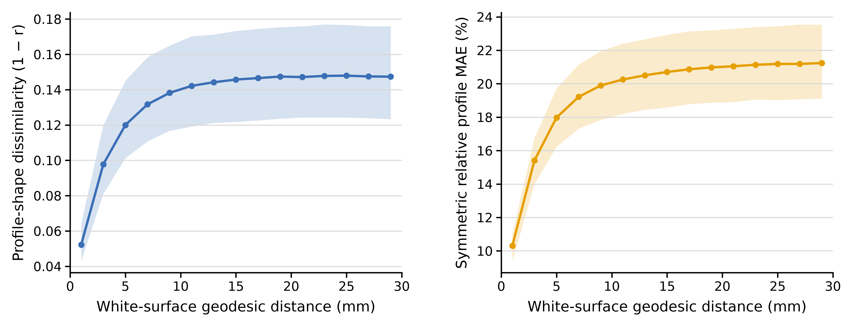
FIGURES 4–5
Figure 4A: nearby columns are more similar
Within-DK profile-shape dissimilarity increases rapidly at short distances, then levels off.
Local profile-shape similarity is spatially structured; high correlation does not imply identical MD.
Source: figure4A_ico5_k15_real_group_summary.csv.
7
Notes:
Native PowerPoint line segments reproduce the saved median and IQR curves. IQR describes between-participant dispersion, not the confidence interval of the median. The reference plateau is 20–30 mm; it is an approximate reference, not a claim of perfect flatness.
Data provenance: Source: figure4A_ico5_k15_real_group_summary.csv.
Displayed figure: exact notebook-exported PNG, without redrawing or modification. Source: /mnt/newStor/paros/paros_WORK/xintong/code/cortical_trajectory_analysis/qc/figure4/outputs/registration_qc_pass_320/real/cohort/Figure4A_ico5_K15_with_relative_MAE.png
Displayed figure: exact notebook-exported PNG, without redrawing or modification. Source: /mnt/newStor/paros/paros_WORK/xintong/code/cortical_trajectory_analysis/qc/figure4/outputs/registration_qc_pass_320/real/cohort/Figure4A_ico5_K15_with_relative_MAE.png

Slide 8
FIGURES 4–5
Figure 4A: correlated profiles still differ in MD magnitude
Relative profile MAE provides a complementary view of numerical differences.
Spatial redundancy in profile shape coexists with measurable numerical variation.
Source: figure4_relative_mae_group_summary.csv.
8
Notes:
Symmetric relative MAE is normalized by the sum of the two median absolute MD values. It is not the conventional per-depth MAPE and should not be described as such. Shape and magnitude metrics answer different questions.
Data provenance: Source: figure4_relative_mae_group_summary.csv.
Displayed figure: exact notebook-exported PNG, without redrawing or modification. Source: /mnt/newStor/paros/paros_WORK/xintong/code/cortical_trajectory_analysis/qc/figure4/outputs/registration_qc_pass_320/real/cohort/Figure4A_ico5_K15_with_relative_MAE.png
Displayed figure: exact notebook-exported PNG, without redrawing or modification. Source: /mnt/newStor/paros/paros_WORK/xintong/code/cortical_trajectory_analysis/qc/figure4/outputs/registration_qc_pass_320/real/cohort/Figure4A_ico5_K15_with_relative_MAE.png

Slide 9
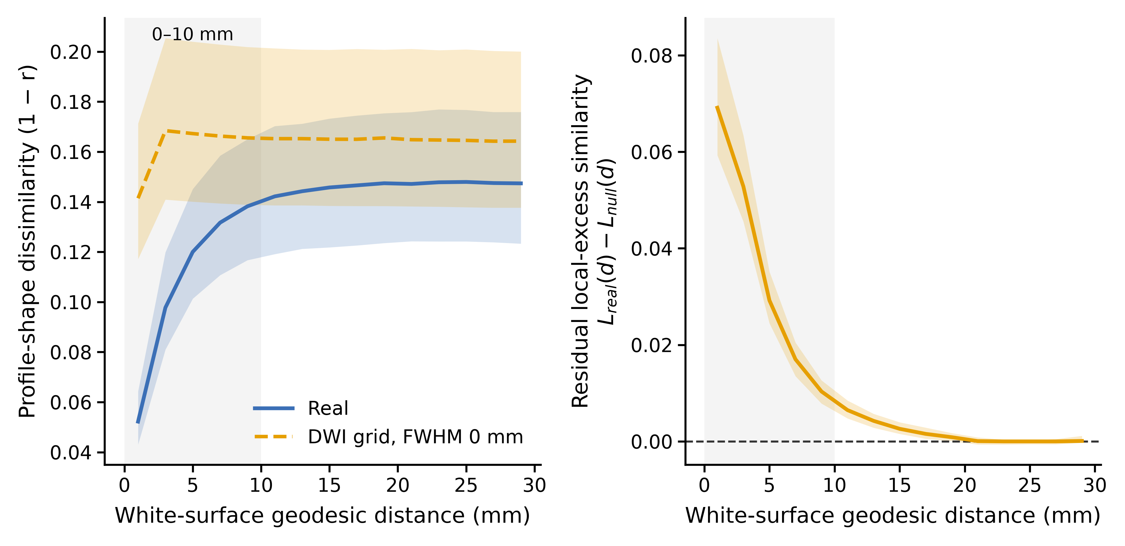
FIGURES 4–5
Figure 4B: acquisition and sampling explain part of local similarity
Primary null: native-DWI Gaussian noise, FWHM = 0 mm, 100 realizations per participant.
Residual structure exceeds this interpolation-only null; it is not a purely physiological estimate.
Sources: formal Figure 4B notebook and seed-fixed acquisition-null cohort tables.
9
Notes:
Generate independent Gaussian noise on each native DWI grid, sample at real O3 coordinates with trilinear interpolation, then recolor to match subject-specific depth mean and 21×21 covariance. FWHM=0 means no additional Gaussian PSF, not an absence of interpolation-induced smoothness. Local excess L(d)=D_far−D(d), far reference 20–30 mm. Residual=L_real−L_null. AUC is not a proportion of biological information. Nonzero PSF sensitivity from older analyses is not merged into this formal primary result.
Data provenance: Sources: formal Figure 4B notebook and seed-fixed acquisition-null cohort tables.
Displayed figure: exact notebook-exported PNG, without redrawing or modification. Source: /mnt/newStor/paros/paros_WORK/xintong/code/cortical_trajectory_analysis/qc/figure4/outputs/registration_qc_pass_320/acquisition_null_fwhm0_seedfix/cohort/Figure4B_ico5_K15_formal_main.png
Displayed figure: exact notebook-exported PNG, without redrawing or modification. Source: /mnt/newStor/paros/paros_WORK/xintong/code/cortical_trajectory_analysis/qc/figure4/outputs/registration_qc_pass_320/acquisition_null_fwhm0_seedfix/cohort/Figure4B_ico5_K15_formal_main.png

Slide 10
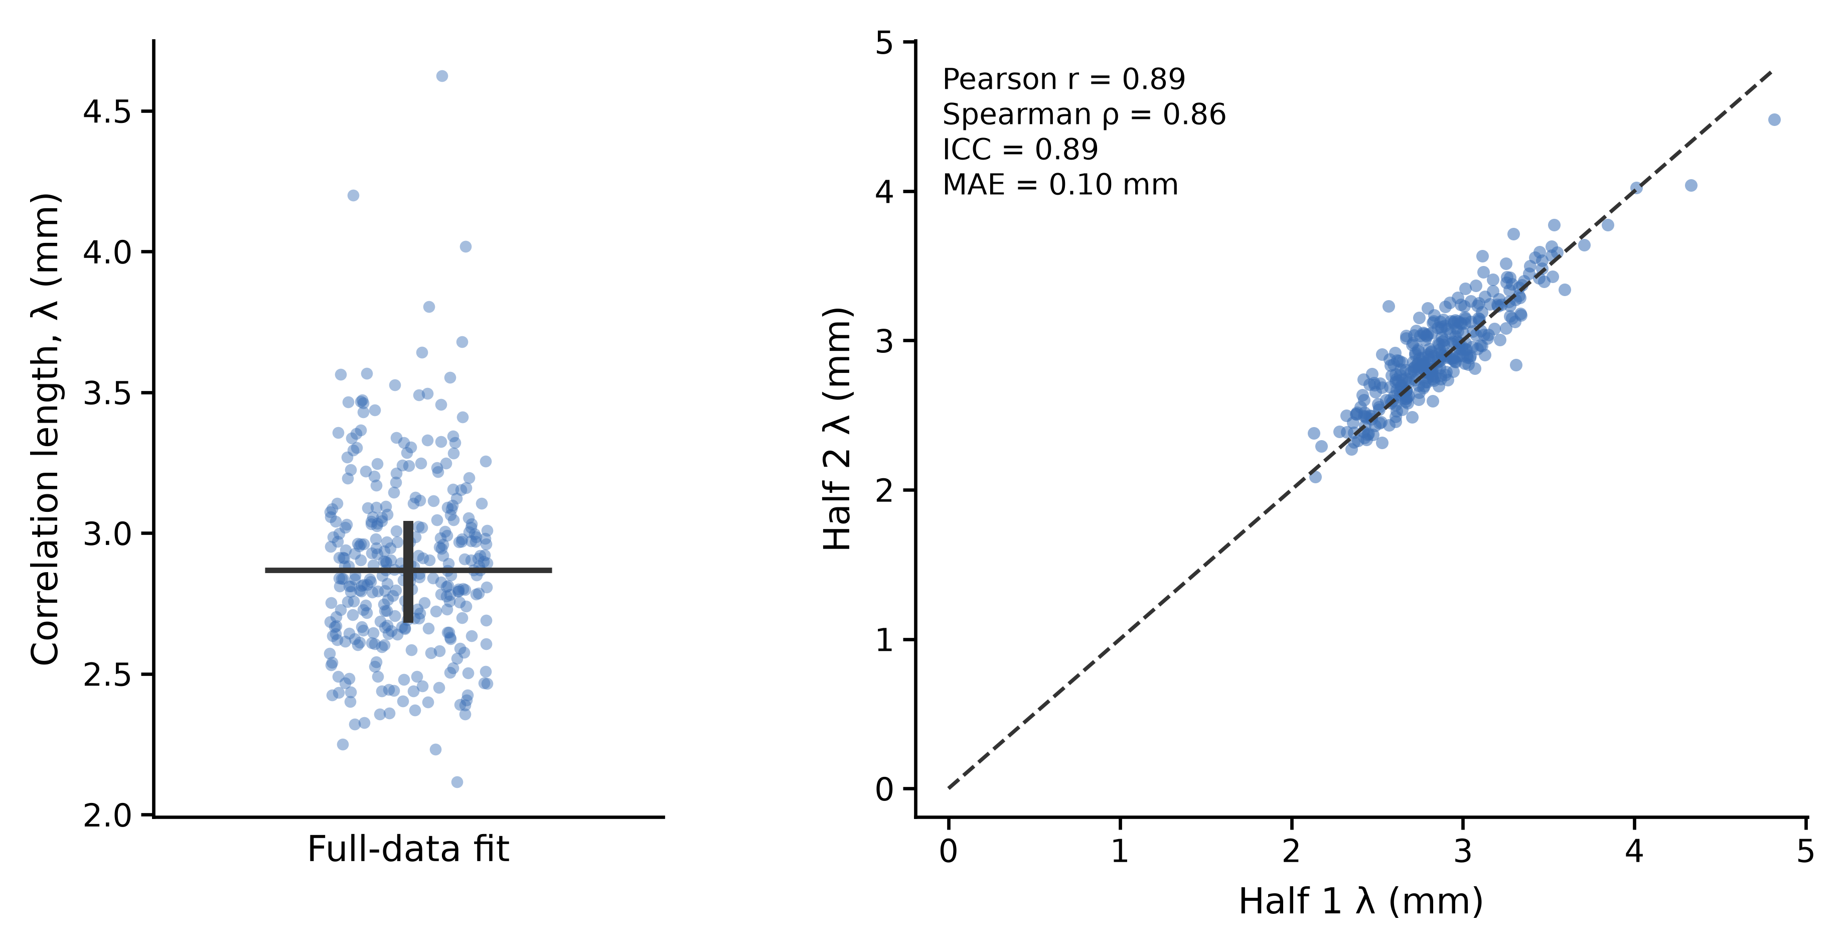
FIGURES 4–5
Figure 4C: a stable millimeter-scale summary of spatial similarity
Exponential model: D(d) = D∞ − A exp(−d / λ).
The fitted scale is stable to anchor splitting; λ does not define a hard sampling threshold.
Sources: figure4C_full_fit_summary.csv; figure4C_fixed_split_reliability.csv.
10
Notes:
λ is the e-folding length of fitted excess similarity, not a hard radius of independence. Fixed anchor split is stratified by hemisphere × DK region and reused across all bins. This is anchor split-half stability, not scan-rescan reliability. Full data: all 320 fits acceptable. Half fits: 320 paired acceptable; no retained fit hits a parameter boundary. Acceptance: R² ≥ .5 and no boundary hit.
Data provenance: Sources: figure4C_full_fit_summary.csv; figure4C_fixed_split_reliability.csv.
Displayed figure: exact notebook-exported PNG, without redrawing or modification. Source: /mnt/newStor/paros/paros_WORK/xintong/code/cortical_trajectory_analysis/qc/figure4/outputs/registration_qc_pass_320/correlation_length/cohort/Figure4C_ico5_K15_correlation_length.png
Displayed figure: exact notebook-exported PNG, without redrawing or modification. Source: /mnt/newStor/paros/paros_WORK/xintong/code/cortical_trajectory_analysis/qc/figure4/outputs/registration_qc_pass_320/correlation_length/cohort/Figure4C_ico5_K15_correlation_length.png

Slide 11
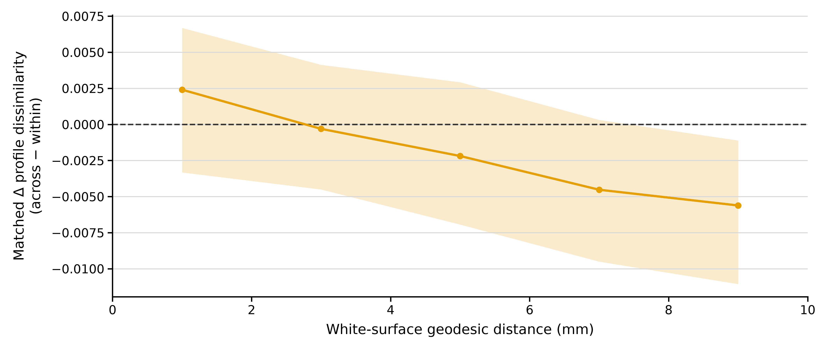
FIGURES 4–5
Figure 4D: no consistent positive DK-boundary shape effect
Same-anchor within/across candidates matched one-to-one; geodesic mismatch ≤0.1 mm.
DK boundaries do not consistently separate more dissimilar local profile shapes under this design.
Sources: formal boundary_matched cohort group and 0–10-mm summary tables.
11
Notes:
ΔD=(1−r_across)−(1−r_within). Aggregate matched-pair mean → anchor-bin mean → bilateral subject-region-bin mean → equal-region subject-bin mean → group median/IQR. Effect is conditional on boundary-eligible anchors and distance matching. Curve uses varying eligible anchors across bins. It is not directly comparable to A’s all-anchor within-region medians. Earlier positive-boundary conclusions are superseded. A small negative aggregate does not establish that DK anatomy is invalid or that cross-region profiles are intrinsically more alike.
Data provenance: Sources: formal boundary_matched cohort group and 0–10-mm summary tables.
Displayed figure: exact notebook-exported PNG, without redrawing or modification. Source: /mnt/newStor/paros/paros_WORK/xintong/code/cortical_trajectory_analysis/qc/figure4/outputs/registration_qc_pass_320/boundary_matched/formal/cohort/Figure4D_boundary_matched_0_10.png
Displayed figure: exact notebook-exported PNG, without redrawing or modification. Source: /mnt/newStor/paros/paros_WORK/xintong/code/cortical_trajectory_analysis/qc/figure4/outputs/registration_qc_pass_320/boundary_matched/formal/cohort/Figure4D_boundary_matched_0_10.png

Slide 12
FIGURES 4–5
Figure 5 methods: a controlled representation comparison
Same 196 CN participants; shared nested folds; fixed LSQR Ridge framework.
•
Outer 5-fold CV estimates prediction error; inner 5-fold CV selects regularization by MAE.
•
Median imputation and feature standardization are fitted within training folds.
•
Ridge α: 21 logarithmically spaced values from 10⁻⁴ to 10⁶.
•
Primary metric: merged out-of-fold MAE; r, RMSE, and R² are secondary.
95% CIs: 10,000 subject-level bootstrap resamples of saved OOF predictions.
Sources: run_ridge.py; saved fold definitions; submission_lsqr_20261028.json.
12
Notes:
Outer 5-fold CV, inner 5-fold CV, stratified by age quantile bins. Median imputation and StandardScaler fit within each training fold. Tune Ridge alpha over logspace(−4,6,21) using inner MAE; evaluate held-out outer folds. Metrics are recomputed from merged OOF predictions. Subject-bootstrap intervals condition on the saved OOF predictions; they do not include model retraining or resampling of the full CV pipeline. Age is from the matched clinical visit. Use fixed LSQR outputs consistently.
Data provenance: Sources: run_ridge.py; saved fold definitions; submission_lsqr_20261028.json.

Slide 13
FIGURES 4–5
Feature comparisons separate depth, spatial density, and geometry
All feature dimensions below are bilateral and are measured per participant.
Scientific comparison | Representations | Feature count
Depth at DK scale | Mean MD → 21-depth profile | 68 → 1,428
Spatial sampling with depth | DK → ico3 → ico4 → ico5 | 1,428 → 24,675 → 98,427 → 393,582
Depth at ico4 scale | Column mean → full profile | 4,687 → 98,427
Geometry at ico4 scale | Full profile + length / curvature | 103,114 each; 107,801 combined
Spatial resolution and feature dimensionality change together; interpret gains under the fixed model.
Sources: feature_build_report.json; column-mean and geometry build reports.
13
Notes:
Mean MD collapses depth within each column; regional mean MD also averages spatially within each DK region. Full ico4 depth features: 4,687×21=98,427. Adding length or curvature adds one scalar per center, 4,687 features each. Length is trajectory length; it is not automatically identical to cortical thickness. Native curvature is mapped using stored barycentric weights.
Data provenance: Sources: feature_build_report.json; column-mean and geometry build reports.

Slide 14
FIGURES 4–5
Depth profiles improve prediction over DK mean MD
Notebook overview of all 11 representations; the DK mean-to-depth contrast provides the baseline.
DK mean → depth: MAE reduction 0.443 y; original FDR q = 0.018.
At the DK scale, preserving depth provides supported predictive benefit.
Sources: Figure5_all_metrics.csv; original predefined_paired_bootstrap.csv.
14
Notes:
Original seven-test comparison family: regional_mean_md−regional_profile ΔMAE=.442738, 95% CI [.149596,.739245], p=.002600, BH q=.018198. These are the original correction-family statistics, not the redefined family in the newer exploratory table.
Data provenance: Sources: Figure5_all_metrics.csv; original predefined_paired_bootstrap.csv.
Displayed figure: exact notebook-exported PNG, without redrawing or modification. Source: /mnt/newStor/paros/paros_WORK/xintong/code/cortical_trajectory_analysis/qc/figure5/outputs/figures/Figure5A_MAE.png
Displayed figure: exact notebook-exported PNG, without redrawing or modification. Source: /mnt/newStor/paros/paros_WORK/xintong/code/cortical_trajectory_analysis/qc/figure5/outputs/figures/Figure5A_MAE.png

Slide 15
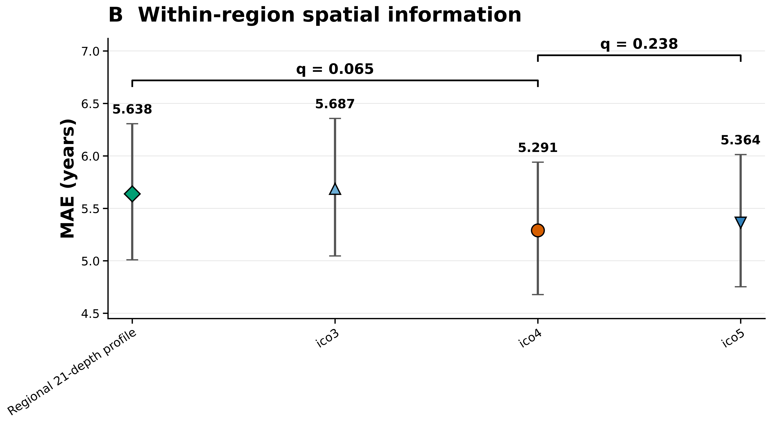
FIGURES 4–5
Spatial density: ico4 improves numerically; ico5 adds no observed gain
The spatial sequence is not a monotonic improvement with denser sampling.
DK depth → ico4: q = 0.053 | ico4 vs ico5: q = 0.227.
The ico4 spatial gain is suggestive; it does not meet the original FDR 0.05 threshold.
Sources: Figure5_all_metrics.csv; Figure5_displayed_MAE_statistics.csv.
15
Notes:
DK profile−ico4 ΔMAE=.347735; original bootstrap CI [.057035,.652521], unadjusted p=.019798; original seven-test BH q=.052728. ico4−ico5 ΔMAE=−.072997; CI [−.177822,.029289], q=.226777. A CI excluding zero combined with q>.05 is possible because CI is unadjusted and q is multiplicity adjusted. No equivalence or noninferiority claim is made.
Data provenance: Sources: Figure5_all_metrics.csv; Figure5_displayed_MAE_statistics.csv.
Displayed figure: exact notebook-exported PNG, without redrawing or modification. Source: /mnt/newStor/paros/paros_WORK/xintong/code/cortical_trajectory_analysis/qc/figure5/outputs/figures/Figure5B_spatial_resolution_MAE.png
Displayed figure: exact notebook-exported PNG, without redrawing or modification. Source: /mnt/newStor/paros/paros_WORK/xintong/code/cortical_trajectory_analysis/qc/figure5/outputs/figures/Figure5B_spatial_resolution_MAE.png

Slide 16
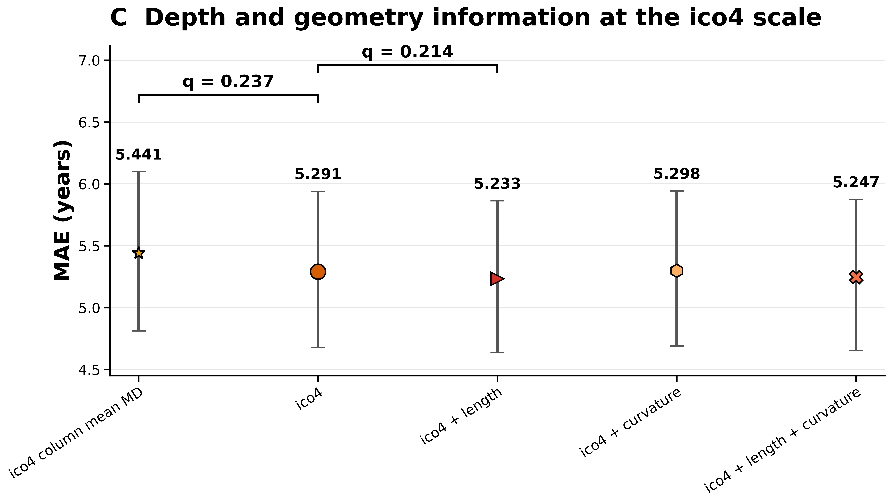
FIGURES 4–5
At ico4, depth and geometry yield modest additional changes
Column mean, full depth, and geometry extensions address distinct information contributions.
Mean → depth: exploratory p = 0.162 | Depth → +length: q = 0.161.
ico4 + length has the lowest numerical MAE (5.233 y); extra-feature benefits remain uncertain.
Sources: latest Figure 5 metrics and displayed paired statistics.
16
Notes:
Column mean vs full depth added after reviewing results: exploratory unadjusted p=.161984, ΔMAE=.149993, CI [−.057946,.364215]. Full depth vs +length ΔMAE=.057147, CI [−.000321,.115386], original three-test geometry q=.160784. Curvature and combined geometry do not show supported additional improvements. Lowest numerical MAE should not be called statistically best.
Data provenance: Sources: latest Figure 5 metrics and displayed paired statistics.
Displayed figure: exact notebook-exported PNG, without redrawing or modification. Source: /mnt/newStor/paros/paros_WORK/xintong/code/cortical_trajectory_analysis/qc/figure5/outputs/figures/Figure5C_ico4_features_MAE.png
Displayed figure: exact notebook-exported PNG, without redrawing or modification. Source: /mnt/newStor/paros/paros_WORK/xintong/code/cortical_trajectory_analysis/qc/figure5/outputs/figures/Figure5C_ico4_features_MAE.png

Slide 17
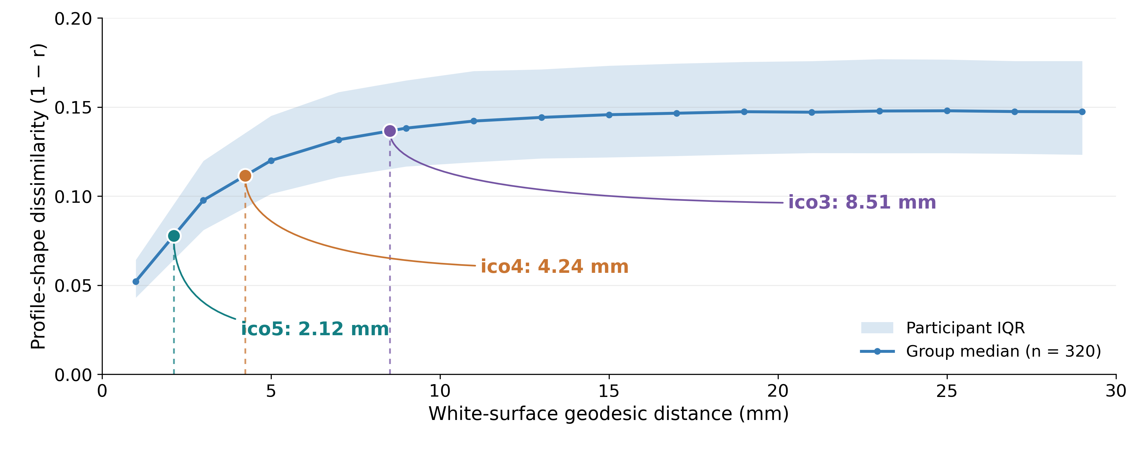
FIGURES 4–5
Integrating spatial similarity with sampling density
Sources: formal Figure 4A/C; ico_nearest_neighbor_summary.csv; Figure 5 OOF metrics.
17
Notes:
Only the Figure 4A profile-shape panel is shown. Reproduced from the exact formal notebook source table using the notebook bin-center convention (1,3,...,29 mm). The blue curve and participant IQR use the saved group summary. Colored markers locate the median nearest-neighbor geodesic spacing of retained template centers: ico5 2.12 mm, ico4 4.24 mm, ico3 8.51 mm. Marker y positions are linearly interpolated on the binned group-median curve for illustration; they are not new empirical estimates or model-performance points. Spacings refer to template centers, not participants. This annotation does not identify an optimal sampling threshold. Standalone PNG, PDF, SVG and plotting code accompany the deck.

Slide 18
FIGURES 4–5
Interpretation and questions for discussion
The strongest evidence concerns depth information; the optimal spatial density remains open.
•
Established: local profiles show distance-dependent similarity; DK depth profiles outperform DK mean MD.
•
Suggestive: ico4 provides a favorable numerical balance of prediction error and feature dimension.
•
Unresolved: added depth at ico4 and geometry yield modest changes with uncertain incremental benefit.
•
Discussion: use ico4 as the working representation, and prioritize generalization and sensitivity checks?
A practical working scale is supported more clearly than a unique biological or predictive optimum.
Cortical MD profiles | Registration-QC cohort update | 320 participants
18
Notes:
Suggested advisor discussion: whether to prioritize ico4 as a pragmatic working representation, whether the formal DK-boundary result merits a main or supplementary panel, and whether further validation should focus on repeated CV/external generalization rather than additional model ranking. Do not present planned analyses as completed.

Slide 19
APPENDIX A
Appendix | Complete prediction metrics
All 11 representations; same 196 merged OOF predictions.
Representation | MAE, y | RMSE, y | Pearson r | R²
ico4 + length | 5.233 | 6.851 | 0.770 | 0.574
ico4 + length + curvature | 5.247 | 6.851 | 0.771 | 0.574
ico4 | 5.291 | 6.939 | 0.761 | 0.563
ico4 + curvature | 5.298 | 6.935 | 0.762 | 0.564
ico5 | 5.364 | 6.992 | 0.757 | 0.556
ico4 column mean MD | 5.441 | 7.100 | 0.741 | 0.543
DK depth profile + thickness | 5.580 | 7.160 | 0.733 | 0.535
DK depth profile | 5.638 | 7.314 | 0.717 | 0.515
ico3 | 5.687 | 7.377 | 0.717 | 0.506
DK thickness | 5.989 | 7.516 | 0.698 | 0.488
DK mean MD | 6.081 | 7.902 | 0.662 | 0.433
Source: Figure5_all_metrics.csv; metric CIs available in companion CSV.
19
Notes:
Data provenance: Source: Figure5_all_metrics.csv; metric CIs available in companion CSV.

Slide 20
APPENDIX B
Appendix | Statistical contrasts and correction families
Use original FDR families; the added column-mean comparison remains exploratory.
A − B | ΔMAE, y | 95% CI | Statistical status
DK mean − DK depth | 0.443 | [0.150, 0.739] | q=.018; 7-test family
DK depth − ico4 | 0.348 | [0.057, 0.653] | q=.053; 7-test family
ico4 − ico5 | −0.073 | [−0.178, 0.029] | q=.227; 7-test family
ico4 mean − depth | 0.150 | [−0.058, 0.364] | Exploratory p=.162
ico4 − ico4 + length | 0.057 | [−0.0003, 0.1154] | q=.161; 3-test family
No formal all-model pairwise ranking or equivalence claim is made.
Sources: original representation / geometry paired-bootstrap tables; Figure5_displayed_MAE_statistics.csv.
20
Notes:
Δ is MAE(A)−MAE(B); positive favors B. Intervals are pointwise unadjusted percentile 95% intervals. Existing formal contrasts retain original multiplicity families: seven representation tests and three ico4 geometry tests. Column mean versus depth is exploratory and receives no q value. Fixed-OOF bootstrap does not quantify all training-set/CV variability.
Data provenance: Sources: original representation / geometry paired-bootstrap tables; Figure5_displayed_MAE_statistics.csv.

Slide 21
APPENDIX C
Appendix | Cohort and metadata qualifications
Detail | Figure 4 (n=320) | Figure 5 (n=196)
HIGH / MEDIUM date match | 105 / 144 | 71 / 107
LOW / ambiguous date match | 45 / 26 | 18 / 0
Sex code 1 / 2 / 9 | 117 / 202 / 1 | 65 / 130 / 1
Age source | Matched-visit VISIT_AGE | Matched-visit VISIT_AGE
LOW matches in Figure 5 require multiple distinct clinical dates with consistently CN status. Sex codes are reported as stored; the codebook was not verified.
Sources: cohort_manifest.csv; cohort_selection/README.md; feature_build_report.json.
21
Notes:
Data provenance: Sources: cohort_manifest.csv; cohort_selection/README.md; feature_build_report.json.

Slide 22
APPENDIX D
Appendix | Analysis provenance and scope
Formal outputs take precedence over historical notebook results.
•
Figure 4: figure4_formal_ico5_k15.ipynb; frozen within-DK A–C and matched-boundary D.
•
Figure 5: plot_figure5.ipynb; fixed-LSQR outputs; 11-representation OOF summaries.
•
Spacing: ico_nearest_neighbor_summary.csv; fsaverage white-surface mesh-edge geodesics.
•
Limitations: mixed diagnosis in Figure 4, clinical-visit age proxy, high feature dimension, and internal validation only.
Text and tables are editable; result panels use the exact notebook-exported figures.
Cortical MD profiles | Registration-QC cohort update | 320 participants
22
Notes:
Full absolute paths are included in the companion data_sources.json and per-slide speaker notes. This presentation changes no analysis outputs and does not retrain models.

