Slide 1
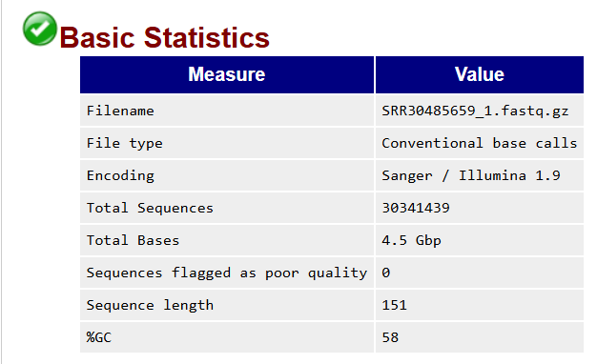
Analysis of data quality control results
Name of the original file which is analysed
Indicates if the file contains base calls and/or colorspace data ; if so, the latter must be converted into base calls
Indicates which ASCii encoding of quality values was found in the file
Total number of sequences / reads sequenced for each sample, each read is 151 bp long (see « Sequence length » row)
Total number of bases : cumulative sum of all bases (A, T, C, G and N) for each read in the whole file
Sequences identified as potentially poor quality
DNA / RNA length : each read is 151 bp long

Slide 2
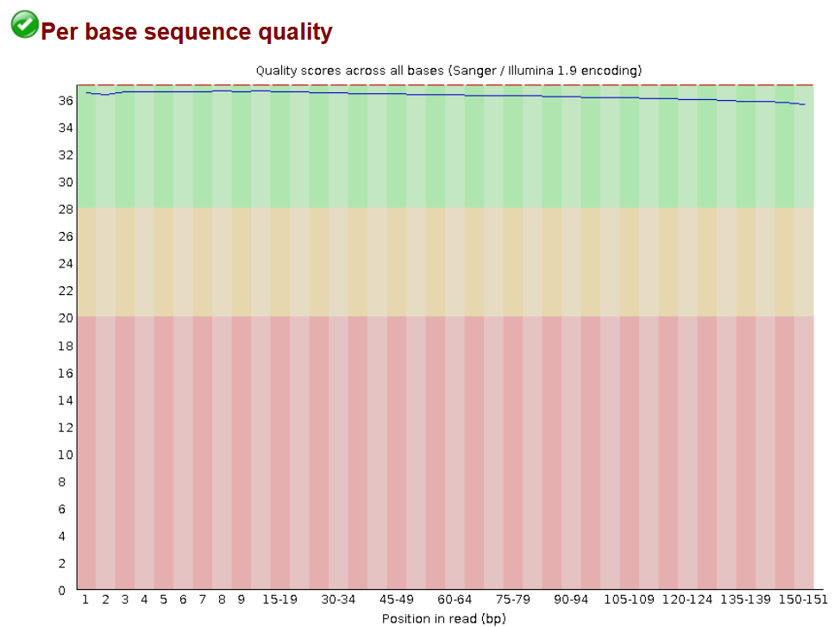

Slide 3
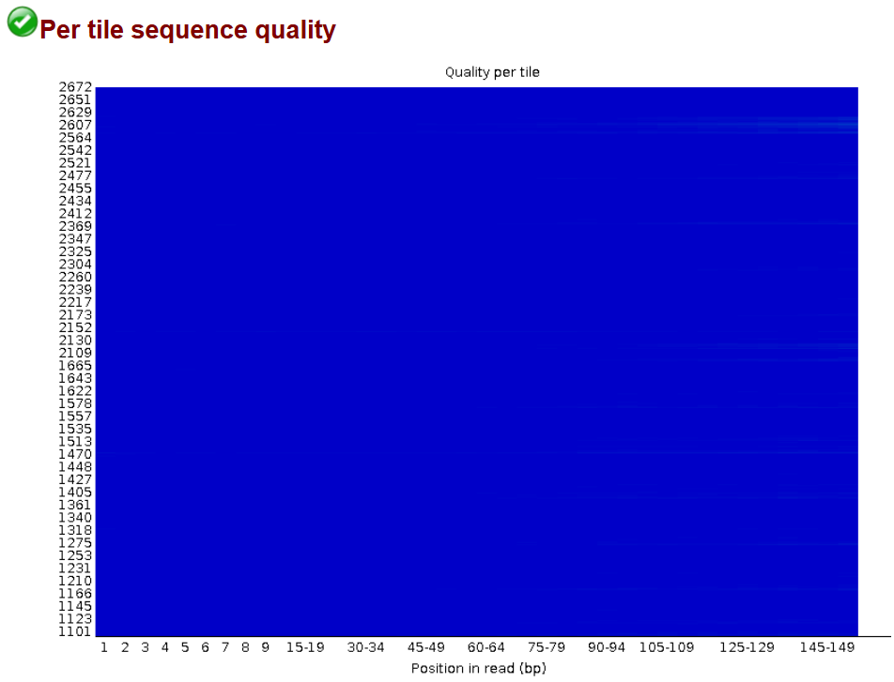

Slide 4
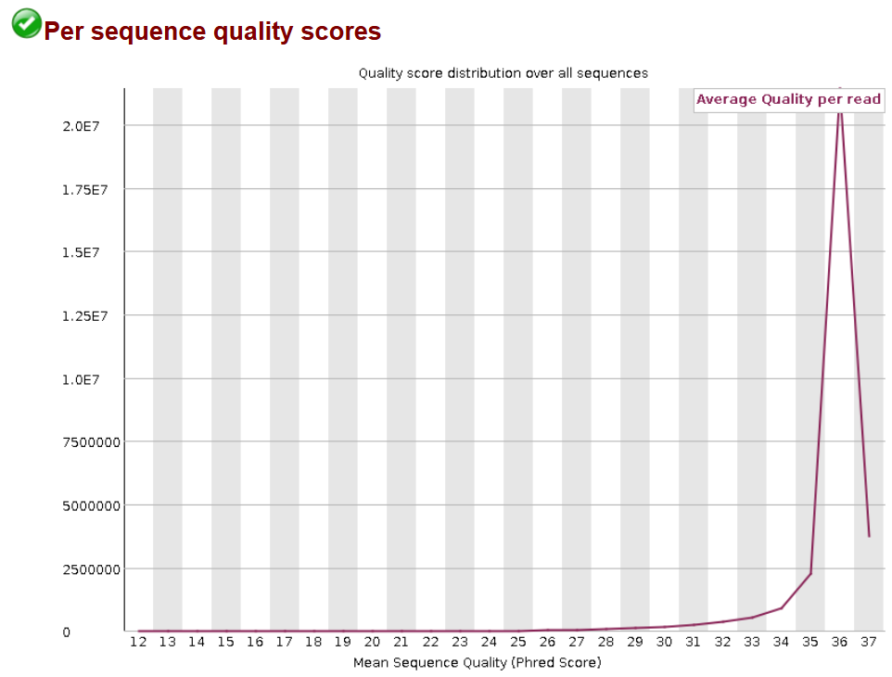

Slide 5
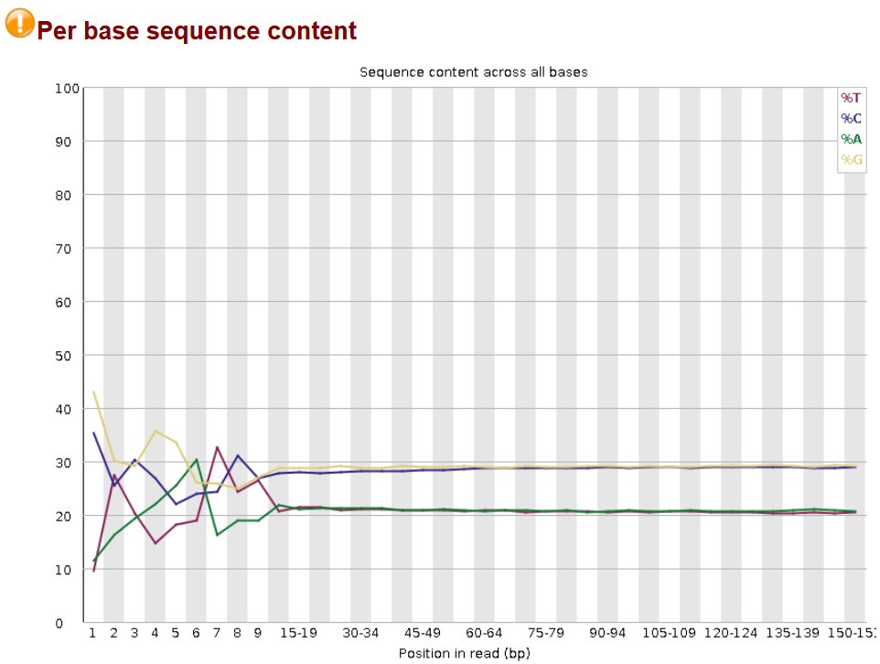

Slide 6
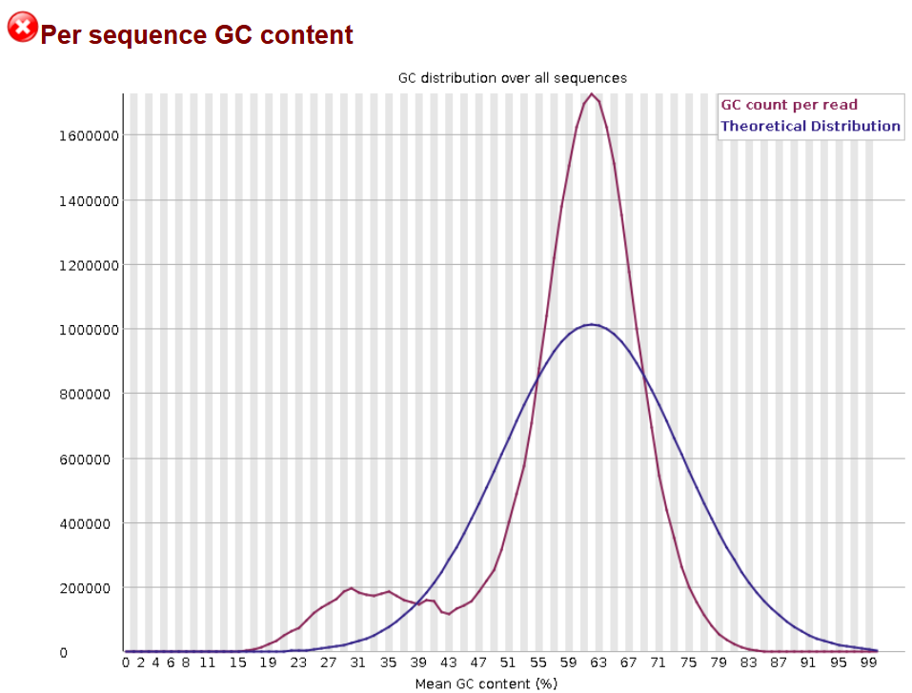

Slide 7
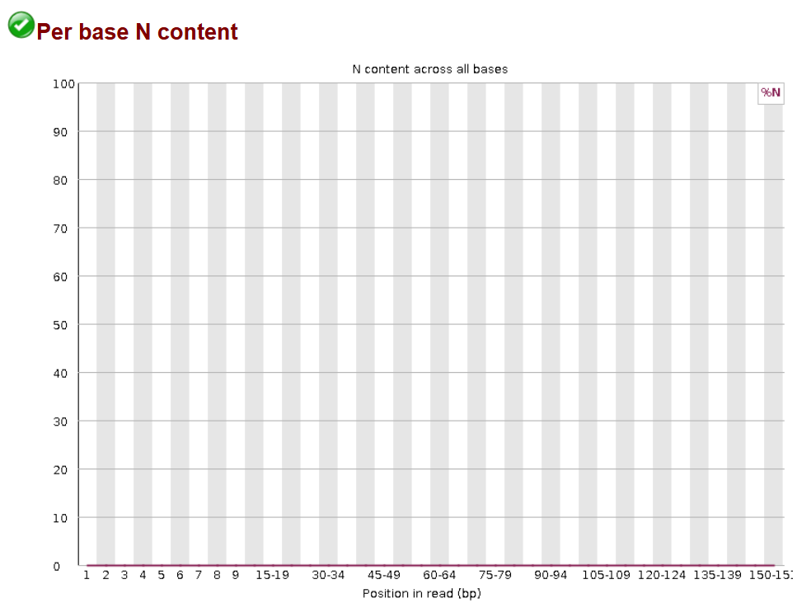

Slide 8
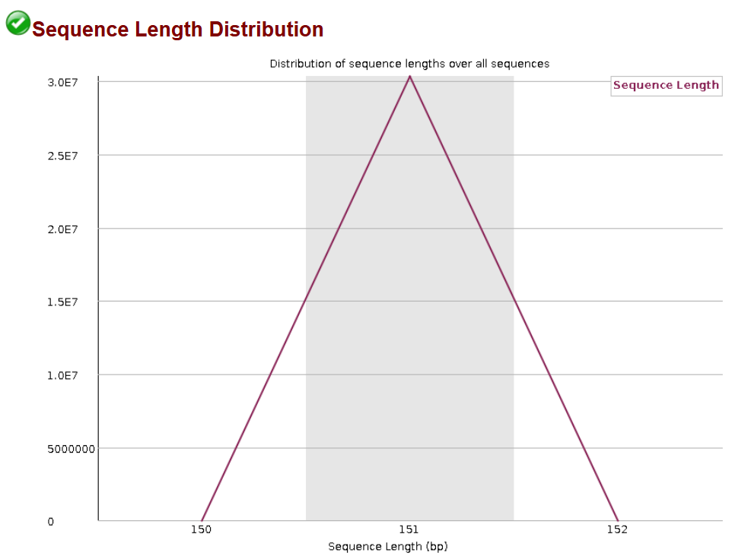

Slide 9
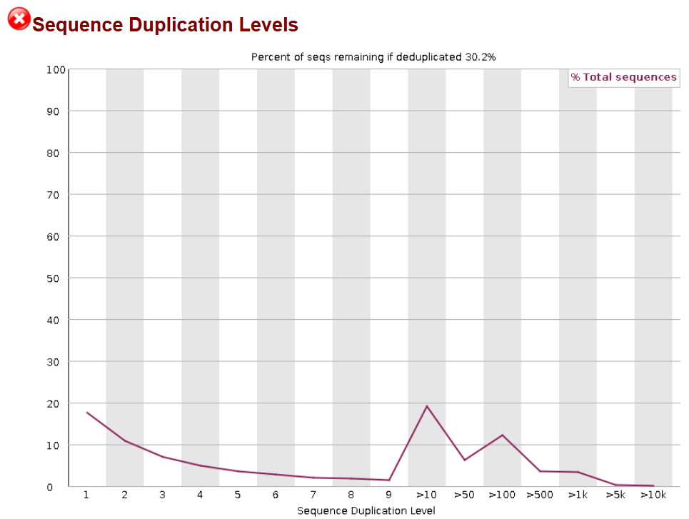

Slide 10


Slide 11
