Slide 1
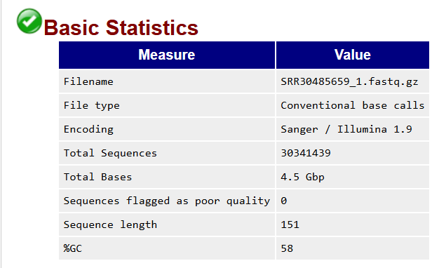
Analysis of data quality control results
Name of the original file which is analysed
Indicates if the file contains base calls and/or colorspace data ; if so, the latter must be converted into base calls
Indicates which ASCii encoding of quality values was found in the file
Total number of sequences / reads sequenced for each sample, each read is 151 bp long (see « Sequence length » row)
Total number of bases : cumulative sum of all bases (A, T, C, G and N) for each read in the whole file
Sequences identified as potentially poor quality
DNA / RNA length : each read is 151 bp long
%GC : we take all the sequences and we calculate the proportion of GC bases among all the bases (A, T, C, G, N), that is to say in the available space.

Slide 2
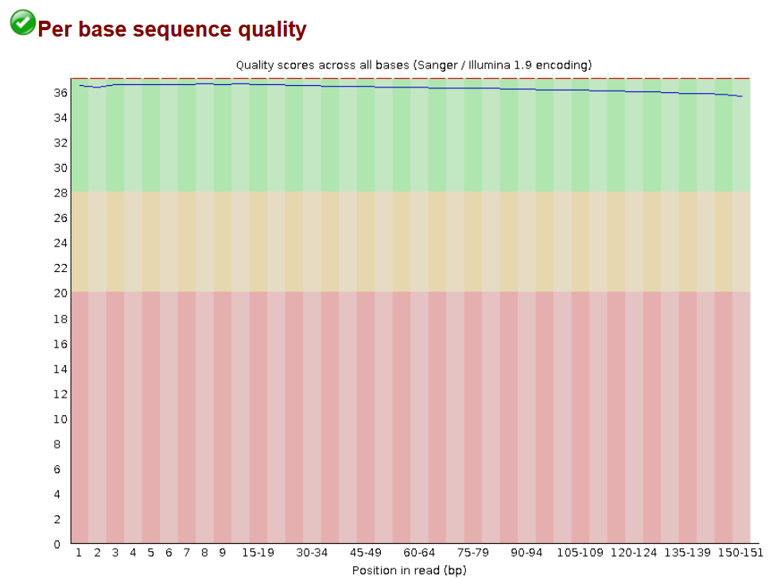
Analysis of data quality control results
Per base quality score according to their position in the reads.
Graph indicating the quality score on a Phred scale, according to the position of the base in the read.
Boxplot of the whole quality values of sequencing.
Y-axis (quality scores) : score base call.
: mean quality
: central red line : median value
: The quality value decreases as the read length increases.
: very good quality calls
: reasonable quality calls
: poor quality calls
=> Good quality calls
Quality scores

Slide 3
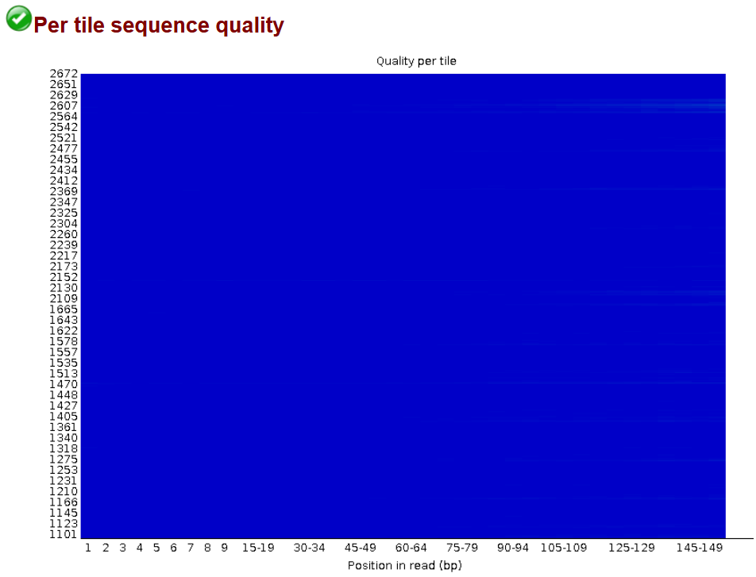
Analysis of data quality control results

Slide 4
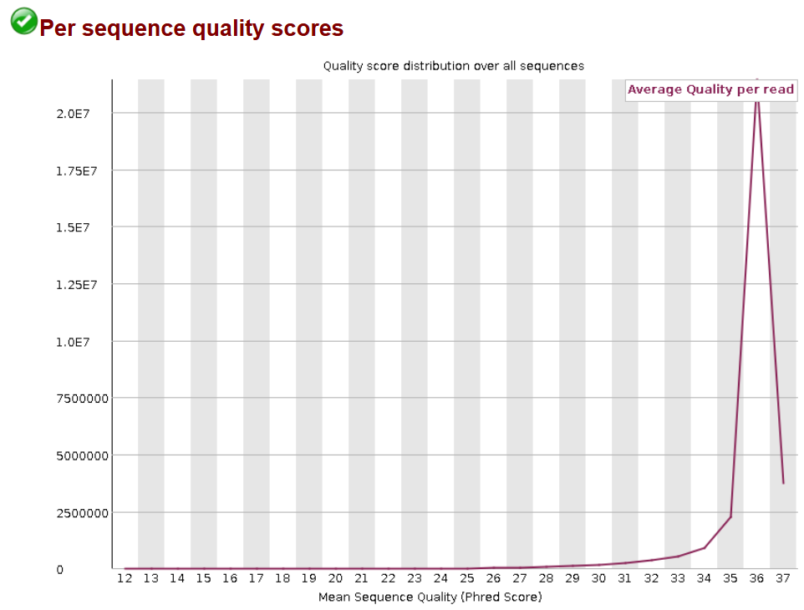
Analysis of data quality control results

Slide 5
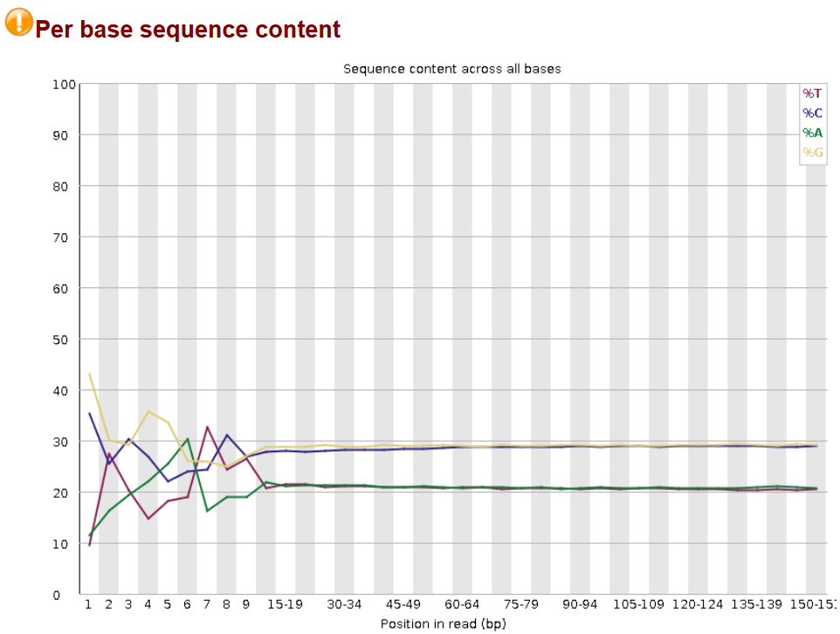
Analysis of data quality control results

Slide 6
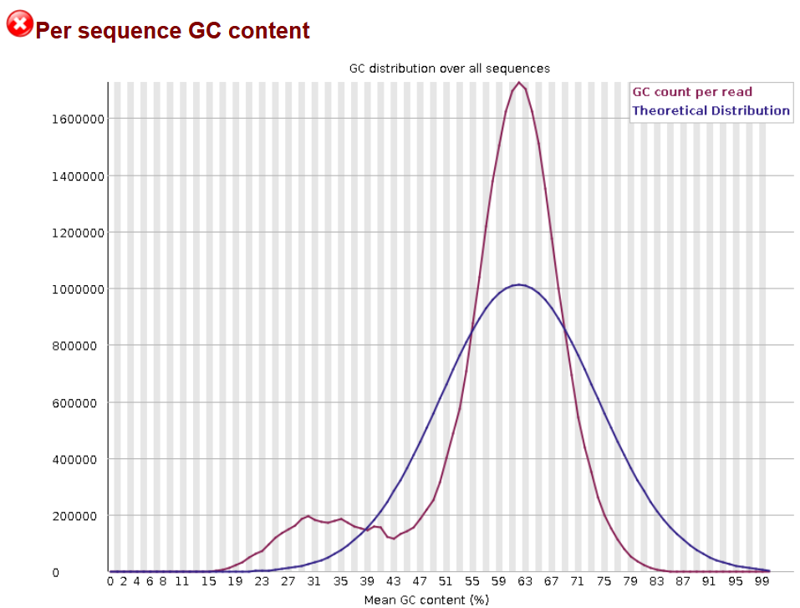
Analysis of data quality control results

Slide 7
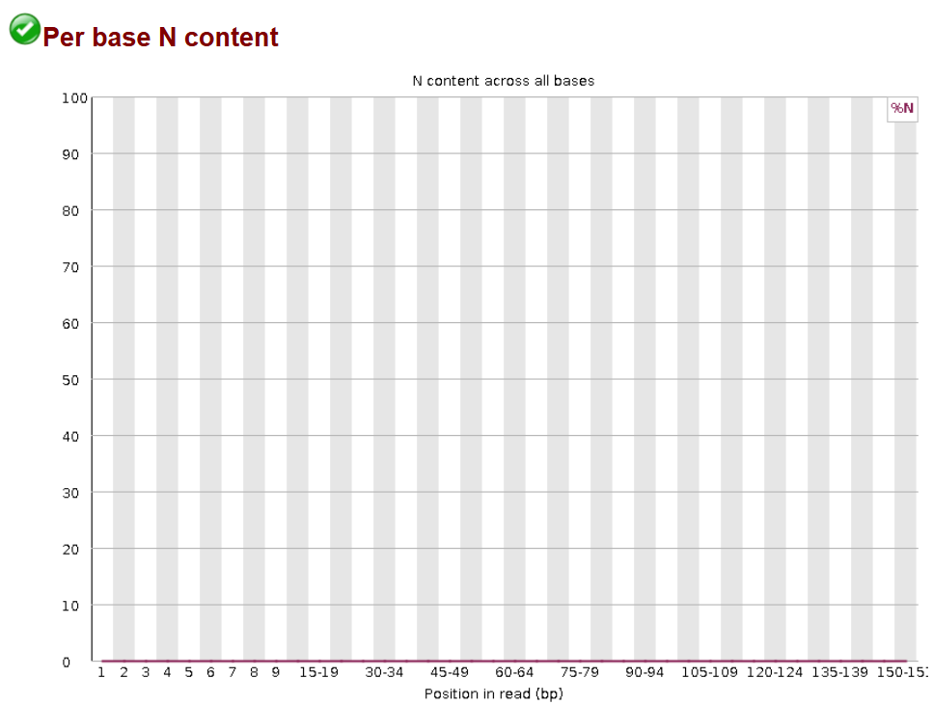
Analysis of data quality control results

Slide 8
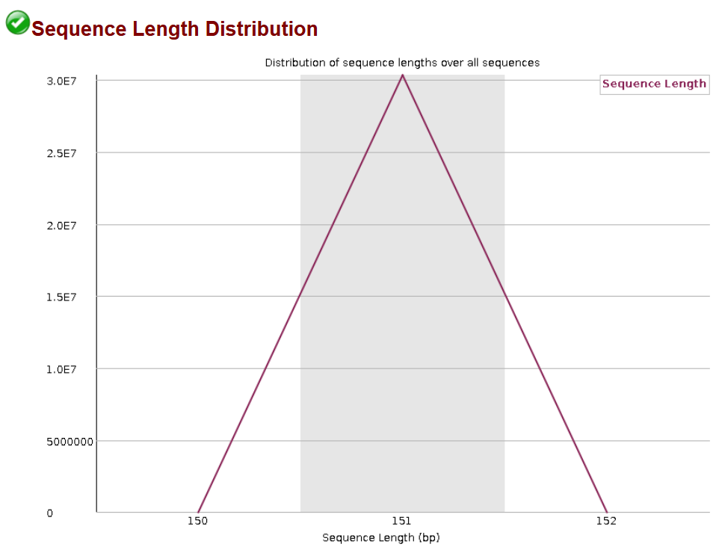
Analysis of data quality control results

Slide 9
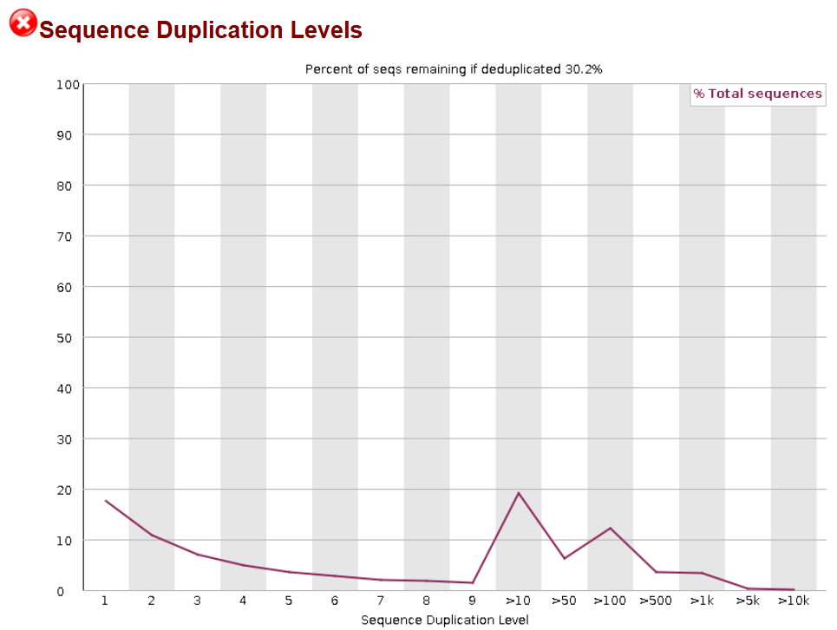
Analysis of data quality control results

Slide 10

Analysis of data quality control results

Slide 11
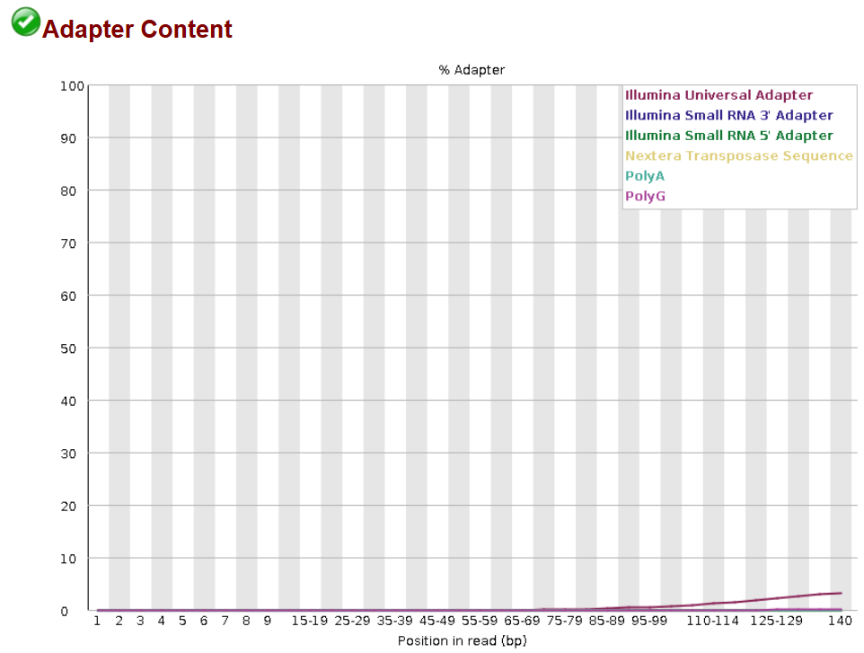
Analysis of data quality control results

