Slide 1
SpringData Turtoring

Slide 2
Before studying springdata, you should know the following technologies:
Spring and SpringMVC(with annotation)
Maven
Hibernate
JPA
SQL
Restful Web Service
Tomcat

Slide 3
Spring Data Overview
Spring Data’s mission is to provide a familiar and consistent, Spring-based programming model for data access while still retaining the special traits of the underlying data store.
It makes it easy to use data access technologies, relational and non-relational databases, map-reduce frameworks, and cloud-based data services.

Slide 4
Spring Data Overview
Community modules non-relational database：
MongoDB: object-document support and repositories for MongoDB
Neo4j: object-graph support and repositories for Neo4j
Redis: in-memory data structure store, used as a database, cache and message broker
Hbase: Leading Open Source In-Memory Data Grid: Distributed Computing
Community modules relational database ：
JDBC: JDBC-based repositories(Oracle, MySQL)
JPA: Makes it easy to implement JPA-based repositories

Slide 5
JPA Spring Data Overview
This module deals with enhanced support for JPA based data access layers
Spring Data JPA aims to significantly improve the implementation of data access layers(DAO layer) by reducing the effort to the amount that’s actually needed. As a developer you write your repository interfaces, including custom finder methods, and Spring will provide the implementation automatically.

Slide 6
SpringData JPA Environment

Slide 7
My development Environment
Spring + configuration ：
Spring + annotation
My environment :
SpringBoot: Quickly build and create Spring applications using the Spring Framework.
Oracle VirtualBox: A cross-platform virtualization software(VMWare)
Operation System: Linux
Docker: A container platform
SSH Client: SmarTTY
DataBase: Mysql
Client: SQLyog
IDE: IntelliJ IDEA
Notes:
https://www.petrikainulainen.net/programming/spring-framework/spring-data-jpa-tutorial-part-one-configuration/
It helps us to run multiple operating systems in our existing computer at the same time. For Example, we can run Linux on our Windows system or run Windows & Linux on our Mac system.
SmarTTY is a free multi-tabbed SSH client that supports copying files and directories with SCP on-the-fly and editing files in-place.
SQLyog is a GUI tool for the relation database management system MySQL

Slide 8
Repository Interface
Notes:
The goal of the Spring Data repository abstraction is to significantly reduce the amount of boilerplate code required to implement data access layers for various persistence stores.

Slide 9
Repository Overview
It takes the domain class to manage as well as the ID type of the domain class as type arguments. This interface acts primarily as a marker interface to capture the types to work with and to help you to discover interfaces that extend this one.
public interface Repository<T, ID extends Serializable> { }
You simply declare an interface that inherit the repository, you don’t need to write any implements of the interface.
you can also annotate your repository interface with @RepositoryDefinition

Slide 10
Repository Inheritance Relationships
Repository： It is a marker interface, any interface extends of Repository that is a Repository interface.
CrudRepository： The CrudRepository provides sophisticated CRUD functionality for the entity class that is being managed.
PagingAndSortingRepository： Implement and provide page-sorting related methods.
JpaRepository： Implement and provide JPA related methods.
Customized Repository :
JpaSpecificationExecutor： Provide an API to define such specifications with the JPA criteria API

Slide 11
Using named queries

Slide 12
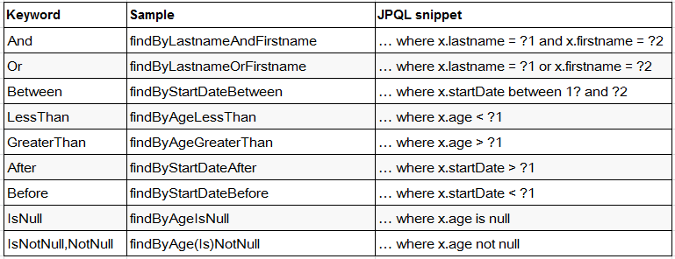
Supported keywords inside method names
The following table describes the keywords supported for JPA and what a method containing that keyword translates to:

Slide 13
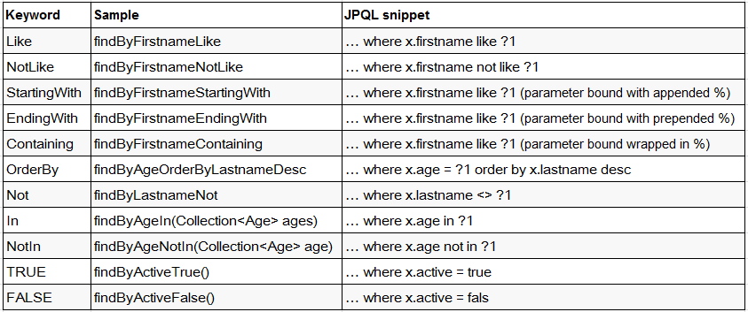
Supported keywords inside method names
Define the query method directly in the interface, and if it is a valid normalized name, you don't have to write the implementation method

Slide 14
Using @Query

Slide 15
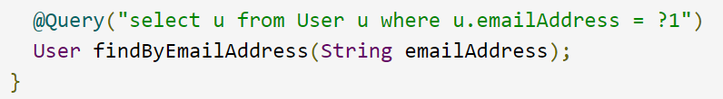
Using@Query
The following example shows a query created with the @Query annotation:
Declare query at the query method using @Query
Notes:
Using named queries to declare queries for entities is a valid approach and works fine for a small number of queries. As the queries themselves are tied to the Java method that executes them, you can actually bind them directly by using the Spring Data JPA @Query annotation rather than annotating them to the domain class. This frees the domain class from persistence specific information and co-locates the query to the repository interface.

Slide 16
Using Named Parameters
By default, Spring Data JPA uses position-based parameter binding.
You can use @Param annotation to give a method parameter a concrete name and bind the name in the query
Notes:
This makes query methods a little error-prone when refactoring regarding the parameter position.

Slide 17
Using Advanced LIKE Expressions
LIKE delimiter character (%) is recognized, and the query is transformed into a valid JPQL query (removing the %). Upon query execution, the parameter passed to the method call gets augmented with the previously recognized LIKE pattern.
@Query("select u from User u where u.firstname like ?1%")
public List<User> findByUuidOrAge(String name);
@Query("select u from User u where u.firstname like %?1")
public List<User> findByUuidOrAge(String firstname);
@Query("select u from User u where u.name like %?1%")
public List<User> findByUuidOrAge(String fristname);

Slide 18
Using Native Queries
The @Query annotation allows for running native queries by setting the nativeQuery flag to true

Slide 19
Modifying Queries
Notes:
All the previous sections describe how to declare queries to access a given entity or collection of entities. You can add custom modifying behavior

Slide 20
@Query and @Modifying execute update operation
Define the operations of update or delete by using @Query and @Modifying annotation
Notice：
The return value of the method should be int, indicating the number of rows affected by the update statement
Transactions must be added where the call is made(service layer), and no transactions can not be executed properly

Slide 21
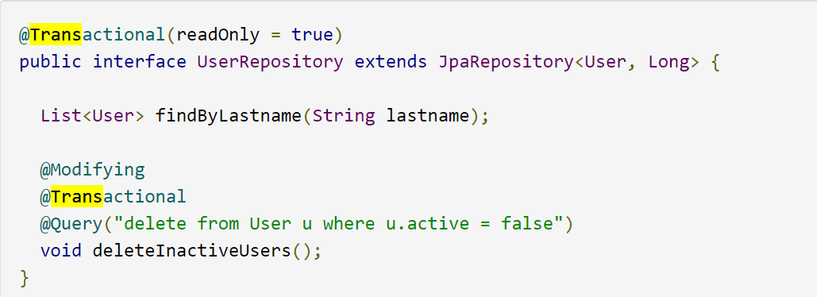
Transaction
For read operations, the transaction configuration readOnly flag is set to true.
Typically, you want the readOnly flag to be set to true, as most of the query methods only read data. In contrast to that, deleteInactiveUsers() makes use of the @Modifying annotation and overrides the transaction configuration. Thus, the method runs with the readOnly flag set to false.

Slide 22
CrudRepository Interface

Slide 23
CrudRepository
CrudRepository interface mainly provides CRUD functions.
T save(T entity); //Saves a given entity.
T saveAll(Iterable<S> entities);//Saves all given entities.
T findOne(ID id);//Retrieves an entity by its id
boolean exists(ID id);//Returns whether an entity with the given id exists
Iterable<T> findAll();//Returns all instances of the type.
long count();//Returns the number of entities available.
void delete(ID id);//Deletes the entity with the given id.
void delete(T entity);//Deletes a given entity.
void delete(Iterable<? extends T> entities);//Deletes the given entities.
void deleteAll();//Deletes all entities managed by the repository.

Slide 24
PagingAndSortingRepository Interface
Notes:
provides methods to do pagination and sorting records.

Slide 25
PagingAndSortingRepository
providing methods to do pagination and sorting records.
Iterable<T> findAll(Sort sort); //Returns all entities sorted the given options.
Page<T> findAll(Pageable pageable); //Returns a Page of entities meeting the paging restriction provided in the Pageable object.

Slide 26
JpaRepository Interface

Slide 27
JpaRepository
providing some JPA-related methods such as flushing the persistence context and deleting records in a batch.
List<T> findAll(); //Find all entities
List<T> findAll(Sort sort); //Sort and find all entities
List<T> save(Iterable<? extends T> entities);//Save all entities
void flush();//Flushes all pending changes to the database.
T saveAndFlush(T entity);//Saves an entity and flushes changes instantly.
void deleteInBatch(Iterable<T> entities);//Delete the given entities in a batch which means it will create a single Query.

Slide 28
JpaSpecificationExecutor Interface

Slide 29
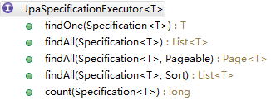
JpaSpecificationExecutor
Interface to allow execution of Specifections based on the JPA criteria API.
Specification： Encapsulating JPA Criteria query conditions. Objects for this interface are usually created using an internal anonymous class.

Slide 30
PagingAndSortingRepository And JpaSpecificationExecutor
JpaSpecificationExecutor implement paging query with query conditions.
PagingAndSortingRepository only performs unconditional paging and sorting.

