Slide 1
SMU
3 March 2024
FRITO LAY
EXPLORATORY ANALYSIS
By: Chloe Barker

Slide 2
GOALS
What are the factors most related to employee attrition (employee turnover)?
How well can we predict employee attrition?
What affect can predicting employee attrition have on costs?

Slide 3
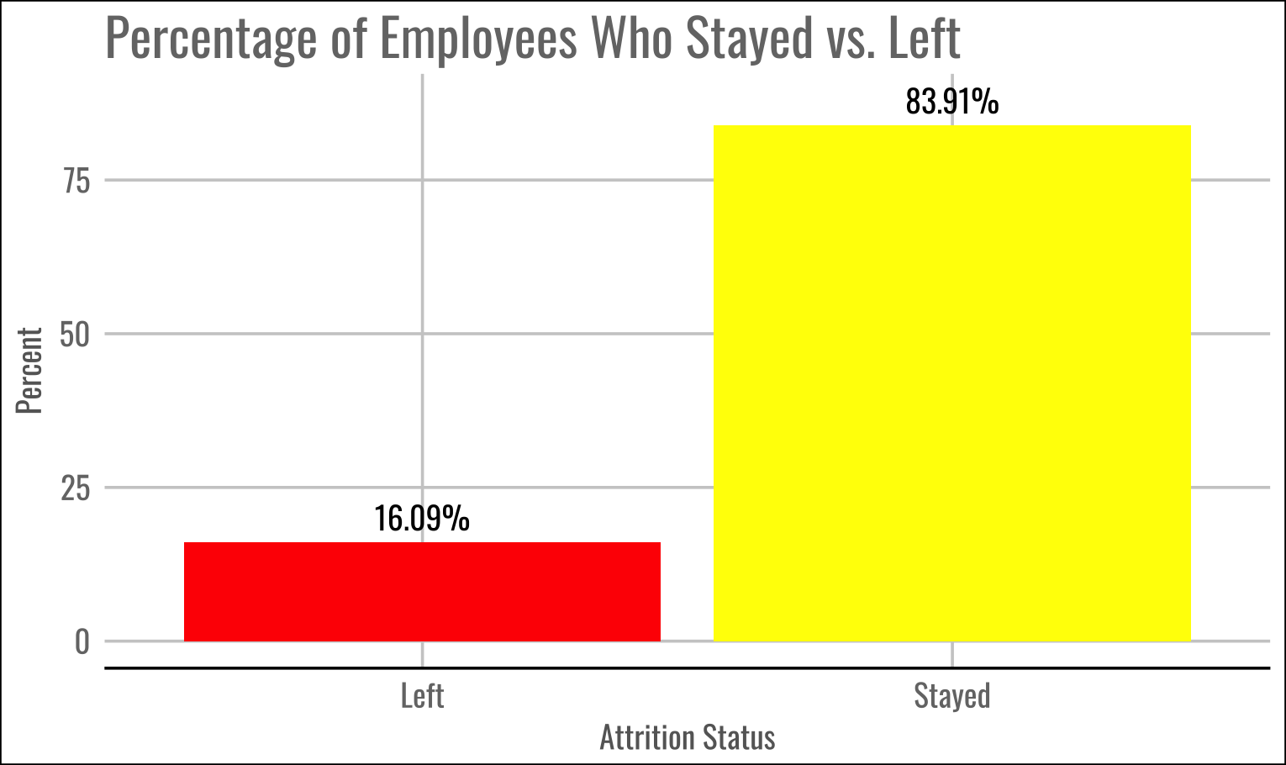
ATTRITION
SUMMARY
Retention (Stayed) | Attrition (Left)
730 Employees | 140 Employees

Slide 4
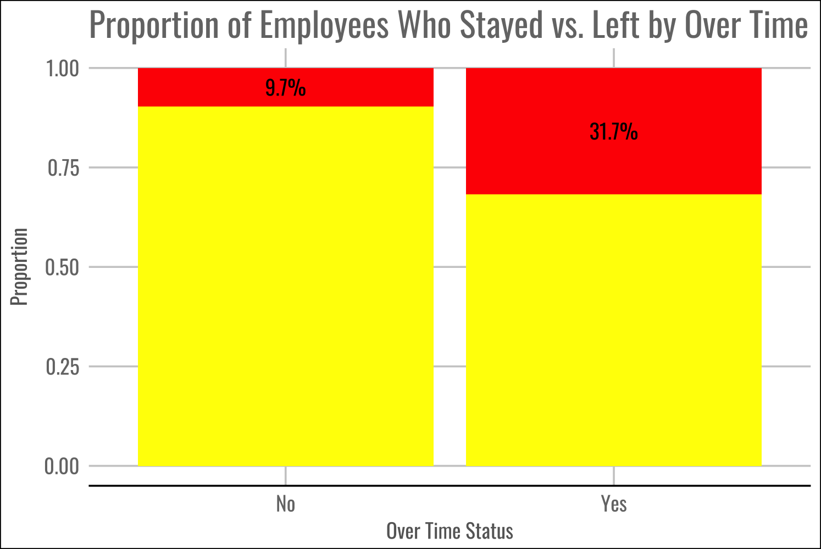
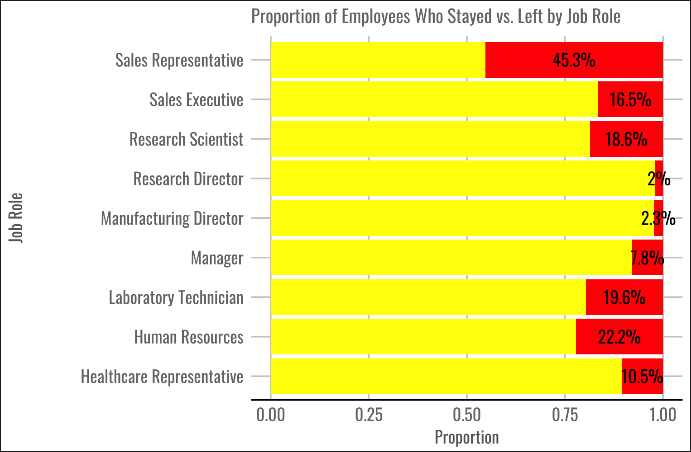
INTERESTING FACTORS

Slide 5
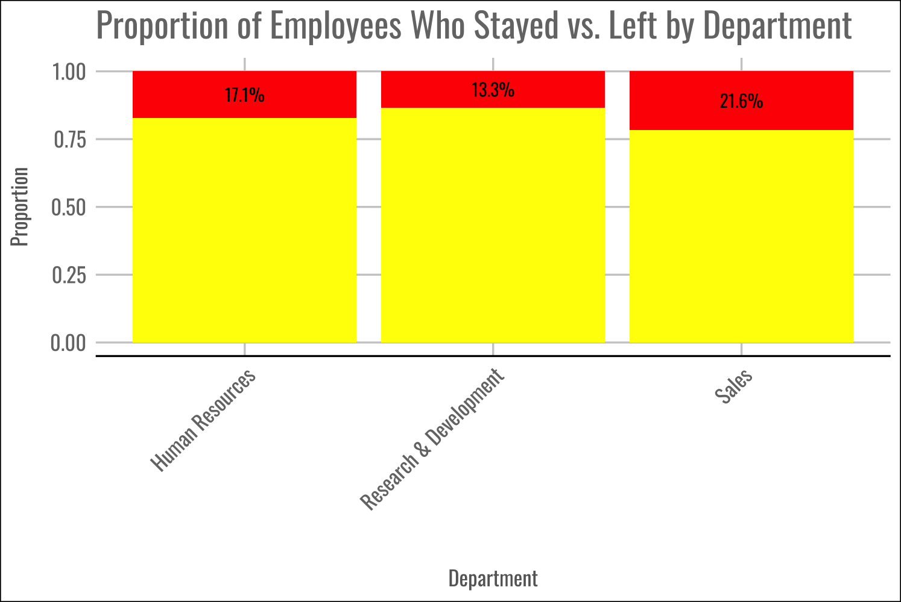
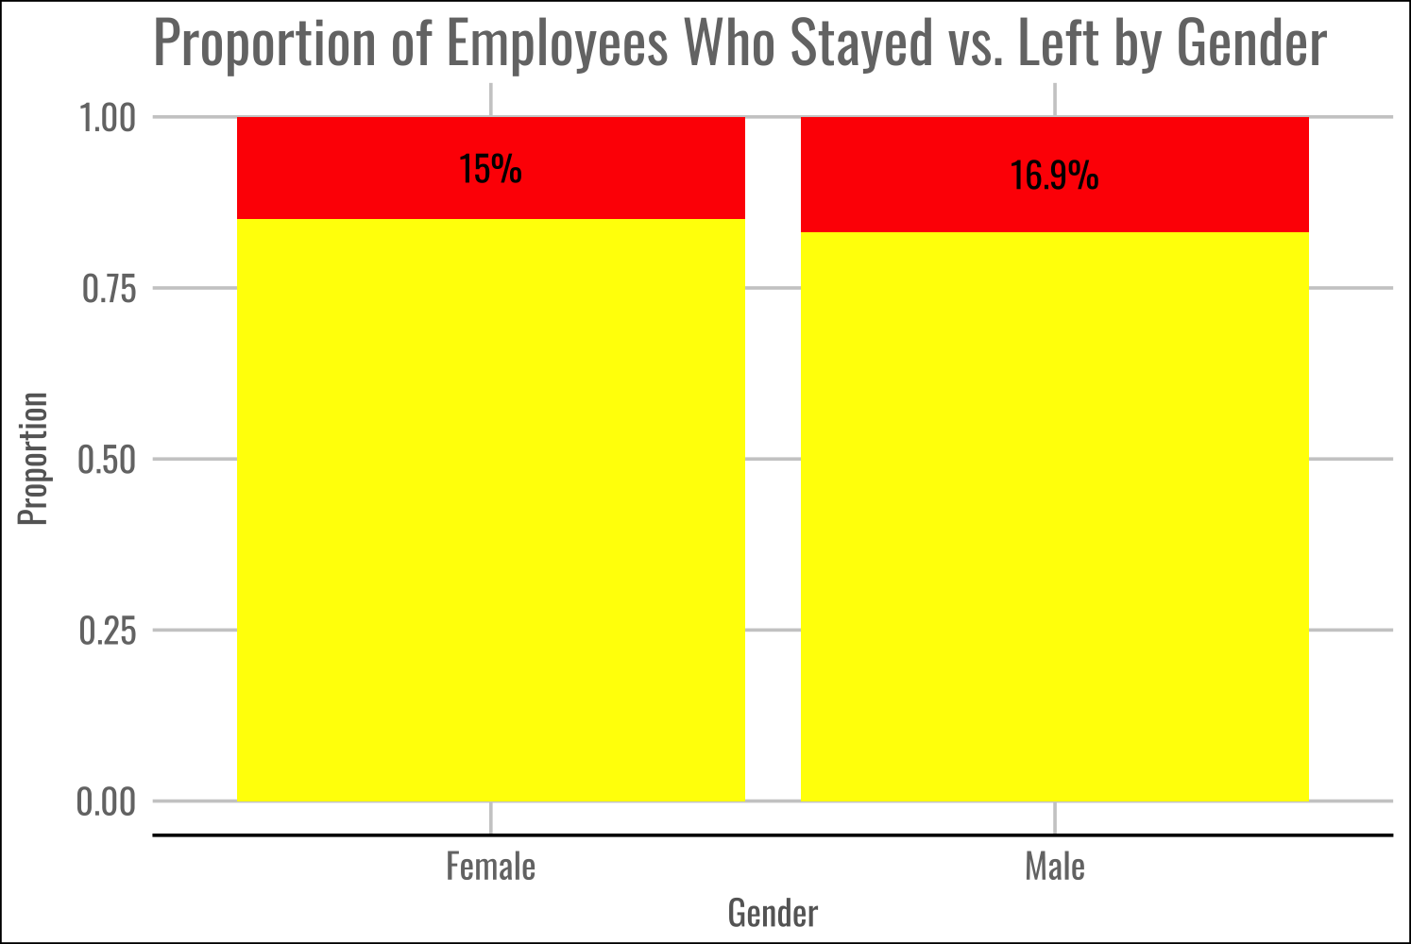
LESS INTERESTING FACTORS

Slide 6
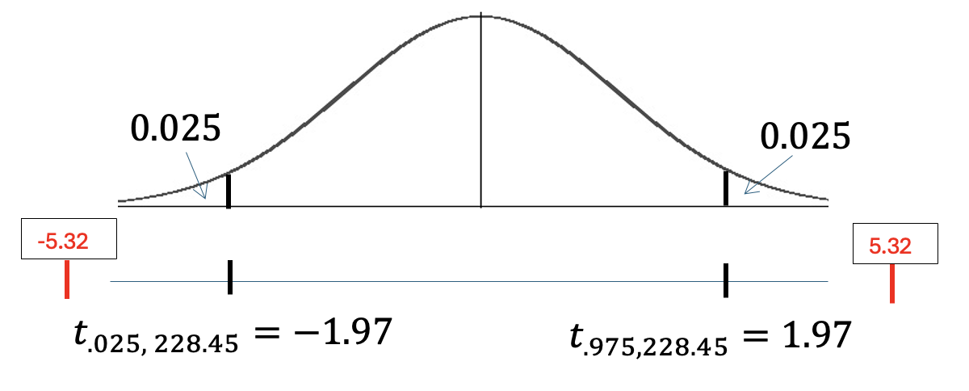
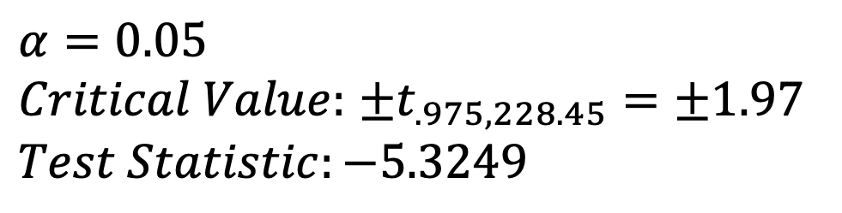
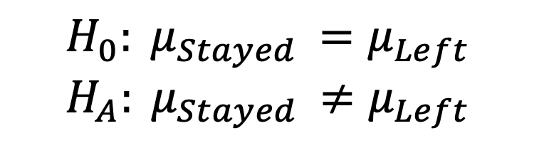
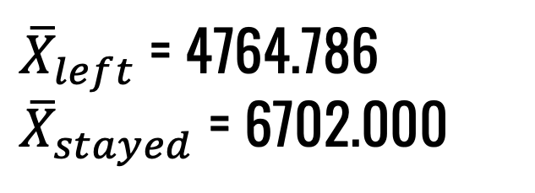
FURTHER ANALYSIS ON NUMERIC VARIABLES
Goal: Test the claim that the mean Monthly Income for the ”Stayed” attrition group is different than that of the “Left” attrition group.
Impact: If this is true then we can consider Monthly Income as a viable variable of interest for the factors with the greatest impact on whether an employee will stay or leave.
Data: We will use the 870 employees from the Frito Lay case study.
$$α=0.05$$
$Critical Value:$ ±$t_{.975,228.45}=\text{±}1.97$
$$Test Statistic:−5.3249$$
$$H_{0}: μ_{Stayed }=μ_{Left }$$
$$H_{A}: μ_{Stayed }≠μ_{Left }$$
${\overline{X}}_{left}$ = 4764.786
${\overline{X}}_{stayed}$ = 6702.000
P-value = 2.412e-07 < .05
Reject Ho

Slide 7
FURTHER ANALYSIS ON NUMERIC VARIABLES
Conclusion: There is strong evidence to suggest that the mean Monthly Income for the ”Stayed” attrition group is greater than that of the “Left” attrition group (p-value < .05 from t-test). We are 95% confident that the mean Monthly Income for the ”Left” attrition group is 1,220.382 to 2,654.047 dollars less than that of the “Stayed” group.

Slide 8
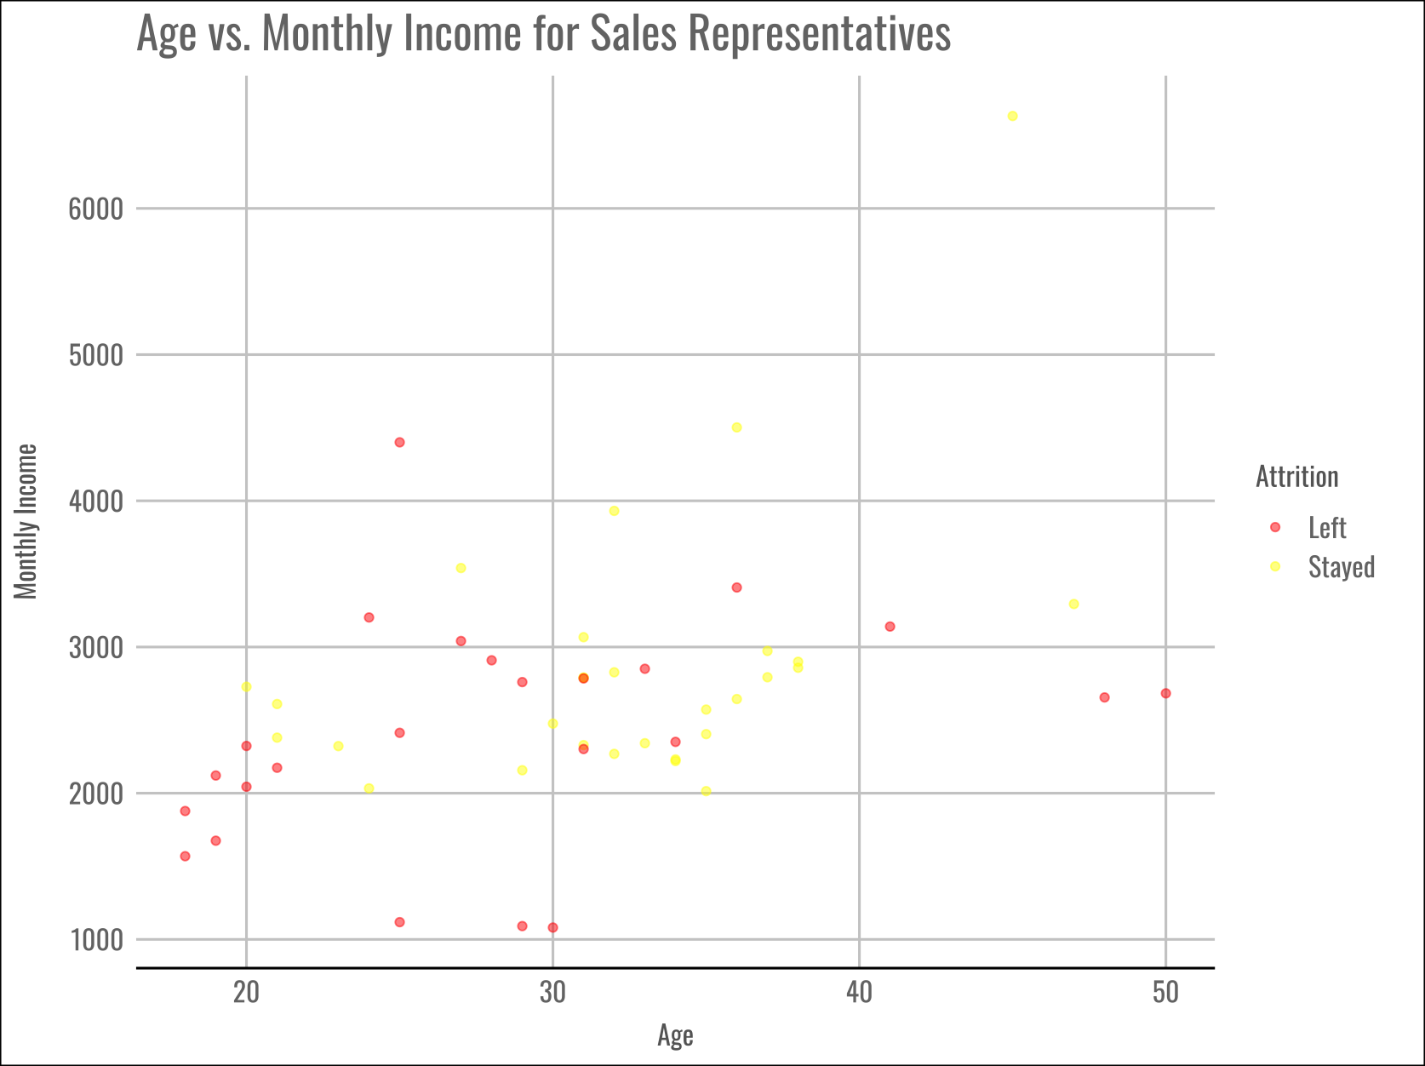

Slide 9
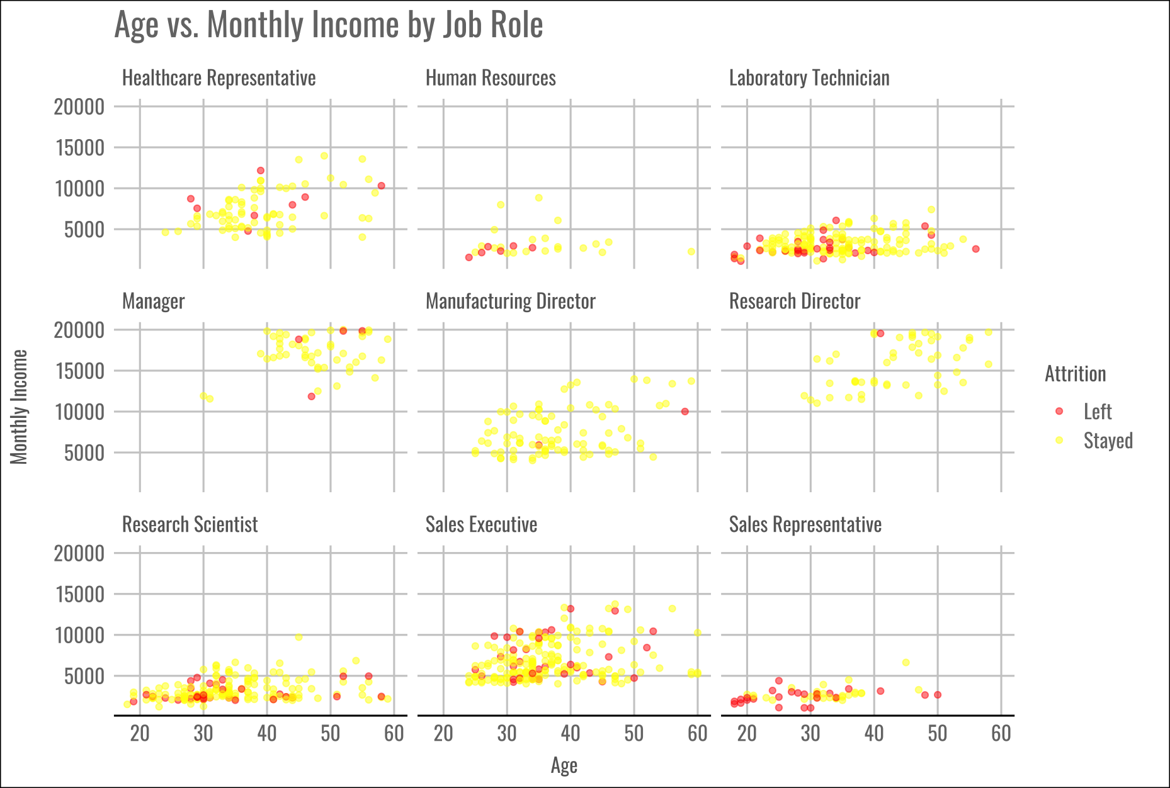

Slide 10
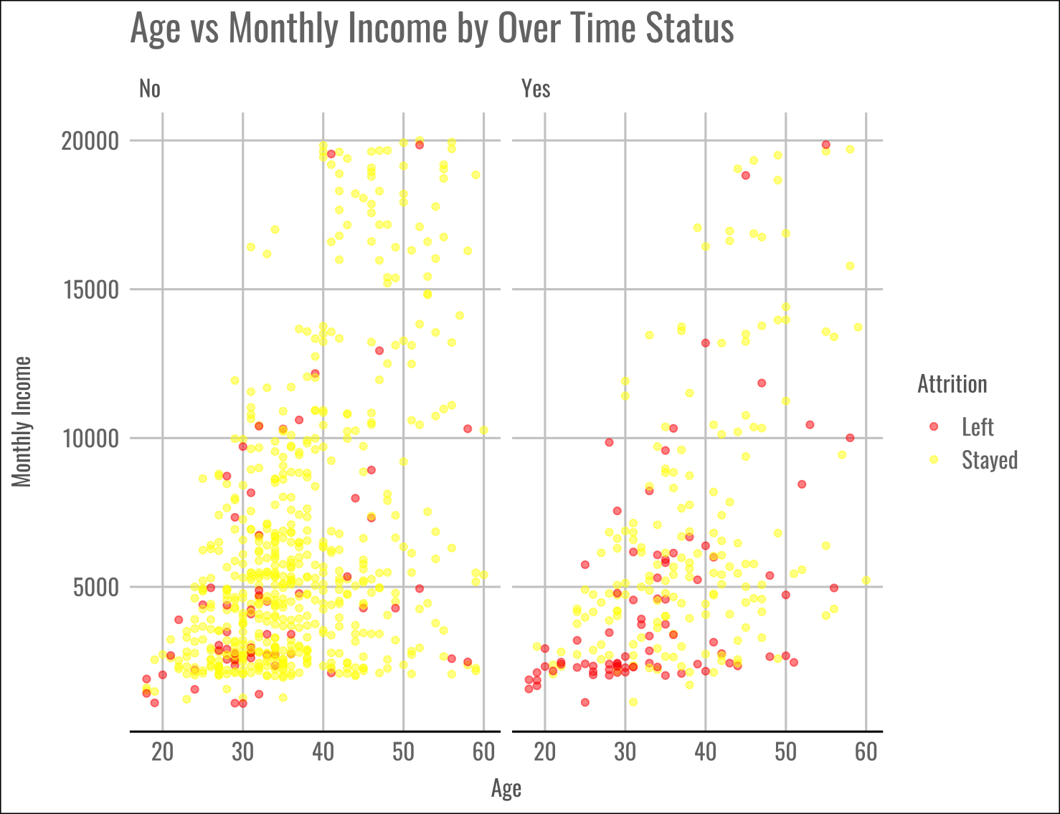

Slide 11
TOP THREE FACTORS
TO PREDICT ATTRITION
AGE
JOB ROLE
OVER TIME

Slide 12
NAÏVE BAYES MODEL
ACCURACY = 64.60%
Out of the employees who actually left and those who actually stayed, our model flagged 63.56% correctly.
(overall proportion of correct predictions)
Threshold for optimal Costs = 0.12
Predictors: Age, Over Time, and Job Role
SENSITIVITY = 77.86%
Out of the employees who actually left, 74.29% were correctly identified as leaving by the model.
 | Actually Left | Actually Stayed
Predicted to Leave | 109 | 277
Predicted to Stay | 31 | 453
SPECIFICITY = 62.05%
Out of the employees who actually stayed, 61.51% were correctly identified as staying by the model.
Threshold | Sensitivity | Specificity | Accuracy
0.12 | 77.86% | 62.05% | 64.6%

Slide 13
COSTS
WHAT WE KNOW:
Incentives to stay are predicted to be around $200 per employee
Predicted costs to be between 50% and 400% of the employee’s salary to recruit a replacement for someone who has left the company
Average Employee Yearly Salary = $76,683.17
Cost Per Incentive for employees predicted to leave = $200
Total cost of incentives for employees who are predicted to leave:
$77, 200
Greater costs for employees predicted to stay but actually left:
For 50% of salary costs: $1,188,589
For 400% of salary costs: $9,508,713
Overall Predicted Costs:
$1,265,789 to $9,585,913
Threshold for optimal costs = 0.12
Threshold | Lower Cost Range | Upper Cost Range | Sensitivity | Specificity | Accuracy
0.15 | $1,748,030 | $13,557,238 | 71.37% | 68.57% | 70.92%
0.12 | $1,265,789 | $9,585,913 | 77.86% | 62.05% | 64.6%

Slide 14
ACCURACY = 72.76%
Out of the employees who actually left and those who actually stayed, our model flagged 72.76% correctly. ( The overall proportion of correct predictions)
KNN MODEL
SENSITIVITY = 94.29%
Out of the employees who actually left, 94.29% were correctly identified as leaving by the model.
Threshold for optimal Costs = 0.15
k-value = 3
Predictors: Age, Over Time, and and Job Role
SPECIFICITY = 68.63%
Out of the employees who actually stayed, 68.63% were correctly identified as staying by the model.
k | Threshold | Sensitivity | Specificity | Accuracy | Lower Cost Range | Upper Cost Range
1 | 0.15 | 97.14% | 78.49% | 81.49% | $211,966.30 | $1,285,531.00
3 | 0.15 | 94.29% | 68.63% | 72.76% | $378,932.70 | $2,526,062.00
5 | 0.15 | 90.00% | 65.62% | 69.54% | $612,182.20 | $4,369,658.00
Predicted Costs:
$378,932.70 to $2,526,062

Slide 15
ADDITIONAL FACTORS
TO CONSIDER
JOB LEVEL
MONTHLY INCOME
YEARS IN CURRENT ROLE

Slide 16
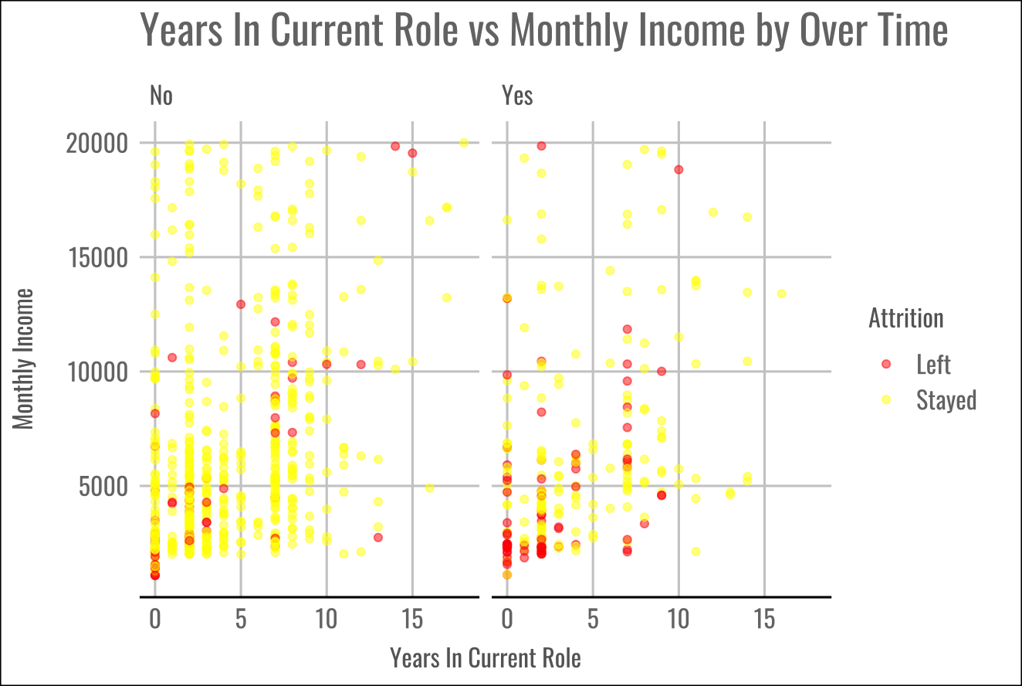

Slide 17
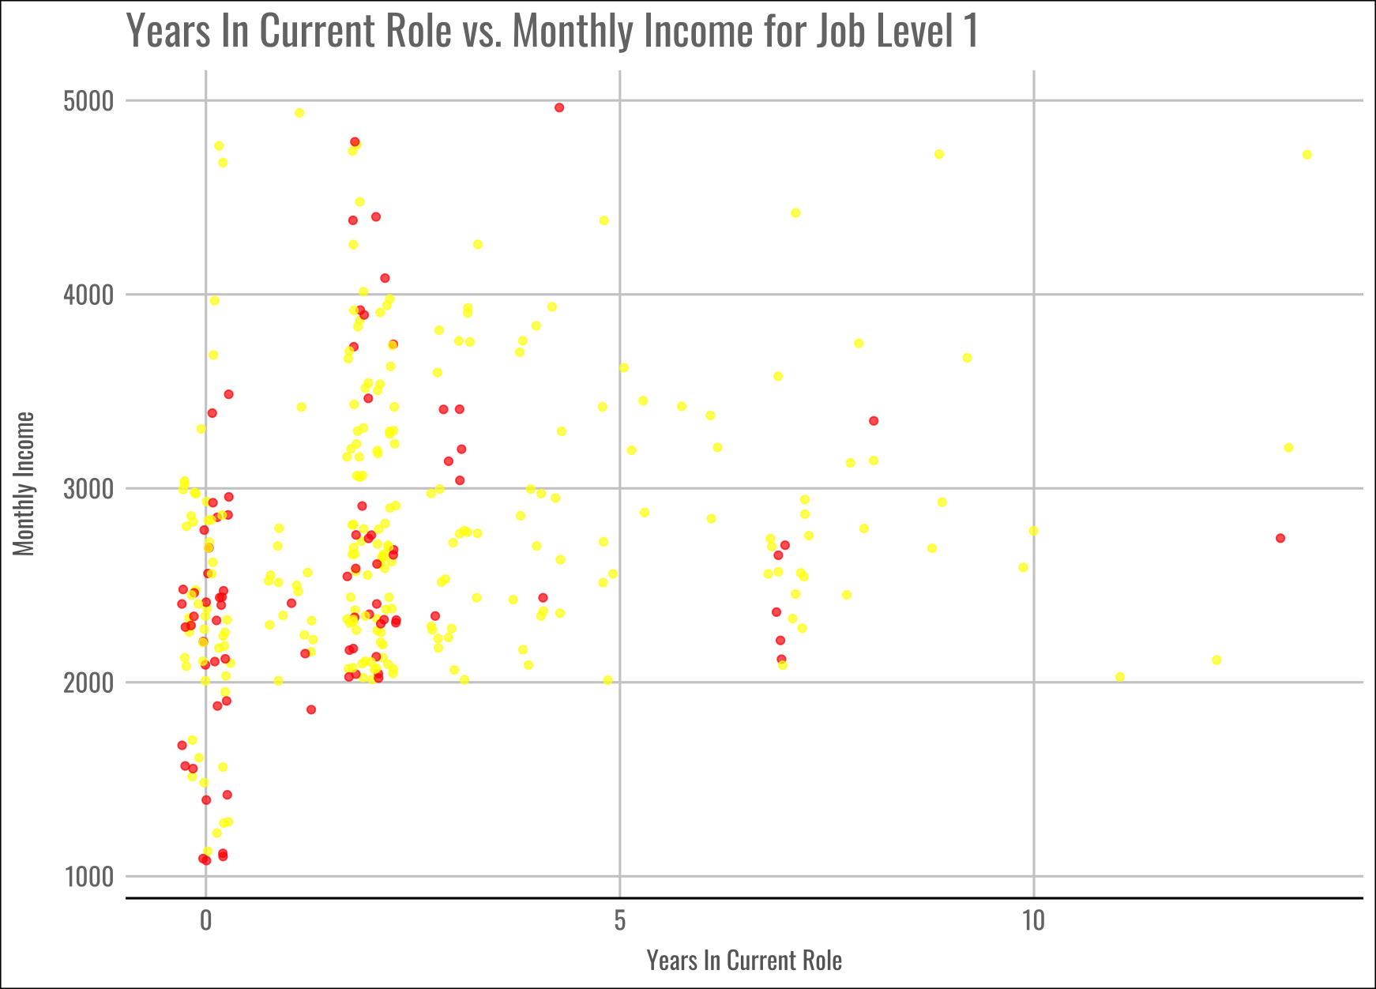

Slide 18
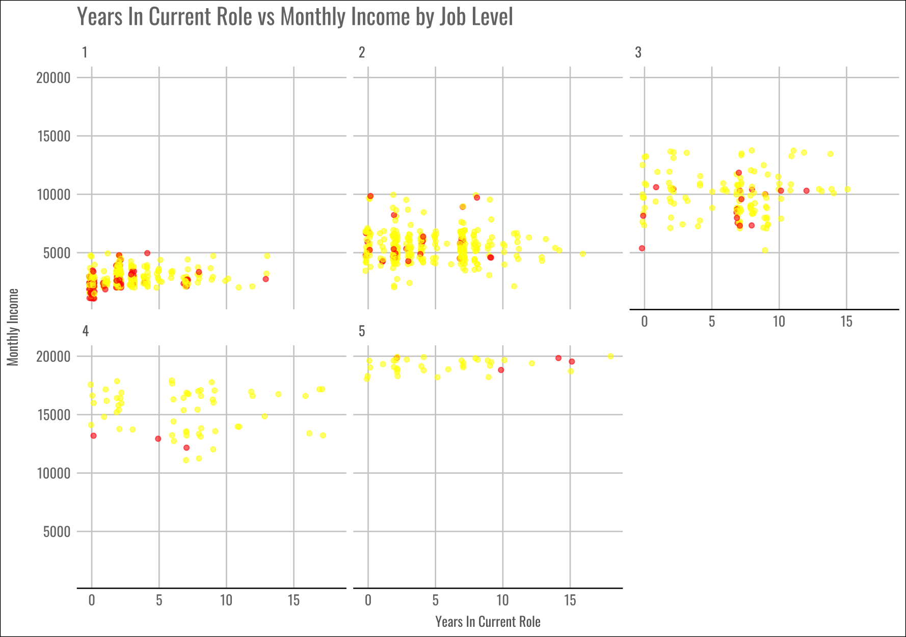

Slide 19
SMU
9 March 2024
THANK YOU
We’re excited to revolutionize Frito Lay with you! Questions?

