Slide 1


Slide 2
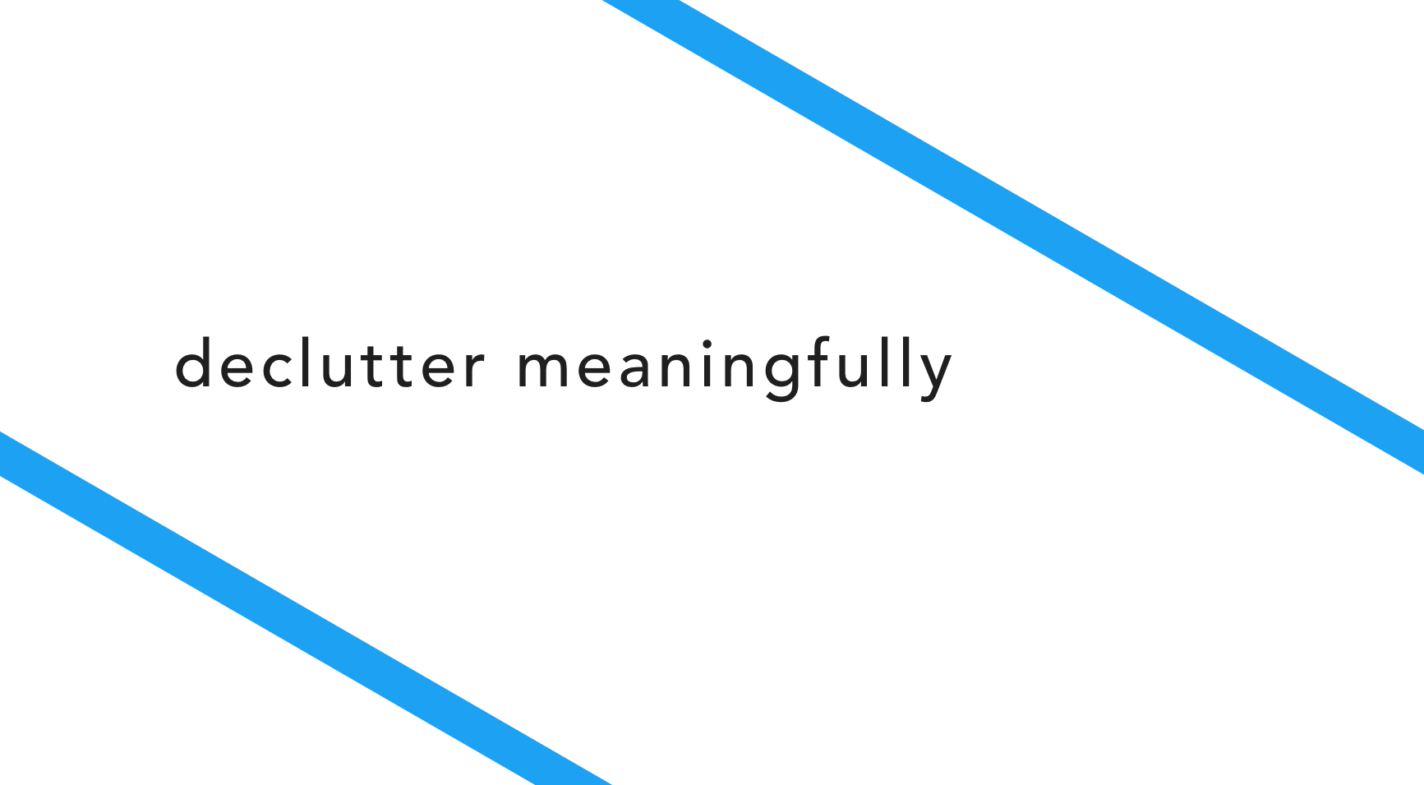

Slide 3

When giving away a sentimental item, you can’t help feeling guilty: Will you need it two weeks down the line? What about all the memories?
Flutter makes parting with objects feel like a celebration, giving you the opportunity to crowdsource new use cases and make donations social.

Slide 4
SIMPLE | Find an object you need
MEDIUM | Find a way to pass on/take care of a sentimental object
COMPLEX | Create and share new experiences where the acquired object is valued.

Slide 5
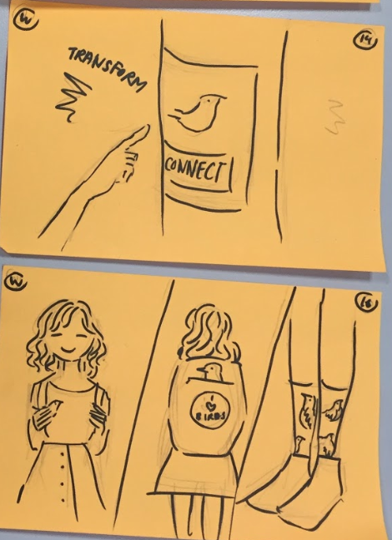
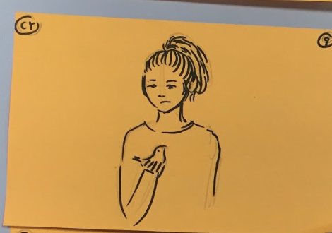
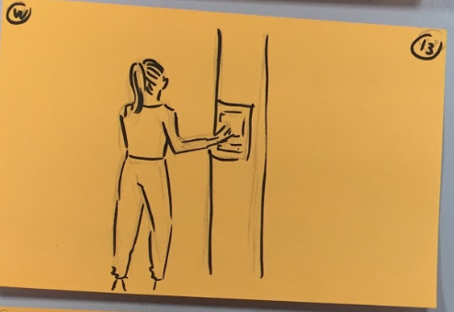
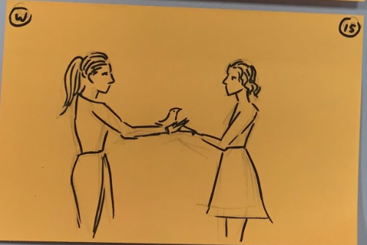
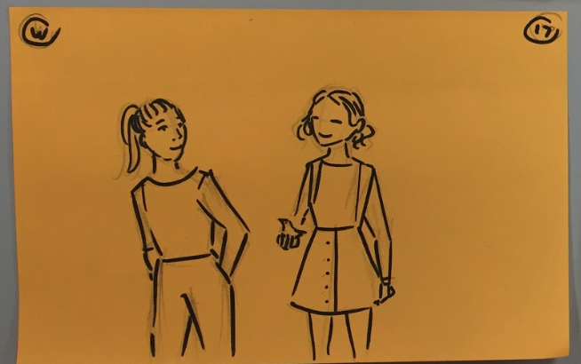
SIMPLE
MEDIUM
COMPLEX

Slide 6
https://youtu.be/6vTzRwOeLyg

