Slide 1
Low-fi Prototyping &
Pilot Usability Testing
Chloe B., Cynthia L., Amy X., Jenny Z.
Notes:
Overview of talk (1 slide) – don’t read this,
​
tell it like a story
●
Team mission statement/Value proposition (1 slide)
●
Selected Interface & Rationale (1 slide)
●
Low-fi prototype structure (1 slide – mainly images)
●
3 tasks & task flows shown carrying out each task w/ low-fi (1 slide per task)
●
Experimental method (1 slide)
●
Experimental results (1-3 slides) (w/ images to describe)
●
Suggested UI changes (1-2 slides)
●
Summary of talk (1 slide)

Slide 2

Mission
Selected interface
Low-fi prototypes
3 task flows
User Testing
Method
Results
Changes
Summary

Slide 3
1.
Mission

Slide 4
Flutter adds emotional security to the decluttering process, allowing people to find others who will value or add meaning to the item.

Slide 5
2.
Selected Interface

Slide 6
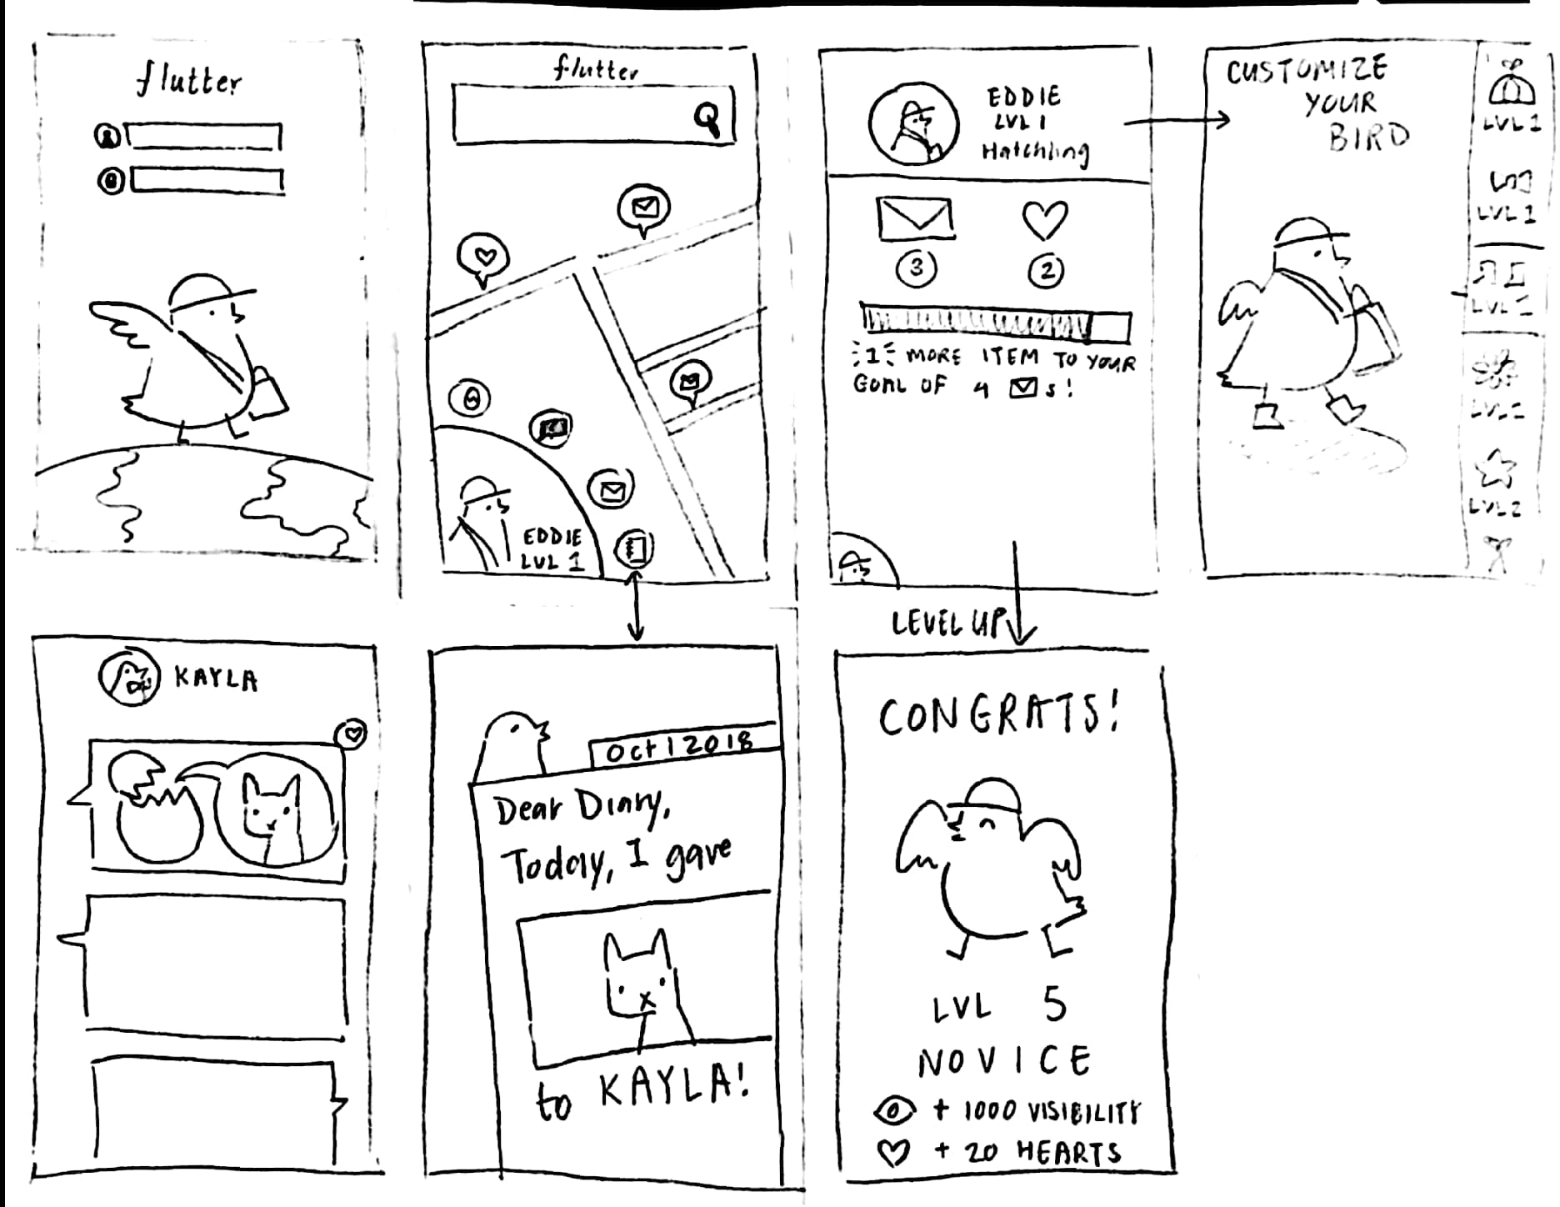
Gamify

Slide 7
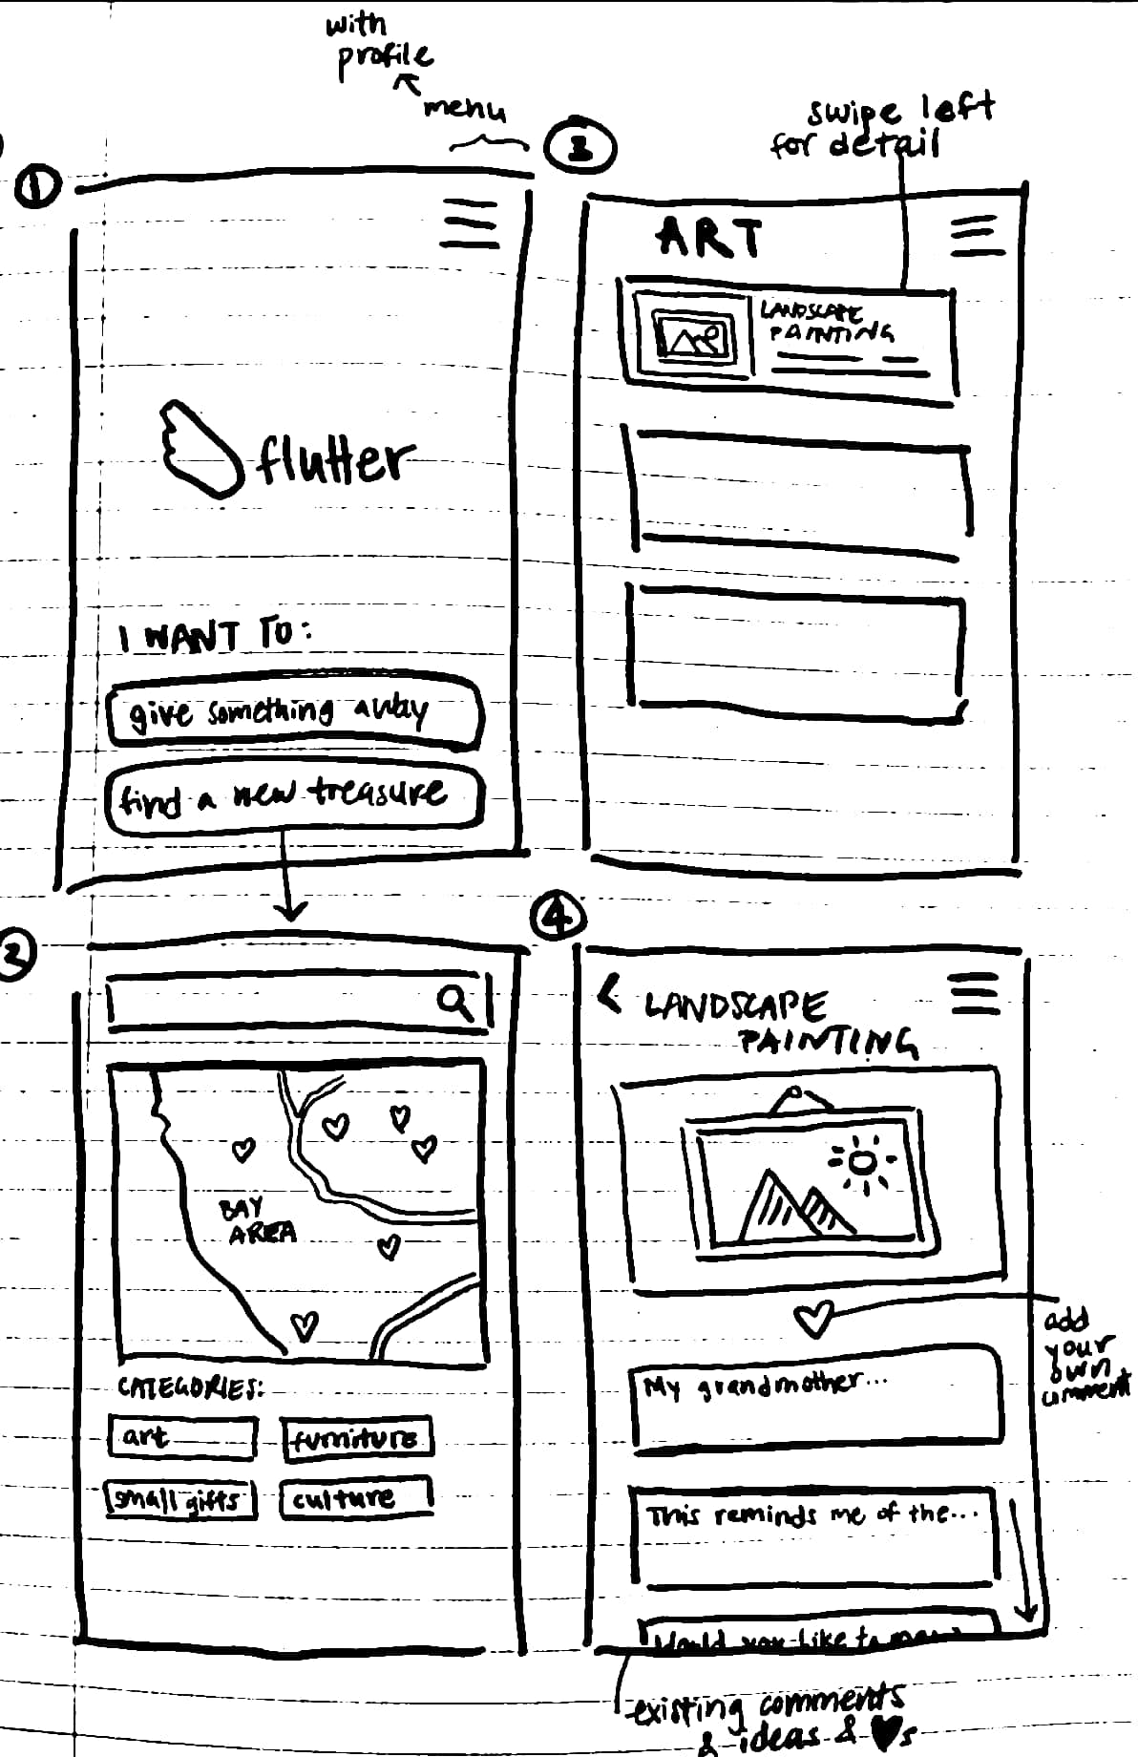
Map

Slide 8
MAP
Simple context emphasizes the items' meanings
Focus on location encourages face-to-face experiences
Privacy concerns related to location data
Notes:
Since data from our experience prototypes had shown how much people value knowing that their sentimental items will be meaningfully treated, we felt that our pros/cons lists pointed us toward the map design.

Slide 9
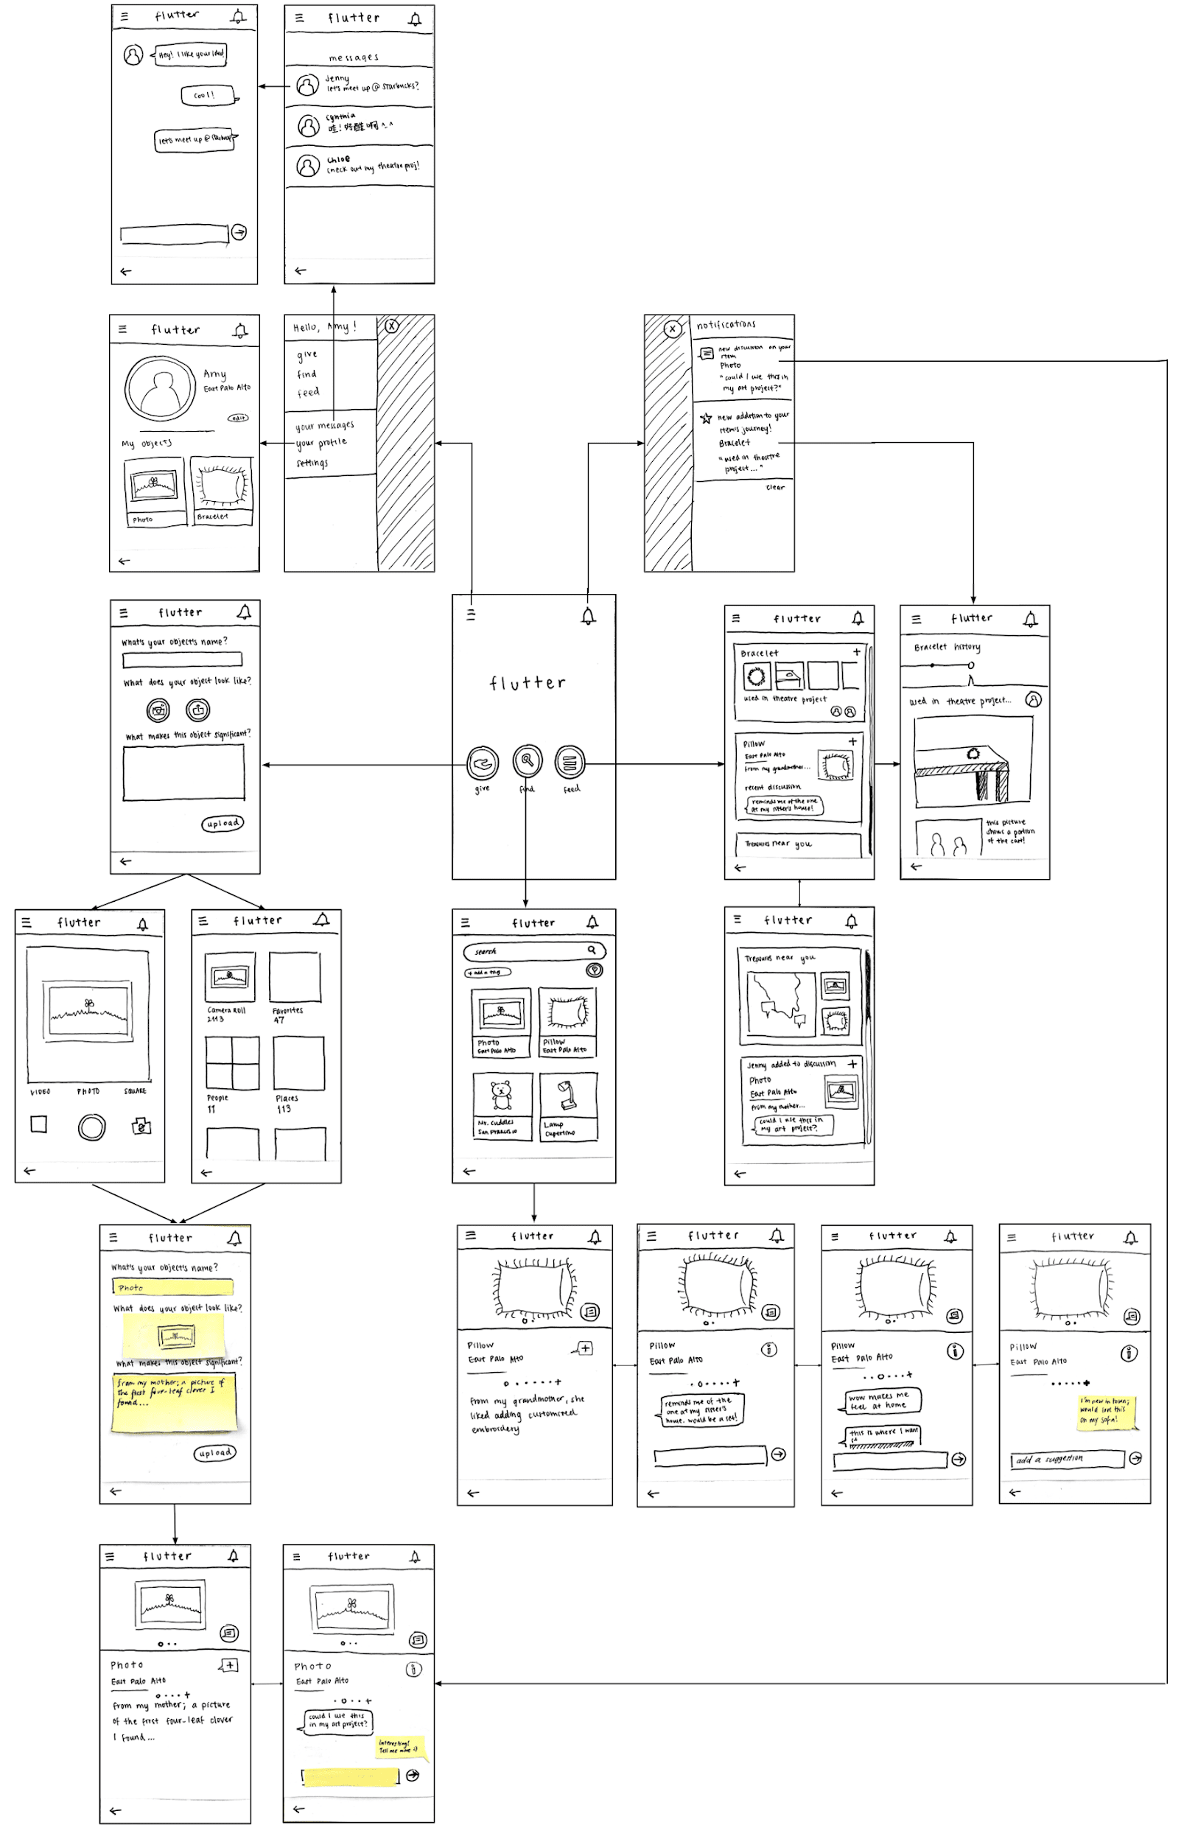
3.
Low-fi Prototype
Notes:
Our design uses touch input to move through visual screens. To simulate this, we created a low-fi prototype using index cards and sticky notes.

Slide 10
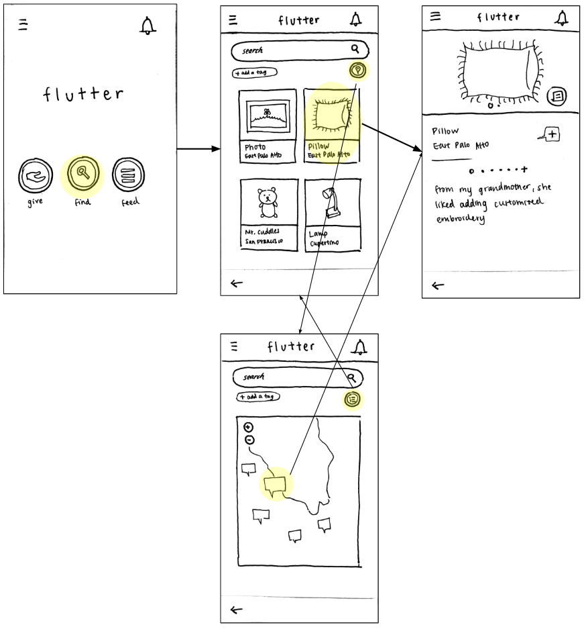
Simple: Find an item
Notes:
Users can browse items displayed on a map. Additionally, users who know what they want can search keywords or select from categories/thumbnail images.

Slide 11
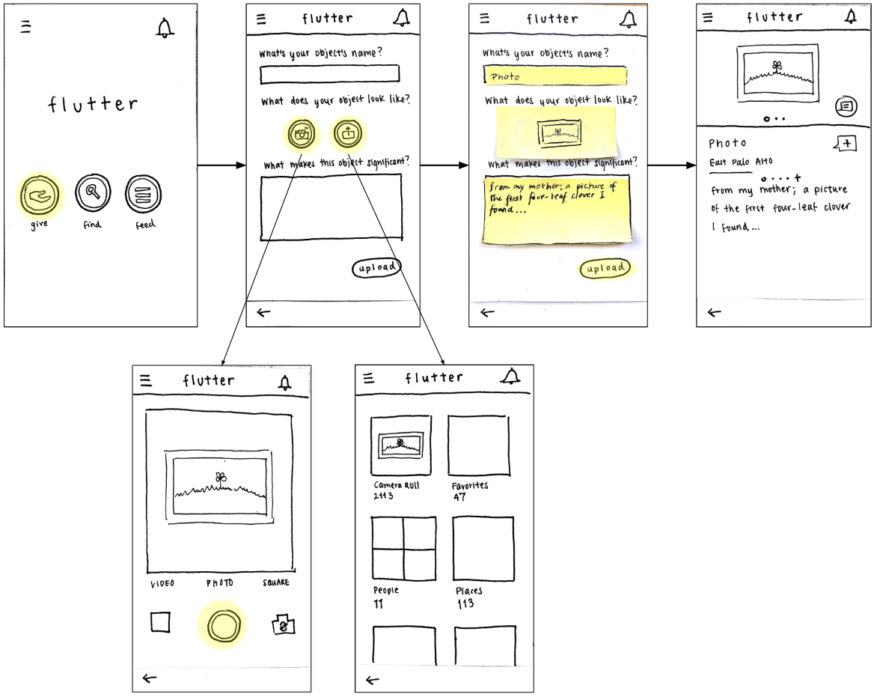
Medium: Give an item
Notes:
Users follow a quick workflow to list an item, which includes adding a title, choosing a photo, and describing the item's meaning.

Slide 12
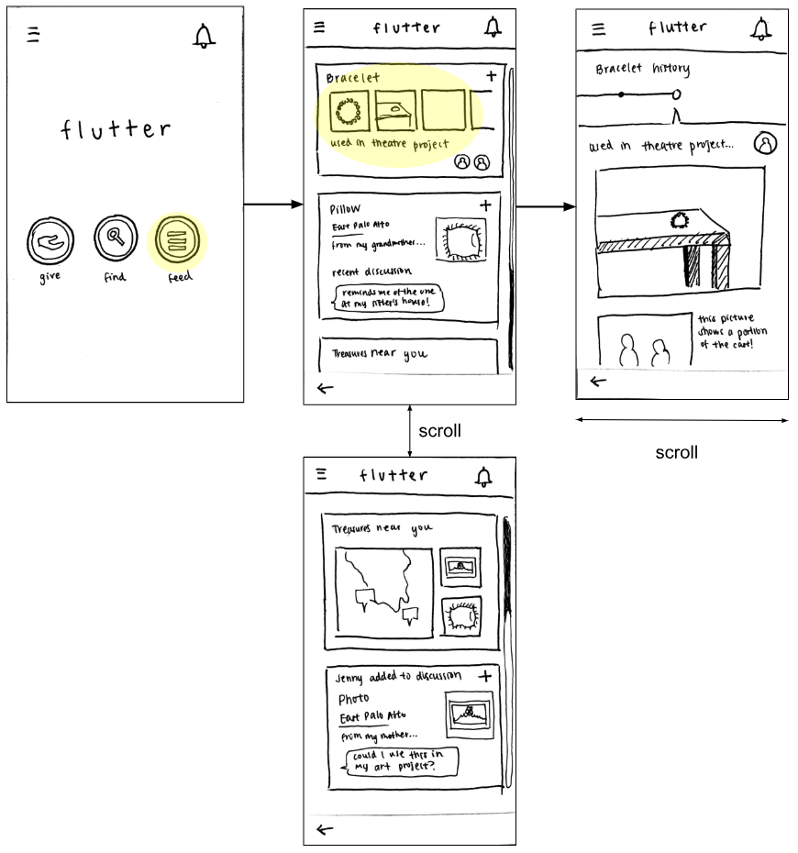
Complex: Connect
& create new experiences
Notes:
Users can view an item's story, which includes its original meaning, any public interactions, and its journey after passing hands.

Slide 13
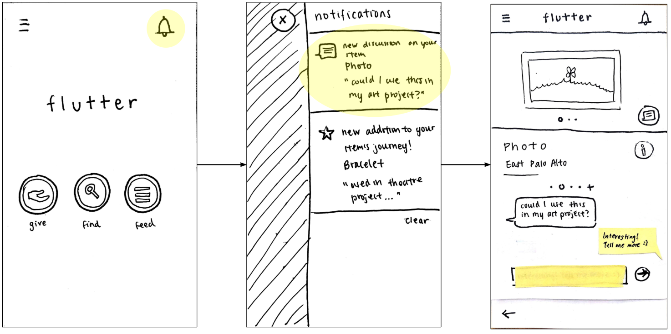
Complex: Connect
& create new experiences
Notes:
Users can comment on a uploaded item's discussion page. The users are encouraged by placeholder prompts to describe how they would use or appreciate the item.

Slide 14
4.
User Testing
Notes:
We recruited people who were early in their careers, since we had previously found that meant they were likely to have less space, move more often, or desire minimalism, and thus want to declutter

Slide 15
Method & Results
"Find a pillow for your new home"
Easy to find an item
Used the thumbnails and search bar
"Give your four-leaf clover photo"
Easy to complete the upload item workflow
Users didn't know what to do afterwards
Notes:
Described the main goal of Flutter.
Placed paper prototype in front of participant and demoed "View profile" (unrelated to tasks being tested)
Asked participant to execute specified tasks.
If participant hit a dead end, asked participant to backtrack and try again.
Record test observations.
The first task was to find a pillow to add to the user’s new home. Participants 1 and 2 were able to successfully find the pillow in the smallest number of steps; participant 3 included a search before clicking on the pillow. Overall, our prototype presented an easy workflow for finding items.
Task two required users to upload a photo of an item to give. All three participants intuitively included a photo and pressed the upload button. At this point, we expected users to view the discussion on their uploaded item and communicate with a person to exchange the item, but all three participants hesitated and didn’t know what to do after uploading.

Slide 16
Method & Results
"Figure out what happened to the bracelet you gave"
Users struggled to find the feed
Users looked in places with only active objects
Transitions
Users tapped back button repeatedly instead of using side menus
Users expressed desire for a home button
Notes:
The third task was to look into the journey of a bracelet the user had recently given away. Participants 1 and 3 were able to locate the feed and complete the task without trouble, but participant 2 went down several dead ends (opened the side menu, viewed profile, looked through currently active objects, verbally expressed frustration).
When transitioning between tasks, participants tended to press the back button multiple times to return to the initial home screen, instead of performing quicker actions, such as opening the side menu. Participants 1 and 2 commented on the repetition but did not discover the easier way of switching tasks.

Slide 17
5.
Changes
Notes:
We found that two aspects of our design were particularly intuitive:
Finding an item is easy for users who know what they want.
The workflow for uploading an item to give is easy to use.

Slide 18
Changes
Users want to be able to "reset" by going back to the main screen.
When users navigate an unfamiliar app, they rarely open any side menus.
Users don't make distinctions between active and inactive objects.
Users tended to ignore the map and other location features.

Slide 19
Changes
Users want to be able to "reset" by going back to the main screen.
When users navigate an unfamiliar app, they rarely open any side menus.
Users don't make distinctions between active and inactive objects.
Users tended to ignore the map and other location features.
Add a home menu and clarify the back button.

Slide 20
Changes
Users want to be able to "reset" by going back to the main screen.
When users navigate an unfamiliar app, they rarely open any side menus.
Users don't make distinctions between active and inactive objects.
Users tended to ignore the map and other location features.
Add a home menu and clarify the back button.
Move features out of the sidebar and into the main flow of the app.

Slide 21
Changes
Users want to be able to "reset" by going back to the main screen.
When users navigate an unfamiliar app, they rarely open any side menus.
Users don't make distinctions between active and inactive objects.
Users tended to ignore the map and other location features.
Add a home menu and clarify the back button.
Move features out of the sidebar and into the main flow of the app.
Explore ways to combine the discussion and feed into a single feature.

Slide 22
Changes
Users want to be able to "reset" by going back to the main screen.
When users navigate an unfamiliar app, they rarely open any side menus.
Users don't make distinctions between active and inactive objects.
Users tended to ignore the map and other location features.
Add a home menu and clarify the back button.
Move features out of the sidebar and into the main flow of the app.
Explore ways to combine the discussion and feed into a single feature.
Reevaluate the importance of location features; potentially drop or make them prominent.

Slide 23
6.
Summary

