Slide 1
Flutter
Medium-Fi Prototype
prototype link
Chloe B., Cynthia L., Amy X., Jenny Z.

Slide 2
declutter meaningfully
People often find themselves keeping a lot of clutter. Many of these objects stay because they hold sentimental value, but not necessarily functional use.
Flutter adds emotional security to the decluttering process, allowing people to find others who will value or add meaning to the item.
overview
tasks
design changes
task flows
prototyping
value proposition
problem
solution
Notes:
Team mission statement + Value proposition

Slide 3
find an object
give an object
before: connect and create new experiences
after: create groups to give and receive objects in
overview
tasks
design changes
task flows
prototyping
simple
medium
complex
Notes:
Task 1: Simple -- Find an item

Slide 4
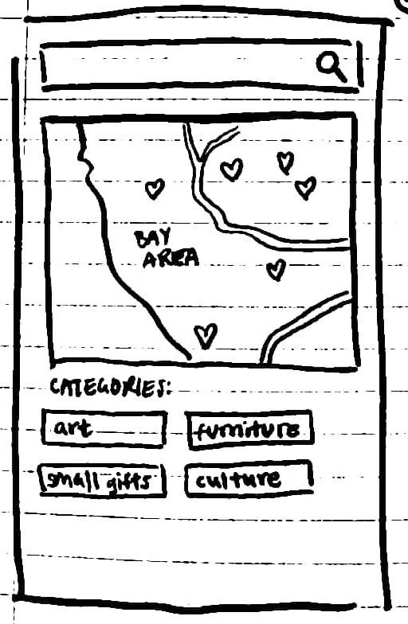
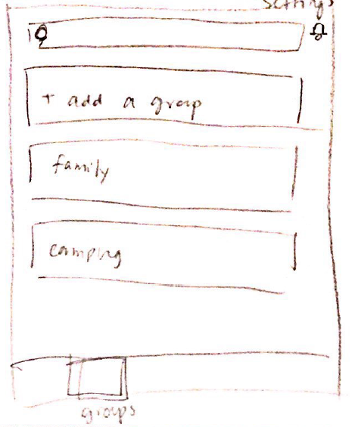
overview
tasks
design changes
task flows
prototyping
narrowing scope
object status change
navigation bar
before
publicly location-based;
open to everybody in location
after
creation of groups of friends or mutual friends

Slide 5
overview
tasks
design changes
task flows
prototyping
narrowing scope
object status change
navigation bar
rationale
concerns from usability testing and section regarding interaction with strangers
retain location-based functionality but remove unintuitive use of map
support from previous needfinding
people give items away to people they know in their communities as opposed to donating and making up for grabs to greater population
people like to have control over their items and where they go (there is more control when you know the person you’re giving to)

Slide 6
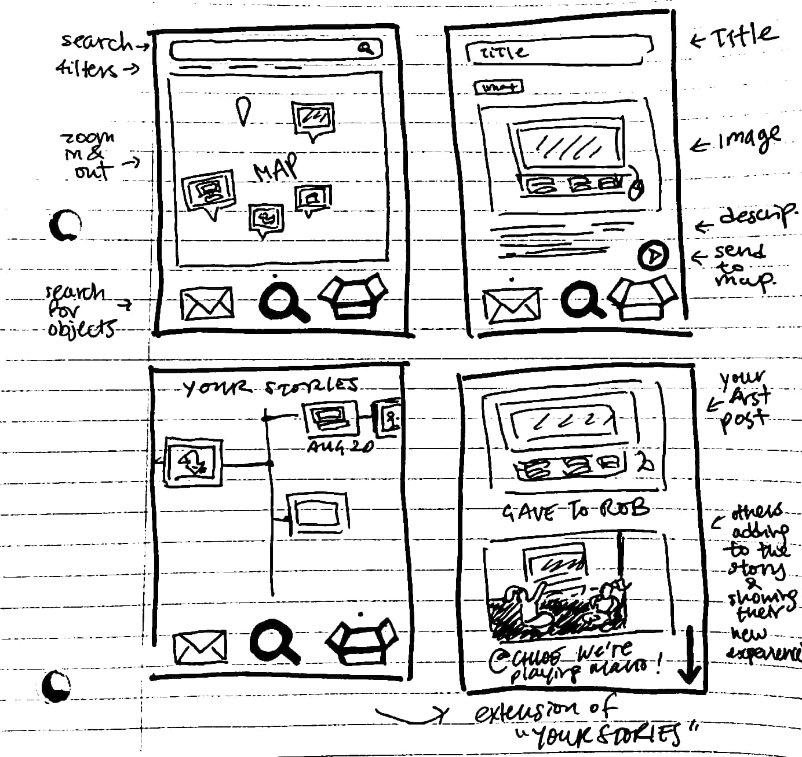
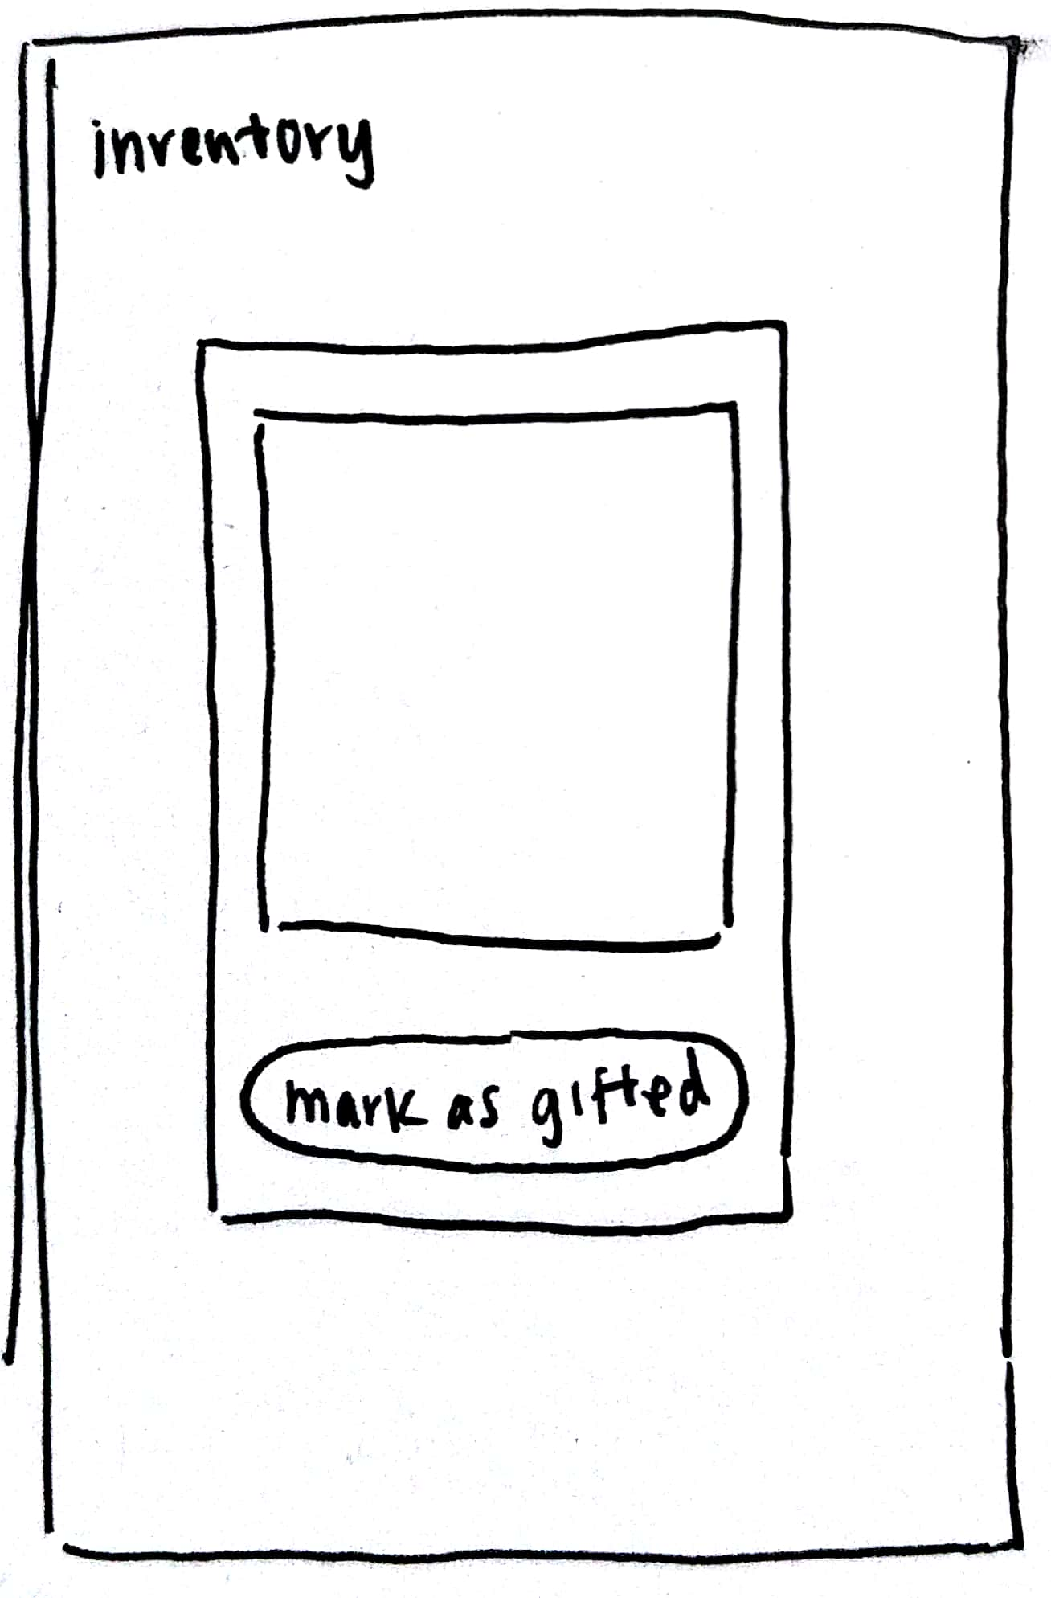
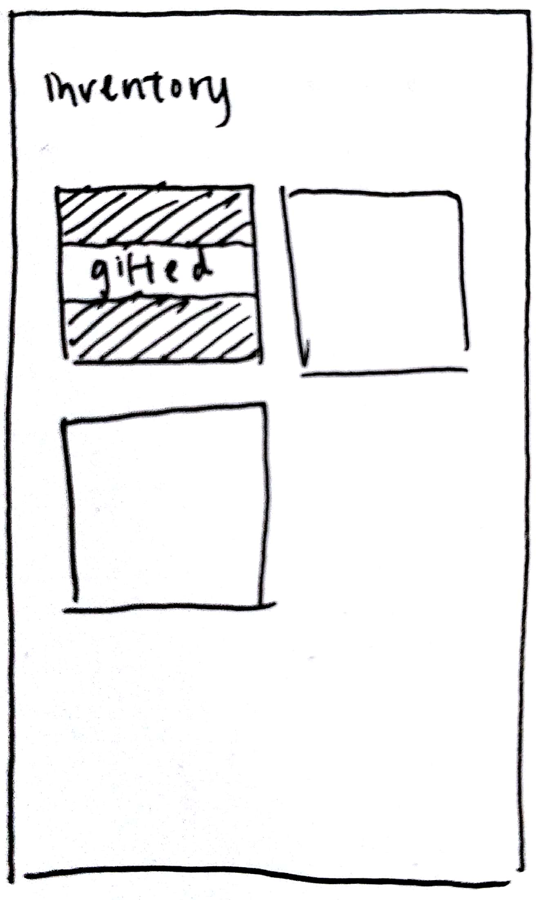
overview
tasks
design changes
task flows
prototyping
narrowing scope
object status change
navigation bar
before
timeline view to indicate that object has been passed on
after
button to explicitly mark item as gifted

Slide 7
overview
tasks
design changes
task flows
prototyping
narrowing scope
object status change
navigation bar
rationale
timeline was not touched by users during usability testing
cannot rely on people to come back in and update
new group feature makes it easy to have these conversations outside of app and in real life; no longer necessary to force this interaction within the app
issue raised in section regarding speedy moving
support from previous needfinding
people are protective of their time

Slide 8
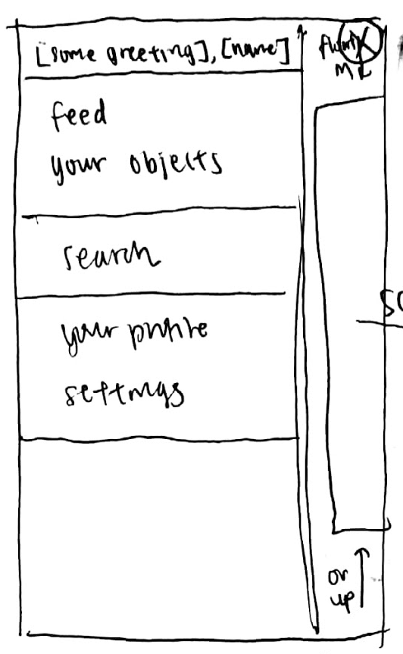
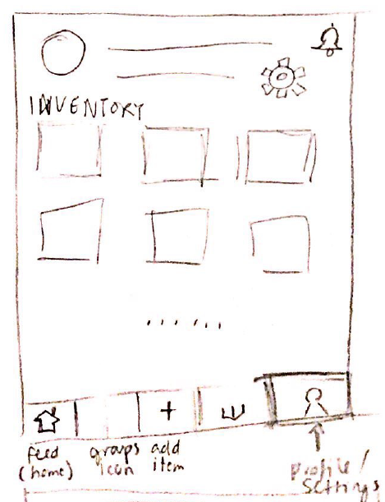
overview
tasks
design changes
task flows
prototyping
narrowing scope
object status change
navigation bar
before
sliding sidebar navigation
after
bottom navigation bar

Slide 9
overview
tasks
design changes
task flows
prototyping
narrowing scope
object status change
navigation bar
rationale
users were clicking back button multiple times to return to home before switching tasks
increased & constant visibility compared to sidebar navigation

Slide 10
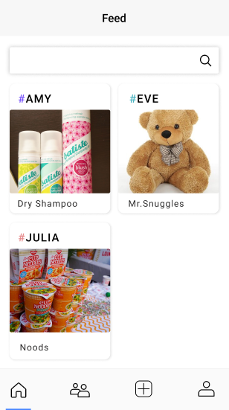
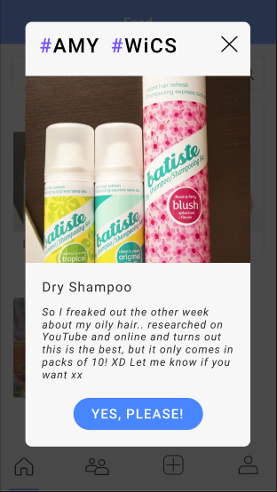
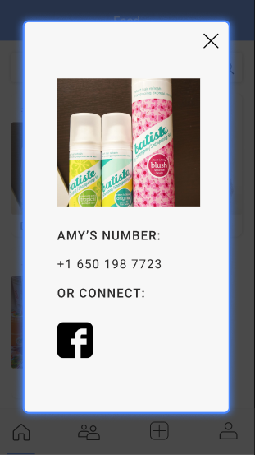
overview
tasks
design changes
task flows
prototyping
simple
medium
complex
find an
object
home/feed
object page
(others)
contact

Slide 11
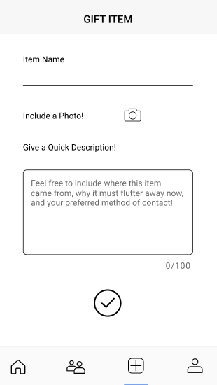
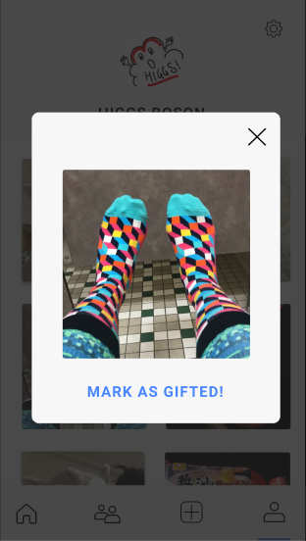
overview
tasks
design changes
task flows
prototyping
simple
medium
complex
give an object
give
object page
(personal)

Slide 12
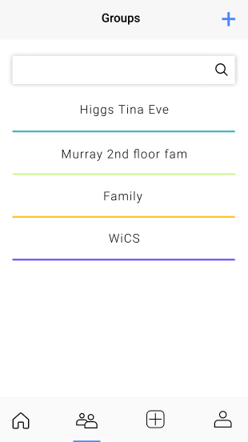
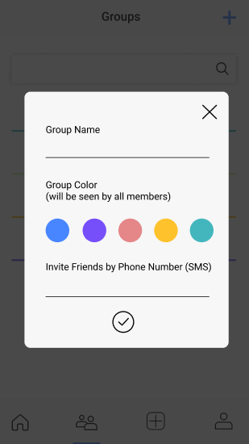
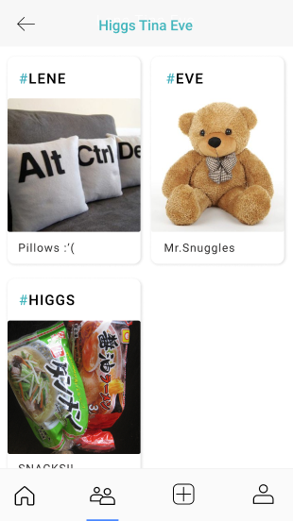
overview
tasks
design changes
task flows
prototyping
simple
medium
complex
create groups to give and receive objects in
groups
new group
group feed

Slide 13
overview
tasks
design changes
task flows
prototyping
tools
limitations
wizard of oz + hard-coded
tool used: figma
pros
easy image drag and drop
retains color palette and transparencies
good recognition of similar dimensions and alignments on page
can be used for design and interaction prototype
cons
doesn't provide selection for automatic iPhone model dimensions, have to manually assess the dimensions of mobile
hotspots for interaction have to be a created element, not intuitive for how to make a general region clickable
limited image editing tools (only image cropping rather than selection and delete or recognising regions)

Slide 14
overview
tasks
design changes
task flows
prototyping
tools
limitations
wizard of oz + hard-coded
figma limitations
swipe interactions between screens omitted
simplicity
account creation workflow omitted
friend invitation workflow omitted
search functionality omitted

Slide 15
overview
tasks
design changes
task flows
prototyping
tools
limitations
wizard of oz + hard-coded
wizard of oz techniques
logged into account of pre-loaded user
hard-coded features
images and information of user’s objects (assuming existing postings)
existing groups of friends that have already been invited to the app
user’s profile settings data
feed objects

