Slide 1
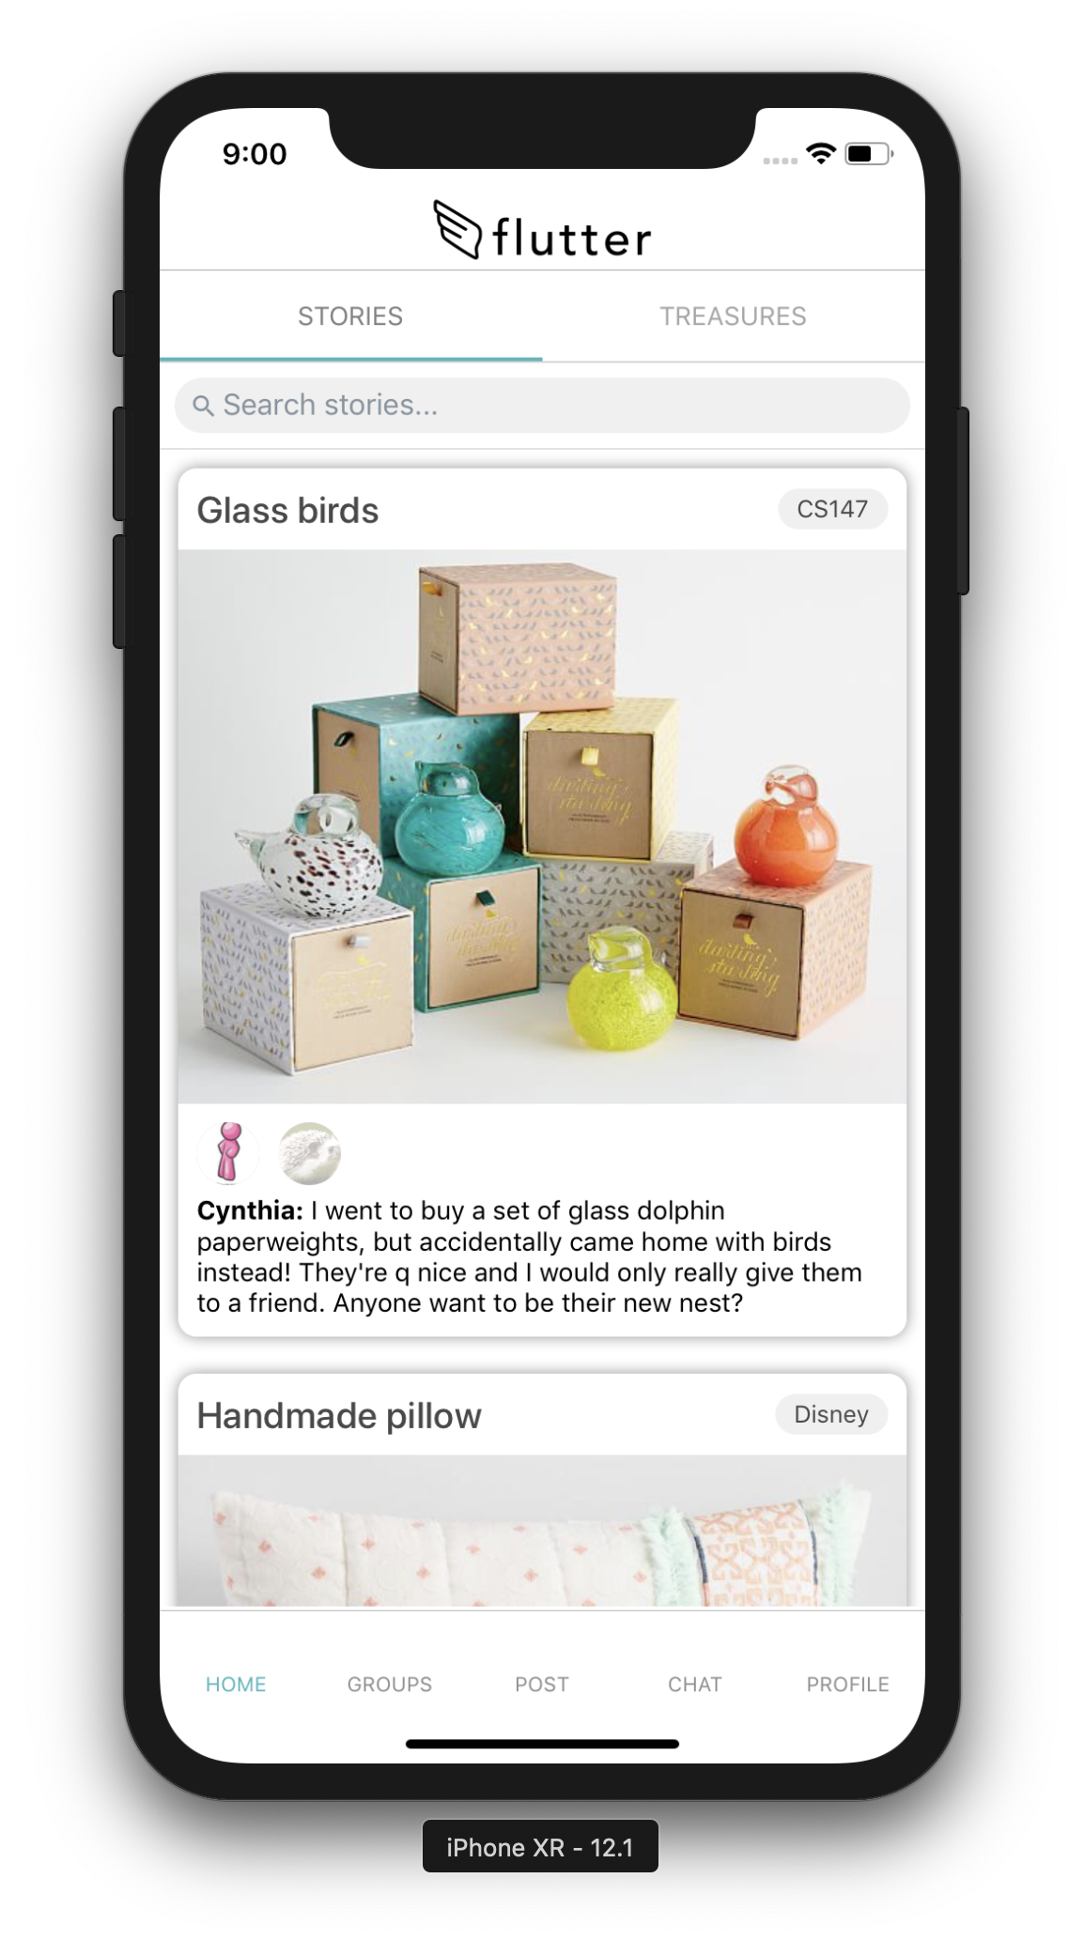

declutter meaningfully

