Slide 1
SMU
9 March 2024
FRITO-LAY
EXPLORATORY ANALYSIS
By: Chloe Barker

Slide 2
GOALS
1. What are the factors most related to employee attrition (employee turnover)?
2. How well can we predict employee attrition?
3. What affect can predicting employee attrition have on costs?

Slide 3
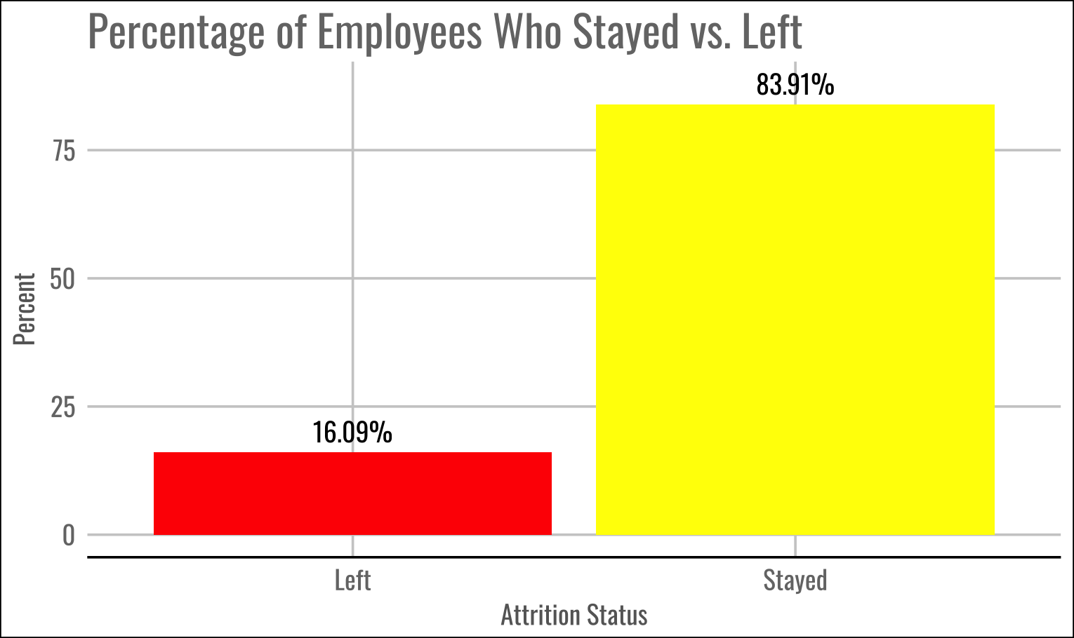
ATTRITION
SUMMARY
Retention (Stayed) | Attrition (Left)
730 Employees | 140 Employees

Slide 4
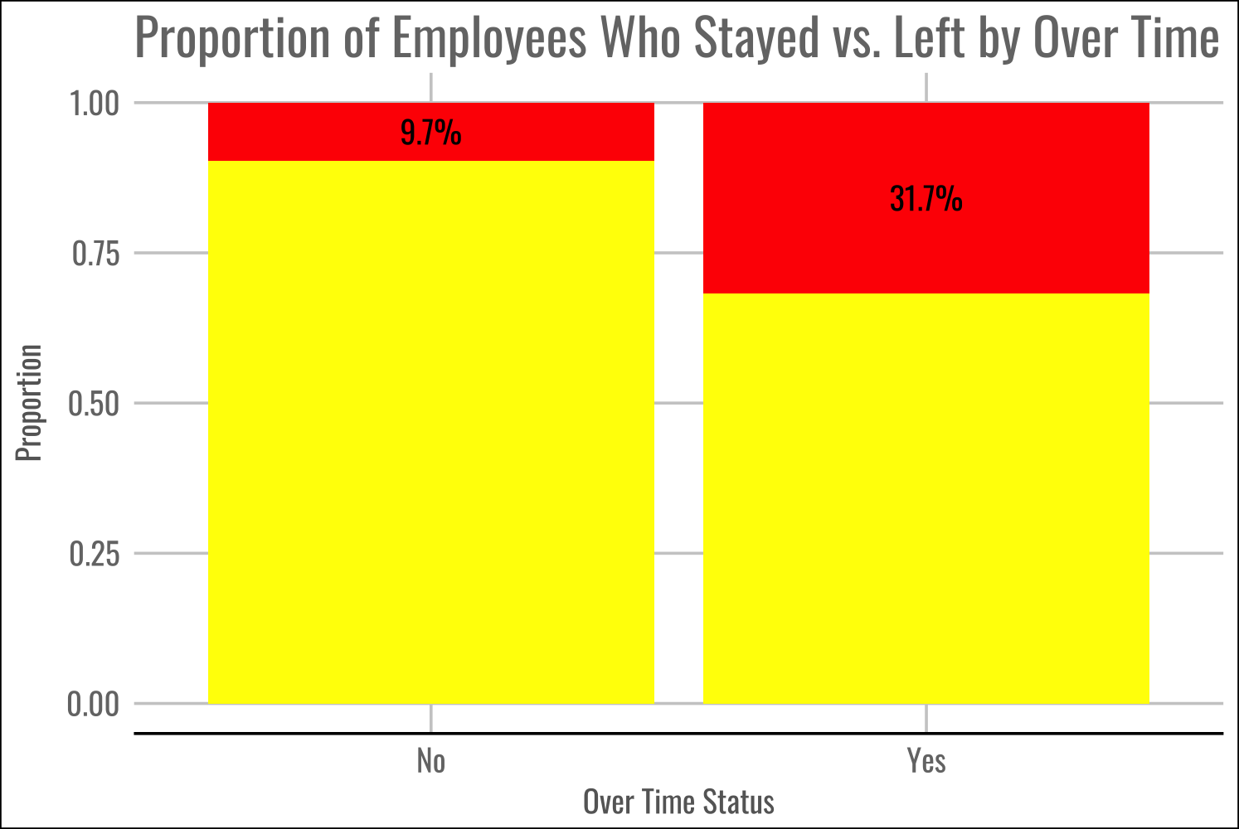
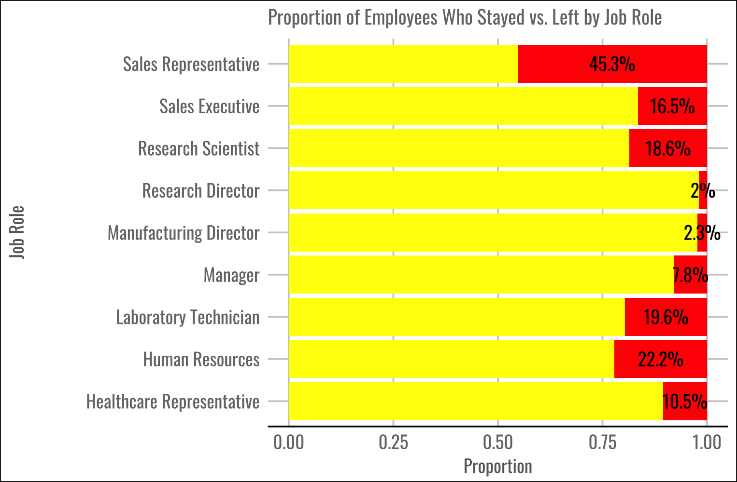
INTERESTING FACTORS

Slide 5
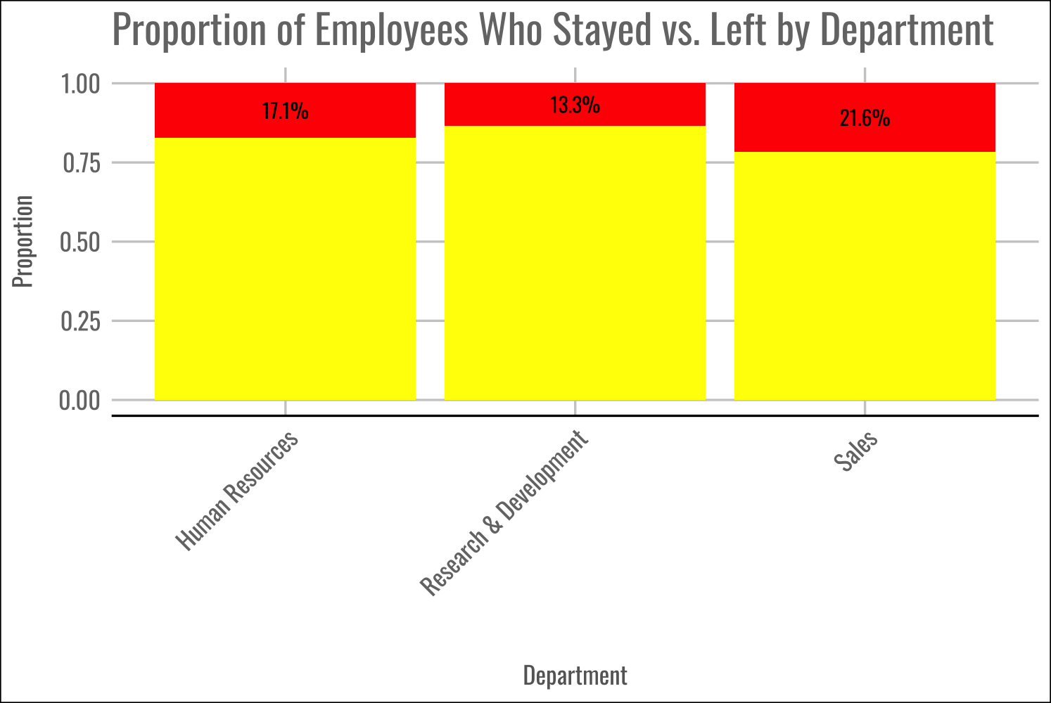
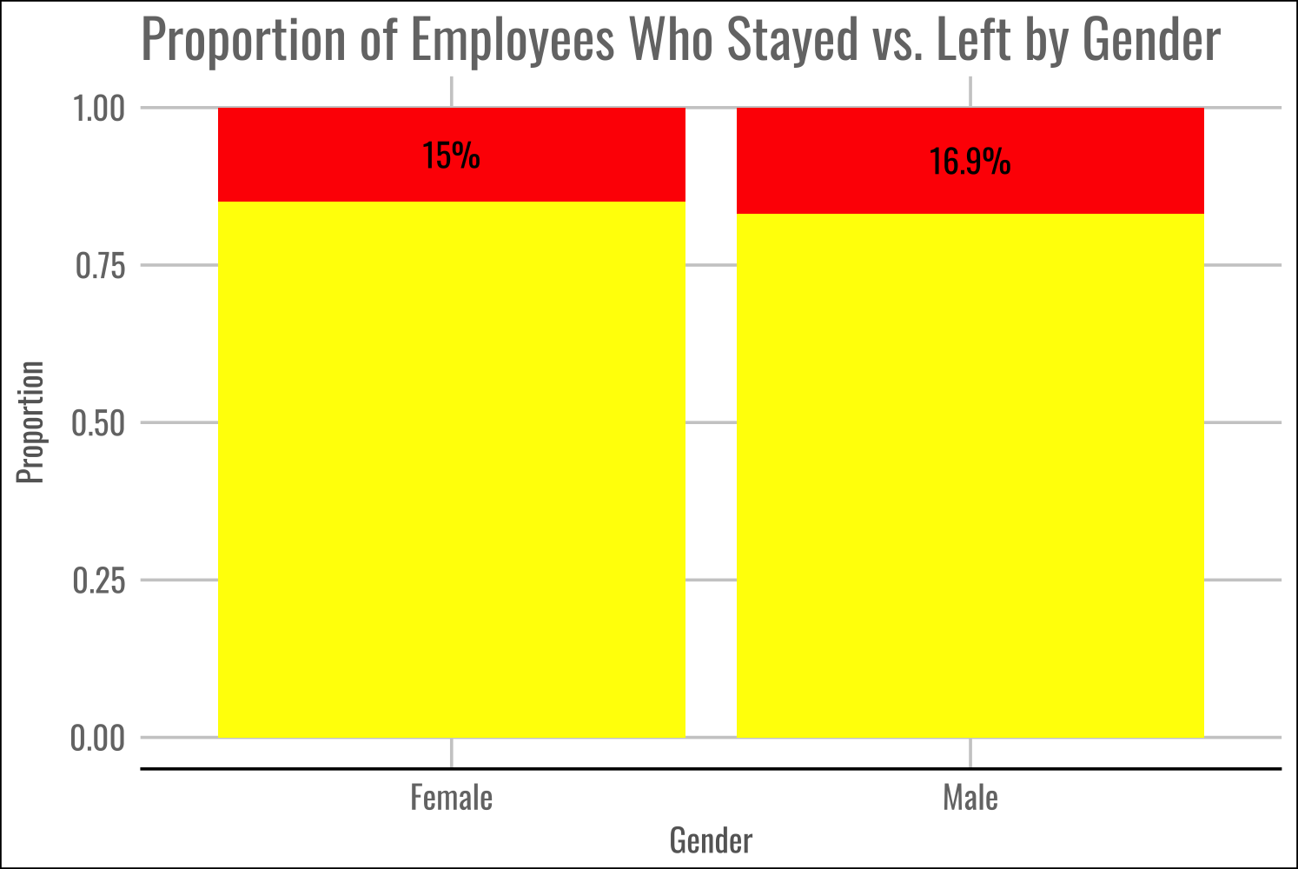
LESS INTERESTING FACTORS

Slide 6
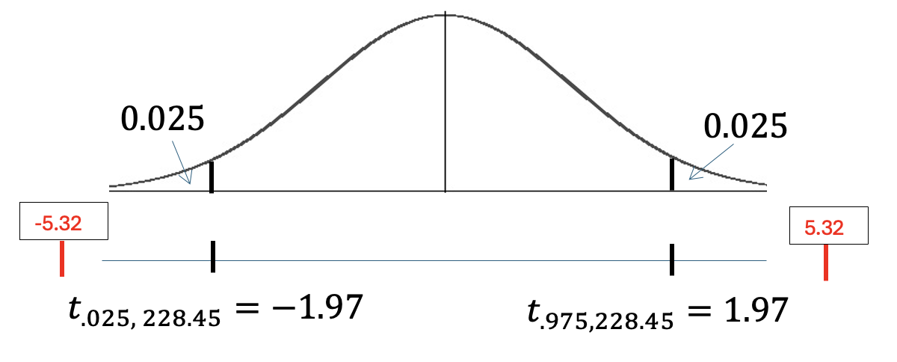
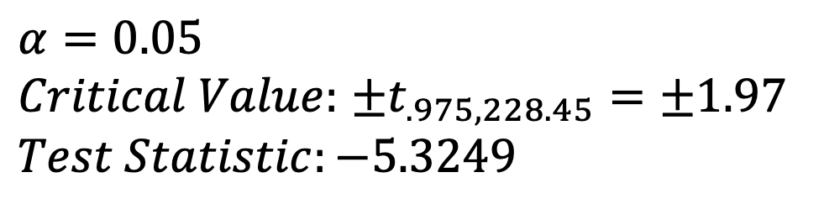
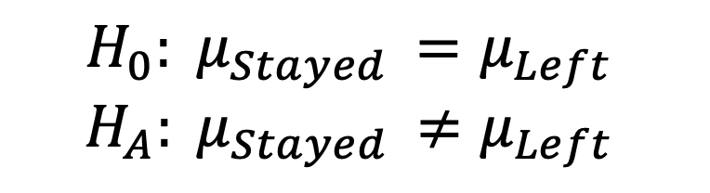
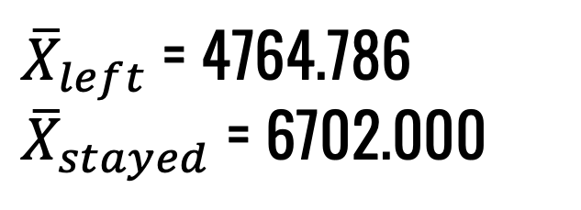
FURTHER ANALYSIS ON NUMERIC VARIABLES
Goal: Test the claim that the mean Monthly Income for the ”Stayed” attrition group is different than that of the “Left” attrition group.
Impact: If this is true then we can consider Monthly Income as a viable variable of interest for the factors with the greatest impact on whether an employee will stay or leave.
Data: We will use the 870 employees from the Frito Lay case study.
$$α=0.05$$
$Critical Value:$ ±$t_{.975,228.45}=\text{±}1.97$
$$Test Statistic:−5.3249$$
$$H_{0}: μ_{Stayed }=μ_{Left }$$
$$H_{A}: μ_{Stayed }≠μ_{Left }$$
${\overline{X}}_{left}$ = 4764.786
${\overline{X}}_{stayed}$ = 6702.000
P-value = 2.412e-07 < .05
Reject Ho

Slide 7
FURTHER ANALYSIS ON NUMERIC VARIABLES
Conclusion: There is strong evidence to suggest that the mean Monthly Income for the ”Stayed” attrition group is greater than that of the “Left” attrition group (p-value < .05 from t-test). We are 95% confident that the mean Monthly Income for the ”Left” attrition group is 1,220.382 to 2,654.047 dollars less than that of the “Stayed” group.

Slide 8
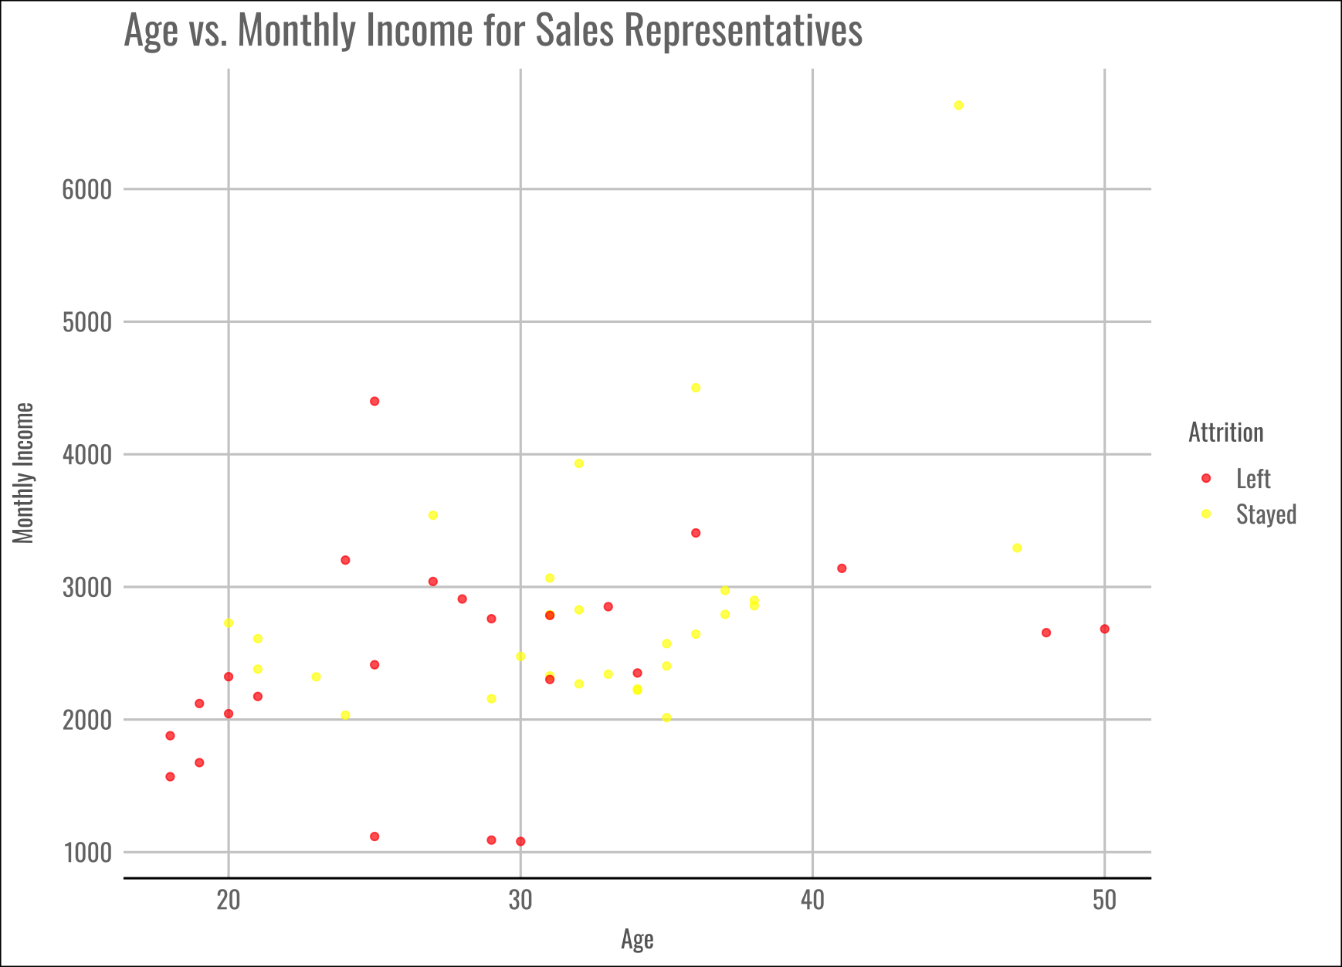

Slide 9
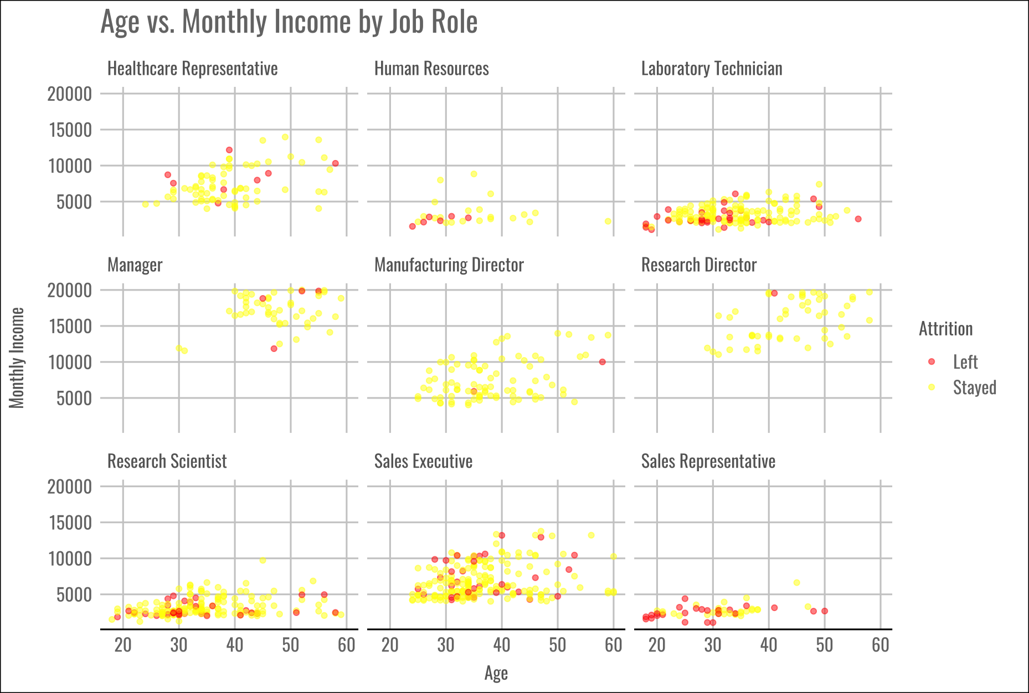

Slide 10
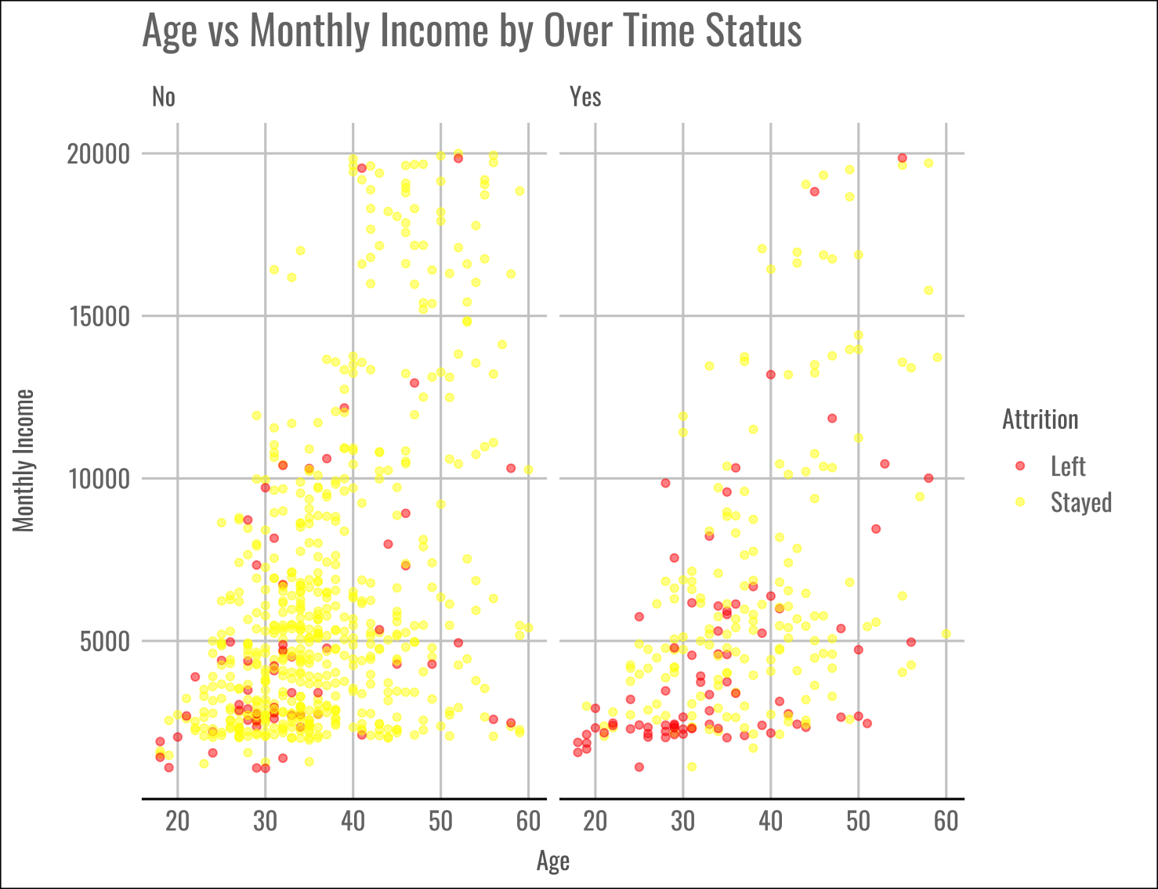

Slide 11
PREDICTED TOP THREE FACTORS INFLUENCING ATTRITION AT FRITO-LAY
AGE
JOB ROLE
OVER TIME

Slide 12
NAÏVE BAYES MODEL
ACCURACY = 64.60%
Out of the employees who actually left and those who actually stayed, our model flagged 64.60% correctly.
(overall proportion of correct predictions)
Threshold for optimal Costs = 0.12
Predictors: Age, Job Role, and Over Time
SENSITIVITY = 77.86%
Out of the employees who actually left, 77.86% were correctly identified as leaving by the model.
 | Actually Left | Actually Stayed
Predicted to Leave | 109 | 277
Predicted to Stay | 31 | 453
SPECIFICITY = 62.05%
Out of the employees who actually stayed, 62.05% were correctly identified as staying by the model.
Threshold | Sensitivity | Specificity | Accuracy
0.12 | 77.86% | 62.05% | 64.6%

Slide 13
COSTS
WHAT WE KNOW:
Incentives to stay are predicted to be around $200 per employee
Predicted costs to be between 50% and 400% of the employee’s salary to recruit a replacement for someone who has left the company
Average Employee Yearly Salary = $76,683.17
Cost Per Incentive for employees predicted to leave = $200
Total cost of incentives for employees who are predicted to leave:
$77, 200
Greater costs for employees predicted to stay but actually left:
For 50% of salary costs: $1,188,589
For 400% of salary costs: $9,508,713
Predicted Costs:
$1,265,789 to $9,585,913
Threshold for optimal costs = 0.12
Threshold | Lower Cost Range | Upper Cost Range | Sensitivity | Specificity | Accuracy
0.15 | $1,748,030 | $13,557,238 | 71.37% | 68.57% | 70.92%
0.12 | $1,265,789 | $9,585,913 | 77.86% | 62.05% | 64.6%

Slide 14
ACCURACY = 72.76%
Out of the employees who actually left and those who actually stayed, our model flagged 72.76% correctly. ( The overall proportion of correct predictions)
kNN MODEL
SENSITIVITY = 94.29%
Out of the employees who actually left, 94.29% were correctly identified as leaving by the model.
Threshold for optimal Costs = 0.15
k-value = 3
Predictors: Age, Over Time, and and Job Role
SPECIFICITY = 68.63%
Out of the employees who actually stayed, 68.63% were correctly identified as staying by the model.
k | Threshold | Sensitivity | Specificity | Accuracy | Lower Cost Range | Upper Cost Range
1 | 0.15 | 97.14% | 78.49% | 81.49% | $211,966.30 | $1,285,531.00
3 | 0.15 | 94.29% | 68.63% | 72.76% | $378,932.70 | $2,526,062.00
5 | 0.15 | 90.00% | 65.62% | 69.54% | $612,182.20 | $4,369,658.00
Predicted Costs:
$378,932.70 to $2,526,062

Slide 15
ADDITIONAL FACTORS
TO CONSIDER
JOB LEVEL
MONTHLY INCOME
YEARS IN CURRENT ROLE

Slide 16
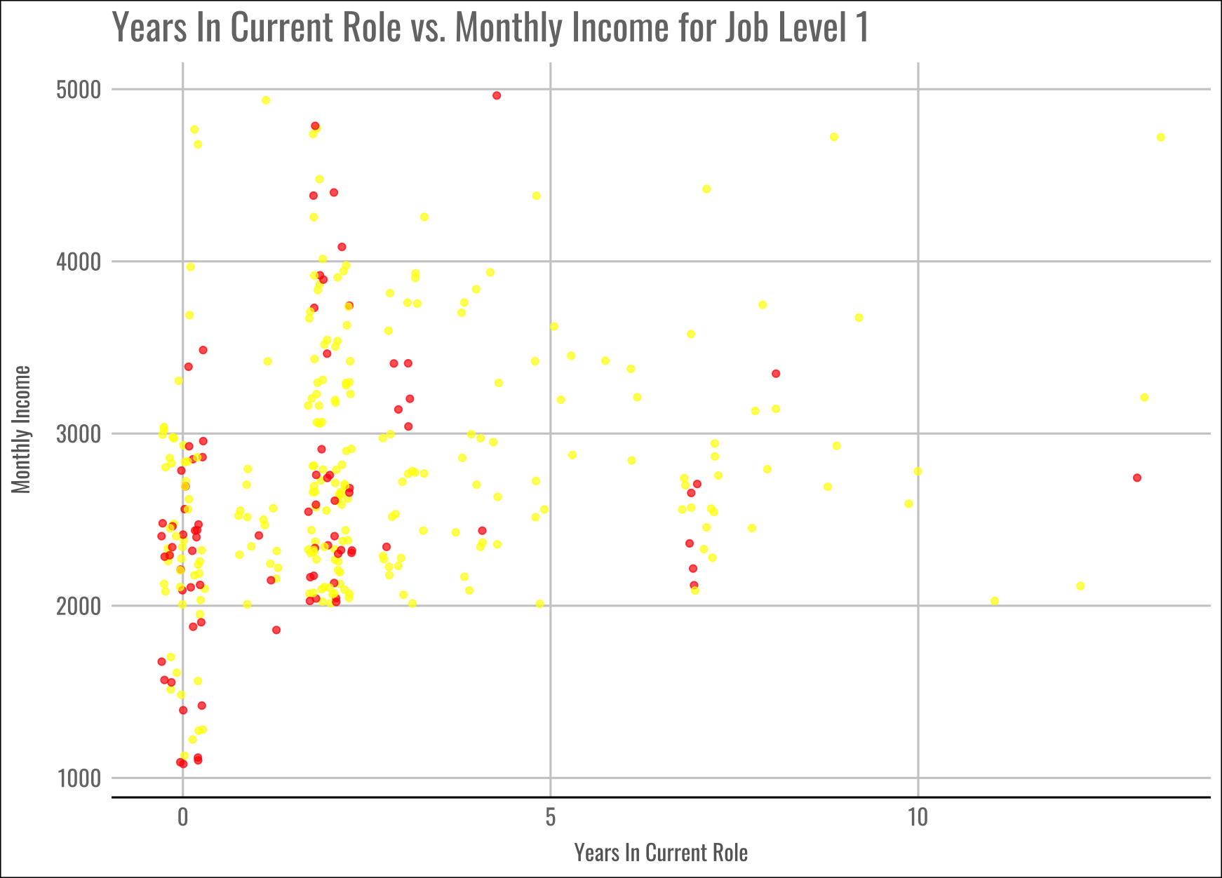

Slide 17
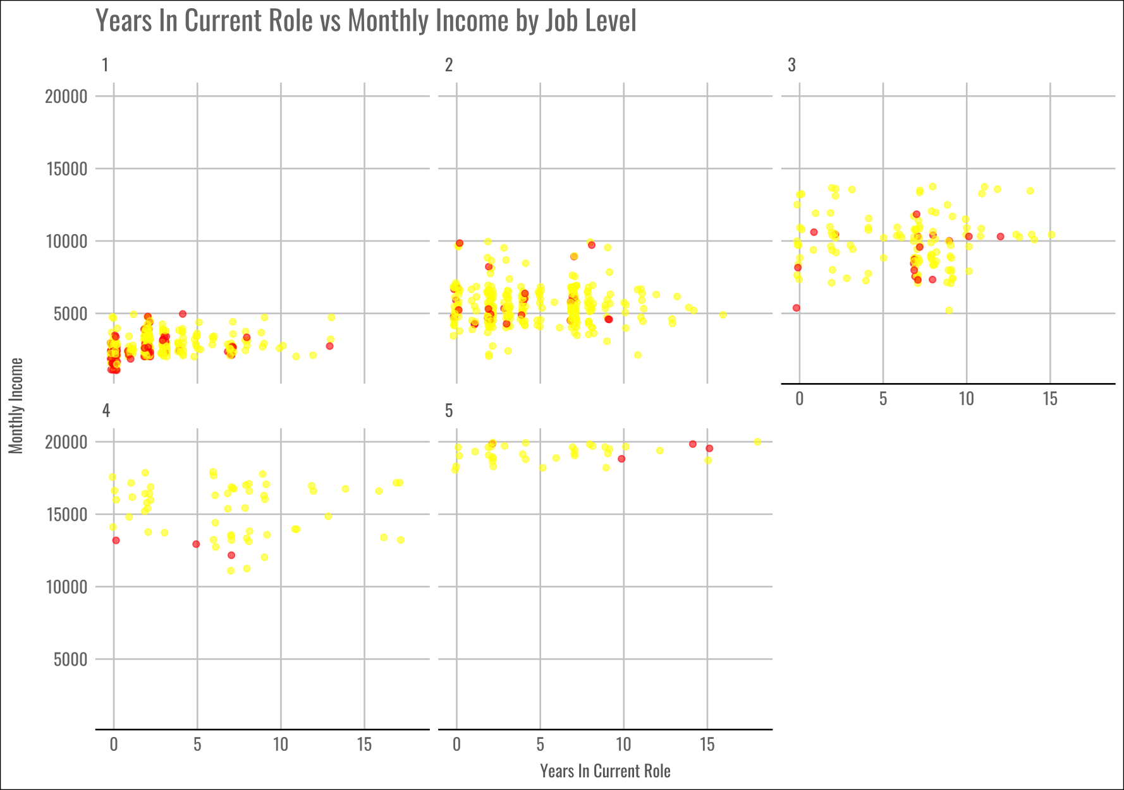

Slide 18
SMU
9 March 2024
THANK YOU
We’re excited to revolutionize Frito-Lay with you! Questions?

