Slide 1
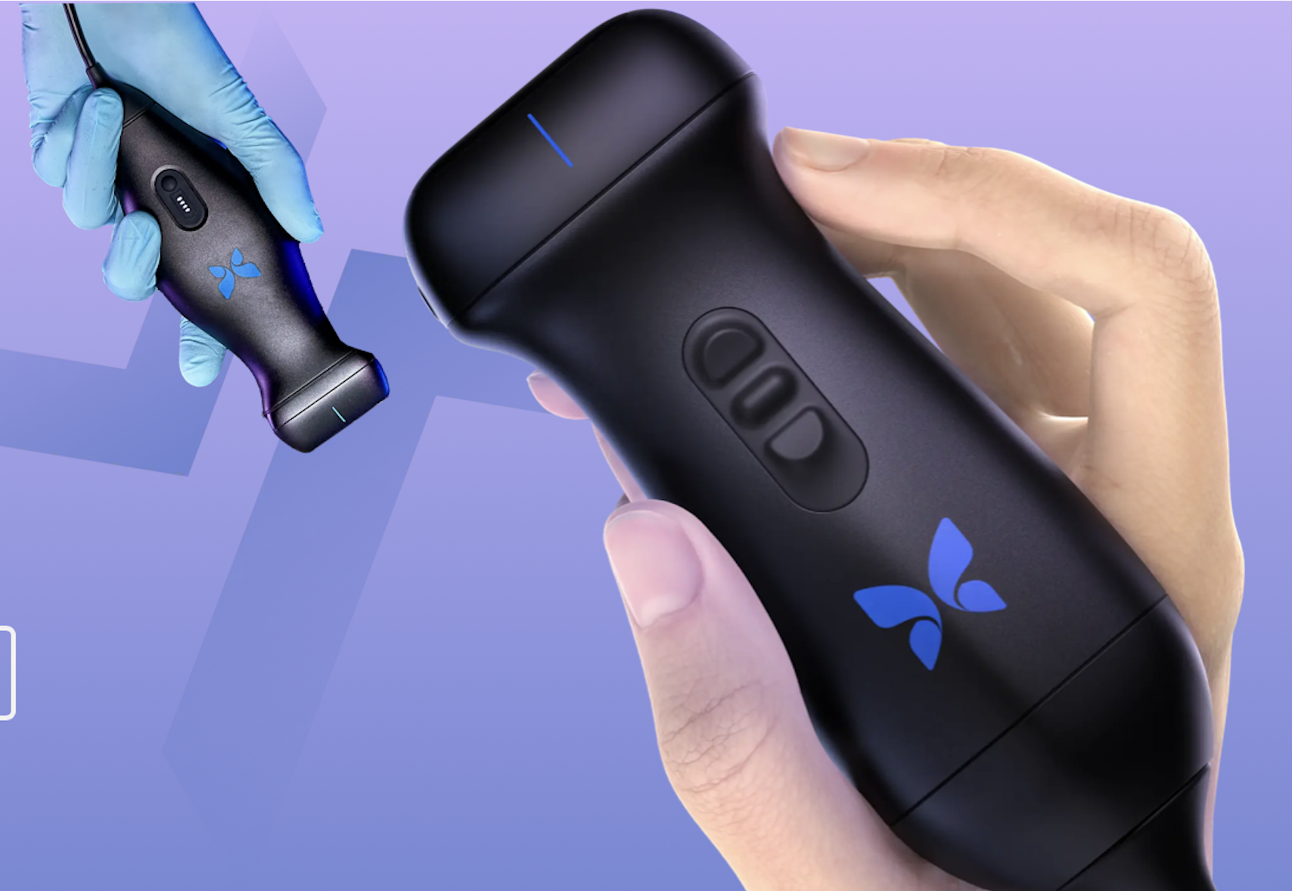

How Data science REVOLUTIONIZES the Future of healthcare
Chloe Barker
Storytelling with Data | Southern Methodist University

Slide 2





Common healthcare challenges
COMPLICATED DIGITAL INTEGRATION | LARGE AND COMPLEX MACHINERY | HIGH COST | LIMITED ACCESS | INNEFFICIENT EMERGENCY RESPONSE AND PATIENT MOBILITY
Many hospitals still use outdated systems that can’t easily share imaging data, limiting remote consultations, second opinions, and team workflows. | Traditional ultrasound machines are large, room-bound, and require multiple probes - impractical for emergency or mobile use. | Imaging devices can cost tens of thousands of dollars, making them inaccessible for small clinics, EMS, and global health settings. | Rural and underresourced areas lack access to imaging tools, causing delays in diagnosis and poorer health outcomes. | Transporting critically ill or trauma patients for imaging is dangerous and time-consuming. Clinicians need tools that come to the patient.

Slide 3
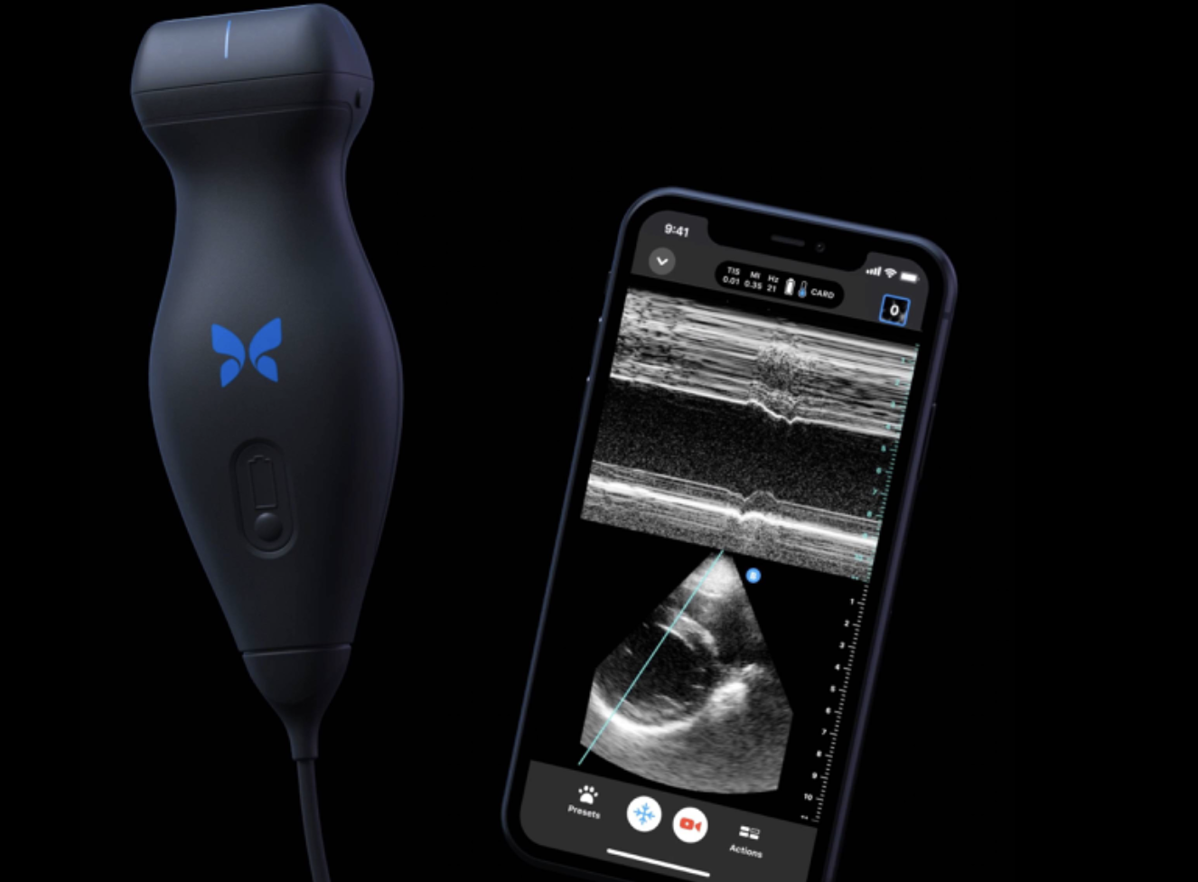
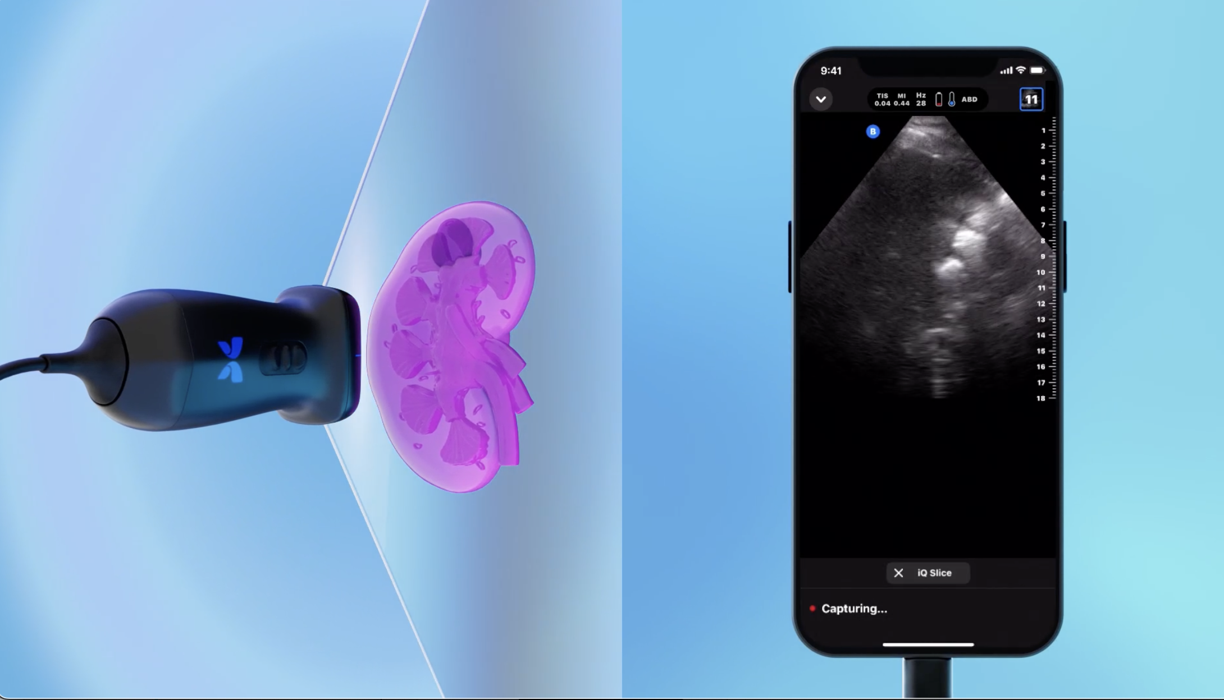
Meet Butterfly IQ/iQ+/IQ³
Butterfly iQ is a portable, point-of-care ultrasound (POCUS) device that connects to smartphones or tablets.
Replaces multiple traditional transducers with a single silicon chip-based probe.
FDA-cleared for whole-body imaging in a wide range of medical settings ( i.e. emergency rooms, rural clinics, etc.).
Enables AI-powered imaging and real-time diagnostics at the bedside or in the field.

Slide 4
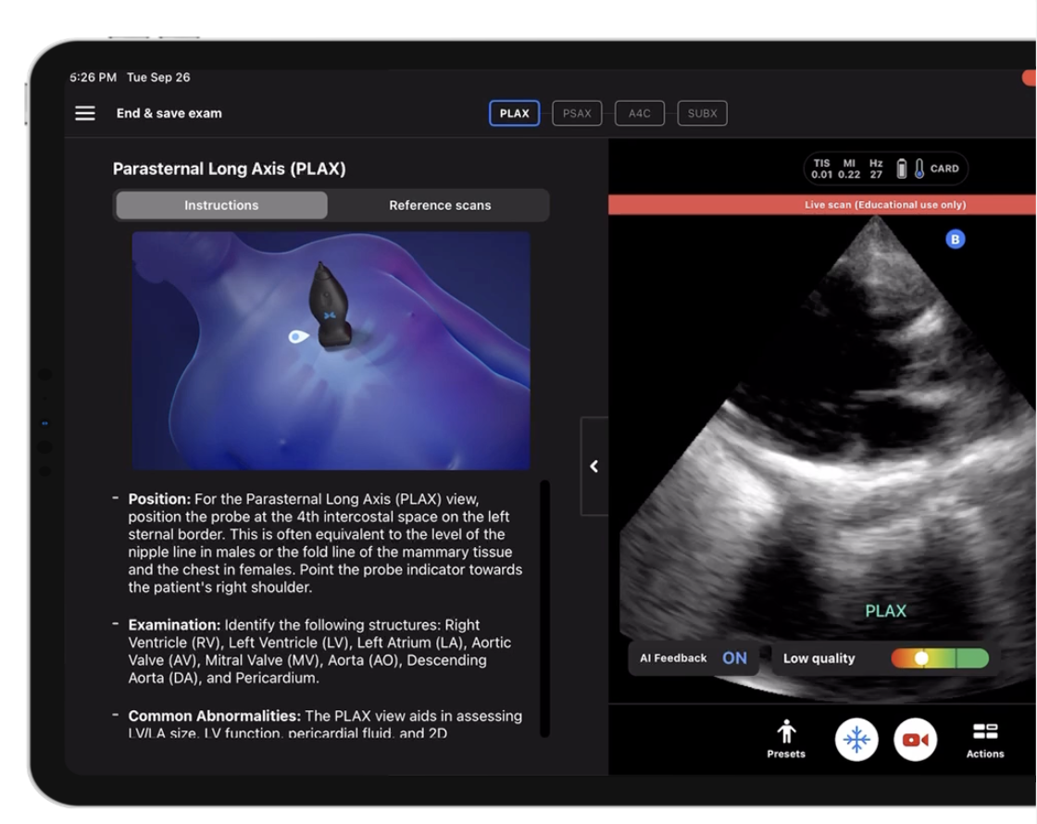
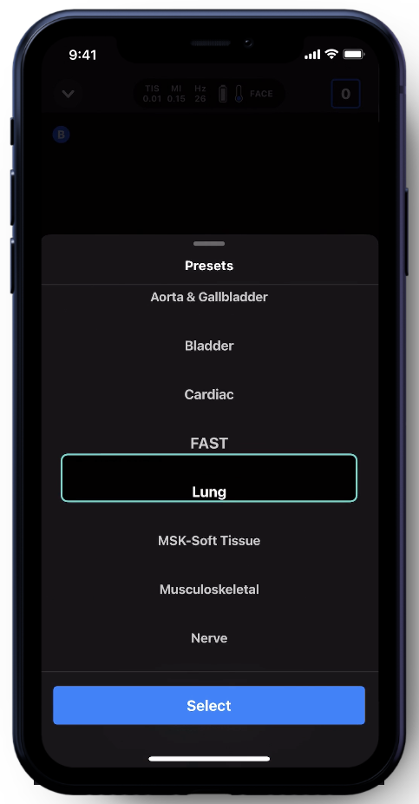
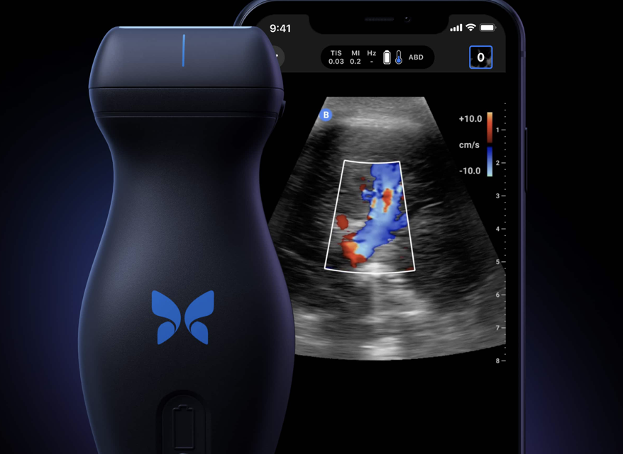
AI Behind the Butterfly iQ+
AI enhances image acquisition and interpretation, & diagnostic speed
Trained on 1B+ frames, 3M+ labeled scans
Real-time guidance for probe positioning and capturing images.
Automated measurements (e.g., bladder volume) with high precision.
ScanLab™ simplifies training for new users & reduces the learning curve for non-specialists.

Slide 5
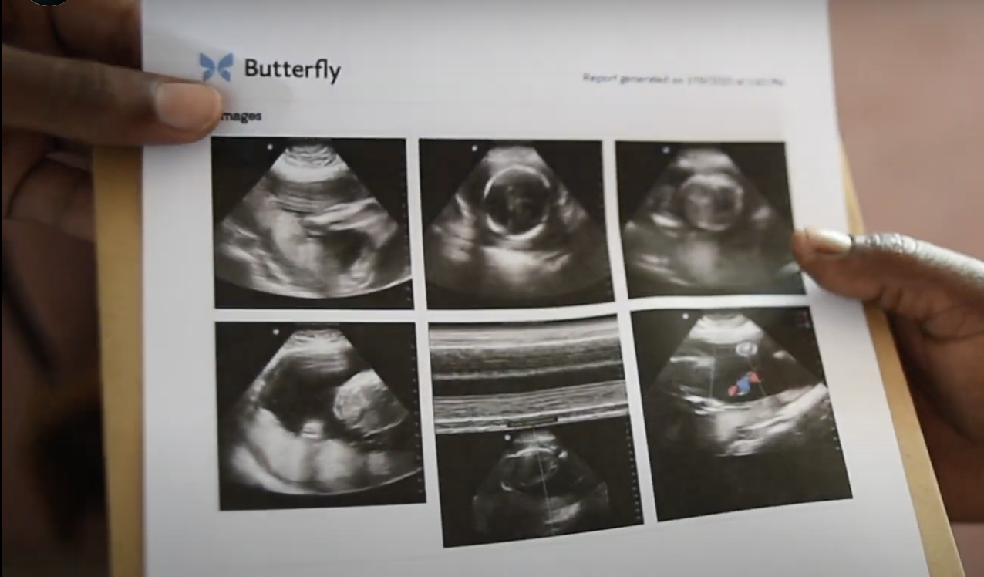

Inside the Technology: Data Science’s role in Butterfly iQ+
Signal Acquisition
CMUT transducer captures raw ultrasound signals
User Interface
Real-time display
User input and annotations
Data Analytics & Feedback
Usage analytics
Model improvement via feedback loops
Population health insights
Image Reconstruction
Real-time image formation
AI/ML-Powered Interpretation
Automated structure recognition
Automated measurements
Quality assessment
Security & Compliance
Data encryption
HIPAA compliance
Digital Signal Procession
Algorithms convert signals to digital data
Noise reduction, artifact removal
Cloud Integration
Secure upload of images and metadata
Remote access and telemedicine

Slide 6
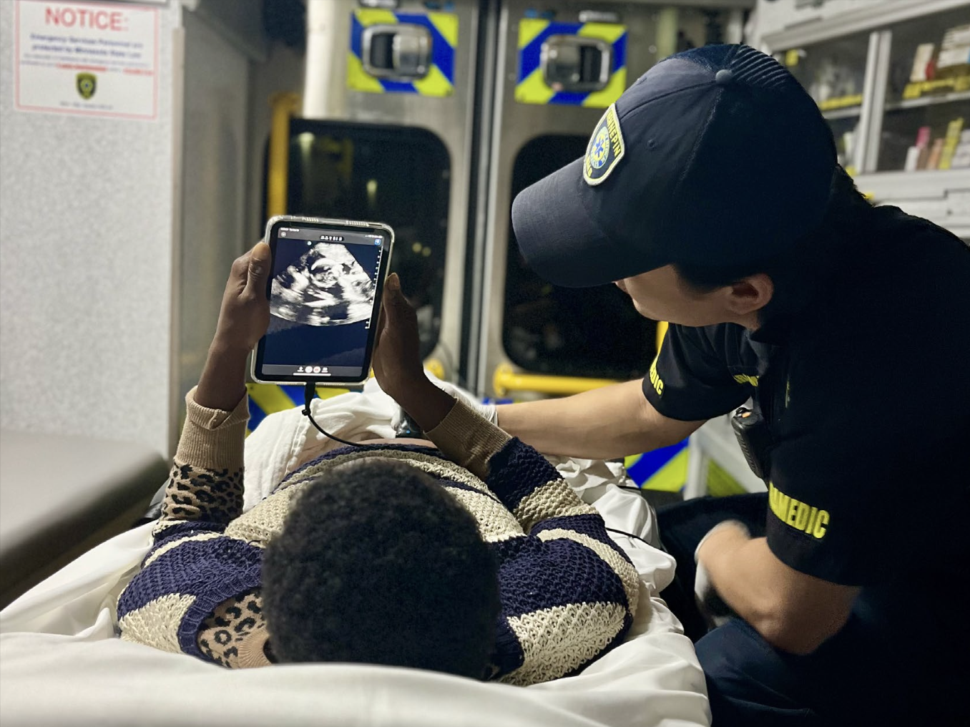
Real-World Case: Hennepin EMS Case Study
40 ambulances equipped with Butterfly iQ+.
210 paramedics trained in its use.
These paramedics completed over 6,000 scans in 2024.
10% of scans significantly changed patient care decisions.
Enabled early diagnosis of serious conditions like pulmonary embolism and aortic aneurysm.

Slide 7
Clinical Use Examples
Lung scans help detect fluid buildup or pneumonia quickly.
Cardiac imaging identifies issues like heart failure before hospital arrival.
Aortic scans detect life-threatening aneurysms in emergency settings.

Slide 8





Butterfly iq bridges the gap
COMPLICATED DIGITAL INTEGRATION | LARGE AND COMPLEX MACHINERY | HIGH COST | LIMITED ACCESS | INNEFICIENT EMERGENCY RESPONSE AND PATIENT MOBILITY
SELF-SERVICE AND SEAMLESS IMAGING | PORTABLE, ALL-IN-ONE DESIGN | AFFORDABLE DIAGNOSTIC IMAGING | EXPANDING IMAGING ACCESS | ON-THE-SPOT EMERGENCY IMAGING
Secure cloud storage + telemedicine-ready platform enables fast image sharing and remote specialist collaboration.
Replaces multiple traditional probes with a single silicon chip; fits in your pocket and connects to a mobile device with multiple preset options.
Lower up-front and maintenance costs thanks to chip-based design, making ultrasound accessible to more providers.
Cost: $500
Portable and battery-powered ideal for fieldwork, rural settings, and global health missions.
Allows paramedics and bedside providers to perform real-time scans without moving the patient - critical in trauma situations.

Slide 9






The Future Is Here — and It’s Smart The perfect pairing of man and machine to make an impact that matters
DATA DRIVEN DECISION MAKING
Empowers clinicians to make faster, more accurate diagnoses at the point of care
ACCESSIBLE AND SCALABLE
Allows for portability and ease of use to deliver high-quality ultrasound imaging anywhere
RAPID RESPONSE
Enables quick responses in critical situations, improving patient outcomes through timely interventions

Slide 10

Thank you! questions?
Chloe Barker chloebarker@smu.edu

