Slide 1
AI in Healthcare: CHALLENGES & Breakthroughs
Data Science News of the Week
Chloe Barker

Slide 2
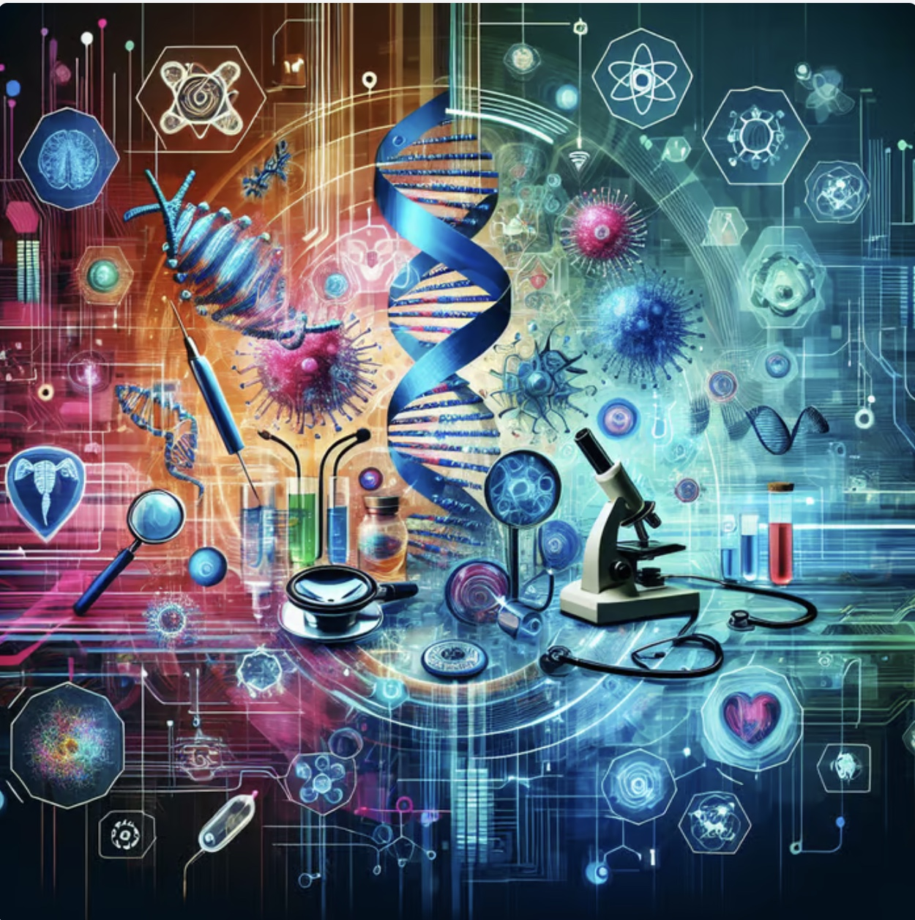
Why this matters
Rising demand for efficient and accurate care
Great advancements in AI and data science tools
Significant potential to improve patient outcomes and reduce healthcare costs

Slide 3
Quick overview of ai & DS in healthcare
Diagnostic imaging & computer vision
Remote patient monitoring
Wearables
Real-time alerts & monitoring
Detecting tumors in medical scans
Analysis of medical images
Predictive analytics
Administrative automation
Identification of high-risk patients
Personalized treatment
Detection of drug interactions
Scheduling
Chatbots
Coding of medical notes

Slide 4
What does ai in medicine look like?
DRUG AND DOSAGE RECOMMENDATIONS
Analysis OF vital signs and test results FOR PERSONALIZED RECOMMENDATIONS
TELEMEDICINE & REMOTE CONSULTATIONS
More Accurate risk assessments
DIAGNOSES OF DISEASES IN MEDICAL IMAGES (MRIs, CT Scans, & x-rays)
PERSONALIZED CARE PLANS
early IDENTIFICATION OF CANCER AND CHRONIC DISEASE
REAL-TIME VITALS MONITORING
Automated appointment scheduling

Slide 5
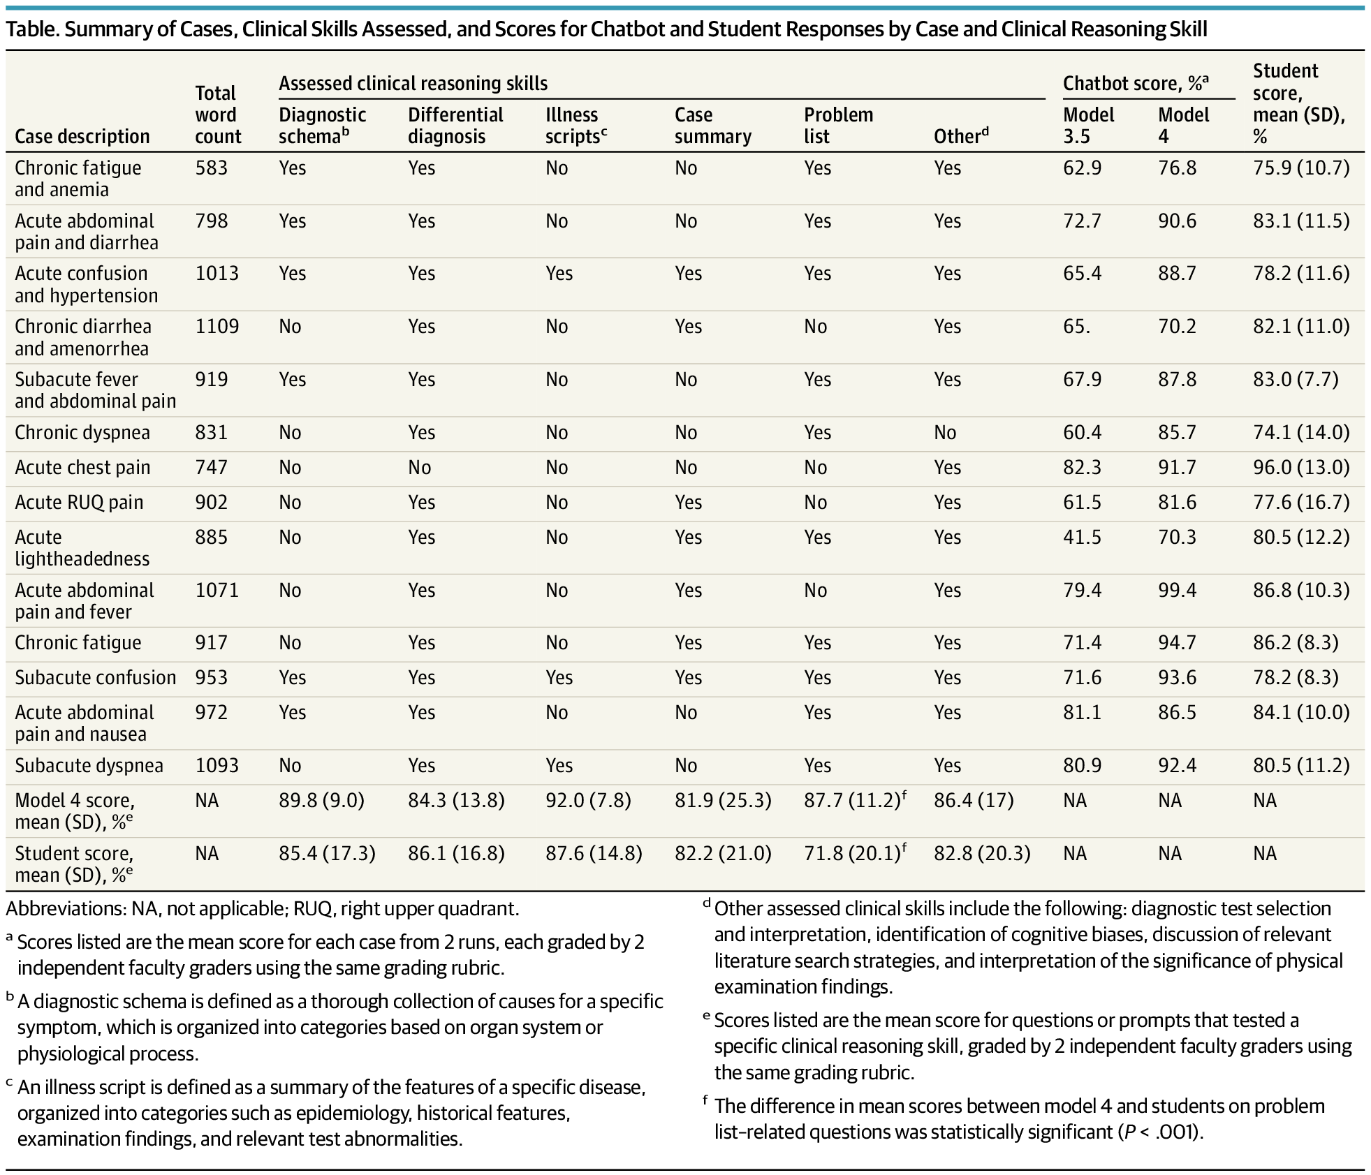
Chat-Gpt 4.0 vs. Medical students
(Strong et al., 2023)

Slide 6
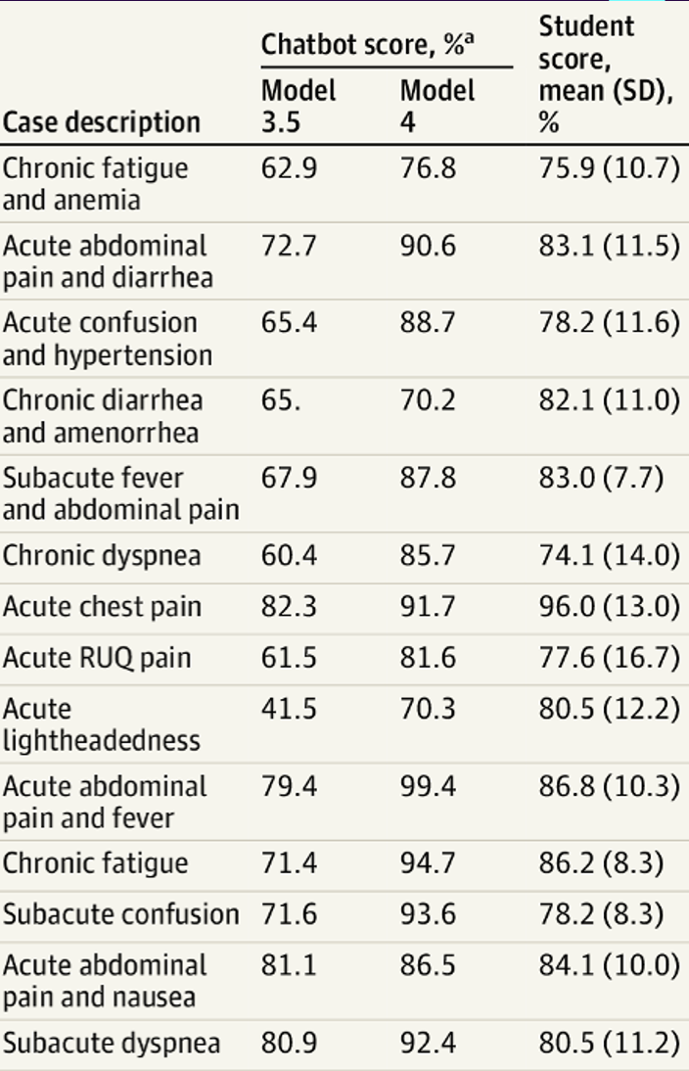
Chat-Gpt 4.0 vs. Medical Students
Findings:
Model 4 of the chatbot outperformed first- and second-year students from Stanford University School of Medicine on clinical reasoning examinations and had significant improvement over Model 3.5.
Implications:
This suggests great potential for growth of chatbot technology over time and within the medical field.
Medicine should integrate AI-related concepts into its curriculum to enhance medical practices and patient outcomes.
(Strong et al., 2023)

Slide 7
Potential benefits
Improve patient outcomes and reduce medical costs
Increase efficiency, reproducibility, and coverage of screening
Overcome human limitation and error
Increase access to healthcare resources
Provide earlier detection and other preventative measures for disease

Slide 8
Some Current research

Slide 9
Breast cancer prediction using machine learning
Breast cancer is the second most diagnosed cancer and the leading cause of death among in women.
Strong limitations in breast cancer diagnosis: mammography has around 70% accuracy on average and there is biopsy-related human error.
A recently published study used eight machine learning classifiers with 11 features that may contribute to breast cancer prognosis on a dataset of 213 breast cancer patients, exploring how feature selection may affect performance in predicting breast cancer diagnoses (Almustafa & La Mogolia, 2025).
Data Collection and Description: The dataset of observations was obtained from the University of Calabar Teaching Hospital cancer registry over 24 months (January 2019 - August 2021).
(Almustafa & La Moglia, 2025)

Slide 10
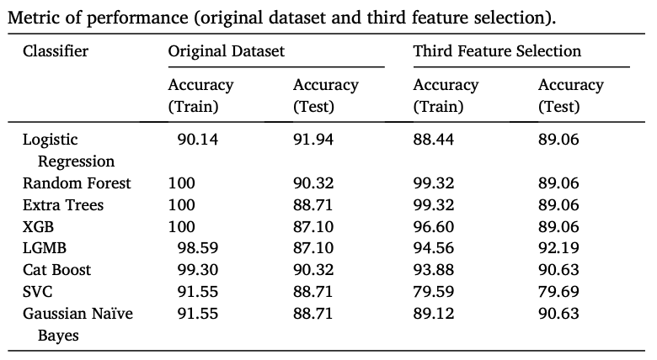
Breast cancer prediction using machine learning
Third Feature Selection : repeat each classifier with their four most important features in predicting the output.
Highest performing accuracies (original data):
Logistic Regression: 91.94 %
Random Forest classifier: 90.32 %
Highest performing accuracy (third feature selection):
LGMB: 92.19 %
(Almustafa & La Moglia, 2025)

Slide 11
IMPLICATIONS
Machine learning can enhance or surpass traditional diagnostic methods, significantly improving accuracy and reducing errors caused by human limitations.
It supports healthcare professionals by providing faster, data-driven insights, resulting in quicker and more accurate breast cancer diagnoses.
The potential of machine learning extends beyond breast cancer detection, offering improved predictive capabilities for various diseases, such as heart disease and diabetes, thereby transforming patient care and outcomes.
(Almustafa & La Moglia, 2025)

Slide 12
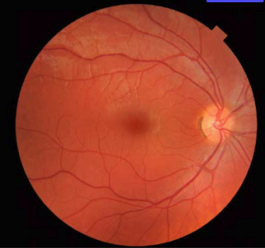
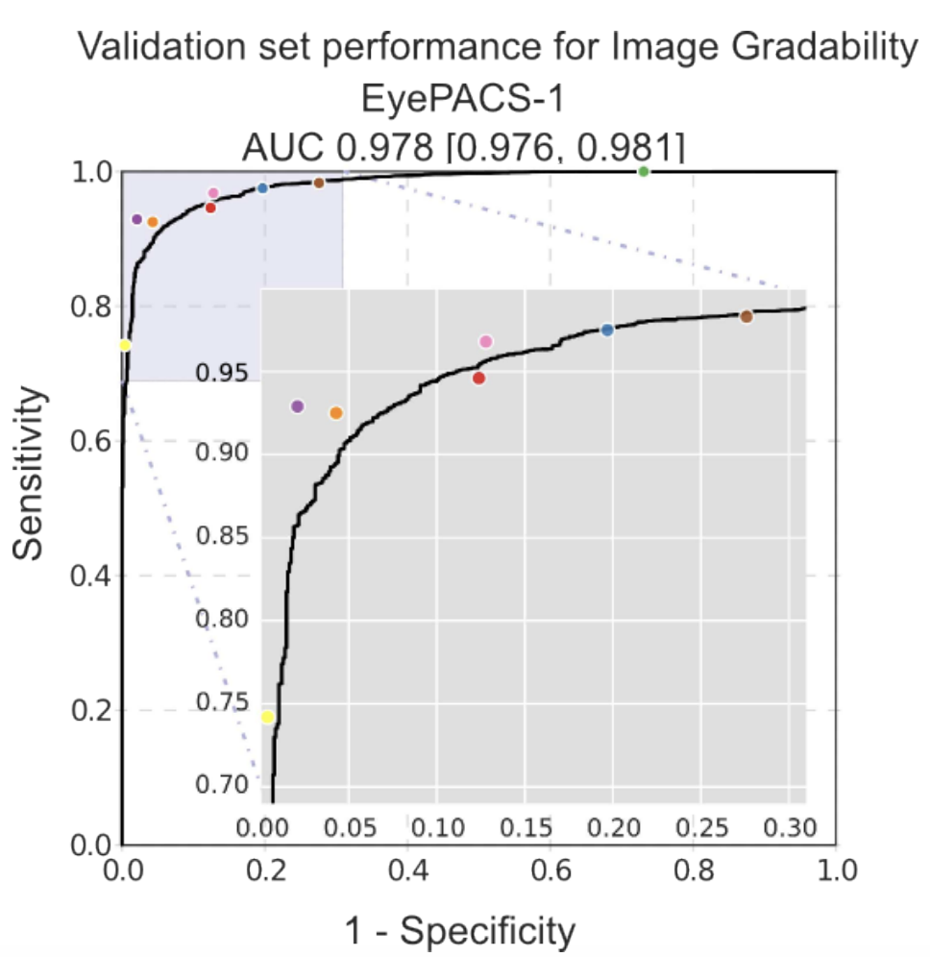
Deep learning algorithm to detect diabetic retinopathy
Deep learning : a predictive algorithm that uses datasets of images to develop patterns and output predictions.
The EyePACS-1 dataset consisted of 9963 images of retinal fundus from 4997 patients with diabetes used to train an algorithm to detect referable diabetic retinopathy.
Sensitivities of 97.5% and 96.1% were achieved with these deep-learning models.
Implications: Great potential for using these models in a clinical setting, as they provide evidence that they meet the standards of the best doctors and beat the standards set by average doctors (Gulshan et al., 2016).
Performance of the Algorithm (Black Curve) and Ophthalmologists (Colored Dots) for Predicting Gradable Images on the EyePACS-1 Dataset (9946 Images)
(Gulshan et al., 2016)

Slide 13




Risks AND CHALLENGES
Data privacy/security
Bias & data quality issues
Protection of sensitive medical data and patient records from breaches.
Risk of inaccurate or biased data influencing healthcare models and algorithms.
Regulatory hurdles (e.g. FDA approvals)
Clinician/patient acceptance and trust
Challenges in meeting regulatory standards for data integration and clinical model deployment.
Resistance to change and low trust in new healthcare technologies.

Slide 14
FUTURE OUTLOOK
Larger, more diverse datasets to reduce bias and have generalizable results
Collaboration across medicine, computer science, and policy
Better data integration & explainable AI for trust
Key takeaways
AI is rapidly reshaping healthcare diagnostics, monitoring, and personalization
Strong promise shown in recent studies (e.g., breast cancer prediction, deep-learning in diagnosis)
Ethical, regulatory, and data challenges remain

Slide 15
Remember!
AI models are powerful educational tools that can complement, rather than replace, medical professionals - greater integration of AI education can empower healthcare workers, improve clinical decision-making, and ultimately enhance patient care.

Slide 16
Thank you
Chloe Barker
chloebarker@smu.edu

Slide 17
REFERENCES
Gulshan, V., Peng, L., Coram, M., Stumpe, M. C., Wu, D., Narayanaswamy, A., Venugopalan, S., Widner, K., Madams, T., Cuadros, J., Kim, R., Raman, R., Nelson, P. C., Mega, J. L., & Webster, D. R. (2016). Development and Validation of a Deep Learning Algorithm for Detection of Diabetic Retinopathy in Retinal Fundus Photographs. JAMA, 316(22), 2402–2410. https://doi.org/10.1001/jama.2016.17216
Hindelang, M., Sitaru, S., & Zink, A. (2024). Transforming Health Care Through Chatbots for Medical History-Taking and Future Directions: Comprehensive Systematic Review. JMIR Med Inform, 12, e56628. 10.2196/56628
La Moglia, A., & Mohamad Almustafa, K. (2025). Breast cancer prediction using machine learning classification algorithms. Intelligence-Based Medicine, 11, 100193. 10.1016/j.ibmed.2024.100193
Li, Y., Li, Y., Wei, M., & Li, G. (2024). Innovation and challenges of artificial intelligence technology in personalized healthcare. Scientific Reports, 14(1)10.1038/s41598-024-70073-7
Strong, E., DiGiammarino, A., Weng, Y., Kumar, A., Hosamani, P., Hom, J., & Chen, J. H. (2023). Chatbot vs Medical Student Performance on Free-Response Clinical Reasoning Examinations. JAMA Internal Medicine, 183(9), 1028–1030. 10.1001/jamainternmed.2023.2909

